Slide 1
Global Studies/Physics 280: Session 21
Plan for This Session
RPv1 is due tomorrow, 10pm !
RE4v1 peer review due Sunday at 10pm
Extra Credit:
News
Module 7: Efforts to Defend Against Nuclear Attacks
Professor Fred Lamb will be presenting a seminar on the Golden Dome in the ACDIS Seminar Series on Tuesday, Apri 14th. This talk will take place at 5:00 PM in Coble Hall - Room 306.
26p280 Defenses, p.

Slide 2
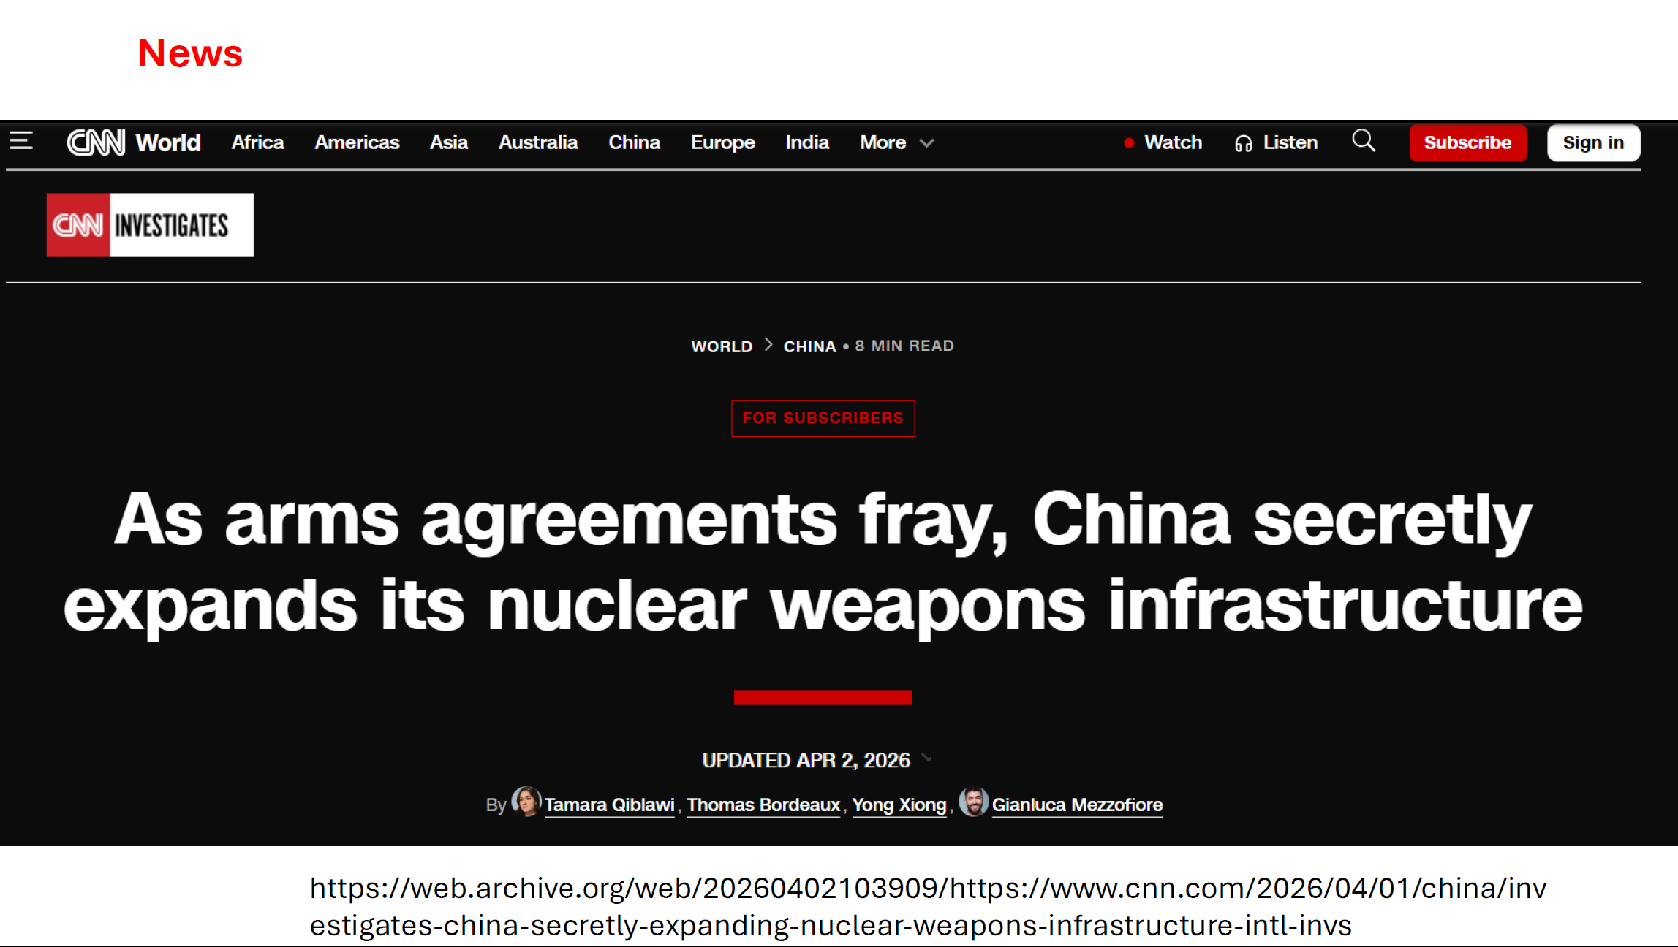
26p280 Defenses, p.

Slide 3
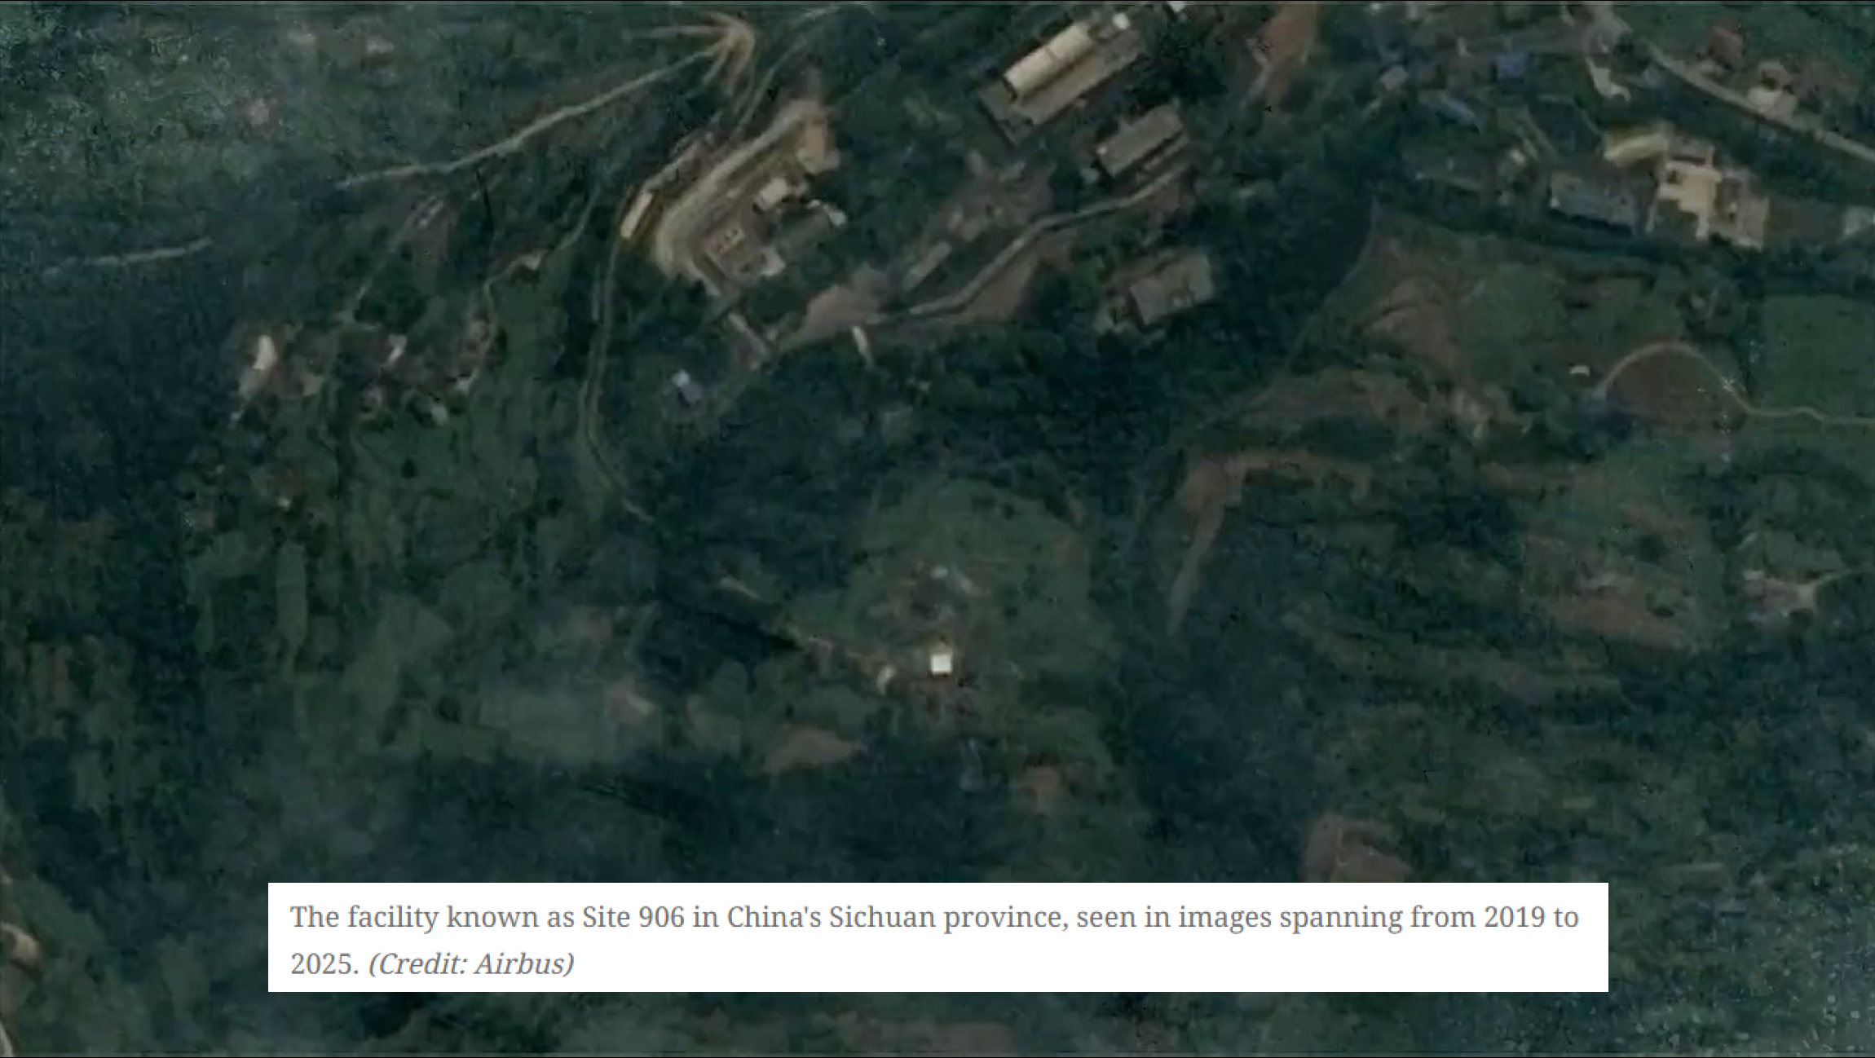
26p280 Defenses, p.

Slide 4
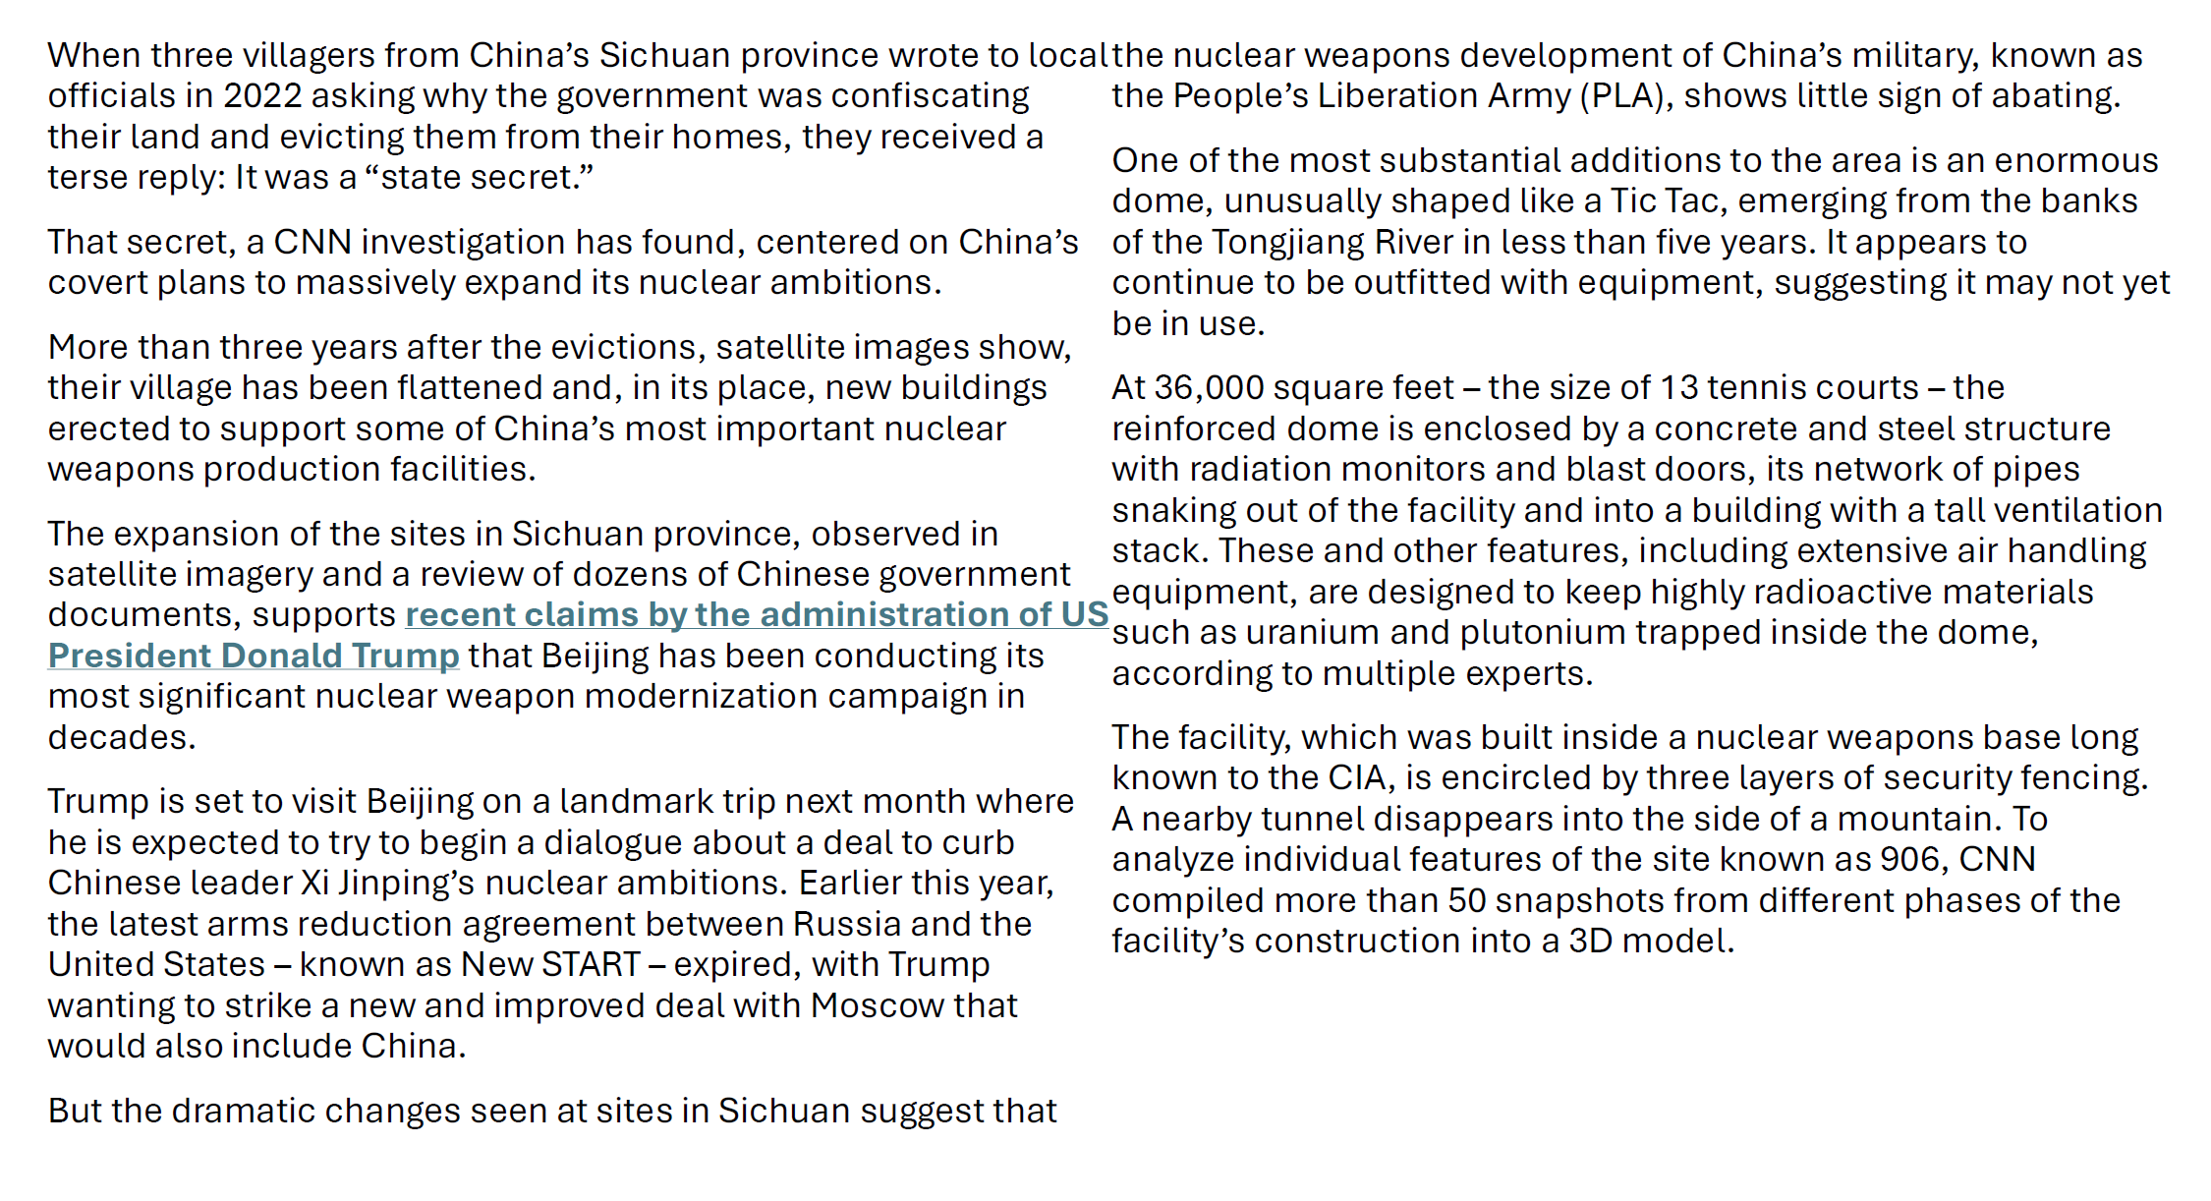
26p280 Defenses, p.

Slide 5
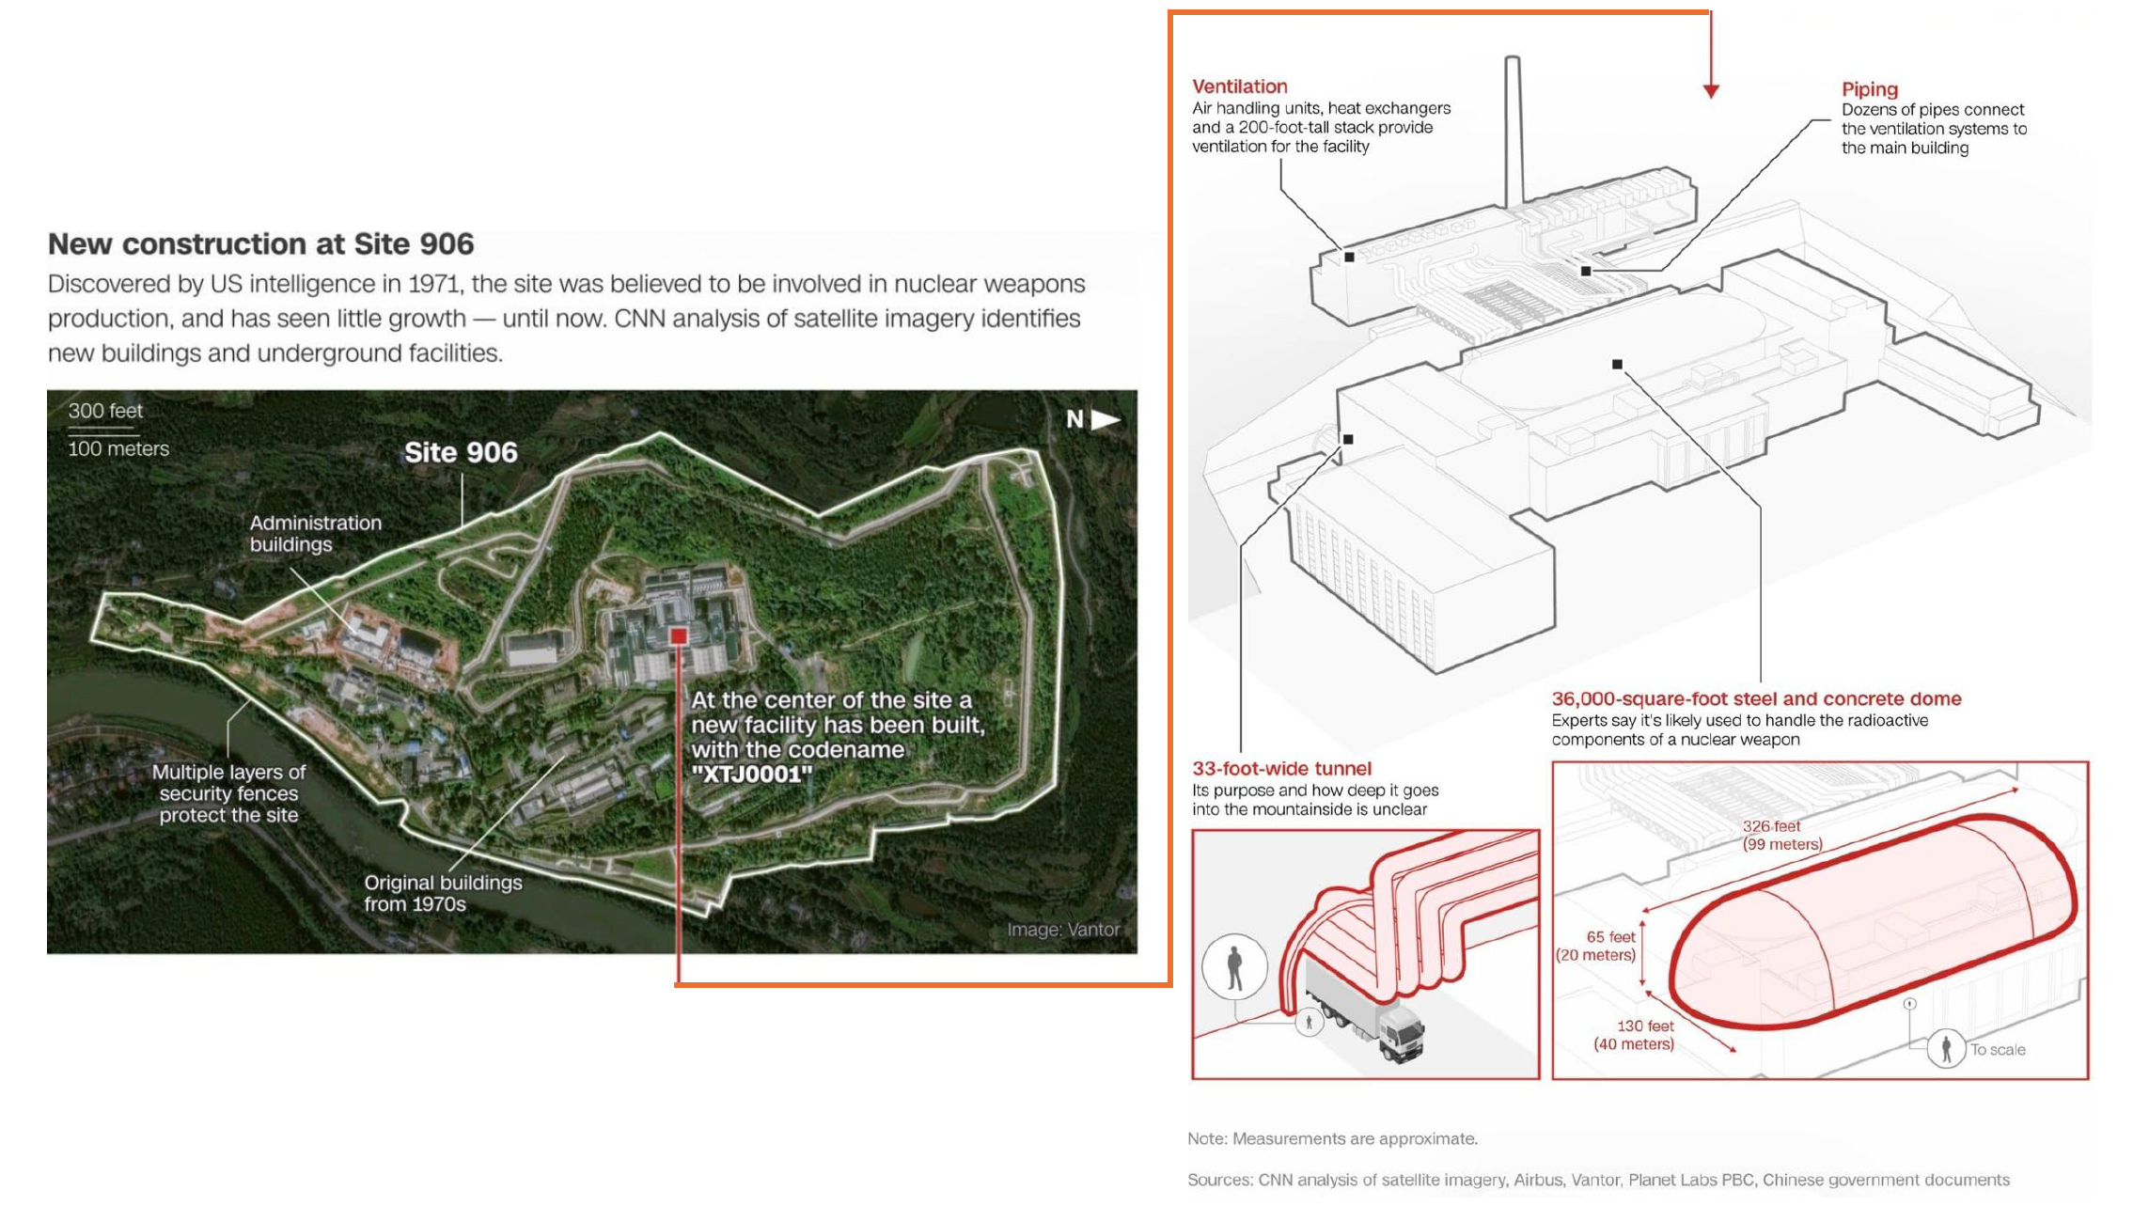
26p280 Defenses, p.

Slide 6
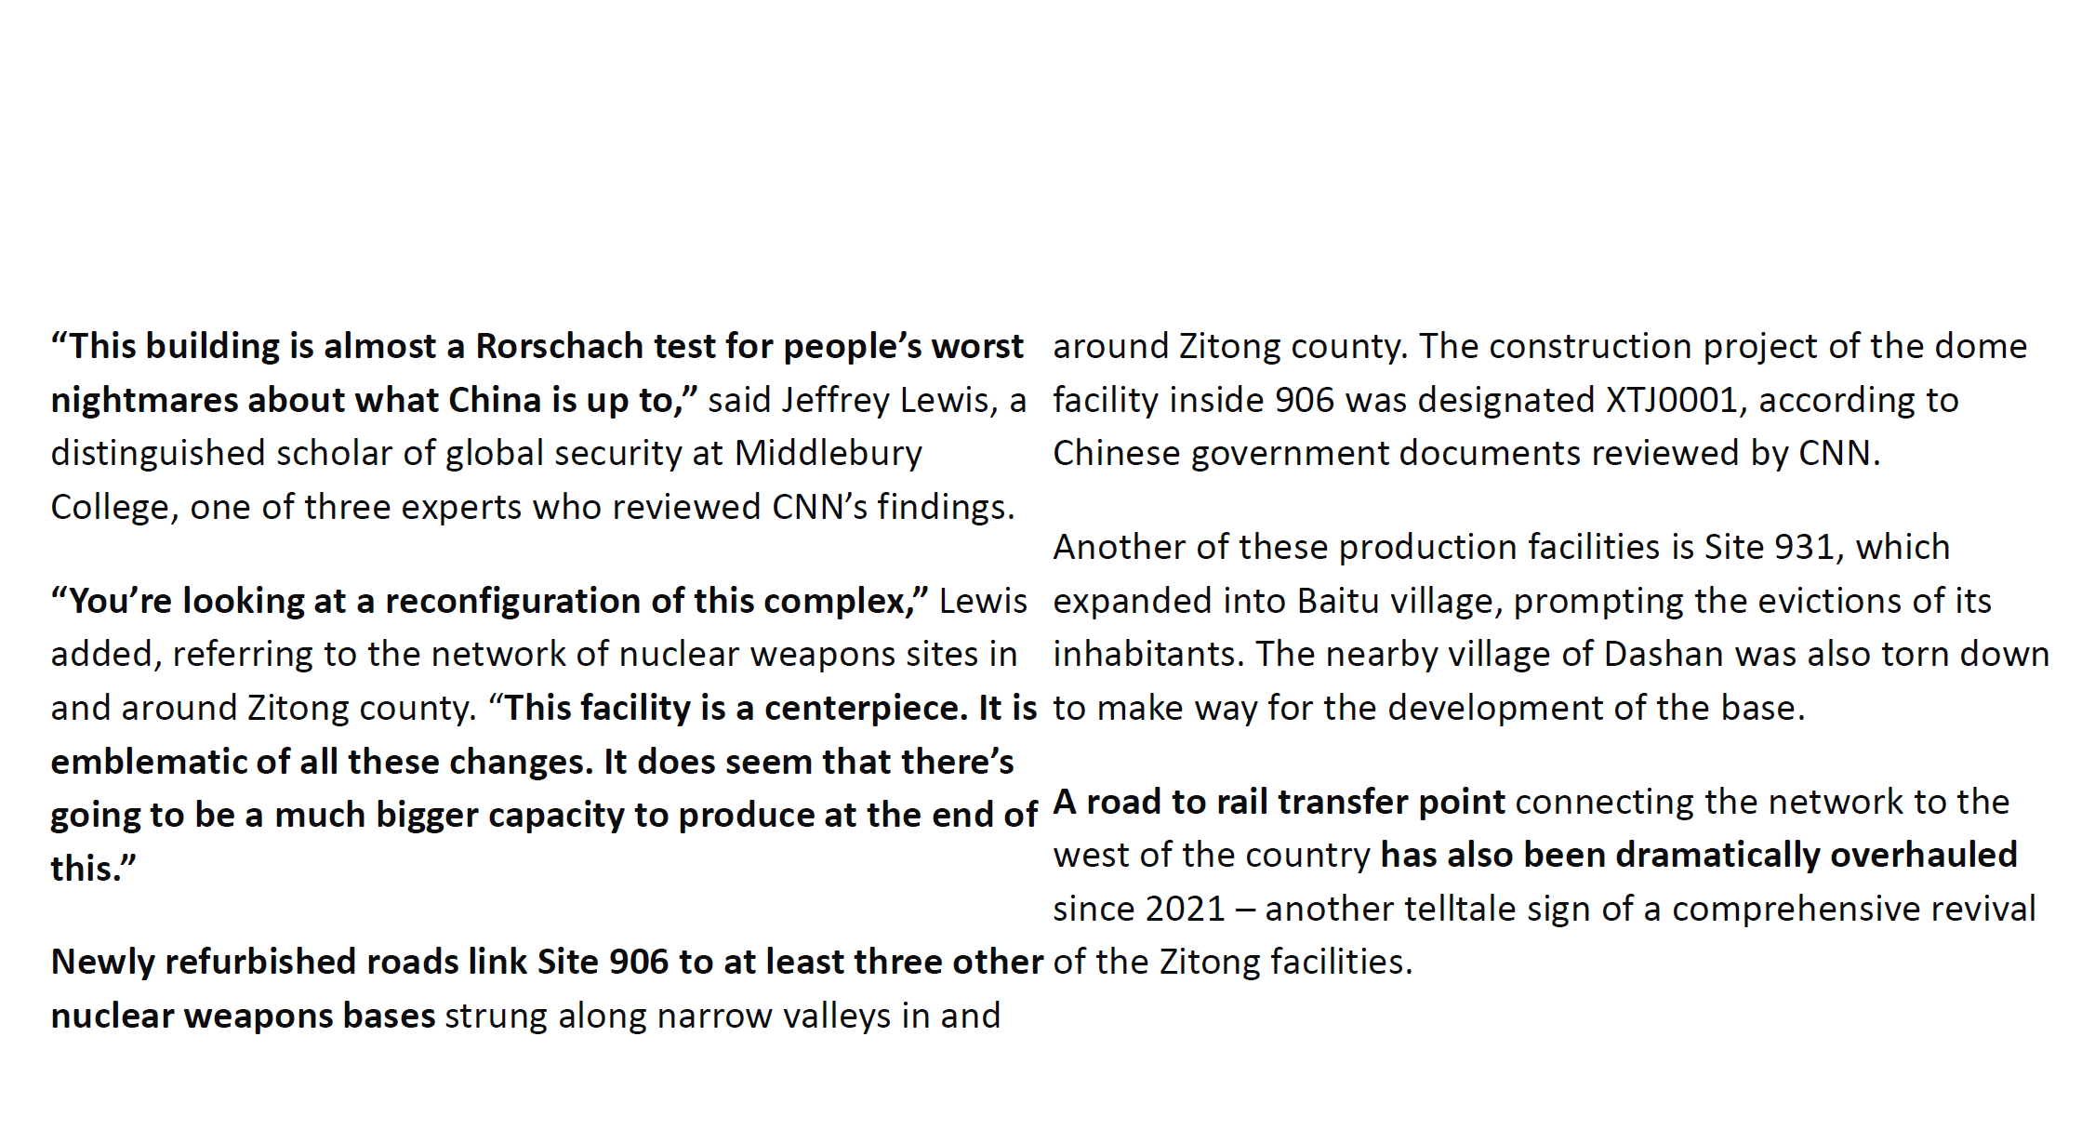
26p280 Defenses, p.

Slide 7
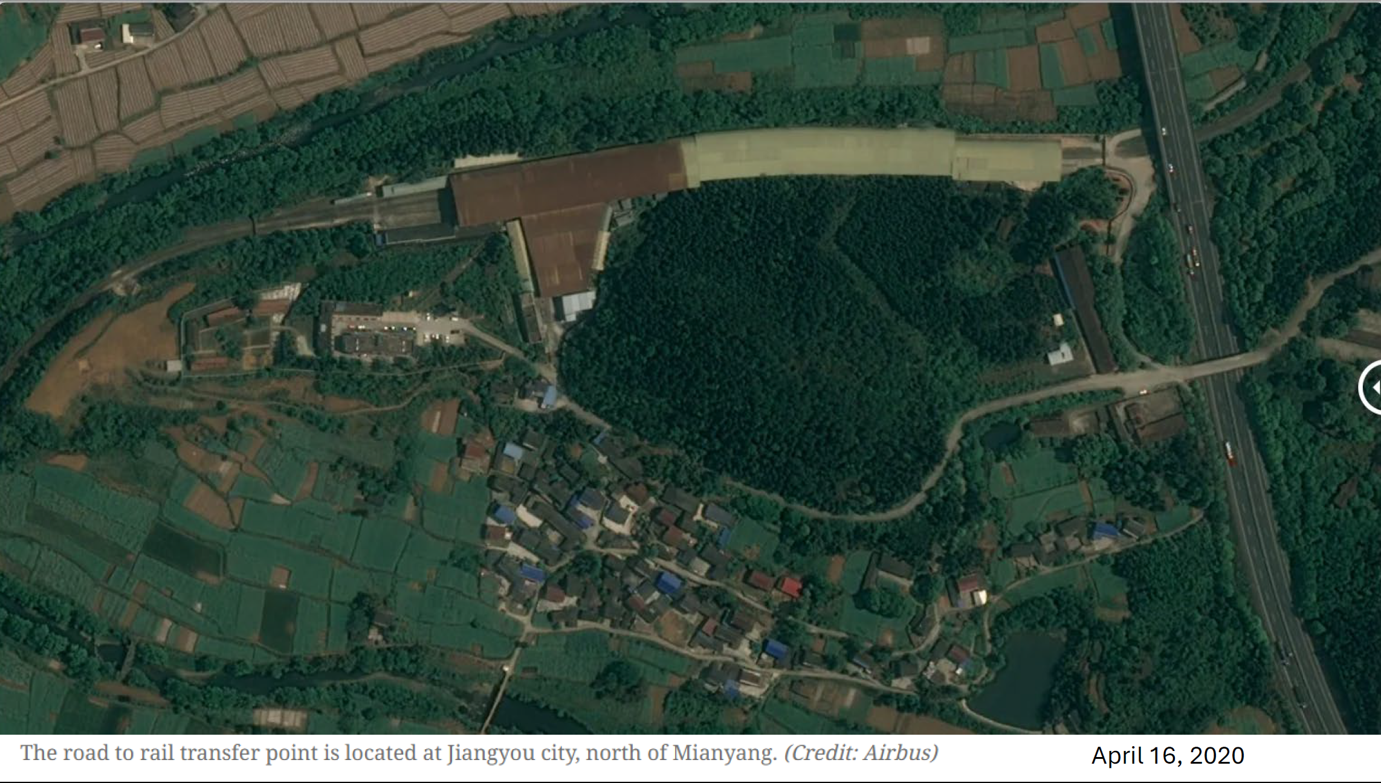
26p280 Defenses, p.

Slide 8
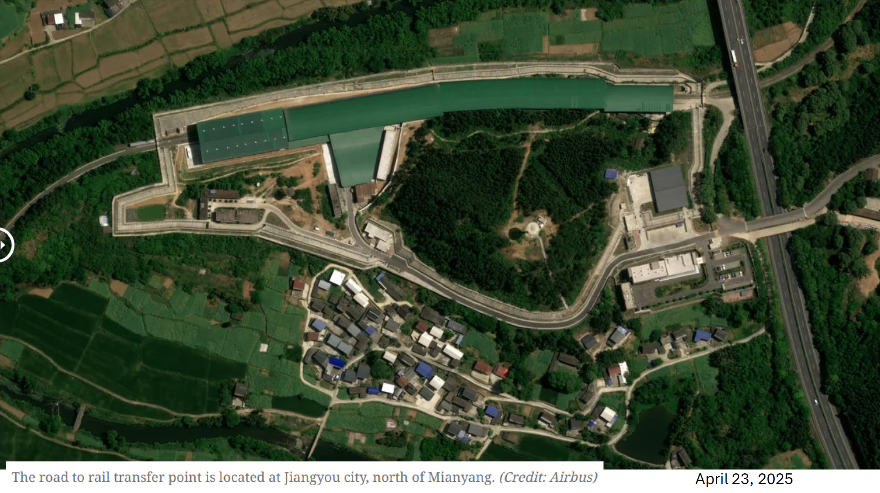
26p280 Defenses, p.

Slide 9
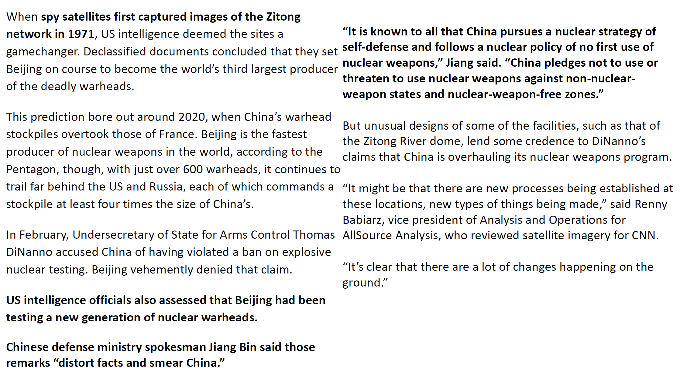
26p280 Defenses, p.

Slide 10
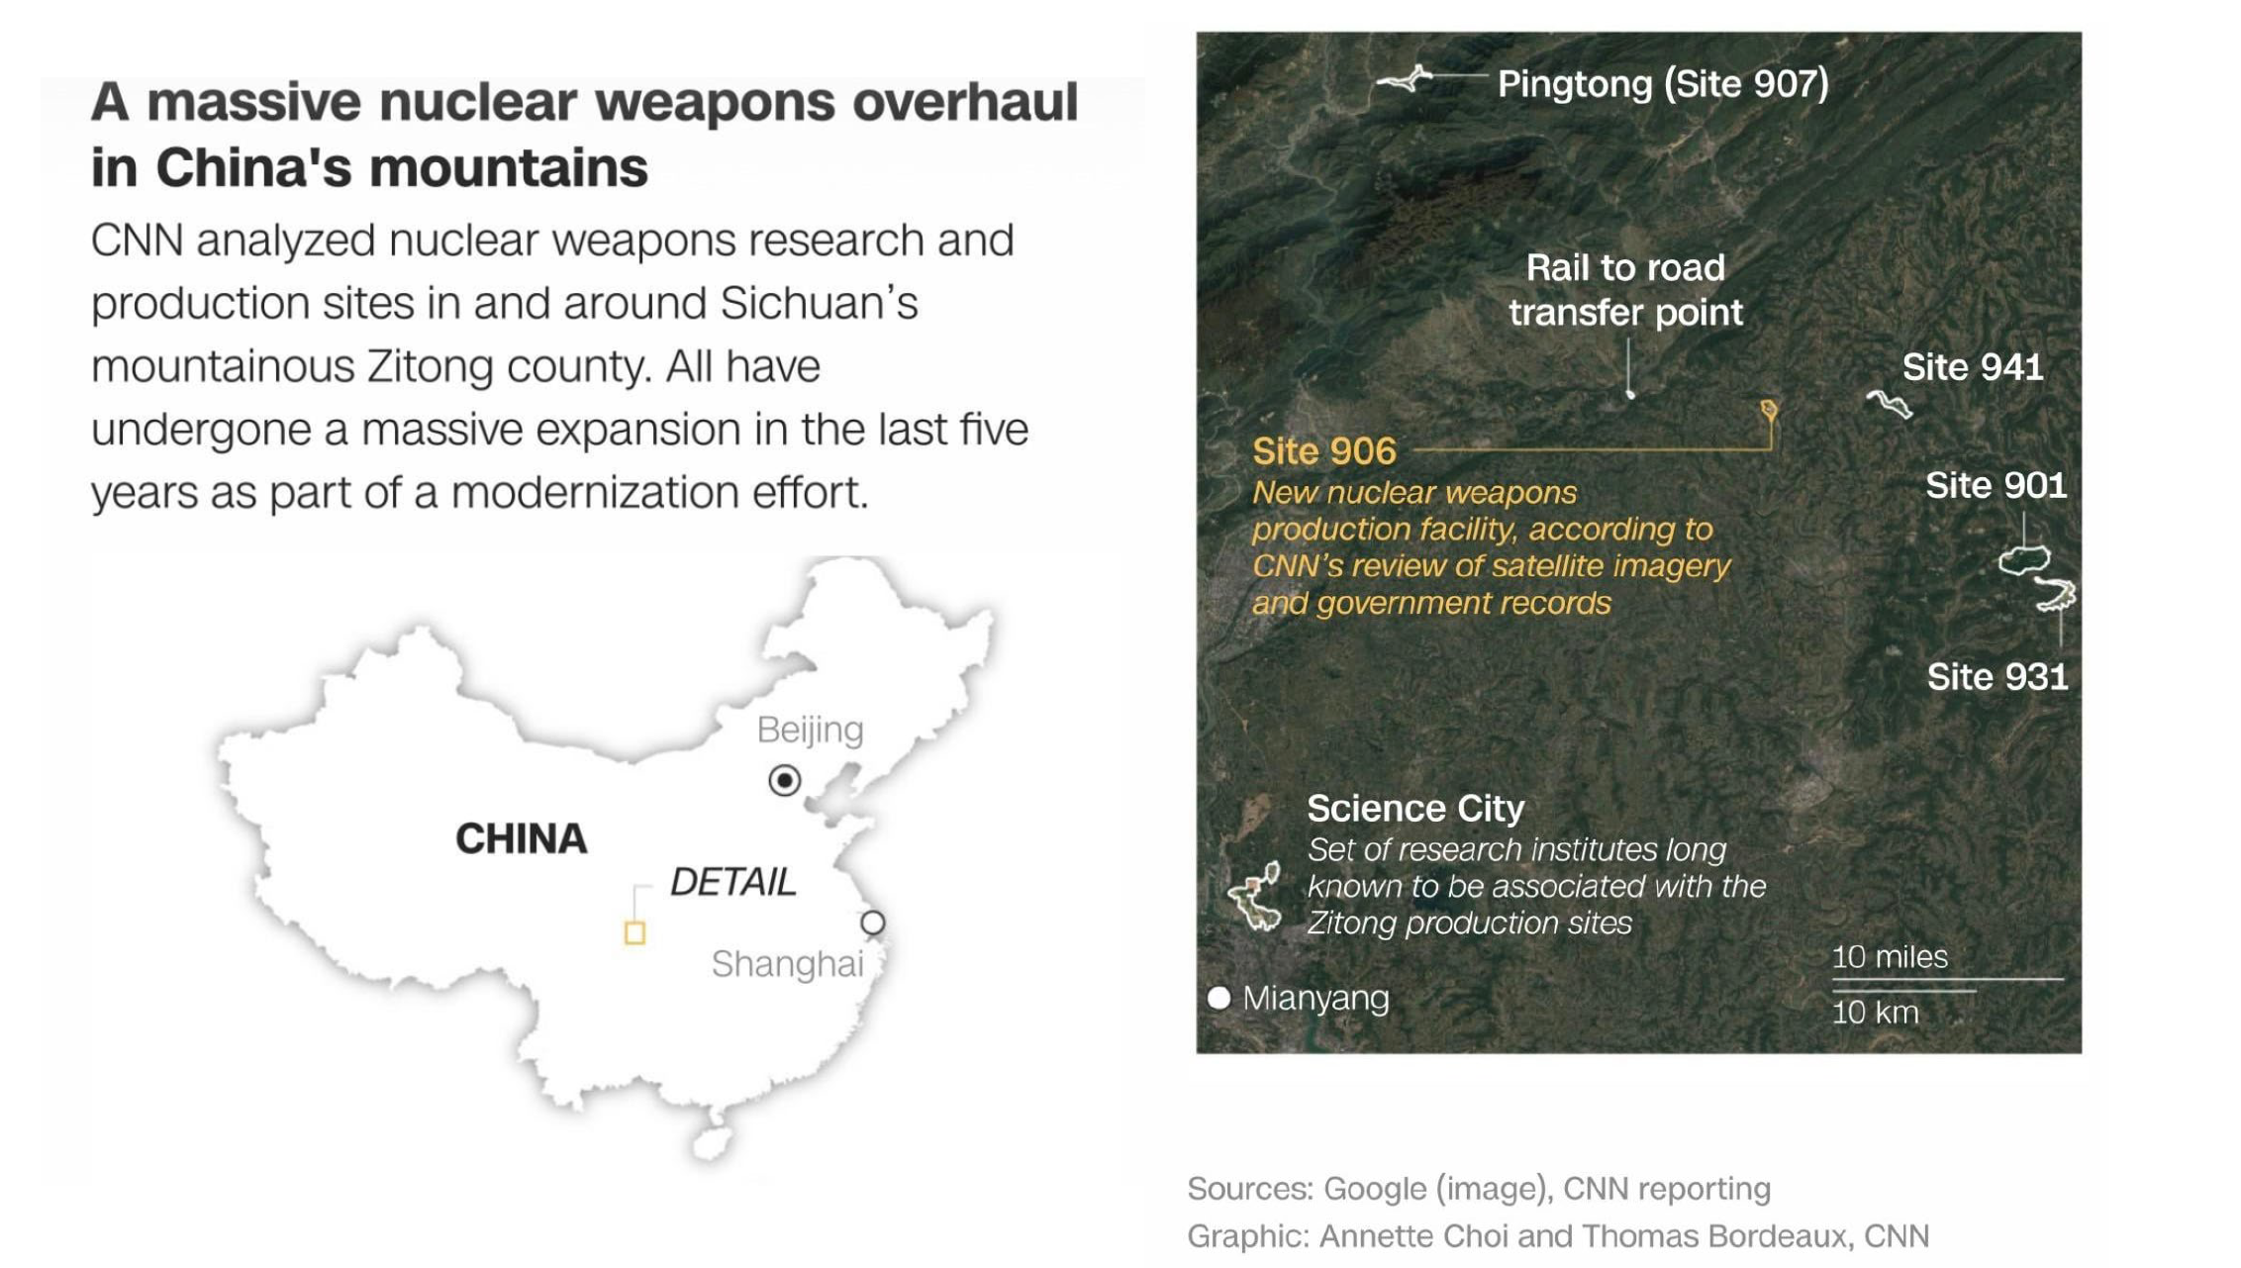
26p280 Defenses, p.

Slide 11
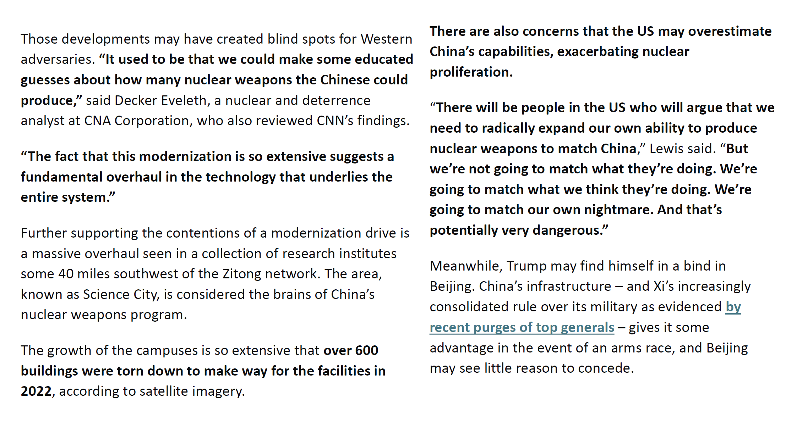
26p280 Defenses, p.

Slide 12
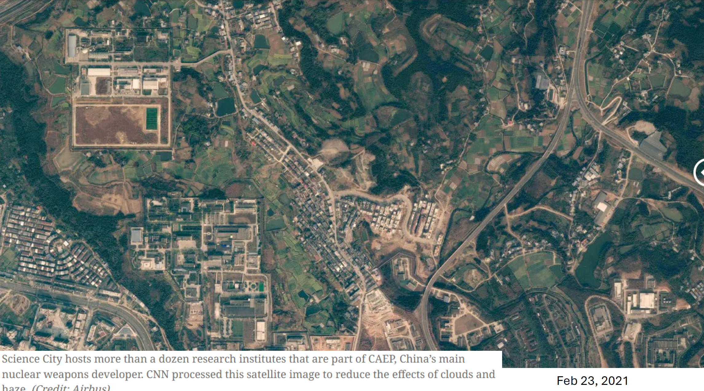
26p280 Defenses, p.

Slide 13
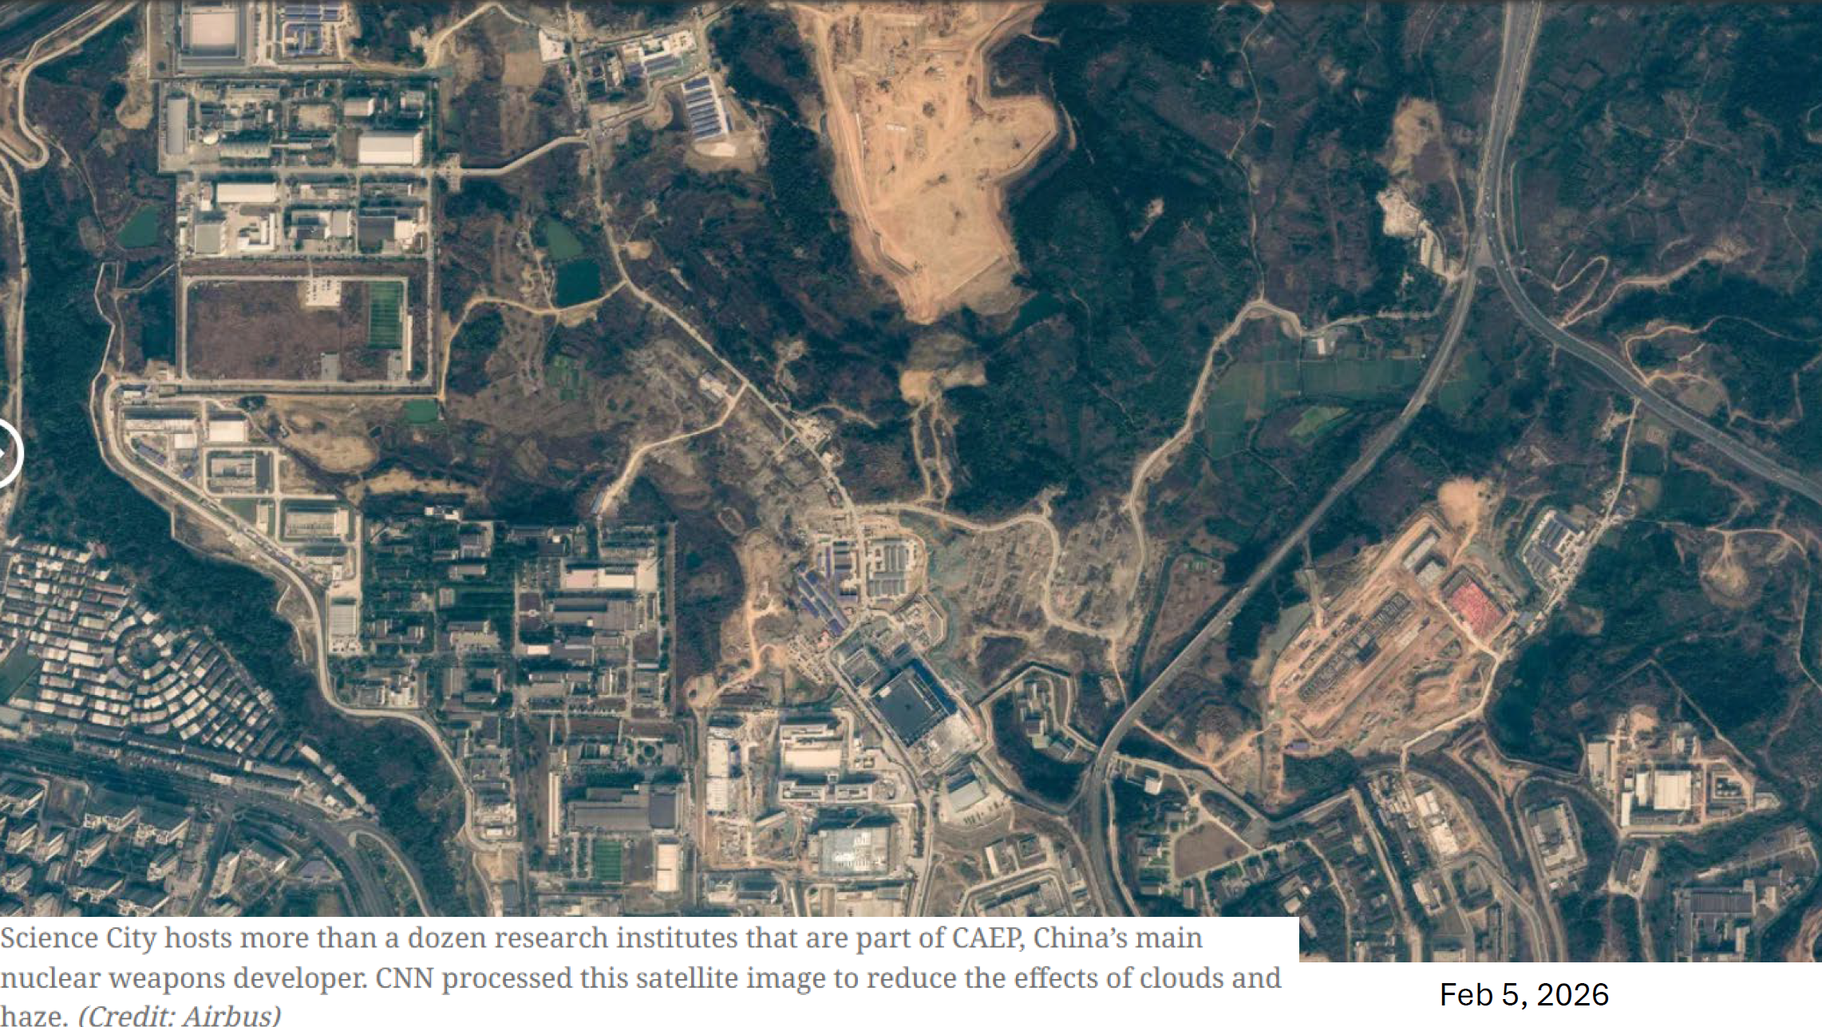
26p280 Defenses, p.

Slide 14
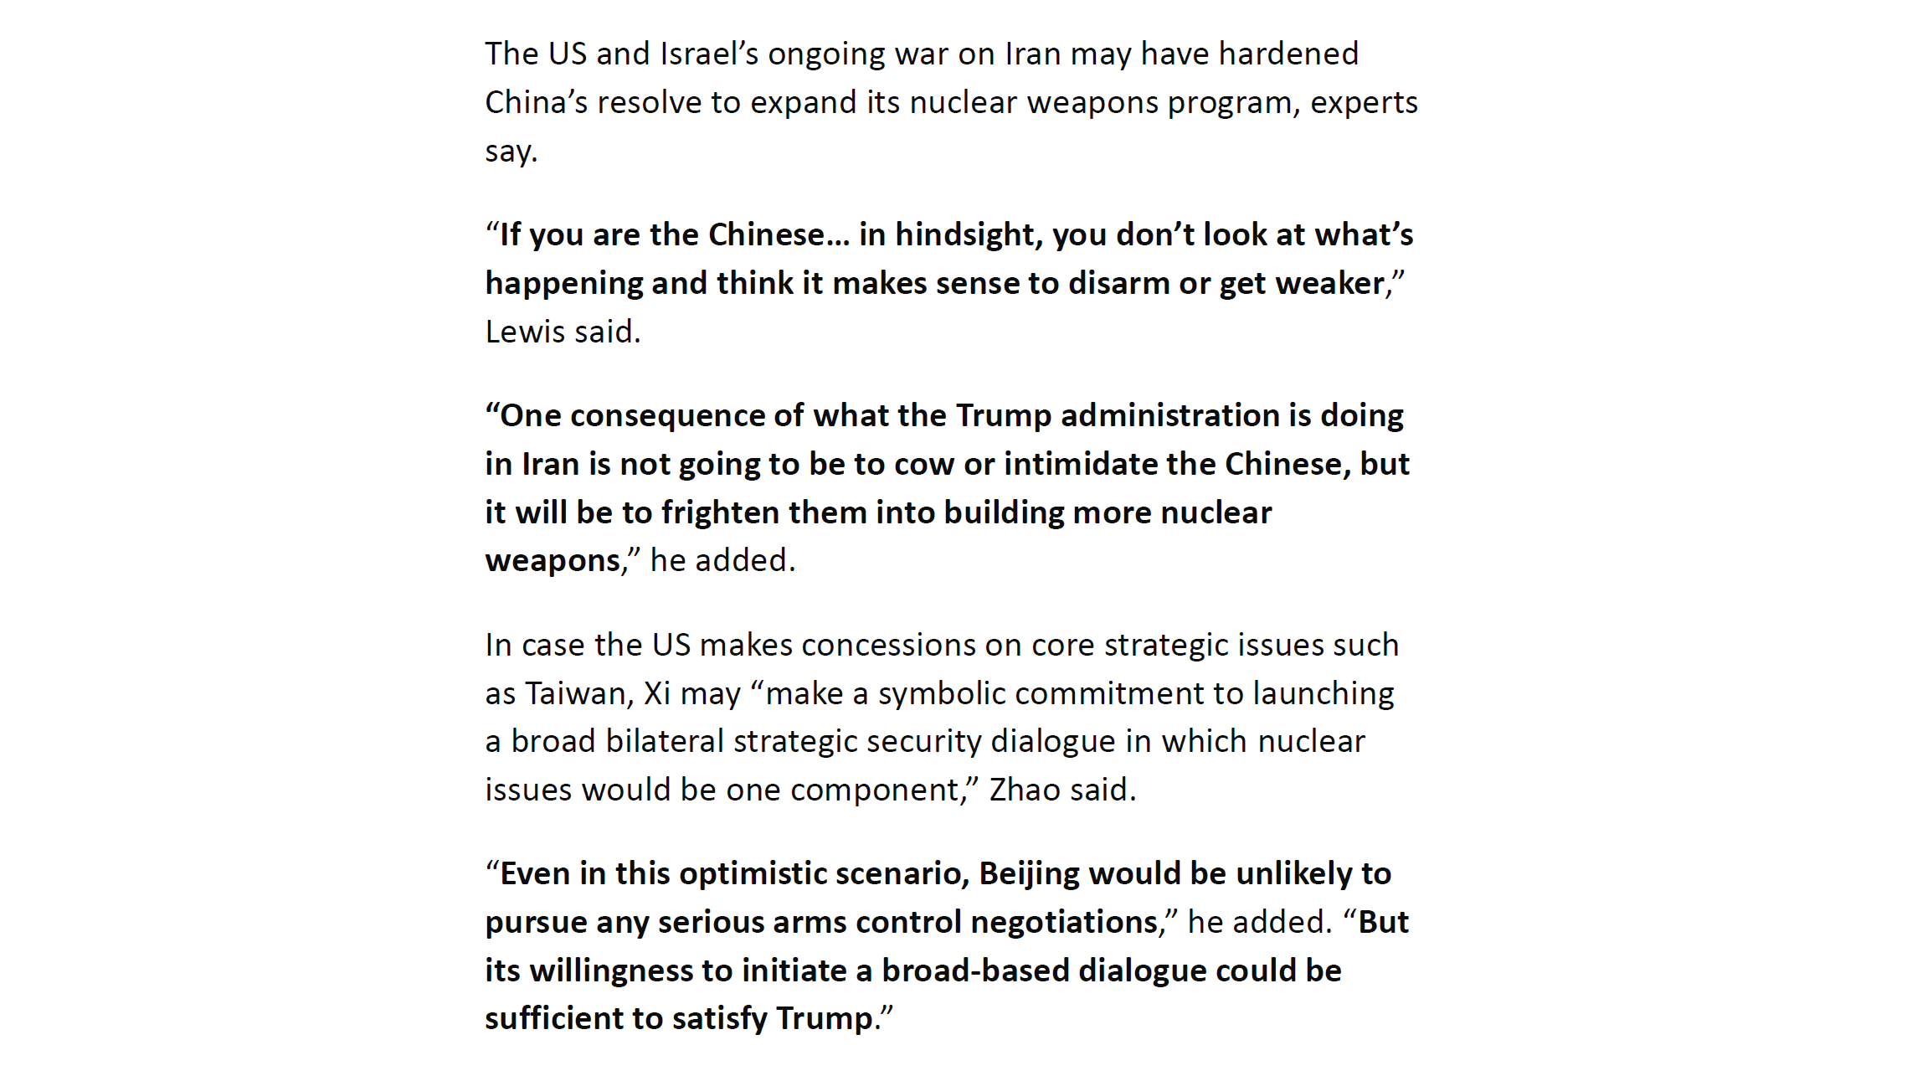
26p280 Defenses, p.

Slide 15
Module 7: Efforts to Defend Against Attacks
Introduction to Defending Against Nuclear Attacks
History of Defending Against Ballistic Missiles
Current and Proposed Missile Defense Programs
26p280 Defenses, p.

Slide 16
Module 7: Efforts to Defend Against Attacks
Introduction to Efforts to Defend Against Nuclear Attack
26p280 Defenses, p.

Slide 17
Types of Defenses Against Nuclear Attacks
Passive defenses (“civil defense”)
Seeks to deter or mitigate rather than defeat an attack
Requires sheltering and crisis relocation
Has been embraced and discarded several times (1950s, 1960s, 1980s)
Active defenses (weapons to destroy weapons)
Seeks to prevent nuclear weapons from detonating at their targets
Requires destruction of delivery vehicles (aircraft, ICBMs, SLBMs, reentry vehicles, cruise missiles, etc.) before they reach their targets
Must be nearly perfect to avoid enormous death and destruction (offensive weapons costing ~$10M can kill 1 million people and destroy $10B worth of property)
26p280 Defenses, p.

Slide 18
Passive Defenses Against Attacks
Sheltering (1950s,1960s,1980s) —
Blast shelters (could withstand ~ 50–100 psi overpressures)
Only a very small fraction of the land area of the US would be subjected to 50 psi, even in an all-out attack
However, most people live in cities and hence would likely be subject to blast, fire, etc.
Fallout shelters (could have protection factors of 100 against fall out)
Radiation from fallout decays rapidly with time
Cumulative exposure would still be serious
Submarine attacks might continue for weeks or months
Problems and costs of providing adequate sanitation, ventilation, food, and water are enormous
Warning time could be very short (~ 10 minutes or less), so most people would not reach shelters
26p280 Defenses, p.

Slide 19
Passive Defenses Against Attacks
Crisis relocation (Reagan,1980s) —
Plans developed by Federal Emergency Management Agency (FEMA)
Plans called for evacuation of all urban and other “high risk” populations and quartering of evacuees in “host” communities
There was confusion over whether many communities were high-risk or low-risk
Feasibility of successful evacuation is doubtful
Many urban areas and host regions refused to participate in planning, finding the concept unworkable and dangerous
1985, passive defense was again dropped
26p280 Defenses, p. 10

Slide 20
Current Direct Threats to the United States Posed by Nuclear-Armed Ballistic Missiles
Two countries currently have nuclear-armed ballistic missiles that can threaten the territory of the United States —
Russia: currently has about 1,550 strategic warheads on delivery vehicles on high alert.
China: DoW estimates about 400 ICBMs with estimated ranges > 5,500km
The United States currently has about 1550 strategic warheads on delivery vehicles on high alert.
Country of concern —
North Korea: has launched successfully two satellites, in principle such rockets should be able to reach Pacific Islands and the continental US. Payload unclear. 60 nuclear warheads according to latest FAS estimates. Warheads may have been miniaturized to fit on ballistic missiles. Short and medium range and long-range missiles have been tested.

Slide 21
Delivery Methods Other Than Long-Range Ballistic Missiles May Pose Greater Threats
Several countries are capable of developing mechanisms to launch SRBMs, MRBMs, or land-attack cruise missiles from forward-based ships or other platforms.
U.S. intelligence and national security assessments consistently judge that the most likely form of attack on the U.S. homeland would involve terrorism, including the potential use of weapons of nuclear weapons delivered by covert, non-missile means:
Non-missile delivery means are —
less costly
easier to acquire
more reliable and accurate
They also can be used without attribution.

Slide 22
Reducing the Threat of Long-Range Nuclear-Armed Ballistic Missiles
Different ways to reduce the threat of nuclear-armed missiles, such as —
Developing friendly relations
Use cooperative diplomacy, incentives, and disincentives to prevent the development and spread of nuclear and missile capabilities and to reduce and eliminate existing threats
Plan to destroy threatening missiles on the ground (preemptive strike: “left of launch”).
Attempt to destroy attacking missiles in flight

Slide 23
Programs to Intercept Nuclear-Armed Ballistic Missiles Have Been Controversial. Why?
U.S. programs to intercept nuclear-armed long-range ballistic missiles have often been used for other purposes —
•
•
•
•
As political bargaining chips
To sidetrack or destroy arms control agreements To create a (false) sense of security
To receive lucrative defense contracts
Programs to intercept nuclear-armed long-range ballistic missiles would not be controversial if —
•
•
•
•
An effective defense was clearly possible using near-term technology Such a system could be built for an acceptable cost
ABM programs would not cause other countries to do things that would end up decreasing our security
ABM programs would not distract the U.S. from taking other steps that would be more effective in increasing our security

Slide 24
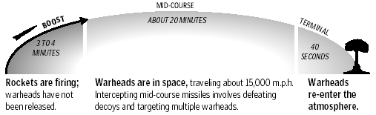
Phases of Flight of a Long-Range Ballistic Missile
Phases of flight —
Boost phase (rocket motors burning) ~ 1 to 4 min
Post-boost phase (MIRVed missiles) ~ 5–10 min
Midcourse phase (ballistic flight) ~ 20 min
Terminal phase (within atmosphere) ~ 30–40 sec
Types of re-entry vehicles —
MRV = multiple RV (not independently targetable)
MIRV = multiple, independently targetable RV
MARV = maneuverable RV

Slide 25
Types of ABM Systems
‘Terminal’ defenses would attack RVs during re-entry —
Traditional (radars & rockets armed with conventional or nuclear warheads)
‘Simple/novel’ systems (curtains of projectiles, ‘dust defense’ using buried bombs)
‘Mid-course’ defenses would attack RVs in space —
Kinetic-kill vehicles, particle beams, x-ray lasers
‘Boost-phase’ defenses would attack missiles during powered flight, when their rocket motors are burning —
IR sensors
Kinetic-kill vehicles (KKVs), lasers, particle beams

Slide 26
ABM System Requirements
Sensors
— Goal: detect, identify, and track targets
— Passive (optical, IR)
— Active (radar, particle beams)
Weapons
— Goal: destroy missile boosters or warheads in flight
Battle management capability
— Detection
— Identification
— Tracking
— Discrimination
— Targeting
— Damage assessment
— Retargeting

Slide 27
Consequences of a Single Warhead Penetrating a Missile Defense System Would Be Horrific
A large (100 kiloton – 1 Megaton) nuclear explosion in a major city would —
kill millions of people
reduce a hundred square miles to rubble
Very little can be done before or after a nuclear explosion to lessen the deaths, injuries, and destruction it causes.
Consequently, failure to intercept even a single nuclear warhead would have horrific consequences beyond anything in human history.
26p280 Defenses, p. 20

Slide 28
The Ongoing Dream of and Quest for a Technological Solution to the Threat of Nuclear-Armed Ballistic Missiles
Over the last 50 years the U.S. has spent more than $300 billion in 2016 dollars on technologies intended to intercept nuclear-armed long-range ballistic missiles in flight.
In recent years, the US is has been spending about $7-10 billion per year on missile defense.
As of now, this enormous effort has not significantly enhanced the security of the United States.

Slide 29
iClicker Question
1/2 of the scripted tests of GMD interceptors were successful. Assume that this measures the kill efficiency of a GMD interceptor to be 50.0%. How many interceptors need to be fired to take down a single incoming warhead with a probability of greater than 90%?
One
Two
Three
Four
Five

Slide 30
iClicker Question
Half of the scripted tests of GMD interceptors were successful. Assume that this measures the kill efficiency of a GMD interceptor to be 50%. How many interceptors need to be fired to take down a single incoming warhead with a probability of greater than 90%?
One Probability to hit is 0.05
Two 1.0-0.5² = 0.75
Three 1.0-0.5³ ~ 0.88
Four 1.0-0.5⁴ ~ 0.94
Five 1.0-0.5⁵ ~ 0.97

Slide 31
Past and Current U.S. Missile Defense Programs
Eisenhower Nike-Zeus Program (1950s) Kennedy Nike-X Program (1960s) Johnson Sentinel Program (1966–68) Nixon Safeguard Program (1969–76) Reagan Star Wars Program (1983–1990)
Bush-I and Clinton Programs (1991–1997)
Clinton National Missile Defense Research Program (1997–2001) Bush-II Missile Defense Program (2001–2009)
Obama Missile Defense Program (2009–present)
Trump’s Golden Dome (2025 – present)
Total spent so far: > $400 billion in 2026 dollars. Most of these systems were never deployed. None were found to be effective.
➔ nuc. armed interceptors: small # of incoming missiles
➔ nuclear armed interceptors inside atmosphere, protect cities
➔ nuclear armed interceptors: protect against limited attack
➔ nuclear armed interceptors: protect missile fields
➔ broad research program for new technologies for ABM

Slide 32
The Nixon Safeguard Program
Based on Sentinel Defense System with reduced scope:
defend missile sites and not the general population
Precision Approach Radar System (PAR) detects incoming
RVs over artic sea and launches:
Long range nuclear armed Spartan missiles to engage
incoming RVs outside the atmosphere.
Short range hypersonic Sprint missiles to engage RVs that
have penetrated the Spartan defense.
Both Spartan and Sprint missiles carried nuclear warheads.
One Safeguard site in North Dakota went into operation on
October 1st, 1975. The house voted to terminate the Safeguard
program on October 2nd, 1975 and the North Dakota site was
deactivated in February 1976.

Slide 33
Module 7: Efforts to Defend Against Attack
Reagan’s ‘Star Wars’ Program (1980s),
R&D program broadly studying technologies for
missile defense: historic example for the challenges
related to missile defense

Slide 34
Reagan’s ABM Weapon Program Motivated by Vision to Render Nuclear Weapons Impotent – Not Based on Evaluation of Current or Future Technological Capabilities
Began with Reagan’s speech on March 23rd, 1983 expressing hope to render nuclear weapons impotent —
Expressed a grand vision to make nuclear weapons “impotent and obsolete”, replacing nuclear deterrence by a defensive weapons system
Surprised experts in the US government and was a radical departure from previous US policy
Contradicted the results of just-completed studies by the White House and the DoD
Did not say success was assured, but implied it was highly likely and could be achieved soon
Launched a major, long-term research and development program: the Strategic Defense Initiative (SDI)

Slide 35
Reagan’s ABM Weapon Program Motivated by Vision to Render Nuclear Weapons Impotent – Not Based on Evaluation of Current or Future Technological Capabilities
Why was almost everyone surprised? —
The President consulted with only a few advisors (not including his Secretary of Defense or his Science Advisor) before giving his speech.
The U.S. already had a very large research program that was investigating ABM weapons.
The White House Science Council had recently completed a study which concluded that missile defense would be technologically infeasible for the foreseeable future.
The Defense Department had completed a series of detailed studies that concluded the prospects for success were very poor and recommended reducing the funding of the existing ABM research program - DDR&E (Defense Department Research & Engineering Enterprise) had testified about them earlier that same day).

Slide 36
Consequences of Reagan’s ABM Weapon Program
Some consequences of Reagan’s ABM politics —
Raised public hopes and expectations that could not be fulfilled (“protection of our population against nuclear attack is a practical possibility and might even be accomplished soon”)
Led to doubling and tripling of expenditures on ABM weapon research and development, increasing budget deficits
Closed off pursuit of alternative approaches to reducing the threat of nuclear weapons
Started expensive programs to develop and deploy extensive missile defenses that continue unsuccessfully to this day

Slide 37
Reagan’s ABM Weapon Program: Challenges
Sensors, computers, and weapons would have had to be integrated into an enormously complex system that—
Would have had to attack ballistic missiles within seconds after having been dormant for years
Would have had to work almost perfectly the first time it was used, even though it could not be tested under realistic conditions
Would have had to work almost perfectly while being attacked by Soviet nuclear and in the future possibly space based weapons

Slide 38
Reagan’s ABM Weapon Program: Challenges
Some technical realities of the time —
A system that was 90% effective would have allowed a Soviet attack to kill 75% of the US population immediately, with millions of later deaths
IR laser weapons would have required space-based mirrors 10 times larger than the largest ever built on the ground and lasers > 10⁶ times brighter
Midcourse intercept would have required detection, tracking, and discrimination of ~ 100,000 objects in space, at existing Soviet force levels
Battle management computer programs would have required more than 100,000 labor-years to write using the most advanced techniques then available and would have had to work almost flawlessly the first time they were used

Slide 39
Reagan’s ABM Weapon Program: Challenges
For every SDI weapon concept that was proposed or imagined, including all space-based weapons, a counter-measure had already been identified.
Unlike the weapons themselves, these counter-measures were —
Possible with existing technology
Relatively cheap
The SDI program did not even attempt to address nuclear weapons carried by —
Air-, sea-, or ground-launched cruise missiles
Submarine-launched ballistic missiles
Bombers
Ships

Slide 40
Reagan’s ABM Weapon Program: Public Perception and Response vs Expert Advise
Knowledgeable people inside and outside the government knew the goal of complete protection was impossible —
Knowledgeable scientists and others outside the government spoke out strongly
— Gave public speeches, talks, articles, etc.
— Pledged not to participate
Knowledgeable people inside government spoke out
— Made cautious public comments
— Some gave forceful secret advice
Allies of Reagan tried to “move the goal posts” to —
Enhancing deterrence
Causing the Soviets to spend money on countermeasures
However, all this had little impact on the public’s perception
26p280 Defenses, p. 36

Slide 41
Physics 280: Session 22
Plan for This Session
Questions
Peer Review for RE4v1 due Sunday at 1pm
Extra Credit Opportunity:
Module 7: Efforts to Defend Against Nuclear Attacks (cont’d)
Professor Fred Lamb will be presenting a seminar on the Golden Dome in the ACDIS Seminar Series on Tuesday, Apri 14th. This talk will take place at 5:00 PM in Coble Hall - Room 306.

Slide 42
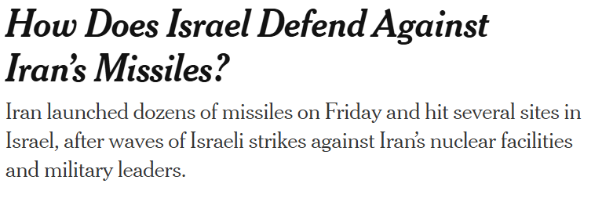


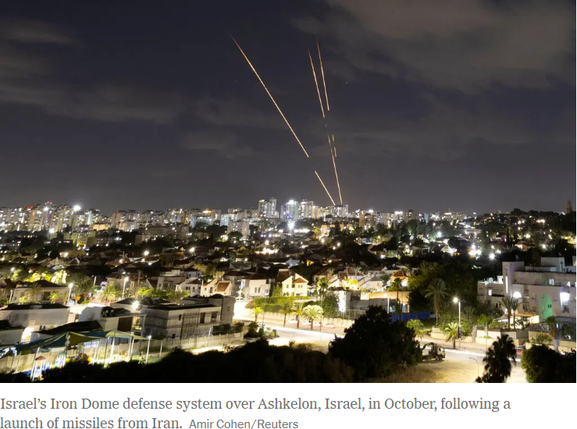
News
What Are Israel’s Defenses Against Iran? - The New York Times

Slide 43
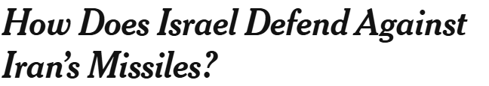
News
Iran launched retaliatory strikes against Israel on Friday, less than a day after Israel’s military carried out a mass attack targeting Tehran’s nuclear program and top commanders.
With billions of dollars worth of sophisticated and multilayered aerial defenses, Israel has long been prepared for a full-scale assault by Iranian missiles and drones.
Those layers of protection are now being put to the test, with Israeli authorities confirming that missiles hit multiple sites. In previous exchanges between the two countries, Iran mostly targeted Israeli military bases. But the scope of Israel’s assault, which devastated Iran’s military chain of command, could prompt a much wider Iranian counterstrike.
“One of the most effective tactics to inflict maximum damage on the Israeli home front would be to overwhelm its air defense systems,” said Joe Truzman, a senior analyst at the Foundation for Defense of Democracies’ Long War Journal.
He said Israel will have “only a brief window to detect, assess, and respond to this looming threat.”
Here’s what to know about Israel’s defenses against Iranian attack.

Slide 44
News
What are Israel’s air defense systems?
Israel’s anti-missile systems include:
Iron Dome: Israel’s best-known air defense system fires interceptors to take down short-range rockets.
David’s Sling: This stationary weapon can shoot down short- and medium-range ballistic and cruise missiles. It has a range of about 185 miles. Like the Iron Dome, it is a “hit-to-kill” weapon that takes down targets by flying into them.
Arrow 2 and 3: These ground-based mobile launchers fire fragmentation warheads packed with explosives that blow up near incoming missiles. The Arrow 2 can intercept targets high in the atmosphere, at an altitude of about 30 miles and a range of about 60 miles. The Arrow 3 can go beyond the atmosphere into space, with a range of up to 1,500 miles. It is one of Israel’s most advanced defenses.
Iron Beam: This high-powered laser was developed to intercept rockets, drones and anti-tank missiles. It was first deployed in the field after Hamas’s 2023 attack on southern Israel, which prompted wars in Gaza and Lebanon.

Slide 45
News
What are the biggest threats to Israel’s defenses?
One of the most serious threats posed by Iran comes from its heavyweight ballistic missiles, which fly at the edge of space at many times the speed of sound. They can cross the roughly 1,000 miles between Iran and Israel in just a few minutes.
Antimissile systems like Arrow 3, which have a limited supply of expensive interceptors, do not always hit their ballistic missile targets.
Last October, analysts at the Middlebury Institute of International Studies at Monterey, in California, concluded that Israel had run low on interceptors, after about 30 Iranian ballistic missiles landed near a military base in southern Israel unscathed. Last month, a Houthi missile launched from Yemen evaded Israeli and American air defense systems to strike near Ben Gurion Airport in Tel Aviv.
It can take years to produce enough missile interceptors to keep them reliably stockpiled, and Israel “has been expending them,” said Tom Karako, a missile defense expert at the Center for Strategic and International Studies in Washington.
Another problem for Israel will be tracking and destroying unmanned drones, which fly low and slow, making them much harder to detect. In the past, Israel has scrambled fighter jets to shoot down drones beyond Israel’s borders; failing that, Israeli forces have used the Iron Dome system, which is most effective against short-range rockets.

Slide 46
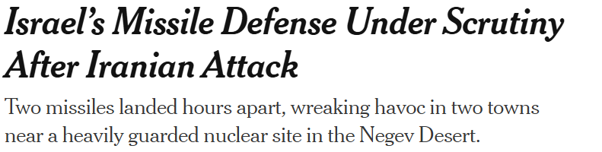


News

Slide 47
News
Few sites in Israel are better protected than its main nuclear research facility and reactor, eight miles from the town of Dimona in the southern Negev Desert.
So when two Iranian ballistic missiles crashed into residential neighborhoods of Dimona and another nearby city, Arad, on Saturday night, evading the country’s vaunted air defenses, even battle-hardened Israelis seemed rattled by the scenes of destruction.
As alarming, perhaps, as the damage was the military’s admission that it had tried to intercept the missiles, which struck about three hours apart. The failures raised discomfiting questions about Israel’s
multilayered missile defense system and its ability to protect its citizens.

Slide 48
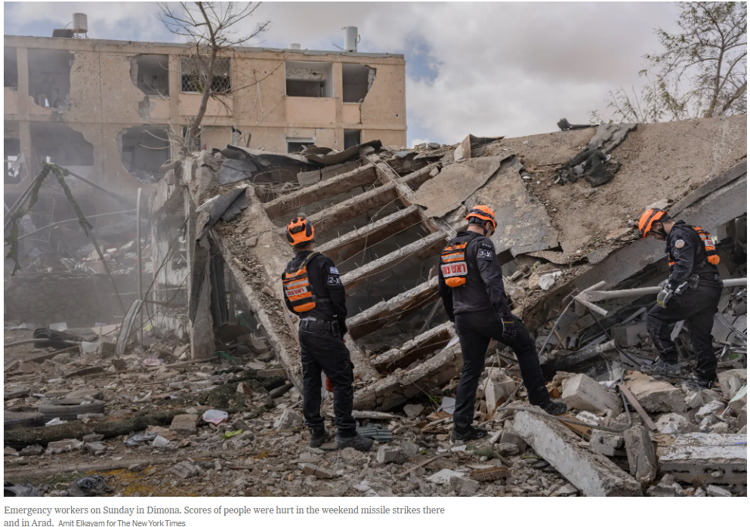
News

Slide 49
News
And it renewed concerns that the military might be holding back on firing its most costly and sophisticated missiles, after reports that its stockpiles might have been drained in the 12-day war with Iran last year. Those concerns may deepen further in coming weeks if the current campaign against Iran is only “midway,” as Lt. Gen. Eyal Zamir, the Israeli military’s chief of staff, said on Saturday.
….
While the military puts the interception rate of Iran’s ballistic missiles at more than 90 percent, officials and experts emphasize that the defenses can never be 100 percent hermetic.
“Dimona is protected with multilayered defense systems — Israeli and American,” said Ran Kochav, a brigadier general in the reserves and former commander of Israel’s air and missile defense forces, “but nothing is perfect. There was an operational failure.”

Slide 50
Reagan’s ABM Weapon Program: Challenges Result in Shifting Focus on Different Technologies
As a result of its technological unreality, the emphasis of the SDI program moved from year to year —
Space-based X-ray lasers
Space-based particle-beam weapons
Space- and ground-based optical and UV lasers
Space-based kinetic energy weapons
Brilliant pebbles (smart rocks)
High- and low-altitude rocket interceptors
None of the resources spent on these exotic technologies contributed significantly to subsequent ABM programs.

Slide 51
Reagan’s ABM Weapon Program: Costs and Demise
Some consequences of the SDI ABM weapon program —
Spurred the race in offensive strategic weapons, until ~ 30,000 were deployed, increasing further cost of strategic armament
Complicated arms control efforts
Large opportunity cost
—Diverted money, manpower, and other resources from education and internationally competitive civilian industries and products
—SDI ended up costing more than $150B in 2016 dollars, but accomplished very little that was useful
The SDI program was greatly reduced by Bush and terminated in 1994 by Clinton. However, Clinton felt compelled to restart a program to defend against long-range ballistic missiles in 1998. Missile defense programs have been pursued by the Bush-II and Obama administrations.

Slide 52
The ‘Nitze Criteria’ for Deploying an ABM System (Important)
In the early 1980s, Paul Nitze argued convincingly that to be considered for deployment, an ABM system must first meet the following three criteria —
The system must be effective
The system must be able to survive attack
The system must be cost-effective at the margin
These criteria were officially adopted ~ 1985 and have become known as the “Nitze criteria” for it to make sense to deploy a missile defense system.
Adoption of these criteria effectively ended any chance of deploying a missile defense system during the 1980’s and 1990’s, because no system then under development could come close to meeting them.
Bush-II departed from the Nitze Criteria in 2001 in order to deploy a missile defense system (see “capability-based development and deployment”).

Slide 53
Lessons from Reagan’s ABM Program (Important)
Missile defense technology is highly challenging
Technology cannot be coerced by good intentions, ideology, or policy (engineering programs must be consistent with technical realities, because nature cannot be fooled)
It is important to understand what technology can and cannot do in a given situation, because to be successful, policies must be consistent with the available technology
An R&D program without clear goals will always waste time and money
Frequent testing is critical and the budget for tests must therefore be large; if there is no commitment to such an effort, the program will fail
An independent evaluation and review process is critical

Slide 54
Patriot in the 1991 Gulf War
Events that formed the US public’s impression—
TV videos of Patriot “engagements” and enthusiastic reports by military spokesmen and news reporters of the Patriot’s successes.
General Schwarzkopf: “The Patriot’s success is 100%—so far, of 33 Scuds engaged, there have been 33 destroyed.”
President Bush, during a celebratory visit to Raytheon, said “Patriot is 41 for 42, 42 Scuds engaged, 41 intercepted... Patriot is proof positive that missile defense works.”
These statements also were aimed at the public in Israel to build trust towards US abilities to defend Israel from Iraqi aggression. Finally, they were aimed at Iraqi leadership to
frustrate Iraqi efforts to widen conflict.

Slide 55
Patriot in the 1991 Gulf War
Later studies showed the Patriot’s actual performance was very poor —
The First Army study (February 1992) was found to have serious flaws by the GAO (Government Accountability Office) and the CRS (Congressional Research Service).
In April 1992, Pedatzur (Tel Aviv) reported only 1 Scud hit by a Patriot based in Israel; found that 4 Patriot warheads had fallen and exploded in populated areas.
A corrected Army study (April 1992) reported a ‘success rate’ > 70% in Saudia Arabia and > 40% in Israel (success = incoming WH destroyed, dudded, or deflected).
A September 1992 GAO study reviewed the corrected Army study and found only 4 engagements (9% of the total) in which there was strong evidence of a Patriot ‘kill’.
A detailed study by Postol & Lewis (MIT, 1991–92) found evidence of 3 hits but no evidence of any ‘kills’. An independent study by the APS largely agreed.
In the end, there was not a single well-documented intercept but many well- documented complete misses
Careful studies came late and had limited impact on the public’s perception that Patriot had succeeded.

Slide 56
Israel: Iron Dome ➔ Short Range Rocket Defense System
Sub-theater missile defense system for missiles with ranges up to 45 miles. One battery consists of 3 rocket launchers with 20 interceptors, controlled by a single battle control station.
Developed and built by Israel Rafael Advanced Defense Systems with significant support from the United States. Israel has ordered 15 batteries at an estimated $1 billion.
After visit to Israel in August 2012, Defense Secretary Leon Panetta reported that the Iron Dome interceptors had a rate of successful interceptions above 80%.
Example (from news media reports): attack from Gaza on March 9th 2012 with over 300 rockets: 177 hit targets in Israel, Iron Dome identified 71 rockets and successfully intercepted 56.

Slide 57
Israel: Iron Dome ➔ Will the Early Reports of Success Hold?
Interview with Ted Postol, MIT
Expert on ballistic missiles and defense
Trajectory of Iron Dome Interceptor
Photograph taken by 280 TA David Levin
in Tel Aviv in summer 2014

Slide 58
Israel: Iron Dome ➔ Will the Early Reports of Success Hold?
Delivery vehicle Speed in [meters/second]
Mach-2 fighter 680
Hamas rocket 500
SCUD missile 2200
ICBM 7000
Short range rockets present a significantly smaller
challenge to missile defense …

Slide 59
iClicker Question
In which situation might a Iron Dome defense be useful?
Defend against single ICBM attack from North Korea on US base in the Pacific.
Defend Seoul against attack with artillery from North Korea.
Defend Seoul against attack with rocket launchers from North Korea.
Defend Washington DC against short range missile attack from forward naval platform.
E. Defend Washington DC against SLCM attack from
forward naval platform.

Slide 60
iClicker Question
In which situation might a Iron Dome defense be useful?
Defend against single ICBM attack from North Korea on US base in the Pacific.
Defend Seoul against attack with artillery from North Korea.
Defend Seoul against attack with rocket launchers from North Korea.
Defend Washington DC against short range missile attack from forward naval platform.
E. Defend Washington DC against SLCM attack from
forward naval platform.

Slide 61
Module 7: Modern Efforts on Missile Defense
Boost-Phase Intercept System ?

Slide 62
Why is There Interest in Boost-Phase Intercept?
Boost-phase intercept has been described as easier than midcourse intercept, because
ICBMs are slowly-moving targets during boost phase
ICBMs have bright exhaust plumes that are easy to track
An ICBM is a unitary target if it can be intercepted before it deploys its warheads and decoys
It is usually assumed that there are few if any effective countermeasures to boost-phase intercept
It is also argued that boost-phase intercept . . .
. . . would reduce the challenge faced by the midcourse layer if it were the first layer of a layered defense

Slide 63
Requirements for a Successful Boost-Phase Intercept
The interceptor rocket must reach the target missile before it has a velocity that will carry its warheads to the defended area.
The interceptor’s final stage (“kill vehicle”) must be able to maneuver to hit the ICBM while it is in powered flight.

Slide 64
Reaching the ICBM in Time
In many situations the interceptor rocket would have only ~ 2 min (solids) or ~ 3 min (liquids) to reach the target ICBM, even with a state-of-the-art space-based detection and tracking system
In some situations, the defense would have only seconds to decide whether to fire, and even if its interceptors were fast and fired immediately, they could have difficulty reaching the ICBM in time

Slide 65
Difficulties for Boost-Phase Intercept
ICBM boost phases are short (4 min liquids, 3 min solids)
The defense has little time to decide whether to fire
Interceptors have little time to reach the ICBM
Geographical constraints require high interceptor speeds
Intercept points for ICBMs from North Korea and Iran are 500 to 1,000 km from potential interceptor basing locations
ICBMs in powered flight accelerate unpredictably
Burn variations, energy management, programmed evasion
Interceptors would have to be fast and agile
A successful intercept is unlikely to destroy warheads
Live warheads could impact the territory of the United States or U.S. friends and allies (“shortfall management problem”)

Slide 66
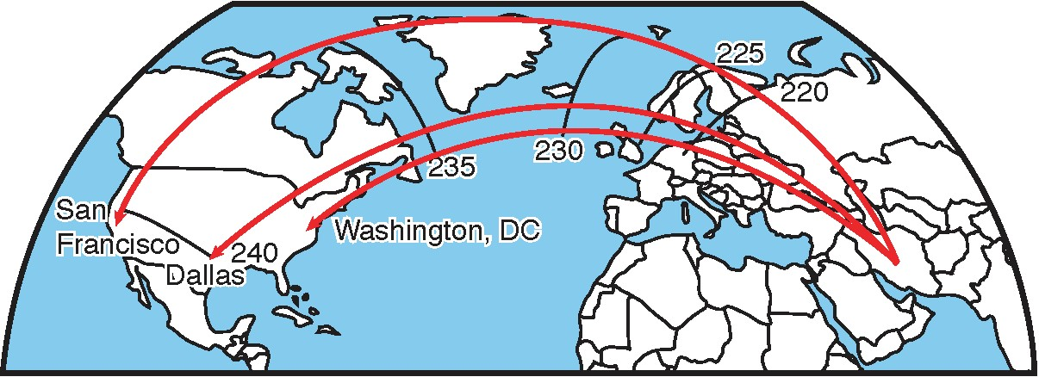
Munitions from Iranian Missiles Could Impact Western Europe or Canada
A successful boost phase intercept (after say 220 seconds of acceleration)
may destroy the missile but leave the payload on course (intact or otherwise).
The payload then continues in un-propelled ballistic flight with a range corresponding
to the length of the shorter boost phase.
The black curves on the plot show the impact location of the payload depending
on the length of boost phase before intercept in seconds.

Slide 67
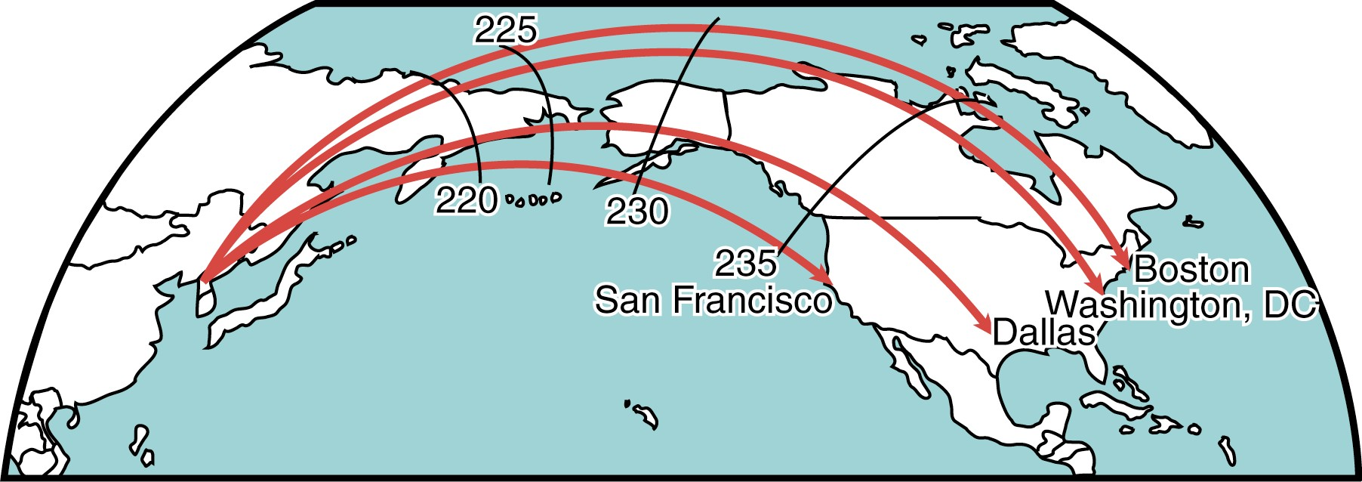
Munitions from North Korean Missiles Could Impact Russia or Canada
A successful boost phase intercept (after say 220 seconds of acceleration)
may destroy the missile but leave the payload on course (intact or otherwise).
The payload then continues in un-propelled ballistic flight with a range corresponding
to the length of the shorter boost phase.
The black curves on the plot show the impact location of the payload depending
on the length of boost phase before intercept in seconds.

Slide 68
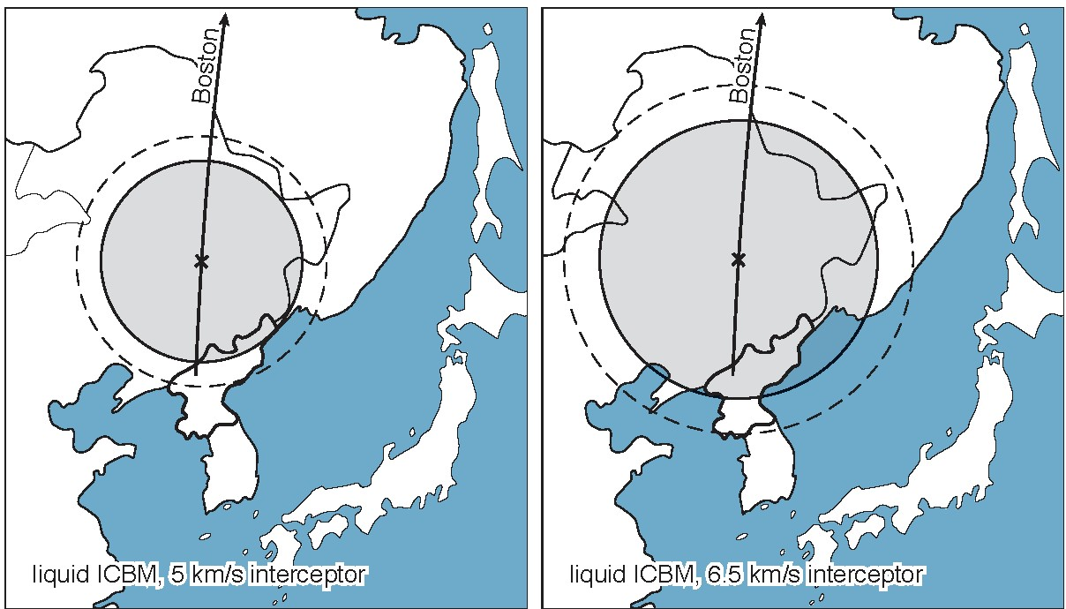
Regional Geography Constrains How Close Interceptors Could Be Based
Solid line: 30 sec.
decision time
Dashed line: No
decision time
Basing areas for a 5 km/s interceptor to defend Boston against a liquid- propellant ICBM launched from North Korea
Basing areas for a 6.5 km/s interceptor to defend Boston against a liquid- propellant ICBM launched from North Korea

Slide 69
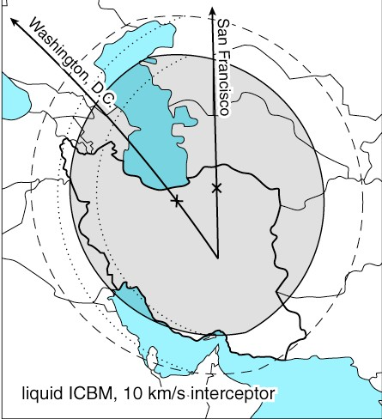
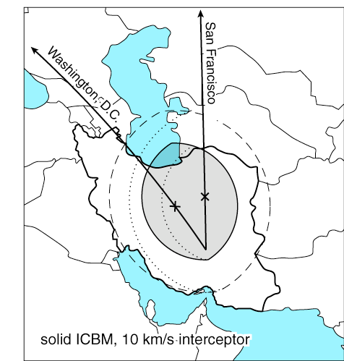
Regional Geography Constrains How Close Interceptors Could Be Based
Basing areas for intercepting a liquid-propellant ICBM from Iran to the Lower 48 States
Basing areas for intercepting a solid-propellant ICBM from Iran to the Lower 48 States

Slide 70
Implications of the Time Constraints
The very short time available to complete the intercept poses significant command-and-control issues —
In some situations the decision whether to fire interceptors would have to be made within a few seconds after a firing solution was obtained
There would generally be too little time to determine using the system’s sensors whether the rocket is an attacking ICBM, a theater ballistic missile, or a rocket launching a satellite
Consequently, interceptors would have to be fired whenever a large rocket in powered flight is detected, without waiting until the nature of the rocket or its trajectory is established
Giving commanders the ability to divert or destroy interceptors in flight might extend the assessment time by about 100 seconds

Slide 71
A System of Space-Based Interceptors Would Require Many Large Satellites
Placing interceptors in space would avoid geographic restrictions on basing, but global geographic constraints would still determine when ICBM must be intercepted
To counter solid-propellant ICBMs, at least 1,600 interceptors would be required, each at 840 kg, for a minimum mass in orbit of 2,000 tonnes
Would require a 5- to 10-fold increase in the annual U.S. space launch capability
To counter liquid-propellant ICBMs, roughly half as many interceptors and space launches would be required
However, a space-based system designed to counter only liquid- propellant ICBMs could become obsolete quickly

Slide 72
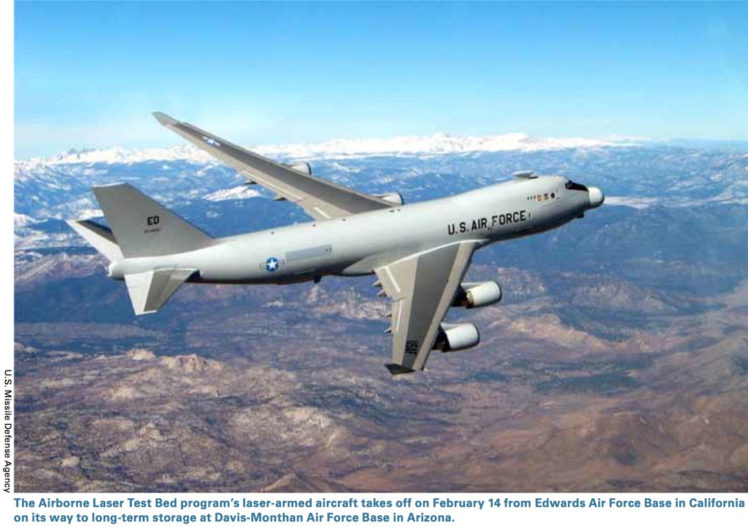
Airborne Laser Boost-Phase Intercept Program

Slide 73
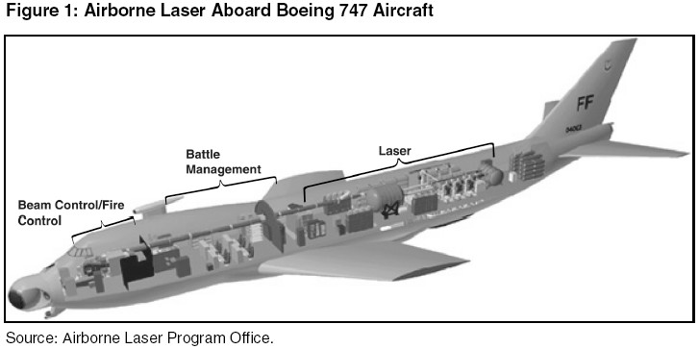
The Airborne Laser Concept

Slide 74
The Airborne Laser Would Have Only Limited Capability Against ICBMs
The ABL’s range would not be limited by time, but by the distance a focused beam could be propagated through the atmosphere
The ABL could in principle be used against ICBMs, if the laser worked as advertised
If it worked as advertised, the ABL would have a range up to 600 km against a liquid-propellant ICBM
Could be useful against ICBMs from North Korea, but not from Iran, unless ABL aircraft could fly over the lower Caspian Sea or Turkmenistan
The ABL would have a range of only 300 km against a solid- propellant ICBM (solid propellant ICBMs are more heat resistant)
Would not be effective in any of the scenarios examined by the APS

Slide 75
The Airborne Laser Would Have Only Limited Capability Against ICBMs
Basing areas for intercepting a solid-propellant ICBM from North Korea
Basing areas for intercepting a solid-propellant ICBM from Iran

Slide 76
Countermeasures Would Challenge Boost-Phase Intercept
A boost-phase defense would not be susceptible to some of the proposed countermeasures to midcourse defense, but it would face countermeasures
Examples of countermeasures to both hit-to-kill and the ABL
Launch several ICBMs nearly simultaneously
Deploy solid-propellant ICBMs
Examples of countermeasures to hit-to-kill
Deploy payload during powered flight
Program evasive maneuvers
Deploy decoys and jammers
Deploy fast-burn boosters with multiple upper stages
Examples of countermeasures to the ABL
Attack the airframe
Roll the ICBM
Use ablative coating
Change the optical properties of the ICBM

Slide 77
iClicker Question
Which of the following is not one of the “Nitze criteria” for considering deployment of an ABM system?
The system must be effective
The system must be able to survive an attack
The system must use the most advanced technology
The system must be cost-effective at the margin
None of the above are “Nitze criteria”

Slide 78
iClicker Answer
Which of the following is not one of the “Nitze criteria” for considering deployment of an ABM system?
The system must be effective
The system must be able to survive an attack
C. The system must use the most advanced technology
The system must be cost-effective at the margin
None of the above are “Nitze criteria”

Slide 79
iClicker Question
Missile Defenses
Which of the following is not a lesson of the Star Wars program?
Missile defense is highly challenging
A rational evaluation of technology capabilities is difficult in light of
external threats, fear and ideology.
An R&D program without clear goals will always waste time and money
Frequent testing is unnecessary
An independent evaluation and review process is critical

Slide 80
iClicker Question
Missile Defenses
Which of the following is not a lesson of the Star Wars program?
Missile defense is highly challenging
A rational evaluation of technology capabilities is difficult in light of
external threats, fear and ideology.
An R&D program without clear goals will always waste time and money
Frequent testing is unnecessary
An independent evaluation and review process is critical

Slide 81
iClicker Question
Missile Defenses
The reported success of the Patriot missile defense system during the 1991 Gulf War was a key argument used to restart the
U.S. program to defend against ICBMs. In the end, how many intercepts of Iraqi short- range missiles were well-documented?
A.
0
5
B.
10
50
100

Slide 82
iClicker Answer
Missile Defenses
The reported success of the Patriot missile defense system during the 1991 Gulf War was a key argument used to restart the
U.S. program to defend against ICBMs. In the end, how many intercepts of Iraqi short- range missiles were well-documented?
A.
0
5
B.
10
50
100

Slide 83
CNN Cold War – “STAR Wars” (1981-1988)
https://www.youtube.com/watch?v=cCVZNNYpTz0

Slide 84
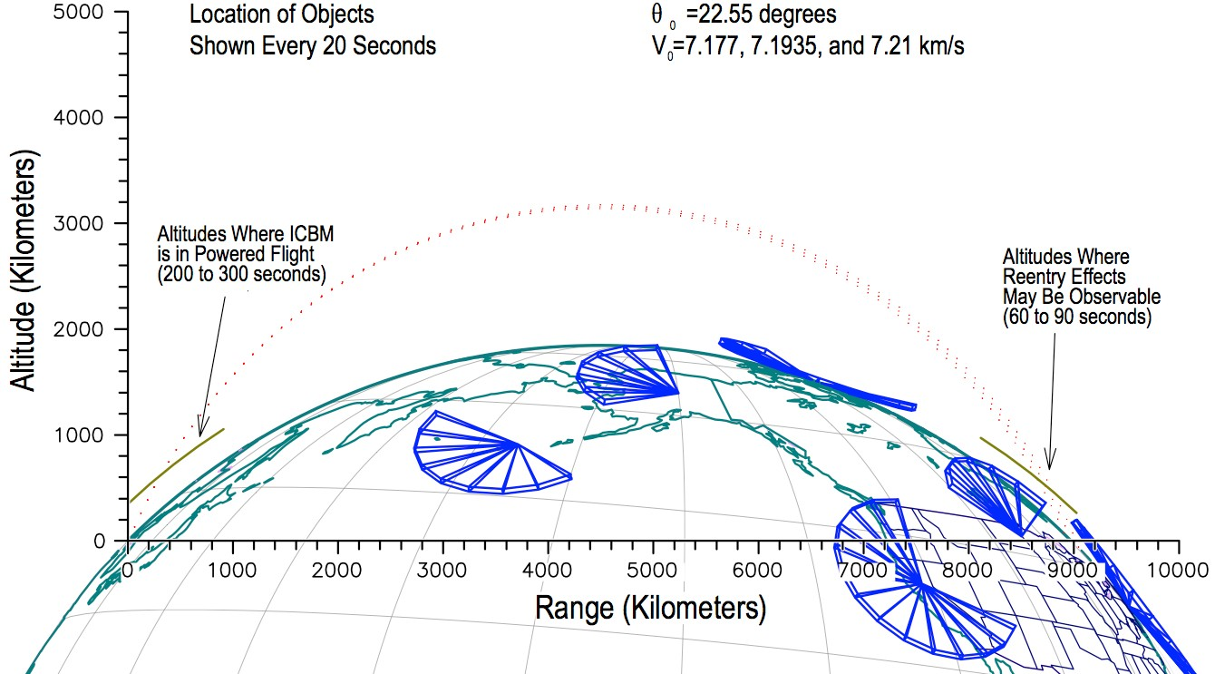
Bush II Defense Initiatives Against Nuclear-Armed Long-Range Ballistic Missiles
From T. Postol
GMD, SM-3 (Aegis)
ABL KEI SBI
THAAD
Patriot

Slide 85
Several of the Bush II Missile Defense Programs have been Scaled Back or Cancelled
Space-based Interceptor (SBI) — cancelled 2003.
Airborne Laser (ABL) — reduced 2008, cancelled 2012.
Kinetic-Energy Interceptor (KEI) — cancelled.
Multiple Kill Vehicle (MKV) — cancelled 2005.
Terminal High-Altitude Area Defense (THAAD) — scaled back, deployed in 2009 to Hawaii and in April 2013 in response to North Korean Missile Threat .
Deployed in March 2018 to South Korea in response to
heightened North Korean Missile Threat.

Slide 86
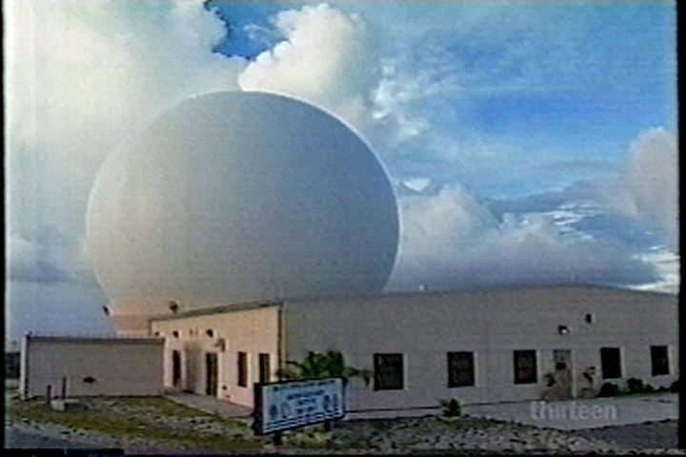
Radar Capabilities for Midcourse Intercept
Land Based Radar
➔ Can’t distinguish warheads from rocket stages
➔ Presently used in GMD system.

Slide 87
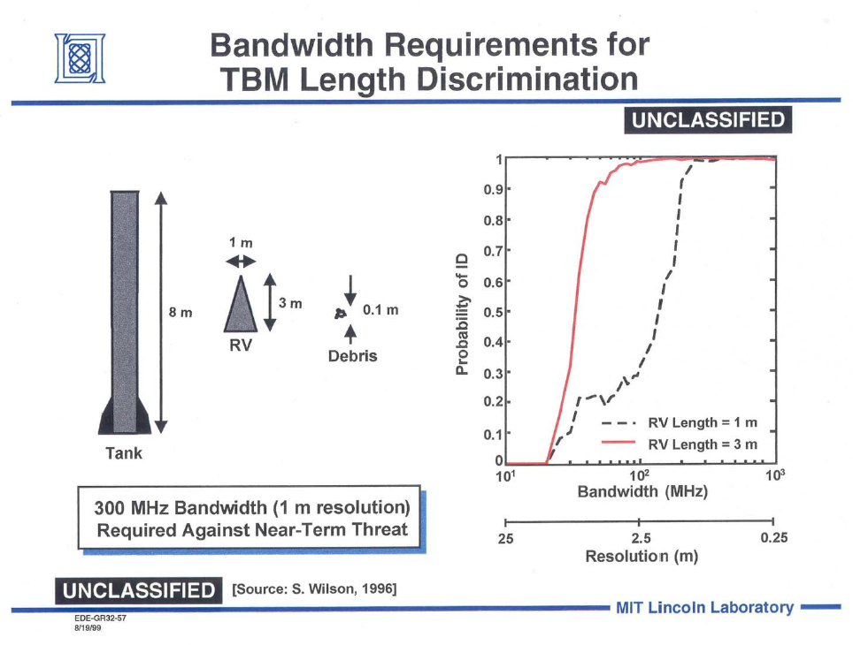
Identification of Re-entry Vehicle Requires Bandwidth higher than 200 MHz

Slide 88

Sea Based X-Band Radar SBX-1
➔ Sufficient resolution to distinguish warheads from rocket stages
➔ Used for tests, not active part of the GMD system – annual operating cost $160 M

Slide 89
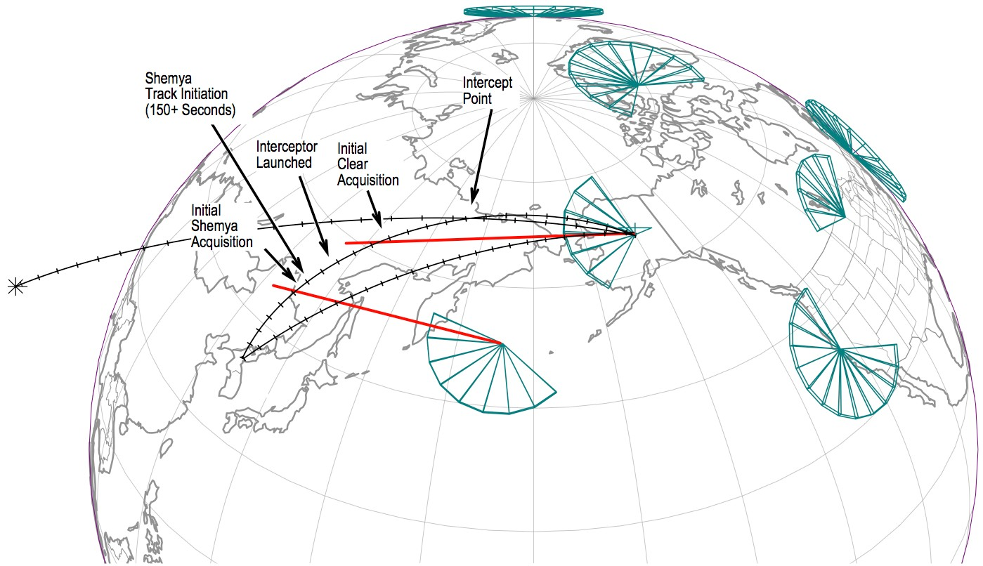
Operational Concept of the Ground-Base Midcourse Intercept (GMD) System
Courtesy T. Postol (MIT)

Slide 90
Challenges to Midcourse Intercept
Each ICBM could launch —
Multiple warheads
Chemical or biological submunitions
A large number of warheads would overwhelm the defense
Each ICBM could launch —
– Countermeasures and penetration aids, including large numbers of lightweight decoys
Outside the atmosphere, these would be difficult to distinguish from warheads and would confuse the defense

Slide 91
Physics Today
April-2018
Ballistic-missile defense (BMD) has been a contentious issue since the Soviet Union launched the Sputnik 1 satellite in 1957. The two dimensions of the controversy concern the ability to neutralize BMD systems with relatively inexpensive countermeasures and the fear that BMD systems will prompt potential adversaries to increase their offensive strategic nuclear forces to ensure they can overwhelm the defense. All BMD systems deployed today to defend the continental US involve the intercept of incoming warheads in space. Many relatively simple countermeasures would be effective against such systems. Figure 4 shows one possibility: lightweight decoys. A 2012 National Research Council report, Making Sense of Ballistic Missile Defense, noted,
Discriminating between actual warheads and lightweight countermeasures has been a contentious issue for midcourse defense for more than 40 years. . . . Based on the information presented to it by the Missile Defense Agency (MDA), the committee learned very little that would help resolve the discrimination issue in the presence of sophisticated countermeasures. In fact, the committee had to seek out people who had put together experiments . . . and who had understood and analyzed the data gathered. Their funding was terminated several years ago, ostensibly for budget reasons, and their expertise was lost. (page 131)
Of course, counter-countermeasures exist, but after more than 50 years of analysis, the advantage remains decisively on the side of the offense.

Slide 92
Physics Today
April-2018

Slide 93
DOT&E 2008 Annual Report on GMD System Evaluation
The January, 2008, DOT&E Annual Report stated:
Flight testing of the GMD system “is not sufficient to provide a high level of statistical confidence in its limited capabilities.”
“The addition of limited operational realism to BMDS testing against strategic threats has uncovered unanticipated deficiencies that will require additional development and testing.”
DOT&E
Office of the Director for Operational Testing & Evaluation

Slide 94
March 2009 Report on the Bush ABM Program by the Government Accountability Office
MDA spent $56 billion researching and deploying elements of the ground- based midcourse defense (GMD) system from 2002–2009.
MDA failed to achieve any of its 6 testing objectives for 2008. Two planned GMD tests were not carried out.
Nevertheless, system elements, including 24 modified GMD interceptors,
were deployed before being fully tested.
The GAO recommended that MDA —
Test its GMD interceptor against a complex scene with countermeasures.
Ensure that items are not manufactured for fielding before their performance has been validated through testing.

Slide 95
Physics 280: Session 24
Plan for This Session
Questions
News
Module 7: Efforts to Defend Against Nuclear Attacks
Next Week: Nuclear arms control

Slide 96
Current Status of the GMD System
The current GMD system:
44 interceptors have been deployed initially in silos. Requested to increase to 64.
Most are in Alaska, a few are in California
Test results:
11 hits in 19 scripted, simplified tests since 1999 (several launch failures— called “no tests” — are not counted)
The launch time and trajectory of the “attacking missile” were known and always the same, closing velocities were slow, no countermeasures were allowed
Current Capability of the GMD system:
Single shot kill probability: 56%
Four interceptor kill probability 97%
Projected cost through FY2019: $41 Billion (source GAO, projection in 2013)

Slide 97
GMD Test Record (from MDA)
http://www.mda.mil/global/documents/pdf/testrecord.pdf
Additional successful test: 3-25-2019

Slide 98
iClicker Question
Even though the tests have been scripted and have not included realistic decoys or other simple countermeasures, the ground-based midcourse defense (GMD) system has achieved what success rate?
0%
10%
50%
80%
90%
26p280 Defenses, p. 140

Slide 99
iClicker Answer
Even though the tests have been scripted and have not included realistic decoys or other simple countermeasures, the ground-based midcourse defense (GMD) system has achieved what success rate?
0%
10%
C. 50%
80%
90%

Slide 100
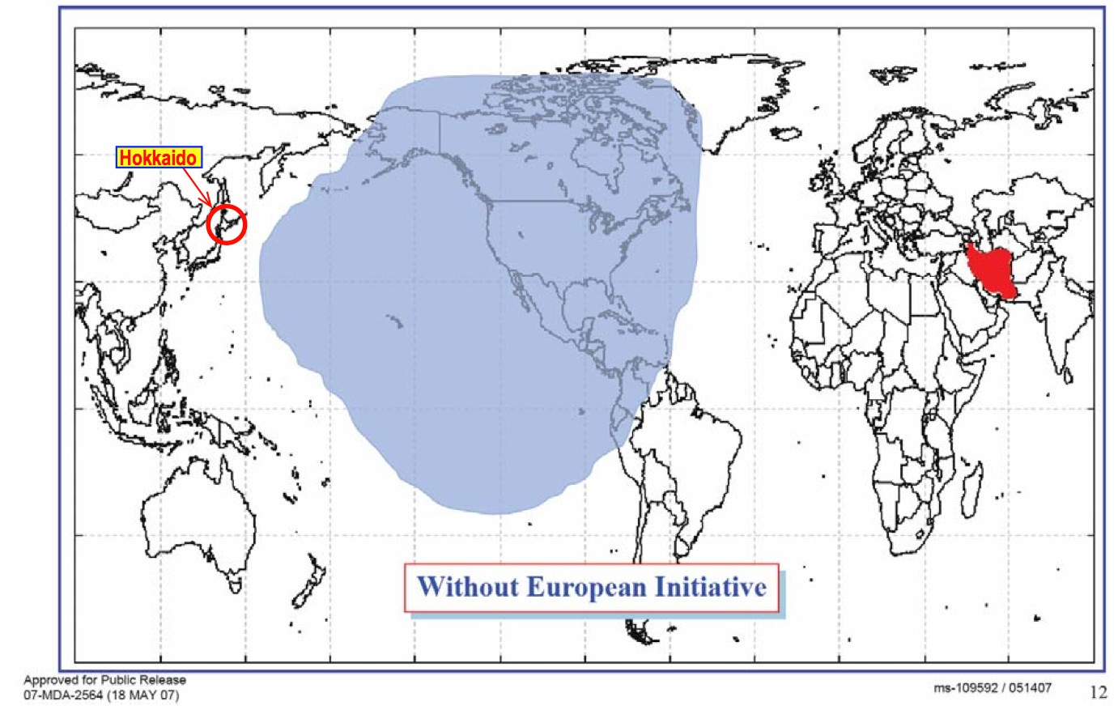
Claimed Theoretical Effectiveness of U.S. GMD Against Iranian Ballistic Missiles

Slide 101
Module 7: Efforts to Defend Against Attacks
European Missile Defense System
(as adapted by the Obama Administration giving up
missile defense launch sites in Eastern Europe in favor
of sea launched missiles)

Slide 102
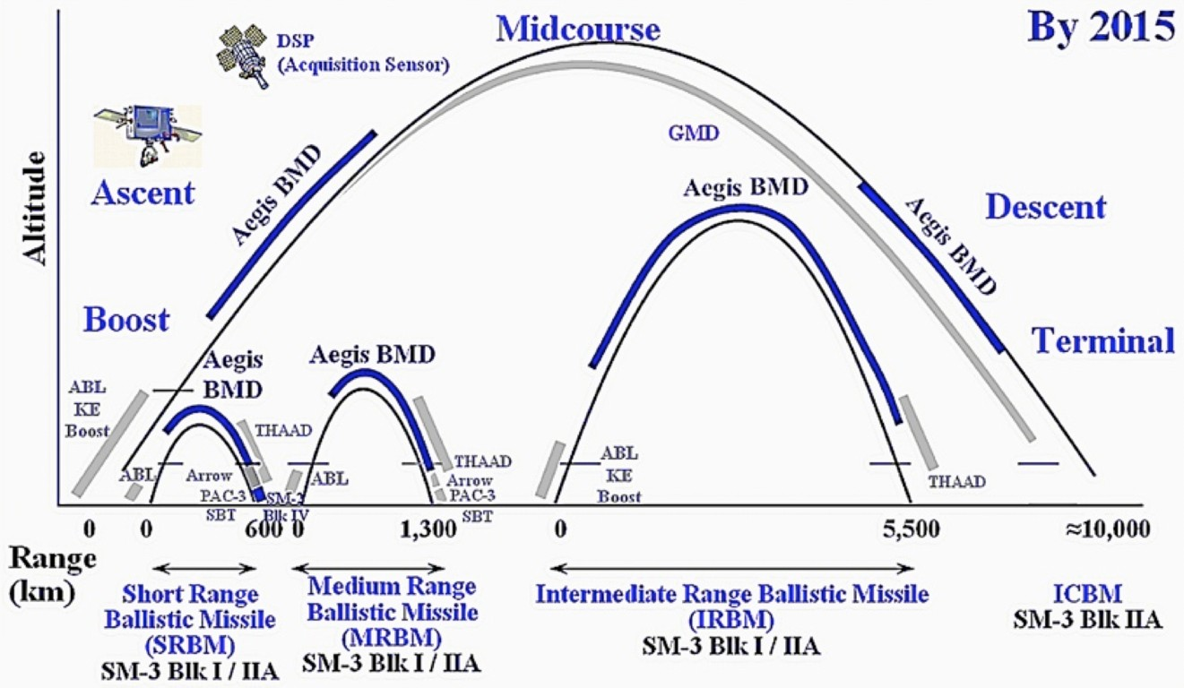
Obama Administration: Phased Adaptive Approach to EMD

Slide 103
Phased Adaptive Approach to EMD
The European Phased Adaptive Approach (PAA) was presented as a more flexible alternative to Bush’s proposed European-based GMD system.
It uses SM-3 interceptors, which are roughly 10X smaller than the 20-ton interceptors of the proposed European-based GMD system and will evolve continuously with increasing capability.
A system using these smaller and lighter interceptors would be incrementally tailored to the perceived threat over the coming decade.

Slide 104
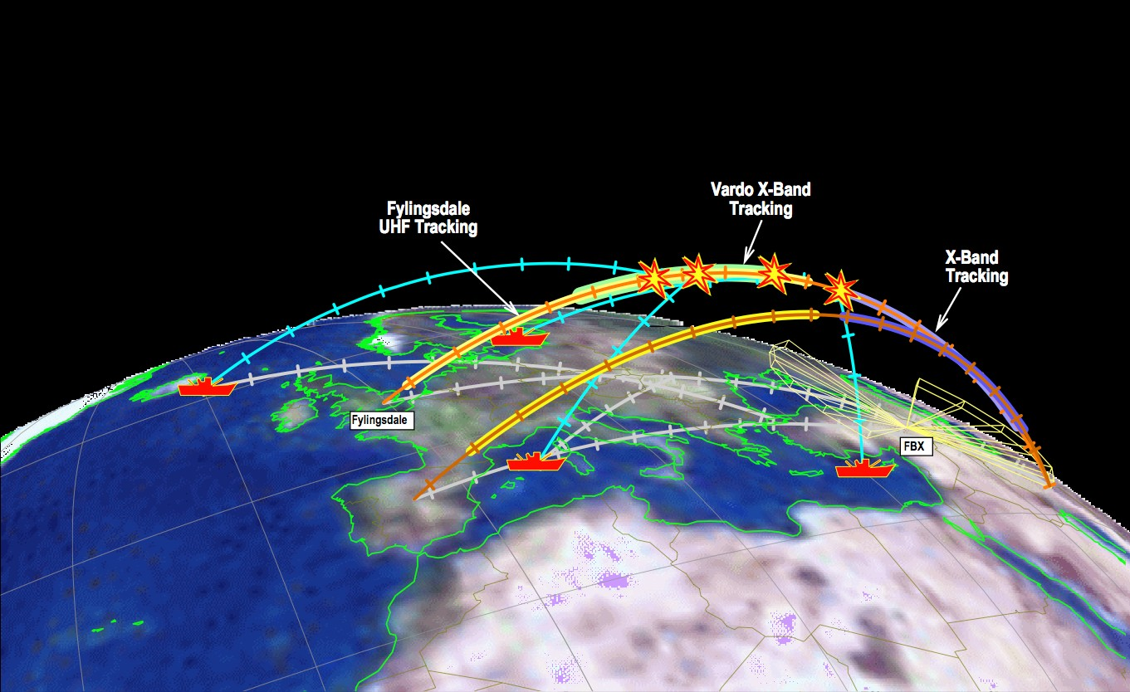
Phased Adaptive Approach to EMD
500 SM-3 interceptors in Phase 4 on 43 ships

Slide 105
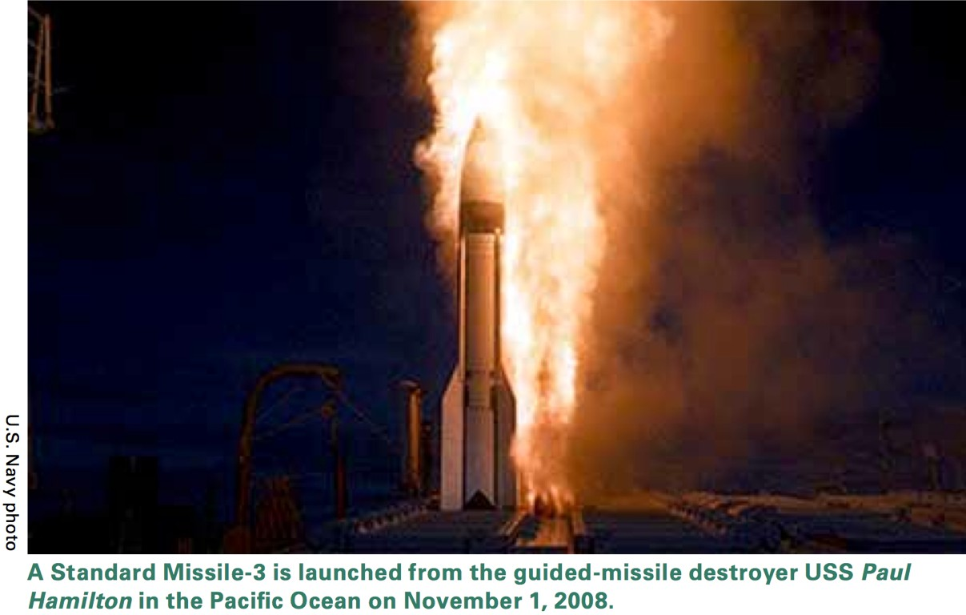
Phased Adaptive Approach to EMD

Slide 106
Phased Adaptive Approach to EMD
The PAA plan called for more than 500 SM-3 interceptors to be based on 43 ships by 2021.
The PAA plan called for SM-3s with increasing capability to be stationed in Romania (in 2015) and in Poland (in 2021).
The plan is to deploy SM-3 IIB interceptors by 2021. They are advertised as having some capability against longer- range missiles.
In a study presented on January 29th , 2013
the GAO concludes that the final phase of PAA in its
present configuration may be ineffective in defending the
US from ICBMs from Iran. The Obama administration
canceled the final phase IV of PAA.

Slide 107
Navy/MDA Plans for Deployment of BMD-Capable Aegis Ships and SM-3 Interceptors

Slide 108
Current MDA Funding Request and Projections for Aegis BMD Program

Slide 109
Recent Funding of Missile Defense Agency
Missile defense, budget —
FY10, $7.9B. (before 9/11 about ~$3.5B/year)
FY11, $8.5B.
FY12, $8.4B.
FY13, $8.3B
FY14, $7.6B
FY15, $7.8B
FY16, $8.3B
FY17, $8.1B
FY18 – FY23, $8.9B – $9.9B
Total MDA spending 1985 to 2022: ~ 235 B

Slide 110
Possible Russian Concerns About the Phased Adaptive Approach to EMD
The main concern of cautious Russian military planners would be the capability of missile defense interceptors to simply reach, or “engage”, Russian strategic warheads, rather than whether any particular engagement results in an actual interception, or “kill.”
Interceptors with a kinematic capability to reach Russian ICBM warheads would be sufficient to raise concerns in Russian national security circles — regardless of the possibility that Russian decoys and other countermeasures might defeat the system in actual engagements.
Hence even a missile defense system that could be rendered ineffective could still create serious concerns for cautious Russian military planners.
26p280 Defenses, p. 118

Slide 111
Possible Russian Concerns About the Phased Adaptive Approach to EMD
The last two phases of the PAA – when the higher burnout velocity “Block II” SM-3 interceptors go on-line – could create legitimate concerns for Russian military analysts.
These interceptors could in principle be used to create an integrated continental U.S. missile defense system that could engage Russian ICBM warheads, either in combination with, or independent of, the Ground-Based Midcourse (GMD) system now deployed in Alaska and California.
This fact introduces the possibility that Russian ICBMs could face many hundreds, or eventually thousands, of SM-3 interceptors, in addition to the 30 or so GMD interceptors already deployed.
Such large numbers of interceptors, which might in reality have little capability in combat, could be expected to create fears among Russian political and military leaders that the PAA could cause some attrition of Russian warheads.

Slide 112
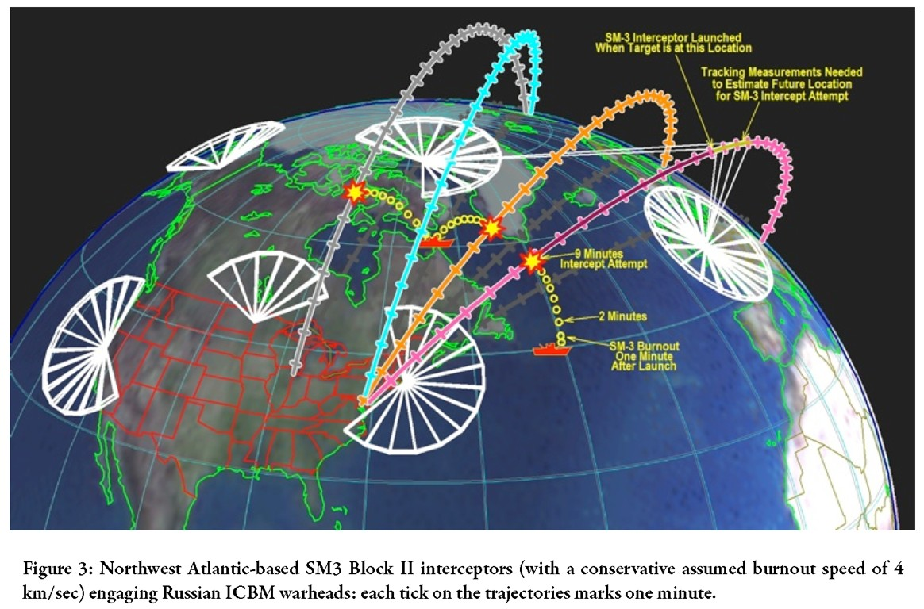
Possible Russian Concerns About the Phased Adaptive Approach to EMD

Slide 113
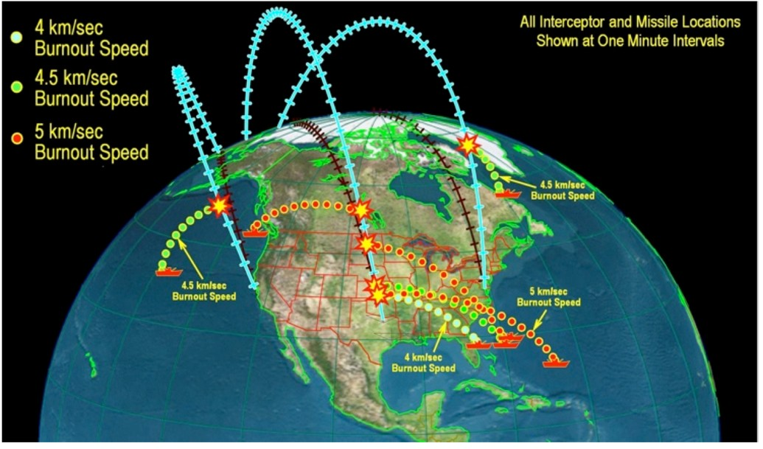
Possible Russian Concerns About the Phased Adaptive Approach to EMD

Slide 114
Defenses Against Long-Range Nuclear-Armed Ballistic Missiles
Summary and Conclusions
26p280 Defenses, p. 114

Slide 115
Status of the U.S. Missile Defense Program
The technical performance of the current GMD ABM system is unclear due to insufficient testing under realistic conditions.
The Phased Adaptive Approach for European Missile Defense may not be effective in defending against ICBMs and requires review. The Obama administration has decided to cancel Phase IV.
Difficult to find solution that will create ABM effective against threats from the DPRK and from Iran and at the same time be not seen as threatening the nuclear deterrent of Russia and China.
26p280 Defenses, p. 115

Slide 116
Some Missile Defense Questions
The material presented in this module shows that the political actions in this area by the U.S. and Russia are not consistent with the scientific-technical realities. What is the reason for this failure?
Is it insufficient scientific-technical advice reaching the highest levels of governments?
Is it deliberate disregard of such advice by national leaders and the inherent conservatism of governments in their inability to change past erroneous decisions?
Is it the skillful exploitation of valid public concerns for security by groups and institutions benefitting from large expenditure on missile defense?
26p280 Defenses, p. 116

Slide 117
Module 7: Defenses Against Nuclear Attack
Supplementary Slides
26p280 Defenses, p. 117

Slide 118
What Might a Successful Approach Look Like?
North Korea
Three no’s — No more bombs No better bombs No export
In return for one yes —
U.S. willingness to address North Korea’s fundamental security concerns, including normalization of relations with the United States + energy and economic aid.
Iran
Two no’s — No bombs No export
In return for one yes —
U.S. willingness to address Iran’s fundamental security concerns. This would probably have to include normalization of relations with the United States
26p280 Defenses, p. 118

Slide 119
Module 7: Efforts to Defend Against Attacks
George W. Bush’s Proposed European Midcourse Intercept System

Slide 120
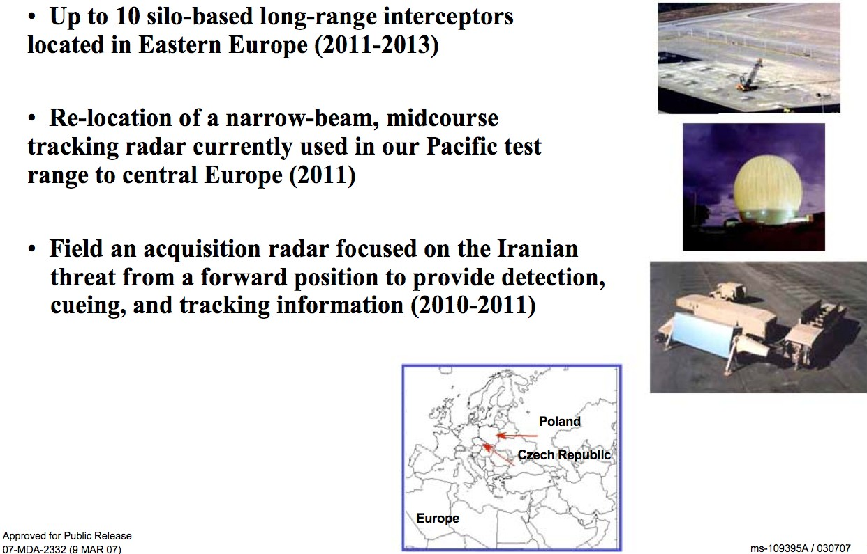
Bush’s Proposed European Missile Defense
(Missile Defense Agency Slide)
Courtesy: T. Postol (MIT)
26p280 Defenses, p. 130

Slide 121
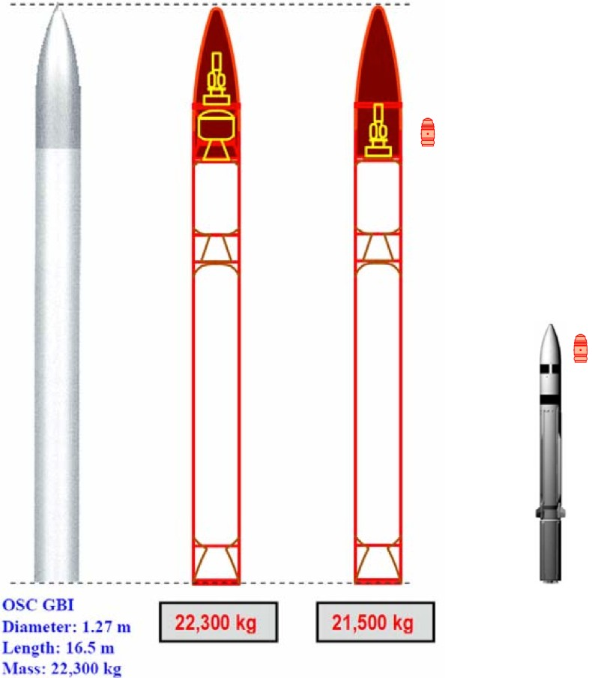
Planned Midcourse Intercept Rockets
Courtesy T. Postol (MIT)

Slide 122
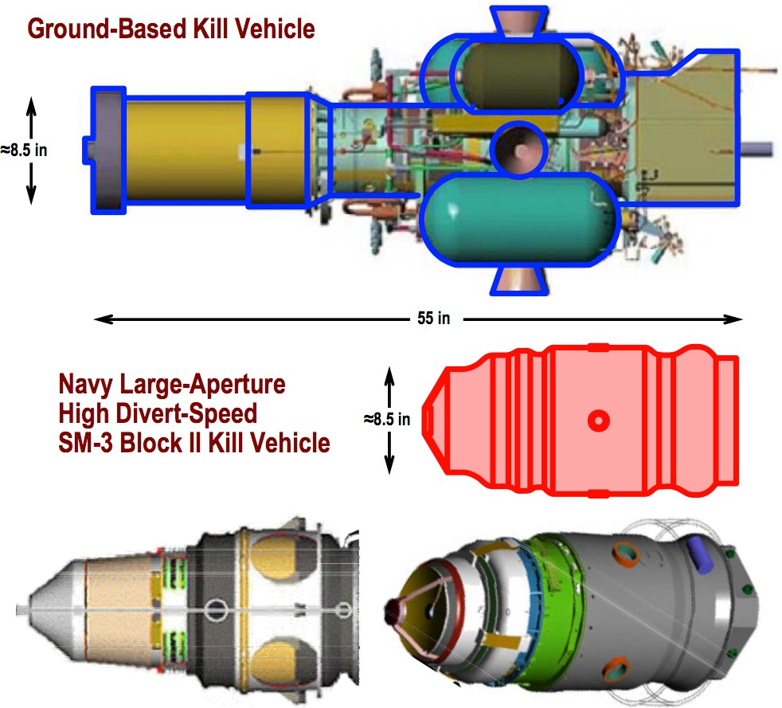
Planned Midcourse Intercept Kill Vehicles
Courtesy T. Postol (MIT)

Slide 123
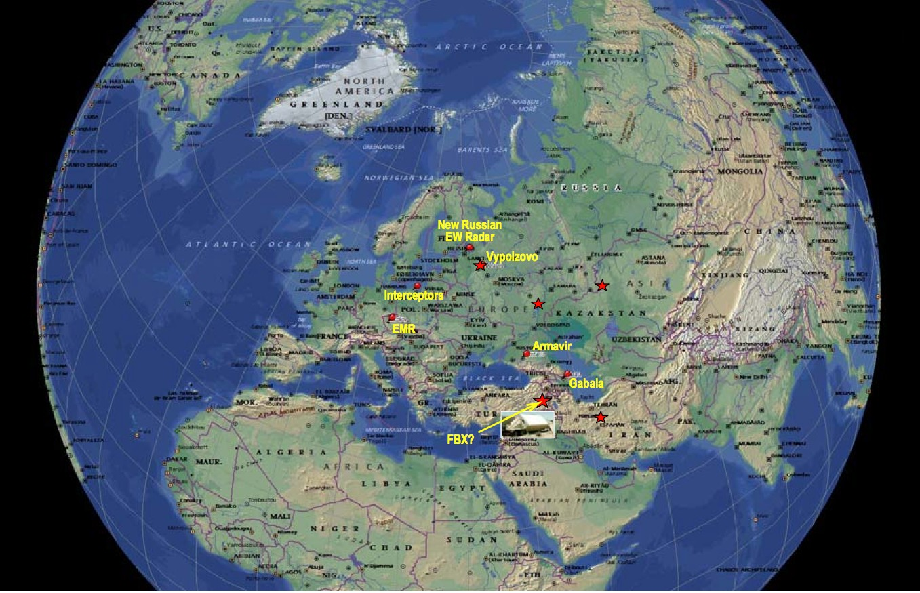
Proposed European Defense Against Ballistic Missiles
Courtesy T. Postol (MIT)

Slide 124
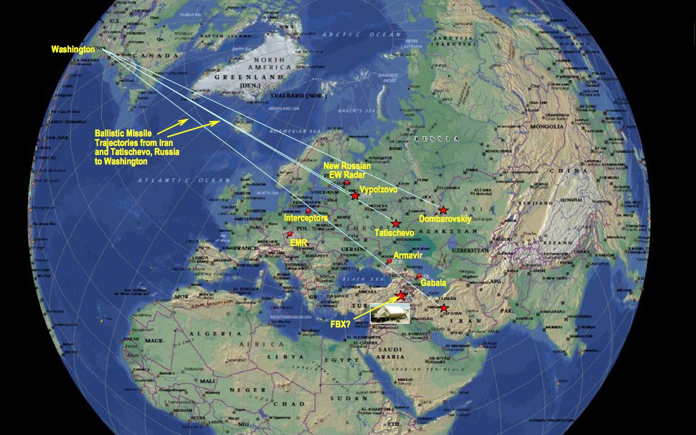
Proposed European Defense Against Ballistic Missiles
Courtesy T. Postol (MIT)

Slide 125
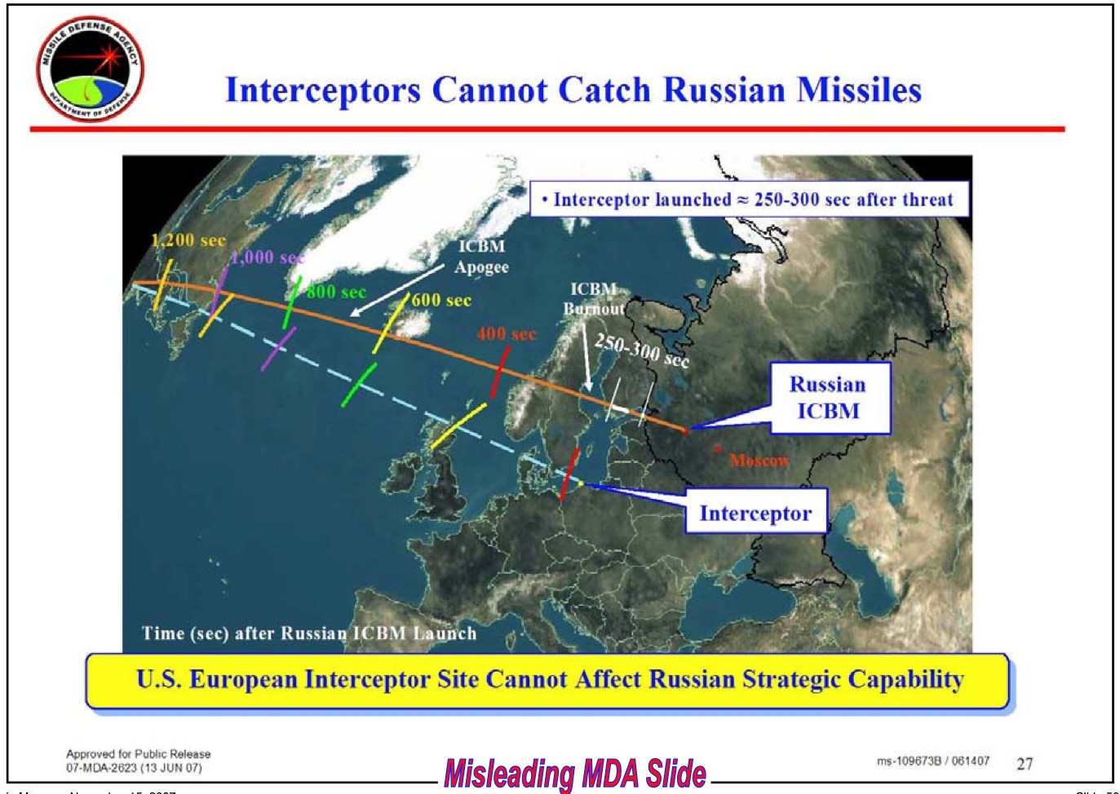
Proposed European Defense Against Ballistic Missiles
Courtesy T. Postol (MIT)

Slide 126
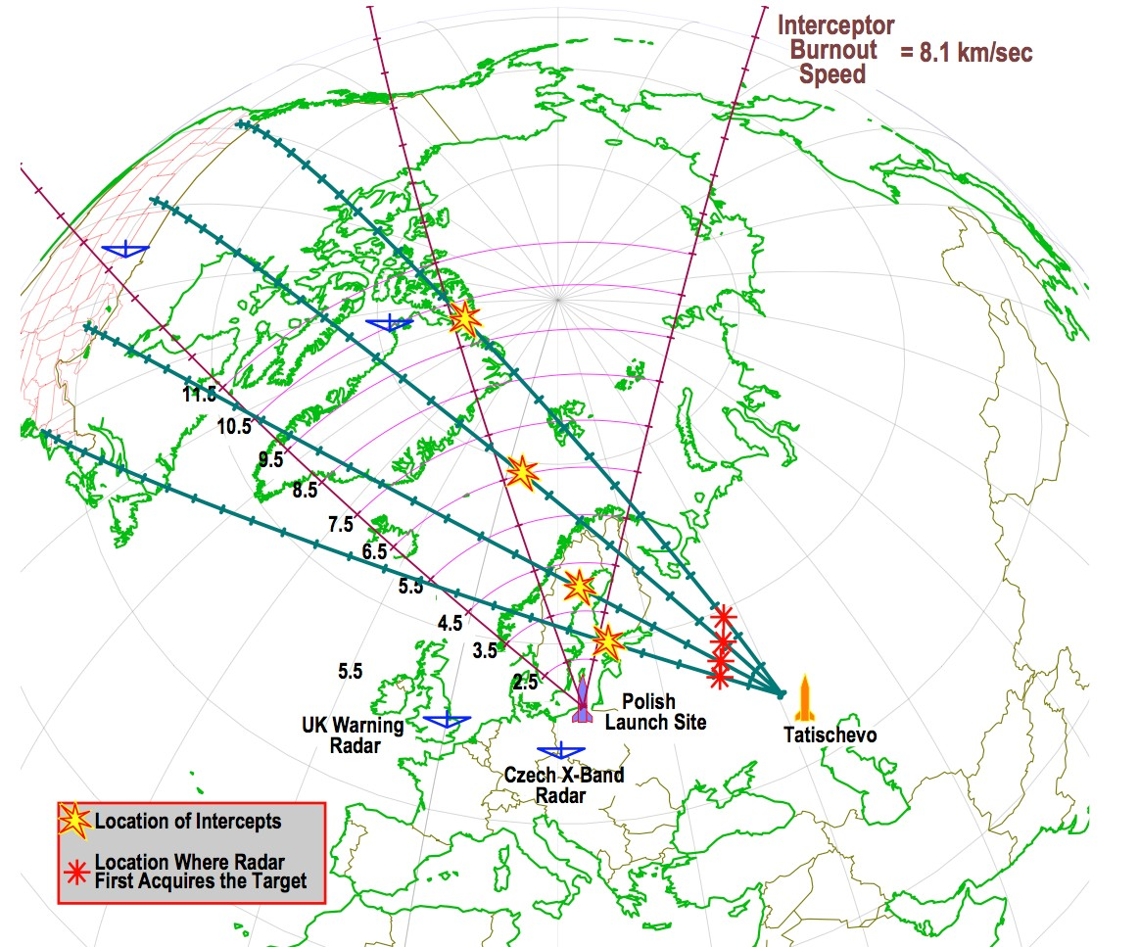
Proposed European Defense Against Ballistic Missiles
Courtesy T. Postol (MIT)

Slide 127
iClicker Question
The interceptor rockets for President Bush’s European-based missile defense program:
Were tested about a dozen times
Were tested only 3 times
Were tested only once
Were never even built

Slide 128
iClicker Answer
The interceptor rockets for President Bush’s European-based missile defense program:
Were tested about a dozen times
Were tested only 3 times
Were tested only once
D. Were never even built

Slide 129
iClicker Question
Obama’s proposed European missile defense system will initially rely primarily on what type of interceptor?
Large ground-based interceptor rockets
Small ship-based interceptor rockets
Ship-based lasers
Airborne lasers
All of the above

Slide 130
iClicker Answer
Obama’s proposed European missile defense system will initially rely primarily on what type of interceptor?
A. Large ground-based interceptor rockets
B. Small ship-based interceptor rockets
Ship-based lasers
Airborne lasers
All of the above
26p280 Defenses, p. 130

Slide 131
Defenses Against Nuclear Attack
Many aspects of this problem are counter-intuitive Very important to distinguish—
Technical issues (nature cannot be fooled)
Policy issues (what is the goal)
Arms race issues (effects on arms races)
Costs vs. benefits, alternatives, opportunity costs
Possible threats and threat evolution (number, characteristics, responsive vs. nonresponsive)
Crucial to avoid “the fallacy of the last move”
26p280 Defenses, p. 131

Slide 132
Consequences of a Nuclear Explosion
A single nuclear explosion can cause unimaginable death and destruction
A “small” (few kiloton) nuclear explosion in a major city would, within seconds to minutes —
kill hundreds of thousands of people
reduce many square miles to rubble
A large (100 kiloton – 1 Megaton) nuclear explosion in a major city would, within seconds to minutes —
kill many millions of people
reduce a hundred square miles to rubble
Very little can be done before or after a nuclear explosion to lessen the deaths, injuries, and destruction it will cause
26p280 Defenses, p. 132

Slide 133
Efforts to Defend the United States Against Attack by Nuclear-Armed Ballistic Missiles
Evolution of perceived threats
Soviet long-range ballistic missiles (1950s – 1990s)
Chinese long-range ballistic missiles (1960s – today)
Accidental or unauthorized launch of ballistic missiles (early 1990s)
North Korean or Iranian long-range missiles (late 1990s – today)
History of U.S. main anti-ballistic missile weapon programs
Nike-Zeus (1950s)
Nike-X (early 1960s)
Sentinel (late 1960s)
Safeguard (1970s)
Star Wars (1980s)
Global Protection Against Accidental Launches (GPALS, early 1990s)
National Missile Defense (late 1990s)
Current Missile Defense Program (2001 to the present)
26p280 Defenses, p. 170

Slide 134
Goals of U.S. ABM Programs
Some past announced or actual ABM program goals —
Defend U.S. cities against a massive attack by Soviet ICBMs (1955–1962)
Support the aerospace industry, defend the Johnson administration against attacks by Republicans, defend the United States against a limited attack by future Chinese missiles (1968)
Defend some U.S. ICBM silos against a Soviet counter-force attack (1968–1975)
Make nuclear weapons impotent and obsolete by creating an “impenetrable shield” that would completely protect the U.S. and all its friends and allies (Reagan, 1983–1988)
Enhance deterrence, defend U.S. missile silos, achieve political advantage, etc. (everyone else, 1983–1988)

Slide 135
Goals of U.S. ABM Programs
ABM program goals (continued) —
Defend the United States against accidental launches of Soviet ICBMs (1988–1990)
Defend the United States against an unspecified, emerging Third- World ballistic missile threat (1990–1991)
Counter the threat of theater ballistic missiles (1991–1998)
Defend the Clinton administration against attacks by Republicans, defend the U.S. against missile attacks by emerging ballistic missile states with which the U.S. did not have friendly relations (1998–2001)
Reward Bush supporters, defend U.S. against missile attacks by the “axis of evil” states (North Korea, Iran, and Iraq), or China, or an accidental launch from Russia, or … (2001–present)

Slide 136
The Patriot Weapon System
Originally an anti-aircraft system (IOC in 1985) Given some ATBM capability in 1988 (PAC-1)
Software upgrade
Specifically designed to counter Soviet TBMs
Given improved ATBM capability in 1990 (PAC-2)
Faster fuse
Fragmenting warhead with larger pellets
Some capability against Soviet Scud missiles
No capability against Iraqi Al-Hussein missiles

Slide 137
Patriot in the 1991 Gulf War
The system—
The US had only 3 PAC-2 interceptors in its inventory at the time the Iraqi’s invaded Kuwait
Changes in system software were made hastily after the invasion
600 PAC-2 interceptors were manufactured by January 1991
PAC-2 interceptors were incorporated into all units deployed to the Gulf
Critical software errors were discovered in the field, one may have caused major US fatalities
No data was recorded in the field to evaluate the Patriot system’s performance

Slide 138
What’s Different About Current U.S. ABM Programs Compared to ‘Star Wars’?
Today’s defined threat is numerically smaller, but nuclear and chemical or biological warheads still require that the defense meet very high performance standards
Geographical factors and missile ranges are more diverse
Defenses against shorter-range (theater or battlefield) missiles are technically easier because of these missiles have lower speeds
Legacy technologies from the Star Wars program are occasionally helpful, but by-and-large the benefits from this enormous expenditure are small

Slide 139
Technological Challenges of Midcourse Intercept
The technological challenge is formidable, most difficult is “discrimination”
The system has to confront an attacking missile that is designed to fool the interceptor into going after one of many decoys RVs
The general performance characteristics of the EKV (com links, sensor suite, agility) will be known to the adversary
The missile’s payload could be one or more nuclear warheads, or dozens or hundreds of hardened chemical or biological munitions (bomblets)
The system must identify and track RVs in the face of countermeasures, including decoys and anti-simulation devices
The Welch panel labeled the Bush II GMD program “Rush to Failure”
The system failed many tests. The DoD therefore exempted the system from any further testing until it was deployed.

Slide 140


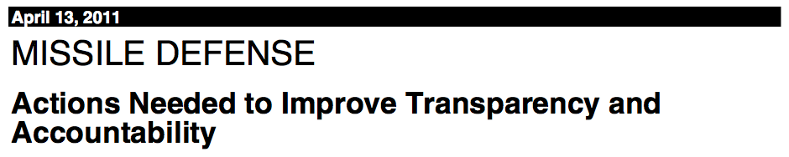
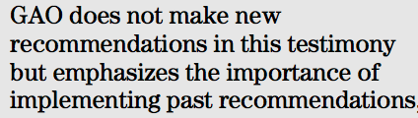
GAO Report on Missile Defense

Slide 141
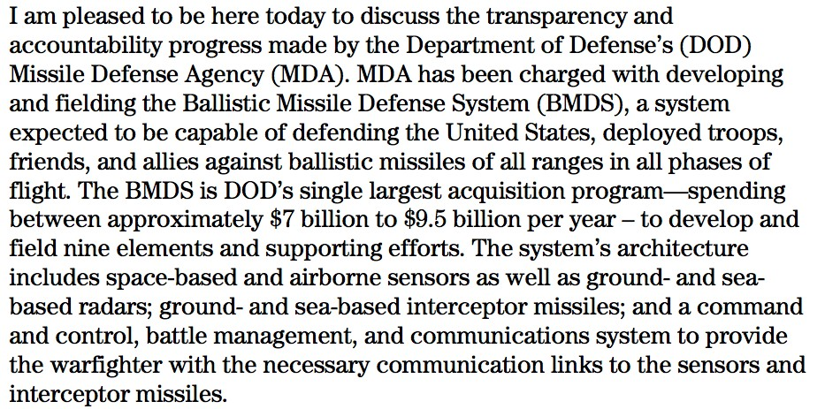
GAO Report on Missile Defense

Slide 142
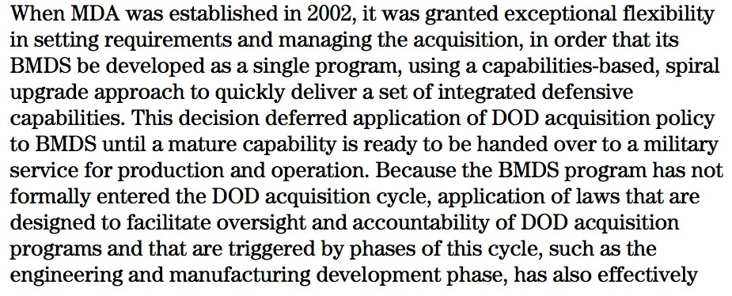
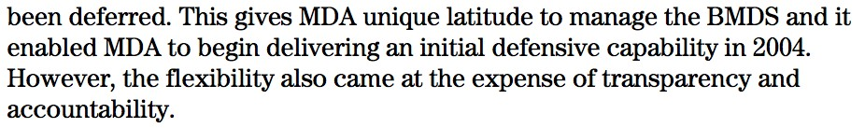
GAO Report on Missile Defense

Slide 143
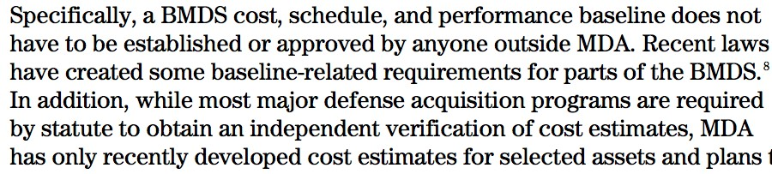
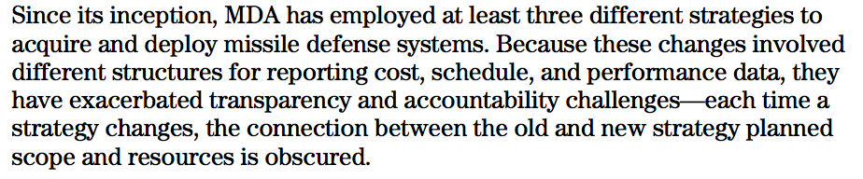
GAO Report on Missile Defense
26p280 Defenses, p. 180

Slide 144

GAO Report on Missile Defense

Slide 145

GAO Report on Missile Defense

Slide 146

GAO Report on Missile Defense

Slide 147

GAO Report on Missile Defense

Slide 148

GAO Report on Missile Defense

Slide 149

GAO Report on Missile Defense

Slide 150

GAO Report on Missile Defense

Slide 151

GAO Report on Missile Defense

Slide 152

GAO Report on Missile Defense

Slide 153
Approach of the APS Boost Missile Defense Study Group
Relied on the threat assessments in unclassified summaries of recent National Intelligence Estimates and Congressional testimony by NIC staff
Considered a range of possible goals for the defense (defending all 50 states, only the largest cities, only one coast, only Hawaii, ...)
Made generally optimistic assumptions about the performance of boost- phase defense systems:
Assumed the attacker would have only early-1960s technology
Assumed the defense would be able to deploy the most advanced technology available ten years from now
Set aside all battle management, communications, command, control, lethality, and reliability issues and countermeasures
Identified system architectures that could work in principle Constructed computer models of missiles, missile tracking systems,
interceptors, and kill vehicles and carried out simulations to determine the performance that would be required for these systems to work
26p280 Defenses, p. 190

Slide 154
Why the APS Study’s Results Differ From Those of Some Other Studies
It considered liquid-propellant model ICBMs based on 40-year-old technology, but did not assume they would have very long (300+ second) boost phases
It considered solid-propellant model ICBMs based on 40-year-old technology It did not assume the defense is “omniscient” —
It did assume the ICBM’s performance characteristics are known exactly (but they may not be)
It did not assume knowledge of the attacker’s intent
—Initial direction of flight and target unknown in advance
—ICBM’s flight path not known in advance
It carefully analyzed kill-vehicle performance required to intercept an accelerating ICBM
It carefully examined the defense technologies likely to be in hand in 10 to 15 years and their implications for interceptor and kill-vehicle performance

Slide 155
Why Solid-Propellant ICBMs Need to Be Considered
The two fundamentally different types of ICBMs (liquid- and solid- propellant) present very different challenges
Although North Korea might initially deploy liquid-propellant ICBMs, recent NIE summaries point to significant transfer of solid- rocket technology among North Korea, Iran, Pakistan, China, and other countries of concern
On the basis of unclassified summaries of the most recent U.S National Intelligence Estimates and briefings, the Study Group concluded that countries of concern might deploy solid-propellant ICBMs within the next 10–15 years, if they were able to purchase or acquire solid-propellant missiles or technology and the U.S pursued a boost-phase missile defense
Because it would take at least a decade for the United States to field a boost-phase missile defense, a defense that is effective only against liquid-propellant ICBMs would risk being obsolete when deployed or soon afterward

Slide 156
Whether the Interceptor Rocket Could Reach the ICBM in Time Depends . . .
On whether the target ICBM is a liquid-or a solid-propellant missile The global geography determines how early in its flight the target
ICBM must be intercepted
Regional geography determines how close to the target ICBM’s flight path interceptors could be based
Generally interceptors must be based far from the intercept point, must fly almost their maximum range (~ 500 km for solid ICBMs or
~ 1,000 km for liquid ICBMs), and must intercept the ICBM at the last possible moment

Slide 157

Reaching and Hitting the Target Would Require Large, Fast Booster Rockets

Slide 158
Hitting an ICBM in Powered Flight Requires a Highly Capable Kill Vehicle
The APS Study found no fundamental obstacle to developing adequate kill vehicles, but —
The kill vehicle must have sensors capable of tracking the cool missile body in the face of the bright exhaust plume, which is displaced from it
Passive infrared, optical, and UV sensors
Active sensors such as LIDAR
The kill vehicle must be able to compensate fully for changes in the flight of the target missile
Must have adequate total divert capability (2.0 to 2.5 km/s)
Must have sufficient acceleration for the endgame (15 g)
Must have fast guidance and control and quick dynamic response
(0.1 s or less total lag)
Kill vehicles with these capabilities would be relatively heavy (90–140 kg)

Slide 159

Hitting an ICBM in Powered Flight is Very Challenging

Slide 160

Global Geography Determines How Early the ICBM Must Be Intercepted
These maps show when an attacking missile could release its warheads to strike U.S. territory; all warheads would be released within 500 km of the missile launch site.
Solid-propellant from North Korea
Solid-propellant from Iran

Slide 161


Regional Geography Determines How Close Interceptors Could Be Based
Basing areas for intercepting a solid- propellant ICBM from
North Korea to Fairbanks
Basing areas for intercepting a solid-propellant ICBM from North Korea to Boston

Slide 162
Shortfall Would Be Difficult to Manage
The goal of a boost-phase defense is to protect the target by causing the attacking missile’s munitions to fall short
A problem inherent in boost-phase defense is that causing the attacking missile’s munitions to fall short could cause nuclear, chemical, or biological weapons to impact other populated areas in the United States or other countries
Some or all of these weapons could be live when they impact Timing intercepts accurately enough to avoid causing this would
be very difficult, if it’s possible at all
An alternative would be to design the interceptor to destroy all warheads or submunitions, but this is likely to be difficult

Slide 163
Munitions from North Korean Missiles Could Impact Russia or Canada
If launched against a target in the central United States, this particular missile would have to be intercepted in a small window between about 225 and 230 seconds after launch, to avoid dropping warheads on Russia or Canada
In reality, the performance characteristics of attacking missiles and their targets are unlikely to be known exactly in advance
Hence timing intercepts accurately enough to avoid causing possible live munitions to fall on Russia or Canada would be very difficult, if it’s possible at all
26p280 Defenses, p. 200

Slide 164
Munitions from Iranian Missiles Could Impact Western Europe
If launched against a target in the central United States, this particular missile would have to be intercepted in a small window between about 225 and 230 seconds after launch, to avoid dropping warheads on Russia or Canada
In reality, the performance characteristics of attacking missiles and their targets are unlikely to be known exactly in advance
Hence timing intercepts accurately enough to avoid causing possible live munitions to fall on Russia or Canada would be very difficult, if it’s possible at all

Slide 165
Summary of the Findings of the APS Study of Boost-Phase Missile Defense
Hit-to-kill interceptors could potentially defend the United States against liquid-propellant ICBMs launched from some countries
Boost-phase defense against solid-propellant ICBMs is unlikely to be practical during the next decade, when all factors are considered
A boost-phase defense against short-or medium-range missiles launched from platforms off U.S. coasts appears feasible
A space-based boost-phase intercept system appears infeasible until the masses of kill vehicles can be reduced substantially
The ABL’s range is likely to be too short for it to be useful except against liquid-propellant ICBMs from North Korea
Countermeasures are possible and should be expected

Slide 166


Test of the Aegis Ship-Based Anti-Missile System

Slide 167

Test of the Aegis Ship-Based Anti-Missile System

Slide 168
Summary
The technical performance of the U.S. ABM system is dubious. None of the few tests has been realistic operational exercises.
Moreover, a very substantial fraction of these tests have resulted in failures, not because of fundamental design flaws but because of insufficient quality control needed by complex systems. The items that failed in these tests had functioned previously.
The target missile trajectories were known beforehand and no decoys or other means of deceptive tactics to defeat the ABM system were employed.
Technically, such decoys are considerably easier to produce than the missile itself; therefore, any nation capable of ballistic missile delivery against the United States could also employ countermeasures adequate to render the system useless.

Slide 169
Missile Defense Conclusions
The current defense of the United States against nuclear weapons is seriously unbalanced.
We have spent more than $300 billion on defenses against nuclear armed long-range ballistic missiles and are currently spending $10 billion per year.
But nothing stemming from this effort enhances the real security of the United States.
As one example, relative to defenses against ballistic missiles, the effort to improve the security of the vast foreign stockpiles of nuclear weapons and critical nuclear weapons usable material has been less by about a factor of 10.
But this effort is the principal way we can prevent clandestine delivery of nuclear weapons against this the United States.

Slide 170
Module 7: Defenses Against Nuclear Attack
End of Module

Slide 171
Reagan’s ‘Star Wars’ ABM Weapon Program
What if Star Wars weapons had been deployed?
It would have aggravated crisis instability.
It would have shortened decision times, removing humans from the loop.
Very large cost [the cost of the originally proposed prototype system exceeded $1 trillion in 1985 $].
It could have created a false sense of security, possibly leading to tragic mistakes.

Slide 172
Module 7: Efforts to Defend Against Attacks
Bush II’s Missile Defense Program (“Total Defense”)

Slide 173
Bush II: Capability-Based Acquisition
The ‘Nitze Criteria’ were officially abandoned.
Instead, the Bush program was “capability-based”, which meant —
No specific goals or requirements. Instead, provide system with best possible technology capabilities and explore and use its utility.
Congress was asked to fund the Missile Defense Agency (MDA) without transparency in the program goals and accounting.
President Bush asked Congress to increase MDA’s budget by large amounts every year.
MDA’s budget in FY2009 year was $10 billion, twice the entire budget of the National Science Foundation.

Slide 174
Criteria for the Proposed GMD System
In addition to the Nitze criteria, President Clinton had established four criteria for deciding whether to move forward with deploying a system:
The threat
The expected cost
The technological maturity of the system
The impact on arms control efforts
President Bush decided to “deploy” the system by 2004, without requiring any of these criteria.
26p280 Defenses, p. 100

Slide 175
Common Issues with Missile Defense Programs during Bush II and Reagan Administrations
Missile defense was ideologically driven.
The policy goals and conceptual framework kept shifting.
The technical goals were unspecified.
The R&D program was not well defined and overextended.
Tests were infrequent, often under unrealistic conditions , and budgets for testing were far too small.
Vital technical information was hidden from the Congress and the public behind a wall of secrecy.
26p280 Defenses, p. 90

Slide 176
The Conundrum of Midcourse Missile Defense
It creates incentives for adversaries and competitors of the United States to increase or modernize their missile forces, but offers no credible defense against them.

Slide 177
iClicker Question
Why would one consider terminal phase interceptors that engage incoming nuclear warheads inside the atmosphere?
Lower cost for interceptors
Decoys burn up in atmosphere
Limited range of radar for defense systems
Avoids EMP from explosions in space
Possibility of visual interceptor guidance

Slide 178
iClicker Question

Slide 179
iClicker Question
Why would one consider terminal phase interceptors that engage incoming nuclear warheads inside the atmosphere?
Lower cost for interceptors
Atmosphere stops decoys
Limited range of radar for defense systems
Avoids EMP from explosions in space
Possibility of visual interceptor guidance

Slide 180
Module 7: Efforts to Defend Against Attacks
Discussion of “SDI” Video

Slide 181
Physics 280: Session 22
Plan for This Session
Questions
Module 7: Efforts to Defend Against Nuclear Attacks (cont’d)

Slide 182
Physics 280: Session 23
Plan for This Session
Questions
News
Module 7: Efforts to Defend Against Nuclear Attacks (cont’d) Video Presenation “Missile Wars”

Slide 183
News
in the LA Times

Slide 184
News
GMD kill vehicle

Slide 185
News

Slide 186
News

Slide 187
News

Slide 188
News

Slide 189
News

Slide 190
News

Slide 191
Physics 280: Session 24
Plan for This Session
Questions
News
Module 7: Efforts to Defend Against Nuclear Attacks
Next Week: Nuclear arms control

Slide 192
Module 7: Efforts to Defend Against Attack
PBS Frontline Video “Missile Wars”

Slide 193
Module 7: Efforts to Defend Against Attack
Discussion of “Missile Wars”

