Slide 1
Lane
1 | Ladder
2 | PER1-1
3 | -
4 | PER1-2
5 | PER1-3
6 | ACTN3-1
7 | -
8 | ACTN3-2
9 | ACTN3-3
10 | TAS2R38-1
11 | -
12 | TAS2R38-2
13 | TAS2R38-3
14 | Ladder
15 | -

Slide 2
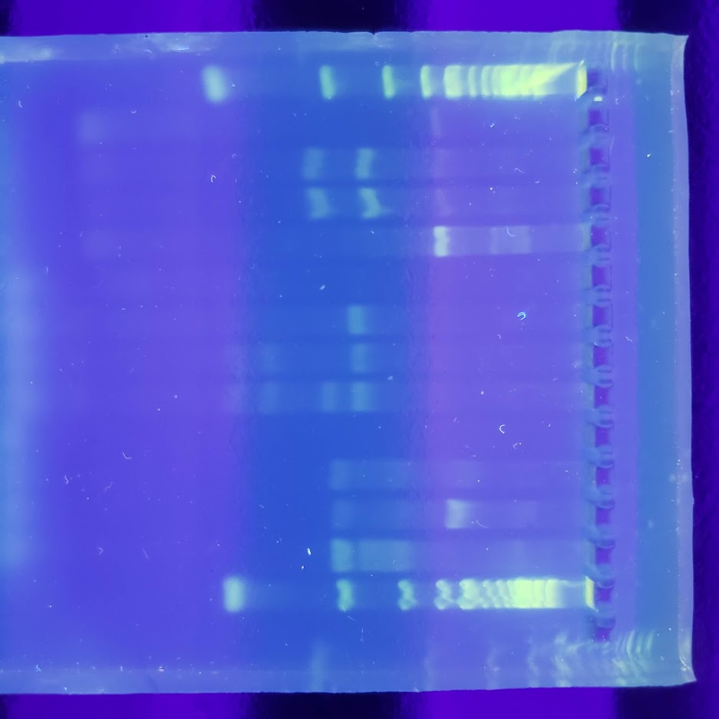
Lane
1 | Ladder
2 | -
3 | PER1-4
4 | PER1-5
5 | PER1-6
6 | -
7 | ACTN3-4
8 | ACTN3-5
9 | ACTN3-6
10 | -
11 | TAS2R38-4
12 | TAS2R38-5
13 | TAS2R38-6
14 | Ladder
15 | -

Slide 3
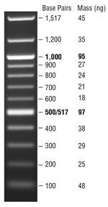
Ladder DNA (Quickload 100 bp DNA Ladder, NEB)

