Slide 1
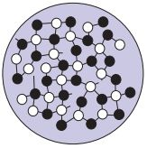
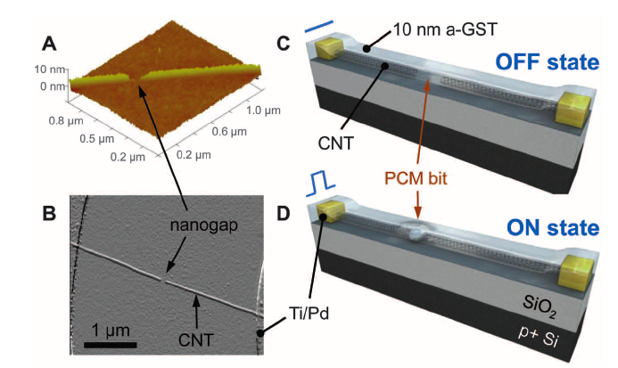
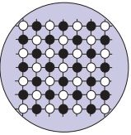
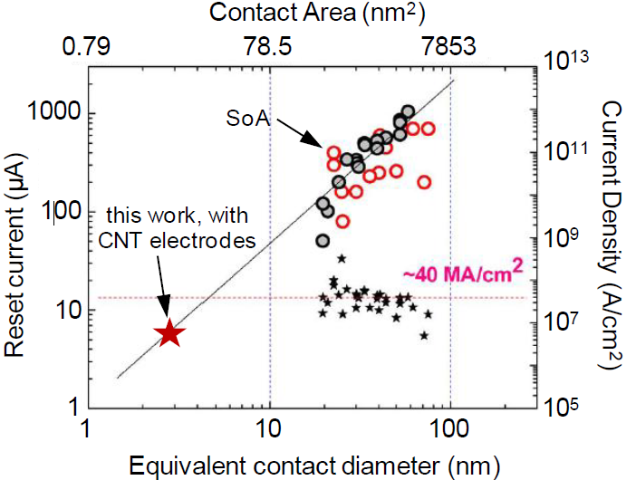
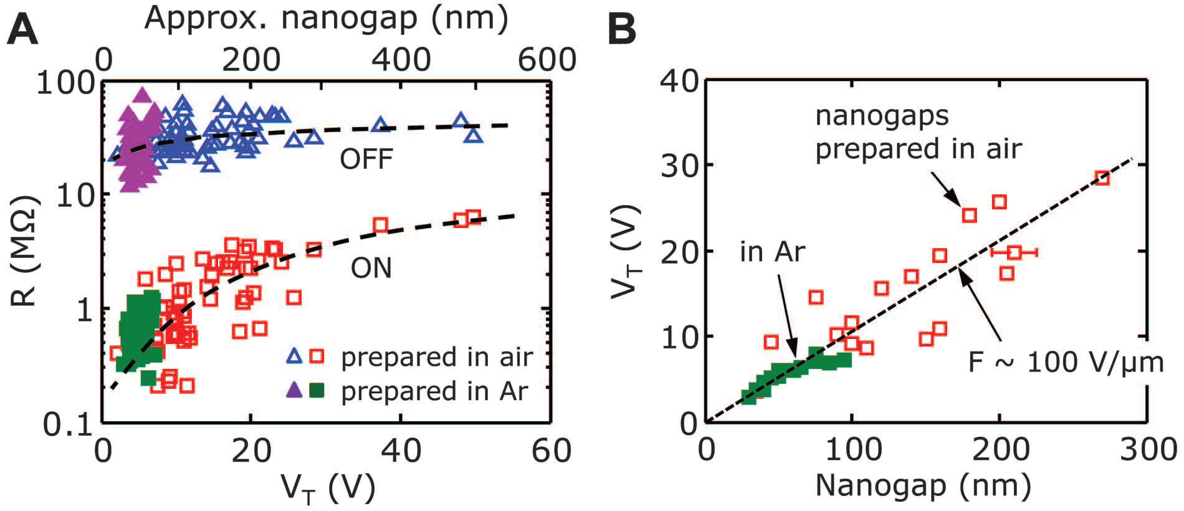
Low Power Switching of Phase-Change Materials with Carbon Nanotube Electrodes*
Feng Xiong, Albert D. Liao, David Estrada, Eric Pop
Department of Electrical and Computer Engineering
Presented By: Caizhi Xu, Yizhi Yu
Man-Hong Wong, Kenneth Schlax
A
Motivation
Results
Conclusions
Set/reset currents at 1µA/5µA were achieved. With 20 ns pulses at best, energy per bit was of order ~100 fJ.
On- and off-state resistance for 105 devices shown versus V_{T}. 61 nanogaps were created in ambient air; the other 44 devices were formed under Ar flow. Ar-formed gaps are consistently smaller and yield lower-power devices.
Threshold voltages scale proportionally to size of nanogap, at an average field of ~100 V/µm.
Phase Change Materials (PCM)
The two phases can be switched with short voltage pulses or localized Joule heating.
Data Storage: The two phases represent “0” and “1”. Electrical current can rewrite data.
A
Electrically programmable PCMs are used widely in applications of:
Nonvolatile Memory
Reprogrammable circuits with:
Low voltage operation
Fast access times
High Endurance
B
Amorphous Phase, High Resistance
Crystalline Phase, Low Resistance
Advantage and Disadvantage of PCM
Advantage: Nonvolatile and reprogrammable
Disadvantage: High programming current.
Motivation in this paper
Achieve low programming current in PCM.
Fig 1. Schematics of CNT-PCM device. (A) AFM imaging of nanogap created after CNT breakdown under electrical stress. (B) AFM image of an as-fabricated device. (C and D) Schematic of device obtained after deposition of GST thin film. Initially in the off state (C), the device is switch on (D) after exposed to electric field.
B
Methods
Fig 2. Comparison of various properties of CNTs versus state-of-the-art devices. Note the log scale.
Carbon nanotubes (CNT) with diameters of 1 to 6 nm are used as electrodes to reversibly induce phase change in bits with programming currents from 0.5 to 8 μA.
CNTs were grown by chemical vapor deposition with Fe catalyst particles on SiO₂/Si substrates.
The CNTs span Ti/Pd metal contacts with 1 to 5 μm of separation.
Nanoscale gaps are created in the CNTs by electrical breakdown in air or under Ar flow.
A Ge₂Sb₂Te₅ (GST) film with 10nm thickness is sputtered on the surface of the device to fill the CNT nanogaps, which creates self-aligned lateral PCM bits.
Atomic force microscopy (AFM) is used to switch and examine the device.
To prolong the switching lifetimes, a 5 nm SiO₂ capping layer is deposited on top of the GST film.
C
The CNTs are 2 orders of magnitude lower in programming current and power than present state-of-the-art devices.
Ultimate goal of research: achieve scaling limit of ~5nm GST bits with CNT electrodes operating at ~0.5V and <1µA and sub-femtojoule per bit with nanosecond switching.
These attributes make them contenders for a universal nonvolatile memory.
* Xiong, Feng, et al. Science. 332, 6029, pp. 568-570 (2011).

