Slide 1
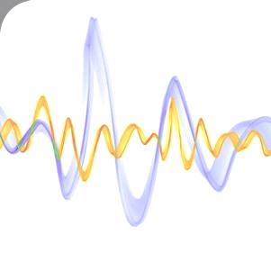
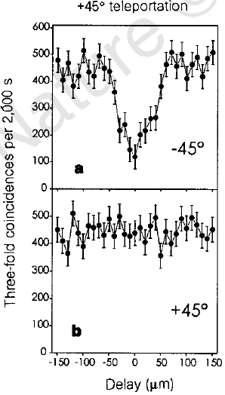
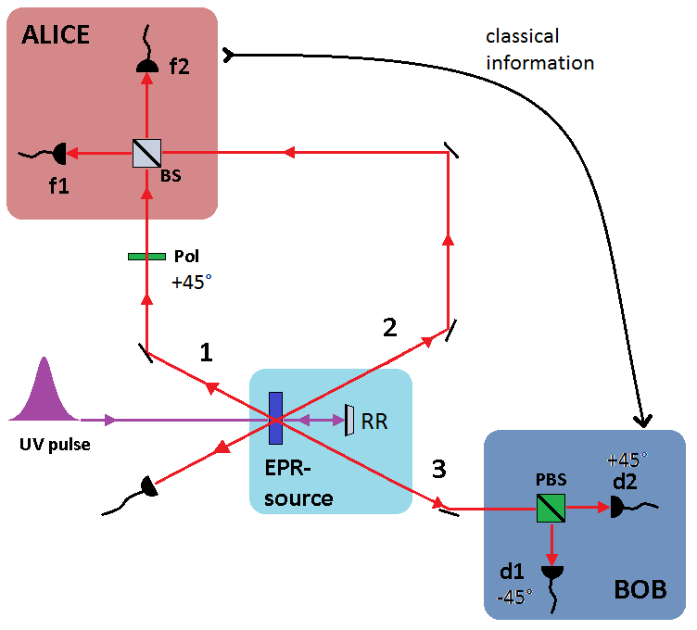
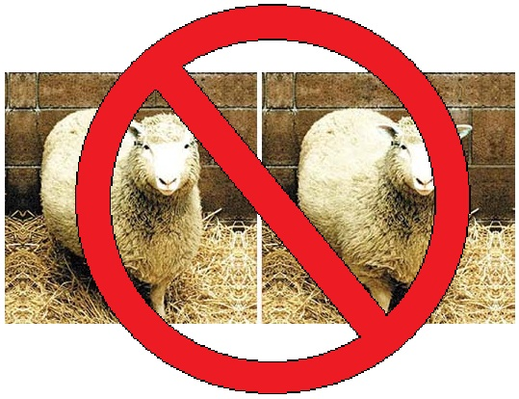
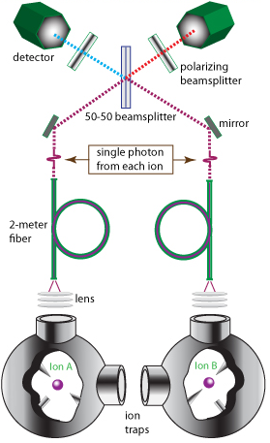
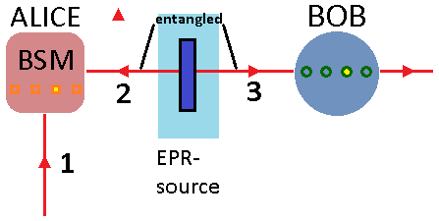
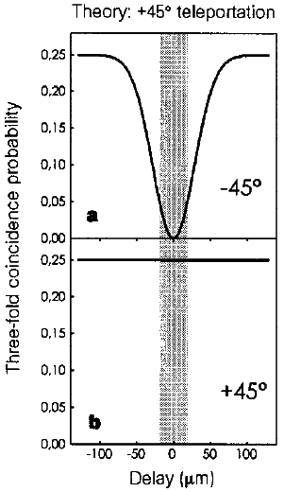
Experimental Quantum Teleportation*
R. Holmes, H. Zhao, B. Guttman and P. Russ
We report on the achievement of quantum teleportation of the polarization state of a single photon. An entangled pair of photons and a Bell-state measurement were used to transfer the polarization state of an initial photon to a target photon. Teleportation will play an important role in quantum communication and information as well as other fundamental tests of quantum mechanics.
Teleportation Experiment
3-fold Coincidences
Entangled photons 2 and 3 from UV pulse through nonlinear crystal
Photon 1 is polarized (Pol) to create initial state
BSM: spatial and temporal overlap of 1 and 2 on a BS
Detectors f1 and f2 check BSM
Detectors d1 and d2 and PBS verify teleportation
Top: 3-fold coincidence d1f1f2 goes to zero with no temporal delay of 1 and 2
Bottom: coincidence count for d2f1f2 is unchanged due to equal 3-fold probability inside and outside region of teleportation
Similar results with teleporting -45°, 90° and circular polarizations
No Cloning in Quantum Mechanics
Alice has particle 1 in state |A> and wants a spatially distant Bob to have this state
Alice cannot measure the state’s properties so Bob can reconstruct – information is lost through observation!
Teleporting with the Other Bell States
Teleportation was achieved in 25% of the cases since only one state is identified in the BSM. If Alice sends classical information about the Bell state of 1-2, Bob puts 3 in initial state of 1 by unitary transformations. However, experimentally identifying all Bell states is not yet possible
Quantum Mechanical Teleportation
What’s Next
What to Expect
Use entanglement and teleportation to transfer information to and from photonic qubits to atomic and ionic qubits
Quantum information can be stored in stable atomic or ionic systems and transferred to other systems using photons
Initial state: +45°
2-3 in state:
|ψ> = |↑>₂|↓>₃ - |↓>₂|↑>₃
Click at f1, f2 means 1-2 are anti-symmetric, only d2 should click
Translate mirror RR to delay temporal overlap
No overlap: 50% f1-f2 coincidence AND 50% d1 or d2 click gives 25% d1f1f2, d2f1f2
No delay, top: 0% d1f1f2 (3 in +45°)
No delay, bottom: 25% 1-2 are anti-symmetric
Alice wants to transfer state of photon 1
EPR-source give entangled 2 and 3
Alice performs a Bell-state measurement (BSM)
2-3 entangled state is one of four possible basis states
Measurement projects 1-2 into state of 2-3 – no information is gained
BSM puts 3 in the initial state of 1, destroys the state of 1 – no clone
Acknowledgements
C. Bennett, I. Cirac, J. Rarity, W. Wootters, P. Zoller and M. Zukowski. Supported by the Austrian Science Foundation FWF, the Austrian Academy of Sciences, the TMR program of the European Union and the US NSF.
*Nature, vol. 390, 1997

