Slide 1
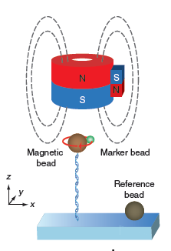
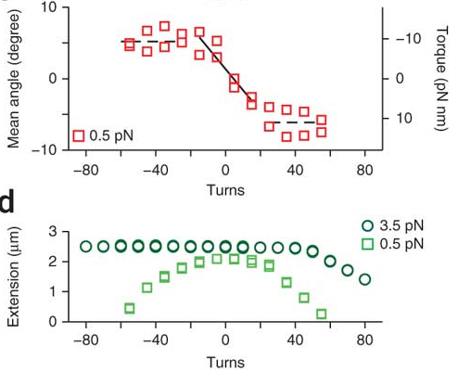
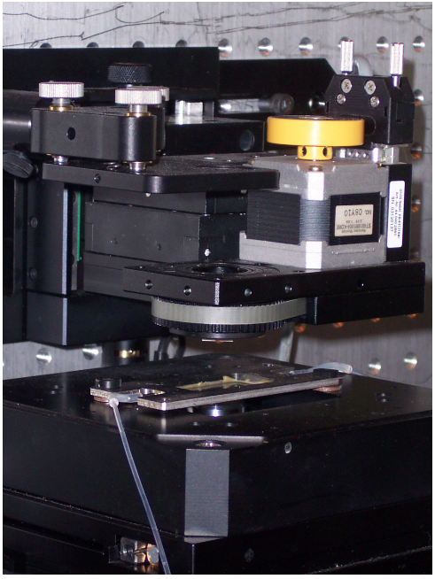
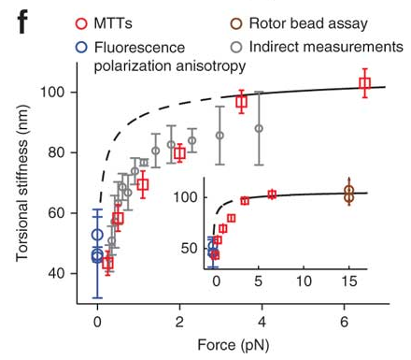
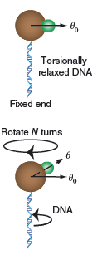
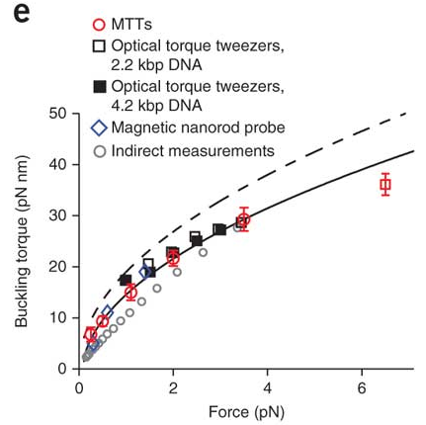
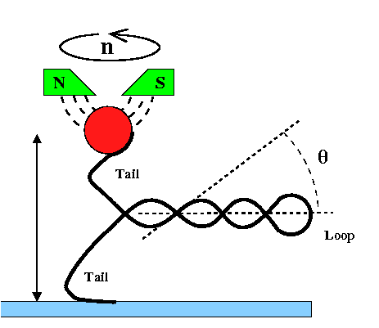
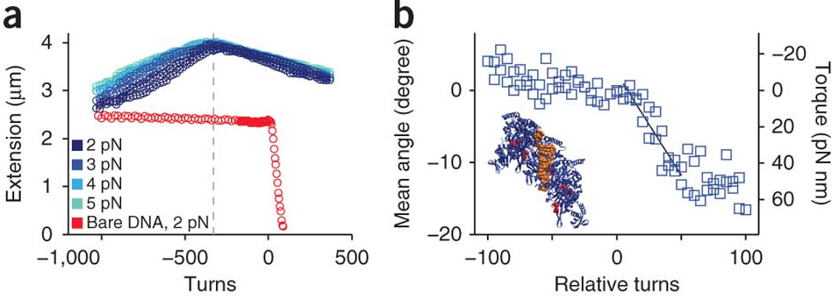
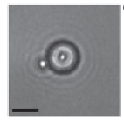
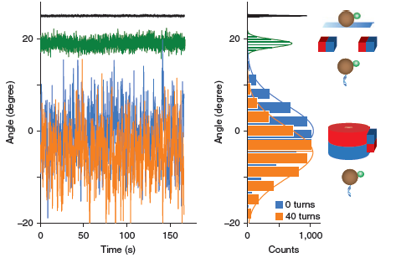
Magnetic Torque Tweezers: measuring torsional stiffness in DNA and RecA-DNA filaments
Lipfert, J., Kerssemakers, J. W., Jager, T. & Dekker, N. H.
Introduction
Theory and Setup
Results
Motivation
dsDNA Torque and Extension Response
To develop a novel design of magnetic torque tweezer which directly measures the torsional stiffness of biomolecules with high sensitivity.
Basic Setup
Under-winding
Over-winding
Strand of DNA linked to magnetic bead, which is pulled upward by a large permanent magnet.
Small secondary magnet can provide torque on magnetic bead. Acts as a low-stiffness angular trap.
critical twist density
1. dsDNA’s torque increases linearly with increasing turns.
2. At critical twist density, it remains constant as buckling torque and DNA start to form Plectonemic Supercoil
What are Magnetic Tweezers?
Magnetic tweezers are a powerful single–molecule technique that can be used to apply stretching forces and torques to biological molecules tethered between a surface and superparamagnetic particles.
The figure on the right shows the actual experimental setup in the laboratory.
The magnet is mounted on top, labeled as A. The magnetic bead-DNA specimen is in a slit on the stage, labeled as B. Note that magnet rotates or pulls the bead, not the DNA.
Torque and Equilibrium Angle
Torsional Trap Stiffness, $k_{rot}$
Buckling Torque and Torsional Stiffness
A
Winding DNA causes it to produce a restoring torque $τ_{DNA}$, opposed by the $τ_{B}$ due to the small magnet.
Winding DNA causes it to produce a restoring torque 𝜏_𝐷𝑁𝐴, opposed by the 𝜏_𝐵 due to the small magnet.
Average angle shifts from equilibrium with increasing $τ_{DNA}$
Average angle shifts from equilibrium with increasing 𝜏_𝐷𝑁𝐴
$$τ_{DNA}={−k}_{rot}\left\langle θ−θ_{0}\right\rangle$$
𝜏_𝐷𝑁𝐴=〖−𝑘〗_𝑟𝑜𝑡 ⟨𝜃−𝜃_0 ⟩
Can measure fluctuations ⟨${δθ}^{2}$⟩ due to thermal effects and apply the equipartition theorem to obtain
Can measure fluctuations ⟨〖δ𝜃〗^2⟩ due to thermal effects and apply the equipartition theorem to obtain
$$k_{rot}=\frac{k_{B}T}{\text{⟨}{δθ}^{2}\text{⟩}}$$
𝑘_𝑟𝑜𝑡=(𝑘_𝐵 𝑇)/("⟨" 〖δ𝜃〗^2 "⟩" )
$k_{rot}$ is a measure of the stiffness of the magnetic trap used.
𝑘_𝑟𝑜𝑡 is a measure of the stiffness of the magnetic trap used.
B
Pros and Cons of Conventional Magnetic Tweezers
Pros: facile application of torque, natural operation in constant force mode, straightforward extension to parallel measurements, absence of sample heating and photodamage.
Cons: torque applied is unsuitably large for DNA, the insensitive measurements resulted in high errors.
Therefore, we developed a new design of magnetic tweezers, called the magnetic torque tweezers.
At forces above 6 pN, underwent a transition from B- to P-DNA
no Plectonemic Supercoil formed.
CCD Cameras, angular shift
Measurement resolution
RecA dsDNA Measurement
_{RecA dsDNA Measurement}
$If k_{rot}$ is known, $τ_{DNA}$ can be found as a function of $\left\langle θ−θ_{0}\right\rangle$.
If 𝑘_𝑟𝑜𝑡 is known, 𝜏_𝐷𝑁𝐴 can be found as a function of ⟨𝜃−𝜃_0 ⟩.
Unmagnetized bead used as marker, tracked by CCD camera to determine angular shift.
$$τ_{DNA}={−k}_{rot}\left\langle θ−θ_{0}\right\rangle$$
𝜏_𝐷𝑁𝐴=〖−𝑘〗_𝑟𝑜𝑡 ⟨𝜃−𝜃_0 ⟩
High angular resolution (~0.1°) in $τ_{DNA}$ measurement due to low angular trap stiffness.
High angular resolution (~0.1°) in 𝜏_𝐷𝑁𝐴 measurement due to low angular trap stiffness.
Such precision is useful for measuring small $τ$ effects
Such precision is useful for measuring small 𝜏 effects
Effective Torsional Stiffness C is determined by the slope!
Effective Torsional Stiffness C is determined by the slope!
crystallographic structure of RecA-DNA
crystallographic structure of RecA-DNA
Compare with dsDNA: Higher Effective Torsional Stiffness
Compare with dsDNA: Higher Effective Torsional Stiffness
* Natural Method, Vol.7 No.12, Dec 2010, 977

