Slide 1
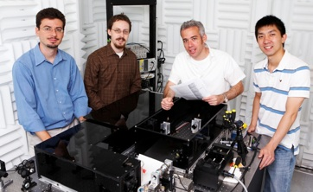
Shedding light on improving bacterial motion tracking
"High-resolution, long-term characterization of bacterial motility using optical tweezers."
In a study by Taejin l. Min, Patrick J. Mears, lon M. Chubiz, Christopher V. Rao, Ido Golding, Yann R. Chemla.
Nature Methods, 6, 831 (2009)
Optical tweezers. Epifluorescence microscopy. Bacteria.
These three terms may not have much in common at first glance, but the work of one research group at UIUC has combined the strengths of optical tweezers and fluorescence microscopy to allow bacteria to be studied for much longer time scales than previously possible, which can give greater insight into what makes a cell move.
In the study, published in Nature Methods, Dr. Yann Chemla and collaborators showed how their novel experimental setup could be used to monitor the motility of a sample of E. coli. Their results show an unprecedented level of dynamics in the behavior of these microorganisms.
From left, University of Illinois physics professor Yann Chemla, graduate student Patrick Mears, physics professor Ido Golding and graduate student Lance Min.| Photo by Lok-hang So. (Courtesy Center for the Physics of Living Cells (CPLC))
Previous studies had already managed to record the motility—i.e., the ability to spontaneously and actively move—of samples of bacteria. The key contribution of the UIUC group was to pin down the bacteria using optical tweezers and thus achieve a remarkable increase in the observation time of the bacteria’s motion. While previous methods allowed the study of bacteria for time spans of a few seconds, this study managed to achieve much longer trapping times, on the order of an hour.
The optical tweezers used in the study consisted of two traps generated by a single laser which pinned the E. coli cells. Imaging of the trapped cells was performed by either bright field or epifluorescence microscopy, and their motion was determined by analyzing the scattered trap light.
This experimental setup helped improve the time resolution, enabling the observation of occasional abrupt changes in the body roll angular velocity with no change in swimming direction. They could also measure that the cells under observation tumbled once every 21.3 ± 1.1 s. The longer observation times also helped quantify the statistics of speed changes ; they were observed to occur spontaneously without tumbling 69.5% of the time, or after a tumble 30.5% of the time.
This experimental setup promises unprecedented in situ control and detailed time-resolved observation of bacteria. In particular, studies of chemotaxis processes is an interesting avenue of research for which the contributions by the UIUC research could prove to be ground breaking.
Group 7
Andrew, Billy, Anirbit and Ian

