Slide 1
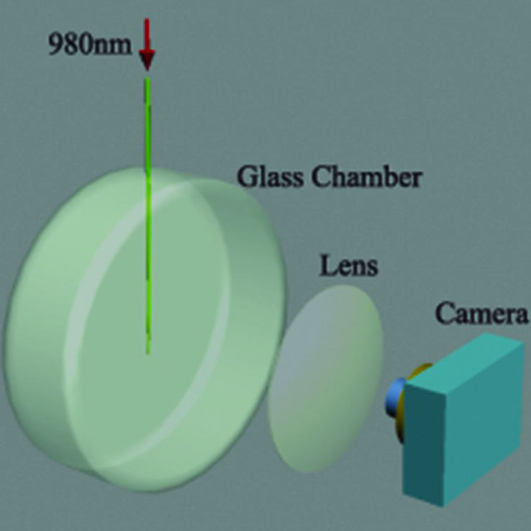
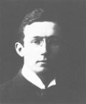
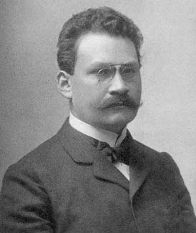
Observation of a Push Force on the End Face of a Nanometer Silica Filament Exerted
by Outgoing Light
Group 9 Chi Xue, Bill Rose, Greg Rosen and Sarvagya Sharma
Motivation
Experimental Method
Results
Determine whether the momentum of light increases or decreases as it traverses a dielectric boundary
Provide a more accurate version of the Ashkin-Dziedzic experiment
Modified Ashkin-Dziedzic experiment using light exiting a silica filament (SF).
Silica filament dimensions: 1.5μm long, 450nm diameter
The filament is bent to the right as pointed by the white arrows, and moves left-upward at the end point.
Out-going light exerts inward force on filament
Light gains momentum when leaving filament
Abraham momentum is correct
The Abraham-Minkowski Debate
Laser wavelengths used: 650nm, 980nm
Pulse lengths: 4/15s with 1/5s between pulses
Top end of silica filament held fixed
Bottom end allowed to move freely in air
Expect change in light’s momentum to exert force on filament tip at boundary
Abraham
Minkowski
Apparatus used to perform experiment and record movement of filament.
Supplementary Experiments
(a) Transmissions of the SF and the fibre are measured. Scattering of the filament contributes only 0.7%, and cannot lead to a movement like that in the experiment.
(b) and (c) A colophony filament (Decomposition temperature: 300℃) is connected to the silica filament. (b) 1 min after turning on the light source. (c) 60 min after turning on the light source.
The colophony filament does not decompose. Temperature is far lower than 300 °C. Deformation due to thermal effect is less than 0.2 μm.
The silica filament is located in vacuum and a electrostatic shield.
(a) shows the static position of the filament.
(b) – (e) show the motion when light arrives. The filament bends.
Air or electrostatic field do not affect the phenomena.
Stationary micrograph of silica filament tip and enlarged profile of red laser beam outgoing from SF tip.
The momentum of light should decrease in a dielectric
As the speed of light decreases in a dielectric, so should the associated momentum
Conforms to the predictions of classical optics
The momentum of light should increase in a dielectric
As the wavelength of light decreases in a dielectric, the associated momentum should increase
Conforms to the predictions of quantum theory
Hypothesis
SF moves backward
light pushes it
light gains momentum in the air
Abraham
SF moves forward
light pulls it
light loses momentum in the air
Minkowski

