Slide 1
Lecture 12: Band structure

Slide 2
Ground state of Ne (10 electrons)

Slide 3
Name an atom, any atom (in the first 3 rows)

Slide 4
Infinite square well: momentum versus energy
Notes:
Psi_n = sin(npix/L) = (e^inpix/L – e^inpix/L)/2i
P(E_n) = 1
P(k_n) = 0.5
P(-k_n) = -0.5
One energy level.

Slide 5
Infinite square well: fermi level
Notes:
A well 5 times as big has more states, so if we put in 5 times as many electrons the top energy is at the same point.

Slide 6
Fermi Level: the infinite limit
Notes:
An actual material is ~ 1 mm or bigger so it’s like infinity compared to nms. So we

Slide 7
Slightly more accurate model
Edge of material
Atoms
Notes:
Need a plot here of the wacker model.

Slide 8
Gaps

Slide 9
Typical band plots

Slide 10
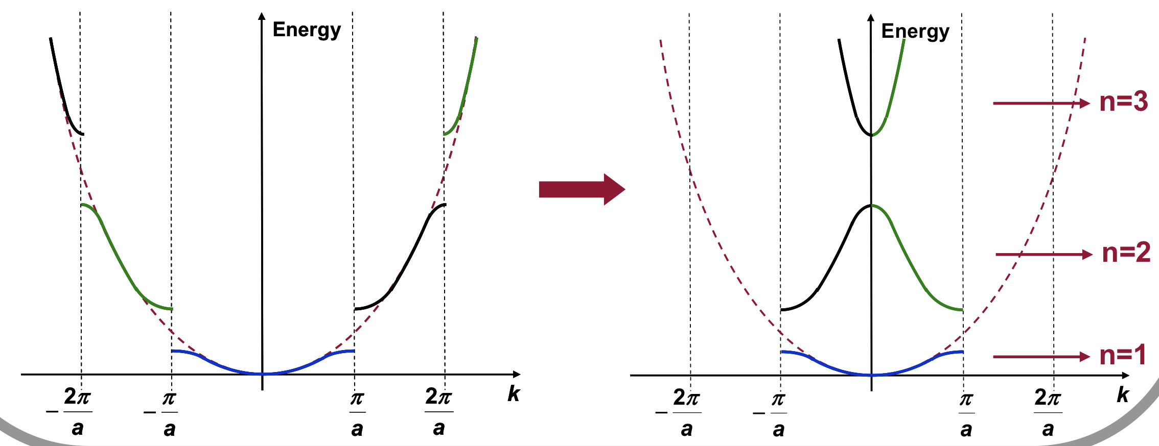
Band Folding

Slide 11
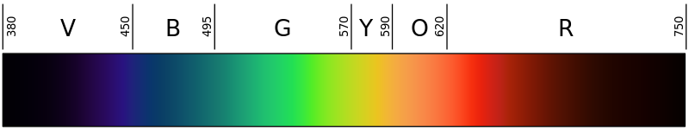
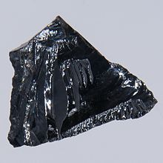
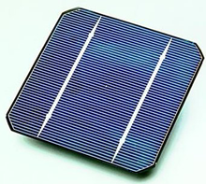
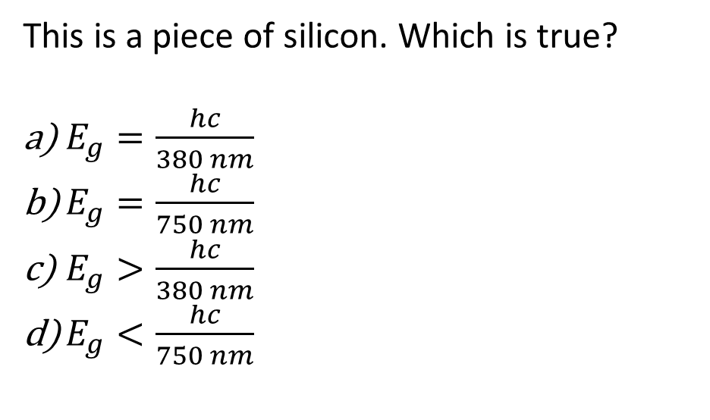
Energy gaps
This is a piece of silicon. Which is true?
$E_{g}=\frac{hc}{380 nm}$
$E_{g}=\frac{hc}{750 nm}$
$E_{g}>\frac{hc}{380 nm}$
$E_{g}<\frac{hc}{750 nm}$

Slide 12
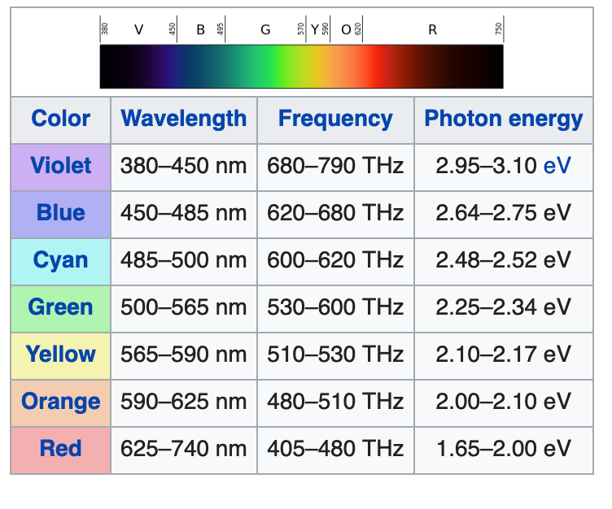
Energy levels
Empty bands
A material has energy levels as diagrammed.
What is true about the material?
It will conduct electricity very well.
Red light will pass through it.
Blue light will pass through it.
2.5 eV gap
Filled bands

Slide 13
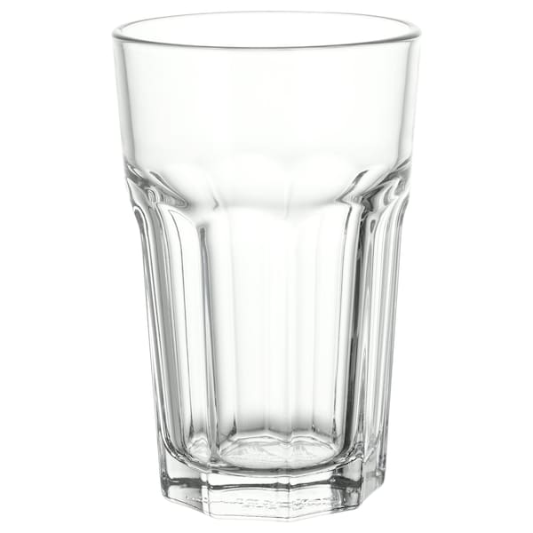
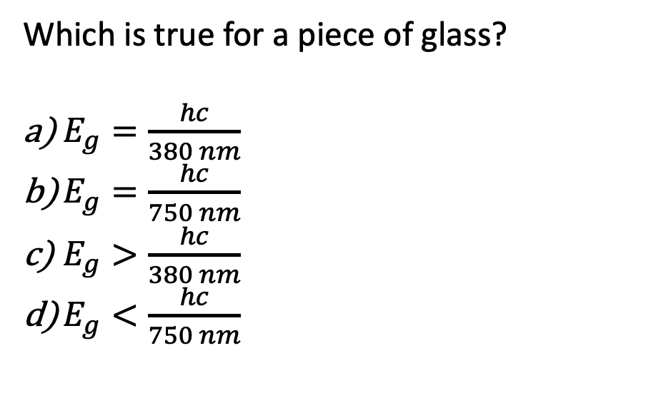
Energy gaps
Which is true for a piece of glass?
$E_{g}=\frac{hc}{380 nm}$
$E_{g}=\frac{hc}{750 nm}$
$E_{g}>\frac{hc}{380 nm}$
$E_{g}<\frac{hc}{750 nm}$
Pokal, from Ikea

Slide 14
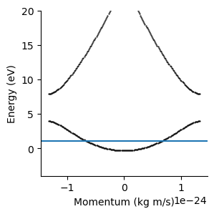
A material has a number of electrons such that in the ground state, all states below the line are occupied with electrons, and all above are unoccupied.
Is this material metallic (does it conduct electricity easily when an electric field is applied)?
Yes
No

Slide 15
Conductor vs insulator
Roughly what Fermi level energy would result in an insulator?
0 eV
4 eV
7 eV
15 eV

Slide 16
Insulators and metals
What electron density corresponds to an insulator?
1 e/atom
2 e/atom
3 e/atom

Slide 17
Semiclassical example
Consider a completely free electron; approximate it as a classical particle. At t=0, it starts at rest in an electric field $ℰ$. How fast will it be moving at time t?

Slide 18
Conduction of electrons: semiclassical model

Slide 19
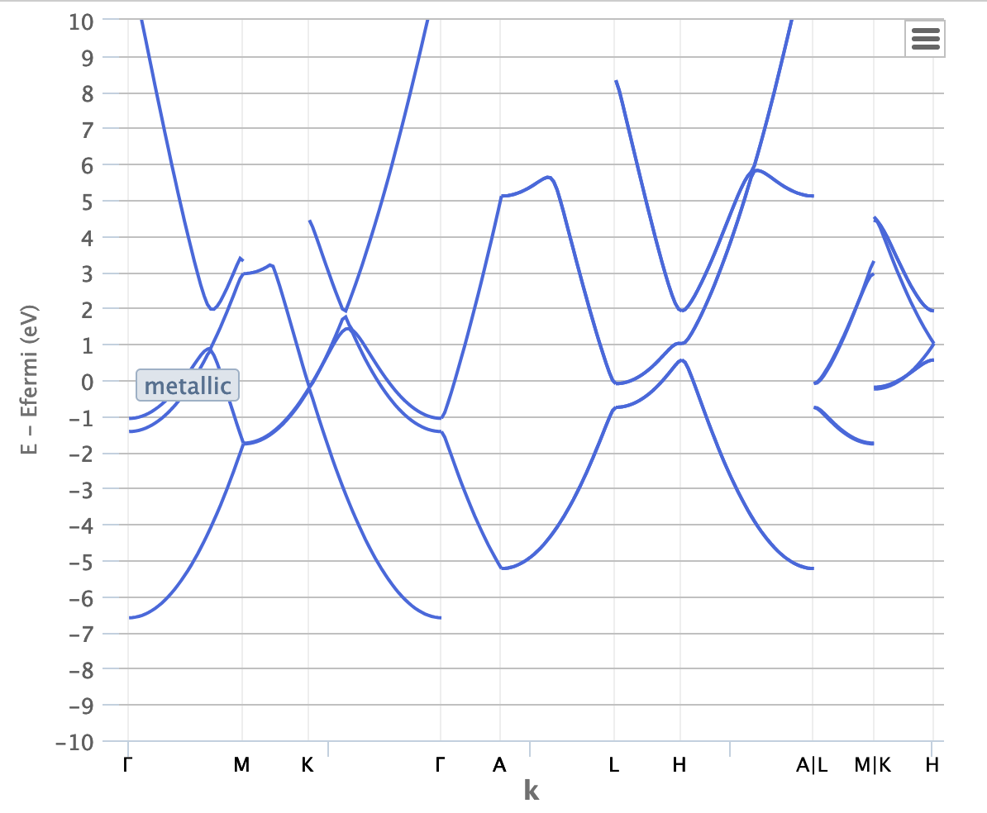
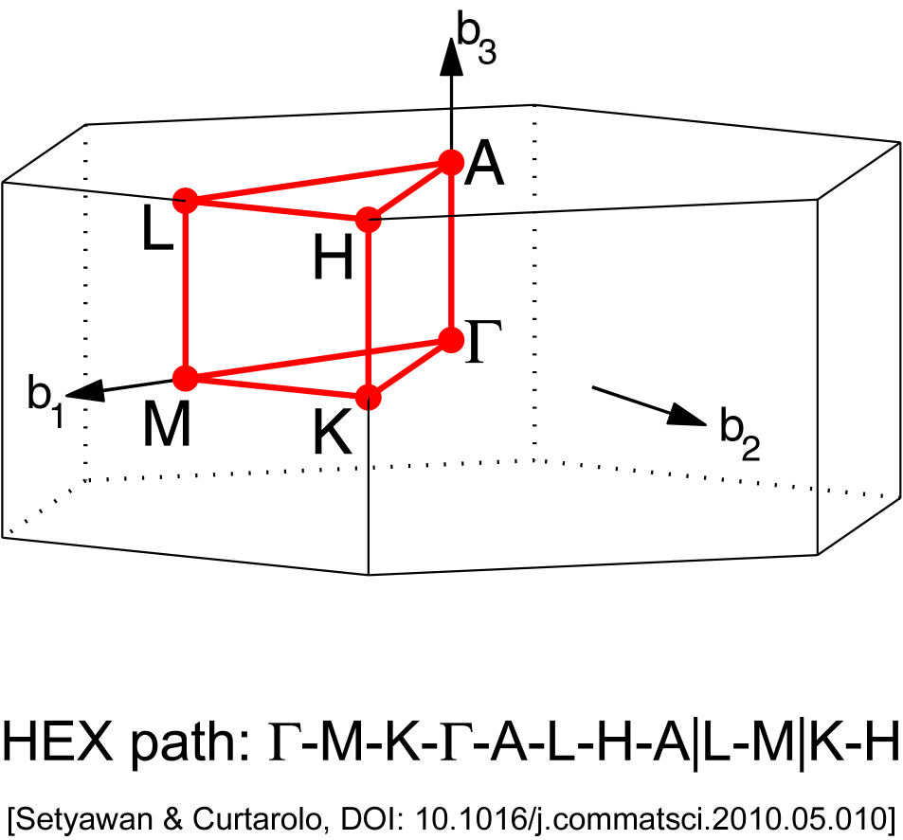
Question from last night: Why is magnesium metallic?
The bands cross in Mg, unlike our simple model!
So there is no gap.
If the bands didn’t cross, it would be an insulator.
Band structure from materialsproject.org – estimated band structures for almost all known crystalline materials

Slide 20
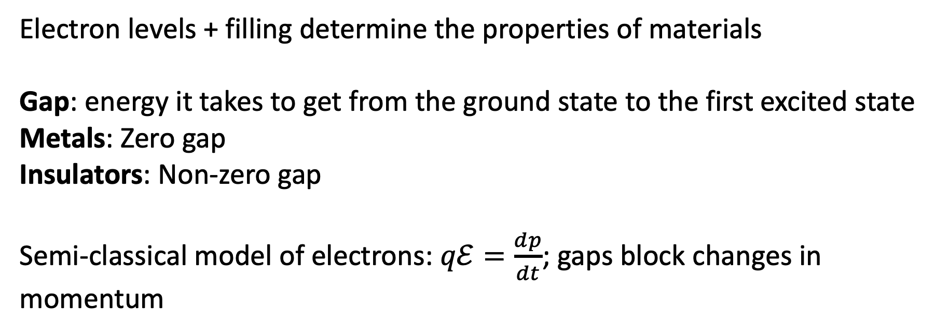
Summary
Electron levels + filling determine the properties of materials
Gap: energy it takes to get from the ground state to the first excited state
Metals: Zero gap
Insulators: Non-zero gap
Semi-classical model of electrons: $qℰ=\frac{dp}{dt}$; gaps block changes in momentum

