Slide 1
Your comments/questions/jokes
Did you do anything exciting during summer so far?
Started teaching PHYS 214
From last semester:
Why don't we normally detect destructive interference in everyday life?
Most of the time, separated wave sources are not coherent, so no interference.
Calculating frequency? It's so easy it Hertz

Slide 2
Some announcements
We set up the iClicker system to allow you to use the smartphone app.
There is only one day on which each exam can be taken. The first exam is on Thursday, June 23, and it covers units 1-4 inclusive. Sign up on the CBTF scheduler!
Can you see each other's responses to the checkpoint? ("student log")

Slide 3
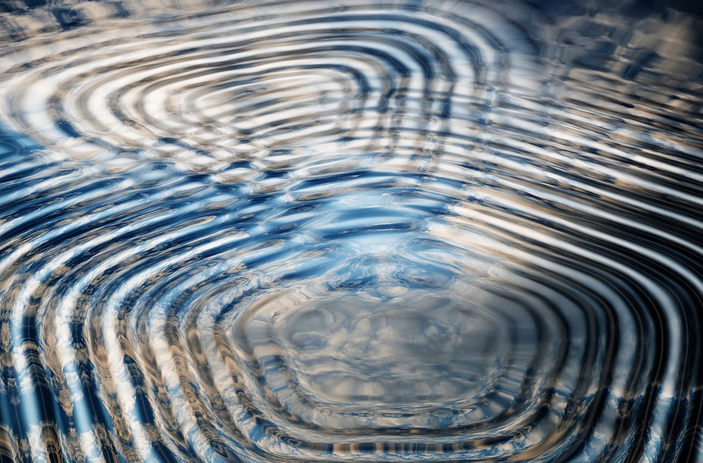
Lecture 2: Interference
Notes:
\

Slide 4
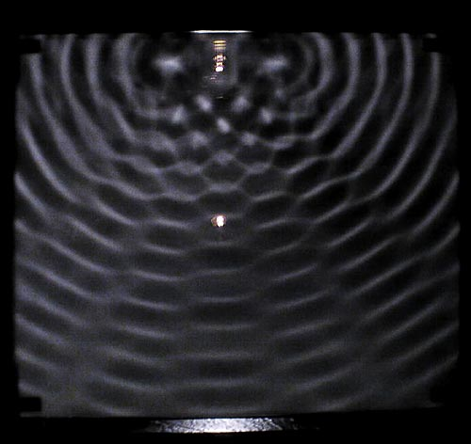
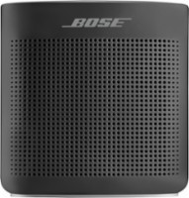
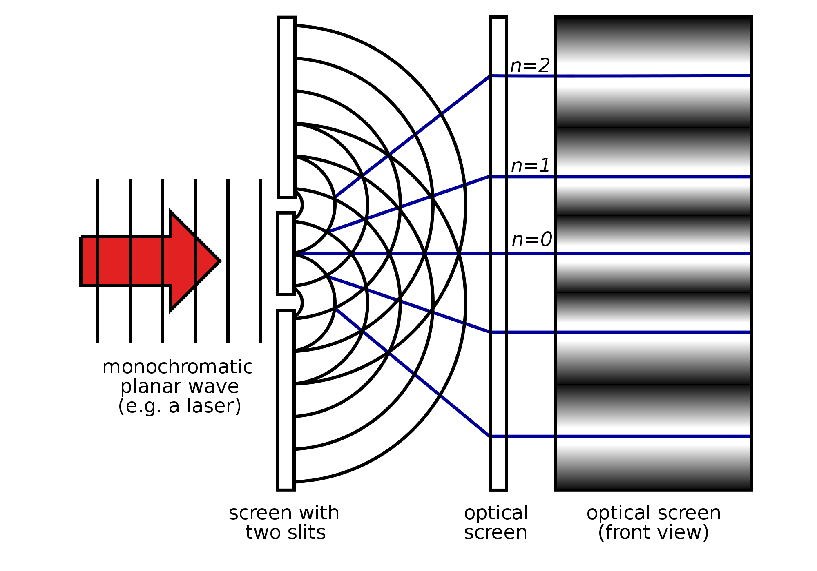
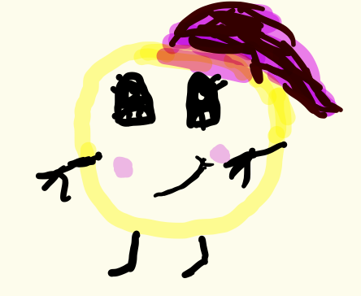
Today
Interference between two coherent wave-generating sources
Waves in water
Sound from two speakers
Light traveling through two slits
Two perfectly coherent sources have exactly the same phase relationship at all times, e.g. two sinusoidal sources synchronized at the same frequency

Slide 5
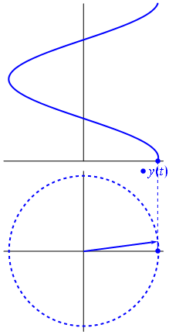
Phasors are graphical tools that represent sinusoidally oscillating quantities

Slide 6
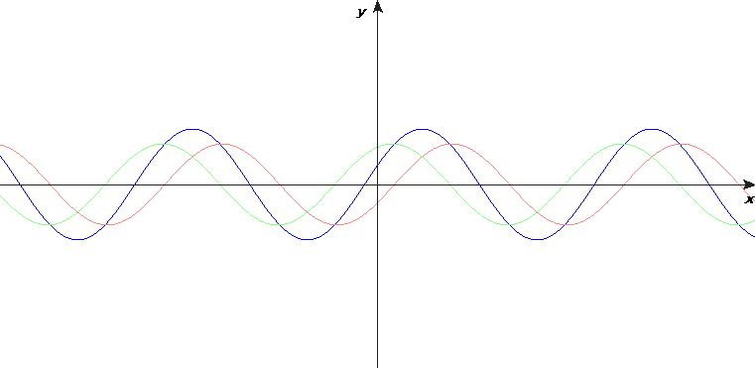
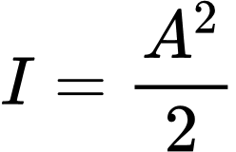
Adding harmonic waves is easier with phasors
What is the intensity experienced by the observer?
Draw and label the phasor diagram
Add the phasors like vectors
Find the length of the resultant
Take the square:
"superposition principle"
If , what is the intensity at a point where and
?
A) I = 0 B) I = 2 (A₁)² C) I = (A₁)²

Slide 7
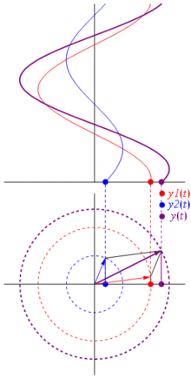

Slide 8
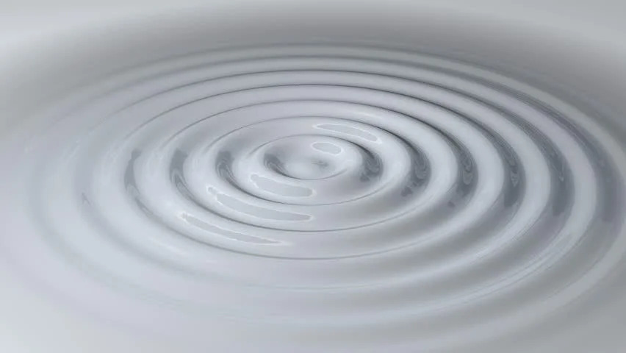
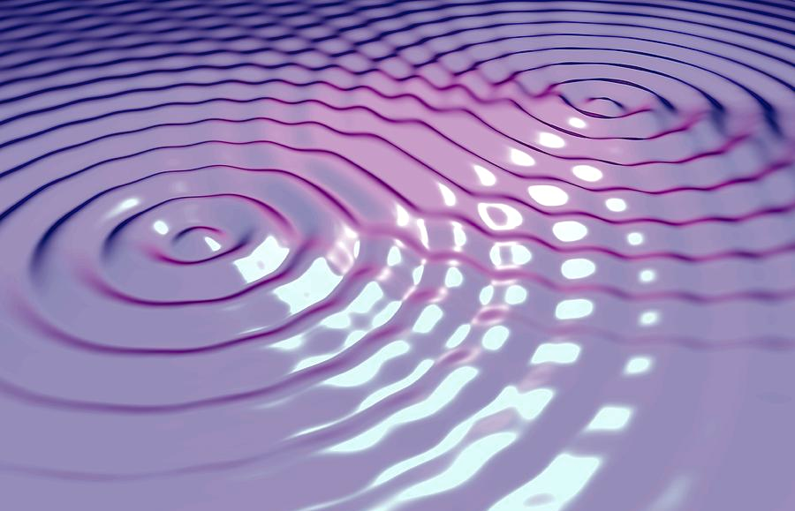
Circular waves, two-source interference setup
Amplitude decreases with r (why must it?)
but we ignore that
superposition principle

Slide 9
Ripple tank demo

Slide 10
two-source interference solution
superposition principle
From trig identities, if A₁ = A₂ we could show
1
If A₁ different from A₂, the easiest way is with phasors.
amplitude at observer
Oscillating part
Draw and label the phasor diagram
Add the phasors like vectors
Find the length of the resultant
Take the square:
Intensity is proportional to (that)²

Slide 11
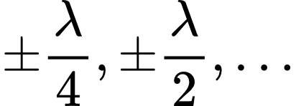
Two speakers emitting in phase with equal amplitudes
$$f_{1}=Acos⁡(\frac{2πr_{1}}{λ}−ωt)$$
$$f_{2}=Acos⁡(\frac{2πr_{2}}{λ}−ωt)$$
$$r_{1}$$
$$r_{2}$$
For what values of r₁-r₂ will the waves interfere destructively at the observer?
A) r₁-r₂ = 0, , , ...
B) r₁-r₂ =
C) r₁-r₂ =
D) r₁-r₂ =
Notes:
$$2π\frac{\left(r_{1}−r_{2}\right)}{λ}$$
Draw the phasor diagram.

Slide 12
Checkpoint
An observer is a distance $r_{1}$ and $r_{2}$ respectively from two wave sources that emit in phase.
Which quantity alone would allow you to compute whether the waves interfere destructively or constructively?
a) The wavelength $λ$.
b) The frequency $f$
c) The amplitudes $A_{1}$and $A_{2}$
d) $λ$ and $f$
e) $λ$ and $A_{1}$and $A_{2}$
Notes:
Write down $A \cos(kx - omega

Slide 13
What if we change the phase offset?
$$f_{1}=Acos⁡(\frac{2πr_{1}}{λ}−ωt)$$
$$f_{2}=Acos⁡(\frac{2πr_{2}}{λ}−ωt+φ_{0})$$
$$r_{1}$$
$$r_{2}$$
What’s the phase difference between these two waves at the listener’s position?
a) $ϕ$
b)$2π\frac{r_{2}−r_{1}−φ_{0}}{λ}$
c) $2π\frac{r_{2}−r_{1}+φ_{0}}{λ}$
d)$2π\frac{\left(r_{2}−r_{1}\right)}{λ}−φ_{0}$
e) $2π\frac{\left(r_{2}−r_{1}\right)}{λ}+φ_{0}$
0

Slide 14
Combining phasors practice
4
1
A
$$r_{1}$$
$I_{1}$= 1/2 W/m²
1
B
$I_{2}$= 8 W/m²
4
$$r_{1}$$
$$\sqrt{1/2}$$
harmonic waves, same frequency, coherent,
C
Two speakers, different amplitudes.
Same distance, $π$ phase difference at observer.
What’s the phasor diagram?
$$2\sqrt{2}$$
$$\sqrt{1/2}$$
D
$$2\sqrt{2}$$
Notes:
A=2-1=1

Slide 15
Combining phasors practice
harmonic waves, same frequency, coherent,
Two speakers, different amplitudes.
Same distance, $\frac{π}{4}$ phase difference at observer.
Which phasor diagram corresponds to this situation?
$$r_{1}$$
$I_{1}$= 1/2 W/m²
$I_{2}$= 8 W/m²
A
$$r_{1}$$
B
$$f_{1}=Acos⁡(\frac{2πr_{1}}{λ}−ωt+\frac{π}{4})$$
$$f_{2}=Acos⁡(\frac{2πr_{1}}{λ}−ωt)$$
1
2
C

Slide 16
Combining amplitudes practice
Two speakers, different amplitudes.
Same distance, same phase at the source (in phase).
What’s the intensity at the observer?
a) 0.5 W/m²
b) 2.5 W/m²
c) 3 W/m²
d) 4.5 W/m²
e) 9 W/m²
harmonic waves, same frequency, coherent,
$$r_{1}$$
$I_{1}$= 1/2 W/m²
$I_{2}$= 2 W/m²
$$r_{1}$$

Slide 17
Intermediate summary
If two waves are same amplitude and same wavelength:
$$I={2A}^{2}\cos^{2}{\frac{φ}{2}}$$
$$φ=\frac{2πδ}{λ}+Δφ_{0}$$
Maxima at $φ=2πm$
Minima at $φ=2π\left(m+\frac{1}{2}\right)$
(m is any integer)
For more sources, or for different amplitudes:
Amplitude <-> length of vector
Phase <-> angle of vector at t=0
Use law of cosines:
$$A^{2}+B^{2}+2AB\cos{φ}=C^{2}$$
with respect to horizontal axis
offset
^
^

Slide 18
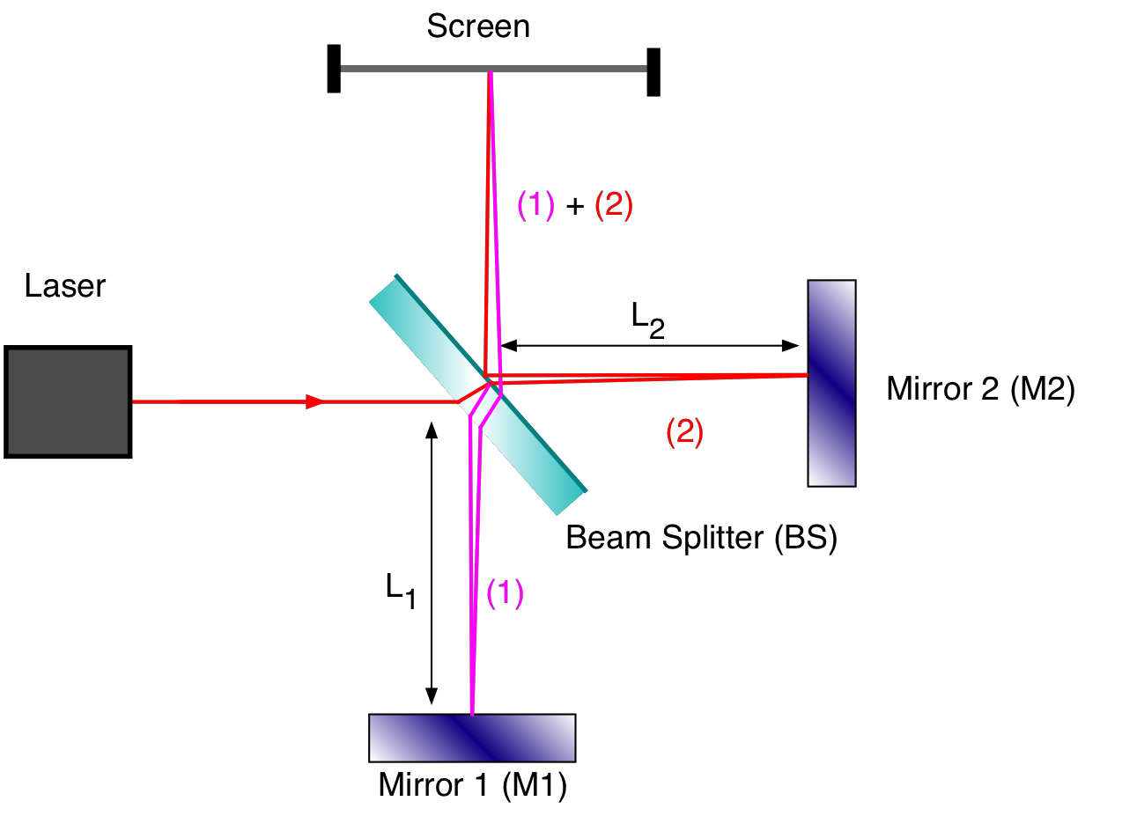
Practice with interference
Light source
Notes:
\

Slide 19
Interferometer
Example of path-length dependent interference. We know the lengths of the arms $L_{2}$ and $L_{1}$.
What is $r_{2}−r_{1}?$
$L_{2}−L_{1}$
$2L_{2}−{2L}_{1}$
$d\sin{θ}$
$2d\sin{θ}$
Need the path from the laser

Slide 20
Interferometer problem
Laser has wavelength $λ$. We observe maximal intensity at the screen. What is the phase difference between the two paths?
$2πn$
$λn$
$2π(n+\frac{1}{2})$
$λ(n+\frac{1}{2})$

Slide 21
Interferometer problem
Laser has wavelength $λ$. We observe maximal intensity at the screen. How far must we move mirror 1 to find the next maximum?
$2π$
$λ$
$π$
$\frac{λ}{2}$

Slide 22
Application: LIGO
https://youtu.be/tQ_teIUb3tE

Slide 23
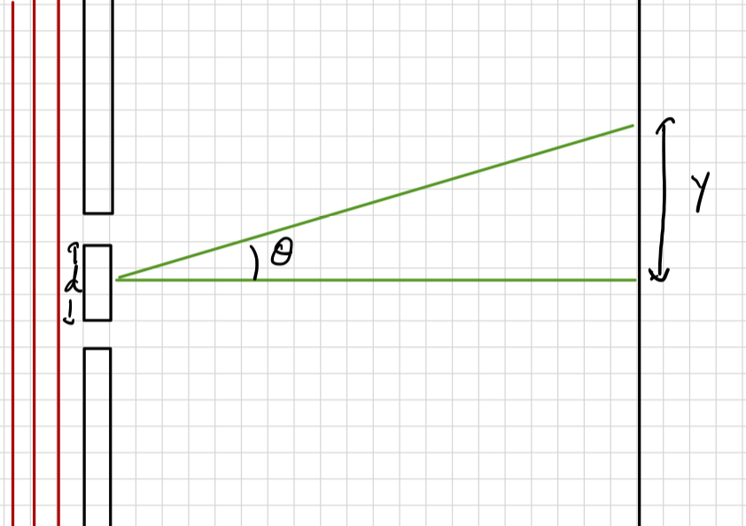
Two-slit experiment
coherent, monochromatic
Each slit acts as a source for light. They are in phase with each other.
What do you expect to see for $I\left(y\right)$?
a) Isolated peak
b) Repeating peaks
c) Two isolated peaks
Notes:
d: distance between the sources
theta: angle from the perpendicular
Make the approximately isosceles triangle
Compute $δ=d\sin{θ}$
So $φ=\frac{2πδ}{λ}=\frac{2πd\sin{θ}}{λ}$

Slide 24
Two-slit experiment
coherent

Slide 25
Two-slit experiment: distances
$$E_{1}\left(y,t\right)=E\cos{(}ωt−kr_{1})$$
$$E_{2}\left(y,t\right)=E\cos{(}ωt−kr_{2})$$
Approximation: L is very big compared to d and y.
L
Notes:
d: distance between the sources
theta: angle from the perpendicular
Make the approximately isosceles triangle
Compute $δ=d\sin{θ}$
So $φ=\frac{2πδ}{λ}=\frac{2πd\sin{θ}}{λ}$

Slide 26
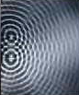
Constructive interference
Constructive interference:
$$φ=2mπ=\frac{2πd\sin{θ}}{λ}$$
What is the formula for $d\sin{θ_{max}?}$
$2mλ$
$2λ$
$2mπλ$
$mλ$
m=2
m=1
m=0
m=-1
m=-2

Slide 27
Summary
Waves generated from two sources at distance $r_{1}$ and $r_{2}.$
To an observer, looks like
$$y_{1}\left(x,t\right)=A_{1}cos⁡(kr_{1}−ωt+φ_{1})$$
$$y_{2}\left(x,t\right)=A_{2}cos⁡(kr_{2}−ωt+φ_{2})$$
To find $y_{1}+y_{2}$, use phasors!
The $kr_{i}+φ_{i}$ term tells us the angle of the phasor. The relative angle is most important for interference.

