Slide 1
Your thoughts/comments/jokes
I don't understand what a potential barrier means, or what a potential of 0 or infinity represents.
A potential barrier is a place where the potential energy is large. Like a hill.
Quantized energy levels: infinite square well, the wave function is A*sin(n*pi*x/L). According to the last checkpoint, does it mean there are two possibilities of momentum but only one energy (since it is in energy eigenstate)?
Yes, that’s what it means. This is because it’s a standing wave. So it is not a momentum eigenstate.

Slide 2
Lecture 8: Time independent Schrödinger equation
$$\frac{−ℏ^{2}}{2m}\frac{∂^{2}Ψ(x)}{∂x^{2}}+U\left(x\right)Ψ\left(x\right)=EΨ(x)$$
Wave functions for which this is true are energy eigenstates.
We will measure energy E with probability 1.

Slide 3
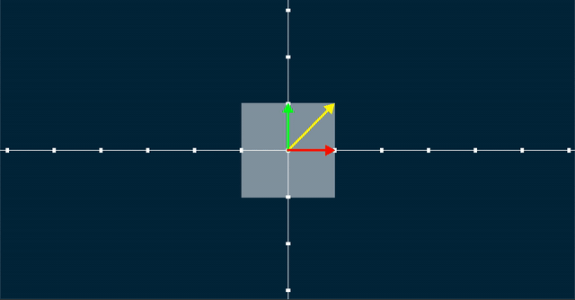
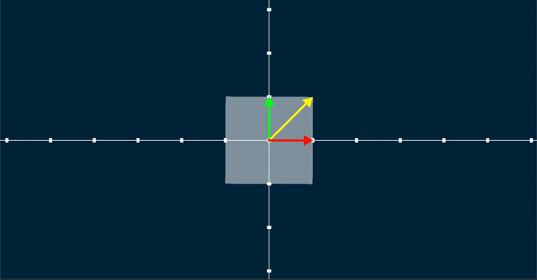
An equation for momentum eigenstates
$$−iℏ\frac{dΨ\left(x\right)}{dx}=p Ψ(x)$$
In general,
If you have a linear transformation T, an eigenstate of this transformation will satisfy the following relation:
$Tv=λv$
Where $λ$ is the eigenvalue and $v$ is the eigenvector/eigenstate

Slide 4
Consistent with $E=\frac{p^{2}}{2m}$ for a free particle
$$\frac{−ℏ^{2}}{2m}\frac{∂^{2}Ψ(x)}{∂x^{2}}=EΨ(x)$$
Is this consistent?
$$Ψ\left(x\right)=Ae^{ikx}$$
$$p=ℏk$$
Expect
$$E=\frac{p^{2}}{2m}=\frac{ℏ^{2}k^{2}}{2m}$$
Wave functions with definite momentum have definite energy if there is no potential energy term (free particles).

Slide 5
The Schrödinger equation
$$\frac{−ℏ^{2}}{2m}\frac{∂^{2}Ψ(x)}{∂x^{2}}+U\left(x\right)Ψ\left(x\right)=EΨ(x)$$
Wave functions that satisfy this are called energy eigenstates; they have definite energy.
Wave functions that satisfy this equation are also stationary; the probability does not change with time.
When a particle is confined, there are discrete energy eigenstates. It cannot take on all energies.
Notes:
U is potential energy
Hbar is h/2pi
Note that Psi(x) does not depend on time here.
The equivalent in classical mechanics is when $v=0$.

Slide 6
Checkpoint
Suppose that the wave function of an electron in an atom DOES NOT satisfy the time-independent Schrödinger equation; that is,
$$\frac{−ℏ^{2}}{2m}\frac{∂^{2}Ψ(x)}{∂x^{2}}+U\left(x\right)Ψ\left(x\right)≠EΨ(x)$$
Which of these statements is true?
This is not possible; wave functions must always satisfy the time-independent Schroedinger equation.
The wave function is an energy eigenstate.
When the energy is measured, several different values have non-zero probability.

Slide 7
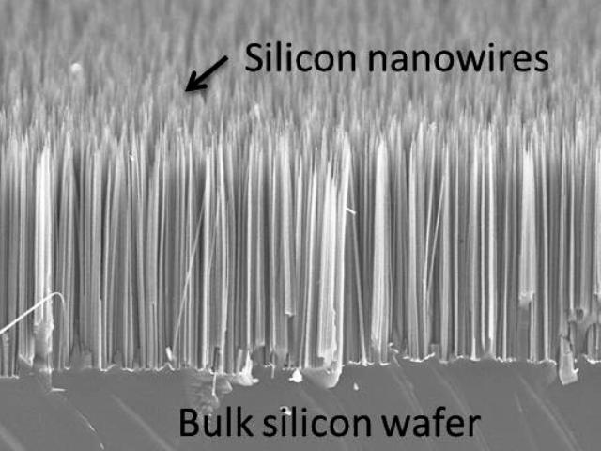
Infinite square well
$$U$$
Infinity
0
Infinity
$$x$$

Slide 8
Infinite square well
Why is it called a square well?
$$\frac{−ℏ^{2}}{2m}\frac{∂^{2}Ψ(x)}{∂x^{2}}+U\left(x\right)Ψ\left(x\right)=EΨ(x)$$
$$U$$
Infinity
0
Infinity
$$x$$
In the regions where $U$ is infinite, what should $Ψ$ be to satisfy the S.E.?
a) $e^{kx}$
b) $sin⁡(kx)$
c) 1
d) 0

Slide 9
Infinite square well
$$\frac{−ℏ^{2}}{2m}\frac{∂^{2}Ψ(x)}{∂x^{2}}+U\left(x\right)Ψ\left(x\right)=EΨ(x)$$
$$U$$
Infinity
0
Infinity
0
L
$$x$$
In the regions where $U$ is 0, what should $Ψ$ be to satisfy the S.E.?
a) $e^{kx}$
b) $sin(kx)$
c) 1
d) 0

Slide 10
Boundary conditions
$$\frac{−ℏ^{2}}{2m}\frac{∂^{2}Ψ(x)}{∂x^{2}}+U\left(x\right)Ψ\left(x\right)=EΨ(x)$$
To have a continuous function:
$$U$$
$$k=\frac{nπ}{L}$$
Infinity
0
Infinity
$$x$$
$$Ψ\left(0\right)=0$$
$$Ψ\left(x\right)=sin⁡(kx)$$
$$Ψ\left(L\right)=0$$
$$Ψ\left(x\right)=0$$
Notes:
Only certain energies are allowed. Guess $Ψ=A \backslash sin kx$
DEMO: string with boundary conditions.
DEMO: Falstad app
https://www.falstad.com/qm1d/

Slide 11
Normalization
$Ψ\left(x\right)=C sin⁡(kx)$ for $0<x<L$ and 0 otherwise
$k=\frac{nπ}{L}$
What should C be to ensure that the particle is in the box with probability 1?
$$C=\sqrt{\frac{2}{L}}$$

Slide 12
Discrete spectrum
$$E_{3}=\frac{{9ℏ}^{2}π^{2}}{2mL^{2}}$$
$$\frac{−ℏ^{2}}{2m}\frac{∂^{2}Ψ_{n}(x)}{∂x^{2}}+U\left(x\right)Ψ_{n}\left(x\right)=EΨ_{n}(x)$$
$Ψ_{n}\left(x\right)=\sqrt{\frac{2}{L}} sin⁡(\frac{nπx}{L})$ for $0<x<L$ and 0 otherwise
$$E_{n}=\frac{{n^{2}ℏ}^{2}π^{2}}{2mL^{2}}$$
$$E_{2}=\frac{{4ℏ}^{2}π^{2}}{2mL^{2}}$$
If we measure the energy, then we will only find an allowed value of E.
The electron can only emit/absorb photons with energy equal to the difference between allowed energies.
$$E_{1}=\frac{ℏ^{2}π^{2}}{2mL^{2}}$$

Slide 13
Photon absorption
A hydrogen atom has an electron starting in its ground state.
What photons can be absorbed, leaving the electron in an excited state?
$hf=E_{1}$
$hf=E_{2}−E_{1}$
$hf=E_{3}−E_{2}$
Any photon can be absorbed.
E₃
Photon, energy hf
E₂
Electron
E₁

Slide 14
Photon emission
A hydrogen atom has an electron starting in its excited state.
What photons can be emitted, leaving the electron in the ground state?
$hf=E_{3}$
$hf=E_{2}−E_{1}$
$hf=E_{3}−E_{1}$
Any photon can be emitted.
Electron
E₃
E₂
E₁

Slide 15
Energies of the infinite square well
An electron is in an infinite square well. Starting in the ground state, the longest wavelength that it can absorb is $λ$. What equation can we solve for $L$?
(Remember, $h=2πℏ$)
$\frac{hc}{λ}=\frac{{4ℏ}^{2}π^{2}}{{2mL}^{2}}$
b) $\frac{hc}{λ}=\frac{ℏ^{2}π^{2}}{{2mL}^{2}}(3^{2}−1^{2})$
c) $\frac{hc}{λ}=\frac{ℏ^{2}π^{2}}{{2mL}^{2}}(2^{2}−1^{2})$

Slide 16
The first few eigenstates
A
$Ψ_{n}\left(x\right)=C sin⁡(\frac{nx}{L})$ for $0<x<L$ and 0 otherwise
$$E_{n}=\frac{{n^{2}ℏ}^{2}}{2mL^{2}}$$
If the ground state (lowest energy) has energy E₁, then which state has energy 4E₁?
a)
b)
c)
B
C

Slide 17
The first few eigenstates
A
$Ψ_{n}\left(x\right)=C sin⁡(\frac{nx}{L})$ for $0<x<L$ and 0 otherwise
$$E_{n}=\frac{{n^{2}ℏ}^{2}}{2mL^{2}}$$
Which state has the least chance of being found right in the middle of the well?
a)
b)
c)
B
C

Slide 18
Vocabulary
State: The state is given by the wave function. Complete description of the physical properties.
Eigenstate: State that satisfies the time-independent Schrödinger equation
Ground state: Eigenstate with the lowest energy.
Excited state: Eigenstate with a higher energy than the ground state.
Quantum number: Since the particle can only take on discrete energies, states and energies are labeled by a number (n for the infinite square well)

Slide 19
Summary
$$\frac{−ℏ^{2}}{2m}\frac{∂^{2}Ψ(x)}{∂x^{2}}+U\left(x\right)Ψ\left(x\right)=EΨ(x)$$
$$U$$
Wave functions that satisfy this are called energy eigenstates; they have definite energy.
Wave functions that satisfy this equation are also stationary; the probability does not change with time. We will show that these states are stationary next week.
When a particle is confined, there are discrete energy eigenstates. It cannot take on all energies.
Infinity
0
Infinity
$Ψ_{n}\left(x\right)=\sqrt{\frac{2}{L}} sin⁡(\frac{nπ1x}{L})$ for $0<x<L$ and 0 otherwise
$$E_{n}=\frac{{n^{2}ℏ}^{2}π^{2}}{2mL^{2}}$$

