Slide 1



I2C
(INTER-INTEGRATED CIRCUIT)
PHYS371
Group 4: Jaime Almanza, Yiming Yu, Yuqing Zhai, Jiaxuan Zhang
09/23/2022

Slide 2

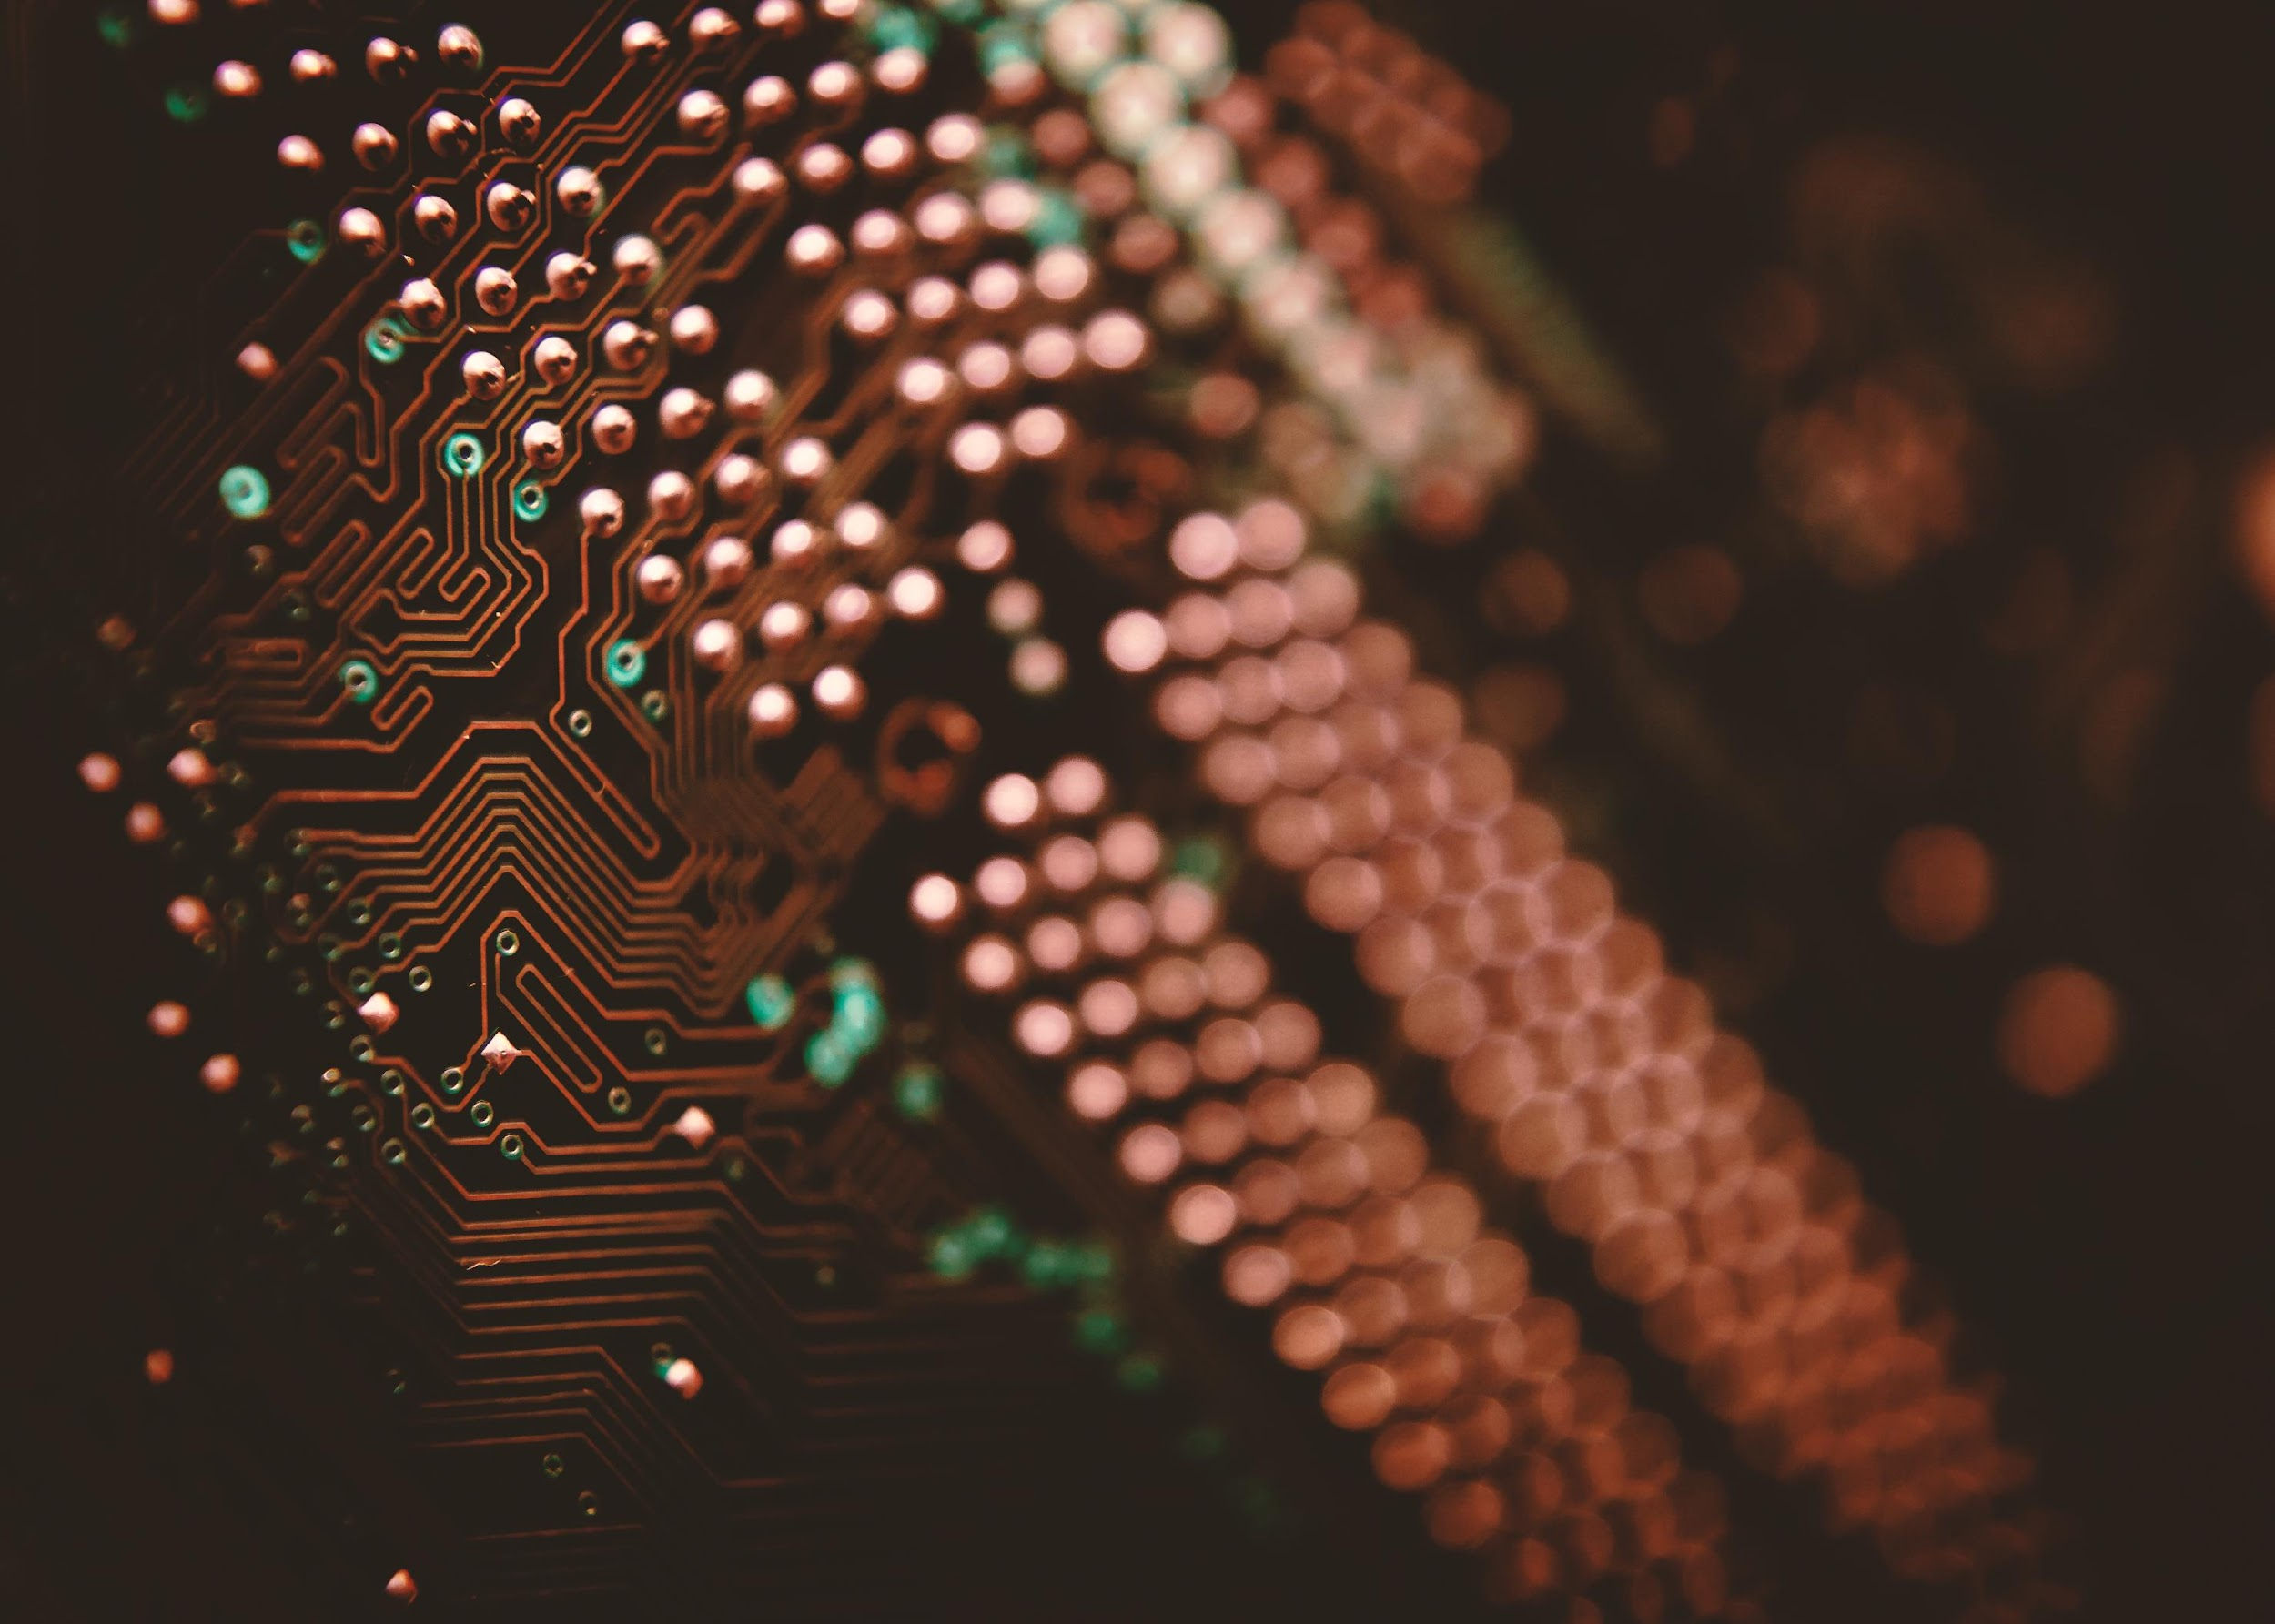



OVERVIEW
An Introduction to I2C
I2C Operating Principle
I2C and SPI

Slide 3


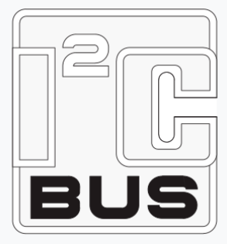
AN INTRODUCTION TO
I2C

Slide 4
BASIC INTRO
I2C (Inter-Integrated Circuit, also known as I²C or IIC):
A synchronous, multi-controller/multi-target (controller/target), packet switched, single-ended, serial communication bus
Invented by Philips Semiconductors in 1982
A peripheral bus widely used for lower-speed communication

Slide 5
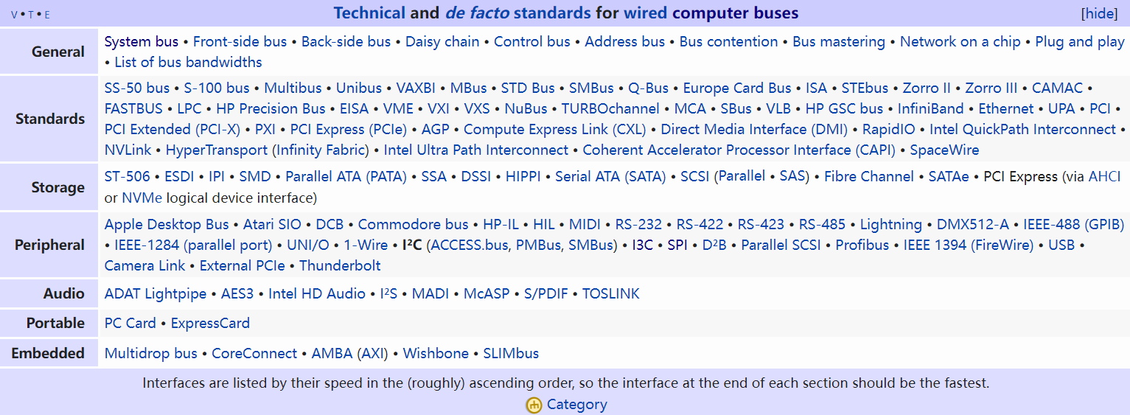
BUSES
A bus is a hardware component, software, or protocol that transfers data between computers, or between components inside a computer

Slide 6
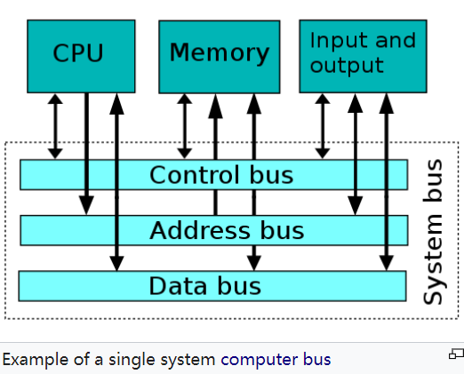
BUSES
Peripheral bus: supports computer peripherals like printers and hard drives
Example: USB (Universal Serial Bus)
System bus:

Slide 7
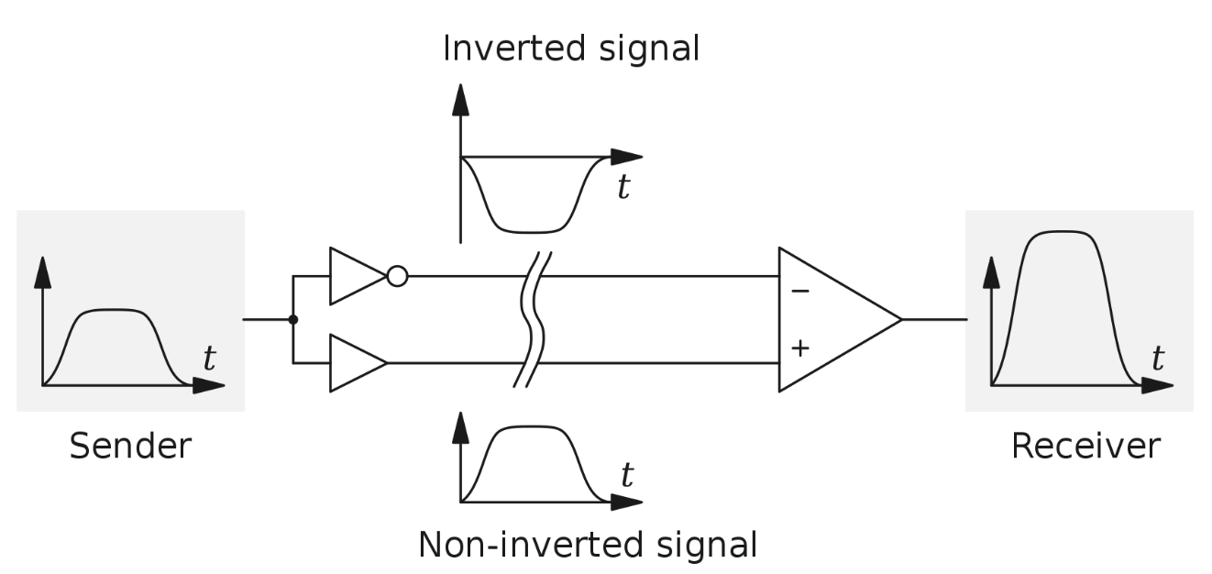
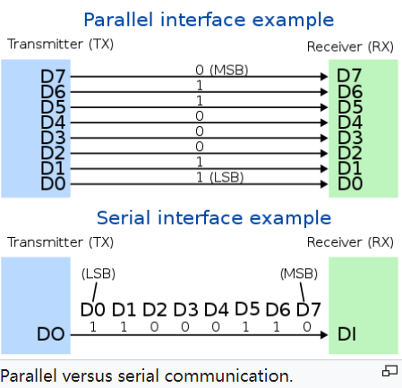
PACKET SWITCHING
A synchronous circuit is a digital circuit synchronized by a clock signal
Packet switching is a method of transmitting data without fixed paths by grouping it into packets with addresses
Single-ended signaling: One wire carries voltage (data) and another connects to ground
(Differential signaling)
Serial communication: send one bit at a time
(Parallel communication)

Slide 8
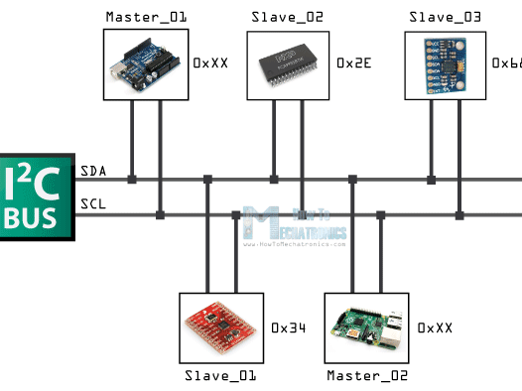
I2C
OPERATING PRINCIPLE

Slide 9
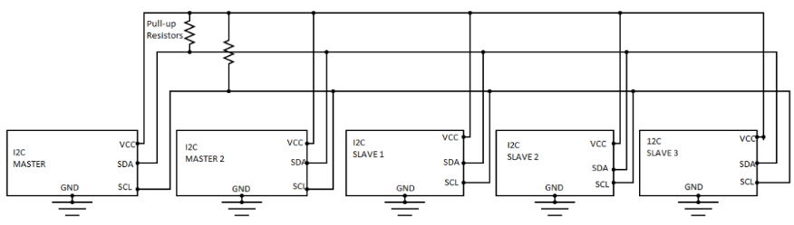
SCHEMATIC
A Master is the device/process that controls other devices (slaves).
These terms become controversial terms since the early 21st century. Alternative terms are used to replace them.

Slide 10
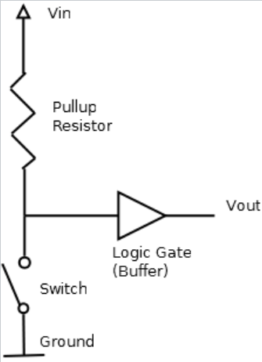
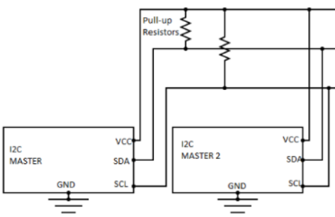
PULL-UP RESISTOR
Vin is connected to ground when the switch is closed

Slide 11
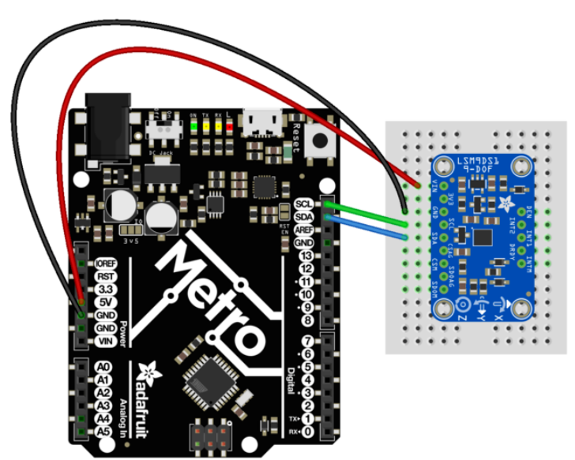
ACCELEROMETER WITH I2C
I2C works as a 2-wire bus:
SDA (serial data) and SCL (serial clock) for data transmission and synchronization

Slide 12
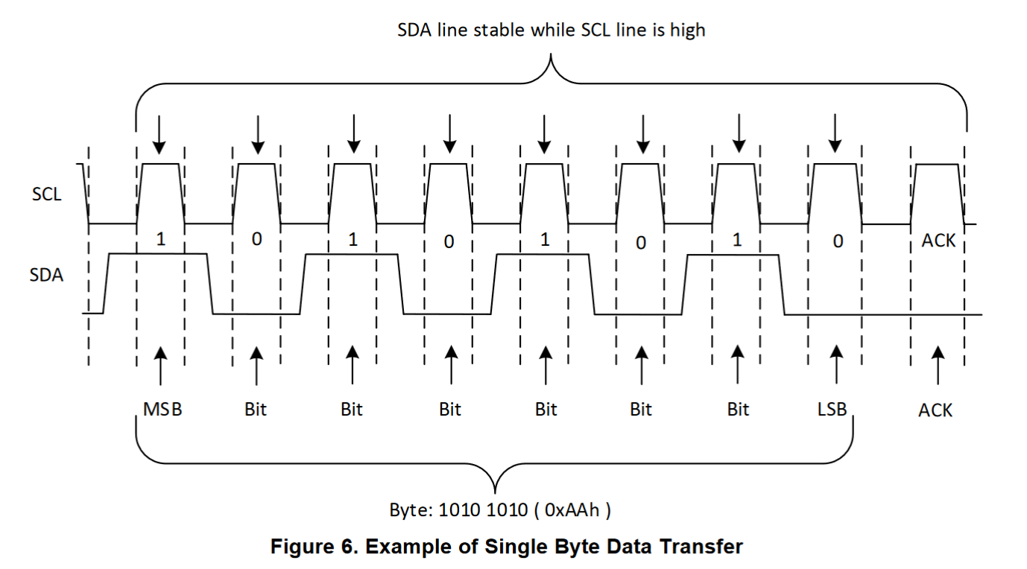
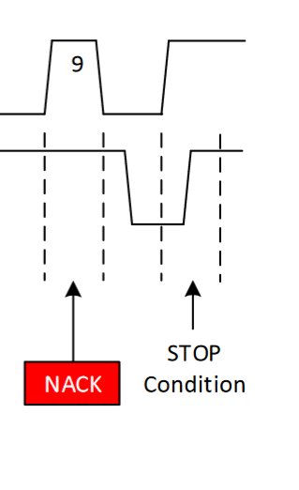
Timing Diagram
Byte Structures

Slide 13
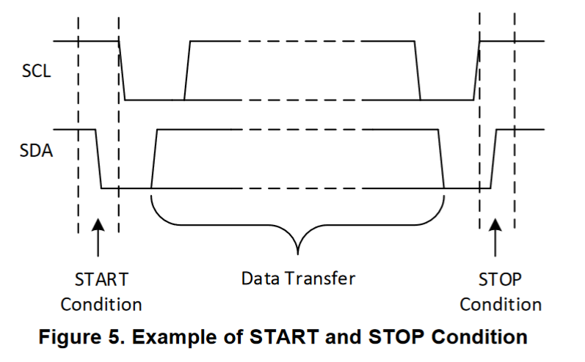
Timing Diagram
Start Condition and End Condition

Slide 14
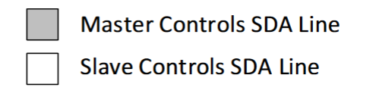
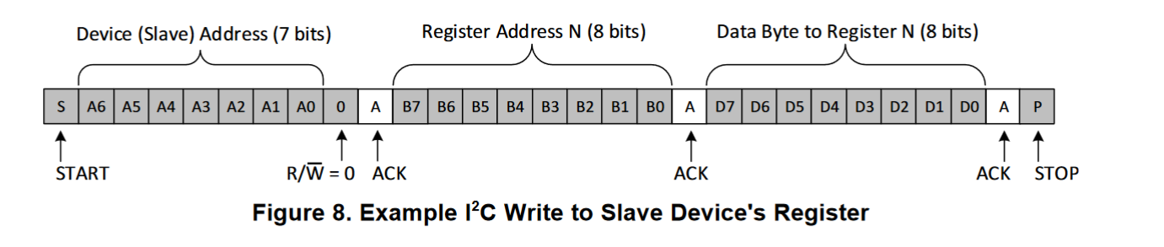
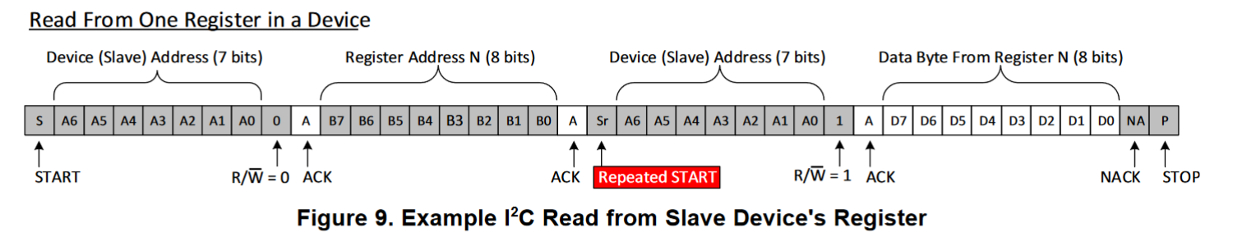
Timing Diagram

Slide 15
I2C Address
I2C addresses for some of the PHYS 371 hardware:
part | I2C address
BME680 | 0x76 or 0x77
DS3231 | 0x68
LSM9DS1 | 0x1E
MicroSD card breakout | SPI
What if…
We have two parts with same I2C address?

Slide 16
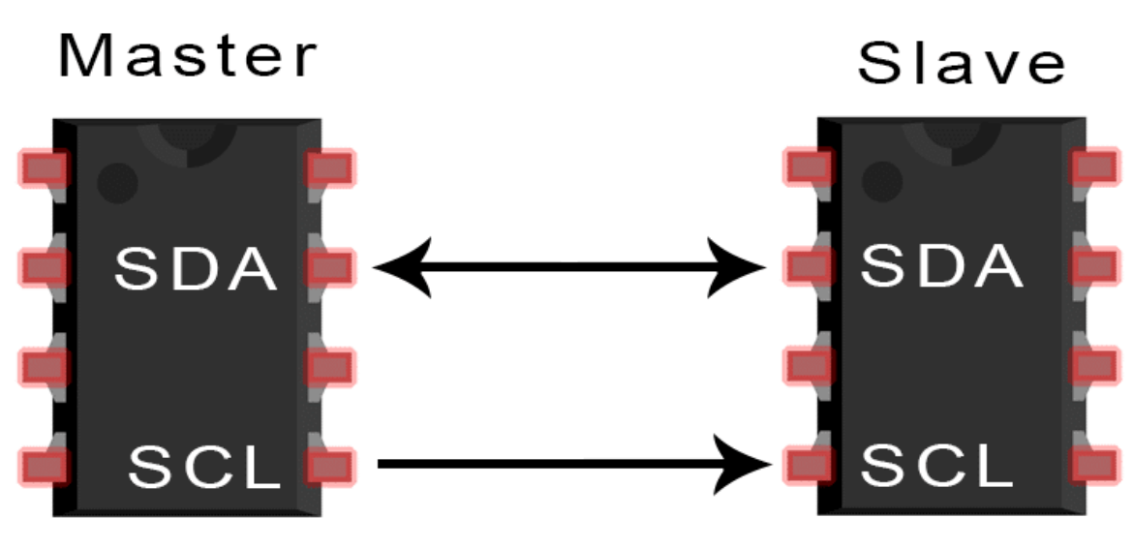
I2C and SPI

Slide 17
COMPARISON
SPI (Serial Peripheral Interface) is another peripheral protocol that define communication between master and slave devices
Compared to SPI, advantages and disadvantages of I2C are:
ADVANTAGES:
Simple to use: only needs 2 wires
DISADVANTAGES:
Slower than SPI
Half-duplex operation: cannot send and receive data at the same time.

Slide 18
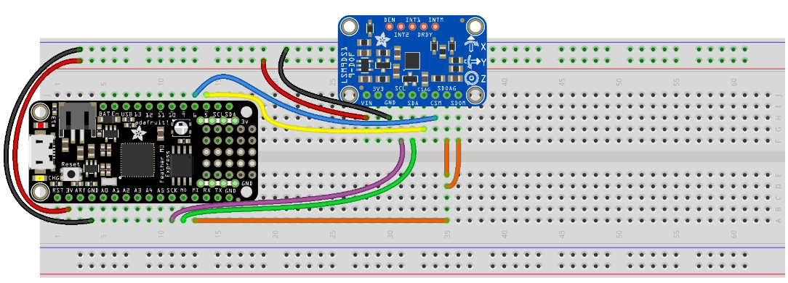
ACCELEROMETER WITH SPI

Slide 19
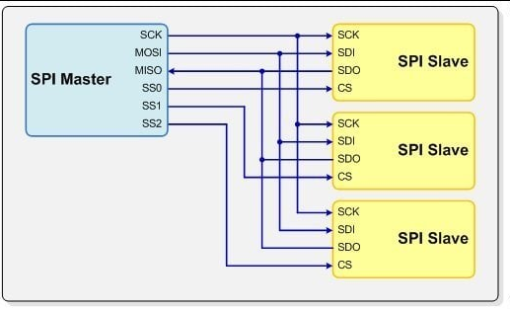
SPI for Multiple Devices

Slide 20
REFERENCE
[1] I2C Communication Protocol - GeeksforGeeks
[2] https://en.wikipedia.org/wiki/I%C2%B2C
[3] https://en.wikipedia.org/wiki/Bus_(computing)
[4] https://en.wikipedia.org/wiki/Synchronous_circuit
[5] https://en.wikipedia.org/wiki/Packet_switching
[6] https://en.wikipedia.org/wiki/Single-ended_signaling
[7] https://en.wikipedia.org/wiki/Serial_communication
[8] https://en.wikipedia.org/wiki/Peripheral_bus
[9] https://en.wikipedia.org/wiki/System_bus
[10] https://en.wikipedia.org/wiki/Master/slave_(technology)
[11] https://en.wikipedia.org/wiki/Pull-up_resistor
[12] https://courses.physics.illinois.edu/phys371/fa2022/code.asp

Slide 21
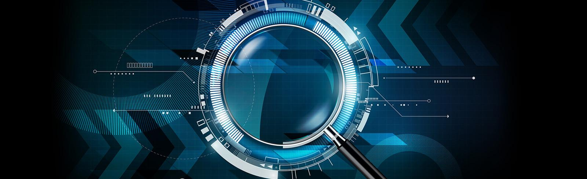
THANKS!

