Slide 1
Electret Microphone

Slide 2
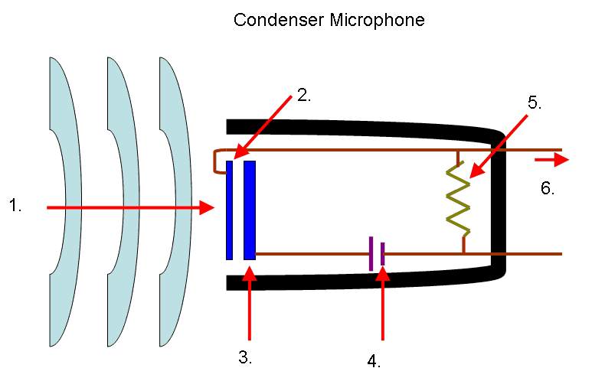
Condenser Microphones
Similar to electret microphones
Uses charged capacitor to generate electric signal
As diaphragm vibrates, capacitance changes resulting in electric signal
Internal battery is needed to polarize the capacitor

Slide 3
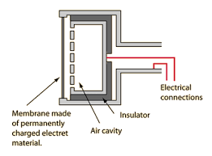
Electret Microphone
Uses permanently charged electret material
Electret and back plate form capacitor
No polarizing voltage needed

Slide 4
Electrets
An electret is a dielectric with a permanent electric dipole moment.
Produces electrostatic field
Made from synthetic polymers
Created by melting material, then cooling it in the presence of a strong electric field

Slide 5
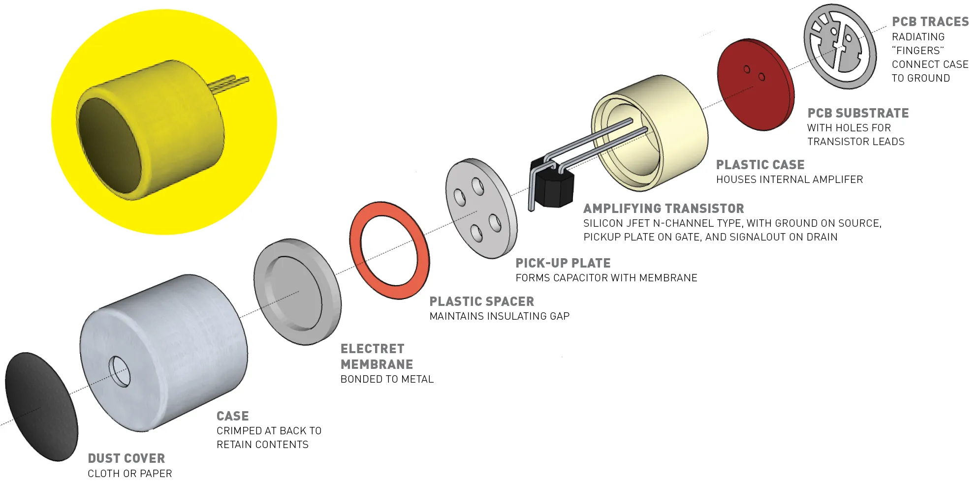
Microphone Construction

Slide 6
Types
Diaphragm
Electret material is used as the diaphragm of the microphone. Common and low quality
Back electret
Electret film applied to back plate, with a diaphragm made with uncharged material
Front electret
Electret film applied to front cover, metalized diaphragm creates the capacitor

Slide 7
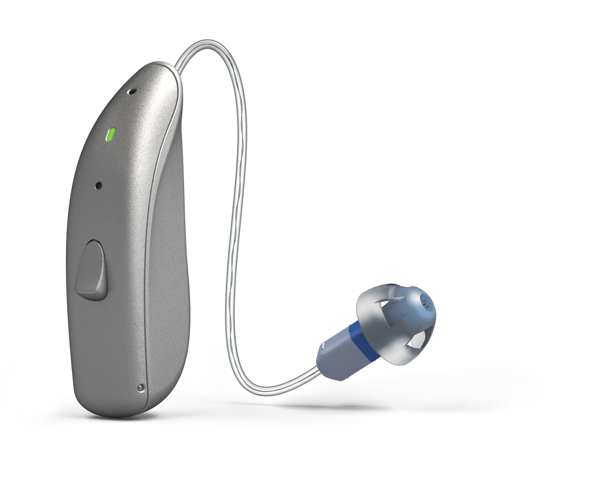
Applications
Cell phones
Computers
Hearing aids
Megaphones

