Slide 1
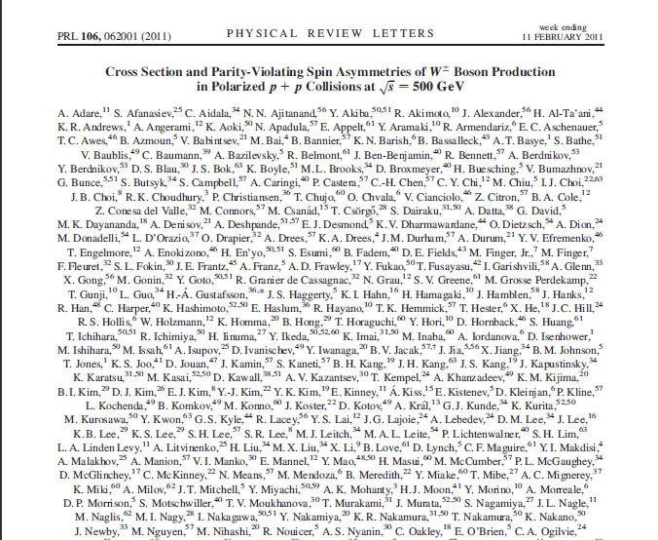

Collaborative Writing
Celia M. Elliott
Department of Physics
University of Illinois
© 2019 Board of Trustees of the University of Illinois
All rights reserved

Slide 2
The first step is deciding who the authors are going to be
Ethical considerations of sharing credit with those who contributed to the work
Choice of co-authors may affect the paper’s real and perceived quality
Things to consider when selecting co-authors
  Importance of the individual’s contribution
  Writing ability, availability, and interest
  Prestige and recognition in the field
Co-authors may not necessarily be co-writers
Notes:
Generally, have those who contributed most to the success of the project, especially those who have solved major technical problems should be co-authors; lesser contributors are mentioned in the acknowledgments section.
Ideally, authors are named in descending order of their relative contributions, but practices vary widely among research disciplines and groups. Unless the list is obviously alphabetical, most readers will assume that the first author made the major contributions to the work.
Some journals are now requiring a detailed statement of the contributions that each author made to the work being reported. See, for example, the “Contributions” section of “Ultrahigh-resolution optical trap with single-fluorophore sensitivity” (http://www.nature.com/nmeth/journal/vaop/ncurrent/full/nmeth.1574.html).

Slide 3
Who should be authors of this paper?
Ahrends (postdoc) and Anderson (graduate student) who actually did the work
Arbeiter (engineer) who fixed a critical problem with the apparatus
Bartholomew (professor)—formulated the key idea, told A² what experiment to do, what to look for, and what it meant when they found it
Chambers (department head and internationally known theorist)— had a number of insightful discussions with Bartholomew
Daniels (technician)—prepared and characterized the super-pure thin films
Notes:
This example is entirely fictitious.
Deciding the lead author is nontrivial; do you make it the most senior person, or the person who contributed the most important idea, or the person who did most of the work? Think about how future authors will cite it. “The fabrication method pioneered by xxxx et al.” will sound ridiculous if you make one of the theorists (Bartholomew or Chambers) the lead author.
This paper reports on the fabrication of semiconducting thin films of CdSe to take exploit their tunable opto-electronic properties.
Chambers contributed several possible theoretical explanations to account for the unexpectedly long charge carrier lifetimes that were observed experimentally.
In addition, Ahrends stuck Anderson with most of the exacting work, but Ahrends needs to find a job and Anderson has several years of graduate school left. Chambers, who can be petty and vindictive, has an ego the size of an aircraft carrier. And Daniels, the only one of the group who doesn’t have a Ph.D., has a permanent chip on his shoulder because he feels under-appreciated and overworked.
One solution to the problem might be multiple publications: Chambers can be lead author on a theoretical paper to Phys. Rev. Lett.; Anderson can be lead author on a paper to J. Appl. Phys., Daniels can be lead author on a technical publication in Optoelectronics or a similar trade journal.

Slide 4
Acknowledgments*
Acknowledge contributions by professional colleagues who are not listed as authors—
do not include titles or academic degrees
Acknowledge financial support in this section, or in a footnote on the first page of the text, depending on the journal’s style
Do not include purely personal acknowledgments
*N.B. There is no e between the g and the m in the
spelling of acknowledgment in U.S. English

Slide 5
Why have multiple authors?
Subject is too large or too complex for
one person
Subject requires a variety of viewpoints
or expertise
Recognized “experts” add prestige and may assure wider readership

Slide 6
Complications sometimes arise with multiple authorship
Opposing judgments about manuscript length, emphasis, publication venue
Differing writing styles
Disputes about assignment of credit
Time needed to resolve differences
Dilution of responsibility

Slide 7
Physicists use one of three approaches
“Plug-and-Play” method
  Each author writes a section, which is assembled into a final draft
  Exploits individual expertise and knowledge
  Inconsistencies in style, tone, tense among sections
“Best ball” method
  Everyone writes his own version of the whole article
  Group selects the best from each
  May still have inconsistencies in the final version
“Filter” method
  Group creates a draft using either of the two methods
  One person with “artistic control” writes the final version to ensure consistency of style and form
Notes:
Some caveats:
The more people involved
The more time it takes.
The less any one person feels responsible for finishing.
The more coordination and integration is required.
Multiple authors may make it difficult to maintain consistent tone, style, word usage.
Joining individually written segments in one document can result in a disorganized, poorly written mess unless one person has editorial control.
Many authors preparing the entire document is usually least efficient and most time-consuming.

Slide 8
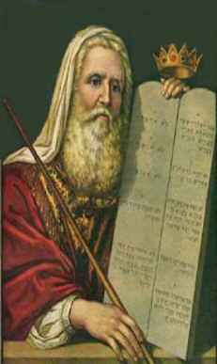
Team-Writing commandments
Name a lead author who has
final editorial control
Limit the size of the team
Strive for a mix of “thinkers”
and “doers”
Decide who has veto power
Discuss upfront how to
resolve conflicts
Notes:
Limit the size of the team—eliminate upfront members who cannot, or will not, contribute.
Consider thanking some contributors in the “acknowledgments” section instead of making them co-authors.

Slide 9
Steps to creating a collaborative paper
Identify the tasks that must be done
  Assign them to specific people
  Set firm deadlines
Establish a routing procedure
Agree on a protocol for recording comments as the manuscript circulates
Collect and circulate comments
Discuss and make changes to the document
Circulate the final draft for all authors’ approval

Slide 10
Decide on routing and file naming
Ensure that someone retains an original of each version of the file
Ensure that the most recent version of the file is what is circulating
If team members are going to make revisions to the original document and save a new version, devise a file-naming strategy so that the changes can be tracked (be aware that some operating systems truncate file names)
Notes:
Some operating systems (Windows 3.x) will open files with long file names but then will truncate them to the first six characters, followed by a tilde and a number. If you’ve devised a file naming strategy that includes important information in longer file names, that information may be lost if someone with a incompatible system opens the file.

Slide 11
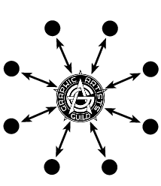
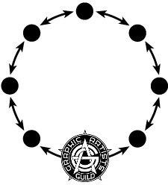
Decide on a routing procedure
“Spoke” routing
“Ring” routing
LEAD
AUTHOR
LEAD
AUTHOR
Notes:
“Spoke” routing
Document goes to all members of the group at the same time.
Members make their comments and return the document to the originator.
Faster turnaround.
Somenone will have to incorporate all the comments into a single document for the next round.
“Ring” routing
Document circulates to each member of the group successively.
Each member revises the file, saves it under a new name, and passes it on to the next person in the group.
File naming protocol very important.
Considerably slower, as each person must wait for the ones earlier in the chain to complete their work.
As the document moves, authors at the end of the chain may not have anything left to add to the document and will start commenting on the comments.

Slide 12
Decide on how you will comment
Commenting via email
  Someone in the group will have to collect and distill individual comments
Inserting comments directly into the text
  Original document may become very hard to read

Slide 13

To recap:
Have clearly defined roles for each author
Name one person who has overall responsibility for the final product
Establish (and enforce) deadlines
Figure out how you’re going to make comments and track versions ahead of time
cmelliot@illinois.edu
http://physics.illinois.edu/people/Celia/
Notes:
Some operating systems (Windows 3.x) will open files with long file names but then will truncate them to the first six characters, followed by a tilde and a number. If you’ve devised a file naming strategy that includes important information in longer file names, that information may be lost if someone with a incompatible system opens the file.

