Slide 1
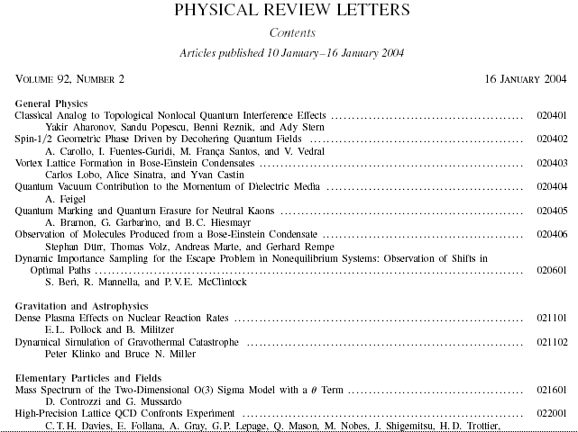

Writing Effective Titles
Celia M. Elliott
University of Illinois
cmelliot@illinois.edu
© 2025 The Board of Trustees of the University of Illinois
All rights reserved.
Notes:
The title is a key element of any form of scientific communication.
The quality and effectiveness of your title is critical in attracting a reader’s attention and in getting appropriate “hits” in electronic databases.
Here, we focus on how to write a title for maximum effect.

Slide 2
You’ll need effective titles for all sorts of things, not just journal articles
Internal reports to bosses
Technical reports to customers
Proposals to customers and funding agencies
Talks
Websites and electronic media
Notes:
Learning to write effective titles is important for more people than academic physicists who write journal articles.

Slide 3
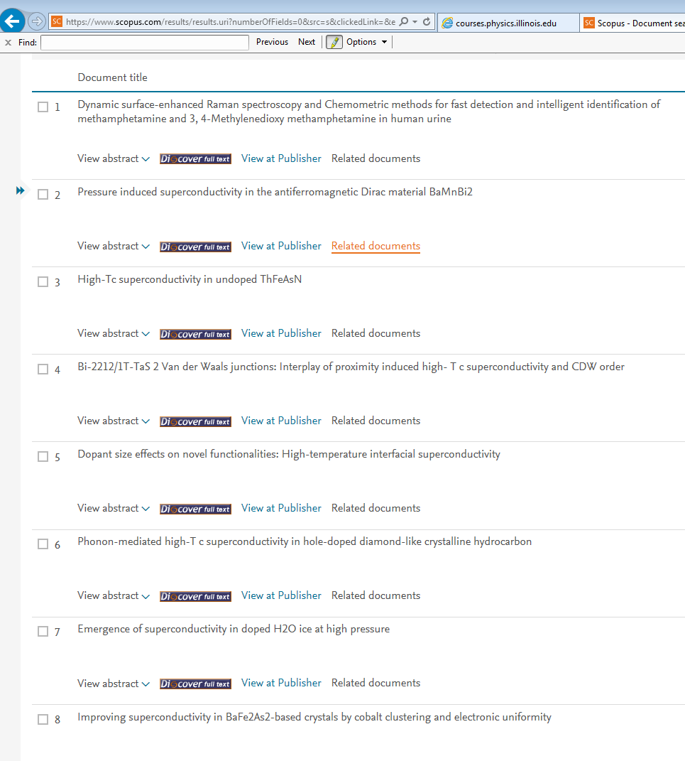
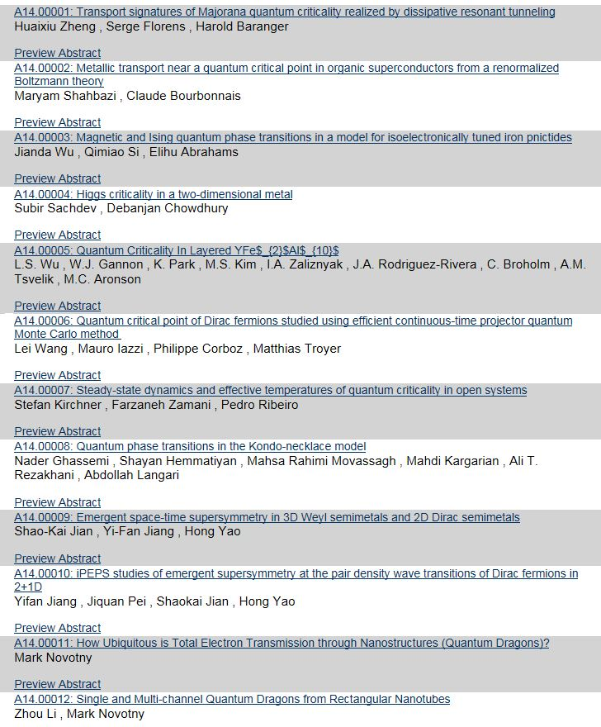
How do you decide which article to read, or which talk to go to?
You usually make a snap judgment based on the title…
Notes:
Scientists scan down a list of titles in the table of contents in a journal, or the latest postings to one of the electronic archives, or to the results of an electronic lit search; you have ≈1 s to capture their attention.
Try an experiment. Go to http://arXiv.org/list/physics/recent, and see how much time you spend looking at the titles of each article as you scan down the list before you decide whether a paper looks interesting and worth investigating further.

Slide 4
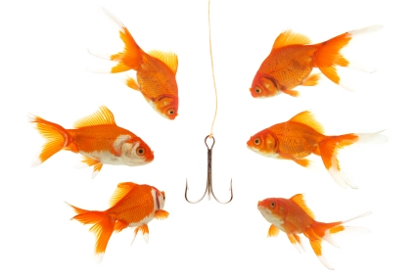
The title is the first hook to your prospective audience...
...make it count!
Notes:
Busy scientists employ three criteria when deciding if they will invest their time in reading a paper or attending a talk:
The information conveyed in the title.
The reputation of the author—if you’re a young scientist without a reputation yet,
see #1 and #3.
The abstract (more about abstracts next week...)
The title must accurately and succinctly convey the content of the paper and allow a busy reader to immediately decide if the paper is applicable to his or her work.

Slide 5

Your title should define and describe the content of your document or talk
A busy reader
should be able
to tell at once
if your doc is
relevant to her
research
Notes:
Write down key words that define and describe your paper. These are the words that belong in your title.
A title cannot capture every nuance of every detail of the paper, but it should accurately and specifically represent “the big picture.”

Slide 6
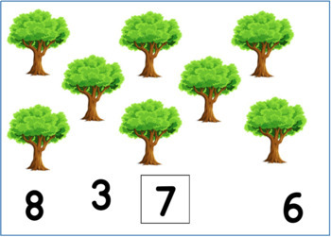
Useless title: “How to count trees?”*
*I am not making this up—Int J Mod Phys C16, 1527–1534 (2005).
Notes:
This title is too vague to help a reader. Is the paper about elementary arithmetic, forestry, environmental science, computer science? Only the author knows.

Slide 7

Play fair with your title
Don’t trick the reader
Notes:
The title must accurately and succinctly convey the content of the paper.
Play fair; don’t “trick” people into reading your paper by a misleading title.
Wastes their time.
Ruins your reputation (see point #2 on Slide 4).

Slide 8

Make it interesting, but not too interesting...
“Looking from the East at an Elephant Trotting West: Direct CP Violation in B⁰ Decays”
I am not making this up either—http://arxiv.org/abs/hep-ph/0203157
Notes:
While a good title helps a reader visualize the likely content of the paper, be careful.
8

Slide 9

Keep titles as short as possible
<12 words;
<10 is even better*
*That’s about the number of words a reader can take in and process as he or she is scanning down a list
Your prospective reader is not going to remember more than that many words anyway
Notes:
Limit titles to <12 words; <10 is even better. That’s about the span of words the human eye can recognize and process as it is scanning down a list.
Important papers don’t have to have long, “impressive” titles:
“Theory of superconductivity,” J. Bardeen, L. Cooper, and J.R. Schrieffer, Phys. Rev. 108, 1175 (1957). Three words; cited 8 970 times (Scopus, 01/18/2025).
Principles of Magnetic Resonance, Charles P. Slichter, 3rd. ed. (New York, Springer, 1990). Four words; cited 120111 times (Google Scholar, 01/18/2025).
“Ground state of the electron gas by a stochastic method,” D.M. Ceperley and B.J. Alder, Phys. Rev. Lett. 45, 566 (1980). Ten words; cited 13 366 times (Scopus, 01/18/2025)
“Dynamics of the dissipative two-state system,” A.J. Leggett et al., Rev. Mod. Phys. 59, 1 (1987). Seven words; cited 4 438 times (Scopus, 01/18/2025)
“Spin echoes,” E.L. Hahn, Phys. Rev. 80, 580 (1950). Two words; cited 4 251 times (Scopus, 01/18/20251)
9

Slide 10

Help your poor reader; put keywords first
Original Title: Application of the time-dependent local
density approximation to conjugated
molecules (11 words)
My edit: Time-dependent local density approximation
for conjugated molecules (8 words)
Original Title: A novel approach to estimate the
stability of one-dimensional quantum
inverse scattering (13 words)
My edit: New stability estimate for 1D quantum inverse
scattering (8 words)
Notes:
Have pity on your busy, overwhelmed readers. Make it easy for them to understand the subject of your paper immediately.
Front load the key words to attract a busy reader’s attention.
Examples:
Original Title #1: 11 words, introductory fluff
Improvement #1: 8 words, keywords front loaded
Original Title #2: 13 words, introductory fluff, “a novel approach” will be discussed next...
Improvement #2: 8 words, keywords first

Slide 11
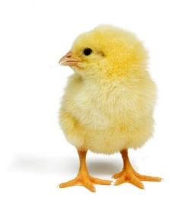
No introductory fluff
???
On the nature of the “hostless” short GRBs
Capabilities of parallel analyses of the structure of materials by field ion and scanning probe microscopy
Unveiling the impurity band induced ferromagnetism in the magnetic semiconductor (Ga,Mn)As
“Frontload” key words; get them on the left side of the list to grab a reader’s attention
Notes:
Good advice from AIP: “Words that do not carry information, such as “The...,” “A...,” “On...,” “Investigation of...,” “Study of...” should be omitted from titles.”
The Phys. Rev. journals also proscribe
“More about…”, “…revisited”, and dangling participles (“…using…”)

Slide 12
No introductory fluff
!!!
On the nature of the “hostless” short GRBs
“Hostless” short gamma ray bursts
Capabilities of parallel analyses of the structure of materials by field ion and scanning probe microscopy (14 words)
Field ion vs scanning probe microscopy
for materials characterization (9 words)
Unveiling the impurity band induced ferromagnetism in the magnetic semiconductor (Ga,Mn)As (11 words)
Impurity-band-induced ferromagnetism
in (Ga,Mn)As (6 words)
Notes:
Write out acronyms in all titles*; not every potential reader may know what a GRB is.
*HOWEVER, some acronyms are so widely recognized in physics that they need not be defined; see https://courses.physics.illinois.edu/PHYS496/sp2025/Resources/AIP_Style_4thed.pdf, Appendix D, p. 44.
*Hey, it’s English. Exceptions are the norm.

Slide 13

Do not use qualitative words
“novel” “interesting” “important”
(that’s up to the reader to decide)
Notes:
Do not use words in the title that make qualitative statements about the work being reported:
“precise,” “accurate”
“important,” “influential”
“innovative,” “unique,” “unprecedented,” “ground-breaking,” “brilliant”
“new”--maybe
Quantitative statements are okay, e.g., “Measurement of the negative muon anomalous magnetic moment to 0.7 ppm,” G.W. Bennett et al., Phys. Rev. Lett. 92, 161802 (2004).

Slide 14

Do not use the names of people*, places*, coined words, equations
*unless it’s standard nomenclature,
e.g., Lorentz force, quantum Hall effect,
de Broglie wavelength
Notes:
The Phys. Rev. journals also proscribe the name of the accelerator or the type of detector used in paper titles (but the particle physicists seem to violate this rule constantly and with impunity—cme).
“people’s names”—unless they are a common adjective. “Fourier transform,” “Green’s function,” “Auger spectroscopy,” “Brillouin limit” are fine. “Amazing New Results from the Kwiat Laboratory at the University of Illinois” is not.
“coined words”—if the word isn’t used outside your own research group, don’t put it in the title; same thing goes for narrow, technical jargon. Exception: “Mottness,” P. Phillips, Ann. Phys. 321, 1634-1650 (2006). BUT—he’d written about 10 papers on this topic before publishing “Mottness,” and the editor fought him on it anyway.
“equations”—don’t put anything in a title that cannot be rendered in straight ASCII text.

Slide 15
No unfamiliar acronyms
Original Title: One-dimensional SPH method
My edit: Smoothed-particle hydrodynamics 1D method
for gas dynamics applications
Original Title: Application of CVS filtering to mixing in
two-dimensional homogeneous turbulence
My edit: Coherent-vortex-simulation filtering for 2D
homogeneous turbulence
Notes:
“unfamiliar acronyms”—the AIP Style Guide provides a list of acronyms that are so common they don’t have to be defined at first use; anything else, leave out of the title or define it.
Examples of allowed acronyms: BCS, bcc, cw, EPR, ESR, fcc, ir, NMR, QCD, QED, rf, RNA, uv
Original Title: One-dimensional SPH method
IMPROVED Title: Smoothed-particle hydrodynamics 1D method for gas dynamics applications
NOTE: Although this title is longer than the original, it avoids the unfamiliar acronym and provides specific information that may be needed by the reader; the original title is probably too generic to be useful.
Original Title: Application of CVS filtering to mixing in two-dimensional homogeneous turbulence
IMPROVED Title*: Coherent-vortex-simulation filtering for 2D homogeneous turbulence
*This example may or may not be an “improved” title; it depends on what the author deems is most important and would be of most interest to readers.

Slide 16
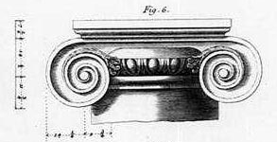
How do I decide what words to capitalize in a title?*
Some journals use “title” capitalization and some use “sentence” capitalization
  Physical Review Letters
  “Complexity of Small Silicon Self-Interstitial Defects”
  Physical Review B
  “Electronic excitations on silver surfaces”
  Science
  “Evidence for 2D Ising superconductivity in gated MoS₂”
Always capitalize the names of proper nouns, even when using sentence capitalization
  “Classification of gapless ℤ₂ spin liquids in 3D Kitaev models”
*Just look it up...
Notes:
There’s no consistency to the use of capitalization in paper titles—not even among journals published by the same organization. Just look it up. If you’re sure you know, look it up anyway;
you will learn humility.
Acta Crystallographica
Crystallography of a new metastable phase in Zr-N alloy
Nuclear Physics B
Five-loop ε expansion for O(n) × O(m) spin models
Physical Review Letters
Extracting Information about the Initial State from Black Hole Radiation
Physical Review B
Emergence of integer quantum Hall effect from chaos
Science
Activation of Cu(111) surface by decomposition into nanoclusters driven by C) adsorption
In “title” capitalization, the first word and all words except prepositions and articles are capitalized.
In “sentence” capitalization, only the first word, proper nouns, and some acronyms are capitalized.
More capitalization rules for science writing:
Celia Elliott’s Field Guide to Capitalization and Acronyms in Physics
https://people.physics.illinois.edu/Celia/Caps&Acronyms.pdf

Slide 17
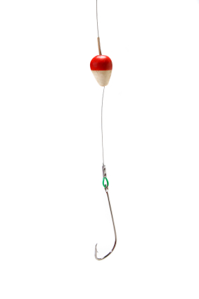

Now for some practice:
Remember: A good title is
concise, descriptive, interesting

Slide 18
“Investigation of accumulation, evolution, and penetration of gaseous products produced by nuclear fission reactions”
Behavior of gaseous nuclear-fission products

Slide 19

“An Overall Picture of the Gas Flow in Massive Cluster Forming Region: The Case of G10.6-0.4”
Gas Flow in Massive Cluster-Forming Region G10.6-0.4
As a matter of principle, I don’t like colon-ated titles; they are often just
an excuse for a run-on title—cme

Slide 20
“Pair contact process with diffusion of pairs”

Slide 21
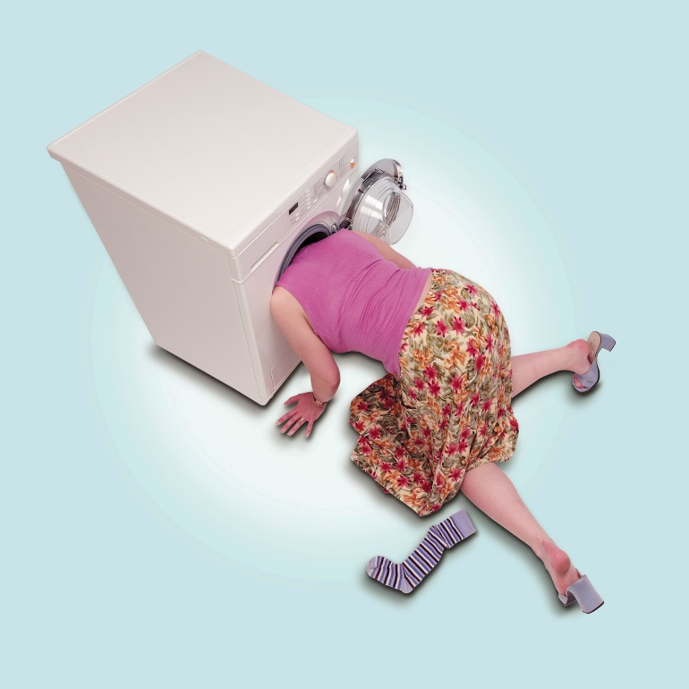
“Pair contact process with diffusion of pairs”
?
Socks and washing machines?

Slide 22
“Optimization of the Neutrino Factory, revisited”
Knowing what kind of “optimization”
would be nice, too

Slide 23
“A note on the implications of gauge invariance in QCD”
“A note on the implications of gauge invariance in QCD”
Notes:
The QCD abbreviation for quantum chromodynamics is okay in this title, because QCD is considered by the American Institute of Physics to be so commonly recognized in physics that it need not be defined.
Copy editor’s marks:
The horizontal line with a squiggle at the right end, written over a word or phrase, means “delete.”
The three horizontal lines beneath a letter means “capitalize this letter.”

Slide 24

“Unique nature of the lowest Landau level in finite graphene samples with zigzag edges: Dirac electrons with mixed bulk-edge character”

Slide 25
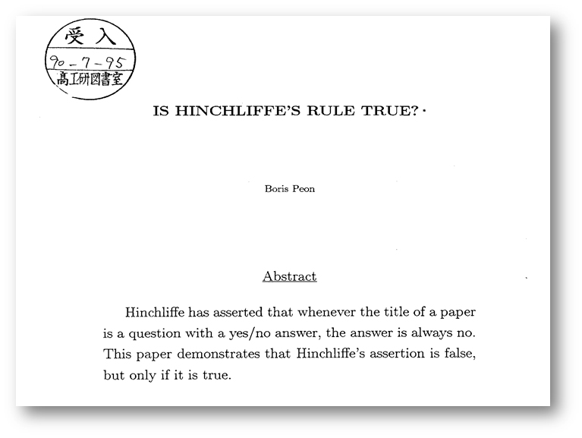
Hinchliffe’s rule for titles:
We’ll talk about
abstracts next week

Slide 26

To recap:
Keep it short
Frontload key words
Provide specific information
Make it interesting (but not too interesting)
cmelliot@illinois.edu
http://physics.illinois.edu/people/Celia/

