Slide 1


Communicating in Science—Celia’s Tips for Science Talks
There are 300 million
PowerPoint users
in the world*
*estimate
They do 30 million
presentations
each day*
*estimate
About a million
presentations are
going on right now*
*estimate
50% of them are
unbearable*
*conservative estimate
“Death by PowerPoint”
Alexei Kapterev
http://www.slideshare.net/thecroaker/death-by-powerpoint/
Celia M. Elliott
Department of Physics
University of Illinois at Urbana-Champaign
© 2025 Board of Trustees of the University of Illinois
All rights Reserved
Notes:
Today, we’ll look at some ways to enhance the communications value of your slides and some tips to avoid humiliation.
The standard software for most scientific talks is MS PowerPoint. Like it or hate it, that’s what nearly all AV systems at conferences are set up to use. If you are determined to be an iconoclast and use some other presentation software, fine, but be prepared for last-minute technical difficulties that will annoy your colleagues and cut into your presentation time. If you demand to use something other than PPT, take a PDF version of your talk that you can use when the computer in the seminar room can’t run Photoshop or LibreOffice.
Alexei Kaptarev’s Death by Powerpoint is an Internet classic not to be missed:
http://www.slideshare.net/thecroaker/death-by-powerpoint/
© 2025 Board of Trustees of the University of Illinois
All rights Reserved

Slide 2
Step 1: PLAN what you’re going to say
Distill your message to one sentence that you could write on a PostIt™ note (main point)
What do you have to explain so the audience understands that message? (subpoints)
Use images instead of text to illustrate your points as much as possible
Overarching message the audience should walk away with
What must I explain?
1.
2.
3.
How can I best illustrate these points?
Notes:
Know your audience!
Determine the style of your talk; what structure best fits your audience and your message?
Find out how much time you have to speak.
Decide on the key points you want to communicate.
Determine how best to use figures to illustrate your key points.
Allow time for rehearsal, feedback, and revision.
© 2025 Board of Trustees of the University of Illinois
All rights Reserved

Slide 3
Before you start the first slide, decide what your ultimate goal is
Disseminate a new result
Provide an overview of the topic
Reinterpret existing results
Propose a new experiment
Explain a new concept or method
Stimulate new collaborations
Educate the audience on a specific concept
Get a job
REJECTED
Overarching goal: Tell a memorable story & teach the audience something interesting
Notes:
NEVER present a slide that looks like this one—too much forgettable text and zero visual interest.
© 2025 Board of Trustees of the University of Illinois
All rights Reserved

Slide 4
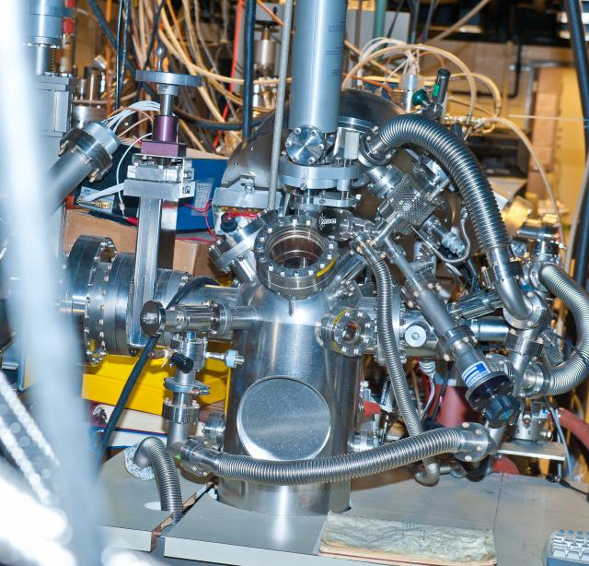
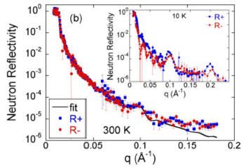

Next step—analyze your audience
What words will
they understand?
Why are they coming to
my talk?
What do I have
to explain?
What do they already know?
What do they believe?
What will confuse them?
What is their level
of expertise?
What do they think is important?
You
Your
audience
Notes:
A common error that beginning researchers make is that they emphasize what they found most interesting, or what they spent the most time doing, and not what the audience wants to know.
Know thy audience! It’s absolutely critical to producing a successful talk or paper (or anything else).
For many of the talks you will give or papers you will write as a scientist or engineer, nobody listening or reading will know as much about the subject as you do. You don’t have to dumb-down your messages, but you do have to draw your listener in and explain things in terms s/he can understand.
So the first rule of effective scientific communications is understand your audience. Who are they? What do they want to know? What do they already understand? What is going to confuse them? What will engage their interest?
Good advice from Elmore Leonard: “Try to leave out the part that readers tend to skip.”
(Elmore Leonard’s Rules for Writers, 24 Feb 2010, http://www.guardian.co.uk/books/2010/feb/24/elmore-leonard-rules-for-writers)
Another consideration as you analyze your audience: think about cross-cultural implications. The use of humor, references to popular culture, and sports analogies are very culture-specific. Will your audience understand your reference to the Kansas City Chiefs or Dancing with the Stars?
© 2025 Board of Trustees of the University of Illinois
All rights Reserved

Slide 5
Your biggest constraint: How much material can you cover in the time allotted for your talk?
Elliott equation:
[1]
Notes:
The amount of time you’re allotted determines how much material you can cover in your talk.
It takes about 6 to 8 minutes to adequately introduce, explain, and summarize one major idea or point in a scientific talk.
N.B. Equation [1] is also about as complicated as anything you’d want to show in a talk. Think about how long it took you to process and understand the point that was being made in this slide, using an equation. Do you really want to tackle
?
?
© 2025 Board of Trustees of the University of Illinois
All rights Reserved

Slide 6
Your biggest constraint: How much material can you cover in the time allotted for your talk?
Elliott equation:
[1]
The number of main points you can make in an oral presentation
Notes:
© 2025 Board of Trustees of the University of Illinois
All rights Reserved

Slide 7
Your biggest constraint: How much material can you cover in the time allotted for your talk?
The time allotted in minutes
Elliott equation:
[1]
Tip: It takes at least 6 to 8 min to adequately introduce, explain, illustrate, give examples of, and summarize a major point in an oral talk
Notes:
© 2025 Board of Trustees of the University of Illinois
All rights Reserved

Slide 8

Don’t try to tell “the whole story”*
*Your objective is
to get the audience
interested enough
to remember your name and read the paper
Distill your talk to a few key points (q.v. Eq. 1)
Present only enough data to
Illustrate your main points
Support your conclusions
Demonstrate the originality of your work
Notes:
A talk is not your paper projected onto the wall.
Your job as a speaker is to thoughtfully select the important points in the paper and convey them in a way that is meaningful and memorable for the audience.
© 2025 Board of Trustees of the University of Illinois
All rights Reserved

Slide 9

More presentation math:
S
[2]
where S is the number of slides that can be presented, and t is the time allotted in minutes
A good “rule of thumb” is to allow about
2 minutes per slide
Allow more time for equations, complex
plots, complicated figures, tabular data
Tip: You cannot show 44 slides in a 15-min presentation, no matter how fast you talk
Notes:
The amount of time you’re allotted also determines the number of slides you should prepare. In general, allow at least 2 min per slide, and more time for slides that present equations, plots, complex figures, or tabular data.
© 2025 Board of Trustees of the University of Illinois
All rights Reserved

Slide 10

How do you start?—with the ideas!
What are the (2 or 3, at most)
main ideas that I want to
convey to the audience?
What is the best (easiest to
understand, most memorable)
way to show them that information?*
*Hint: It’s probably not by written words
that you read off the screen
Notes:
The introductory material flows from these ideas :
- What motivated the work? How does it fit into work that has already been done?
- What background information does the audience need to understand these points?
The body of the presentation also flows from these ideas:
- What supporting evidence and data must be presented?
- How can you most effectively present those data—in text, figures, graphs, equations?
N.B. In most cases, “text” is the worst way to convey scientific data.
For a wonderful introduction to how to present quantitative information, see Edward Tufte’s Visual Explanations (Cheshire, CT, Graphics Press, 1997).
© 2025 Board of Trustees of the University of Illinois
All rights Reserved

Slide 11
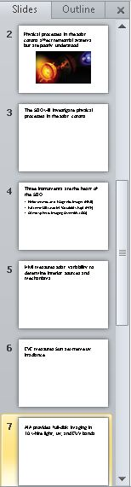
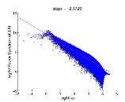
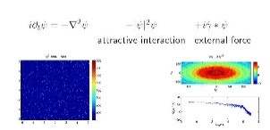
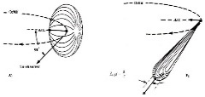
The sentences become slide titles
—one main idea per slide
Use the rest of the slide to explain and support the statement at the top of the slide
Write out main ideas in full
sentences
Tip: Read the sentences one after the other.
Do they form a logical narrative?
In “outline” view, moving slides around
to ensure a logical story is easy!
Notes:
These key sentences encapsulate your whole talk; they provide the motivation, describe the methods, highlight the key results, explain your conclusions.
Arrange the key sentences, one per slide, and move them around until you have a logical, coherent narrative story line.
© 2025 Board of Trustees of the University of Illinois
All rights Reserved

Slide 12
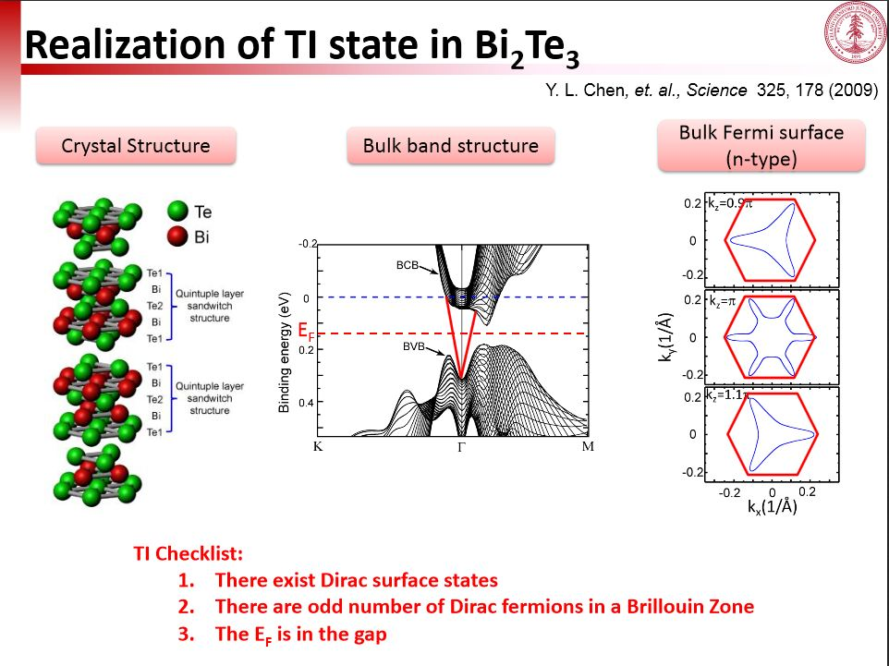
Every other element that you put on the slide should explain or amplify the motivating statement
Should be larger
Yulin Chen, “Direct Probing the Electronic Structures of Topological Insulators,”
Tutorial on topological insulators, APS March meeting, 2011
http://www.stanford.edu/~chenyl/APS_Tutorial_2011_YulinChen.pdf
Notes:
People read slides from top down, and they’ll look at the words at the top of the slide first. Make it state one of your key points. People pay the most attention at the top of each new slide. Keep them engaged and interested by what they look at next. Make it the supporting evidence for your statement.
© 2025 Board of Trustees of the University of Illinois
All rights Reserved

Slide 13
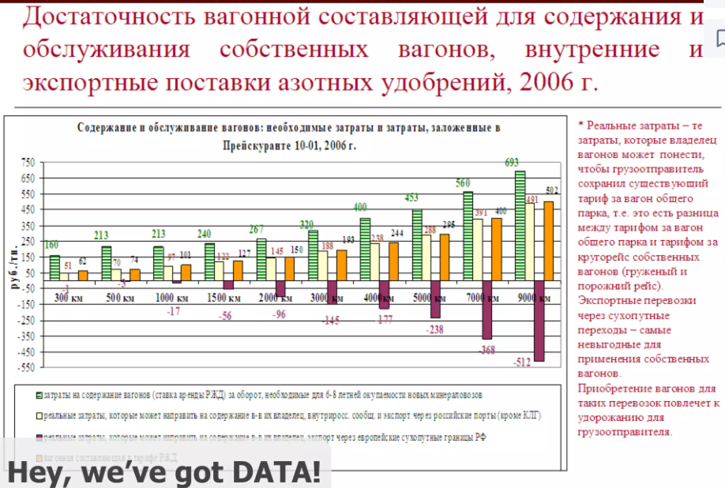
Step 2: MAKE effective slides
Think of each slide as a paragraph in a paper
“Topic sentence” goes at the top of the slide
Everything else on the slide
  1. Explains
  2. Expands on
  3. Gives evidence for that statement
First, the “don’t”s …
REJECTED
Alexei Kapterev
Notes:
Illustration taken from Alexei Kaptarev’s Death by Powerpoint.
http://www.slideshare.net/thecroaker/death-by-powerpoint/
© 2025 Board of Trustees of the University of Illinois
All rights Reserved

Slide 14



Don’t use photographic or “fill” backgrounds
They’re distracting
They make your text too
hard to read
They get boring after the first
two or three
Yes, it’s Illini
Orange, but
nobody can
read the text
Even if it’s on
hydrophobic
materials
Even if you
think it looks
really cool
Even if your talk
is about koalas
Just don’t do it!
Notes:
Don’t use photographic or textured backgrounds—just don’t do it. They’re distracting, they get boring after you’ve seen the first one, and the superimposed text is often impossible to read.
© 2025 Board of Trustees of the University of Illinois
All rights Reserved

Slide 15
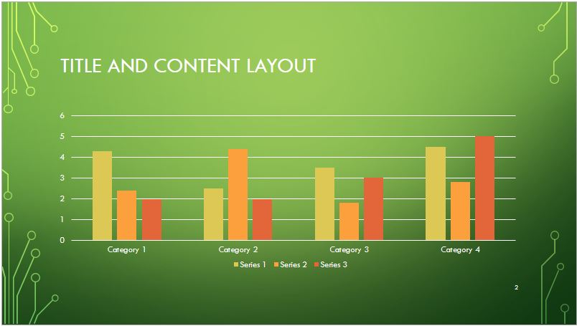
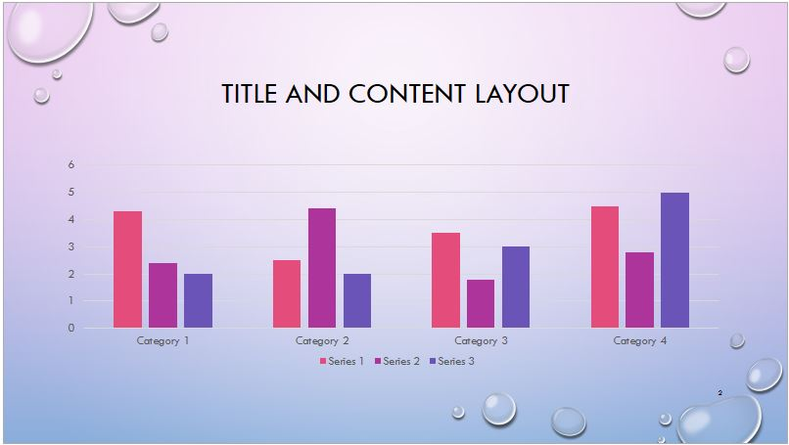
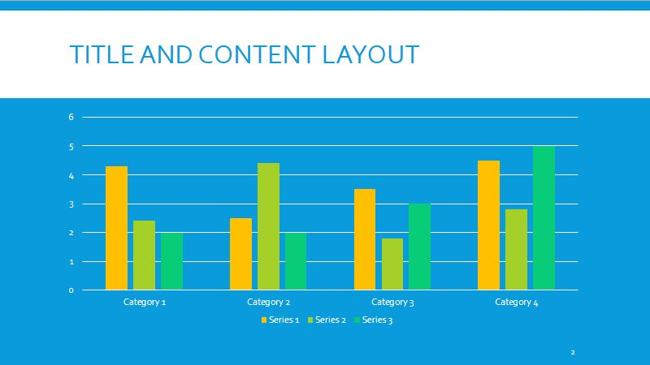
Don’t use one of the PPT templates
They take up too much real estate with
meaningless graphics
They force you to devote 25% of the slide to
the “title”
They trivialize your message by promoting
style over substance
Many are just hideous
Notes:
You want the audience to be thinking about what you’re saying and looking at the evidence you’re presenting, not swooning (or snickering) over your artistic taste.
© 2025 Board of Trustees of the University of Illinois
All rights Reserved

Slide 16

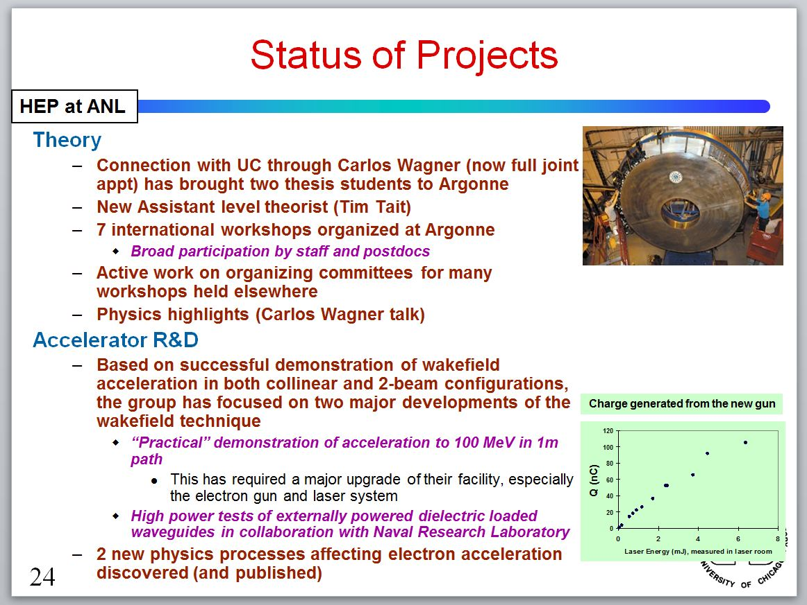
Don’t use unless you are presenting an actual list
REJECTED
Notes:
I recommend turning off the “bullet list” format, which is the default in PPT. Presenting ideas in bulleted lists implies hierarchies or relationships that may not, in fact, exist.
“Lists can communicate only three logical relationships: sequence (first to last in time), priority (least to most important, or vice versa), or simple membership in a set (these items are related to one another in some way, but the nature of that relationship remains unstated). A list can show only one of those relationships at a time.” Gordon Shaw, Robert Brown, Philip Bromiley, “Strategic Stories: How 3M is Rewriting Business Planning,” Harvard Business Review 76, 42–44 (1998).
Turning off the bullets also gives you more slide real estate to work with.
© 2025 Board of Trustees of the University of Illinois
All rights Reserved

Slide 17

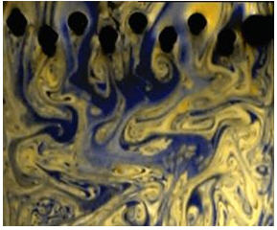
Don’t use red or green to convey important information*
Development of turbulence in a soap film as its surface is raked by a wire comb. Courtesy Nigel D. Goldenfeld
*Between 8 and 12 percent of white males are red-green colorblind—who’s your audience?
Notes:
If you use color to convey information, make sure that information transfers as you intended it and is accessible to everyone in your audience. You can upload a figure to https://www.color-blindness.com/coblis-color-blindness-simulator/ and see how the figure will look to people with the most common forms of colorblindness.
Another good resource is http://www.colourblindawareness.org/colour-blindness/.
© 2025 Board of Trustees of the University of Illinois
All rights Reserved

Slide 18
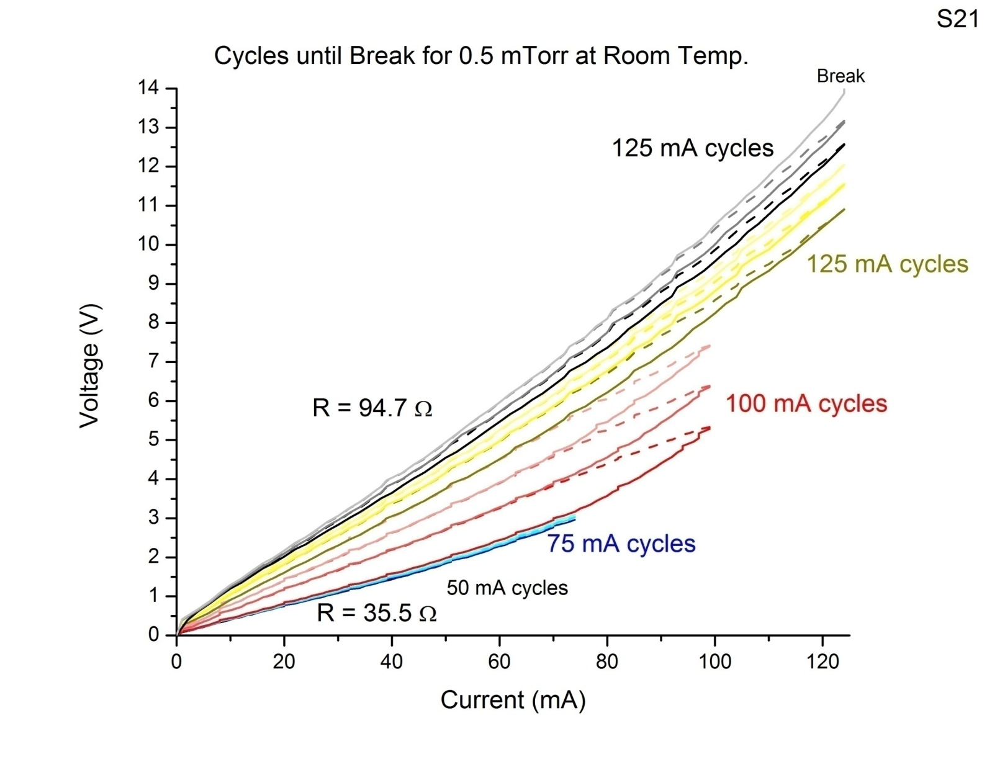
DO replace the content-less PPT “title” with a meaningful motivating statement
IV curves showed an increase in resistance with Joule heating
Results
Plot courtesy Thomas Hymel
Tip 1: Write the statement as a sentence and left-justify it
Tip 2: Turn off the “auto-correct” feature in PPT that reduces the font size if you exceed the number of characters MS thinks you should have on a line
Notes:
The default for PowerPoint slide “titles” is centered. Change it to left-justified.
Turn off the automatic “fitting” functions in PPT to avoid having PPT reduce your font size if you exceed the number of characters MS thinks you should have on a line.
From the “File” menu, click on the “Options” link, and then select “Proofing” from the menu. In the dialogue box, click on the “Autocorrect Options” button. When that dialogue box opens, uncheck the “Autofit Title” and “Autofit Body Text” boxes.
© 2025 Board of Trustees of the University of Illinois
All rights Reserved

Slide 19
DO use the SEEE method to present your ideas effectively
State your main point
Evidence
Example
Explanation
Notes:
Put a motivating statement at the top of your slide that summarizes the point of the slide.
People pay attention when something changes in their environment—for instance, when a slide changes. Take advantage of that sharpened attention to articulate your message in an immediately identifiable, memorable way.
Use the rest of the slide to explain, give evidence for, or provide examples of the idea presented in the motivating statement at the top of the slide.
© 2025 Board of Trustees of the University of Illinois
All rights Reserved

Slide 20
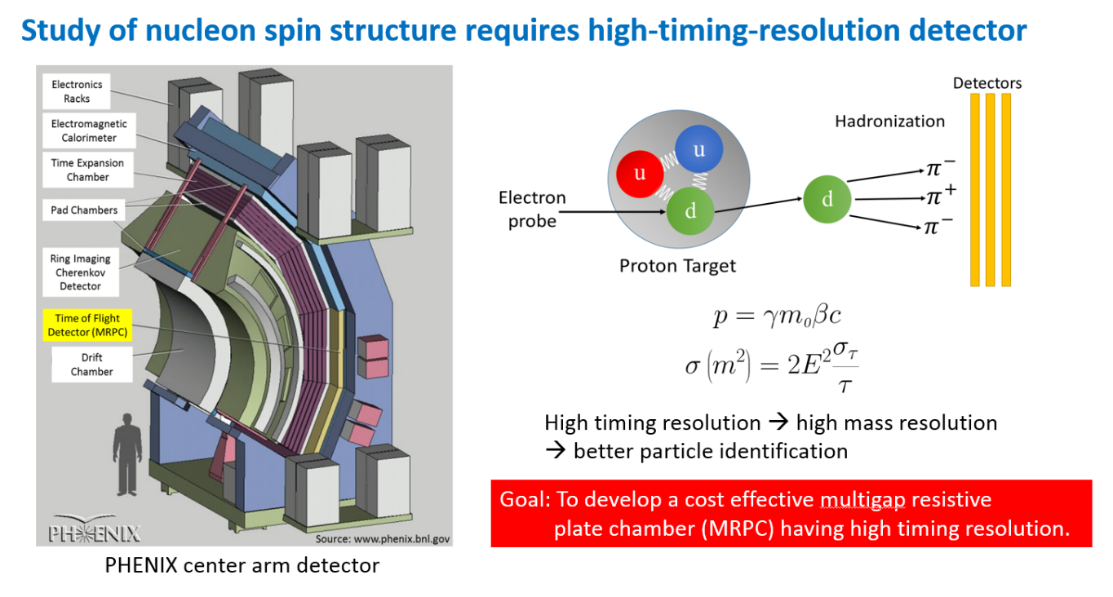
DO use the SEEE method to present your ideas effectively
State your main point
Evidence
Example
Explanation
Courtesy Jun Hui See Toh
Notes:
Use the rest of the slide to explain, give evidence for, or provide examples of the idea presented in the motivating statement at the top of the slide.
© 2025 Board of Trustees of the University of Illinois
All rights Reserved

Slide 21
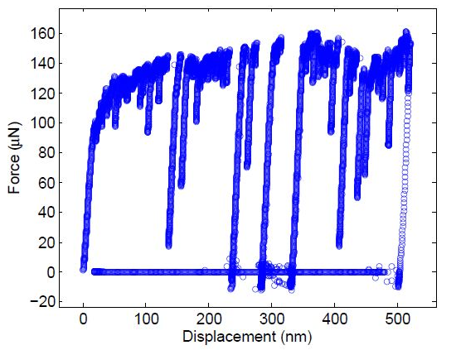
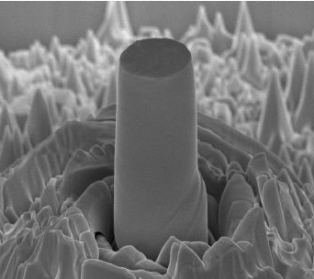
DO label all elements in a figure
Point out important features
Provide a scale
Label both axes of graphs and show units
Give credit
2.98 μm
Micropillar
9.10 μm
3.16 μm
Substrate
SEM image of gold micropillars
(Courtesy M. Wraith)
Displacement controlled compression of the micropillars
(Courtesy M. Wraith)
Notes:
What about captions? Every figure in a paper must have a caption that explains the figure and points out important features. Some scientists say that figures for talks don’t require captions or labels—you’re standing there explaining them, after all.
I, however, think images in talks should have short, explanatory captions that orient the audience. They’re going to look at the picture on the slide first—before you explain it—and they’re going to want to know immediately what is being depicted.
If you’ve used somebody else’s figure, you should at a minimum give credit for it, and perhaps provide a URL or bibliographic reference for where the original may be found.
Another tip for ALL figures—if you show a photograph or drawing of something, provide some sort of visual clue to its scale. The audience may have no idea if the apparatus shown below is 5-cm long or 5-m long from just looking at this image.
© 2025 Board of Trustees of the University of Illinois
All rights Reserved

Slide 22
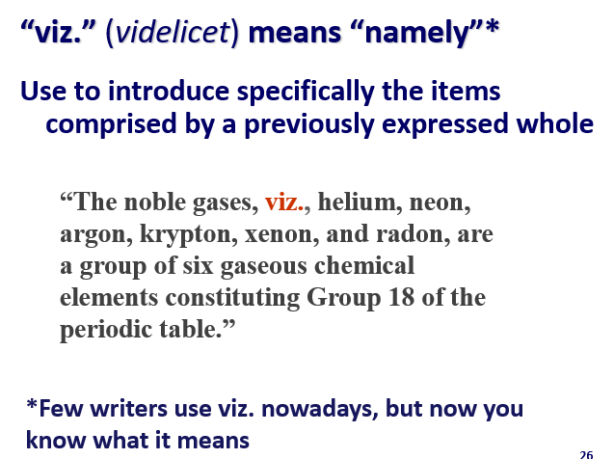

DO number your slides
3
Notes:
© 2025 Board of Trustees of the University of Illinois
All rights Reserved

Slide 23
DO use a simple sans serif font
Serif fonts don’t project as well, because the narrow parts tend to fade away
Eschew weird fonts (including Comic Sans*)
Use one main font color and, at most,
one contrasting font color for emphasis
Use one main font and, at most, one
contrasting font for emphasis
Use mixed upper and lower case for text—WRITING IN ALL CAPS LOOKS LIKE YOU’RE
SHOUTING (and it’s much harder to read—and proofread!)
REJECTED
*or risk professional ridicule
Notes:
Do as I say, not as I do. This slide, while typical of an academic lecture to facilitate note-taking, has w-a-a-a-a-a-y too much text on it for a science talk.
Keep text to a minimum—use just enough words to orient the audience to what they are seeing. You want them to be listening to you, not reading a novella off the screen.
© 2025 Board of Trustees of the University of Illinois
All rights Reserved

Slide 24
Sans serif fonts are easier to read when projected
Two main families of font styles
Sans serif—all the lines of the letters
are the same thickness
Serif—some lines are thinner and extra thin strokes are added at the base & ends of letters
Calibri Tahoma
Helvetica Univers
Arial Verdana
Times Aptos Serif
Georgia Palatino Linotype
Century MingLiu
Notes:
Serifs are added to some fonts to make large blocks of text easier to read by adding “footers” to some letters, making long lines of text easier to track. Consequently, serif fonts are most often used in printed books, magazines, and newspapers.
However, sans serif fonts are preferred for the text on slides and websites. The resolution of LCD projectors and computer monitors is considerably less than standard printed pieces (72 dpi vs. 300 dpi to 600 dpi for print). Consequently, the thin lines of serif fonts tend to become fuzzy or fade out when projected, particularly for smaller font sizes. I strongly recommend that you use a standard sans serif font for your slides.
And whatever font you use, make it boldface (crtl + b) for higher contrast with the background.
© 2025 Board of Trustees of the University of Illinois
All rights Reserved

Slide 25

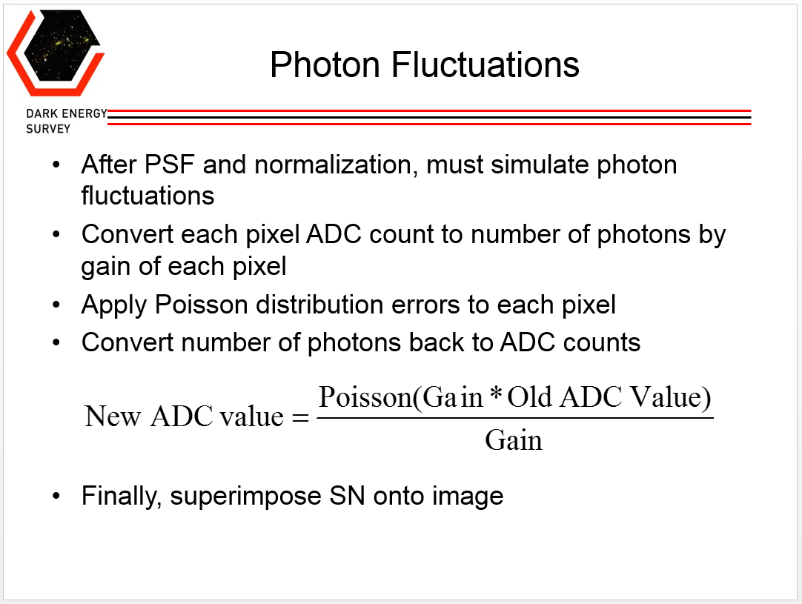
DO use equations only if absolutely necessary to convey your message
Slide Courtesy Nick Langellier
Replace math with words
  Slow down; talk through step by step
  Define all symbols
  Explain relevance
  Make them large enough to be easily read
Notes:
PowerPoint animations can be useful in presenting equations:
Highlight relevant terms in different colors
Drop out terms
Replace symbols with words
Blow up parts of the equation or use arrows as pointers as you walk the audience through it

Slide 26
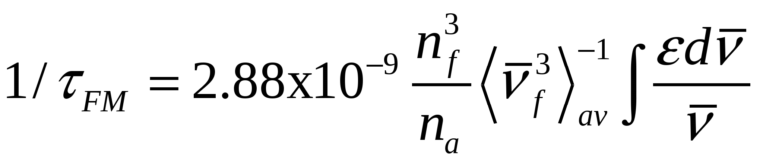
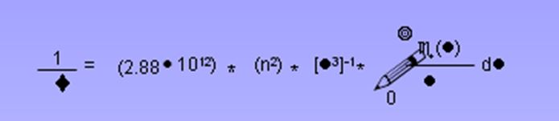
DO “embed” special fonts in PPT to avoid embarrassing surprises at the conference
The Strickler–Berg relation opens the door for comparing measured spectral quantities
your computer
Different computer—Voilà! Pencils!
The Strickler–Berg relation opens the door for comparing measured spectral quantities
conference computer
Notes:
Every computer has its own individual “library” of fonts; if PPT cannot find a font when you open your presentation on a different machine, it just arbitrarily substitutes a font that it thinks is “close.” Often, it isn’t...
© 2025 Board of Trustees of the University of Illinois
All rights Reserved

Slide 27
DO choose a neutral background and a high-contrast color for the text
Use a light-colored background with dark text
Use a dark background with light text
This isn’t high-enough contrast
Neither is this
Don’t ever put red on blue
Or blue on red
And avoid using gradient fills, too
Notes:
Be aware that colors that look bright and crisp on your monitor may look entirely different when projected. In particular, pastel colors and thin lines fade away. Use bright, primary colors, bold fonts, and thick lines.
© 2025 Board of Trustees of the University of Illinois
All rights Reserved

Slide 28
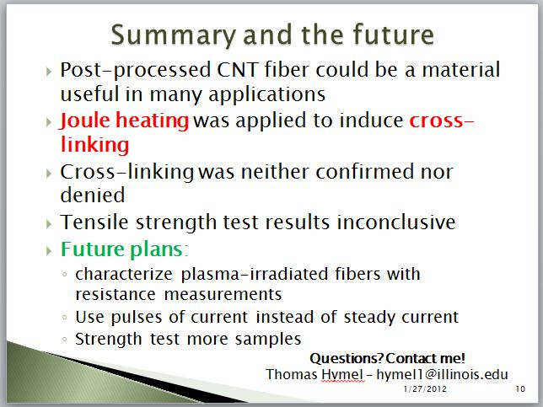
DO provide a “summary” slide and make it count!
Recap key results
Reiterate principal conclusions
Repeat your contact information
Tip: Your last slide will probably get the longest exposure, and it will be the first thing people see when they wake up
Slide Courtesy Thomas Hymel
Notes:
The summary slide lets you reiterate your key points and cues the audience that you will soon be taking questions. Leave it on the screen during the “questions” period—it will help people review what they’ve learned and remind them of questions they want to ask.
Add your contact information at the bottom of the summary slide; people may not remember it from your title slide.

Slide 29
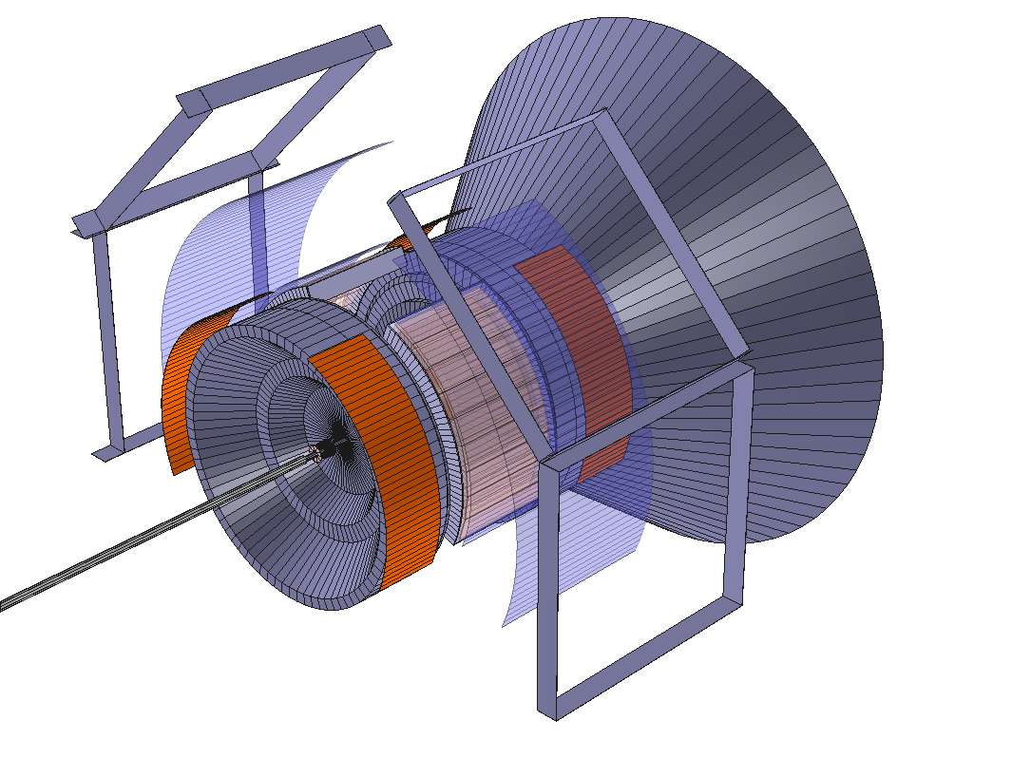
Most people will remember your images better than your words…
Figures promote audience interest, provide supporting evidence, help explain complex ideas and relationships quickly, and give the audience something to remember
…and they’ll look at the figures first, too
Notes:
Use engaging, visually interesting figures to draw listeners into your story and give them something to remember.
Illustrate each of your main points with an engaging image.
“Graphic excellence is that which gives to the viewer the greatest number of ideas in the shortest time with the least ink in the smallest place.”—Edward Tufte
© 2025 Board of Trustees of the University of Illinois
All rights Reserved

Slide 30
Who can tell me the four reasons to include figures in your talk?
Three reasons?
Two reasons?
Who remembers the image shown on the previous slide?
I rest my case…
Notes:
People remember pictures much longer and better than they remember words.
© 2025 Board of Trustees of the University of Illinois
All rights Reserved

Slide 31
Most people will remember your images better than your words…
Figures promote audience interest, provide supporting evidence, help explain complex ideas and relationships quickly, and give the audience something to remember.
…and they’ll look at the figures first, too
Notes:
Let’s look at this slide again. If its purpose was to convey the four reasons why speakers should include figures in their talks, the slide was set up from the beginning to fail because of the way the information was presented.
© 2025 Board of Trustees of the University of Illinois
All rights Reserved

Slide 32

Figures serve four purposes in talks
Engage the audience and capture their interest
Provide supporting evidence
Help explain complex ideas and relationships quickly
Give the audience a visual, memorable “hook” to hang your key ideas on
PHENIX detector at the Relativistic Heavy Ion Collider
Courtesy M. Grosse Perdekamp
Tip: Add a brief caption to orient the audience immediately—they’re going to look at the figure before you explain it—and always add a scale
Notes:
First, change the motivating statement at the top of the slide to emphasize the idea that there are four reasons to use figures. In the original slide, the message in the title is “remember the figure,” and the subtitle is “look at the figure first.”
Present the points in a numbered list—easier to process (and remember) that there are four reasons than to sort them out from narrative text presented in paragraph style.
Most Western languages are read from left to right and top to bottom. Place your important points strategically—at the top of the slide and along the left margin. Put your illustrative pictures at the right and lower down on the slide.
Put important ideas in a contrasting color—people look at color first, too.
And always, always, always include a scale for any illustration.
© 2025 Board of Trustees of the University of Illinois
All rights Reserved

Slide 33
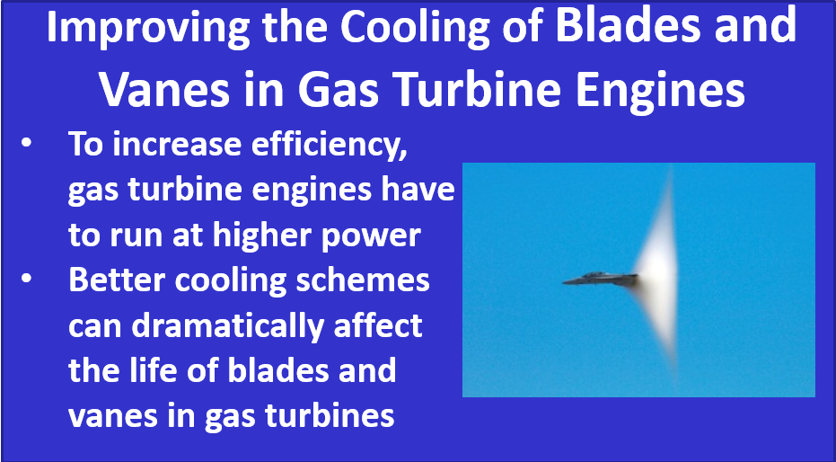
Visual images should inform, explain, or persuade, not merely decorate
Notes:
While a spectacular and captivating photo (of a vapor cloud forming around an F-18 Super Hornet as it approaches the sound barrier), this image has nothing to do with cooling schemes for gas turbine engines. Instead of explaining or amplifying the ideas presented, the photo competes with them.
Anybody going to this talk probably already knows what a jet airplane looks like. All this image does is distract the audience from the information the speaker is trying to convey. Who wants to pay attention to the boring, dense text when they can try to figure out what kind of fighter jet this is and why a vapor cloud is forming around it?
This slide also illustrates a problem with presenting information in bulleted lists. The narrative text all runs together.
© 2025 Board of Trustees of the University of Illinois
All rights Reserved

Slide 34
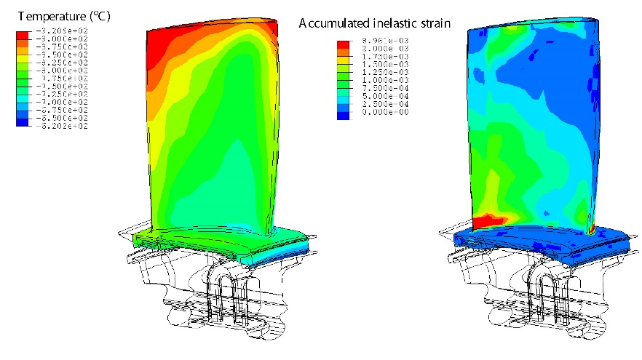
Here’s how I’d change this slide:
Improved cooling increases operating lifetimes of blades and vanes in gas turbine engines
Higher power =
increased efficiency
Higher power =
more heat produced
Better cooling schemes =
increased lifetimes of
blades and vanes
Add a motivating statement to replace the bland “title”
Turn off the bullets for more room
Write short phrases instead of full narrative sentences
Increase the interline spacing for improved readability
Show some data!
Notes:
Here’s how to improve this slide:
Change the centered title to a left-justified statement.
Turn off the bullets, “hanging indent” the text, and add extra space between items to make the text easier to read.
Write short phrases, not full narrative sentences, to make the text easier to read.
Change the interline spacing to make the text more compact, which allows more text per vertical inch and more inter-item spacing. On the “Paragraph” section of the ribbon, click on the down arrow to open the dialog box:
Then change the spacing to “Multiple” and type 0.9 in the box.
© 2025 Board of Trustees of the University of Illinois
All rights Reserved

Slide 35
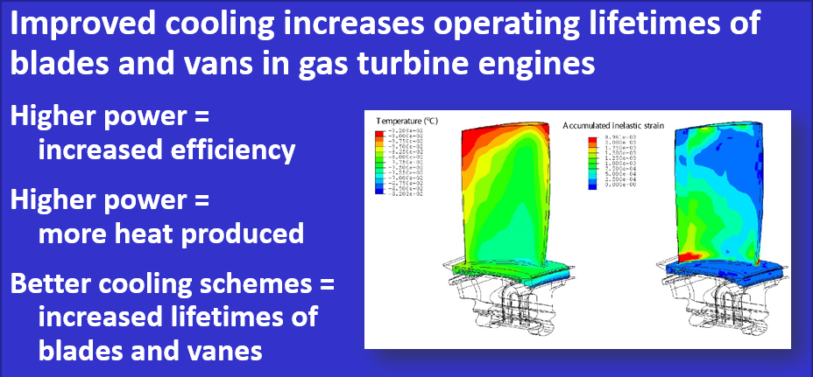
Before
After
Notes:
Here’s the “before” and “after” versions of the slide. Which do you think does a better job of informing, educating, and persuading the audience?
© 2025 Board of Trustees of the University of Illinois
All rights Reserved

Slide 36
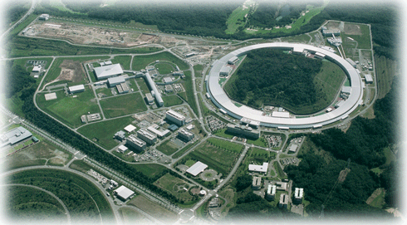
Use manual line breaks so that the text is not interrupted in awkward places
SPring-8: electron storage ring for synchrotron radiation, 8 GeV
LEPS = Laser Electron Photon beam @ SPring-8
Compton back scatter 351 nm Ar (UV) laser photons off electrons
produces 1.5-2.4
GeV photon beam
Avoid big empty spaces, too
Notes:
To make a line break without starting a new item, press Shift+space bar.
Use the “Arrange” command on the “Drawing” toolbar in PPT to arrange text and figures in layers. Right click on the item you want to arrange and then click on the arrow to the left of the “Send to Back” or “Bring to Front” options to arrange layers.
Extra text boxes don’t cost anything. You can use more than one on a slide to maximize your slide real estate.
© 2025 Board of Trustees of the University of Illinois
All rights Reserved

Slide 37
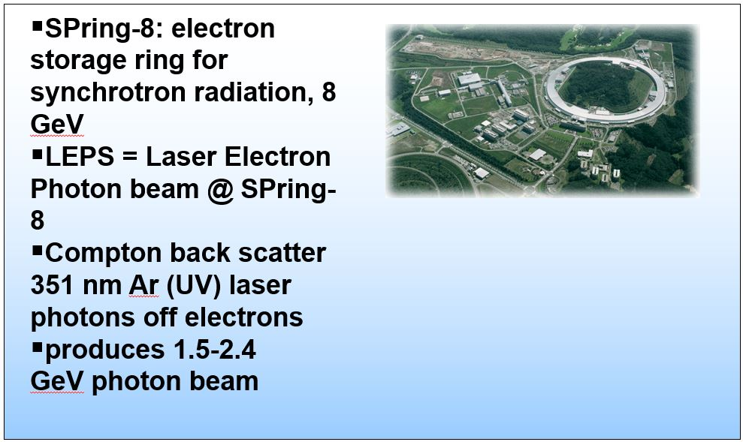
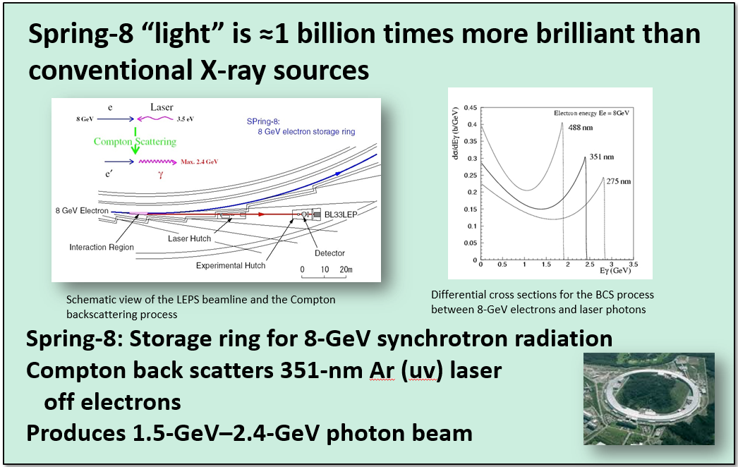
Here’s how to do a slide make-over
Add an informative
title
Show some data!
Position important
info strategically
Maximize your
slide real estate
Use short captions to orient the viewer immediately
Notes:
Here’s how I would improve the previous slide.
Add a motivating statement at the top of the slide.
Make the obligatory aerial photo of the accelerator smaller and stick it at the lower right of the slide.
Turn off the bullets and tighten up the prose to reduce the number of lines of text.
Use the additional space you’ve freed up to show a cartoon of the physical process, a schematic of the beamline, and the energy spectra of the photons, and put those images at the top of the slide to emphasize them.
If you just have to show the mandatory aerial photo of the accelerator, make it smaller, move it off center-stage, and crop to emphasize the ring, not the surrounding countryside. A scale would be really nice, but although I found 48 different aerial photographs of SPring-8 on the Internet, not one showed how big it is. A label superimposed on the photo that shows where LEPS is located on the ring would be a good addition, too.
Some technical-editing changes:
A hyphen is required between 8 and GeV in the first line, 351 and nm in the second line, and 1.5 and GeV and 2.4 and GeV in the last line of text. In every case, the number is combined with the unit to make an adjective that describes the size of the following noun; you indicate that it’s an adjective by hyphenating the two components.
The abbreviation for “ultraviolet” (and infrared) is always written lower case.
Provide both lower and upper units for numbers in a range.
Indicate a range by an en dash, not a hyphen.
Images taken from http://www.rcnp.osaka-u.ac.jp/Divisions/np1-b/lepsbl.html.
© 2025 Board of Trustees of the University of Illinois
All rights Reserved

Slide 38
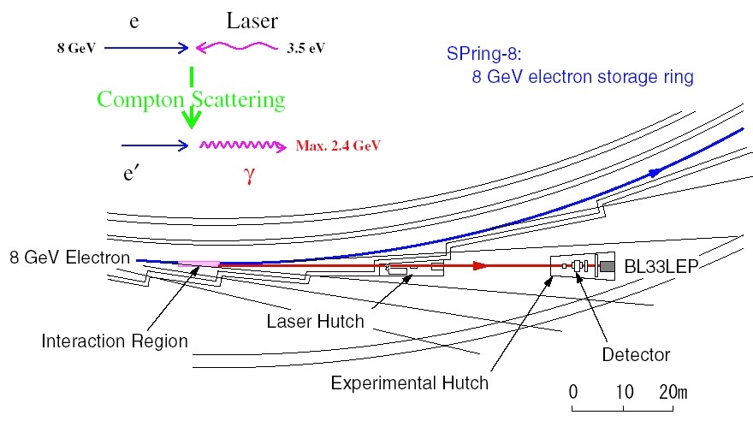
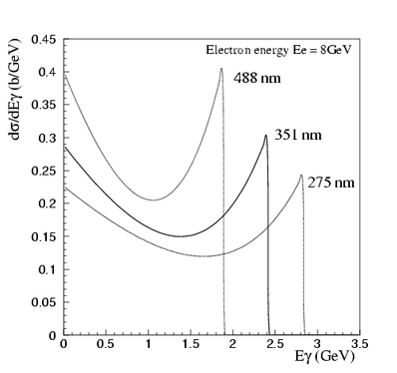

Use PPT animation to control the audience’s attention while you’re speaking
Spring-8 “light” is ≈1 billion times more brilliant than
conventional X-ray sources
Schematic view of the LEPS beamline and the Compton
backscattering process
Differential cross sections for the BCS process
between 8-GeV electrons and laser photons
Spring-8: Storage ring for 8-GeV synchrotron radiation
Compton back scatters 351-nm Ar (uv) laser
off electrons
Produces 1.5-GeV–2.4-GeV photon beam
Notes:
When you present an audience with a complicated slide like this one, they don’t know what to look at first and they try to look at everything instead of listening to you. Control their attention by using animations to present bits of information at a time, synchronized with what you are saying.
Using animations requires practice and rehearsal—we’ve all forgotten about an animation and then were surprised when something popped up when we were expecting that click to bring up the next slide.
Mark up your notes pages to indicate animations so you can keep track of them as you are speaking.
© 2025 Board of Trustees of the University of Illinois
All rights Reserved

Slide 39
Use PPT animation to control the audience’s attention while you’re speaking
Spring-8 “light” is ≈1 billion times more brilliant than
conventional X-ray sources
Spring-8: Storage ring for 8-GeV synchrotron radiation
Compton back scatters 351-nm Ar (uv) laser
off electrons
Produces 1.5-GeV–2.4-GeV photon beam
Notes:
© 2025 Board of Trustees of the University of Illinois
All rights Reserved

Slide 40
Use PPT animation to control the audience’s attention while you’re speaking
Spring-8 “light” is ≈1 billion times more brilliant than
conventional X-ray sources
The Compton backscattering process and schematic view of the LEPS beamline
Differential cross sections for the BCS process
between 8-GeV electrons and laser photons
Spring-8: Storage ring for 8-GeV synchrotron radiation
Compton back scatters 351-nm Ar (uv) laser
off electrons
Produces 1.5-GeV–2.4-GeV photon beam
Notes:
© 2025 Board of Trustees of the University of Illinois
All rights Reserved

Slide 41
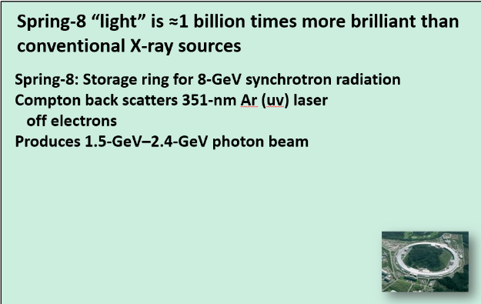
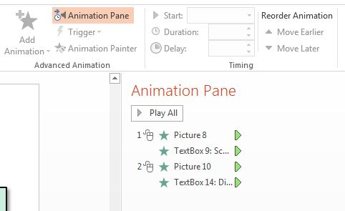
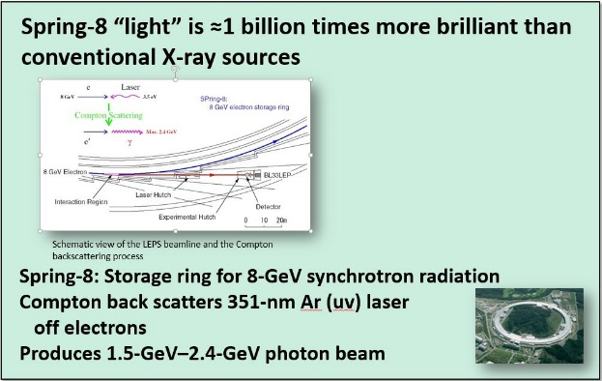
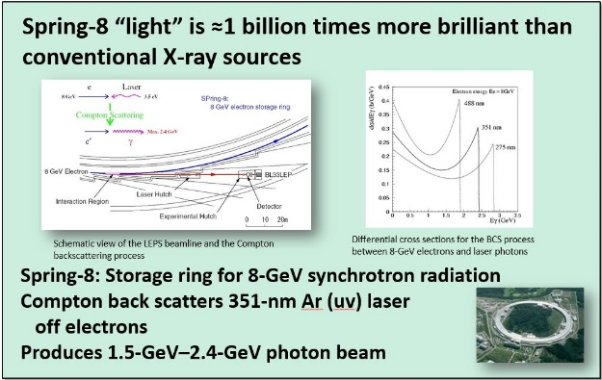
You can “build” slides in one of two ways
Use PPT animation
( learning curve)
Create multiple slides*
*Tip: Use the “Insert Duplicate Slide”
tool for smooth builds
Notes:
The animation tool gives you more control and offers a variety of special effects. However, like anything else, there’s a learning curve associated with it, and you’ll have to invest time to get good at it.
Creating multiple slides is easier—at least initially—and extra slides don’t cost a dime. For best results, do the first, stripped down slide, and then use the “insert duplicate slide” tool to make each subsequent slide. That way, you don’t have slight variations in the position of text and figures (which is distracting and annoying) when you switch from one slide to the next.
On the main toolbar in PPT, click on the “Insert” tab.
When the “Insert” ribbon comes up, click on the down arrow on the “New Slide” icon (first one on the far left), and scroll to the bottom of the menu to “Duplicate Selected Slides” and click on it. (I have no idea why MS uses this language; when you click on that item, PPT inserts a duplicate of the slide you are on—you cannot “select” multiple slides. <sigh>)
© 2025 Board of Trustees of the University of Illinois
All rights Reserved

Slide 42


Never ever put anything on a slide that you do not thoroughly understand
That figure you got from somebody else and added at the last minute…
Notes:
© 2025 Board of Trustees of the University of Illinois
All rights Reserved

Slide 43

…will be all the audience asks questions about
Tip: Don’t put anything on a slide that you don’t explicitly talk about, either!
Notes:
© 2025 Board of Trustees of the University of Illinois
All rights Reserved

Slide 44


Technology presents its own challenges
Seminar and conference rooms are increasingly being outfitted with LCD monitors instead of fluorescent projector screens
Laser pointers don’t work on LCD monitors
oops!
Use the built-in PPT laser pointer (awkward)
Add animated arrows to your slide to point out important features
Notes:
You could point out features with your hand, but the monitors are often mounted on the wall across the room, or behind you, where you cannot easily reach them without really distracting the audience.
Don’t try to use your laser pointer and then say, “Huh! The laser pointer doesn’t work. Wow! Now what do I do? Well, I guess you can see what I mean…”
© 2025 Board of Trustees of the University of Illinois
All rights Reserved

Slide 45
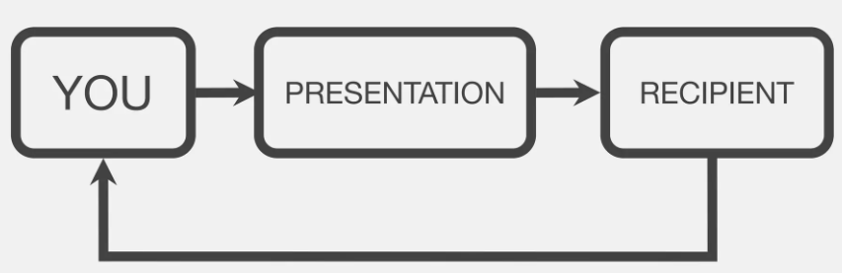
Step 3: PRACTICE out loud
Don’t just flip through your slides; say them out loud
Ask for volunteers to listen and critique your practice sessions
Record yourself on your phone or Zoom so you can observe your talk
FEEDBACK: Get some!
45
Notes:
This slide is a horrible example—do not present slides that look like this at your talk. It has way too much text and zero visual interest. It tells your audience “I might be able to be more boring, but I frankly don’t think it’s worth finding out for the likes of you.”
© 2025 Board of Trustees of the University of Illinois
All rights Reserved

Slide 46

Train yourself to avoid verbal “fillers”
You know, sometimes, like, we really really use some words too much, right? So, um, maybe we can, I don’t know, concentrate on, like, eliminating filler words. Filler words definitely appear in, um, literally all of our sentences when we talk to our, you know, friends. But we really should, like, avoid them in formal, you know, talks.
Notes:
See http://www.cracked.com/article_16335_7-innocent-gestures-that-can-get-you-killed-overseas.html. The examples are quite true, but the language is a bit too vernacular for this straight-laced Midwesterner. Read at your own risk.—cme

Slide 47


Use minimal hand gestures
Distracts the audience if
you’re flapping around
Use a laser pointer,
not your arm
An innocuous gesture in
your culture may
mean something
entirely different
in another culture
Tip: Avoid laser-pointer acrobatics
Notes:
See http://www.cracked.com/article_16335_7-innocent-gestures-that-can-get-you-killed-overseas.html. The examples are quite true, but the language is a bit too vernacular for this straight-laced Midwesterner. Read at your own risk.—cme

Slide 48

If English is not your first language
(and even if it is!)…use the simplest word
Tip: Watch for cues from the audience—if they look confused, slow down, repeat, ask a rhetorical question, solicit a question, explain
Notes:
Do not use jargon unless you explain it (What is SPH, anyway?).
Choose the simplest words—imagine that you are giving a talk in English to people who don’t speak English as a first or even a second language. In physics, you probably are!
If English is not your first language, do not be embarrassed to ask a native speaker to review your presentation and correct your pronunciation.
Practice speaking slowly and distinctly, whatever your first language is.

Slide 49
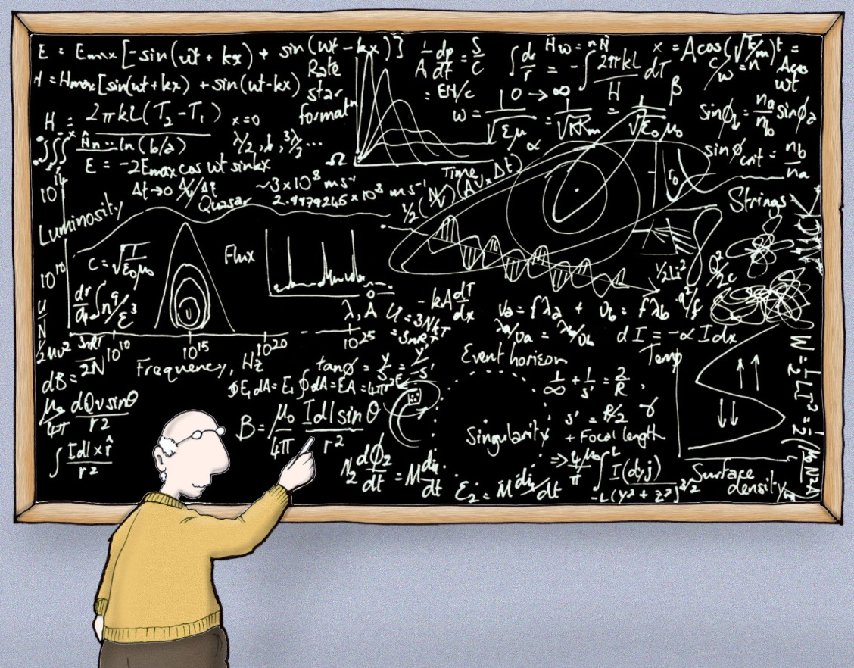
Step 4: CHECK your timing
If you consistently go over your allotted time,
Narrow the scope
of your talk
Cut down the
number of main
points
Eliminate slides
DON’T
compensate by skipping slides or
talking faster
Astrophysics made simple
lab-initio.com
Notes:
This slide is a horrible example—do not present slides that look like this at your talk. It has way too much text and zero visual interest. It tells your audience “I might be able to be more boring, but I frankly don’t think it’s worth finding out for the likes of you.”
© 2025 Board of Trustees of the University of Illinois
All rights Reserved

Slide 50

Before you leave for your talk, email an editable copy of your file to yourself, at an address you can get to from the road
Laptops fail
Thumb drives get lost
Files get corrupted
The person who was
supposed to load your talk on the seminar room’s computer gets sick or forgets
Tip: Print out a hard copy of the “notes” pages and take it along. Note animations on the hard copy.
Notes:
Take along a printed copy of the “notes” pages, too. Use them to rehearse on the plane. Mark where the animations occur.
© 2025 Board of Trustees of the University of Illinois
All rights Reserved

Slide 51
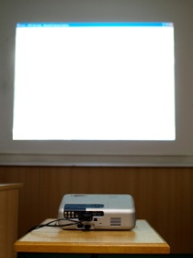
Step 5: On the day of your talk
Check everything
before your talk
If it can go wrong,
it will
Trust me
No Signal
Notes:
Arrive ahead of your appointed time. Don’t dash in at the last minute, panting and out of breath, in your coat, umbrella, galoshes, backpack, juggling a bag of exhibit-hall geegaws.
Check everything before your talk.
Check the projector:
Make sure you know how to turn it on.
See that it is plugged in and accepting the signal from your laptop.
Adjust the focus.
Check microphones, pointer, other tools.
If a clip-on mike is used, make sure it is fastened securely, check the volume, and then leave it alone.
Arrange your slides, notes, and other materials so you can reach everything without fumbling.
If the battery on your laptop dies or the bulb burns out on the LCD projector, can you still give your talk? (Here’s where the hard copy of the notes pages is essential.)
Do not expect the conference organizers to take care of all your needs if you do not tell them what they are ahead of time. Did you request an overhead projector? Slide projector? An adapter for your Mac?
TURN OFF YOUR CELL PHONE!!
© 2025 Board of Trustees of the University of Illinois
All rights Reserved

Slide 52
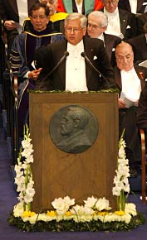
A word about appropriate dress…
Tip: Wear comfortable clothes that present
a neat, professional appearance (and to which you
can attach a lapel microphone and power supply)
Notes:
The day of your talk is not the day to try out your new thong underwear or strapless underwire bra.
Wear comfortable shoes.
Wear a shirt or blouse that you can clip a portable microphone to, so that it is positioned about 5–6 in. below your mouth. Turtlenecks and tee shirts should be avoided, because there’s no good place to clip the microphone where it won’t slip.
Wear slacks or a skirt with a waistband or pockets for the microphone’s power supply.

Slide 53

Handling questions is an essential part of giving a talk
Always repeat the question
What if you don’t know the answer?
If the questioner disagrees, don’t argue
Never insult
the questioner
If the question is off
topic, deflect
Notes:
Always repeat the question (summarize or paraphrase it) before you plunge ahead with your answer. Not everyone may have heard it, and repeating it not only allows the questioner to clarify if you’ve misunderstood, it also gives you a few precious seconds to think about your answer.
If you don’t know the answer, don’t bluff! Simply say, “That’s an excellent question. We haven’t looked at that.” or “I’m not sure; I’ll have to think about that.” It’s okay not to know the answer; it’s not okay to make something up on the fly.
If the questioner disagrees, or wanders too far off-topic, you can always say, “Thank you for sharing these interesting ideas. Let’s talk about this further after the session...”
Resist the temptation to set a questioner straight, particularly if the questioner is ignorant, deluded, or obnoxious. You’ll just look bad. A talk is a forum to share your ideas; it’s not a point-scoring debate.

Slide 54

To recap:
Determine your goal(s) for the talk and analyze your audience
Decide on the major points you want to make
Design your talk to make these points clearly, concisely, and memorably
Select colors and images judiciously—pay attention to slide aesthetics
Rehearse and revise (shorten!)
cmelliot@illinois.edu
http://physics.illinois.edu/people/Celia/
Notes:
Notes and Questions:
© 2025 Board of Trustees of the University of Illinois
All rights Reserved

