Slide 1
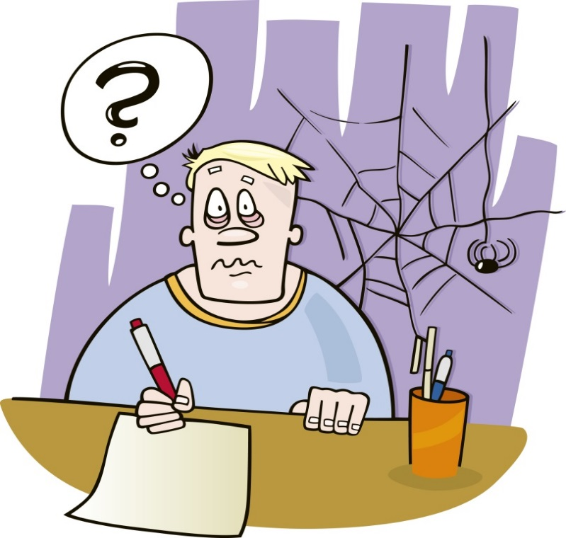

How to Get Started if You Hate to Write
writer’s
block
Part I―Outlining
Celia M. Elliott
Department of Physics
cmelliot@illinois.edu
© 2023 The Board of Trustees of the University of Illinois
All rights reserved.
Notes:
All images used in this talk, unless otherwise identified, are royalty-free and have been purchased from istockphoto.com. http://www.istockphoto.com
© 2023 The Board of Trustees of the University of Illinois
All rights reserved.
How to Get Started if You Hate to Write, Part I
Celia M. Elliott, PHYS 496
02/08/2023

Slide 2

One thing I’ve learned in physics, you have to satisfy both the theorists and the experimentalists…
…so this talk has two parts:
a theory of technical writing
the nuts and bolts of first putting together a scientific paper
1
Notes:
2
© 2023 The Board of Trustees of the University of Illinois
All rights reserved.
In this lecture, I’ll talk mostly about writing papers, but the advice and techniques apply to any form of communication—oral, written, or visual.
How to Get Started if You Hate to Write, Part I
Celia M. Elliott, PHYS 496
02/08/2023

Slide 3
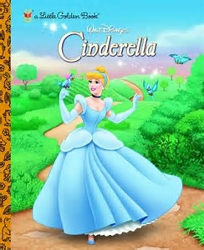

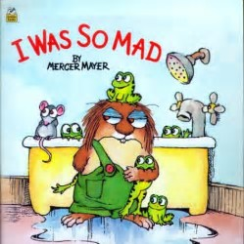

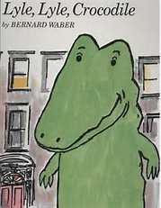
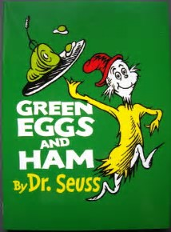
Close your eyes and picture in your mind your favorite childhood storybook
What made it so attractive to you?
2
Notes:
© 2023 Board of Trustees of the University of Illinois
All rights Reserved
02/08/2023
How to Get Started if You Hate to Write,
Celia M. Elliott

Slide 4
I’m going to guess that book had
Words you understood
Interesting, engaging pictures
A simple, direct storyline
Clear connections and transitions
A satisfying ending
Ideas that captured your imagination and expanded your horizons
Guess what!
Nothing has really changed since you were 5.
3
Notes:
Think about what made a good story when you were 5 years old. The same elements that attracted you as a child still work—interesting pictures, words you understand, simple, direct storyline, a logical structure, analogy, an enthusiastic narrator, something that stimulates your imagination and makes you think.
© 2023 Board of Trustees of the University of Illinois
All rights Reserved
02/08/2023
How to Get Started if You Hate to Write, Part I
Celia M. Elliott, PHYS 496

Slide 5
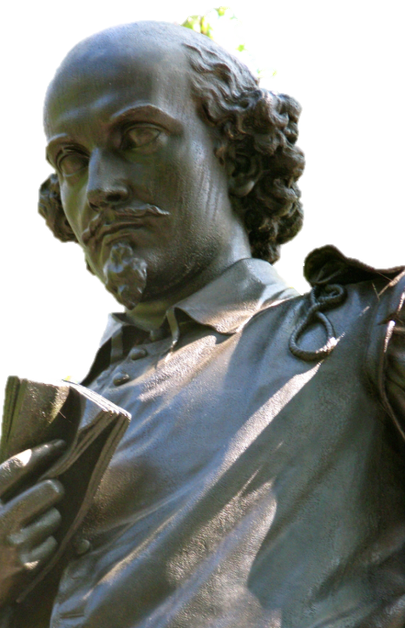
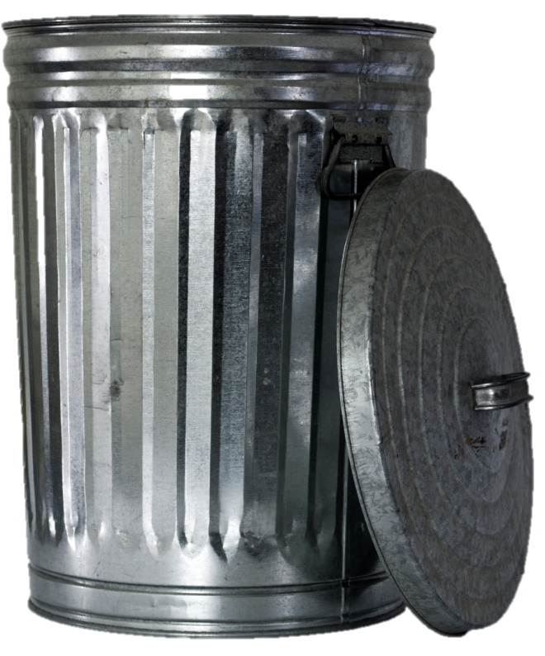

First step, throw out most of what you’ve been taught about “writing”
Scientific writing ain’t Shakespeare
Your purpose is to inform, educate,
and persuade—not to entertain
Write with concrete, quantitative
nouns and strong verbs, not
adjectives and adverbs
Use the simplest word
Write short sentences and
control your modifiers
No literary flourishes
4
Notes:
5
© 2023 The Board of Trustees of the University of Illinois
All rights reserved.
Scientific writing is fundamentally different from other kinds of writing—in tone, in style, in content, in organization.
Good scientific writing is concise, direct, concrete, and unambiguous.
The harder the concepts, the simpler and more transparent the writing should be.
How to Get Started if You Hate to Write, Part I
Celia M. Elliott, PHYS 496
02/08/2023

Slide 6

Technical writing is a craft, not an art
Like any other craft,
you have to learn
the techniques
You have to get feed-
back from experts
The same skills that
make you a good scientist or engineer will
make you a good technical writer
  logic
  precision
  the ability to recognize patterns and sort out what’s important
5
Notes:
Learning to write in the style described here will not only make you a better writer, it will also make you a better scientist. It will force you to see holes in your thinking, areas where you’ve made assumptions, places where you should add references, or data, or further analysis.
6
© 2023 The Board of Trustees of the University of Illinois
All rights reserved.
How to Get Started if You Hate to Write, Part I
Celia M. Elliott, PHYS 496
02/08/2023

Slide 7

Successful science writing is
Written with the reader in mind
Logically constructed—think “linear”
Clearly and succinctly expressed
Precisely and simply worded
Written to inform and
persuade
6
Notes:
The first step in any writing project should be an analysis of the audience for whom the document is intended.
7
© 2023 The Board of Trustees of the University of Illinois
All rights reserved.
How to Get Started if You Hate to Write, Part I
Celia M. Elliott, PHYS 496
02/08/2023

Slide 8

As you are thinking about your writing task, first ask yourself four questions:
What is my purpose in writing this document? What’s my ultimate goal?
Who is going to read it? What do they already know, and what am I going to have to explain? What do they want to get out of this paper?
What one thing do I want the reader to remember? What’s the “take-away” message?
What are my space/time/page constraints?
7
Notes:
© 2023 The Board of Trustees of the University of Illinois
All rights reserved.
At this stage of your writing project, think about what you want to convey to your audience. What are the important points that you want them to understand and remember?
How to Get Started if You Hate to Write, Part I
Celia M. Elliott, PHYS 496
02/08/2023

Slide 9

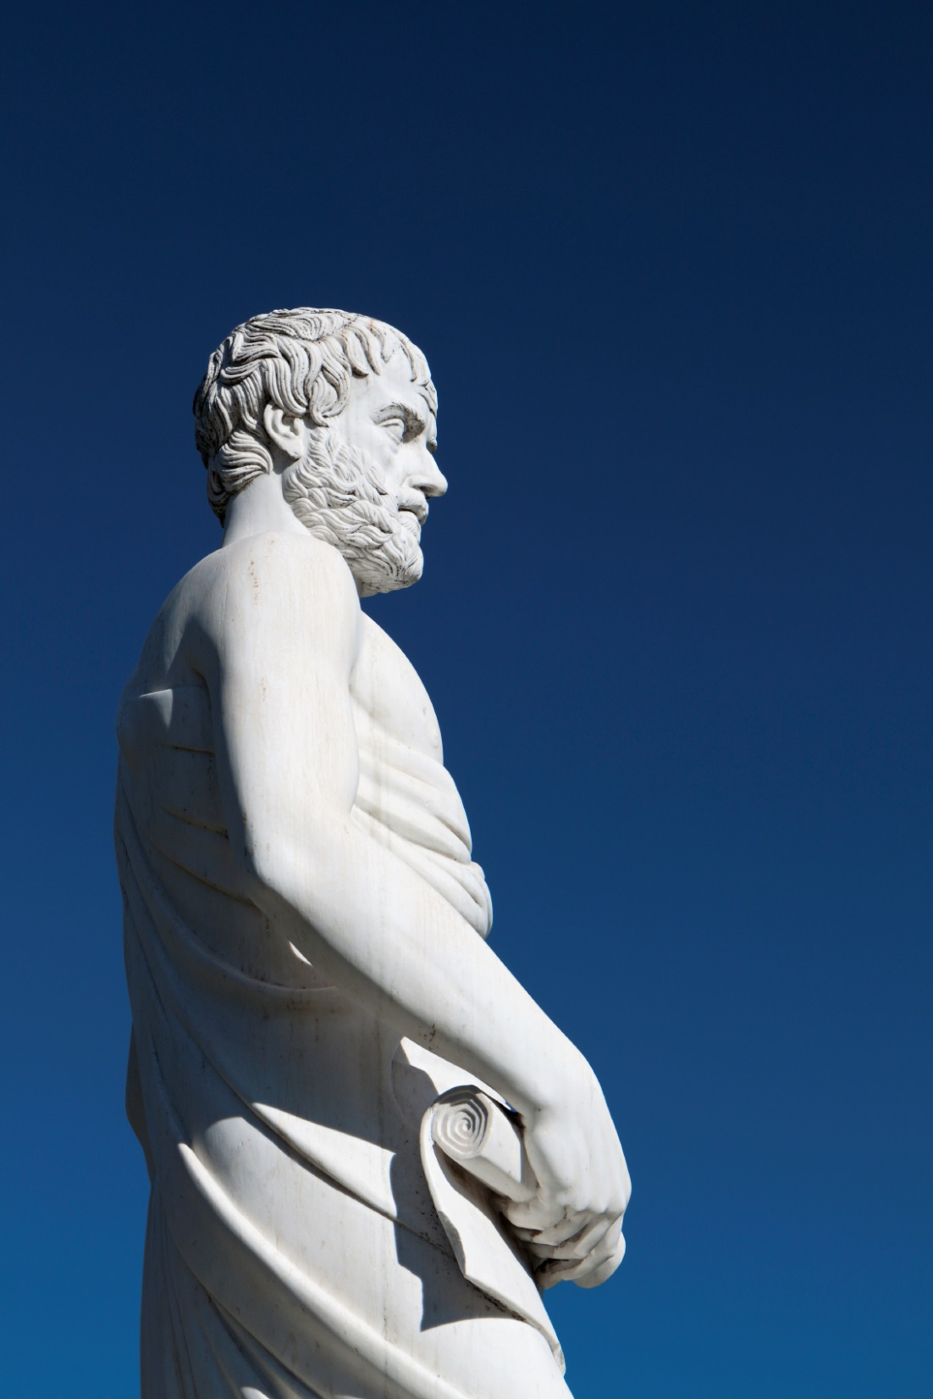
Logic before language! or
Think first, then write
“Logic before language”
Two-way relationship between thinking and writing—feedback loop
λογική πριν
γλώσσα
Careful, deliberate writing assists in developing logical scientific thought
Scientific writing is a process;
good writing evolves as your
thinking matures
Learning to write well will make
you a better physicist
8
Notes:
logikí̱ prin gló̱ssa (loyeekee prin glōssuh)
Too often, scientists think of doing research and writing as discrete tasks that have little to do with one another. Today, I’d like you to think of them as a feedback loop, where progress in one informs and drives progress in the other.
From Peter Woodford: “Somehow the discipline of crystallizing a thought into a grammatical sentence with a beginning, a middle, and an end clarifies, sharpens, and delimits the thought.”
© 2023 The Board of Trustees of the University of Illinois
All rights reserved.
How to Get Started if You Hate to Write, Part I
Celia M. Elliott, PHYS 496
02/08/2023

Slide 10

Novice writers use the
“core dump” method
—inefficient and produces poor results
Always start from a plan—always!
Promotes thinking
Easiest way to get started if you don’t like
to write
Gives you control over length and focus
Increases the logical persuasiveness* and coherence of your final paper (or talk)
*“Persuasion in Technical Communications,”
http://people.physics.illinois.edu/Celia/Persuasion.pdf
9
Notes:
Novice writers often just word-spew and then try to go back and “fix” what they’ve written. It’s inefficient, time-consuming, and usually produces bad results.
© 2023 The Board of Trustees of the University of Illinois
All rights reserved.
How to Get Started if You Hate to Write, Part I
Celia M. Elliott, PHYS 496
02/08/2023

Slide 11
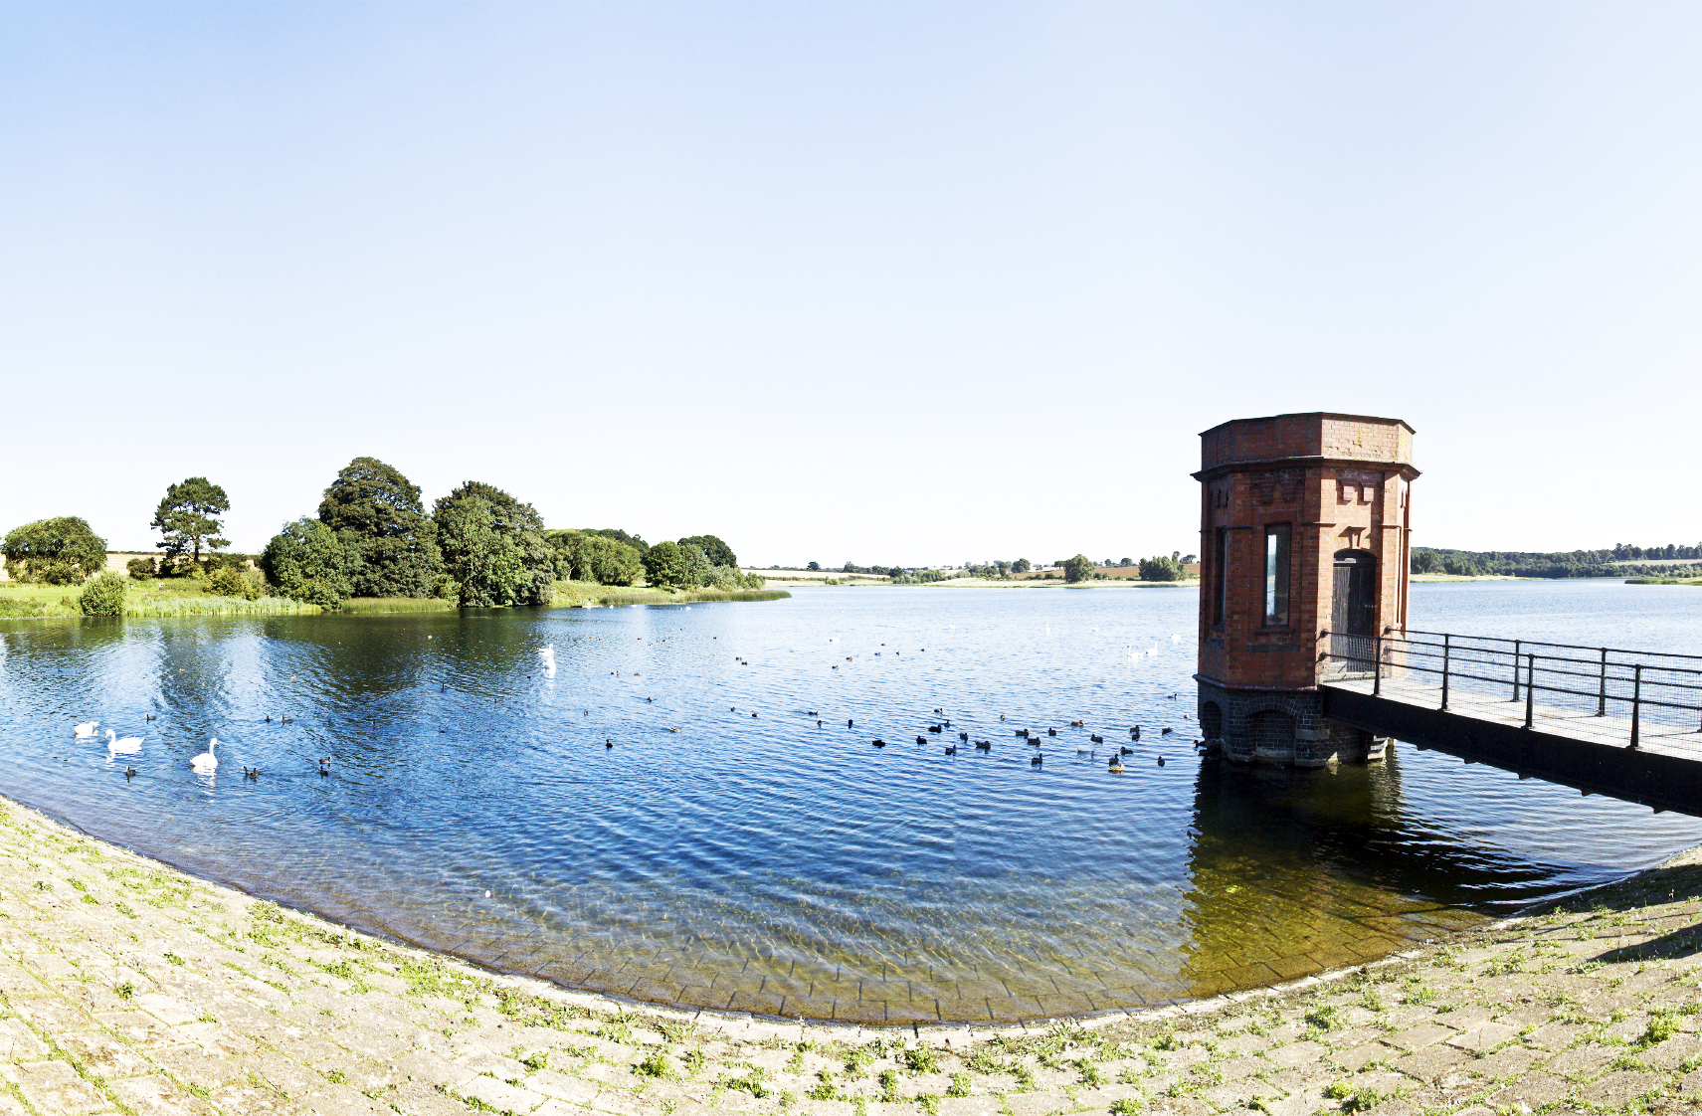
Use the “reservoir” system*
Create separate reservoirs for
Background
Materials & Methods
Results
Discussion
Refs
Concentrate on facts, ideas, images,
logical connections
Add to your reservoirs as you take
and analyze data
Experiment with different reservoir methods
to find what works best for you
10
*Scientific Writing for Graduate Students, ed. F. Peter Woodford (Rockefeller University Press, 1968).
Notes:
The idea of creating separate holding pens for various parts of a technical document was first articulated, as far as I know, by F. Peter Woodford in Scientific Writing for Graduate Students: A CBE Manual (Rockefeller University Press, New York, 1968). Although targeted to graduate students in the life sciences and dated in language (not all scientists are men!), the fundamentals of Woodford’s approach remain sound.
Vernon Booth, a major god in my pantheon (Communicating in Science: Writing a scientific paper and speaking at scientific meetings, 2nd ed. [Cambridge University Press, Cambridge, 1993]) also recommends the use of writing reservoirs.
© 2023 The Board of Trustees of the University of Illinois
All rights reserved.
How to Get Started if You Hate to Write, Part I
Celia M. Elliott, PHYS 496
02/08/2023

Slide 12
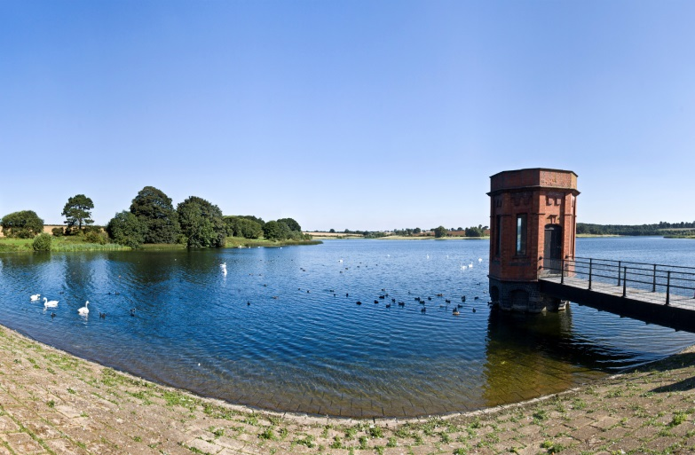
Fill your reservoirs thoughtfully
Is the item really necessary?
To what reservoir does it logically belong?
Content for reservoirs:
Facts, observations, data
Figures and captions
Tables
Analogies
Ideas and speculations
Unanswered questions
Key words
Felicitous phrases
11
Notes:
At this stage, don’t worry too much about niceties of language—concentrate on including essentials, eliminating superfluities, and getting things sorted into the right categories.
© 2023 The Board of Trustees of the University of Illinois
All rights reserved.
How to Get Started if You Hate to Write, Part I
Celia M. Elliott, PHYS 496
02/08/2023

Slide 13


Now you’re ready to start building a coherent narrative
In the next steps,
we’ll take the content of our reservoirs and make a plan to guide the building
of our paper
12
Notes:
© 2023 The Board of Trustees of the University of Illinois
All rights reserved.
How to Get Started if You Hate to Write, Part I
Celia M. Elliott, PHYS 496
02/08/2023

Slide 14

RULE #1: Never write anything without first analyzing your audience
Who is going to read my paper?
What do they already know?
(words, concepts, methods)
What don’t they know that
I will have to explain?
Where might they become confused?
Where can I send them for more information?
What is most important for them to understand?
13
Notes:
Think carefully about who you want to read your paper, and craft your message to engage that reader.
© 2023 The Board of Trustees of the University of Illinois
All rights reserved.
How to Get Started if You Hate to Write, Part I
Celia M. Elliott, PHYS 496
02/08/2023

Slide 15

RULE #2: Tell a good story
Orient the reader with a solid
introduction
Emphasize what is new
Use language that is understandable and
meaningful for your reader
Arrange the narrative so the logic is clear—
use transitional statements to guide your reader
Provide clear, visually interesting, memorable
figures
Provide a strong summary; don’t just trail off at the end
14
Notes:
If the first rule of writing a successful paper is to know your audience, the second rule is tell a good story, in language that your reader will understand.
© 2023 The Board of Trustees of the University of Illinois
All rights reserved.
How to Get Started if You Hate to Write, Part I
Celia M. Elliott, PHYS 496
02/08/2023

Slide 16

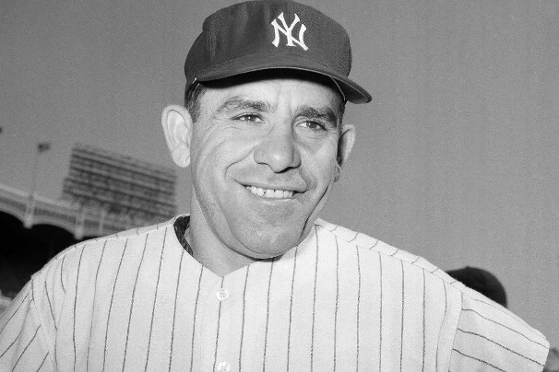
RULE #3: Never write anything without first writing a synopsis and an outline!
“If you don’t know where you are going, you might wind up someplace else.”
—Yogi Berra
Paper written without a synopsis or outline….
15
Notes:
02/08/2023
© 2023 The Board of Trustees of the University of Illinois
All rights reserved.
How to Get Started if You Hate to Write, Part I
Celia M. Elliott, PHYS 496
02/08/2023

Slide 17
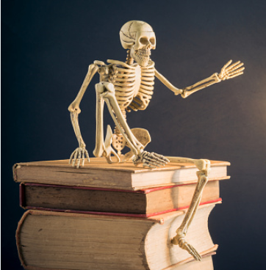
Start out with a five-sentence synopsis
What was the goal?
How does it fit into the
context of prior work?
What method(s) did
you use?
What were your results?
What do they mean?
Answer each question in one coherent sentence
The synopsis is the skeleton that will hold up the rest of your story
16
Notes:
Writing a synopsis is a good way to get started, because it defines the content and scope of your paper.
Note that the synopsis looks a lot like the recipe for an abstract that we looked at last week, but the synopsis serves a different purpose. It is a planning document to guide you as you develop the ideas in the paper. But writing is a process, and your content or emphasis may change as you draft and revise your paper. The abstract must represent the final finished paper.
Think of the synopsis as the skeleton—it gives the whole paper its shape and supports your evidence and arguments.
17
© 2023 The Board of Trustees of the University of Illinois
All rights reserved.
How to Get Started if You Hate to Write, Part I
Celia M. Elliott, PHYS 496
02/08/2023

Slide 18

Next, make an outline to avoid an amateur’s mistakes
Using chronological instead of
analytical order
Devoting the most ink to the parts that took the longest to do
Including superfluous or discursive information
Omitting discussion of assumptions
Failing to provide logical transitions
Each sentence in your synopsis becomes a section
of your outline
17
Notes:
Some beginning authors think that if they spent 90 percent of their time on some aspect of the experiment, they should devote 90 percent of the paper to that topic, or they should present a chronological history of the experiment.
Readers don’t want to know all the things that went wrong, all the components that failed, all the adjustments that had to be made to get the data. They want to know what worked, how it worked, what the results are, and what you think they mean.
Remember, a journal is an archive of your results and how you got them so others can reproduce them, not a cemetery where you bury all your mistakes.
18
© 2023 The Board of Trustees of the University of Illinois
All rights reserved.
How to Get Started if You Hate to Write, Part I
Celia M. Elliott, PHYS 496
02/08/2023

Slide 19
Your outline should accommodate the standard model of physics papers
Background and Introduction
Methods/Procedure
Results
Discussion
Conclusions
Acknowledgments
References
Make outlines for §I. through §V.
18
Notes:
Formal scientific papers are always presented in this order, but they’re not written in this order.
No experienced researcher that I know starts with the title and writes a paper sequentially. Nobody.
Most scientists and engineers usually write papers in the following order:
Methods
Results
Discussion
Conclusions
Background and Introduction
References
Acknowledgments
Abstract & Final Title
You must have an outline to keep a coherent narrative flow as you write the separate sections of a paper.
19
© 2023 The Board of Trustees of the University of Illinois
All rights reserved.
How to Get Started if You Hate to Write, Part I
Celia M. Elliott, PHYS 496
02/08/2023

Slide 20
Writers use two kinds of outlines—
“topic” and “sentence”
Topic outlines use short phrases
  CO₂ underground storage—motivation
  Advantages of deep saline formations
  Convection could provide “stirring”
  Boycott effect
A topic outline is a good way to get started, but it may not be detailed enough for science writing
19
Notes:
An outline is a tool that enables you to look systematically at how a paper or presentation is organized. Learning to write from an outline is one of the easiest ways to (1) get started and (2) improve the content and coherence of your scientific writing.
Today, we’ll look at how to use outlines to get started on any writing project.
A topic outline consists of short phrases. Here’s an example of a topic outline for a paper on carbon sequestration in deep saline geological formations.
A topic outline may be best for organizing a number of issues or ideas that could be presented in a several different ways, where the order of presentation is not important. Unfortunately, that is not typically the case for science papers.
20
© 2023 The Board of Trustees of the University of Illinois
All rights reserved.
How to Get Started if You Hate to Write, Part I
Celia M. Elliott, PHYS 496
02/08/2023

Slide 21
Writers use two kinds of outlines—
“topic” and “sentence”
Topic outlines use short phrases
  CO₂ underground storage—motivation
  Advantages of deep saline formations
  Convection could provide “stirring”
  Boycott effect
Sentence outlines use full sentences (duh!)
  Deep saline aquifers (DSAs) are underground salt-water reservoirs capped by impermeable rocks.
  DSAs offer large storage capacity for carbon capture and sequestration.
  Sequestered CO₂ rises and forms a separate layer that restricts dissolution.
20
Notes:
Today we’ll look at the sentence outline, which is better suited for papers (and talks) that require complex information to be presented in strict logical order.
Topic outlines are fast and easy to write. You might find it helpful to sketch out a topic outline first and then expand it into a full-sentence outline.
Many of the ideas about full-sentence outlining are taken from a course given by Ohio Eminent Scholar and Professor of Physics at The Ohio State University, John W. Wilkins (who is also a Physics Illinois alumnus). His trenchant thinking and incisive writing on communicating in physics are gratefully acknowledged.
21
© 2023 The Board of Trustees of the University of Illinois
All rights reserved.
How to Get Started if You Hate to Write, Part I
Celia M. Elliott, PHYS 496
02/08/2023

Slide 22
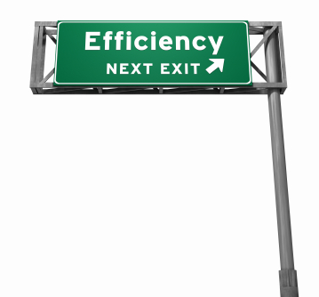
Practice full-sentence outlining
Improved clarity
Improved logical argument
Improved cohesiveness; better transitions
Improved conciseness
Improved control of length
Improved writing efficiency
Improved reader experience
This slide is an example of a “topic” outline—the order that the points are presented in doesn’t really matter
21
Notes:
Writing a sentence outline will help you as a writer in a variety of ways:
Your writing will be clearer and more direct. It’s unlikely that you’ll write a cogent paragraph until you can write a sentence that plainly articulates the point of that paragraph.
Your arguments will be stronger. A sentence outline shows you the narrative flow of the paper. Are your ideas arranged in the most logical, persuasive way to lead the reader to the conclusions you want him or her to reach? It’s much easier to move sentences around as you are planning a paper than it is whole pages.
Your paper will be more cohesive, because you’ll be more aware of where transitions are needed to move the reader from one idea to the next.
Your writing will be more concise. A sentence outline will help you spot superfluous material that stands in the way of a straightforward narrative.
You will get a better idea of the size and scope of your final paper. The length of proposals, journal articles, and conference papers is usually strictly limited. A sentence outline makes it easier to estimate what the final length of your document will be and allows you to make any needed adjustments earlier in the writing process. It’s agonizing to make major cuts after you’ve already gotten something written, and you’ll avoid the temptation of leaving digressions in your paper because of pride of authorship.
You will ultimately save time. The investment in planning and getting organized now will pay off in an easier-to-write, coherent, clear final document.
Your colleagues will eagerly look forward to hearing your next talk or reading your next paper. Your reviewers will expedite your publications. Funders will shower you with $$$. (Okay, maybe not #3...).
© 2023 The Board of Trustees of the University of Illinois
All rights reserved.
How to Get Started if You Hate to Write, Part I
Celia M. Elliott, PHYS 496
02/08/2023

Slide 23
Tips for writing a sentence outline
Make your sentences as specific and quantitative as possible.
If you have two closely related sentences, combine, differentiate, or eliminate one.
Make a logic map of your sentences; can you show a linear progression of your ideas?
Devise a method that makes it easier to move sentences around and “see” the overall structure of the paper.
This slide is an example of a “sentence” outline—use it for writing projects (papers, proposals, talks) where it’s important to show a logical progression of your ideas
22
Notes:
Make your sentences as specific as possible. The purpose of the sentence outline is to help you spot missing or superfluous material. If your sentences are vague and general, you’ll lose the main advantage of sentence outlining.
If you have two sentences that say about the same thing, eliminate one of them, combine them, or differentiate them.
Ideally in science writing, the narrative should flow logically and incrementally from Point A to Point B to Point C to the conclusions. If your outline does not reveal a logical progression of ideas, move things around until it does.
A word processing document that displays only part of your outline at a time may not be the best way to get an overall look at your paper. Experiment with other methods—index cards dealt out on a big table, Post-It notes stuck on a wall—use your imagination.
© 2023 The Board of Trustees of the University of Illinois
All rights reserved.
How to Get Started if You Hate to Write, Part I
Celia M. Elliott, PHYS 496
02/08/2023

Slide 24
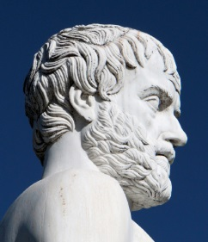

Commit to writing incrementally
Think “feedback loop”
Write in increments:
Construct a preliminary outline, based on your initial goals for the project
Write portions of the “results” and “discussion” sections while you’re taking and analyzing data
Add to your references as you go
Make your figures and tables early
Advantages:
More complete, persuasive paper
Finished result faster, giving you
more time to edit and polish
23
Notes:
Commit to writing incrementally; writing should be an integral part of your research work—remember “feedback loop.”
Advantages of the incremental method:
You may discover additional data that are needed while the equipment is still set up and the project ongoing.
You get a finished paper faster, with more time to revise and edit.
H.B. Michaelson, How to Write and Publish Engineering Reports and Papers (Oryx Press, Phoenix, 1990).
24
© 2023 The Board of Trustees of the University of Illinois
All rights reserved.
How to Get Started if You Hate to Write, Part I
Celia M. Elliott, PHYS 496
02/08/2023

Slide 25

Expect to rewrite—many times
24
Notes:
The probability that a first draft will not require revision asymptotically approaches 0.
“Perfection is achieved, not when there is nothing left to add, but when there is nothing left to take away.”
—Antoine-Marie-Roger de Saint-Exupery
Brevity is a key goal. Use your revisions to clarify and simplify.
Give yourself adequate time to reflect and rewrite.
Writing well is a learned skill—train yourself to recognize good writing; emulate good examples, and practice, practice, practice.
© 2023 The Board of Trustees of the University of Illinois
All rights reserved.
How to Get Started if You Hate to Write, Part I
Celia M. Elliott, PHYS 496
02/08/2023

Slide 26



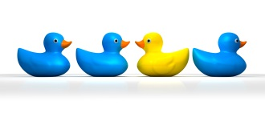
To recap...
Think
Plan
Write
Think first
Analyze your audience and know your purpose
Commit to writing incrementally—start filling
your reservoirs while you’re still taking data
Make an outline and use it
Writing well is a learned skill!
cmelliot@illinois.edu
http://physics.illinois.edu/people/Celia/
Notes:
NOTES:
© 2023 The Board of Trustees of the University of Illinois
All rights reserved.
How to Get Started if You Hate to Write, Part I
Celia M. Elliott, PHYS 496
02/08/2023

