Slide 1
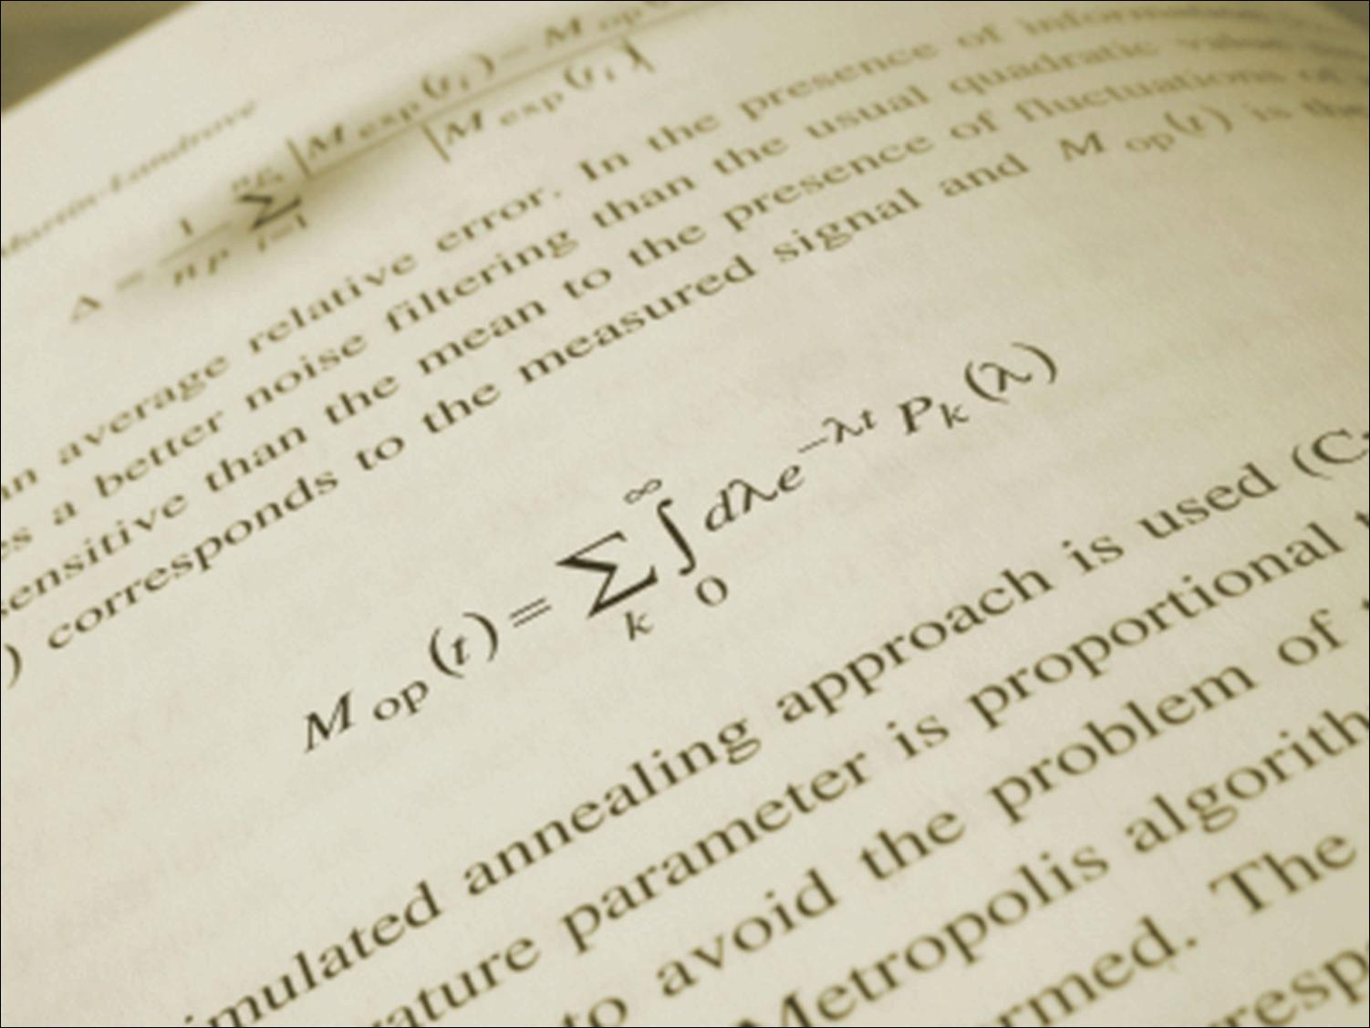

How to Read a Physics Paper—The Four i’s +1
Celia M. Elliott and Brian DeMarco
Department of Physics
University of Illinois at Urbana-Champaign
with thanks to Igor Roshchin, Texas A&M, who first gave me the idea,
and Lance Cooper, Laura Greene, and Kevin Pitts, U. Illinois
© 2023 The Board of Trustees of the University of Illinois
All Rights Reserved.
Notes:
In this talk, we’ll look at how scientists read journal articles—which generally is not to begin at the beginning and read every word through to the end. We’ll consider why this unconventional reading style is advantageous and how you can use it to identify papers that are worth the time and effort to read thoroughly.
1

Slide 2
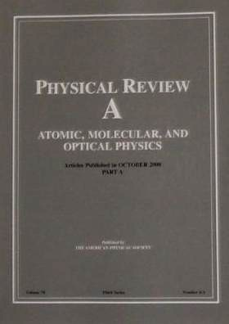
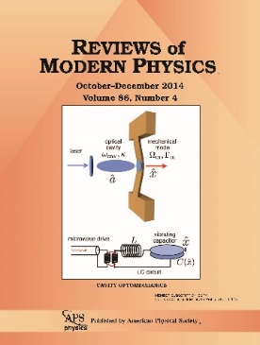
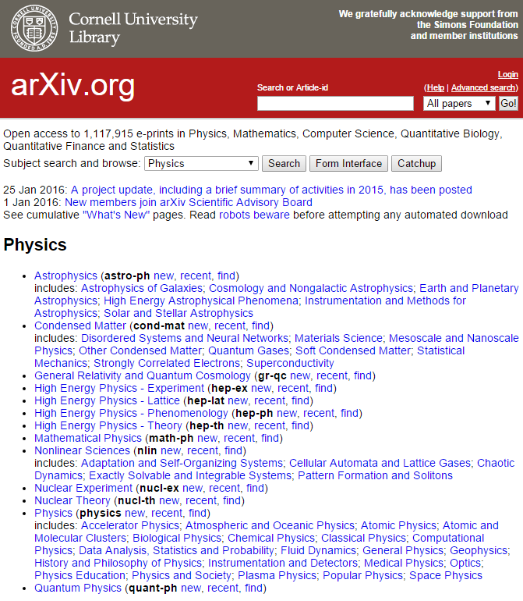
Why read papers, and what kind?
Peer-reviewed papers are the primary means of communication in physics
Three broad categories:
  High profile (first time) results
  Detailed methods & results
  Review: synthesis by expert(s)
Preprints (not peer reviewed)
  Most current research
  arXiv
  ChemRxiv
  OSF Preprints (all disciplines)
  ESS Open Archive (earth & space)
Notes:
Earth & Space Science Open Archive—American Geophysical Union; also contains posters presented at major meetings

Slide 3
How do you decide on what to read?
Learn about a new development in your area:
  Focus on results in PRL or PRA (BCDE)- like journals
  New formalism or methods are in methods & formalisms (or in the supplement)

Slide 4
How do you decide on what to read?
Learn about a new development in your area:
  Focus on results in PRL or PRA (BCDE)- like journals
  New formalism or methods are in methods & formalisms (or in the supplement)
Learn something new (physics is interconnected):
  Start with review papers, books, and theses
  First focus on broad understanding
  Then pick up on details concerning the physics,
  methods, and results!

Slide 5
A screening and reading method
The four i’s (+1)
Importance
Iteration
Interpretation
Integration

Slide 6
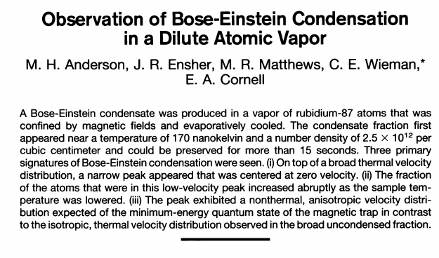
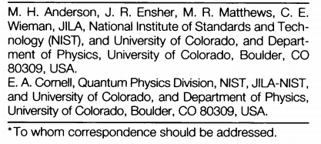
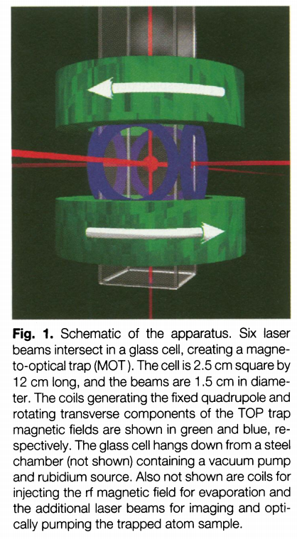
The first i: importance
Does the paper contain information (methods, results, conclusions) that has implications for your research?
  Read the title and the abstract
  Look at the author list and their
  affiliations
  Read the conclusions
  Look at the figures and captions
  Look at the references
Is the paper worth reading? Study or go on?
Notes:
Scientists are busy, and far more papers are published every year than anyone could reasonably be expected to read.
The first step is to determine whether a paper is worth your time, i.e., determine its importance to your research.
Note that your purpose for reading a paper (and hence your focus) may vary from paper to paper. In some cases, you’ll want to concentrate on the methods or techniques described, to determine if they could be adapted for your project, and you won’t care about the authors’ specific results or conclusions.
Looking to see who wrote the paper is an important data point, but certainly not the only one. If someone whose affiliation is in a department of industrial engineering has written a paper announcing some world-shattering discovery in quantum measurement theory, you would rightly treat that paper with more skepticism than a paper written by Tony Leggett. However, young people and new people make important discoveries all the time, and some very good work is done in what might be considered unexpected places (e.g., Ernst Ising [Ising model] spent his whole career in the United States [after fleeing Nazi Germany] at Bradley University in Peoria, Illinois).

Slide 7
Second i: iterate
Skim the article and identify its structure
Many (not all) physics papers:
Introduction, Methods (brief), Results, Discussion, sometimes Methods (again)
Conclusions, References
2. Find main points of each section
3. Generate questions: active reading
Read to answer those questions
Iterate!
Turn on your skepticism filter and take notes as you read!

Slide 8
Second i: iterate (continued)
Take the paper apart, section by section, and identify the key ideas
Highlight anything you don’t understand
Cross-check the narrative with the figures and
tables
Go back and re-read your highlighted sections;
refer to the references or supplementary info
Repeat until you thoroughly understand the
parts of interest to you
Notes:
Don’t get bogged down in your initial reading. Make a note of something you don’t understand (underline it, highlight it, put a ☹ or a  in the margin next to it), but keep reading.

Slide 9
The third i: interpret
Put the paper aside and write down the key
ideas in your own words
Check what you’ve written against the paper;
have you correctly represented the information
and emphasis of the original paper?
Are there parts that you still don’t understand?
(go back to iteration)
Do you agree with what the authors have said?
Have they provided sufficient detail and
supporting evidence? (Again: turn on your skepticism filter)

Slide 10
The final i: integrate
Evaluate how the information presented in the
paper fits with what you already know
Does it contradict something that you believe?
Does it raise new questions that you should
investigate?
Does it describe a method that you could use?
Is it something that you should refer to in the
future? (If so, how are you going to keep track of it?)
The four i’s of mindful reading

Slide 11
+1: Storing information for future access
Devise a system to keep track of what you read
Store pdfs of important papers on your computer,
(i.e., create your own library)
Categorize the papers in some sensible way
Name papers in a way that can jog your memory
Many software solutions are available
(https://en.Wikipedia.org/wiki/Comparison_of_reference_management_software)
Popular choices (some supported by the Library)
Mendeley, Zotero, RefWorks, EndNote
Consult your adviser and senior students in
your group and get their recommendations
Notes:
In addition to entering the bibliographic information for a paper in your citation manager, think about keeping a separate “reading” notebook, where you keep additional notes/questions/observations about the paper. Then in the citation manager, record the notebook number and page number where you have additional notes about the content of the paper.

Slide 12

Now for the practical bits...

Slide 13
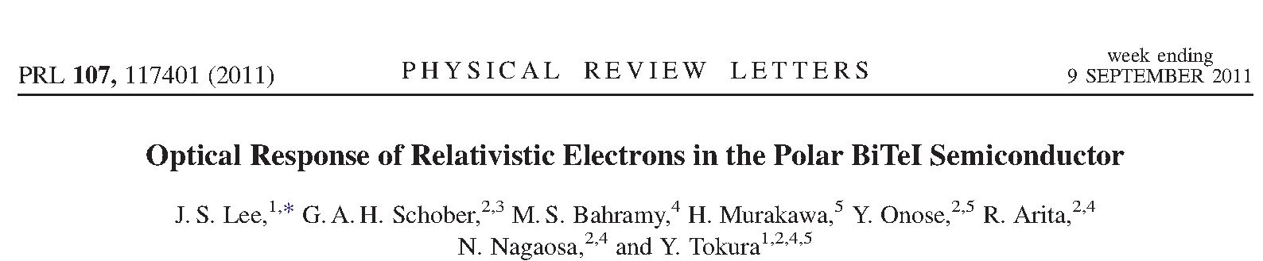
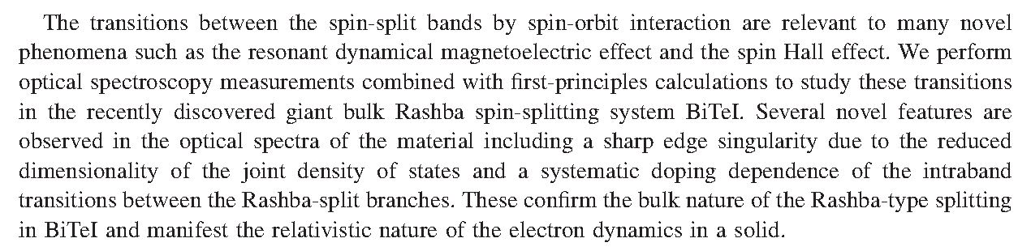
Here’s one way to deconstruct a paper
Read the abstract and write down the main
ideas you think the paper will present
Notes:
BiTeI bismuth tellurium iodide

Slide 14
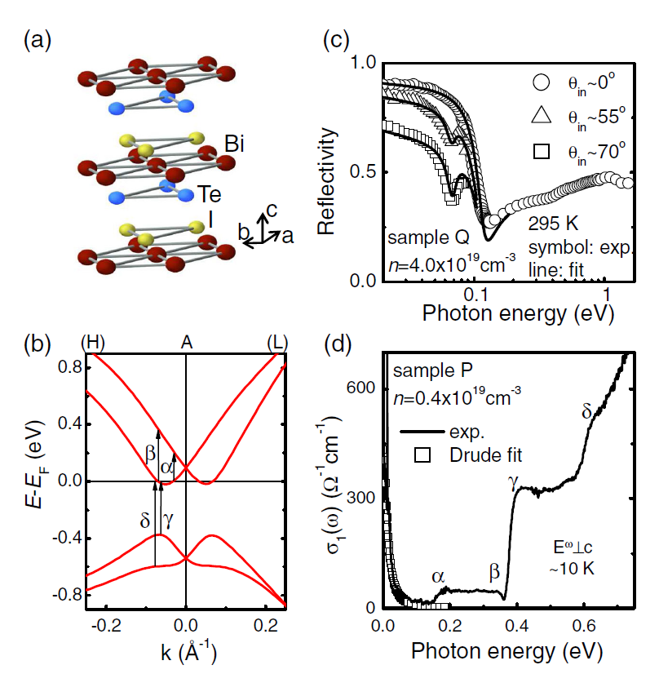
Next, look at the figures and tables
Write down a one-sentence description of each
Crystal structure of BiTeI; red is Bi, blue is Te, and yellow is I.
Band dispersion points in the H and L directions; possible optical transitions indicated by arrows with an index of α, β, γ, and δ.
Reflectivity spectra were taken for one sample (Q) at different incident angles, as shown by variations in photon energy (eV).
Optical conductivity spectra were obtained by polarizing light directed normal to the c axis (solid line) and compared with a theoretical curve (open squares) based on the Drude model.
J.S. Lee et al., Phys. Rev. Lett. 107, 117401 (2011).
Notes:
Writing down a description of the figure will make you really look at the figure and understand it. Make a note of any questions you have about the figure.

Slide 15
Next, read the first sentence of each paragraph
Highlight any sentences that you don’t
understand
Look at the sentences. Can you see a logical
progression of ideas?
Summarize the logical argument in a short
paragraph
Notes:
In scientific writing, the first sentence in a paragraph is (should be) the topic sentence of that paragraph. Additional sentences in the paragraph should explain, amplify, give evidence for, add examples or counterevidence for, and summarize the first sentence.

Slide 16
Go back to any sentences you highlighted
Study the corresponding paragraph—does it
answer your questions?
If you still don’t understand the sentence you
highlighted, devise a strategy to figure out
what it means
Look up key words
Find a review article on the topic
Check the references
Check for supplementary material
Google the author’s name to see if she
has a research website

Slide 17
Read the conclusions section
Have the authors supported their conclusions?
How do their conclusions fit in with what you
already know?
Is there anything you don’t agree with?
Is there anything that you still don’t understand?
How can you resolve the issues?

Slide 18
Figure out a way to keep track of this paper
Enter the bibliographic information into your
citation manager
In your notes, clearly differentiate direct quotes
from the paper and what you’ve paraphrased
Important: Develop your own method to deconstruct papers

Slide 19
To recap:
Importance—first determine if the paper is
worth reading
Iterate—go back over sections of the paper
until you understand it; consult other sources
if necessary
Interpret—summarize the main points in
your own words
Integrate—synthesize the ideas with what
you already know and believe
Investigate a citation management system to
keep track of what you read
Notes:
Notes:

Slide 20
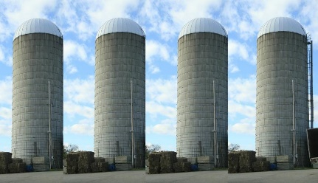


Final words:
Pro tip: Scan the arXiv each week via RSS feed!
Physics ideas are interconnected—
intentionally break out of you silo periodically and read something different
Strive for mindful reading; not a
linear process, takes practice
cmelliot@illinois.edu

