Slide 1


Writing Referee Reports
Celia M. Elliott
Department of Physics
University of Illinois
cmelliot@illinois.edu
2024 © The Board of Trustees of the University of Illinois
All rights reserved.
Notes:
Referees, who are generally unpaid volunteers, play an essential role in the scientific enterprise. It is part of every scientist’s obligation to the community to serve as a referee if requested, to the extent that his or her expertise allows.
Today we’ll look at the various duties and responsibilities of referees and how to write referee reports.
The terms “referee” and “reviewer” are used interchangeably in US English to mean an expert who provides an objective opinion about the scientific and technical merit of a paper, nomination, or application.
Training by George Miley and useful discussions with David Hertzog and Lance Cooper are gratefully acknowledged.
An excellent resource for novice referees is “Introduction to refereeing,” IOP Publishing, http://images.iop.org/referees/.

Slide 2
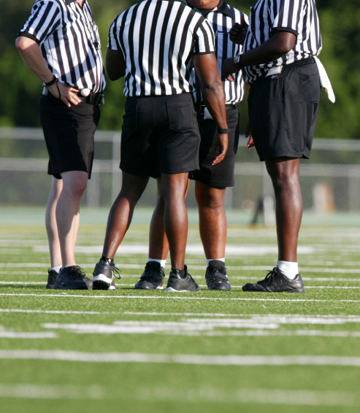
What does a referee do for science?
Safeguards the integrity of the archival literature
Ensures $$ invested in research are spent wisely
Ensures that people are rewarded on the merits of their work
Notes:
Today we’re going to focus specifically on reviewing scientific articles. But referees also evaluate proposals for funding agencies and nominations for prizes and awards. They evaluate the suitability of candidates for jobs and for promotion and tenure.

Slide 3
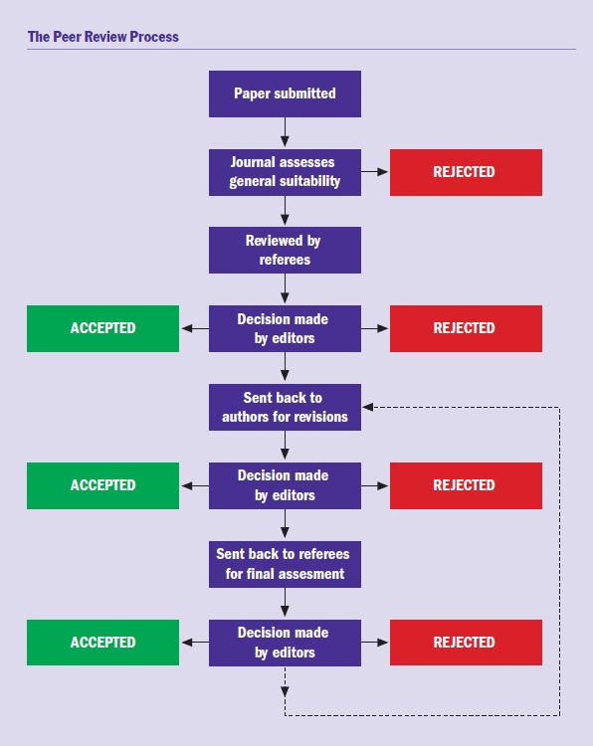
Referees evaluate scientific articles before they are published
Ensures only credible, high-quality research is published
Improves the quality of published papers
Ensures papers are published in appropriate journals
IOP Publishing
http://images.iop.org/referees/
Notes:
Journal editors generally have established criteria for the suitability of publications in their journals.
These criteria vary from journal to journal and generally depend on the nature of the journal’s readership.
The job of the referee is to provide an objective, expert opinion on whether the submitted paper satisfies the stated criteria of the journal. The reviewer must thus understand not only the scientific methods and results presented in the paper, he or she must also understand the aims, scope, and general readership of the journal.
Most journals will provide very specific instructions to referees about the criteria that are to be applied when evaluating a manuscript for publication.

Slide 4

You should have three objectives in refereeing a paper
“Protecting the cathedral by testing the brick” (paraphrase of Max Delbrück, Nobel Laureate, 1969)
Helping the authors produce a better paper (clearer, more persuasive, more concise, more logical, better referenced)
Maintaining your objectivity and professional ethics

Slide 5
Questions to ask yourself before you agree to be a referee
Do I have the necessary expertise?
Do I have a conflict of interest?
Can I be objective and offer constructive criticism?
Can I refrain from taking advantage?
Can I provide a timely review? (Can I meet the journal’s deadline?)
Can I preserve the anonymity of review?
Notes:
To provide an adequate review, you must be sufficiently familiar with the research topic to adequately assess the originality of the research, the quality of the work, the validity of the results and conclusions, and the significance and impact of the work being presented. If you do not have the necessary expertise, you should immediately notify the editor that you cannot review the paper because it is outside your area. You can suggest the names of other scientists who might be better suited to review, but you may not forward the manuscript to someone else to review.
If you have a prior relationship with one of the authors or if you are in direct competition with one of them, you should immediately tell the editor that you have a conflict of interest, disclose the nature of the conflict, and let the editor decide if you should review.
If you have pre-existing opinions about an author that would affect your objectivity—either positively or negatively—you should recuse yourself from review.
One benefit to referees for performing this service is they learn about innovative new work before it is published. However, it is a breach of ethics to use information obtained in the review process for your own personal benefit.
Can you realistically do an adequate review in the time the editor has suggested? If you cannot, either ask the editor if you can have more time or decline the review. It is not fair to the authors either to take an unreasonable amount of time to do the review or to provide a hasty, superficial, ill-considered review.
It is an absolute obligation of a referee to preserve the anonymity of review. Under no circumstances should a referee contact the authors or disclose that he or she was a referee. If you have a question for the authors, send it to them via the editor.

Slide 6
Reviewing vs. reading a paper
As a reader, you are more likely to presume the details presented in the paper are true and correct (experts have already signed off on it)
As a referee, you have an obligation to carefully evaluate
the “truth” of what is being presented
the originality and significance of the work
the suitability of the methods used
the validity of the results
the persuasiveness of the conclusions
Notes:
Referees must be more skeptical than readers. The referee is the first defense against the proliferation of bad science and the wasting of people’s time and funders’ money.

Slide 7
Questions to ask yourself as you’re reading
Does the title reflect the contents?
Are the figures and tables clear and informative? Are additional figures or tables needed?
Is any superfluous material included that should be removed or moved to an appendix?
Is the conclusions section adequate?
Is the ms. free of typos and grammatical errors?
Is the English understandable?
Is conventional nomenclature and notation observed?
Notes:
While it is helpful to mark obvious spelling and grammatical errors for the authors, your job is to be a referee and assess the quality of the research, not to be a copy editor and correct every comma. However, do point out language that is imprecise, ambiguous, or misleading.
If the English is so poor that you cannot understand what the authors are trying to convey, you are not obliged to struggle to parse or “translate” every sentence. Simply return the ms. to the editor with the notation that you are unable to review it because the English is sufficiently incomprehensible that you cannot evaluate the paper.

Slide 8
Essentials of a good referee report
Summarizes the main points
Provides an evaluation on each criterion identified by the journal
Gives a specific recommendation for or against publication
Lists specific mandatory and suggested changes to the paper
Highlights both the paper’s strengths and weaknesses
Provides examples and gives reasons
Notes:
Begin your review with a summary of the most important points in the paper to 1) show that you’ve actually read the paper, and 2) help the editors understand it.
Next, go down the list of review criteria provided by the journal and address each point; state how well the paper meets each criterion.
At some point in the review, explicitly state your recommendation for or against publication. Put the recommendation at the beginning or the end of the report and highlight it so the editor can see it immediately. Common recommendations are:
Accept paper for publication as written.
Publish after the authors have considered optional suggestions (and provide the editor with those suggestions).
Publish after the authors have made mandatory corrections (and specify what those corrections are).
Reject the paper.
If you make suggestions for how the paper could be improved, be sure to tell the editor whether the suggested changes are optional or mandatory.
If you want to re-review any revisions to the ms. before it is published, so state in your report.

Slide 9
“Review unto others…”*
Do not personally criticize the authors; focus on improving the paper, not straightening out the researchers
Do not make statements or claims without providing examples, explanations and evidence
Strive for the highest standards of objectivity and honesty
Do not use information obtained through review for personal benefit
*Professor Lance Cooper’s “Golden Rule for Referees”
Notes:
Your report should be written constructively, in a collegial tone, to benefit the understanding of both the authors and the editors.
In a positive, respectful, constructive way, point out experimental problems, flaws in the authors’ arguments, or alternative interpretations not proposed by the authors.
Provide appropriate references if inadequate credit is given to previous work.
Excellent resource for novice referees: “Introduction to refereeing,” IOP Publishing, http://images.iop.org/referees/.

Slide 10

Your assignment:
Prepare referee reports for the article you have been assigned
Address your comments to the “editor”
Use the posted rubric for evaluating the article
Back up your criticisms with examples
Make specific suggestions for how the article could be improved
Make a specific recommendation for or against publication and give your reasons
Submit your report by October 18
cmelliot@illinois.edu
http://physics.illinois.edu/people/Celia/
Notes:
NOTES:

