Slide 1


Revising Technical Manuscripts
Celia M. Elliott
University of Illinois
cmelliot@illinois.edu
With thanks to the fabulous Physics faculty at the University of Illinois
© 2024 The Board of Trustees of the University of Illinois
All rights reserved.
Notes:
Today we are going to look at techniques to revise and polish technical manuscripts.

Slide 2

Plan for time to reflect and revise
You should allow as much time for revision as
you did for writing your paper in the first place
Revising concentrates on four elements
  Clarifying the selection and presentation of ideas, tailored to the audience
  Organizing the narrative logically
  Evaluating the use of language
  (emphasis, tone, vocabulary)
  Proofreading for
  mechanical errors
Notes:
Because we think in words, the act of expressing observation in language—of distilling amorphous thoughts into words—is a powerful tool for clarifying your thinking.
Translating your thoughts into words so that you can communicate them to someone else forces you
to question your assumptions.
to look for holes.
to fill in gaps in your thinking.
Rewriting often takes more time that writing. As you are planning your timeline for completing your paper, build in sufficient time for getting feedback from others and revising the manuscript.
The probability that a first-draft paper, ripped off the printer 30 ns before the deadline, will be acceptable work asymptotically approaches 0.
2
Revising Technical Manuscripts
Celia M. Elliott
02/21/2024
© 2024 The Board of Trustees of the University of Illinois
All rights reserved.

Slide 3
Revising should proceed in three steps
Reading for content and logical organization (ideas and structure)
Editing for style (language, tone, emphasis)
Proofreading for mechanics
(spelling, punctuation, and grammar)
Allow sufficient time for each step!
(it will always take longer than expected)
The Elliott editing equations:
t = 4h + ε [1]
t = 5(h + a) + ε [2]
Notes:
Think of the process as zooming in on the manuscript.
I have learned that you can talk and talk and talk to physicists, but if you really want to get their attention, show them an equation. Hence the Elliott editing equations given above.
In Eq. 1, t is the time it actually takes to edit a manuscript, h is the number of hours you think any idiot should be able to do it in, and ε is not necessarily trivial.
Equation 2 is the expression for the time it takes to edit a paper that has multiple authors, where t is the time it actually takes, h is the number of hours you think it should take, a is the number of authors, and ε, again, is not necessarily trivial.
Revising Technical Manuscripts,
Celia M. Elliott
© 2024 The Board of Trustees of the University of Illinois
All rights reserved.
02/21/2024

Slide 4
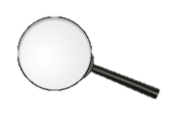
1. Look at the science first
(macroscopic scale)
Is the information valid, significant, timely,
and complete?
Is the context clear? What is new and different? What have you contributed?
Is the information presented at an appropriate level for the audience and the purpose?
Is the narrative arranged in a logical, coherent
structure?
Do the main points stand out?
Do figures, equations, and tables support, emphasize, and clarify the main points?
Notes:
The first pass is from the macroscopic (section) level—look at the science.
Are the main points clearly identifiable and given appropriate emphasis?
Do figures and tables support and enhance the main points?
Is the narrative coherent—is there a clearly defined progression from background to hypothesis to method to results to conclusions?
TIP: Cut and paste the first sentence of each paragraph into a new document. Read it aloud. Does it adequately tell your story? Are there gaps or omissions?
See http://people.physics.illinois.edu/Celia/Lectures/Paragraphs.pdf for tips on how to build effective paragraphs to incorporate an organic, logical structure in your writing.
Have you supplied sufficient background so that the reader can understand the significance of your work? Have you provided appropriate context through adequate referencing of prior work?
Have you made your case? Have you justified your assumptions, anticipated reader questions and objections, and supported your arguments?
Is it clear what you have contributed?
Revising Technical Manuscripts,
Celia M. Elliott
© 2024 The Board of Trustees of the University of Illinois
All rights reserved.
02/21/2024

Slide 5
Provide logical transitions
One section ends with:
  “… Improved sensitivity is important because amplifiers and signal processors are nonlinear
  and thus can mix signals that lie outside the desired band; the mixing generates signals with frequencies that appear as in-band noise.”
Begin the next section with:
  “To achieve the improved filter performance, high-quality expitaxial films of YBCO have been...”
The logical connection between the two sections is made clear by repeating the idea of improving performance
Notes:
Revising Technical Manuscripts,
Celia M. Elliott
© 2024 The Board of Trustees of the University of Illinois
All rights reserved.
02/21/2024

Slide 6
Include summary statements
At the end of each paragraph to lead logically
to the next paragraph
At the end of each subsection
At the end of each section
At the end of the paper
TIP: Adding summary statements helps readers follow your logical argument and prompts them
to go back and re-read if they don’t understand something
Notes:
Provide summary statements at the end of each major section of the paper.
The old speaker’s rule is “Tell them what you’re going to tell them. Tell them. Tell them what you told them.” That advice is just as valid for paper and reports. Take if from a mother—telling somebody something important three times is not overkill.
Revising Technical Manuscripts,
Celia M. Elliott
© 2024 The Board of Trustees of the University of Illinois
All rights reserved.
02/21/2024

Slide 7
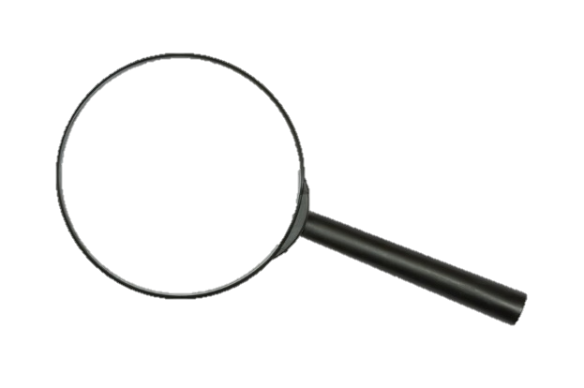
2. Focus on the “style”
(mesoscopic scale)
Use precise, unambiguous language
Avoid gratuitous jargon—who’s your audience?
Use straightforward, declarative sentences
and keep them short (<25 words)
Break up walls of text; one (and only one!) main idea per paragraph
Eliminate every superfluous word and redundant phrase
Make sure every pronoun has a clear antecedent and every demonstrative has a clarifying noun
Notes:
Next, zoom in to the mesoscopic (intermediate) level—look at the words.
Is the language clear and unambiguous?
Have you defined all acronyms and technical jargon that may be unfamiliar to your audience?
Have you used the simplest word to unambiguously convey your meaning?
Revising Technical Manuscripts,
Celia M. Elliott
© 2024 The Board of Trustees of the University of Illinois
All rights reserved.
02/21/2024

Slide 8
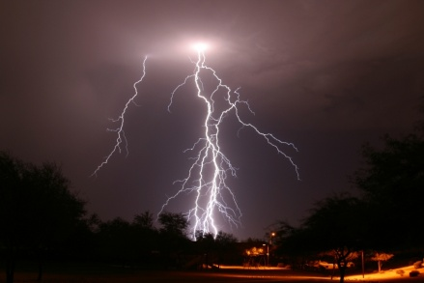
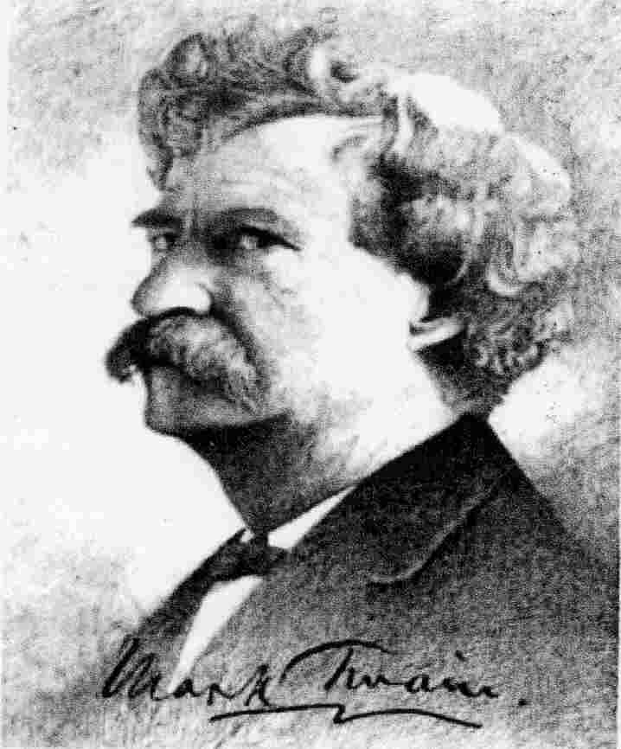

Semantics and syntax control clear communication
“Semantics” is the meaning of words;
you must have a vocabulary adequate to describe things precisely
The difference between the right word and the almost-right word is the difference between lightning and lightning bug.
—Mark Twain
Scale your use of jargon to
the intended audience
Notes:
Revising Technical Manuscripts,
Celia M. Elliott
© 2024 The Board of Trustees of the University of Illinois
All rights reserved.
Note that words have connotations (overtones of associated ideas or emotions) beyond their literal dictionary meanings, which also affect the appropriateness of word choice.
02/21/2024

Slide 9
Example: dis⋅place⋅ment [disˈplāsmənt]
Δx = x_{f} – x₀ (physicist)
the volume moved by the stroke of a piston (mechanical engineer)
a geological fault (seismologist)
the volume of water displaced by a vessel floating in it (marine engineer)
percolation (pharmacist)
abnormality in the position or form of a leaf or organ (botanist)
a defense mechanism in which an emotion is transferred to another, more acceptable object (psychologist)
Notes:
Semantics—the indirect relation between words and meaning; note that words have different connotations in different contexts; e.g., “displacement.”
Revising Technical Manuscripts,
Celia M. Elliott
23 Feb 2018
© 2018 The Board of Trustees of the University of Illinois
All rights reserved.

Slide 10
“Syntax” is how words are ordered
English has five basic syntax rules:
A sentence must have a subject & a verb
A sentence should express one main idea
“Normal” syntax: subject → verb → object
An object can be “direct” (answers what or whom) or “indirect” (answers for what or
to whom)
Adjectives and adverbs precede the words they describe or limit
Notes:
Revising Technical Manuscripts,
Celia M. Elliott
© 2024 The Board of Trustees of the University of Illinois
All rights reserved.
Of course, English has many more “rules” than these five, and about as many exceptions as rules. But adhering to these rules will go a long way toward your goal of clear, unambiguous communication.
02/21/2024

Slide 11
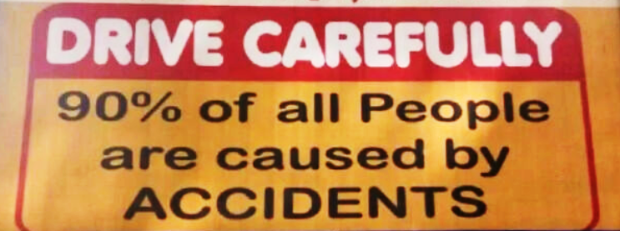
Careless syntax can change the meaning of a sentence
Notes:
Revising Technical Manuscripts,
Celia M. Elliott
© 2024 The Board of Trustees of the University of Illinois
All rights reserved.
02/21/2024

Slide 12
Here’s a BCS theory example:
“Two months later, in late January of 1957, Bob wrote down the wave function for the superconducting state on a New York subway train.”
s-wave
d-wave
p-wave
Notes:
Subway trains in New York are superconducting?
One way to avoid sloppy syntax is to write shorter sentences and control your modifiers. We’ll see how and why in a minute…
Revising Technical Manuscripts,
Celia M. Elliott
23 Feb 2018
© 2018 The Board of Trustees of the University of Illinois
All rights reserved.

Slide 13
Avoid “abstractitis”
“writing that is so abstruse that even the writer does not know what he or she is trying to say”—Sir Ernest Gowers, GCB
“The words …dance before my eyes in a meaningless procession: cross-reference to cross-reference, exception upon exception—couched in abstract terms that offer no handle to seize hold of—leave in my mind only a confused sense of some vitally important, but successfully concealed, purport, which it is my duty to extract, but which is within my power, if at all, only after the most inordinate expenditure of time.” (Yale L.J. 167, 169 [1947]).
Notes:
As defined by Ernest Gowers and quoted by Bryan Garner in Garner’s Modern American Usage, abstractitis is writing that is so abstruse that even the writer does not know what he or she is trying to say.
While Gowers in this case was talking about the U.S. Internal Revenue Code, he could easily have been describing many physics papers.
Gowers’ use of a 68-word sentence is a rant for another day.
Revising Technical Manuscripts,
Celia M. Elliott
© 2024 The Board of Trustees of the University of Illinois
All rights reserved.
02/21/2024

Slide 14
How to avoid “abstractitis”
Clarify—replace jargon with accessible terminology; use simple subjects and direct action verbs; de-convolute syntax
Quantify—replace wimpy, qualitative adjectives with quantitative descriptors
Objectify—give concrete examples;
use analogies
Notes:
Revising Technical Manuscripts,
Celia M. Elliott
© 2024 The Board of Trustees of the University of Illinois
All rights reserved.
02/21/2024

Slide 15
Use these techniques to revise for clarity and conciseness
*
  Write shorter sentences
  Limit the number of modifying
  clauses & prepositional phrases
  Keep verbs close to subjects
  Express ideas in positives,
  not negatives
  Avoid indirect constructions;
  put the subject first
  Eliminate unnecessary words
  De-nounify verbs
*Illustration only, does not
represent actual data.
(But it could.)
Notes:
We’ll look at how to apply each of these editing techniques next.
Revising Technical Manuscripts,
Celia M. Elliott
02/21/2024
© 2024 The Board of Trustees of the University of Illinois
All rights reserved.

Slide 16
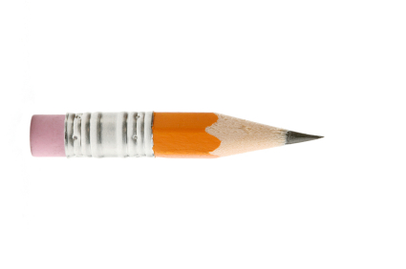
Write shorter sentences (<25 words)
The following sentence (63 words), while grammatically correct, is impossible to understand on the first reading
“A program of chemical analysis and receptor modeling is proposed in which samples obtained at the EB ENTEK sites will be used to estimate the sources and/or source regions of trace elemental deposition into the area and the effects of specific urban areas on the airborne particulate matter compositions and thus, their potential contribution to the contamination of the area’s water supplies.”
Avoid long strings of nouns used as adjectives, too
mean field anisotropic superconducting reverse bias toroid magnet
<sigh>
Notes:
Write short sentences—fewer than 25 words.
Avoid long strings of nouns used as adjectives—“mean field anisotropic superconducting reverse bias toroid magnet” (or MASRBTM, to its fans)
Observe the “three-preposition” rule.* If you have a sentence that contains more than three prepositions, rewrite it before it wanders off to die.
Writing shorter paragraphs will also help your reader follow the logic of your narrative. For more information on how to write strong paragraphs, see
http://people.physics.illinois.edu/Celia/Lectures/Paragraphs.pdf.
*With thanks to Stephanie Teich-McGoldrick of Sandia National Laboratories,
who first introduced me to the three-preposition rule.
Revising Technical Manuscripts,
Celia M. Elliott
02/21/2024
© 2024 The Board of Trustees of the University of Illinois
All rights reserved.

Slide 17
Keep verbs close to their subjects
  Several schemes ranging from minimal computational cost and poor accuracy to high computational cost and high accuracy can be employed.
  Several schemes can be employed, ranging from minimal computational cost and poor accuracy to
  high computational cost and great accuracy.
  A program to be used in conjunction with a PC data acquisition card was written.
  A program was written for use with a PC data acquisition card.
Notes:
One of the pitfalls of using the passive voice is the tendency by amateurs to maroon the verb at the end of the sentence. Avoid this practice.
Revising Technical Manuscripts,
Celia M. Elliott
© 2024 The Board of Trustees of the University of Illinois
All rights reserved.
02/21/2024

Slide 18
Recast negative expressions— a positive is easier to understand and is usually more concise
  Although some data supported the hypothesis, it could not be concluded that output scaled linearly with current.
  Output appeared to scale nonlinearly with current.
  Arcing under high-current operation could not be avoided without the use of the insulated feedthrough.
  The insulated feedthrough prevented arcing,
  even during high-current operation.
Notes:
Ideas expressed as positives are almost always easier to process and grasp quickly. Readers must undergo a second step of deciphering ideas presented as negatives; they have to backtrack to figure out what something is, if you tell them what it is not. Don’t make your readers work this hard.
Revising Technical Manuscripts,
Celia M. Elliott
© 2024 The Board of Trustees of the University of Illinois
All rights reserved.
02/21/2024

Slide 19
Avoid beginning clauses with “There are…” or “It is…—put the subject first and plunge right in
  “Aside from the point defect corresponding to the cone’s vertex, there is a ‘focal’ set consisting of the two parabolic segments x² = b|y| + b²/4.”
  “In addition to the point defect corresponding to the cone’s vertex, a ‘focal’ set occurs that consists
  of the two parabolic segments x² = b|y| + b²/4.
Notes:
Train yourself to spot “It is...” and “There are...” sentences and rewrite them in the passive voice, which puts the important point first in the sentence (“front loads”).
Revising Technical Manuscripts,
Celia M. Elliott
© 2024 The Board of Trustees of the University of Illinois
All rights reserved.
02/21/2024

Slide 20
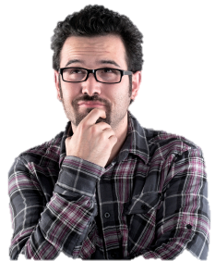
Make sure pronouns refer to the correct antecedent
Non-commutative geometry is obtained when the latter equation fails and is replaced by another equation, as in the case of the quantum Hall system. The interpretation of this effect in superstrings is startling, however, because it is a fundamental theory of spacetime, and it means that
we cannot think of spacetime in terms
of ordinary smooth geometry, as in
general relativity.
or any antecedent…
Notes:
Ideally, a pronoun should refer to the noun immediately preceding it. Don’t make the reader go back several sentences to determine what “it” you mean. By the same token, you may not use a pronoun until you have first used the noun to which the pronoun refers.
Revising Technical Manuscripts,
Celia M. Elliott
© 2024 The Board of Trustees of the University of Illinois
All rights reserved.
02/21/2024

Slide 21
Avoid the big A’s—amphibologies and anthropomorphism
Beware of words with multiple meanings
  A sintered mixture for the experimental heating rod was prepared from martensitic steel and 5% nickel. This element proved to be unsatisfactory.
  A subtle but important point about the series of points generated is that they are not statistically
  independent points.
Don’t give human traits to inanimate objects
  The substrate tells the YBCO how to align during growth.
  The dial needs to be set at …
Notes:
The dial doesn’t care…
Revising Technical Manuscripts,
Celia M. Elliott
© 2024 The Board of Trustees of the University of Illinois
All rights reserved.
02/21/2024

Slide 22

Be sure to use the right word
Alternate or alternative?
Ability or capacity?
Affect or effect?
Principle or principal?
Optimal or optimum?
Biannual or biennial?
Compliment or complement?
Bryan A. Garner, Garner’s Modern American Usage
(New York, Oxford University Press, 2003)
Theodore Bernstein, The Careful Writer
(New York, Atheneum, 1965)
Ms. Particular’s Micro-Lectures on Style and Usage
(http://people.physics.illinois.edu/Celia/MsP/MsParticular.htm)
Notes:
Revising Technical Manuscripts,
Celia M. Elliott
© 2024 The Board of Trustees of the University of Illinois
All rights reserved.
02/21/2024

Slide 23
No more naked “this”es—just don’t
In some pellet designs, the average ionic charge, Z, and the laser intensity, I, are large enough that the distribution function is predicted to be non-Maxwellian (flat-topped). This has important consequences: reduction of the absorption rate, electron flux, and modification of the continuum x-ray emission rates.
A certain amount of energy is required to cause an electron to spin flip when it is beside another electron. Thus, the energy required is double this and is provided by the incident photons.
“This means that…”
i.e., or thus
Notes:
Revising Technical Manuscripts,
Celia M. Elliott
© 2024 The Board of Trustees of the University of Illinois
All rights reserved.
02/21/2024

Slide 24
Change nouns ending in -tion,
-ment, and -ance back into verbs
  The most common use for Raman spectroscopy is
  for the observation of phonons. (13 words)
  Raman spectroscopy is most commonly used to observe phonons. (9 words)
  We proceeded to make an arrangement of the superconducting islands on the substrate with the STM tip. (17 words)
  We arranged the supercoducting islands on the substrate using the STM tip. (12 words)
The superconducting islands were arranged on the
substrate using the STM tip. (Better?)
24
Notes:
Many English words derived from Latin change verbs into the nominative form by adding –tion, –ment, and –ance suffixes to the verbs. Thus act (v.) becomes action (n.), arrange (v.) becomes arrangement (n.), and perform (v.) becomes performance.
An easy way to improve the conciseness and vigor of your writing is to be on the alert for these nouns and change them back into the verbs they came from.
Revising Technical Manuscripts,
Celia M. Elliott
© 2024 The Board of Trustees of the University of Illinois
All rights reserved.
02/21/2024

Slide 25
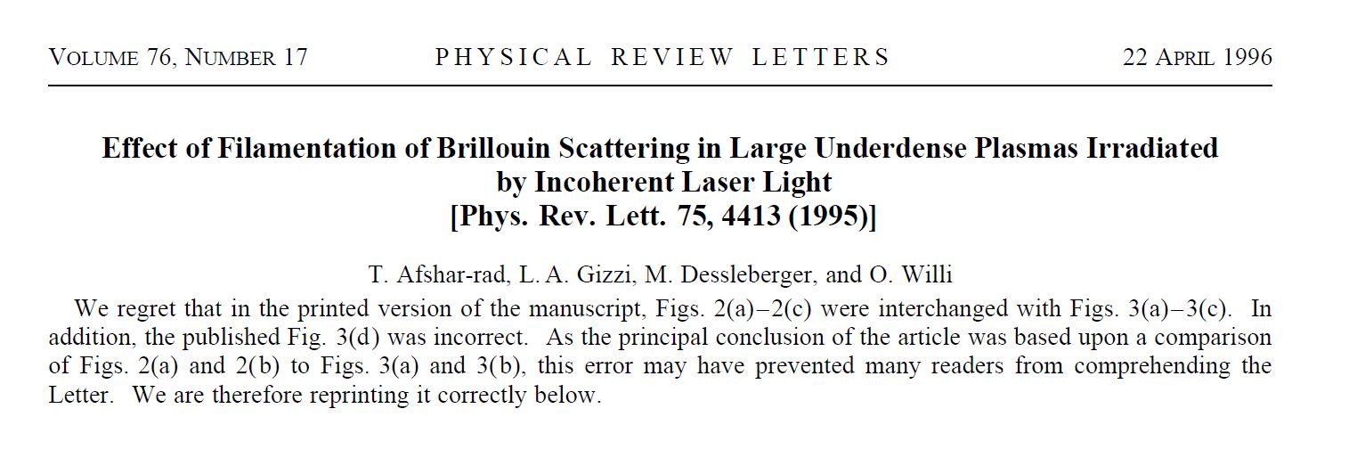
3. Now for proofreading
(microscopi c scale)
Editing concentrates on ideas and expression
Proofing concentrates on mechanics
The importance of proofreading cannot be
overstated
You do not want to be these authors. Believe me.
Notes:
Revising Technical Manuscripts,
Celia M. Elliott
© 2024 The Board of Trustees of the University of Illinois
All rights reserved.
02/21/2024

Slide 26
Profread—proofred—proofread!
Be aware of the special pitfalls for technical material
  ∝ or α
  - or – or —
  x or × or χ
Tips for proofreading technical material
  Proofread from a hard copy
  Read right to left, bottom to top
  Proofread everything (titles, subheadings, captions)
  Use a spellchecker, and check every flagged word
  Use ALL CAPS sparingly
  Allow enough time!

Slide 27
Proofreading examines the manuscript one word at a time
Acronyms, mathematical symbols, and special characters are defined at first usage
Format and typography are consistent and conform to manuscript preparation rules
Technical writing conventions are observed
Grammar and usage are flawless
Punctuation and spelling are perfect
TIP 1: Always proofread from a hard copy
TIP 2: Start at the bottom right-hand corner and read backwards and up
Notes:
Revising Technical Manuscripts,
Celia M. Elliott
© 2024 The Board of Trustees of the University of Illinois
All rights reserved.
02/21/2024

Slide 28

Maintain witless consistency throughout the text
Terminology—always call the same things by the same names
Typography—use of italics and boldface
Expression of numbers
Definitions of symbols or special characters
Legends in figures
Style of subheadings, captions, table titles
Use of color
People expect differences to mean something!
Notes:
If you talk for four pages about a “solar collector” and suddenly introduce a “solar absorber” on Page 5, a careful reader will wonder if something qualitatively different is being described.
Revising Technical Manuscripts,
Celia M. Elliott
© 2024 The Board of Trustees of the University of Illinois
All rights reserved.
02/21/2024

Slide 29
Present a professional-looking document
Select an appropriate font and size
Use no more than two font styles
Automatically hyphenate the document to avoid annoying white spaces in fully justified lines
Position graphics strategically
Select an attractive page layout
  Adequate white space
  Clean, uncluttered appearance
Notes:
Revising Technical Manuscripts,
Celia M. Elliott
© 2024 The Board of Trustees of the University of Illinois
All rights reserved.
02/21/2024

Slide 30

To recap:
Assess important ideas,
logical structure,
precise language,
“mechanical errors”
—in this order
Focus on semantics and syntax—simplest word and most direct sentence structure
Eliminate digressions and redundancies
Pay attention to transitions and reader cues
Proofread from a hard copy
Allow enough time!
cmelliot@illinois.edu
http://physics.illinois.edu/people/Celia/
Notes:
Notes:
Revising Technical Manuscripts,
Celia M. Elliott
© 2024 The Board of Trustees of the University of Illinois
All rights reserved.
02/21/2024

