Slide 1


Equine Diagnostic Applications of Real-Time Kinematics Precision
GPS systems
Seth Cox, Samriddhi Bhatia, Boyun Wang

Slide 2



Bio
Seth Cox
Primary tasks include:
Developing code for the project
Managing and learning how to operate the GPS system
Samriddhi Bhatia
Primary tasks include:
Manage and design the inductive charging system.
Involved in developing the design for the equine GPS system's PCB housing and collar
Boyun Wang
Primary tasks include:
Manage and design PCB and Circuit Design.
Involved in design and improve collar and GPS antenna
2

Slide 3
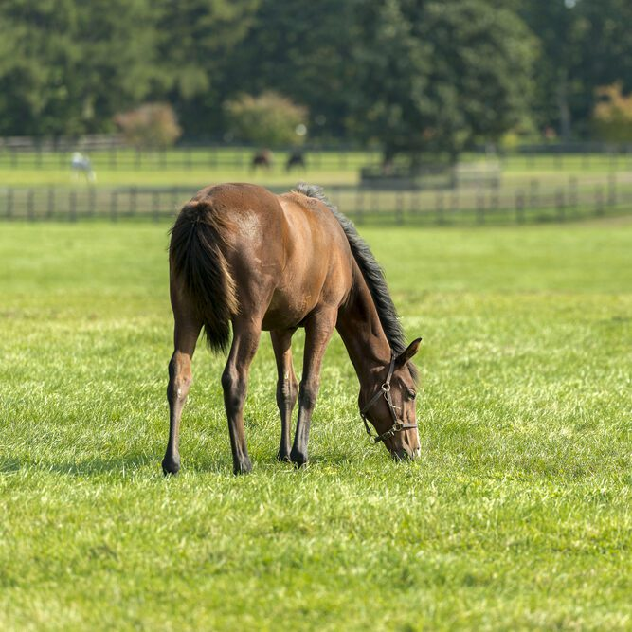
Purpose
Hypothesis Exploration:
GPS monitors can effectively identify nuanced movements linked to specific behaviors, enabling the detection of irregularities indicating potential health or environmental concerns in the pasture.
Recognizes the potential of GPS systems in monitoring a horse's behavior during recovery from illness, providing critical data for assessing the effectiveness of recovery strategies and ensuring the well-being of the horse as it returns to normal activities.
3

Slide 4
General Background
Sedentary Lifestyle Impact:
  Limited studies show sedentary lifestyles in domesticated horses may affect health and hoof quality.
GPS in Racehorse Training:
  GPS units in racehorse training offer precise workload measures and insights into injury risks.
Widespread GPS Adoption:
  Equine industry widely employs GPS for assessing exercise, competition, behavior, and fitness (Linder et al., 2020).
Equine Behavior Evolution:
  Evolution from the "golden age" of gait analysis to modern detection of age, disease, and fatigue.
  IMUs crucial for objective gait measurements.
GPS and IMU Synergies:
  Recognizing synergies between GPS and IMU systems for accurate and cost-effective equine monitoring.
4

Slide 5
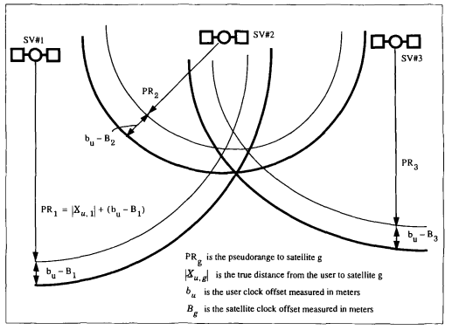

GPS RTK Background - How a GPS Works
GPS modules find their position via a process called trilateration. This is done by finding the range from multiple satellites to see where they intersect.
The GPS module determines the range by using the position of the satellite as well as the time the signal from the satellite was sent out via,
$$ρ_{i}=c∆t_{i}=\sqrt{{\left(x−x_{\text{sat} ,i}\right)}^{2}+{\left(y−y_{\text{sat} ,i}\right)}^{2}+{\left(z−z_{\text{sat} ,i}\right)}^{2}}$$
This assumes that the signal traveled in a straight line to the GPS module. In practice there are many sources of error affecting this measurement. This leads to the ‘pseudorange’. Sources of error are
Atmospheric effects, specifically refraction in the ionosphere and troposphere
Clock offsets between the satellite and GPS module
Errors in the Satellites Ephemeral data
Selective Availability (Turned off in 2000)
Image adapted from The Global Positioning System: Signals, Measurements, and Performance by Per K. Enge
5

Slide 6
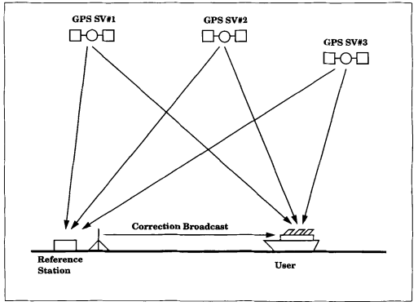
GPS RTK Background – Intro to RTK
So how do we account for these errors? Real Time Kinematics (RTK) mitigates these errors and provides the user with ≈ 1cm accuracy. RTK requires the use of two GPS modules, one acting as a base station with a known location, and a rover whose position we are interested in finding. You also need some form of data link between them.
The Basic Steps to this process are:
The base station measures its pseudorange and the phase of the carrier signals, from this it can make estimates on the error the system is seeing since it already knows its position.
The base station sends this information, including its location and the phase of the carrier wave to the rover. This is done using the Radio Technical Commission for Maritime Services (RTCM) protocol
The rover then finds its pseudorange and uses the data the base station sent to it to find its relative position to the base station to high precision.
Image adapted from The Global Positioning System: Signals, Measurements, and Performance by Per K. Enge
6

Slide 7


GPS RTK Background - RTK Algorithm
To find the relative position of the rover from the base station, the rover must calculate the phase difference between the signals arriving there, and at the base station. This is done via process known as double difference processing. Mathematically this looks like,
$$ϕ_{\text{base} ,i}=\frac{2π}{λ}\left[ρ_{i}−N_{i}λ+ϵ_{ϕ}+I_{i}−T_{i}+c\left(b_{\text{sat} ,i}−b_{\text{base} }\right)\right],$$
which finds the phase of the signal at the base station/rover. For double difference processing we need to find the phase difference between the base station and rover for 2 different signals and subtract them. This results in,
$$ΔΦ=\frac{2π}{λ}\left(ρ_{rec,1}−ρ_{base,1}−ρ_{rec,2}+ρ_{base,2}−λ\left(N_{rec,1}−N_{base,1}−N_{rec,2}+N_{base,2}\right)\right),$$
which resolves the issue to 4 integer ambiguities. Solve these and you have the relative position. This is what is known as RTK ‘floating’ mode.
Solving for these requires taking multiple sets of data and complex algorithms to solve. The time it takes for the rover to ‘fix’ is what denotes the quality of a device.
This process works on the assumption that the errors seen by the base station are the same as those experienced by the rover.
Variables in Equations:
$λ$ - Wavelength
$ϵ_{ϕ}$ - System Noise
$I_{i}$ - Ionospheric Error
$T_{i}$ - Tropospheric Error
$c$ – Speed of Light
$N_{i}$ - Integer Ambiguity
$b$ – Clock Bias
7

Slide 8
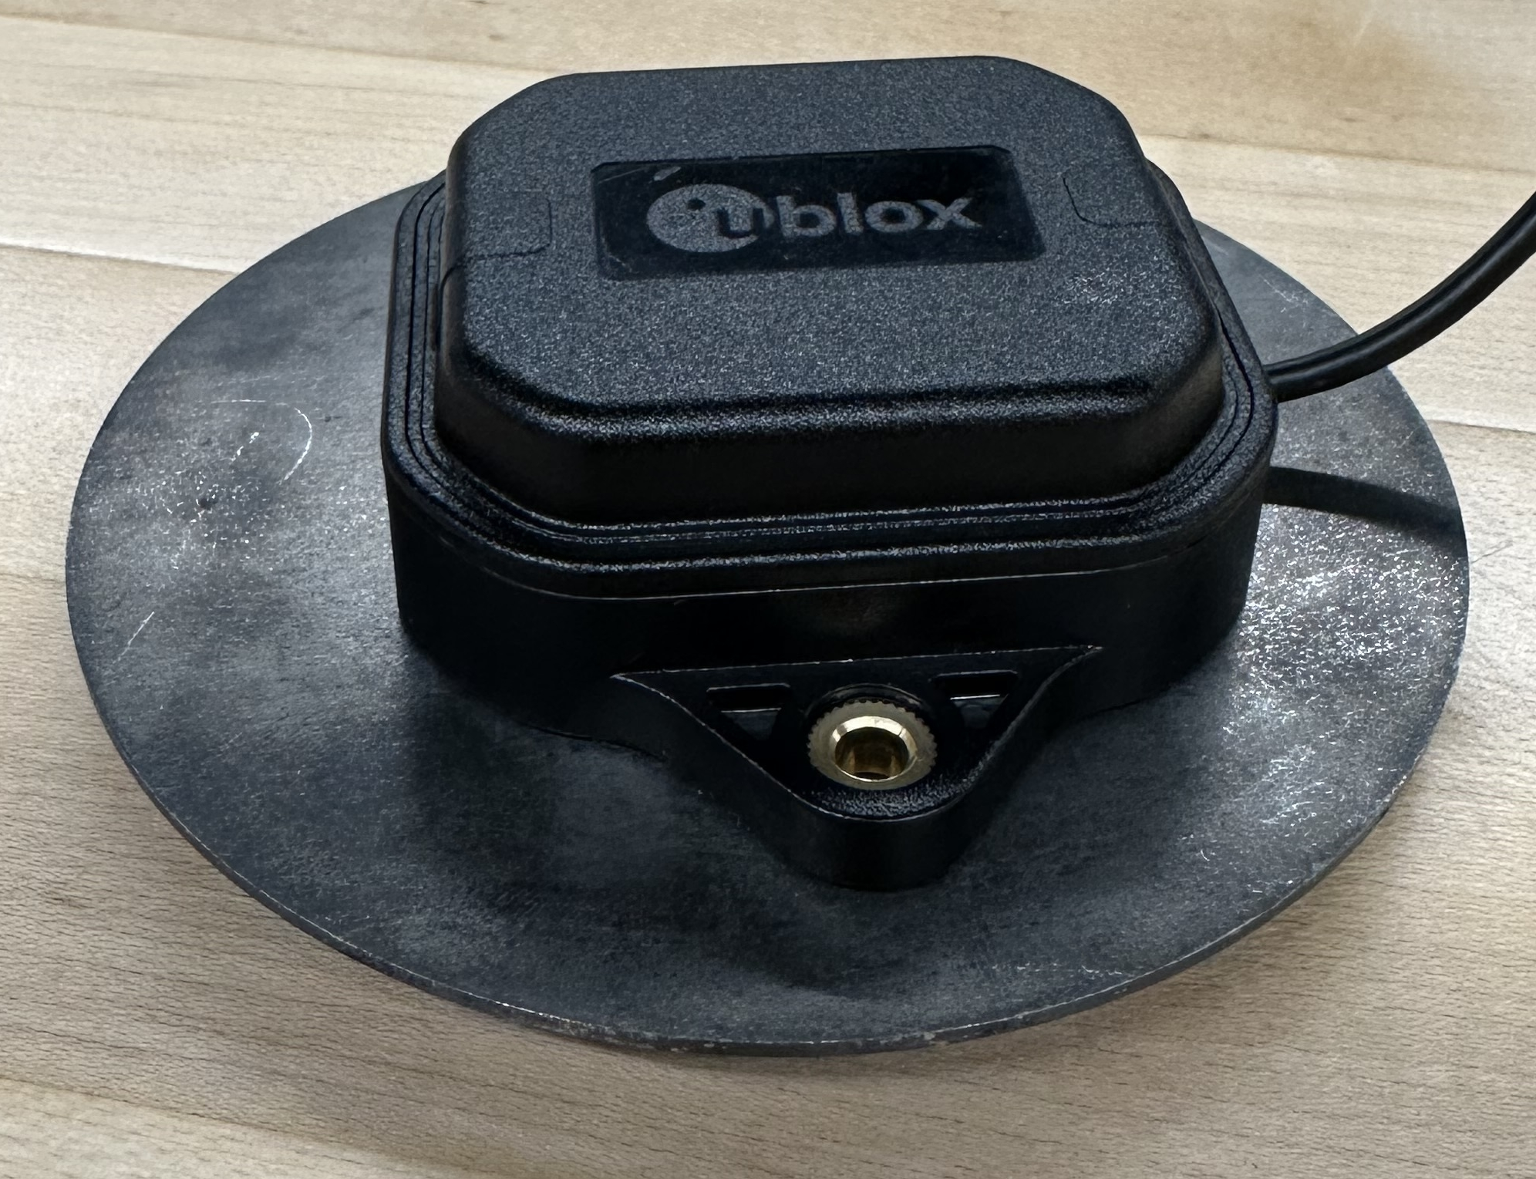
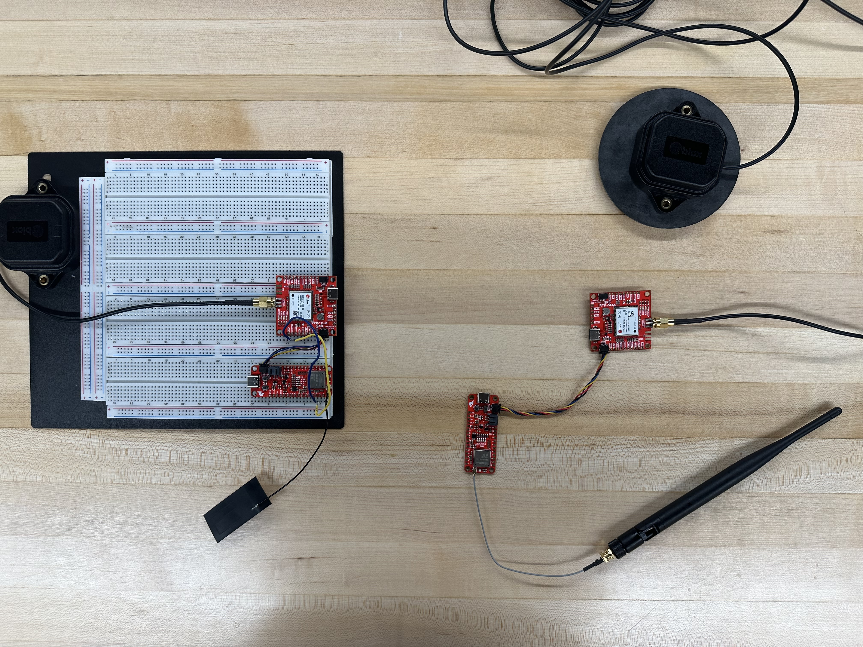
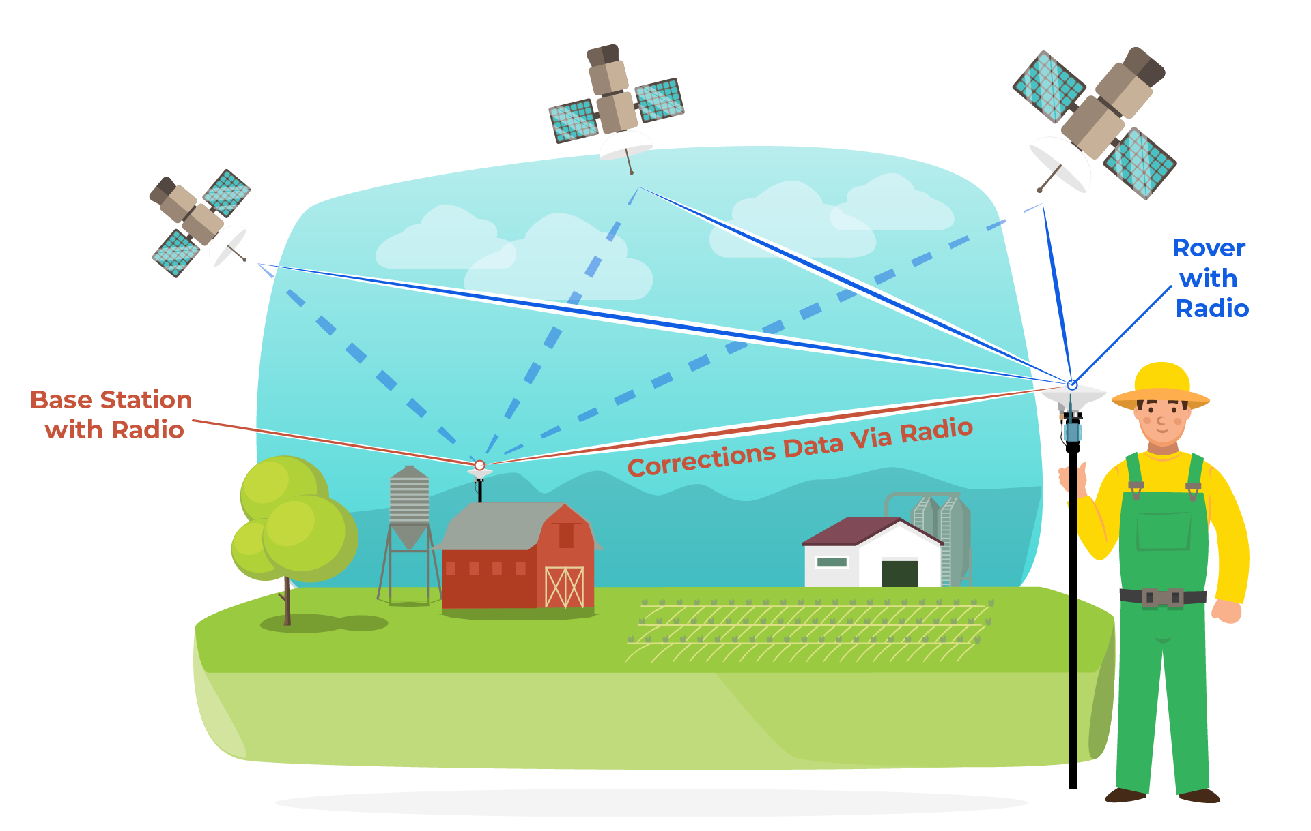
Experimental Set-up
System components: Two GPS-RTK-SMA Breakout boards by Sparkfun Electronics.
Communication Setup : Each board is paired with LoRa Thing Plus - expLoRaBLE board, allowing communication over the radio antenna of 915 MHz.
Antenna and Grounding plates: ANN-MB-00 GNSS multiband antenna for both L1 and L2 frequency bands along with grounding plates.
Base Station Set-up and Data Collection : Data collection for upto 24 hours on the Roof of Loomis for minimal disturbance. RTCM message transfer to GPS module on the rover
Power and access : Base Station is powered by computer directly. Remote access to Base station's computer through Window's Remote Access Feature. Rover powered by a battery and charged via an inductive charging system.
8

Slide 9
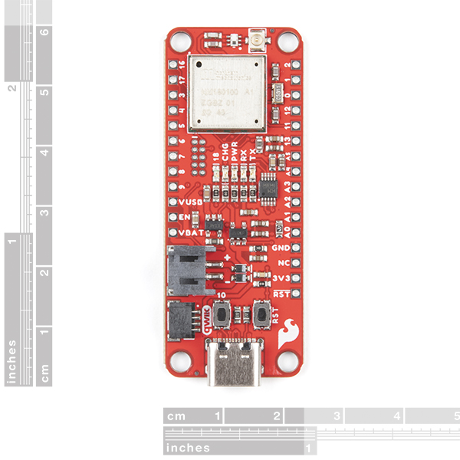
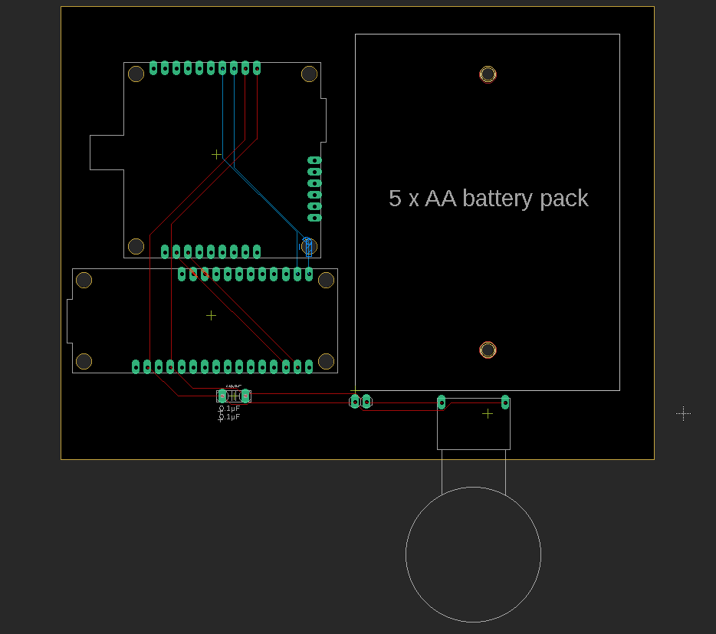
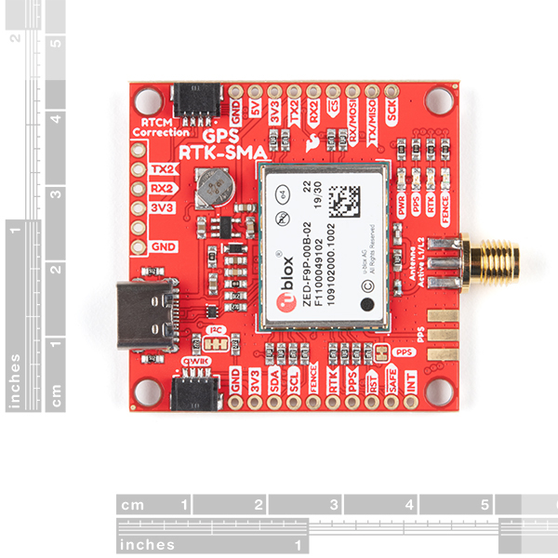
PCB Design
Equine GPS Rover PCB Design:
Equipment:
a. SparkFun GPS-RTK-SMA Breakout - ZED-F9P (Qwiic)
b. SparkFun LoRa Thing Plus – expLoRaBLE
c. 5 AA Battery Pack
d. Inductive Charging Set - 5V @ 500mA max Output Part
Connection:
a. General I2C, Replaced for Qwiic System
b. Serial Connection
The GPS module and the expLoRaBLE board are connected via both I2C and the Serial port to allow easy communication between the two devices as well as to provide a channel for the expLoRaBLE board to send the RTCM messages it receives from the base station over.
9

Slide 10
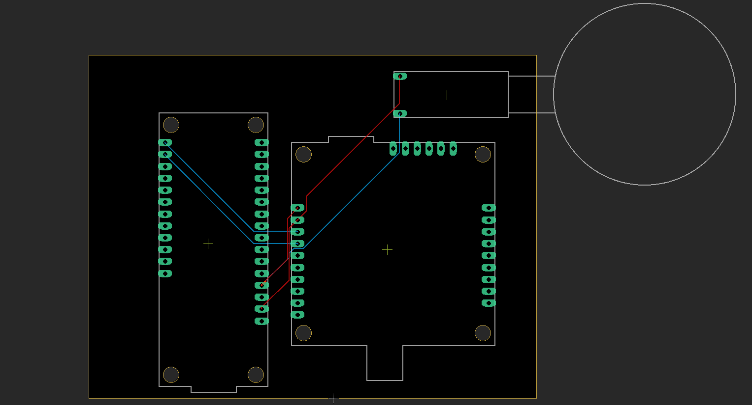
PCB Design
Base Station PCB Design:
Components:
a. SparkFun GPS-RTK-SMA Breakout - ZED-F9P (Qwiic)
b. SparkFun LoRa Thing Plus – expLoRaBLE
c. Inductive Charging Set - 5V @ 500mA max: Input Part
Connection:
a. General I2C, Replaced for Qwiic System
b. Charge for Inductive Charging Coil
10

Slide 11
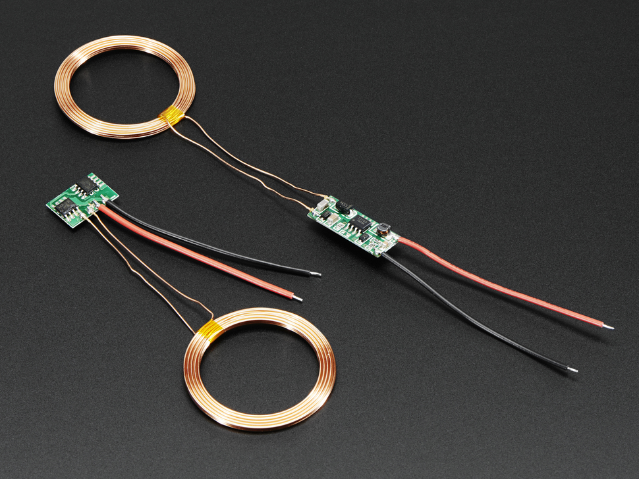
Housing Design and Setup
Charging Choice: Inductive Charging
Why We need to use Inductive Charging?
1. Convenient
2. Waterproof
How it works?
1. These chargers work by taking a power transformer and splitting it in half, an AC waveform is generated into one, and couples into the second coil.
2. Any non-ferrous/non-conductive material (eg air, wood, leather, plastic, paper, glass) can be used between the two coils. The material doesn't affect the distance or efficiency.
14

Slide 12
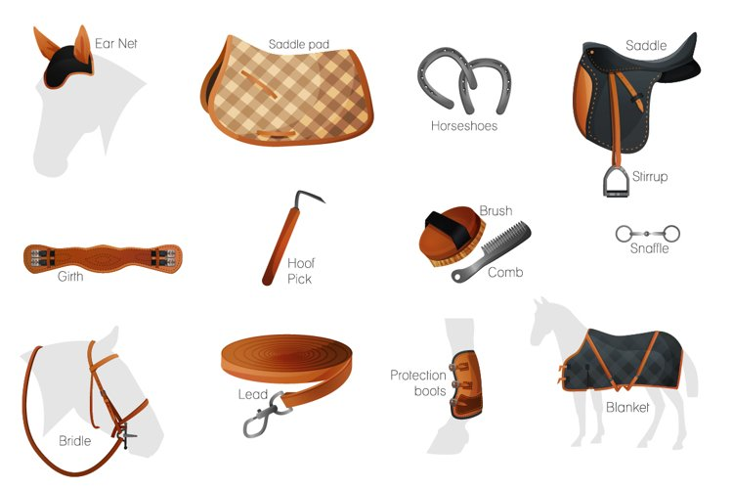
Housing Design and Setup
Equine GPS Rover:
Components:
PCB Board with Circuit
External Design
1. Where should we put the device on the Horse?
Possible Places:
a. Back
b. Neck
11

Slide 13
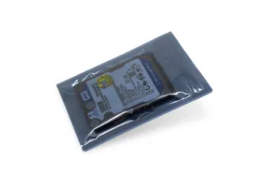
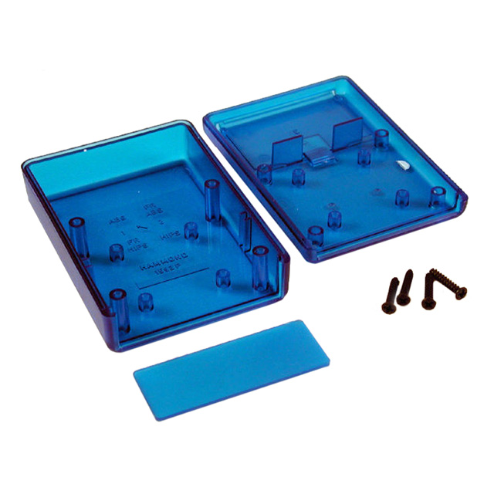
Housing Design and Setup
Equine GPS Rover:
Design Selection:
Sealed PCB Bag: A customized bag made of carbon fiber and other materials has waterproof, anti-corrosive, and mildew-proof functions, and the waterproof antenna also extends from one end.
PCB Box with Screw: A custom-sized waterproof case with screws to ensure waterproof sealing and a waterproof antenna extending from one end to maintain signal strength.
Things to Consider:
Environmental factors
The comfort of the horse
12

Slide 14
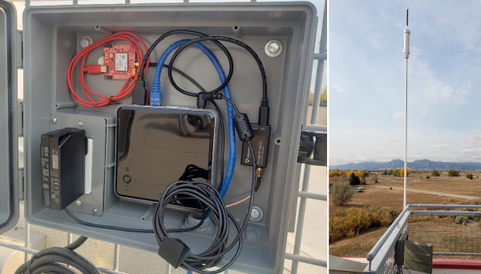
Housing Design and Setup
The reference Base Station:
Assembly and power supply:
Assemble the PCB circuit board powered by USB and connect it to the reference computer. We aim to build an analogous setup to the one provided by SparkFun's tutorial on building a DIY GNSS reference station.
External shell:
1. The system adopts a completely waterproof shell to ensure that the internal components are protected from weather conditions.
2. The receiving antenna is placed in an obstacle-free area to ensure the strength and integrity of the received signal.
13

Slide 15
Data Acquisition and Procedure
To acquire accuracy data, 4 separate tests were done, each over a one-minute time interval which corresponds to approximately 60 data points.
Tests were done to gauge the accuracy with/without the steel grounding plate, and when the rover was moving.
For the stationary test, the rover system was placed a little over 1 meter from the base station and was not touched for the entire test.
For the moving test, one of us walks around in circles in the same spot each time approximately 1-2 meters from the base station.
Accuracy data was collected using the built in horizontal and vertical accuracy functions of the GPS breakout board.
We also measured the range of the radio antennae by walking down the street and noting when we lost connection.
15

Slide 16
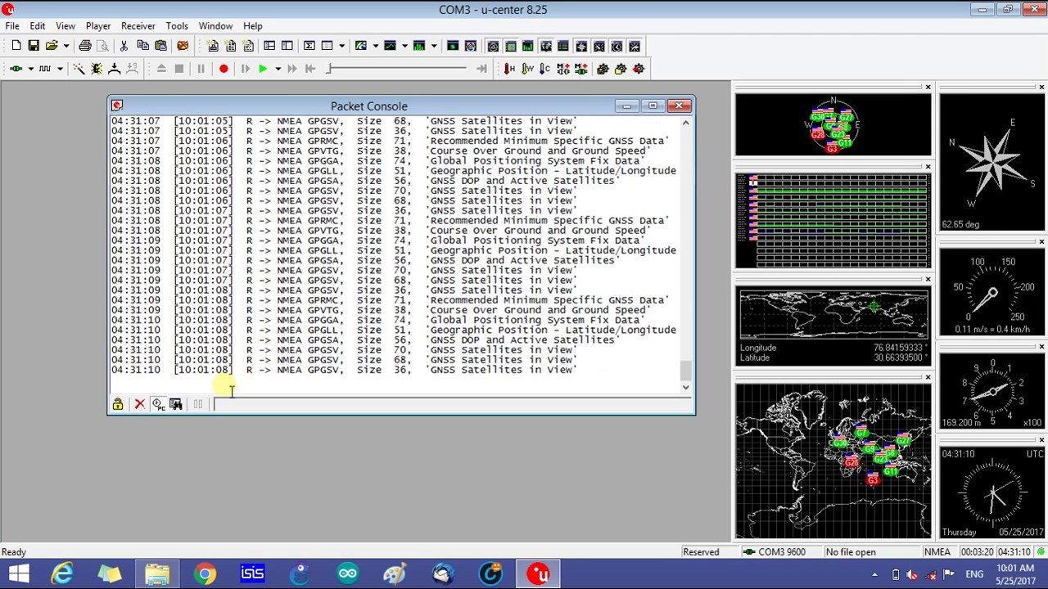
Data Acquisition and Procedure
GPS Data can also be acquired using the software U-Center.
This program lets us control all aspects of the GPS module inside the program instead of the code.
This program will be used to determine the coordinates of the antenna once the permanent base station is installed.
15

Slide 17
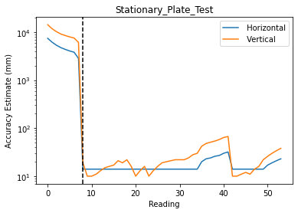
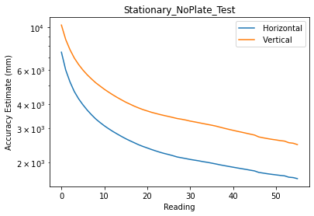
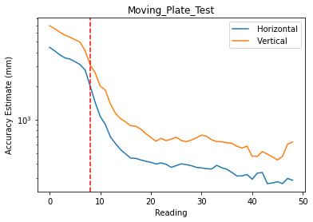
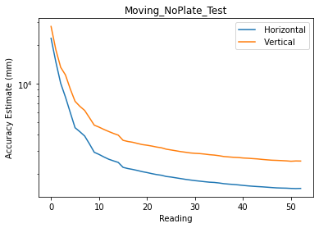
Results
Data from accuracy tests while stationary and moving, and with/without grounding plate.
These tests confirm the plate is necessary, device never comes close to a fix without it.
Further tests need to be done to test the effects of moving on the accuracy, is there a maximum speed the device can move while fixed/fixing?
Vertical accuracy is always at least slightly worse than horizontal, something to keep in mind.
16

Slide 18
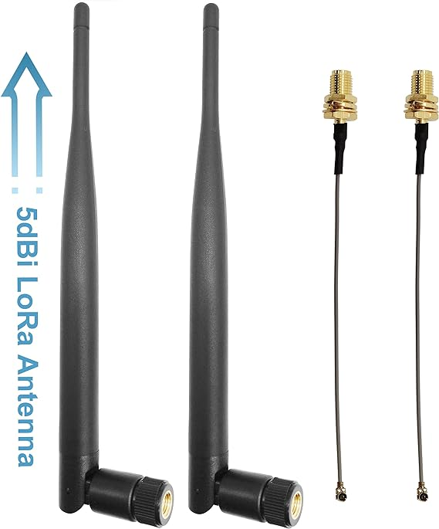
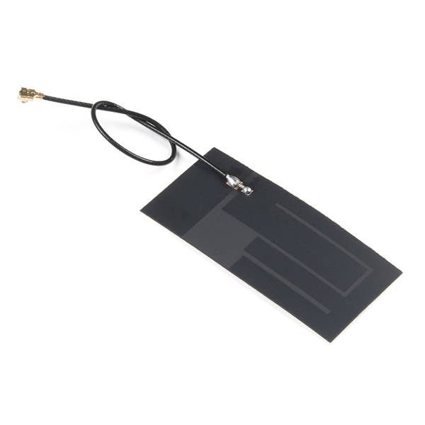
Discussion
Antenna:
Gain: 8dBi internal antenna
Not meet expectation
Present Choice
17

Slide 19
Future Goals
Determine what kind of positional data we would like to collect.
Develop code that can analyze the collected data and compare new data to the established norm.
Test with RTK application and improve with the housing design being suitable for horse.
Further improve the range between wearable equipment and reference base station. Test how cover materials affected the signal intensity and the range.
18

Slide 20
Potential Problems
If the moving issue with regards to accuracy is not solved, this places a severe limitation on the potential applications of our system.
The bulk of the device may become too much to be comfortably placed on the horse.
19

Slide 21
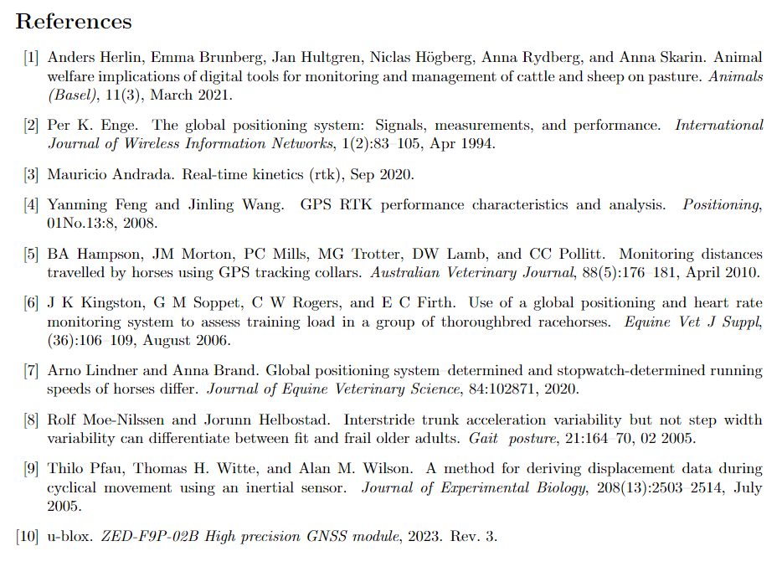
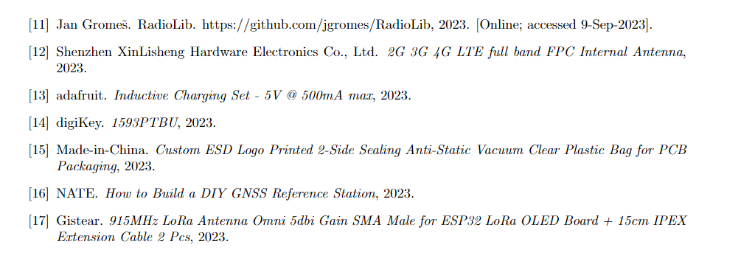
Questions?
Acknowledgement:
George Golin & Yuk Tung Liu
Sparkfun Electronics
Annette Marie McCoy
20

