Slide 1
Apache Spark
Lecture by: Faria Kalim (lead TA)
CS425 Fall 2019
UIUC
Notes:
2012

Slide 2
Why Spark?
Another system for big data analytics
Isn’t MapReduce good enough?
  Simplifies batch processing on large commodity clusters

Slide 3
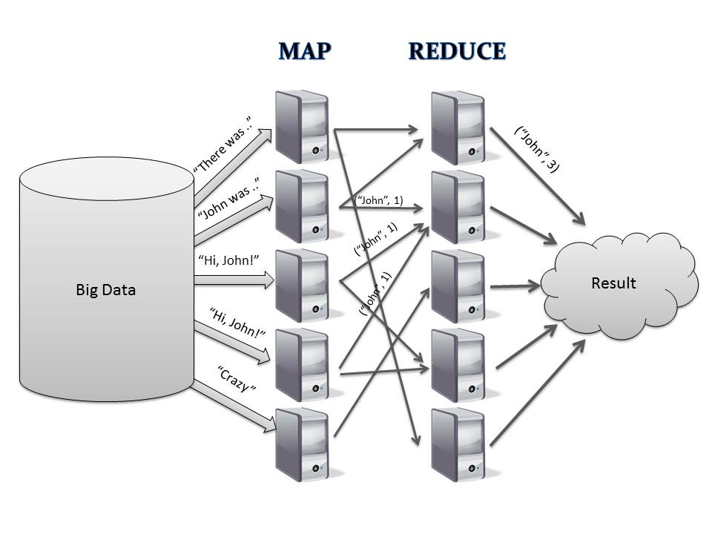
Expensive save to disk for fault tolerance

Slide 4
Why Spark?
MapReduce can be expensive for some applications e.g.,
  Iterative
  Interactive
Lacks efficient data sharing
Specialized frameworks did evolve for different programming models
  Bulk Synchronous Processing (Pregel)
  Iterative MapReduce (Haloop) ….

Slide 5
Solution: Resilient Distributed Datasets (RDDs)
RDDs
  Immutable, partitioned collection of records
  Built through coarse grained transformations (map, join …)
  Can be cached for efficient reuse
Notes:
Apply the same operations to many pieces of data

Slide 6

RDD
RDD
RDD
Read
HDFS
Read
Cache
Map
Reduce

Slide 7
Solution: Resilient Distributed Datasets (RDDs)
RDDs
  Immutable, partitioned collection of records
  Built through coarse grained, ordered transformations (map, join …)
Fault Recovery?
  Lineage!
    Log the coarse grained operation applied to a partitioned dataset
    Simply recompute the lost partition if failure occurs!
    No cost if no failure

Slide 8
RDD
RDD
RDD
Read
HDFS
Read
Cache
Map
Reduce
HDFS
Read
Map
RDD
Reduce
RDD
Lineage
RDD

Slide 9
RDD
RDD
RDD
Read
HDFS
RDDs track the graph of transformations that built them (their lineage) to rebuild lost data
Read
Cache
Map
Reduce
HDFS
Read
Map
RDD
Reduce
RDD
Lineage
RDD

Slide 10
What can you do with Spark?
RDD operations
  Transformations e.g., filter, join, map, group-by …
  Actions e.g., count, print …
Control
  Partitioning
  Persistence

Slide 11
Partitioning
PageRank
Links
(url, neighbors)
Ranks
(url, ranks)
Joins take place repeatedly
Good partitioning reduces shuffles
Contributions
Ranks
(url, ranks)
Contributions

Slide 12
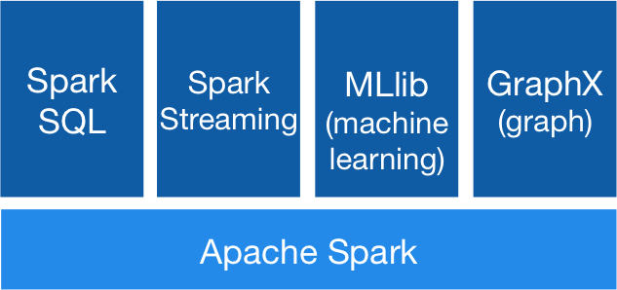
Generality
RDDs allow unification of different programming models
  Stream Processing
  Graph Processing
  Machine Learning …..

Slide 13
Gather-Apply-Scatter on GraphX
A
B
Vertices | Neighbors
A | B
A | C
B | C
D | C
A
B
A
C
D
C
B
C
D
C
Graph Represented In a Table
Triplets

Slide 14
Gather-Apply-Scatter on GraphX
A
B
A
B
A
C
D
C
B
C
D
C
Gather at A
Group-By A

Slide 15
Gather-Apply-Scatter on GraphX
A
B
A
B
A
C
D
C
B
C
D
C
Apply
Map

Slide 16
Gather-Apply-Scatter on GraphX
A
B
B
A
B
C
A
B
A
C
C
B
D
C
B
C
A
C
C
D
D
C
Scatter
Triplets
Join

Slide 17
Summary
RDDs provide a simple and efficient programming model
Generalized to a broad set of applications
Leverages coarse-grained nature of parallel algorithms for failure recovery

