Slide 1
CS 425 / ECE 428
Distributed Systems
Fall 2020
Indranil Gupta (Indy)
Lecture 5: Gossiping
All slides © IG

Slide 2
Jokes for this Topic
(You will get these jokes as you start understanding the topic)
Did you know the SRM protocol was a talented kid? Reportedly it had a NAK for all new things it heard.
In the gossip protocol, Infected node tapped the Un-infected node on the elbow and whispered, “You Beta wear a mask!”
The ants were carrying a heavy load. The smart ant gossiped to its neighbor, “Hey, stop pushing -- pull is much faster!”
<insert your own Covid-related epidemic joke here (if you wish)>
2

Slide 3
Exercises
When are ACK-based multicast protocols preferable over NAK-based multicast protocols (and vice versa)?
Gossip Epidemiology Analysis walk through:
Derive extremes (t=0 and infinity) for equations (gossip analysis).
Derive t=clogN variant.
In push gossip, suppose one limits the gossip to stop after K rounds, K being a constant. What fraction of processes get the gossip?
Why is pull gossip faster than push?
Topology-aware gossip: Why does it still maintain O(log(N)) latency in a 2 subnet scenario?
(Leftover MapReduce problem)
3

Slide 5
Multicast
5

Slide 6
Fault-tolerance and Scalability
Needs:
Reliability (Atomicity)
100% receipt
Speed
6

Slide 7
Centralized
7

Slide 8
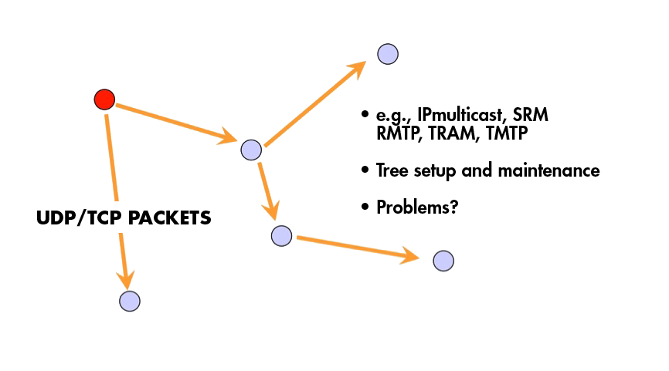
Tree-Based
8

Slide 9
Tree-based Multicast Protocols
Build a spanning tree among the processes of the multicast group
Use spanning tree to disseminate multicasts
Use either acknowledgments (ACKs) or negative acknowledgements (NAKs) to repair multicasts not received
SRM (Scalable Reliable Multicast)
Uses NAKs
But adds random delays, and uses exponential backoff to avoid NAK storms
RMTP (Reliable Multicast Transport Protocol)
Uses ACKs
But ACKs only sent to designated receivers, which then re-transmit missing multicasts
These protocols still cause an O(N) ACK/NAK overhead [Birman99]
9

Slide 10
A Third Approach
10

Slide 11
A Third Approach
11

Slide 12
A Third Approach
12

Slide 13
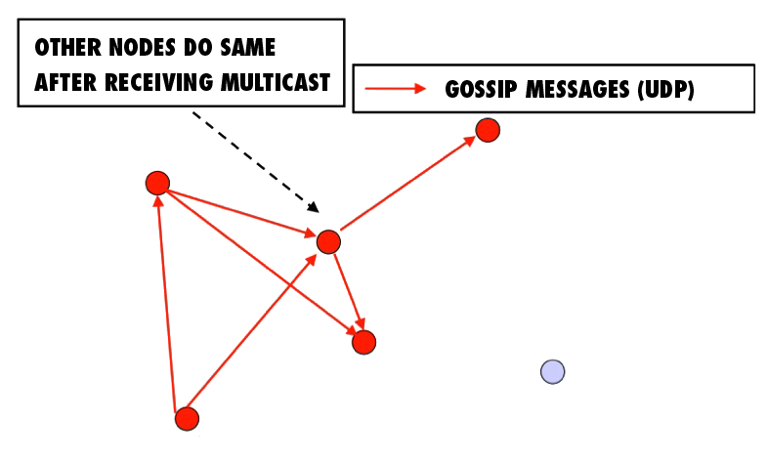
A Third Approach
13

Slide 14
“Epidemic” Multicast (or “Gossip”)
14

Slide 15
Push vs. Pull
So that was “Push” gossip
Once you have a multicast message, you start gossiping about it
Multiple messages? Gossip a random subset of them, or recently-received ones, or higher priority ones
There’s also “Pull” gossip
Periodically poll a few randomly selected processes for new multicast messages that you haven’t received
Get those messages
Hybrid variant: Push-Pull
As the name suggests
15

Slide 16
Properties
Claim that the simple Push protocol
Is lightweight in large groups
Spreads a multicast quickly
Is highly fault-tolerant
16

Slide 17
Analysis
From old mathematical branch of Epidemiology [Bailey 75]
Population of (n+1) individuals mixing homogeneously
Contact rate between any individual pair is
At any time, each individual is either uninfected (numbering x) or infected (numbering y)
Then,
and at all times
Infected–uninfected contact turns latter infected, and it stays infected
17

Slide 18
Analysis (contd.)
Continuous time process
Then
(why?)
with solution:
(can you derive it?)
18

Slide 20
Epidemic Multicast
20

Slide 21
Epidemic Multicast Analysis
(why?)
Substituting, at time t=clog(n), the number of infected is
(correct? can you derive it?)
21

Slide 22
Analysis (contd.)
Set c,b to be small numbers independent of n
Within clog(n) rounds, [low latency]
all but number of nodes receive the multicast
[reliability]
each node has transmitted no more than cblog(n)gossip messages [lightweight]
22

Slide 23
Why is log(N) low?
log(N) is not constant in theory
But pragmatically, it is a very slowly growing number
Base 2
log(1000) ~ 10
log(1M) ~ 20
log (1B) ~ 30
log(all IPv4 addresses) = 32
log(all IPv6 addresses) = 128
23

Slide 24
Fault-tolerance
Packet loss
50% packet loss: analyze with b replaced with b/2
To achieve same reliability as 0% packet loss, takes twice as many rounds
Node failure
50% of nodes fail: analyze with n replaced with n/2 and b replaced with b/2
Same as above
24

Slide 25
Fault-tolerance
With failures, is it possible that the epidemic might die out quickly?
Possible, but improbable:
Once a few nodes are infected, with high probability, the epidemic will not die out
So the analysis we saw in the previous slides is actually behavior with high probability
[Galey and Dani 98]
Think: why do rumors spread so fast? why do infectious diseases cascade quickly into epidemics? why does a virus or worm spread rapidly?
25

Slide 26
Pull Gossip: Analysis
In all forms of gossip, it takes O(log(N)) rounds before about N/2 processes get the gossip
Why? Because that’s the fastest you can spread a message – a spanning tree with fanout (degree) of constant degree has O(log(N)) total nodes
Thereafter, pull gossip is faster than push gossip
After the ith, round let be the fraction of non-infected processes. Let each round have k pulls. Then
This is super-exponential
Second half of pull gossip finishes in time O(log(log(N))
26

Slide 27
Topology-Aware Gossip
Network topology is hierarchical
Random gossip target selection => core routers face O(N) load (Why?)
Fix: In subnet i, which contains n_{i} nodes, pick gossip target in your subnet with probability (1-1/n_{i})
Router load=O(1)
Dissemination time=O(log(N))
N/2 nodes in a subnet
Router
N/2 nodes in a subnet
27

Slide 29
Answer – Push Analysis (contd.)
Using:
Substituting, at time t=clog(n)
29

Slide 30
SO,...
Is this all theory and a bunch of equations?
Or are there implementations yet?
30

Slide 31
Some implementations
Clearinghouse and Bayou projects: email and database transactions [PODC ‘87]
refDBMS system [Usenix ‘94]
Bimodal Multicast [ACM TOCS ‘99]
Sensor networks [Li Li et al, Infocom ‘02, and PBBF, ICDCS ‘05]
AWS EC2 and S3 Cloud (rumored). [‘00s]
Cassandra key-value store (and others) use gossip for maintaining membership lists
Usenet NNTP (Network News Transport Protocol) [‘79]
31

Slide 32
NNTP Inter-server Protocol
Each client uploads and downloads news posts from a news server
2.
CHECK <Message IDs>
Upstream
Server
Downstream
Server
238 {Give me!}
TAKETHIS <Message>
239 OK
Server retains news posts for a while,
transmits them lazily, deletes them after a while.
32

Slide 33
Summary
Multicast is an important problem
Tree-based multicast protocols
When concerned about scale and fault-tolerance, gossip is an attractive solution
Also known as epidemics
Fast, reliable, fault-tolerant, scalable, topology-aware
33

