Slide 1
Chapter 1: Introduction
Our goal:
get “feel” and terminology
more depth, detail later in course
approach:
use Internet as example
Overview:
what’s the Internet
what’s a protocol?
network edge
access net, physical media
network core
Internet/ISP structure
performance: loss, delay
protocol layers, service models
network modeling

Slide 2
Chapter 1: roadmap
1.1 What is the Internet?
1.2 Network edge
1.3 Network access and physical media
1.4 Network core
1.5 Internet structure and ISPs
1.6 Delay & loss in packet-switched networks
1.7 Protocol layers, service models
1.8 History

Slide 3
What’s the Internet: “nuts and bolts” view
millions of connected computing devices:
hosts = end systems
running network apps
communication links
fiber, copper, radio, satellite
Different transmission rates
routers: forward packets (chunks of data)
router
workstation
server
mobile
local ISP
regional ISP
company
network
Notes:
What’s a human being?
Head, arm, legs, 2 eyes and eye-brows, etc.
A huge neural network capable of processing and fusing multi-modal sensor data, all running with liquid logic
A bunch of biological creatures, self organizing them into hierarchies via intangible notions of power, and eventually going back to square one with revolutions and world wars

Slide 4
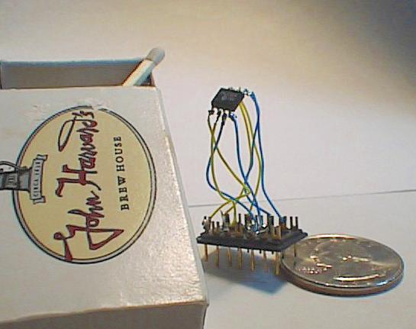
“Cool” internet appliances
Web-enabled toaster +
weather forecaster
IP picture frame
http://www.ceiva.com/
World’s smallest web server
http://www-ccs.cs.umass.edu/~shri/iPic.html
Internet phones

Slide 5
What’s the Internet: “nuts and bolts” view
protocols coordinate communication
Who gets to transmit?
What path to take?
What message format?
e.g., TCP, IP, HTTP, FTP, PPP
Internet: “network of networks”
loosely hierarchical
public Internet Vs private intranet
Internet standards
RFC: Request for comments
IETF: Internet Engineering Task Force
router
workstation
server
mobile
local ISP
regional ISP
company
network

Slide 6
What’s the Internet: a service view
communication infrastructure enables distributed applications:
Web, email, games, e-commerce, file sharing
communication services provided to apps:
Connectionless unreliable
connection-oriented reliable
Can you give an analogy of this in real life services

Slide 7
What’s a protocol?
human protocols:
“what’s the time?”
“I have a question”
introductions
… specific msgs sent
… specific actions taken when msgs received, or other events
network protocols:
machines rather than humans
all communication activity in Internet coordinated by protocols
protocols define format, order of msgs sent and received among network entities, and actions taken on msg transmission, receipt

Slide 8
What’s a protocol?
a human protocol and a computer network protocol:
Hi
TCP connection
request
Hi
TCP connection
response
Got the
time?
Get http://www.awl.com/kurose-ross
2:00
<file>
time
Q: This one trivial. Can u think of a more complex case?

Slide 9
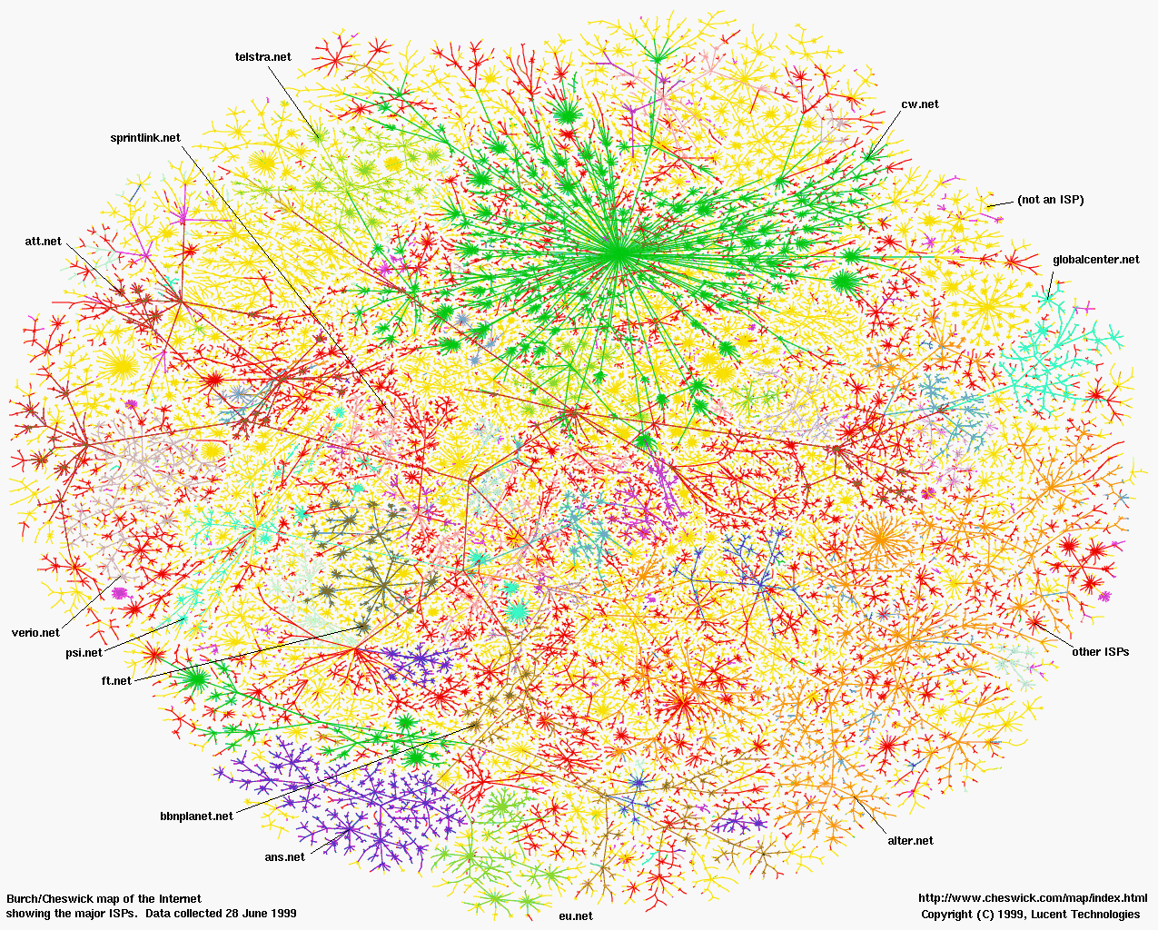

Slide 10
Chapter 1: roadmap
1.1 What is the Internet?
1.2 Network edge
1.3 Network access and physical media
1.4 Network core
1.5 Internet structure and ISPs
1.6 Delay & loss in packet-switched networks
1.7 Protocol layers, service models
1.8 History

Slide 11
A closer look at network structure:
network edge: applications and hosts
network core:
routers
network of networks
access networks, physical media: communication links

Slide 12
The network edge:
end systems (hosts):
run application programs
e.g. Web, email
client/server model
client host requests, receives service from always-on server
e.g. Web browser/server; email client/server
peer-peer model:
minimal use of dedicated servers
e.g. Skype, BitTorrent, KaZaA
Any idea how?

Slide 14
Network edge: connection-oriented service
Goal: data transfer between end systems
Connection: prepare for data transfer ahead of time
Request / Respond
set up “state” in two communicating hosts
TCP - Transmission Control Protocol
Internet’s connection-oriented service
TCP service [RFC 793]
reliable, in-order byte-stream data transfer
loss: acknowledgements and retransmissions
flow control:
sender won’t overwhelm receiver
congestion control:
senders “slow down sending rate” when network congested

Slide 15
Network edge: connectionless service
Goal: data transfer between end systems
same as before!
UDP - User Datagram Protocol [RFC 768]:
connectionless
unreliable data transfer
no flow control
no congestion control
App’s using TCP:
HTTP (Web), FTP (file transfer), Telnet (remote login), SMTP (email)
App’s using UDP:
streaming media, teleconferencing, DNS, Internet telephony

Slide 16
Chapter 1: roadmap
1.1 What is the Internet?
1.2 Network edge
1.3 Network access and physical media
1.4 Network core
1.5 Internet structure and ISPs
1.6 Delay & loss in packet-switched networks
1.7 Protocol layers, service models
1.8 History

Slide 17
Access networks and physical media
Q: How to connect end systems to edge router?
residential access nets
institutional access networks (school, company)
mobile access networks
Keep in mind:
bandwidth (bits per second) of access network?
shared or dedicated?

Slide 18
Residential access: point to point access
Dialup via modem
up to 56Kbps direct access to router (often less)
Can’t surf and phone at same time: can’t be “always on”
ADSL: asymmetric digital subscriber line
up to 1 Mbps upstream (today typically < 256 kbps)
up to 8 Mbps downstream (today typically < 1 Mbps)
FDM: 50 kHz - 1 MHz for downstream
4 kHz - 50 kHz for upstream
0 kHz - 4 kHz for ordinary telephone

Slide 19
Residential access: cable modems
HFC: hybrid fiber coax
asymmetric: up to 30Mbps downstream, 2 Mbps upstream
network of cable and fiber attaches home to ISP router
homes share access to router
deployment: available via cable TV companies

Slide 20
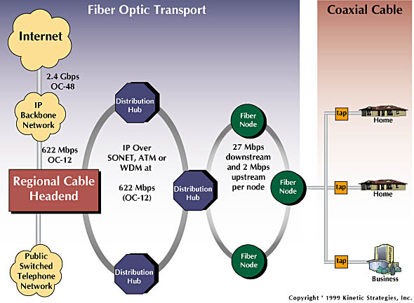
Residential access: cable modems
Diagram: http://www.cabledatacomnews.com/cmic/diagram.html

Slide 21
Cable Network Architecture: Overview
Typically 500 to 5,000 homes
cable headend
cable distribution
network (simplified)
home

Slide 22
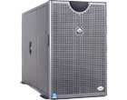
Cable Network Architecture: Overview
server(s)
cable headend
cable distribution
network
home

Slide 23
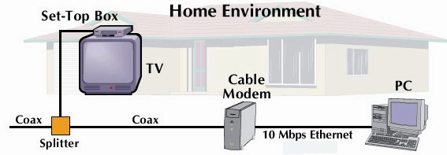
Cable Network Architecture: Overview
cable headend
cable distribution
network (simplified)
home

Slide 24
Cable Network Architecture: Overview
FDM:
C
O
N
T
R
O
L
V
I
D
E
O
V
I
D
E
O
V
I
D
E
O
V
I
D
E
O
V
I
D
E
O
V
I
D
E
O
D
A
T
A
D
A
T
A
1
2
3
4
5
6
7
8
9
Channels
cable headend
cable distribution
network
home

Slide 25
DSL vs Cable Modem
DSL is point to point
Thus data rate does not reduce when neighbor uses his/her DSL
But, DSL uses twisted-pair, and transmission technology cannot support more than ~10Mbps
Cable Modems share the pipe to the cable headend.
Thus, your data rate can reduce when neighbors are surfing concurrently
However, fibre optic lines have significantly higher data rate (fat pipe)
Even if other users, data rate may still be higher

Slide 26
Company access: local area networks
company/univ local area network (LAN) connects end system to edge router
Ethernet:
shared or dedicated link connects end system and router
10 Mbs, 100Mbps, Gigabit Ethernet
LANs: chapter 5

Slide 27
Wireless access networks
shared wireless access network connects end system to router
via base station aka “access point”
wireless LANs:
802.11b/g (WiFi): 11 or 54 Mbps
wider-area wireless access
provided by telco operator
3G ~ 384 kbps
Will it happen??
GPRS in Europe/US
router
base
station
mobile
hosts

Slide 28
Home networks
Typical home network components:
ADSL or cable modem
router/firewall/NAT
Ethernet
wireless access
point
wireless
laptops
to/from
cable
headend
cable
modem
router/
firewall
wireless
access
point
Ethernet

Slide 29
Chapter 1: roadmap
1.1 What is the Internet?
1.2 Network edge
1.3 Network access and physical media
1.4 Network core
1.5 Internet structure and ISPs
1.6 Delay & loss in packet-switched networks
1.7 Protocol layers, service models
1.8 History

Slide 30
The Network Core
mesh of interconnected routers
the fundamental question: how is data transferred through net?
circuit switching: dedicated circuit per call: telephone net
packet-switching: data sent thru net in discrete “chunks”

Slide 31
Network Core: Circuit Switching
End-end resources reserved for “call”
link bandwidth, switch capacity
dedicated resources: no sharing
circuit-like (guaranteed) performance
call setup required
Analogy: When president travels, a CS path set up.

Slide 32
Network Core: Circuit Switching
network resources (e.g., bandwidth) divided into “pieces”
pieces allocated to calls
resource piece idle if not used by owning call (no sharing)
dividing link bandwidth into “pieces”
frequency division
time division

Slide 33
Circuit Switching: FDM and TDM
Example:
FDM
4 users
frequency
time
TDM
frequency
time
Notes:
Two simple multiple access control techniques.
Each mobile’s share of the bandwidth is divided into portions for the uplink and the downlink. Also, possibly, out of band signaling.
As we will see, used in AMPS, GSM, IS-54/136

Slide 34
FDM Vs TDM
What are the tradeoffs?
(Dis)Advantage of dividing frequency ?
(Dis)Advantage of dividing time ?

Slide 35
Numerical example
How long does it take to send a file of 640,000 bits from host A to host B over a circuit-switched network?
All links are 1.536 Mbps
Each link uses TDM with 24 slots/sec
500 msec to establish end-to-end circuit
Let’s work it out!

Slide 36
Another numerical example
How long does it take to send a file of 640,000 bits from host A to host B over a circuit-switched network?
All links are 1.536 Mbps
Each link uses FDM with 24 channels (frequencies)
500 msec to establish end-to-end circuit
Let’s work it out!

Slide 37
Network Core: Packet Switching
each end-end data stream divided into packets
user A, B packets share network resources
each packet uses full link bandwidth
resources used as needed
resource contention:
aggregate resource demand can exceed amount available
Packets queue up
store and forward: packets move one hop at a time
Node receives complete packet before forwarding
Bandwidth division into “pieces”
Dedicated allocation
Resource reservation

Slide 38
Packet Switching: Statistical Multiplexing
100 Mb/s
Ethernet
A
C
statistical multiplexing
1.5 Mb/s
B
queue of packets
waiting for output
link
D
E
Sequence of A & B packets does not have fixed pattern, shared on demand ➔ statistical multiplexing.
TDM: each host gets same slot in revolving TDM frame.

Slide 39
Compare
Thoughts on tradeoffs between packet switching and circuit switching?
Which one would you take?
Under what circumstances?
Why?

Slide 40
Packet switching versus circuit switching
Packet switching allows more users to use network!
1 Mb/s link
each user:
100 kb/s when “active”
active 10% of time
circuit-switching:
10 users
packet switching:
with 35 users, probability > 10 active less than .0004
N users
1 Mbps link
Q: how did we get value 0.0004?

Slide 41
Packet switching versus circuit switching
Is packet switching a “slam dunk winner?”
Great for bursty data
resource sharing
simpler, no call setup
Excessive congestion: packet delay and loss
protocols needed for reliability, congestion control
Q: How to provide circuit-like behavior?
bandwidth guarantees needed for audio/video apps
still unsolved (chapter 7)
Why?

Slide 42
Packet-switching: store-and-forward
L
R
R
R
Takes L/R seconds to transmit (push out) packet of L bits on to link or R bps
Entire packet must arrive at router before it can be transmitted on next link: store and forward
delay = 3L/R (assuming zero propagation delay)
Example:
L = 7.5 Mbits
R = 1.5 Mbps
delay = 15 sec
more on delay shortly …

Slide 43
Packet-switched networks: forwarding
Goal: move packets through routers from source to destination
we’ll study several path selection (routing) algorithms (chap 4)
datagram network:
destination address in packet determines next hop
routes may change during session
analogy: driving, asking directions
virtual circuit network:
packet carries tag (virtual circuit ID), tag determines next hop
fixed path determined at call setup time, remains fixed thru call
routers maintain per-call state

Slide 44
Network Taxonomy
Telecommunication
networks
Circuit-switched
networks
Packet-switched
networks
FDM
TDM
Networks
with VCs
Datagram
Networks
Datagram network is not either connection-oriented
or connectionless.
Internet provides both connection-oriented (TCP) and
connectionless services (UDP) to apps.

Slide 45
Chapter 1: roadmap
1.1 What is the Internet?
1.2 Network edge
1.3 Network access and physical media
1.4 Network core
1.5 Internet structure and ISPs
1.6 Delay & loss in packet-switched networks
1.7 Protocol layers, service models
1.8 History

Slide 46
Internet structure: network of networks
roughly hierarchical
at center: “tier-1” ISPs (e.g., MCI, Sprint, AT&T, Cable and Wireless), national/international coverage
treat each other as equals
Tier-1 providers also interconnect at public network access points (NAPs)
Tier-1 providers interconnect (peer) privately
Tier 1 ISP
NAP
Tier 1 ISP
Tier 1 ISP

Slide 47
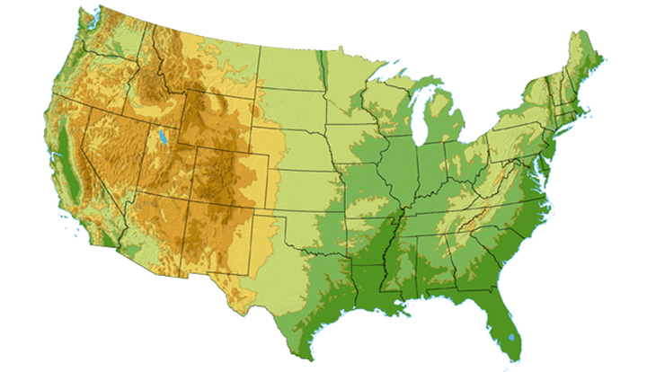
Tier-1 ISP: e.g., Sprint
Sprint US backbone network
DS3 (45 Mbps)
OC3 (155 Mbps)
OC12 (622 Mbps)
OC48 (2.4 Gbps)
Seattle
Tacoma
POP: point-of-presence
to/from backbone
Stockton
New York
Cheyenne
Chicago
Pennsauken
…
peering
….
Relay
San Jose
Roachdale
Wash. DC
Kansas City
Anaheim
…
…
…
Atlanta
to/from customers
Fort Worth
Orlando

Slide 48
Internet structure: network of networks
“Tier-2” ISPs: smaller (often regional) ISPs
Connect to one or more tier-1 ISPs, possibly other tier-2 ISPs
Tier-2 ISPs also peer privately with each other, interconnect at NAP
Tier-2 ISP pays tier-1 ISP for connectivity to rest of Internet
tier-2 ISP is customer of
tier-1 provider
Tier-2 ISP
Tier-2 ISP
Tier 1 ISP
NAP
Tier 1 ISP
Tier 1 ISP
Tier-2 ISP
Tier-2 ISP
Tier-2 ISP

Slide 49
Internet structure: network of networks
“Tier-3” ISPs and local ISPs
last hop (“access”) network (closest to end systems)
local
ISP
Tier 3
ISP
local
ISP
local
ISP
local
ISP
Local and tier- 3 ISPs are customers of
higher tier ISPs
connecting them to rest of Internet
Tier-2 ISP
Tier-2 ISP
Tier 1 ISP
NAP
Tier 1 ISP
Tier 1 ISP
Tier-2 ISP
Tier-2 ISP
Tier-2 ISP
local
ISP
local
ISP
local
ISP
local
ISP

Slide 50
Internet structure: network of networks
a packet passes through many networks!
local (taxi) → T1 (bus) → T2 (domestic) → T3 (international)
local
ISP
Tier 3
ISP
local
ISP
local
ISP
local
ISP
Tier-2 ISP
Tier-2 ISP
Tier 1 ISP
NAP
Tier 1 ISP
Tier 1 ISP
Tier-2 ISP
Tier-2 ISP
Tier-2 ISP
local
ISP
local
ISP
local
ISP
local
ISP

Slide 51
Organizing the giant structure
Networks are complex!
many “pieces”:
hosts
routers
links of various media
applications
protocols
hardware, software
Question:
Is there any hope of organizing structure of network?
Or at least our discussion of networks?

Slide 52
Turn to analogies in air travel
ticket (purchase)
baggage (check)
gates (load)
runway takeoff
airplane routing
ticket (complain)
baggage (claim)
gates (unload)
runway landing
airplane routing
airplane routing
a series of steps

Slide 53
Layering of airline functionality
ticket (purchase)
baggage (check)
gates (load)
runway (takeoff)
airplane routing
ticket (complain)
baggage (claim
gates (unload)
runway (land)
airplane routing
ticket
baggage
gate
takeoff/landing
airplane routing
airplane routing
airplane routing
departure
airport
intermediate air-traffic
control centers
arrival
airport
Layers: each layer implements a service
layers communicate with peer layers
rely on services provided by layer below

Slide 54
Why layering?
Explicit structure allows identification, relationship of complex system’s pieces
Modularization eases maintenance, updating of system
change of implementation of layer’s service transparent to rest of system
e.g., runway delay (wheels up time) depends on clearance of destination runway … doesn’t change the baggage tagging systems … or flight to gate assignment

Slide 55
Protocol “Layers”
Service of each layer encapsulated
Universally agreed services called
PROTOCOLS
A large part of this course will focus on
understanding protocols for
networking systems

Slide 56
Internet protocol stack
application: supporting network applications
FTP, SMTP, HTTP, DNS …
transport: host-host data transfer
TCP, UDP …
network: routing of datagrams from source to destination
IP, BGP, routing protocols …
link: data transfer between neighboring network elements
PPP, Ethernet, WiFi, Bluetooth …
physical: bits “on the wire”
OFDM, DSSS, CDMA, Coding …
application
transport
network
link
physical

Slide 57
Encapsulation
source
message
M
application
transport
network
link
physical
segment
H_{t}
M
datagram
H_{n}
H_{t}
M
frame
H_{l}
H_{n}
H_{t}
M
H_{l}
H_{n}
H_{t}
M
link
physical
H_{l}
H_{n}
H_{t}
M
switch
destination
H_{n}
H_{t}
M
network
link
physical
H_{n}
H_{t}
M
M
application
transport
network
link
physical
H_{l}
H_{n}
H_{t}
M
H_{l}
H_{n}
H_{t}
M
H_{t}
M
H_{n}
H_{t}
M
H_{l}
H_{n}
H_{t}
M
router

Slide 58
Success of Layering
Protocol stack successful in Internet
Internet uses wired physical layer links
Very reliable
Bit Error Rate (BER) = 10⁻⁸
What about wireless networks
Very unreliable due to channel fluctuations
Due to co-channel interference
Due to external noise
Does horizontal layering still hold ?

Slide 59
Assignment # -1
Watch “City in the Sky” documentary on Netflix
You will appreciate both airline systems and
The Internet much more than you do now …

Slide 60
Chapter 1: roadmap
1.1 What is the Internet?
1.2 Network edge
1.3 Network access and physical media
1.4 Network core
1.5 Internet structure and ISPs
1.6 Delay & loss in packet-switched networks
1.7 Protocol layers, service models
1.8 History

Slide 61
How do loss and delay occur?
packets queue in router buffers
packet arrival rate to link exceeds output link capacity
packets queue, wait for turn
packet being transmitted (delay)
A
B
packets queueing (delay)
free (available) buffers: arriving packets
dropped (loss) if no free buffers

Slide 62
Four sources of packet delay
1. nodal processing:
check bit errors
determine output link
2. queueing
time waiting at output link for transmission
depends on congestion level of router
transmission
A
propagation
B
nodal
processing
queueing

Slide 63
Delay in packet-switched networks
3. Transmission delay:
R=link bandwidth (bps)
L=packet length (bits)
time to send bits into link = L/R
4. Propagation delay:
d = length of physical link
s = propagation speed in medium (~2x10⁸ m/sec)
propagation delay = d/s
Note: s and R are very different quantities!
transmission
A
propagation
B
nodal
processing
queueing

Slide 64
Caravan analogy
100 km
100 km
ten-car
caravan
toll
booth
toll
booth
Cars “propagate” at 100 km/hr
Toll booth takes 12 sec to service a car (transmission time)
car~bit; caravan ~ packet
Q: How long until caravan is lined up before 2nd toll booth?
Time to “push” entire caravan through toll booth onto highway = 12*10 = 120 sec
Time for last car to propagate from 1st to 2nd toll both: 100km/(100km/hr)= 1 hr
A: 62 minutes

Slide 65
Caravan analogy (more)
100 km
100 km
ten-car
caravan
toll
booth
toll
booth
Yes! After 7 min, 1st car at 2nd booth and 3 cars still at 1st booth.
1st bit of packet can arrive at 2nd router before packet is fully transmitted at 1st router!
See Ethernet applet at AWL Web site
Cars now “propagate” at 1000 km/hr
Toll booth now takes 1 min to service a car
Q: Will cars arrive to 2nd booth before all cars serviced at 1st booth?

Slide 66
Nodal delay
d_{proc} = processing delay
typically a few microsecs or less
d_{queue} = queuing delay
depends on congestion
d_{trans} = transmission delay
= L/R, significant for low-speed links
d_{prop} = propagation delay
a few microsecs to hundreds of msecs

Slide 67
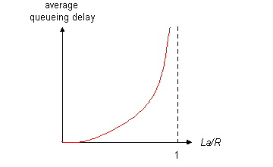
Queueing delay (revisited)
R=link bandwidth (bps)
L=packet length (bits)
a=average packet arrival rate
traffic intensity = La/R
La/R ~ 0: average queueing delay small
La/R -> 1: delays become large
La/R > 1: more “work” arriving than can be serviced, average delay infinite!

Slide 68
“Real” Internet delays and routes
What do “real” Internet delay & loss look like?
Traceroute program: provides delay measurement from source to router along end-end Internet path towards destination. For all i:
sends three packets that will reach router i on path towards destination
router i will return packets to sender
sender times interval between transmission and reply.
3 probes
3 probes
3 probes

Slide 69
“Real” Internet delays and routes
traceroute: gaia.cs.umass.edu to www.eurecom.fr
Three delay measurements from
gaia.cs.umass.edu to cs-gw.cs.umass.edu
1 cs-gw (128.119.240.254) 1 ms 1 ms 2 ms
2 border1-rt-fa5-1-0.gw.umass.edu (128.119.3.145) 1 ms 1 ms 2 ms
3 cht-vbns.gw.umass.edu (128.119.3.130) 6 ms 5 ms 5 ms
4 jn1-at1-0-0-19.wor.vbns.net (204.147.132.129) 16 ms 11 ms 13 ms
5 jn1-so7-0-0-0.wae.vbns.net (204.147.136.136) 21 ms 18 ms 18 ms
6 abilene-vbns.abilene.ucaid.edu (198.32.11.9) 22 ms 18 ms 22 ms
7 nycm-wash.abilene.ucaid.edu (198.32.8.46) 22 ms 22 ms 22 ms
8 62.40.103.253 (62.40.103.253) 104 ms 109 ms 106 ms
9 de2-1.de1.de.geant.net (62.40.96.129) 109 ms 102 ms 104 ms
10 de.fr1.fr.geant.net (62.40.96.50) 113 ms 121 ms 114 ms
11 renater-gw.fr1.fr.geant.net (62.40.103.54) 112 ms 114 ms 112 ms
12 nio-n2.cssi.renater.fr (193.51.206.13) 111 ms 114 ms 116 ms
13 nice.cssi.renater.fr (195.220.98.102) 123 ms 125 ms 124 ms
14 r3t2-nice.cssi.renater.fr (195.220.98.110) 126 ms 126 ms 124 ms
15 eurecom-valbonne.r3t2.ft.net (193.48.50.54) 135 ms 128 ms 133 ms
16 194.214.211.25 (194.214.211.25) 126 ms 128 ms 126 ms
17 * * *
18 * * *
19 fantasia.eurecom.fr (193.55.113.142) 132 ms 128 ms 136 ms
trans-oceanic
link
* means no response (probe lost, router not replying)

Slide 70
Packet loss
queue (aka buffer) preceding link has finite capacity
when packet arrives to full queue, packet is dropped (aka lost)
lost packet may be retransmitted by previous node, by source end system, or not retransmitted at all

Slide 71
Questions?

Slide 72
Introduction: Summary
Covered a “ton” of material!
Internet overview
what’s a protocol?
network edge, core, access network
packet-switching versus circuit-switching
Internet/ISP structure
performance: loss, delay
layering and service models
You now have:
context, overview, “feel” of networking
more depth, detail to follow!

Slide 73
Chapter 1: roadmap
1.1 What is the Internet?
1.2 Network edge
1.3 Network core
1.4 Network access and physical media
1.5 Internet structure and ISPs
1.6 Delay & loss in packet-switched networks
1.7 Protocol layers, service models
1.8 History

Slide 74
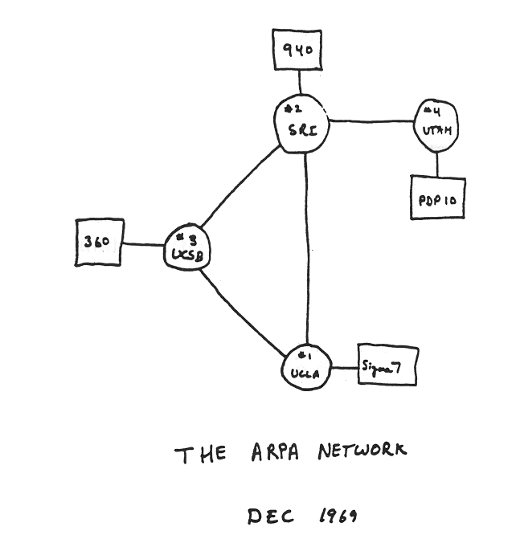
Internet History
1961-1972: Early packet-switching principles
1961: Kleinrock - queueing theory shows effectiveness of packet-switching
1964: Baran - packet-switching in military nets
1967: ARPAnet conceived by Advanced Research Projects Agency
1969: first ARPAnet node operational
1972:
ARPAnet public demonstration
NCP (Network Control Protocol) first host-host protocol
first e-mail program
ARPAnet has 15 nodes

Slide 75
Internet History
1972-1980: Internetworking, new and proprietary nets
1970: ALOHAnet satellite network in Hawaii
1974: Cerf and Kahn - architecture for interconnecting networks
1976: Ethernet at Xerox PARC
late70’s: proprietary architectures: DECnet, SNA, XNA
late 70’s: switching fixed length packets (ATM precursor)
1979: ARPAnet has 200 nodes
Cerf and Kahn’s internetworking principles:
minimalism, autonomy - no internal changes required to interconnect networks
best effort service model
stateless routers
decentralized control
define today’s Internet architecture

Slide 76
Internet History
1980-1990: new protocols, a proliferation of networks
1983: deployment of TCP/IP
1982: smtp e-mail protocol defined
1983: DNS defined for name-to-IP-address translation
1985: ftp protocol defined
1988: TCP congestion control
new national networks: Csnet, BITnet, NSFnet, Minitel
100,000 hosts connected to confederation of networks

Slide 77
Internet History
1990, 2000’s: commercialization, the Web, new apps
Early 1990’s: ARPAnet decommissioned
1991: NSF lifts restrictions on commercial use of NSFnet (decommissioned, 1995)
early 1990s: Web
hypertext [Bush 1945, Nelson 1960’s]
HTML, HTTP: Berners-Lee
1994: Mosaic, later Netscape
late 1990’s: commercialization of the Web
Late 1990’s – 2000’s:
more killer apps: instant messaging, P2P file sharing
network security to forefront
est. 50 million host, 100 million+ users
backbone links running at Gbps

Slide 78
Physical Media
Twisted Pair (TP)
two insulated copper wires
Category 3: traditional phone wires, 10 Mbps Ethernet
Category 5: 100Mbps Ethernet
Bit: propagates between transmitter/rcvr pairs
physical link: what lies between transmitter & receiver
guided media:
signals propagate in solid media: copper, fiber, coax
unguided media:
signals propagate freely, e.g., radio

Slide 79
Physical Media: coax, fiber
Fiber optic cable:
glass fiber carrying light pulses, each pulse a bit
high-speed operation:
high-speed point-to-point transmission (e.g., 10’s-100’s Gps)
low error rate: repeaters spaced far apart ; immune to electromagnetic noise
Coaxial cable:
two concentric copper conductors
bidirectional
baseband:
single channel on cable
legacy Ethernet
broadband:
multiple channels on cable
HFC

Slide 80
Physical media: radio
signal carried in electromagnetic spectrum
no physical “wire”
bidirectional
propagation environment effects:
reflection
obstruction by objects
interference
Radio link types:
terrestrial microwave
e.g. up to 45 Mbps channels
LAN (e.g., Wifi)
11Mbps, 54 Mbps
wide-area (e.g., cellular)
e.g. 3G: hundreds of kbps
satellite
Kbps to 45Mbps channel (or multiple smaller channels)
270 msec end-end delay
geosynchronous versus low altitude

Slide 81
Why layering?
Dealing with complex systems:
explicit structure allows identification, relationship of complex system’s pieces
layered reference model for discussion
modularization eases maintenance, updating of system
change of implementation of layer’s service transparent to rest of system
e.g., change in baggage procedure doesn’t affect rest of system (as long as all baggage sections know)
layering considered harmful?

