Slide 1
Chapter 5: The Data Link Layer
Our goals:
understand principles behind data link layer services:
error detection, correction
sharing a broadcast channel: multiple access
link layer addressing
reliable data transfer, flow control: done!
instantiation and implementation of various link layer technologies

Slide 2
Link Layer
5.1 Introduction and services
5.2 Error detection and correction
5.3Multiple access protocols
5.4 Link-Layer Addressing
5.5 Ethernet
5.6 Hubs and switches
5.7 PPP

Slide 3
Link Layer: Introduction
“link”
Some terminology:
hosts and routers are nodes
communication channels that connect adjacent nodes along communication path are links
wired links
wireless links
LANs
layer-2 packet is a frame, encapsulates datagram
data-link layer has responsibility of
transferring datagram from one node
to adjacent node over a link

Slide 4
Link layer: context
Datagram transferred by different link protocols over different links:
e.g., Ethernet on first link, frame relay on intermediate links, 802.11 on last link
Each link protocol provides different services
e.g., may or may not provide rdt over link
transportation analogy
trip from Princeton to Lausanne
limo: Princeton to JFK
plane: JFK to Geneva
train: Geneva to Lausanne
tourist = datagram
transport segment = communication link
travel agent = routing algorithm
transportation access = link layer protocol
Traffic lights,
Airport control,
Platform scheduling,

Slide 5
Link Layer Services
Framing, link access:
encapsulate datagram into frame, adding header, trailer
channel access if shared medium
“MAC” addresses used in frame headers to identify source, dest
different from IP address!
Reliable delivery between adjacent nodes
we learned how to do this already (chapter 3)!
seldom used on low bit error link (fiber, some twisted pair)
wireless links: high error rates
Q: why both link-level and end-end reliability?

Slide 6
Link Layer Services (more)
Flow Control:
pacing between adjacent sending and receiving nodes
Error Detection:
errors caused by signal attenuation, noise.
receiver detects presence of errors:
signals sender for retransmission or drops frame
Error Correction:
receiver identifies and corrects bit error(s) without resorting to retransmission
Half-duplex and full-duplex
with half duplex, nodes at both ends of link can transmit, but not at same time

Slide 7
Adaptors Communicating
datagram
link layer protocol
rcving
node
sending
node
frame
frame
adapter
adapter
link layer implemented in “adaptor” (aka NIC)
Ethernet card, PCMCI card, 802.11 card
sending side:
encapsulates datagram in a frame
adds error checking bits, rdt, flow control, etc.
receiving side
looks for errors, rdt, flow control, etc
extracts datagram, passes to rcving node
adapter is semi-autonomous
link & physical layers

Slide 8
Link Layer
5.1 Introduction and services
5.2 Error detection and correction
5.3Multiple access protocols
5.4 Link-Layer Addressing
5.5 Ethernet
5.6 Hubs and switches
5.7 PPP
5.8 Link Virtualization: ATM

Slide 9
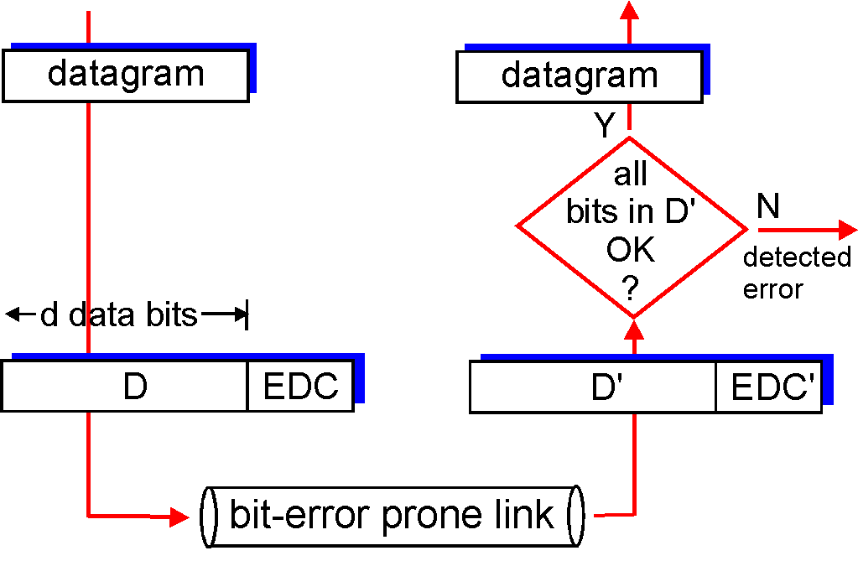
Error Detection
EDC= Error Detection and Correction bits (redundancy)
D = Data protected by error checking, may include header fields
Error detection not 100% reliable!
protocol may miss some errors, but rarely
larger EDC field yields better detection and correction

Slide 10
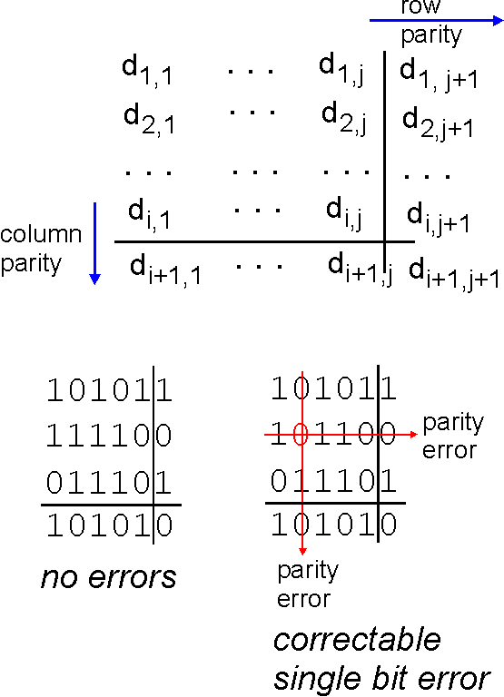
Parity Checking
Single Bit Parity:
Detect single bit errors
Two Dimensional Bit Parity:
Detect and correct single bit errors
0
0

Slide 11
Internet checksum
Goal: detect “errors” (e.g., flipped bits) in transmitted segment (note: used at transport layer only)
Sender:
treat segment contents as sequence of 16-bit integers
checksum: addition (1’s complement sum) of segment contents
sender puts checksum value into UDP checksum field
Receiver:
compute checksum of received segment
check if computed checksum equals checksum field value:
NO - error detected
YES - no error detected. But maybe errors nonetheless? More later ….

Slide 12
Link Layer
5.1 Introduction and services
5.2 Error detection and correction
5.3Multiple access protocols
5.4 Link-Layer Addressing
5.5 Ethernet
5.6 Hubs and switches
5.7 PPP
5.8 Link Virtualization: ATM

Slide 13
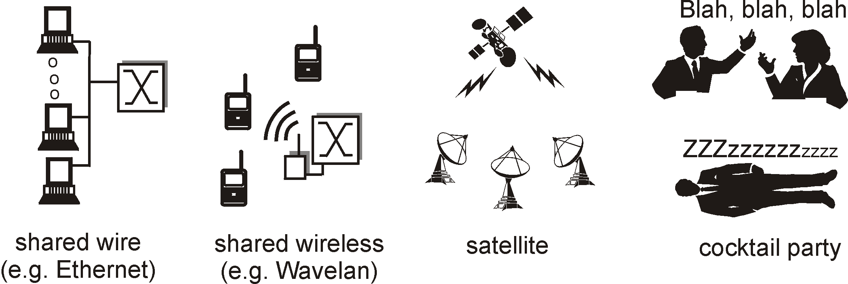
Multiple Access Links and Protocols
Two types of “links”:
point-to-point
PPP for dial-up access
point-to-point link between Ethernet switch and host
broadcast (shared wire or medium)
traditional Ethernet
Bluetooth
802.11 wireless LAN

Slide 14
Multiple Access protocols
single shared broadcast channel
two or more simultaneous transmissions by nodes: interference
collision if node receives two or more signals at the same time
multiple access protocol
distributed algorithm that determines how nodes share channel, i.e., determine when node can transmit
communication about channel sharing must use channel itself!
no out-of-band channel for coordination

Slide 15
Ideal Multiple Access Protocol
Broadcast channel of rate R bps
1. When one node wants to transmit, it can send at rate R.
2. When M nodes want to transmit, each can send at average rate R/M
3. Fully decentralized:
no special node to coordinate transmissions
no synchronization of clocks, slots
4. Simple

Slide 16
MAC Protocols: a taxonomy
Three broad classes:
Channel Partitioning
divide channel into smaller “pieces” (time slots, frequency, code)
allocate piece to node for exclusive use
Random Access
channel not divided, allow collisions
“recover” from collisions
“Taking turns”
Nodes take turns, but nodes with more to send can take longer turns

Slide 17
Channel Partitioning MAC protocols: TDMA
TDMA: time division multiple access
access to channel in "rounds"
each station gets fixed length slot (length = pkt trans time) in each round
unused slots go idle
example: 6-station LAN, 1,3,4 have pkt, slots 2,5,6 idle
TDM (Time Division Multiplexing): channel divided into N time slots, one per user; inefficient with low duty cycle users and at light load.
FDM (Frequency Division Multiplexing): frequency subdivided.

Slide 18
Channel Partitioning MAC protocols: FDMA
FDMA: frequency division multiple access
channel spectrum divided into frequency bands
each station assigned fixed frequency band
unused transmission time in frequency bands go idle
example: 6-station LAN, 1,3,4 have pkt, frequency bands 2,5,6 idle
TDM (Time Division Multiplexing): channel divided into N time slots, one per user; inefficient with low duty cycle users and at light load.
FDM (Frequency Division Multiplexing): frequency subdivided.
time
frequency bands

Slide 19
Random Access Protocols
When node has packet to send
transmit at full channel data rate R.
no a priori coordination among nodes
two or more transmitting nodes ➜ “collision”,
random access MAC protocol specifies:
how to detect collisions
how to recover from collisions (e.g., via delayed retransmissions)
Examples of random access MAC protocols:
slotted ALOHA
ALOHA
CSMA, CSMA/CD, CSMA/CA

Slide 20
Slotted ALOHA
Assumptions
all frames same size
time is divided into equal size slots, time to transmit 1 frame
nodes start to transmit frames only at beginning of slots
nodes are synchronized
if 2 or more nodes transmit in slot, all nodes detect collision
Operation
when node obtains fresh frame, it transmits in next slot
no collision, node can send new frame in next slot
if collision, node retransmits frame in each subsequent slot with prob. p until success

Slide 21
Slotted ALOHA
Pros
single active node can continuously transmit at full rate of channel
highly decentralized: only slots in nodes need to be in sync
simple
Cons
collisions, wasting slots
idle slots
nodes must be able to detect collision in less than time to transmit packet
clock synchronization

Slide 22
Slotted Aloha efficiency
Efficiency is the long-run fraction of successful slots when there are many nodes, each with many frames to send
For max efficiency with N nodes, find p* that maximizes Np(1-p)^{N-1}
For many nodes, take limit of Np*(1-p*)^{N-1} as N goes to infinity, gives 1/e = .37
Suppose N nodes with many frames to send, each transmits in slot with probability p
prob that node 1 has success in a slot = p(1-p)^{N-1}
prob that any node has a success = Np(1-p)^{N-1}
At best: channel
used for useful
transmissions 37%
of time!

Slide 23
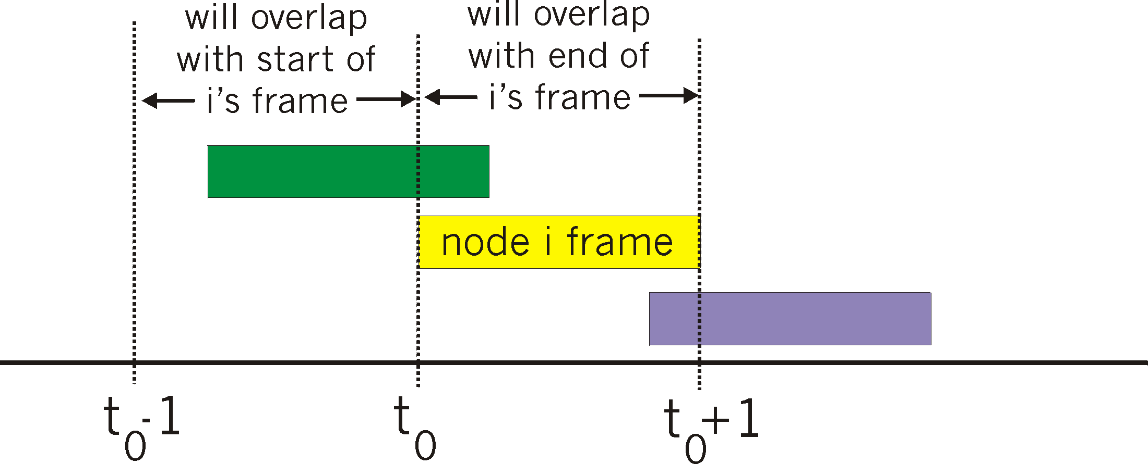
Pure (unslotted) ALOHA
unslotted Aloha: simpler, no synchronization
when frame first arrives
transmit immediately
collision probability increases:
frame sent at t₀ collides with other frames sent in [t₀-1,t₀+1]

Slide 24
Pure Aloha efficiency
P(success by given node) = P(node transmits) .
P(no other node transmits in [t₀-1,t₀] .
P(no other node transmits in [t₀,t₀+1]
= p . (1-p)^{N-1 .} (1-p)^{N-1}
= p . (1-p)^{2(N-1)}
… choosing optimum p and then letting n -> infty ...
^{= 1/(2e) = .18}
Even worse !

Slide 25
CSMA (Carrier Sense Multiple Access)
CSMA: listen before transmit:
If channel sensed idle: transmit entire frame
If channel sensed busy, defer transmission
Human analogy: don’t interrupt others!

Slide 26
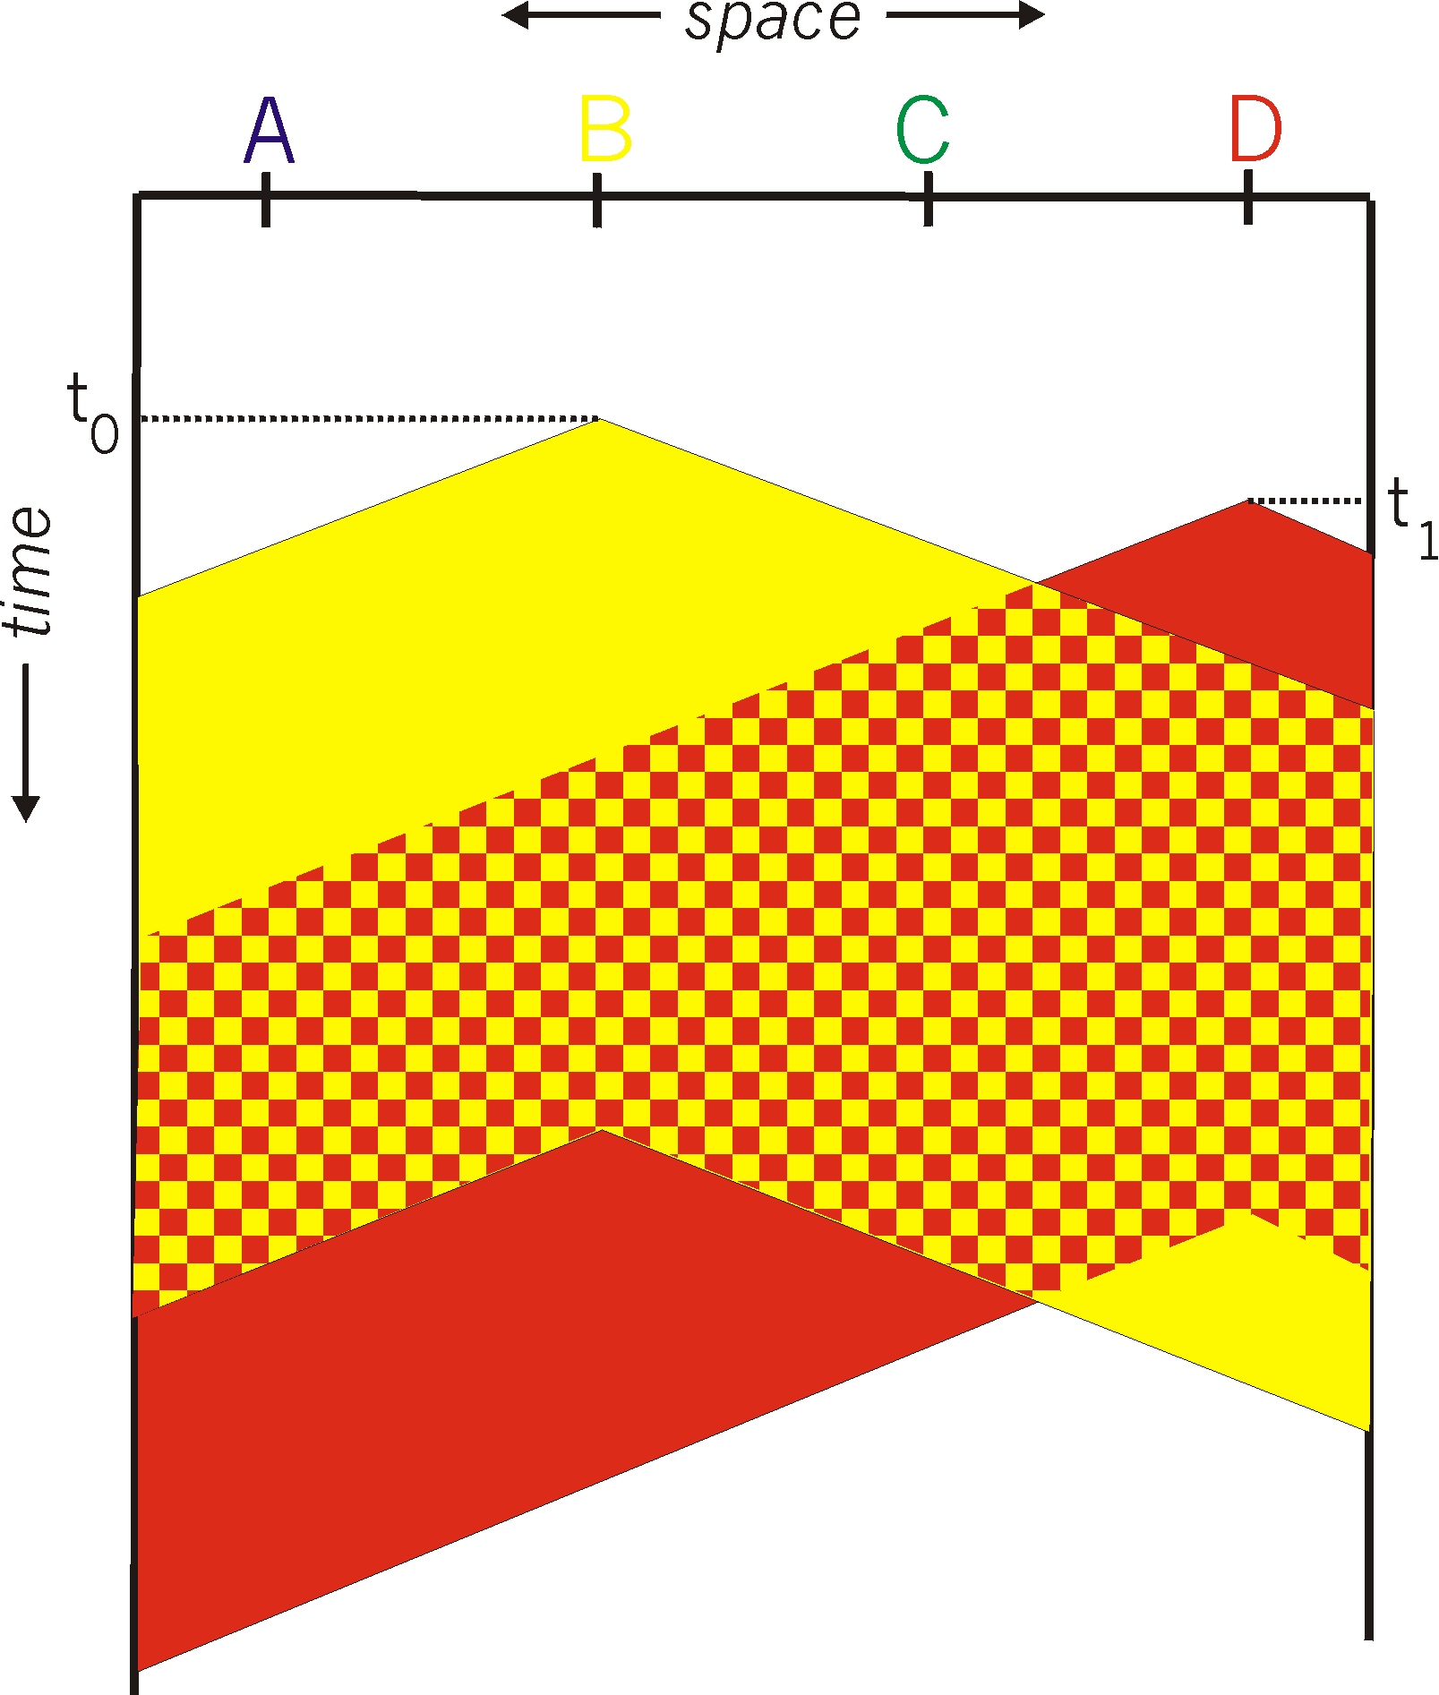
CSMA collisions
spatial layout of nodes
collisions can still occur:
propagation delay means
two nodes may not hear
each other’s transmission
collision:
entire packet transmission
time wasted
note:
role of distance & propagation delay in determining collision probability

Slide 27
CSMA/CD (Collision Detection)
CSMA/CD: carrier sensing, deferral as in CSMA
collisions detected within short time
colliding transmissions aborted, reducing channel wastage
collision detection:
easy in wired LANs: measure signal strengths, compare transmitted, received signals
difficult in wireless LANs: receiver shut off while transmitting
human analogy: the polite conversationalist

Slide 28
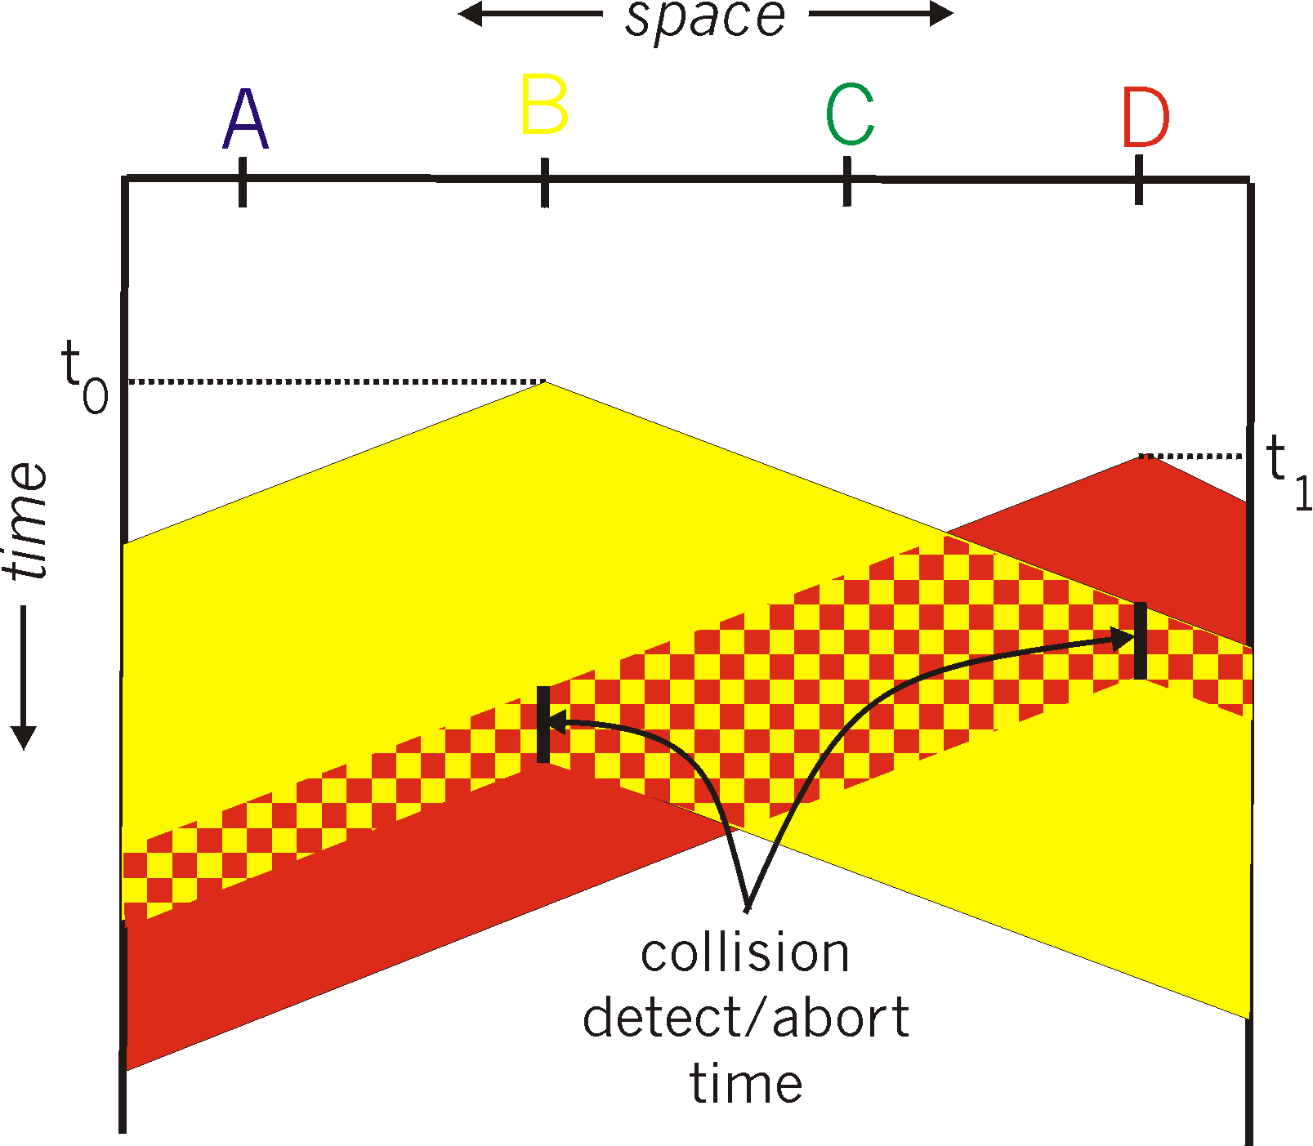
CSMA/CD collision detection

Slide 29
“Taking Turns” MAC protocols
channel partitioning MAC protocols:
share channel efficiently and fairly at high load
inefficient at low load: delay in channel access, 1/N bandwidth allocated even if only 1 active node!
Random access MAC protocols
efficient at low load: single node can fully utilize channel
high load: collision overhead
“taking turns” protocols
look for best of both worlds!

Slide 30
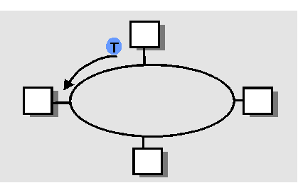
“Taking Turns” MAC protocols
Polling:
master node “invites” slave nodes to transmit in turn
concerns:
polling overhead
latency
single point of failure (master)
Token passing:
control token passed from one node to next sequentially.
token message
concerns:
token overhead
latency
single point of failure (token)

Slide 31
Summary of MAC protocols
What do you do with a shared media?
Channel Partitioning, by time, frequency or code
Time Division, Frequency Division
Random partitioning (dynamic),
ALOHA, S-ALOHA, CSMA, CSMA/CD
carrier sensing: easy in some technologies (wire), hard in others (wireless)
CSMA/CD used in Ethernet
CSMA/CA used in 802.11
Taking Turns
polling from a central site, token passing

Slide 32
Link Layer
5.1 Introduction and services
5.2 Error detection and correction
5.3Multiple access protocols
5.4 Link-Layer Addressing
5.5 Ethernet
5.6 Hubs and switches
5.7 PPP
5.8 Link Virtualization: ATM

Slide 33
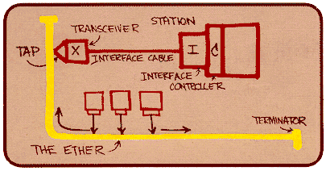
Ethernet
“dominant” wired LAN technology:
cheap $20 for 100Mbs!
first widely used LAN technology
Simpler, cheaper than token LANs and ATM
Kept up with speed race: 10 Mbps – 10 Gbps
Metcalfe’s Ethernet
sketch

Slide 34
Star topology
Bus topology popular through mid 90s
Now star topology prevails
Connection choices: hub or switch (more later)
hub or
switch

Slide 35
Ethernet Frame Structure
Sending adapter encapsulates IP datagram (or other network layer protocol packet) in Ethernet frame
Preamble:
7 bytes with pattern 10101010 followed by one byte with pattern 10101011
used to synchronize receiver, sender clock rates

Slide 36
Ethernet Frame Structure (more)
Addresses: 6 bytes
if adapter receives frame with matching destination address, or with broadcast address (eg ARP packet), it passes data in frame to net-layer protocol
otherwise, adapter discards frame
Type: indicates the higher layer protocol (mostly IP but others may be supported such as Novell IPX and AppleTalk)
CRC: checked at receiver, if error is detected, the frame is simply dropped

Slide 37
Unreliable, connectionless service
Connectionless: No handshaking between sending and receiving adapter.
Unreliable: receiving adapter doesn’t send acks or nacks to sending adapter
stream of datagrams passed to network layer can have gaps
gaps will be filled if app is using TCP
otherwise, app will see the gaps

Slide 38
Ethernet uses CSMA/CD
No slots
adapter doesn’t transmit if it senses that some other adapter is transmitting, that is, carrier sense
transmitting adapter aborts when it senses that another adapter is transmitting, that is, collision detection
Before attempting a retransmission, adapter waits a random time, that is, random access

Slide 39
Ethernet CSMA/CD algorithm
1. Adaptor receives datagram from net layer & creates frame
2. If adapter senses channel idle, it starts to transmit frame. If it senses channel busy, waits until channel idle and then transmits
3. If adapter transmits entire frame without detecting another transmission, the adapter is done with frame !
4. If adapter detects another transmission while transmitting, aborts and sends jam signal
5. After aborting, adapter enters exponential backoff: after the mth collision, adapter chooses a K at random from {0,1,2,…,2^{m}-1}. Adapter waits K·512 bit times and returns to Step 2

Slide 40
Question
Is it possible that:
A collision happens in Ethernet
But is not detected at the MAC layer
Remember: CSMA/CD does not use MAC layer ACKs

Slide 41
Ethernet’s CSMA/CD (more)
Jam Signal: make sure all other transmitters are aware of collision; 48 bits
Bit time: .1 microsec for 10 Mbps Ethernet ; for K=1023, wait time is about 50 msec
Exponential Backoff:
Goal: adapt retransmission attempts to estimated current load
heavy load: random wait will be longer
first collision: choose K from {0,1}; delay is K· 512 bit transmission times
after second collision: choose K from {0,1,2,3}…
after ten collisions, choose K from {0,1,2,3,4,…,1023}
See/interact with Java
applet on AWL Web site:
highly recommended !

Slide 42
CSMA/CD efficiency
T_{prop} = max prop between 2 nodes in LAN
t_{trans} = time to transmit max-size frame
Efficiency goes to 1 as t_{prop} goes to 0
Goes to 1 as t_{trans} goes to infinity
Much better than ALOHA, but still decentralized, simple, and cheap

Slide 43
LAN technologies
Data link layer so far:
services, error detection/correction, multiple access
Next: LAN technologies
addressing
Ethernet
hubs, switches
PPP

Slide 44
Can we use the same concepts from Ethernet in wireless?

Slide 45
Link Layer
5.1 Introduction and services
5.2 Error detection and correction
5.3Multiple access protocols
5.4 Link-Layer Addressing
5.5 Ethernet
5.6 Hubs and switches

Slide 46
MAC Addresses and ARP
32-bit IP address:
network-layer address
used to get datagram to destination IP subnet
MAC (or LAN or physical or Ethernet) address:
used to get frame from one interface to another physically-connected interface (same network)
48 bit MAC address (for most LANs) burned in the adapter ROM

Slide 47
LAN Addresses and ARP
Each adapter on LAN has unique LAN address
1A-2F-BB-76-09-AD
Broadcast address =
FF-FF-FF-FF-FF-FF
LAN
(wired or
wireless)
= adapter
71-65-F7-2B-08-53
58-23-D7-FA-20-B0
0C-C4-11-6F-E3-98

Slide 48
LAN Address (more)
MAC address allocation administered by IEEE
manufacturer buys portion of MAC address space (to assure uniqueness)
Analogy:
(a) MAC address: like Social Security Number
(b) IP address: like postal address
MAC flat address ➜ portability
can move LAN card from one LAN to another
IP hierarchical address NOT portable
depends on IP subnet to which node is attached

Slide 49
ARP: Address Resolution Protocol
Question: how to determine
MAC address of B
knowing B’s IP address?
Each IP node (Host, Router) on LAN has ARP table
ARP Table: IP/MAC address mappings for some LAN nodes
< IP address; MAC address; TTL>
TTL (Time To Live): time after which address mapping will be forgotten (typically 20 min)
237.196.7.78
1A-2F-BB-76-09-AD
237.196.7.23
237.196.7.14
LAN
71-65-F7-2B-08-53
58-23-D7-FA-20-B0
0C-C4-11-6F-E3-98
237.196.7.88

Slide 50
ARP protocol: Same LAN (network)
A wants to send datagram to B, and B’s MAC address not in A’s ARP table.
A broadcasts ARP query packet, containing B's IP address
Dest MAC address = FF-FF-FF-FF-FF-FF
all machines on LAN receive ARP query
B receives ARP packet, replies to A with its (B's) MAC address
frame sent to A’s MAC address (unicast)
A caches (saves) IP-to-MAC address pair in its ARP table until information becomes old (times out)
soft state: information that times out (goes away) unless refreshed
ARP is “plug-and-play”:
nodes create their ARP tables without intervention from net administrator

Slide 51
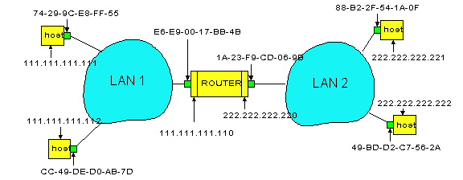
Routing to another LAN
walkthrough: send datagram from A to B via R
assume A know’s B IP address
Two ARP tables in router R, one for each IP network (LAN)
In routing table at source Host, find router 111.111.111.110
In ARP table at source, find MAC address E6-E9-00-17-BB-4B, etc
A
R
B

Slide 52
A creates datagram with source A, destination B
A uses ARP to get R’s MAC address for 111.111.111.110
A creates link-layer frame with R's MAC address as dest, frame contains A-to-B IP datagram
A’s adapter sends frame
R’s adapter receives frame
R removes IP datagram from Ethernet frame, sees its destined to B
R uses ARP to get B’s MAC address
R creates frame containing A-to-B IP datagram sends to B
A
R
B

Slide 53
Link Layer
5.1 Introduction and services
5.2 Error detection and correction
5.3Multiple access protocols
5.4 Link-Layer Addressing
5.5 Ethernet
5.6 Interconnections: Hubs and switches

Slide 54
Interconnecting with hubs
Backbone hub interconnects LAN segments
Extends max distance between nodes
But individual segment collision domains become one large collision domain
Also, can’t interconnect 10BaseT & 100BaseT
hub
hub
hub
hub

Slide 55
Hubs
Hubs are essentially physical-layer repeaters:
bits coming from one link go out all other links
at the same rate
no frame buffering
no CSMA/CD at hub: adapters detect collisions
provides net management functionality
twisted pair
hub

Slide 56
10BaseT and 100BaseT
10/100 Mbps rate; latter called “fast ethernet”
T stands for Twisted Pair
Nodes connect to a hub: “star topology”; 100 m max distance between nodes and hub
twisted pair
hub

Slide 57
Gbit Ethernet
uses standard Ethernet frame format
allows for point-to-point links and shared broadcast channels
in shared mode, CSMA/CD is used; short distances between nodes required for efficiency
uses hubs, called here “Buffered Distributors”
Full-Duplex at 1 Gbps for point-to-point links
10 Gbps now !

Slide 58
Switch
Link layer device
stores and forwards Ethernet frames
examines frame header and selectively forwards frame based on MAC dest address
when frame is to be forwarded on segment, uses CSMA/CD to access segment
transparent
hosts are unaware of presence of switches
plug-and-play, self-learning
switches do not need to be configured

Slide 59
Forwarding
switch
1
2
3
hub
hub
hub
How do determine onto which LAN segment to forward frame?
Looks like a routing problem...

Slide 60
Self learning
A switch has a switch table
entry in switch table:
(MAC Address, Interface, Time Stamp)
stale entries in table dropped (TTL can be 60 min)
switch learns which hosts can be reached through which interfaces
when frame received, switch “learns” location of sender: incoming LAN segment
records sender/location pair in switch table

Slide 61
Filtering/Forwarding
When switch receives a frame:
index switch table using MAC dest address
if entry found for destination then{
if dest on segment from which frame arrived then drop the frame
else forward the frame on interface indicated
}
else flood
forward on all but the interface
on which the frame arrived

Slide 62
Switch example
Suppose C sends frame to D
switch
address
interface
1
A
B
E
G
1
1
2
3
2
3
hub
hub
hub
A
I
D
F
B
C
G
H
E
Switch receives frame from C
notes in bridge table that C is on interface 1
because D is not in table, switch forwards frame into interfaces 2 and 3
frame received by D

Slide 63
Switch example
Suppose D replies back with frame to C.
address
interface
switch
A
B
E
G
C
1
1
2
3
1
hub
hub
hub
A
I
D
F
B
C
G
H
E
Switch receives frame from from D
notes in bridge table that D is on interface 2
because C is in table, switch forwards frame only to interface 1
frame received by C

Slide 64
Switch: traffic isolation
switch installation breaks subnet into LAN segments
switch filters packets:
same-LAN-segment frames not usually forwarded onto other LAN segments
segments become separate collision domains
switch
collision domain
hub
hub
hub
collision domain
collision domain

Slide 65
Switches: dedicated access
Switch with many interfaces
Hosts have direct connection to switch
No collisions; full duplex
Switching: A-to-A’ and B-to-B’ simultaneously, no collisions
A
C’
B
switch
C
B’
A’

Slide 66
More on Switches
cut-through switching: frame forwarded from input to output port without first collecting entire frame
slight reduction in latency
combinations of shared/dedicated, 10/100/1000 Mbps interfaces

Slide 67
Institutional network
mail server
to external
network
router
web server
switch
IP subnet
hub
hub
hub

Slide 68
So …
What’s the difference between
switches and routers?

Slide 69
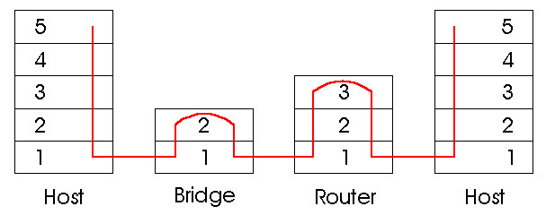
Switches vs. Routers
both store-and-forward devices
routers: network layer devices (examine network layer headers)
switches are link layer devices
routers maintain routing tables, implement routing algorithms
switches maintain switch tables, implement filtering, learning algorithms

Slide 70
Summary comparison

Slide 71
Questions?

Slide 72
Link Layer
5.1 Introduction and services
5.2 Error detection and correction
5.3Multiple access protocols
5.4 Link-Layer Addressing
5.5 Ethernet
5.6 Hubs and switches
5.7 PPP
5.8 Link Virtualization: ATM

Slide 73
Point to Point Data Link Control
one sender, one receiver, one link: easier than broadcast link:
no Media Access Control
no need for explicit MAC addressing
e.g., dialup link, ISDN line
popular point-to-point DLC protocols:
PPP (point-to-point protocol)
HDLC: High level data link control (Data link used to be considered “high layer” in protocol stack!

Slide 74
PPP Design Requirements [RFC 1557]
packet framing: encapsulation of network-layer datagram in data link frame
carry network layer data of any network layer protocol (not just IP) at same time
ability to demultiplex upwards
bit transparency: must carry any bit pattern in the data field
error detection (no correction)
connection liveness: detect, signal link failure to network layer
network layer address negotiation: endpoint can learn/configure each other’s network address

Slide 75
PPP non-requirements
no error correction/recovery
no flow control
out of order delivery OK
no need to support multipoint links (e.g., polling)
Error recovery, flow control, data re-ordering
all relegated to higher layers!

Slide 76
PPP Data Frame
Flag: delimiter (framing)
Address: does nothing (only one option)
Control: does nothing; in the future possible multiple control fields
Protocol: upper layer protocol to which frame delivered (eg, PPP-LCP, IP, IPCP, etc)

Slide 77
PPP Data Frame
info: upper layer data being carried
check: cyclic redundancy check for error detection

Slide 78
Byte Stuffing
“data transparency” requirement: data field must be allowed to include flag pattern <01111110>
Q: is received <01111110> data or flag?
Sender: adds (“stuffs”) extra < 01111110> byte after each < 01111110> data byte
Receiver:
two 01111110 bytes in a row: discard first byte, continue data reception
single 01111110: flag byte

Slide 79
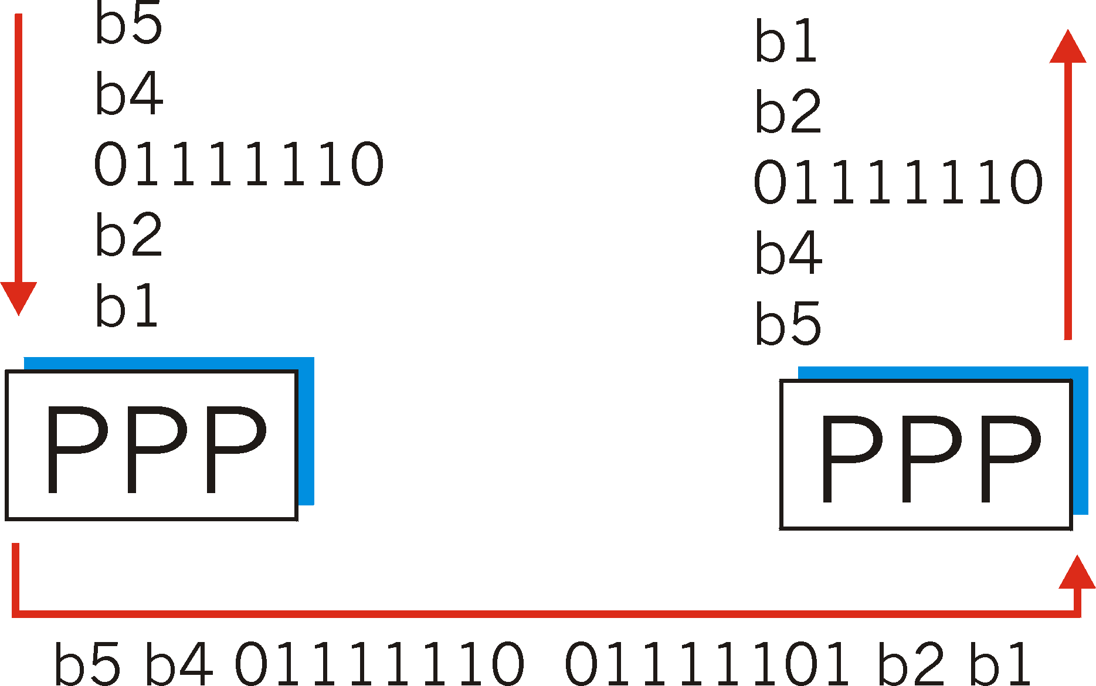
Byte Stuffing
flag byte
pattern
in data
to send
flag byte pattern plus
stuffed byte in transmitted data

Slide 80
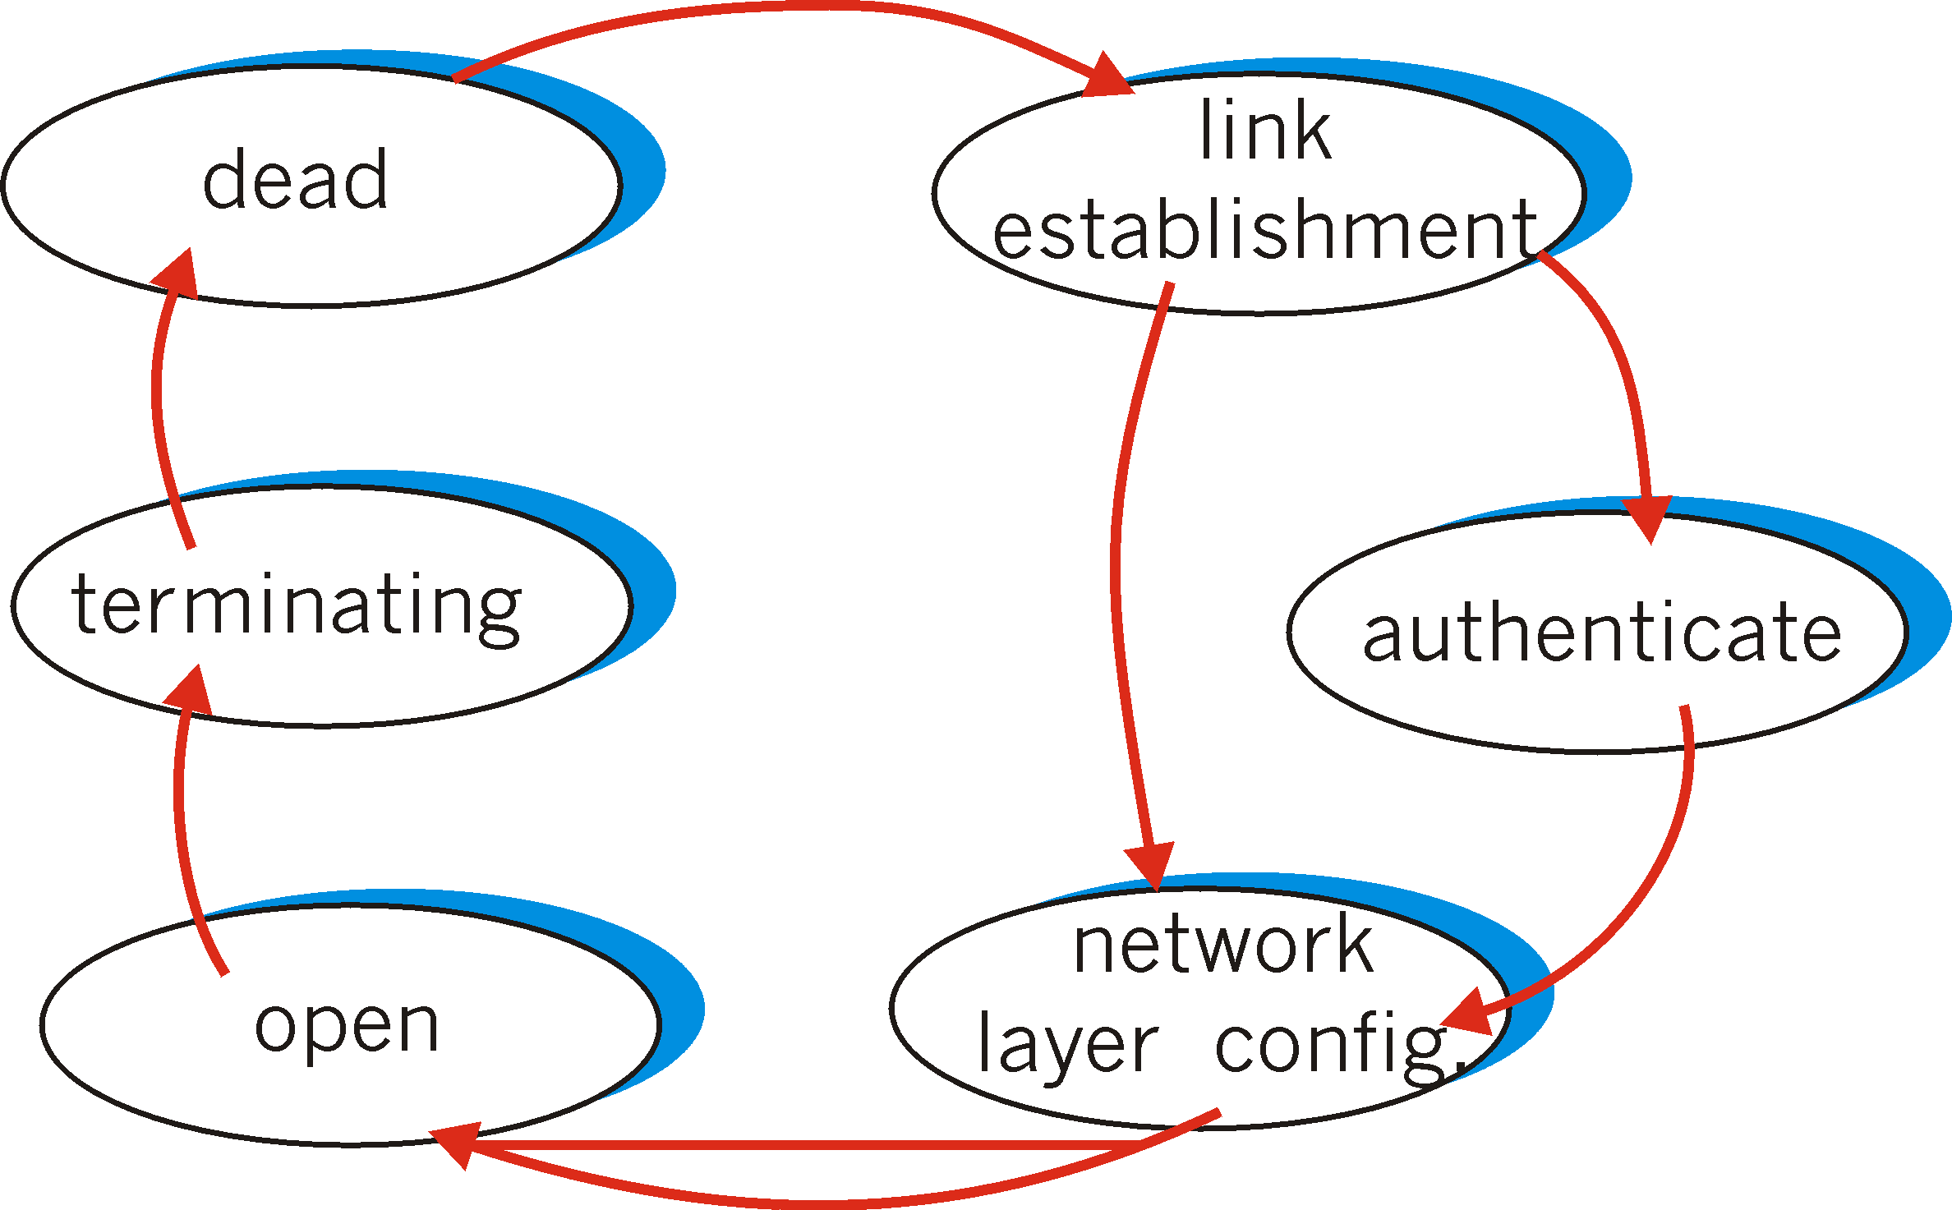
PPP Data Control Protocol
Before exchanging network-layer data, data link peers must
configure PPP link (max. frame length, authentication)
learn/configure network
layer information
for IP: carry IP Control Protocol (IPCP) msgs (protocol field: 8021) to configure/learn IP address

Slide 81
Link Layer
5.1 Introduction and services
5.2 Error detection and correction
5.3Multiple access protocols
5.4 Link-Layer Addressing
5.5 Ethernet
5.6 Hubs and switches
5.7 PPP
5.8 Link Virtualization: ATM and MPLS

Slide 82
Virtualization of networks
Virtualization of resources: a powerful abstraction in systems engineering:
computing examples: virtual memory, virtual devices
Virtual machines: e.g., java
IBM VM os from 1960’s/70’s
layering of abstractions: don’t sweat the details of the lower layer, only deal with lower layers abstractly

Slide 83
The Internet: virtualizing networks
1974: multiple unconnected nets
ARPAnet
data-over-cable networks
packet satellite network (Aloha)
packet radio network
… differing in:
addressing conventions
packet formats
error recovery
routing
ARPAnet
satellite net
"A Protocol for Packet Network Intercommunication",
V. Cerf, R. Kahn, IEEE Transactions on Communications,
May, 1974, pp. 637-648.

Slide 84
The Internet: virtualizing networks
Internetwork layer (IP):
addressing: internetwork appears as a single, uniform entity, despite underlying local network heterogeneity
network of networks
Gateway:
“embed internetwork packets in local packet format or extract them”
route (at internetwork level) to next gateway
gateway
ARPAnet
satellite net

Slide 85
Cerf & Kahn’s Internetwork Architecture
What is virtualized?
two layers of addressing: internetwork and local network
new layer (IP) makes everything homogeneous at internetwork layer
underlying local network technology
cable
satellite
56K telephone modem
today: ATM, MPLS
… “invisible” at internetwork layer. Looks like a link layer technology to IP!

Slide 86
ATM and MPLS
ATM, MPLS separate networks in their own right
different service models, addressing, routing from Internet
viewed by Internet as logical link connecting IP routers
just like dialup link is really part of separate network (telephone network)
ATM, MPSL: of technical interest in their own right

Slide 87
Asynchronous Transfer Mode: ATM
1990’s/00 standard for high-speed (155Mbps to 622 Mbps and higher) Broadband Integrated Service Digital Network architecture
Goal: integrated, end-end transport to carry voice, video, data
meeting timing/QoS requirements of voice, video (versus Internet best-effort model)
“next generation” telephony:
packet-switching (fixed length packets, called “cells”) using virtual circuits

Slide 88
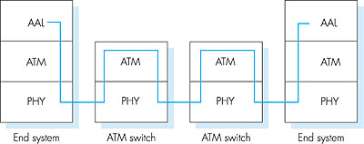
ATM architecture
adaptation layer: only at edge of ATM network
data segmentation/reassembly
roughly analagous to Internet transport layer
ATM layer: “network” layer
cell switching, routing
physical layer

Slide 89
ATM: network or link layer?
Vision: end-to-end transport: “ATM from desktop to desktop”
ATM is a network technology
Reality: used to connect IP backbone routers
“IP over ATM”
ATM as switched link layer, connecting IP routers
IP
network
ATM
network

Slide 90
ATM Adaptation Layer (AAL)
ATM Adaptation Layer (AAL): “adapts” upper layers (IP or native ATM applications) to ATM layer below
AAL present only in end systems, not in switches
AAL layer segment (header/trailer fields, data) fragmented across multiple ATM cells
analogy: TCP segment in many IP packets

Slide 91
ATM Layer: Virtual Circuits
VC transport: cells carried on VC from source to dest
call setup, teardown for each call before data can flow
each packet carries VC identifier (not destination ID)
every switch on source-dest path maintain “state” for each passing connection
link,switch resources (bandwidth, buffers) may be allocated to VC: to get circuit-like perf.
Permanent VCs (PVCs)
long lasting connections
typically: “permanent” route between two IP routers
Switched VCs (SVC):
dynamically set up on per-call basis

Slide 92
ATM VCs
Advantages of ATM VC approach:
QoS performance guarantee for connection mapped to VC (bandwidth, delay, delay jitter)
Drawbacks of ATM VC approach:
Inefficient support of datagram traffic
SVC introduces call setup latency, processing overhead for short lived connections

Slide 93
ATM Layer: ATM cell
5-byte ATM cell header
48-byte payload
Why?: small payload -> short cell-creation delay for digitized voice
halfway between 32 and 64 (compromise!)
Cell header
Cell format

Slide 94
ATM cell header
VCI: virtual channel ID
will change from link to link thru net
PT: Payload type (e.g. RM cell versus data cell)
CLP: Cell Loss Priority bit
CLP = 1 implies low priority cell, can be discarded if congestion
HEC: Header Error Checksum
cyclic redundancy check

Slide 95
IP-Over-ATM
IP over ATM
replace “network” (e.g., LAN segment) with ATM network
ATM addresses, IP addresses
Classic IP only
3 “networks” (e.g., LAN segments)
MAC (802.3) and IP addresses
ATM
network
Ethernet
LANs
Ethernet
LANs

Slide 96
IP-Over-ATM
app
transport
IP
AAL
ATM
phy
app
transport
IP
Eth
phy
IP
AAL
ATM
phy
Eth
ATM
phy
phy
ATM
phy

Slide 97
Datagram Journey in IP-over-ATM Network
at Source Host:
IP layer maps between IP, ATM dest address (using ARP)
passes datagram to AAL5
AAL5 encapsulates data, segments cells, passes to ATM layer
ATM network: moves cell along VC to destination
at Destination Host:
AAL5 reassembles cells into original datagram
if CRC OK, datagram is passed to IP

Slide 98
Multiprotocol label switching (MPLS)
initial goal: speed up IP forwarding by using fixed length label (instead of IP address) to do forwarding
borrowing ideas from Virtual Circuit (VC) approach
but IP datagram still keeps IP address!
PPP or Ethernet
header
IP header
remainder of link-layer frame
MPLS header
label
Exp
S
TTL
20
3
1
5

Slide 99
MPLS capable routers
a.k.a. label-switched router
forwards packets to outgoing interface based only on label value (don’t inspect IP address)
MPLS forwarding table distinct from IP forwarding tables
signaling protocol needed to set up forwarding
RSVP-TE
forwarding possible along paths that IP alone would not allow (e.g., source-specific routing) !!
use MPLS for traffic engineering

Slide 100
MPLS forwarding tables
in out out
label label dest interface
10 A 0
in out out
label label dest interface
12 D 0
8 A 1
10 6 A 1
12 9 D 0
R6
0
0
D
1
1
R4
R3
R5
0
0
A
R2
in out out
label label dest interface
R1
in out out
label label dest interface
6 - A 0
8 6 A 0

Slide 101
Chapter 5: Summary
principles behind data link layer services:
error detection, correction
sharing a broadcast channel: multiple access
link layer addressing
instantiation and implementation of various link layer technologies
Ethernet
switched LANS
PPP
virtualized networks as a link layer: ATM, MPLS

Slide 102
ATM Physical Layer (more)
Two pieces (sublayers) of physical layer:
Transmission Convergence Sublayer (TCS): adapts ATM layer above to PMD sublayer below
Physical Medium Dependent: depends on physical medium being used
TCS Functions:
Header checksum generation: 8 bits CRC
Cell delineation
With “unstructured” PMD sublayer, transmission of idle cells when no data cells to send

Slide 103
ATM Physical Layer
Physical Medium Dependent (PMD) sublayer
SONET/SDH: transmission frame structure (like a container carrying bits);
bit synchronization;
bandwidth partitions (TDM);
several speeds: OC3 = 155.52 Mbps; OC12 = 622.08 Mbps; OC48 = 2.45 Gbps, OC192 = 9.6 Gbps
TI/T3: transmission frame structure (old telephone hierarchy): 1.5 Mbps/ 45 Mbps
unstructured: just cells (busy/idle)

Slide 104
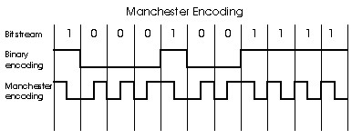
Manchester encoding
Used in 10BaseT
Each bit has a transition
Allows clocks in sending and receiving nodes to synchronize to each other
no need for a centralized, global clock among nodes!
Hey, this is physical-layer stuff!

Slide 105
Checksumming: Cyclic Redundancy Check
view data bits, D, as a binary number
choose r+1 bit pattern (generator), G
goal: choose r CRC bits, R, such that
<D,R> exactly divisible by G (modulo 2)
receiver knows G, divides <D,R> by G. If non-zero remainder: error detected!
can detect all burst errors less than r+1 bits
widely used in practice

Slide 106
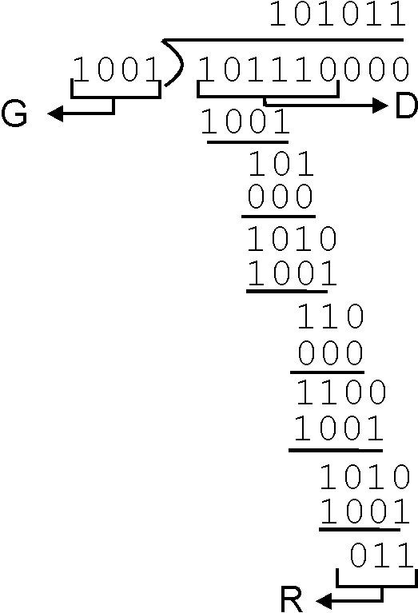
CRC Example
Want:
D.2^{r} XOR R = nG
equivalently:
D.2^{r} = nG XOR R
equivalently:
if we divide D.2^{r} by G, want remainder R
D.2^{r}
G
R = remainder[ ]

Slide 107
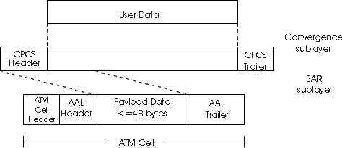
ATM Adaptation Layer (AAL) [more]
Different versions of AAL layers, depending on ATM service class:
AAL1: for CBR (Constant Bit Rate) services, e.g. circuit emulation
AAL2: for VBR (Variable Bit Rate) services, e.g., MPEG video
AAL5: for data (eg, IP datagrams)
User data
AAL PDU
ATM cell

Slide 108
ATM Layer
Service: transport cells across ATM network
analogous to IP network layer
very different services than IP network layer
Network
Architecture
Internet
ATM
ATM
ATM
ATM
Service
Model
best effort
CBR
VBR
ABR
UBR
Guarantees ?
Congestion
feedback
no (inferred
via loss)
no
congestion
no
congestion
yes
no
Bandwidth
none
constant
rate
guaranteed
rate
guaranteed
minimum
none
Loss
no
yes
yes
no
no
Order
no
yes
yes
yes
yes
Timing
no
yes
yes
no
no

Slide 109
IP-Over-ATM
Issues:
IP datagrams into ATM AAL5 PDUs
from IP addresses to ATM addresses
just like IP addresses to 802.3 MAC addresses!
ATM
network
Ethernet
LANs

