Slide 1

CS440/ECE448 Lecture 11: Random Variables
CC-BY 3.0, Mark Hasegawa-Johnson, February 2019

Slide 2
Random Variables
Random Variables
  RV = function from outcomes to numbers
  Notation
  Probability Mass Function (pmf)
  Expected Value
Domain of a Random Variable
  Domain Type: Categorical vs. Numerical
  Domain Size: Finite vs. Countably Infinite vs. Uncountably Infinite
Joint, Marginal, and Conditional Random Variables
  Marginalization and Conditioning
  Law of Total Probability
  Random Vectors
  Jointly Random Class and Measurement Variables
Functions of Random Variables
  Probability Mass Function
  Expectation

Slide 3
Random variables
We describe the (uncertain) state of the world using random variables
  Denoted by capital letters
  R: Is it raining?
  W: What’s the weather?
  D: What is the outcome of rolling two dice?
  S: What is the speed of my car (in MPH)?
Just like variables in CSPs, random variables take on values in a domain
  Domain values must be mutually exclusive and exhaustive
  R in {True, False}
  W in {Sunny, Cloudy, Rainy, Snow}
  D in {(1,1), (1,2), … (6,6)}
  S in [0, 200]

Slide 4
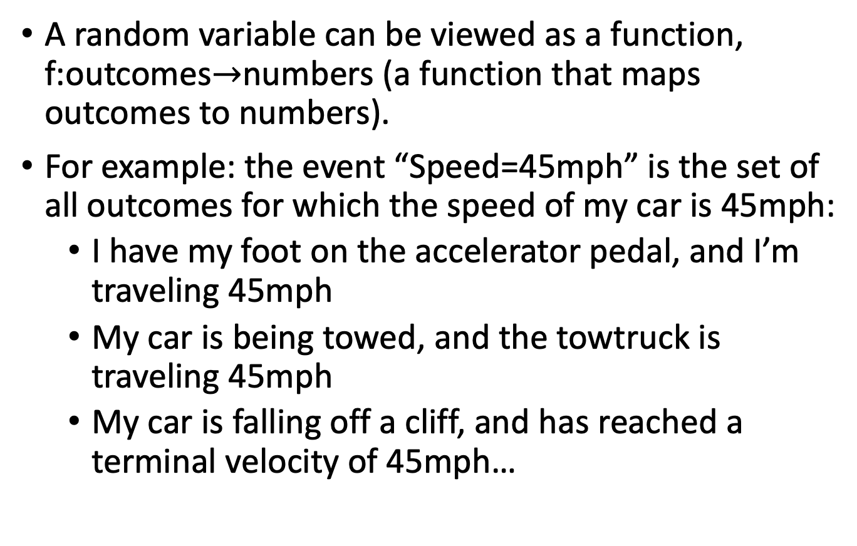
Random variables
A random variable can be viewed as a function, f:outcomes$→$numbers (a function that maps outcomes to numbers).
For example: the event “Speed=45mph” is the set of all outcomes for which the speed of my car is 45mph:
  I have my foot on the accelerator pedal, and I’m traveling 45mph
  My car is being towed, and the towtruck is traveling 45mph
  My car is falling off a cliff, and has reached a terminal velocity of 45mph…

Slide 5
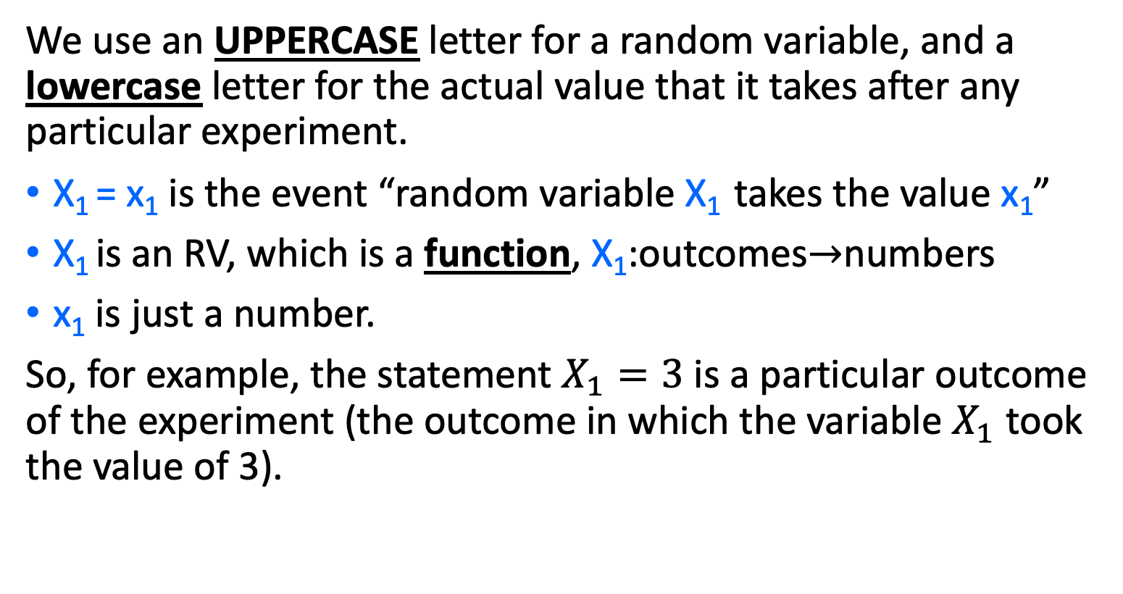
Random Variables are Uppercase, Instances are Lowercase
We use an UPPERCASE letter for a random variable, and a lowercase letter for the actual value that it takes after any particular experiment.
X₁ = x₁ is the event “random variable X₁ takes the value x₁”
X₁ is an RV, which is a function, X₁:outcomes$→$numbers
x₁ is just a number.
So, for example, the statement $X_{1}=3$ is a particular outcome of the experiment (the outcome in which the variable $X_{1}$ took the value of 3).

Slide 6
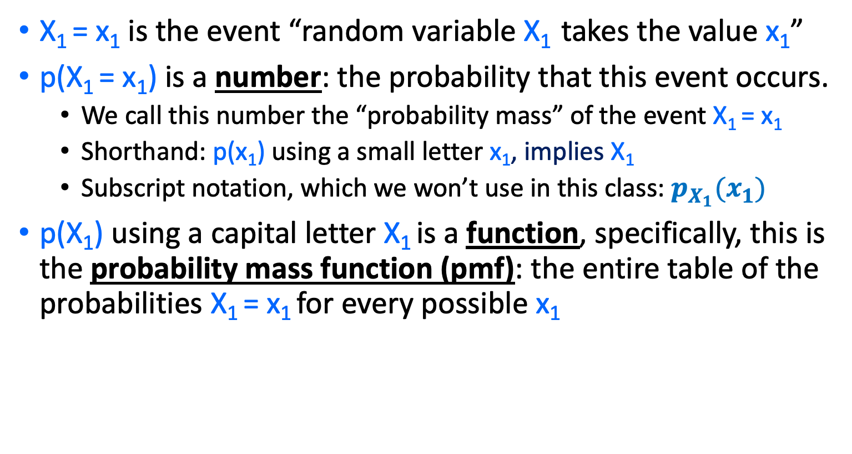
Probability Mass Function (pmf) is a lowercase p.
X₁ = x₁ is the event “random variable X₁ takes the value x₁”
p(X₁ = x₁) is a number: the probability that this event occurs.
  We call this number the “probability mass” of the event X₁ = x₁
  Shorthand: p(x₁) using a small letter x₁, implies X₁
  Subscript notation, which we won’t use in this class: $p_{X_{1}}(x_{1})$
p(X₁) using a capital letter X₁ is a function, specifically, this is the probability mass function (pmf): the entire table of the probabilities X₁ = x₁ for every possible x₁

Slide 7
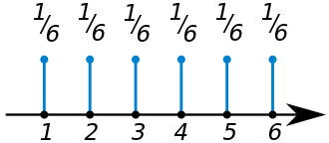
Probability Mass Function
The “Probability Mass Function” (pmf) of a random variable X is defined to be the function P(X=value), as a function of the different possible values.
Wikipedia: “The probability mass function of a fair die. All the numbers on the die have an equal chance of appearing on top when the die stops rolling.”

Slide 8
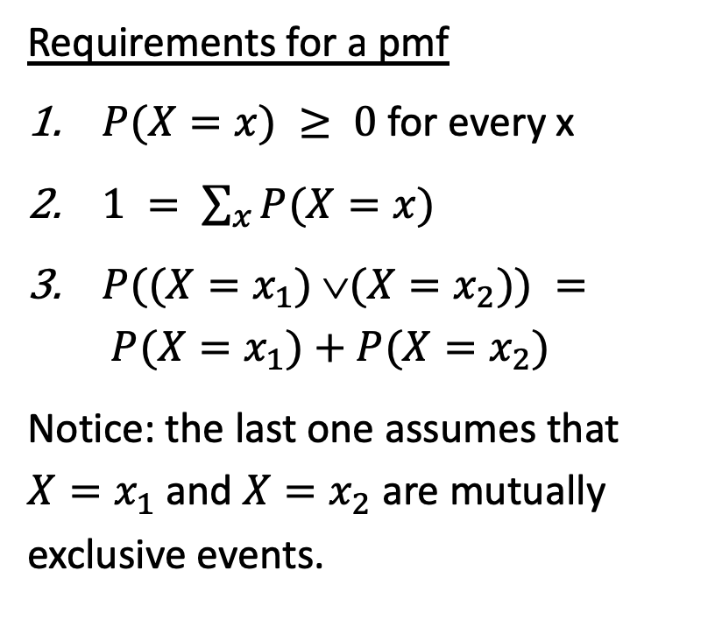
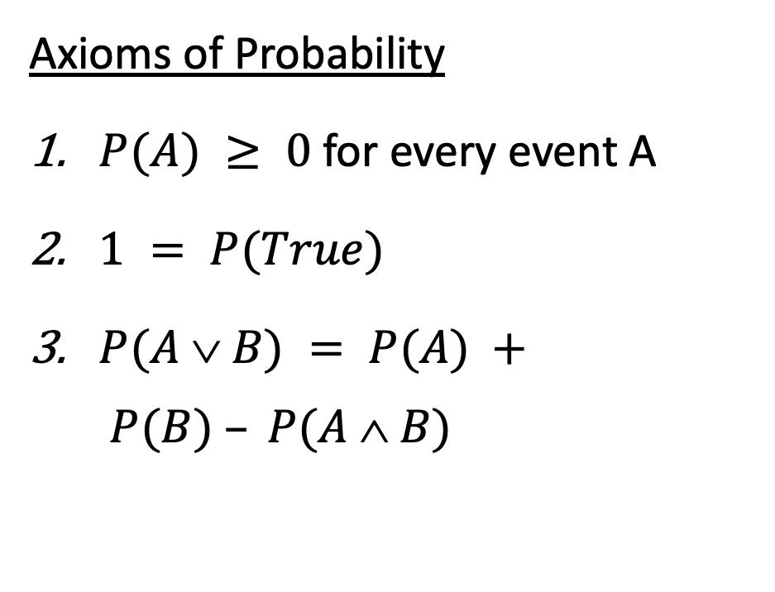
Requirements for a Probability Mass Function
Axioms of Probability
$P(A) ≥ 0$for every event A
$1 = P(True)$
$P(A  B) = P(A) + P(B) – P(A  B)$
Requirements for a pmf
$P(X=x) ≥ 0$for every x
$1 = \sum_{x}{P(X=x)}$
$P((X=x_{1}) (X=x_{2})) = P(X=x_{1})+P(X=x_{2})$
Notice: the last one assumes that $X=x_{1}$ and $X=x_{2}$ are mutually exclusive events.

Slide 9
Random Variables
Random Variables
  RV = function from outcomes to numbers
  Notation
  Probability Mass Function (pmf)
  Expected Value
Domain of a Random Variable
  Domain Type: Categorical vs. Numerical
  Domain Size: Finite vs. Countably Infinite vs. Uncountably Infinite
Joint, Marginal, and Conditional Random Variables
  Marginalization and Conditioning
  Law of Total Probability
  Random Vectors
  Jointly Random Class and Measurement Variables
Functions of Random Variables
  Probability Mass Function
  Expectation

Slide 10
Expected Value
Expected Value of a random variable = the average value, averaged over an infinite number of independent trials

Slide 11

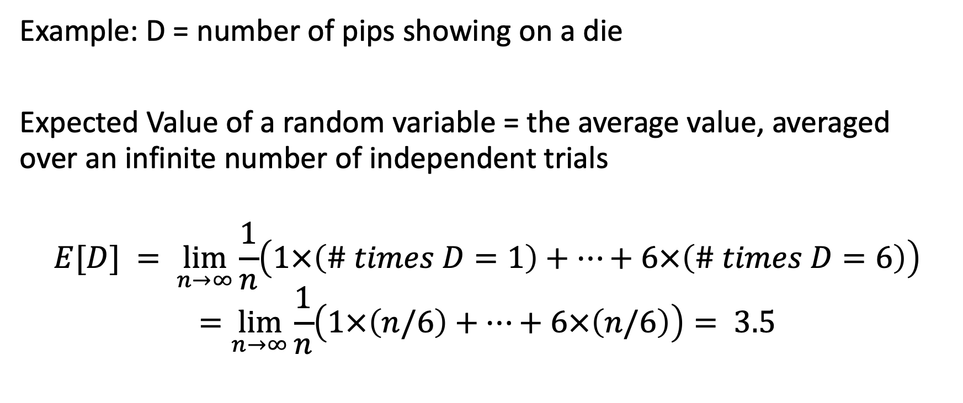
Expected Value
Example: D = number of pips showing on a die
Expected Value of a random variable = the average value, averaged over an infinite number of independent trials
$$E[D] = \lim_{n→∞}\frac{1}{n}\left(1×\left(\# times D=1\right)+…+6×\left(\# times D=6\right)\right)$$
$$=\lim_{n→∞}\frac{1}{n}\left(1×\left(n/6\right)+…+6×\left(n/6\right)\right)= 3.5$$

Slide 12
Expected Value
Expected Value of a random variable = the average value, averaged over an infinite number of independent trials
= sum{ value * P(variable=value) }

Slide 13

Center of Mass (from physics)
Center of Mass
= sum{ position * Mass(position) }

Slide 14
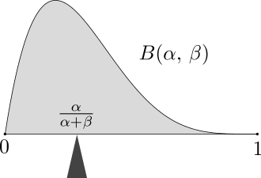
Expected Value = Center of Probability “Mass”
Expected Value of a random variable = the average value, averaged over an infinite number of independent trials
= sum{ value * P(variable=value) }
Wikipedia: “The mass of probability distribution is balanced at the expected value.”

Slide 15
Probability Mass Function
The “Probability Mass Function” (pmf) of a random variable X is defined to be the function P(X=value), as a function of the different possible values.
Why it’s useful: expected value = center of mass.
Wikipedia: “The probability mass function of a fair die. All the numbers on the die have an equal chance of appearing on top when the die stops rolling.” The expected value is 3.5.

Slide 16
Random Variables
Random Variables
  RV = function from outcomes to numbers
  Notation
  Probability Mass Function (pmf)
  Expected Value
Domain of a Random Variable
  Domain Type: Categorical vs. Numerical
  Domain Size: Finite vs. Countably Infinite vs. Uncountably Infinite
Joint, Marginal, and Conditional Random Variables
  Marginalization and Conditioning
  Law of Total Probability
  Random Vectors
  Jointly Random Class and Measurement Variables
Functions of Random Variables
  Probability Mass Function
  Expectation

Slide 17
Domain of a Random Variable
The “Domain” of a Random Variable is the set of its possible values.

Slide 18

Domain of a Random Variable
The domain can be numerical. For example:
  The number of pips showing on a die
  The age, in years, of a person that you choose at random off the street
  The number of days of sunshine in the month of March
  The minimum temperature tonight, in degrees Celsius
The domain can also be categorical. For example:
  The color chosen by a spinner in the game of Twister
  The color of the shirt worn by a person chosen at random
  The type of weather tomorrow: { sunny, cloudy with no precipitation, raining, snowing, sleet }

Slide 19
Expectation and PMF
Expected Value is only well defined for numerical domains.
E[X] = sum value * P(X=value)
pmf is well defined even for categorical domains.
Example: X = color shown on the spinner
P(X=red) = (1/4)
P(X=blue) = (1/4)
P(X=green) = (1/4)
P(X=yellow) = (1/4)

Slide 20
Size of the Domain = # Different Possible Values
Domain of a random variable can be finite.
Example: D = value, in dollars, of the next coin you find. Domain = {1.00, 0.50, 0.25, 0.10, 0.05, 0.01}, Size of the domain=6.
Domain of a random variable can be “countably infinite.”
Example: X = number of words in the next Game of Thrones novel. No matter how large you guess, it’s possible it might be even longer, so we say the domain is infinite.
Requirement: 1 = sum P(X=x)
Domain of a random variable can be “uncountably infinite.”
Example: a variable whose value can be ANY REAL NUMBER.
How we deal with this: P(X=x) is ill-defined, but P(a≤X<b) is well-defined.

Slide 21
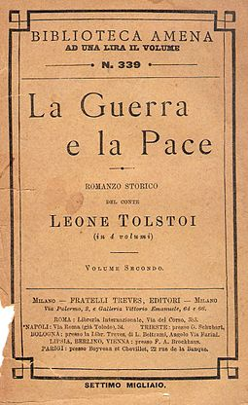
Expectation and PMF
Expected value can be calculated from PMF only if the domain is finite, or countably infinite.
E[X] = sum value * P(X=value)
Example: X = number of words in the next GoT novel.
E[X] = P(X=1) + 2*P(X=2) + 3*P(X=3) + …
If you know P(X=x) for all x (even if “all x” is an infinite set), then you can compute this expectation by solving the infinite series.

Slide 22
Random Variables
Random Variables
  RV = function from outcomes to numbers
  Notation
  Probability Mass Function (pmf)
  Expected Value
Domain of a Random Variable
  Domain Type: Categorical vs. Numerical
  Domain Size: Finite vs. Countably Infinite vs. Uncountably Infinite
Joint, Marginal, and Conditional Random Variables
  Marginalization and Conditioning
  Law of Total Probability
  Random Vectors
  Jointly Random Class and Measurement Variables
Functions of Random Variables
  Probability Mass Function
  Expectation

Slide 23
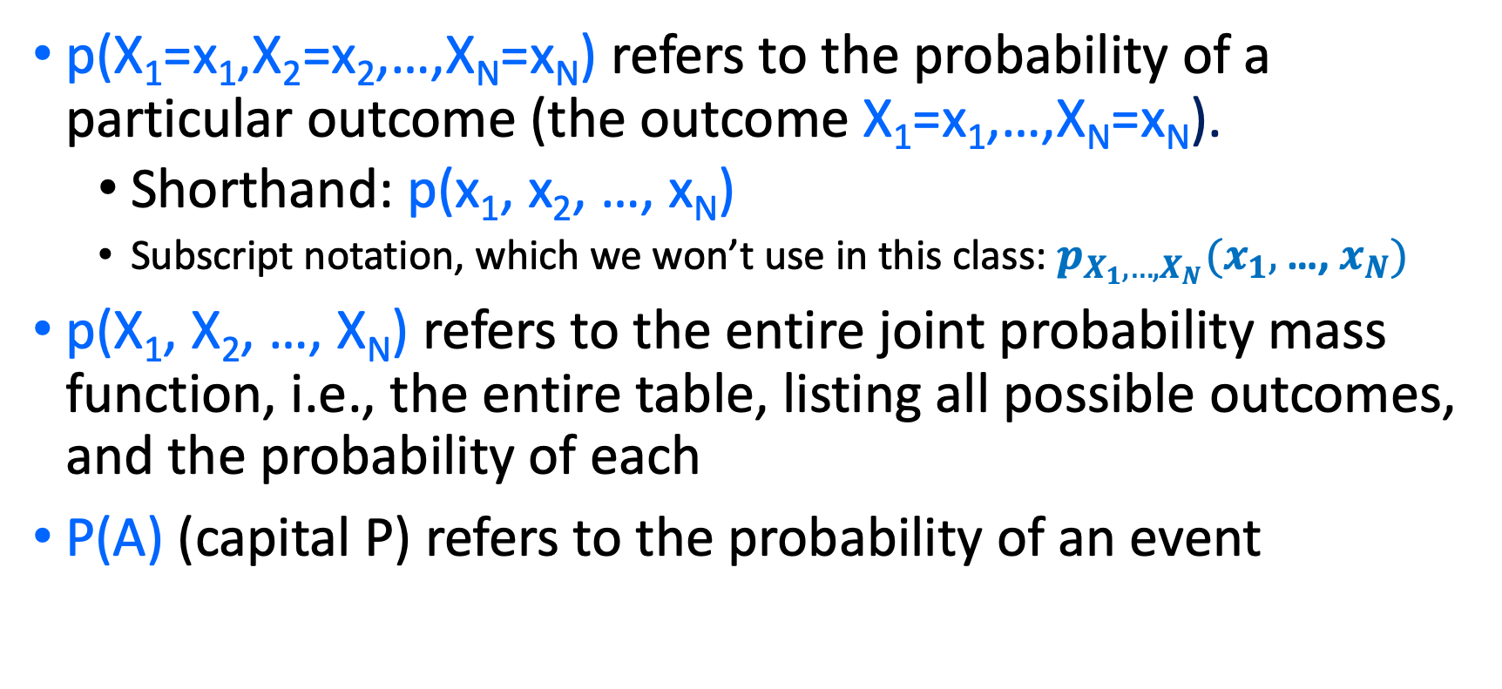
Joint probability mass function (joint pmf)
p(X₁=x₁,X₂=x₂,…,X_{N}=x_{N}) refers to the probability of a particular outcome (the outcome X₁=x₁,…,X_{N}=x_{N}).
  Shorthand: p(x₁, x₂, …, x_{N})
  Subscript notation, which we won’t use in this class: $p_{X_{1}, …,X_{N}}(x_{1},$…, $x_{N})$
p(X₁, X₂, …, X_{N}) refers to the entire joint probability mass function, i.e., the entire table, listing all possible outcomes, and the probability of each
P(A) (capital P) refers to the probability of an event

Slide 24
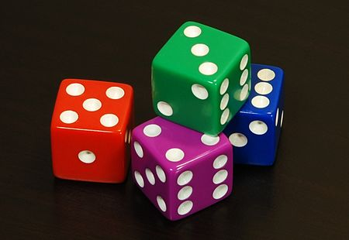
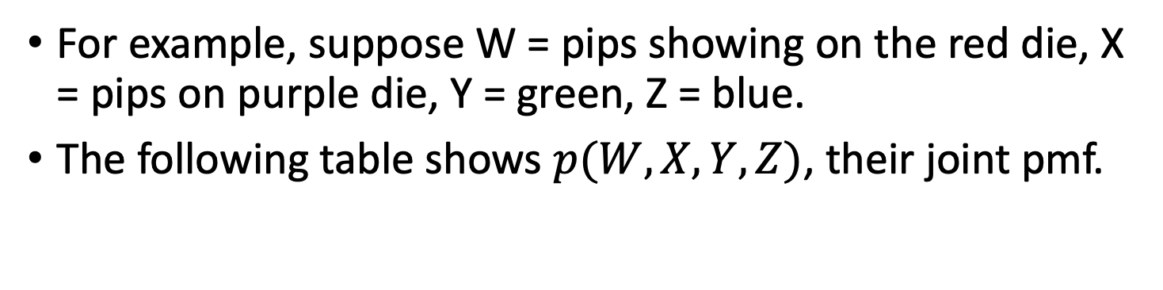
Joint Random Variables
For example, suppose W = pips showing on the red die, X = pips on purple die, Y = green, Z = blue.
The following table shows $p(W,X,Y,Z)$, their joint pmf.
w | x | y | z | P(W=w,X=x,Y=y,Z=z)
1 | 1 | 1 | 1 | 1/1296
1 | 1 | 1 | 2 | 1/1296
… |  | … |  | …
6 | 6 | 6 | 4 | 1/1296
6 | 6 | 6 | 5 | 1/1296
6 | 6 | 6 | 6 | 1/1296

Slide 25
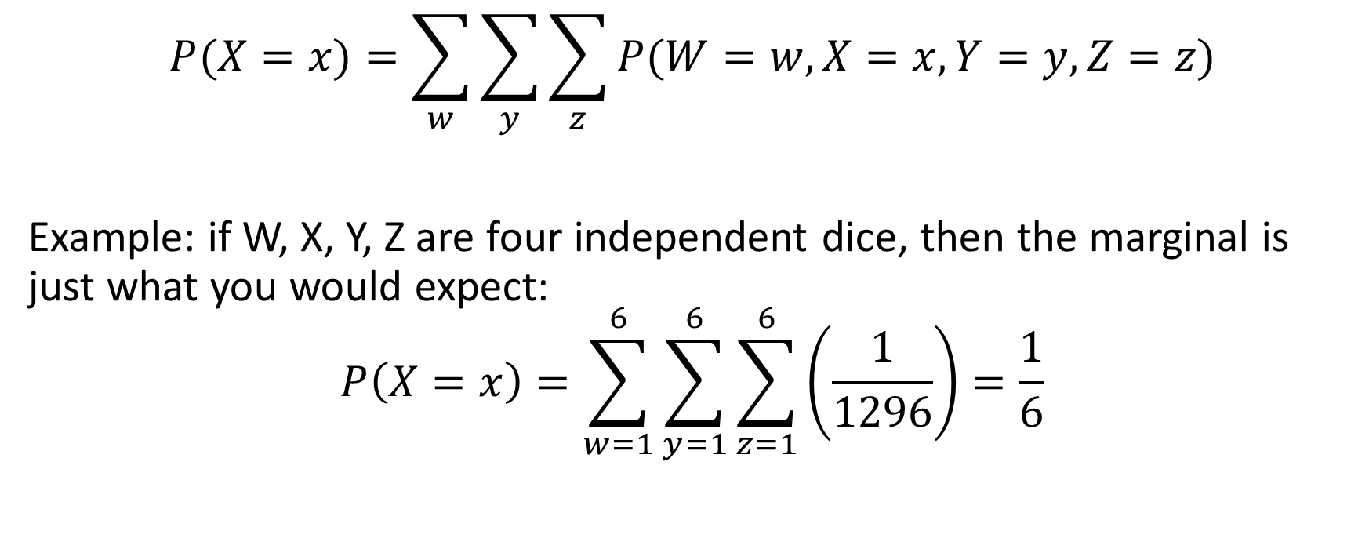
Marginalization
$$P(X=x)=\sum_{w}{\sum_{y}{\sum_{z}{P(W=w,X=x,Y=y,Z=z)}}}$$
Example: if W, X, Y, Z are four independent dice, then the marginal is just what you would expect:
$$P\left(X=x\right)=\sum_{w=1}^{6}{\sum_{y=1}^{6}{\sum_{z=1}^{6}{\left(\frac{1}{1296}\right)}}}=\frac{1}{6}$$

Slide 26
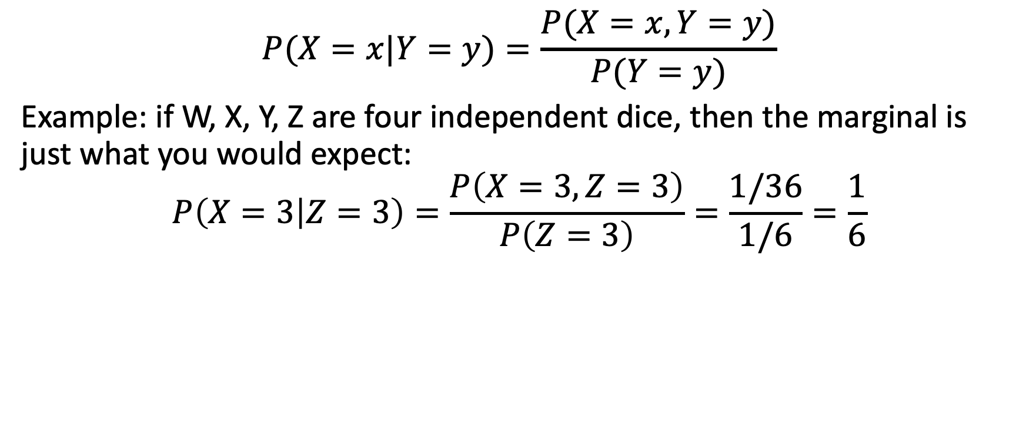
Conditioning
$$P(X=x|Y=y)=\frac{P(X=x,Y=y)}{P(Y=y)}$$
Example: if W, X, Y, Z are four independent dice, then the marginal is just what you would expect:
$$P\left(X=3 | Z=3\right)=\frac{P\left(X=3,Z=3\right)}{P\left(Z=3\right)}=\frac{1/36}{1/6}=\frac{1}{6}$$

Slide 27
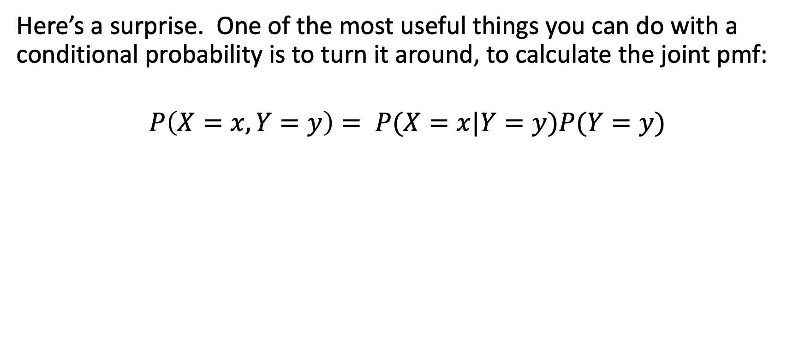
Conditioning
Here’s a surprise. One of the most useful things you can do with a conditional probability is to turn it around, to calculate the joint pmf:
$$P\left(X=x,Y=y\right)= P(X=x|Y=y)P(Y=y)$$

Slide 28
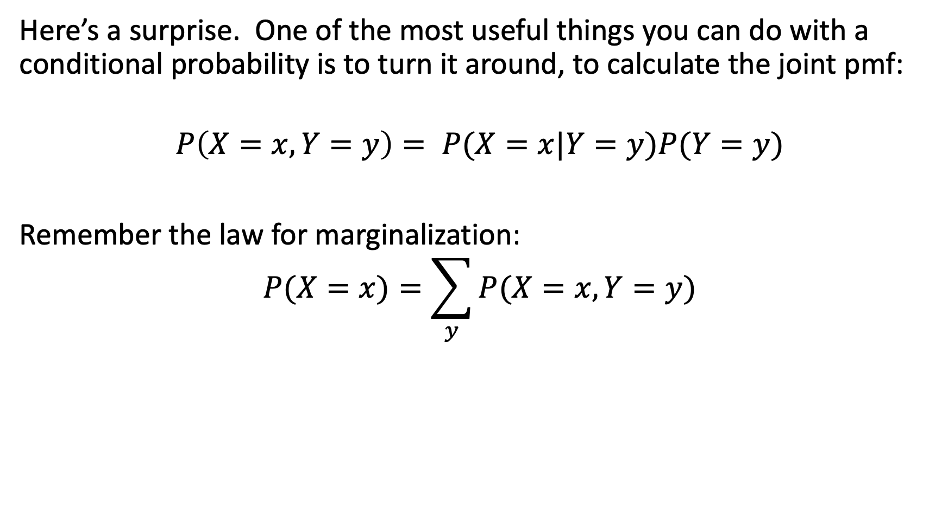
Conditioning+Marginalization
Here’s a surprise. One of the most useful things you can do with a conditional probability is to turn it around, to calculate the joint pmf:
$$P\left(X=x,Y=y\right)= P(X=x|Y=y)P(Y=y)$$
Remember the law for marginalization:
$$P(X=x)=\sum_{y}{P(X=x,Y=y)}$$

Slide 29
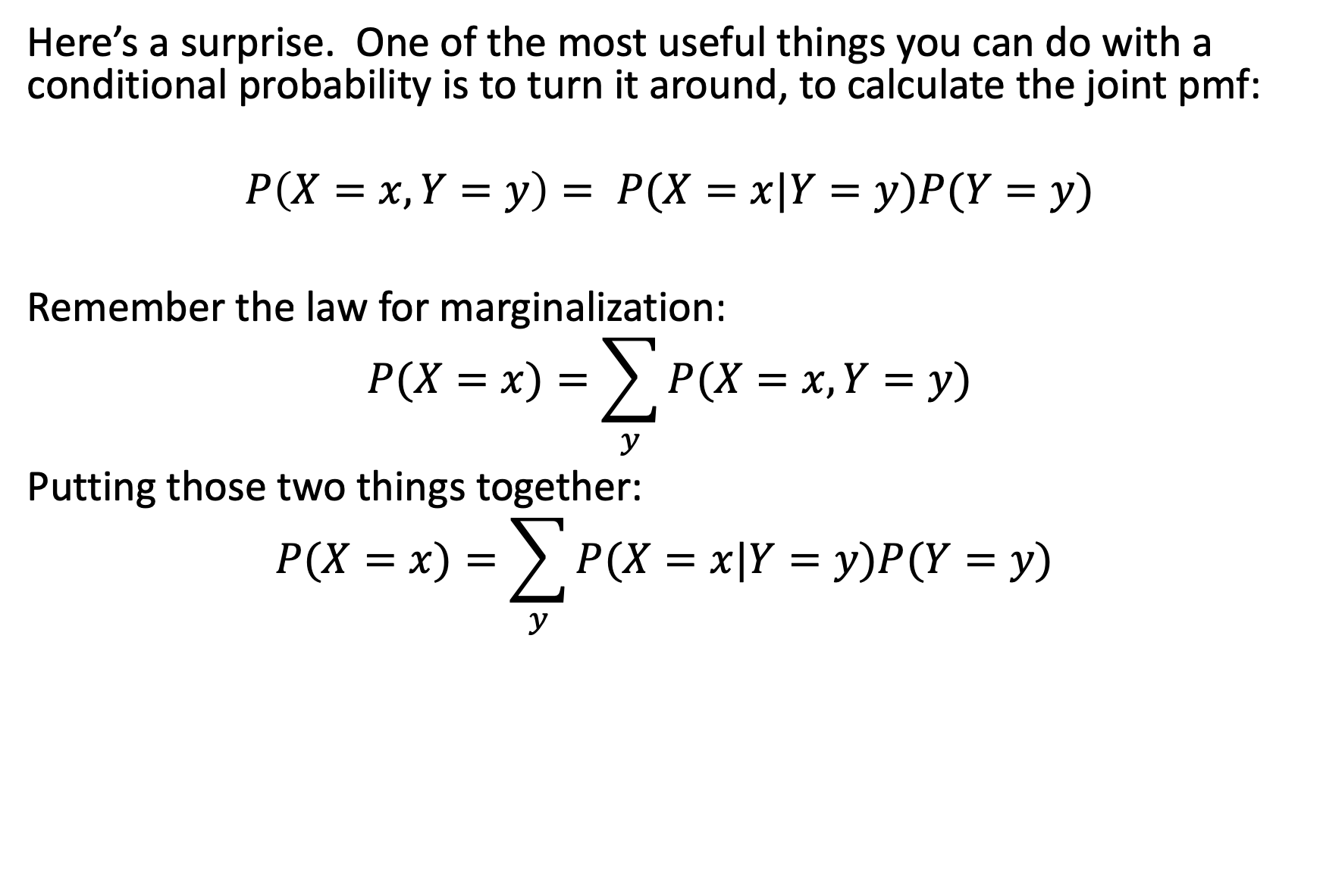
Conditioning+Marginalization= Law of Total Probability
Here’s a surprise. One of the most useful things you can do with a conditional probability is to turn it around, to calculate the joint pmf:
$$P\left(X=x,Y=y\right)= P(X=x|Y=y)P(Y=y)$$
Remember the law for marginalization:
$$P(X=x)=\sum_{y}{P(X=x,Y=y)}$$
Putting those two things together:
$$P(X=x)=\sum_{y}{P(X=x|Y=y)P(Y=y) }$$

Slide 30
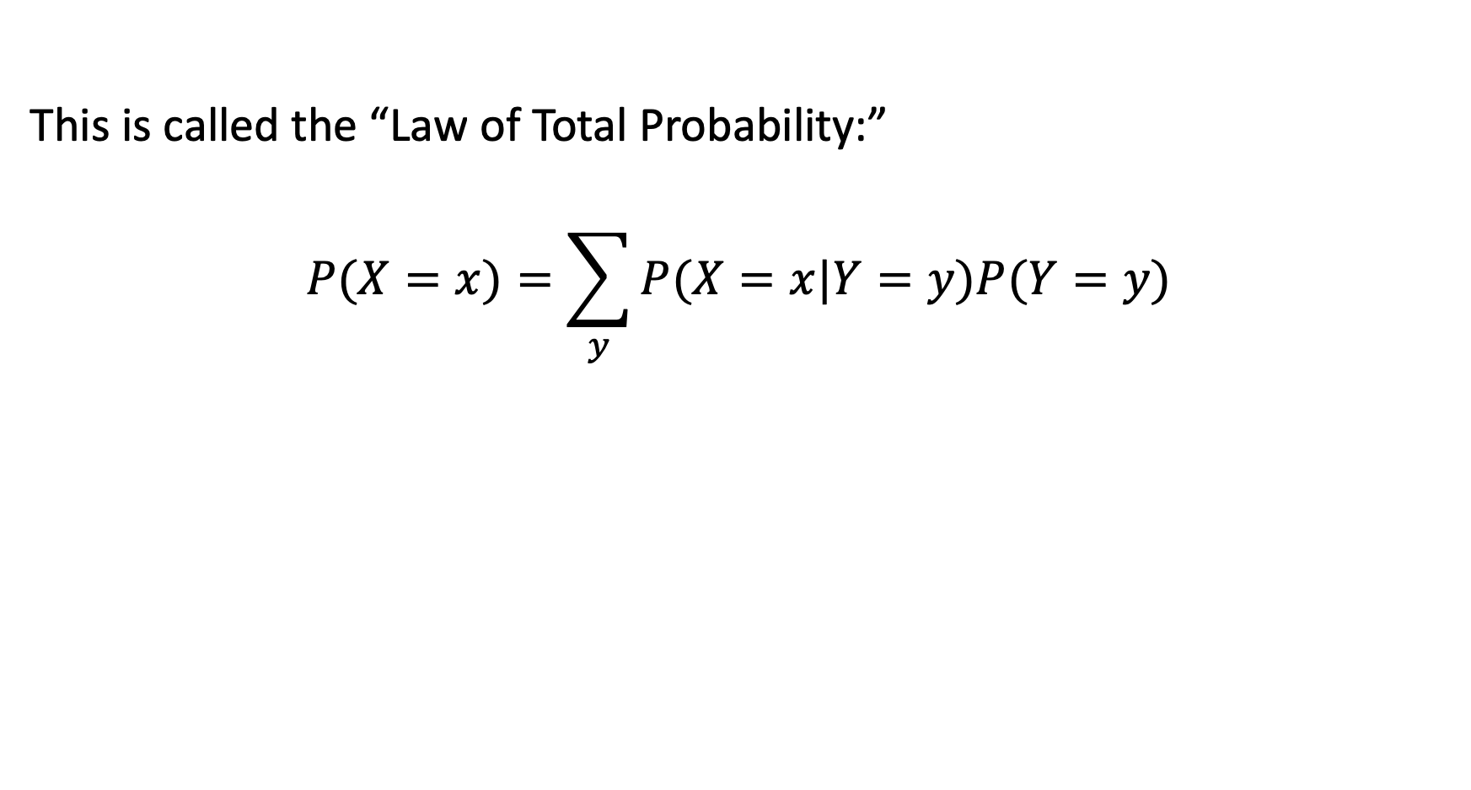
Law of Total Probability
This is called the “Law of Total Probability:”
$$P(X=x)=\sum_{y}{P(X=x|Y=y)P(Y=y) }$$

Slide 31

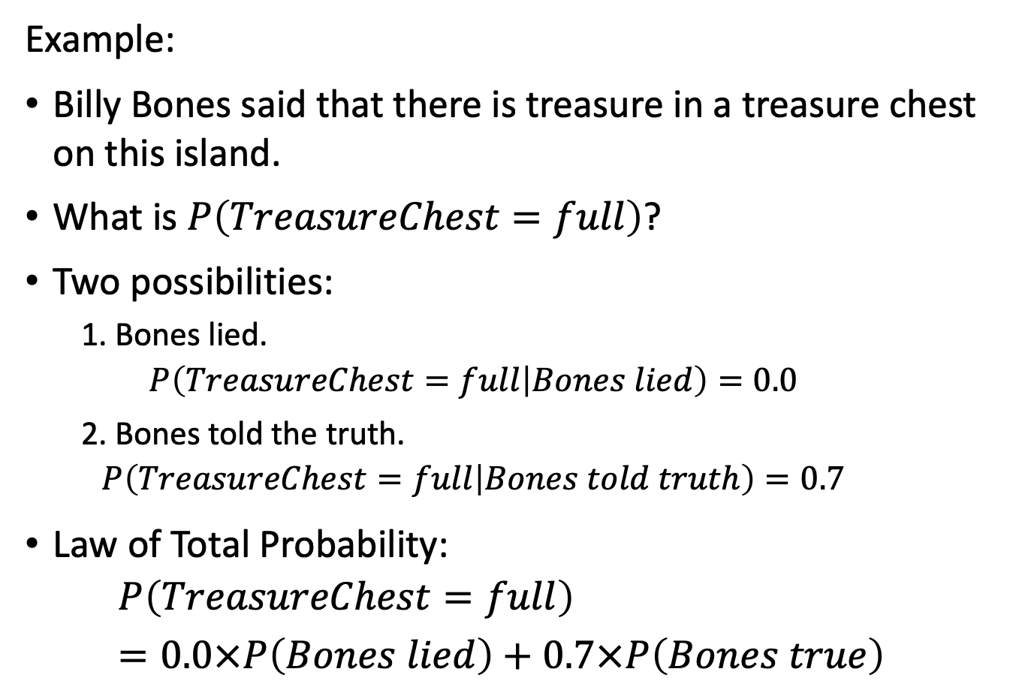
Law of Total Probability
Example:
Billy Bones said that there is treasure in a treasure chest on this island.
What is $P\left(TreasureChest=full\right)$?
Two possibilities:
  1. Bones lied.
  $$P\left(TreasureChest=full | Bones lied\right)=0.0$$
  2. Bones told the truth.
  $$P\left(TreasureChest=full | Bones told truth\right)=0.7$$
Law of Total Probability:
$$P\left(TreasureChest=full\right)=0.0×P\left(Bones lied\right)+0.7×P\left(Bones true\right)$$

Slide 32
Random Variables
Random Variables
  RV = function from outcomes to numbers
  Notation
  Probability Mass Function (pmf)
  Expected Value
Domain of a Random Variable
  Domain Type: Categorical vs. Numerical
  Domain Size: Finite vs. Countably Infinite vs. Uncountably Infinite
Joint, Marginal, and Conditional Random Variables
  Marginalization and Conditioning
  Law of Total Probability
  Random Vectors
  Jointly Random Class and Measurement Variables
Functions of Random Variables
  Probability Mass Function
  Expectation

Slide 33
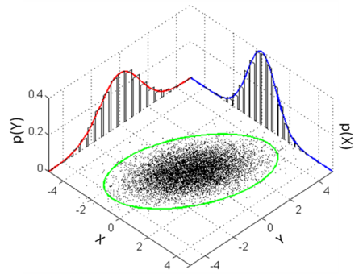
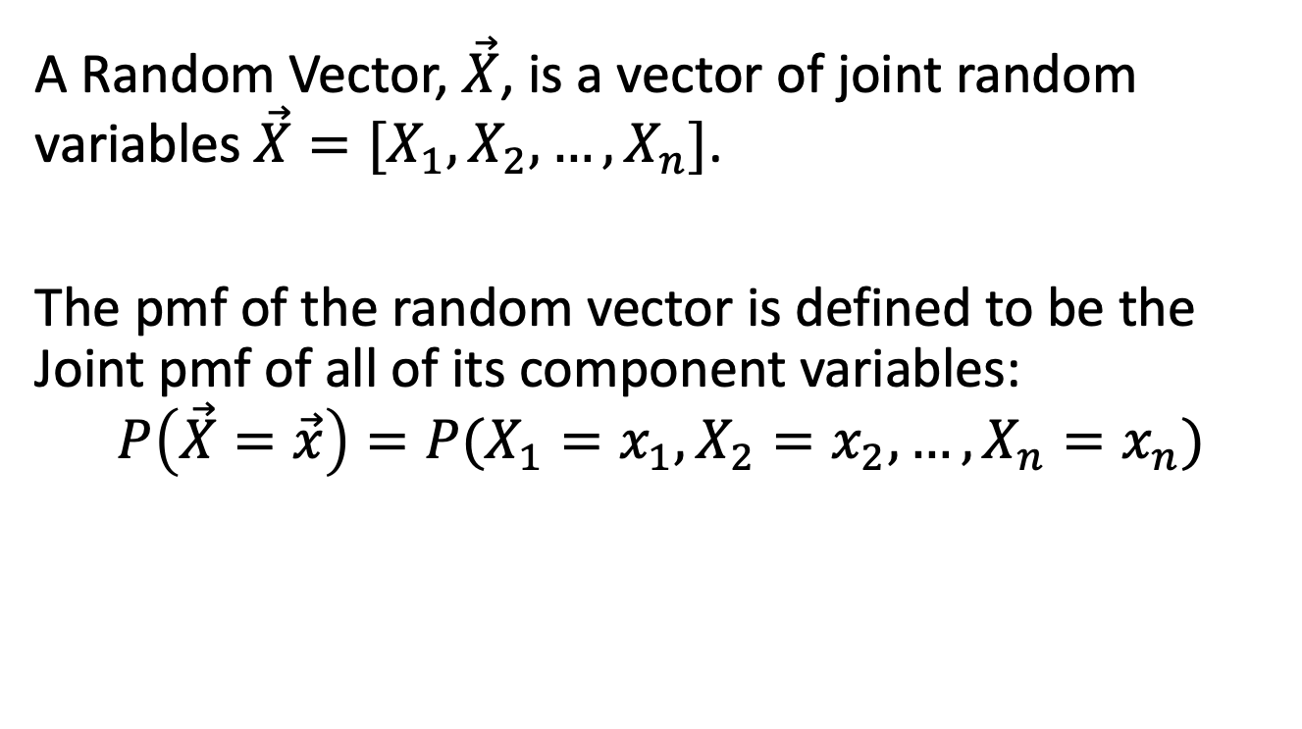
Random Vector
A Random Vector, $\vec{X}$, is a vector of joint random variables $\vec{X}=[X_{1},X_{2},…,X_{n}]$.
The pmf of the random vector is defined to be the Joint pmf of all of its component variables:
$$P\left(\vec{X}=\vec{x}\right)=P(X_{1}=x_{1},X_{2}=x_{2},…,X_{n}=x_{n})$$

Slide 34
Jointly Random Class and Measurement Variables
The most important case of joint random variables for AI: jointly random categorical (class) and numerical (measurement) variables.
For example, Y= type of fruit, X = weight of the fruit.
We’ll talk A LOT more about this in a few lectures (Bayesian inference).
x | y | P(X=x,Y=y)
10g | Grape | 0.68
10g | Apple | 0.06
100g | Grape | 0.02
100g | Apple | 0.34

Slide 35
Random Variables
Random Variables
  RV = function from outcomes to numbers
  Notation
  Probability Mass Function (pmf)
  Expected Value
Domain of a Random Variable
  Domain Type: Categorical vs. Numerical
  Domain Size: Finite vs. Countably Infinite vs. Uncountably Infinite
Joint, Marginal, and Conditional Random Variables
  Marginalization and Conditioning
  Law of Total Probability
  Random Vectors
  Jointly Random Class and Measurement Variables
Functions of Random Variables
  Probability Mass Function
  Expectation

Slide 36
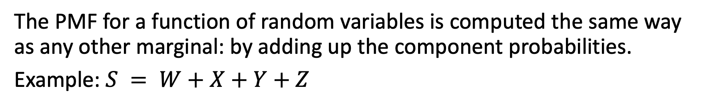
Functions of Random Variables: PMF
The PMF for a function of random variables is computed the same way as any other marginal: by adding up the component probabilities.
Example: $S = W+X+Y+Z$
w | x | y | z | s | P(W=w,X=x,Y=y,Z=z,S=s)
1 | 1 | 1 | 1 | 4 | 1/1296
1 | 1 | 1 | 2 | 5 | 1/1296
1 | 1 | 2 | 1 | 5 | 1/1296
… | … | … | … | … | …

Slide 37
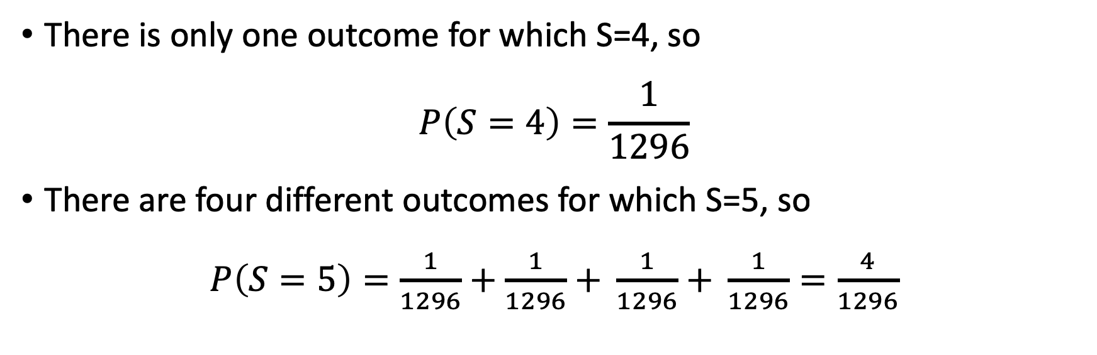
Functions of Random Variables: PMF
w | x | y | z | s | P(W=w,X=x,Y=y,Z=z,S=s)
1 | 1 | 1 | 1 | 4 | 1/1296
1 | 1 | 1 | 2 | 5 | 1/1296
1 | 1 | 2 | 1 | 5 | 1/1296
… | … | … | … | … | …
There is only one outcome for which S=4, so
$$P\left(S=4\right)=\frac{1}{1296}$$
There are four different outcomes for which S=5, so
$P\left(S=5\right)=\frac{1}{1296}+\frac{1}{1296}$ $+ \frac{1}{1296}$ $+ \frac{1}{1296}=\frac{4}{1296}$

Slide 38
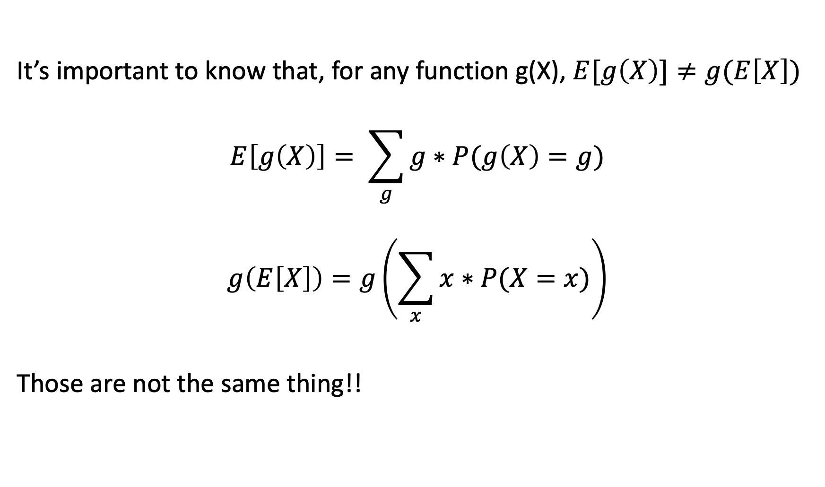
Functions of Random Variables: Expectation
It’s important to know that, for any function g(X), $E[g\left(X\right)]≠g(E\left[X\right])$
$$E\left[g\left(X\right)\right]= \sum_{g}{g∗P(g\left(X\right)=g)}$$
$$g\left(E\left[X\right]\right)=g\left(\sum_{x}{x∗P(X=x)}\right)$$
Those are not the same thing!!

Slide 39
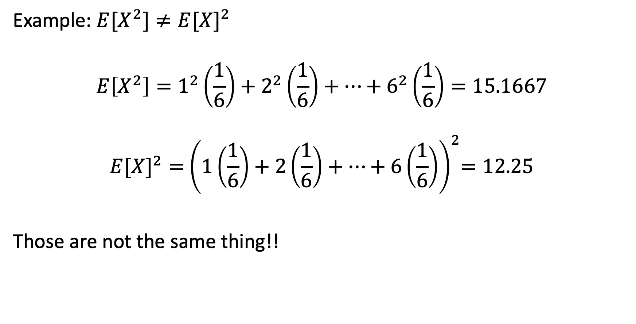
Functions of Random Variables: Expectation
Example: $E[X^{2}]≠{E[X]}^{2}$
$$E\left[X^{2}\right]=1^{2}\left(\frac{1}{6}\right)+2^{2}\left(\frac{1}{6}\right)+…+6^{2}\left(\frac{1}{6}\right)=15.1667$$
$${E[X]}^{2}={ \left(1\left(\frac{1}{6}\right)+2\left(\frac{1}{6}\right)+…+6\left(\frac{1}{6}\right)\right)}^{2}=12.25$$
Those are not the same thing!!

Slide 40
Random Variables
Random Variables
  RV = function from outcomes to numbers
  Notation
  Probability Mass Function (pmf)
  Expected Value
Domain of a Random Variable
  Domain Type: Categorical vs. Numerical
  Domain Size: Finite vs. Countably Infinite vs. Uncountably Infinite
Joint, Marginal, and Conditional Random Variables
  Marginalization and Conditioning
  Law of Total Probability
  Random Vectors
  Jointly Random Class and Measurement Variables
Functions of Random Variables
  Probability Mass Function
  Expectation

Slide 41
