Slide 1
CS440/ECE448 Artificial Intelligence
Lecture 25:
Natural Language Processing with Neural Nets
Julia Hockenmaier
April 2019

Slide 2
Today’s lecture
A very quick intro to natural language processing (NLP)
  What is NLP? Why is NLP hard?
How are neural networks (“deep learning”) being used in NLP
  And why do they work so well?

Slide 3
Recap:
Neural Nets/Deep Learning

Slide 4
What is “deep learning”?
Neural networks, typically with several hidden layers
  (depth = # of hidden layers)
  Single-layer neural nets are linear classifiers
  Multi-layer neural nets are more expressive
Very impressive performance gains in computer vision (ImageNet) and speech recognition over the last several years.
Neural nets have been around for decades.
Why have they suddenly made a comeback?
  Fast computers (GPUs!) and (very) large datasets have made it possible to train these very complex models.

Slide 5
Single-layer feedforward nets
For binary classification tasks: Single output unit
Return 1 if y > 0.5
Return 0 otherwise
Output unit: scalar y
Input layer: vector x
For multiclass
classification tasks:
K output units (a vector)
Each output unit yi
corresponds to a class i
Return argmaxi(yi) where
y_{i} = P(i) = softmax(zi)
= exp(zi) ∕ ∑k=0..K exp(zk)
Output layer: vector y
Input layer: vector x

Slide 6
Multi-layer feedforward networks
We can generalize this to multi-layer feedforward nets
Output layer: vector y
Hidden layer: vector hn
… … …
… … …
… … ….
Hidden layer: vector h1
Input layer: vector x

Slide 7
Multiclass models: softmax(yi)
Multiclass classification = predict one of K classes.
  Return the class i with the highest score: argmaxi(yi)
In neural networks, this is typically done by using the softmax function, which maps real-valued vectors in R^{K} to distributions over the K outputs
Given a vector z = (z0…zK) of activations z_{i} for each K classes
Probability of class i: P(i) = softmax(zi) = exp(zi) ∕ ∑k=0..K exp(zk)
    (NB: This is just logistic regression)

Slide 8

Nonlinear activation functions
Sigmoid (logistic function): σ(x) = 1/(1 + e^{−x})
  Useful for output units (probabilities) [0,1] range
Hyperbolic tangent: tanh(x) = (e^{2x −}1)/(e^{2x}+1)
  Useful for internal units: [-1,1] range
Hard tanh (approximates tanh)
  htanh(x) = ⁻1 for x < ⁻1, 1 for x > 1, x otherwise
Rectified Linear Unit: ReLU(x) = max(0, x)
  Useful for internal units

Slide 9
What is Natural Language Processing?
… and why is it challenging?

Slide 10
What is Natural Language?
Any human language: English, Chinese, Arabic, Inuktitut,…
  NLP typically assumes written language (this could be transcripts of spoken language).
  Speech understanding and generation requires additional tools (signal processing etc.)
Consists of a vocabulary (set of words) and a grammar
to form phrases and sentences from these words.
  NLP (and modern linguistics) is largely not concerned with ”prescriptive” grammar (which is what you may have learned in school), but with formal (computational) models of grammar, and with how people actually use language
Used by people to communicate
  Texts written by a single person: articles, books, tweets, etc.
  Dialogues: communications between two or more people

Slide 11
What is Natural Language Processing?
Any processing of (written) natural languages by computers:
Natural Language Understanding (NLU)
  Translate from text to a semantic meaning representation
  May (should?) require reasoning over semantic representations
Natural Language Generation (NLG)
  Produce text (e.g. from a semantic representation)
  Decode what to say as well as how to say it.
Dialogue Systems:
  Require both NLU and NLG
  Often task-driven (e.g. to book a flight, get customer service, etc.)
Machine Translation:
  Translate from one human language to another
  Typically done without intermediate semantic representations

Slide 12
What do we mean by “meaning”?
Lexical semantics: the (literal) meaning of words
  Nouns (mostly) describe entities, verbs actions, events, states, adjectives and adverbs properties, prepositions relations, etc.
Compositional semantics: the (literal) meaning of sentences
  Principle of compositionality:
  The meaning of a phrase or sentence depends on the meanings of its parts
  and on how these parts are put together.
  Declarative sentences describe events, entities or facts,
  questions request information from the listener,
  commands request actions from the listener, etc.
Pragmatics studies how (non-literal) meaning depends on context, speaker intent, etc.

Slide 13
How do we represent “meaning”?
A) Symbolic meaning representation languages:
  Often based on (predicate) logic (or inspired by it)
  May focus on different aspects of meaning, depending on the application
  Have to be explicitly defined and specified
  Can be verified by humans (useful for development/explainability)

Slide 14
NLU: How do we get to that “meaning”?
A) The traditional NLP pipeline assumes a sequence of intermediate symbolic representations,
produced by models whose output can be reused by any system
  Map raw text to part-of-speech tags,
  then map POS-tagged text to syntactic parse trees,
  then map syntactically parsed text to semantic parses, etc.

Slide 15
Components of the NLP pipeline
All steps (except tokenization) return a symbolic representation
  Tokenization: Identify word and sentence boundaries
  POS tagging: Label each word as noun, verb, etc.
  Named Entity Recognition (NER): Identify all named mentions of people, places, organizations, dates etc. as such
  Coreference Resolution (Coref): Identify which mentions in a document refer to the same entity
  (Syntactic) Parsing: Identify the grammatical structure of each sentence
  Semantic Parsing: Identify the meaning of each sentence
  Discourse Parsing: Identify the (rhetorical) relations between sentences/phrases

Slide 16
Why is NLU difficult?
Natural languages are infinite…
  … because their vocabularies have a power law distribution (Zipf’s Law)
  … and because their grammars allow recursive structures
Natural languages are highly ambiguous…
  … because many words have multiple senses
  … and because there is a combinatorial explosion of sentence meanings
Much of the meaning is not expressed explicitly…
  … because listeners/readers have commonsense/world knowledge
  … and because they can draw inferences from what is and isn’t said.

Slide 17
Why is NLU difficult?
Natural languages are infinite…
  … so any input will contain new/unknown words/constructions
Natural languages are highly ambiguous…
  … so recovering the correct structure/meaning is often very difficult
Much of the meaning is not expressed explicitly…
  … so a symbolic meaning representation of the explicit meaning
  may not be sufficient.

Slide 18
Why are NLG and MT difficult?
The generated text (or translation) has to be fluent
  Sentences should be grammatical. Texts need to be coherent/cohesive.
  This requires capturing non-local dependencies
  between words that are far apart in the string.
The text (or translation) has to convey the intended meaning.
  Translations have to be faithful to the original.
  Generated text should not be misunderstood by the human reader
  But there are many different ways to express the same information
NLG and MT are difficult to evaluate automatically
  Automated metrics exist, but correlate poorly with human judgments

Slide 19
NLP research questions redux…
…and answers from traditional NLP
How do you represent (or predict) words?
  Each word is its own atomic symbol.
  All unknown words are mapped to the same UNK token.
  We capture lexical semantics through an ontology (WordNet) or sparse vectors
How do you represent (or predict) word sequences?
  Through an n-gram language model (with fixed n=3,4,5,…), or a grammar
How do you represent (or predict) structures?
  Representations are symbolic
  Predictions are made by statistical models/classifiers

Slide 20
Neural Approaches to NLP

Slide 21
Challenges in using NNs for NLP
NLP input (and output) consists of variable length sequences
of discrete symbols (sentences, documents, …)
But the input to neural nets typically consists of
fixed-length continuous vectors
Solutions
1) Learn a mapping (embedding) from discrete symbols (words) to dense continuous vectors that can be used as input to NNs
2) Use recurrent neural nets to handle variable length inputs and outputs

Slide 22
Added benefits of these solutions
Benefits of word embeddings:
  Words that are similar have similar word vectors
  We have a much better handle on lexical semantics
  Because we can train these embeddings on massive amounts of raw text, we now have a much better way to handle and generalize to rare and unseen words.
Benefits of recurrent nets:
  We do not need to learn and store explicit n-gram models
  RNNs are much better at capturing non-local dependencies
  RNNs need far fewer parameters than n-gram models with large n.

Slide 23
How does NLP use NNs?
Word embeddings (word2vec, Glove, etc.)
  Train a NN to predict a word from its context (or the context from a word).
  This gives a dense vector representation of each word
Neural language models:
  Use recurrent neural networks (RNNs) to predict word sequences
  More advanced: use LSTMs (special case of RNNs)
Sequence-to-sequence (seq2seq) models:
  From machine translation: use one RNN to encode source string, and another RNN to decode this into a target string.
  Also used for automatic image captioning, etc.
Convolutional neural networks (CNNs)
  Used for text classification

Slide 24
How do we represent “meaning”?
A) Symbolic meaning representation languages:
  Often based on (predicate) logic (or inspired by it)
  May focus on different aspects of meaning, depending on the application
  Have to be explicitly defined and specified
  Can be verified by humans (useful for development/explainability)
B) Continuous (vector-based) meaning representations:
  Non-neural approaches: sparse vectors with a very large number of dimensions (10K+) each of which has an explicit interpretation
  Neural approaches: dense vectors with far fewer dimensions (~300) without explicit interpretation
  Are automatically learned from data.
  Can typically not be verified by humans.

Slide 25
NLU: How do we get to that “meaning”?
A) The traditional NLP pipeline assumes a sequence of intermediate symbolic representations,
produced by models whose output can be reused by any system
  Map raw text to part-of-speech tags,
  then map POS-tagged text to syntactic parse trees,
  then map syntactically parsed text to semantic parses, etc.
B) Many current neural models map directly from text to the output required for the task.
  Map each word in a text to a vector representation
  Train the neural model to perform the task directly from these vectors
  Intermediate representations (activations of hidden layers) may be used by other neural models, but are difficult to interpret by humans

Slide 26
NLP research questions redux …
…and answers from neural NLP
How do you represent (or predict) words?
  Each word is a dense vector (embedding) that captures a lot of syntactic and semantic information implicitly.
  Character embeddings allow us us handle unseen words more robustly
How do you represent (or predict) word sequences?
  Through a recurrent neural net that does not need to truncate history
  to a fixed length
How do you represent (or predict) structures?
  Input is typically assumed to be raw text (mapped to embeddings)
  Output representations may still be symbolic
  Internal representations are dense vectors (activations),
  without explicit interpretation

Slide 27
Language models

Slide 28
Traditional Language Models
A language model defines a distribution P(w) over the strings
w = w1w2..wi… in a language
Typically we factor P(w) such that we compute the probability
word by word: P(w) = P(w1) P(w2 | w1)… P(wi | w1…wi−1)
Standard n-gram models make the Markov assumption that wi depends (only) on the preceding n−1 words: P(wi | w1…wi−1) := P(wi | wi−n+1…wi−1)
  We know that this independence assumption is invalid
  (there are many long-range dependencies), but it is computationally and statistically necessary (we can’t store or estimate larger models)

Slide 29
Neural Language Models
A neural LM defines a distribution over the V words in the vocabulary, conditioned on the preceding words.
Output layer: V units (one per word in the vocabulary)
with softmax to get a distribution
Input: Represent each preceding word by its
d-dimensional embedding.
  Fixed-length history (n-gram): use preceding n−1 words
  Variable-length history: use a recurrent neural net

Slide 30
Recurrent neural networks (RNNs)
Basic RNN: Modify the standard feedforward architecture (which predicts a string w0…wn one word at a time) such that the output of the current step (wi) is given as additional input to the next time step (when predicting the output for wi+1).
  “Output” — typically (the last) hidden layer.
output
output
hidden
hidden
input
input
Feedforward Net
Recurrent Net

Slide 31
Basic RNNs
Each time step corresponds to a feedforward net where the hidden layer gets its input not just from the layer below but also from the activations of the hidden layer at the previous time step
output
hidden
input

Slide 32
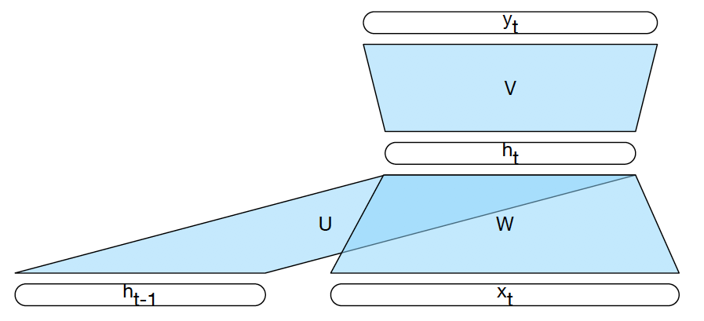
Basic RNNs
Each time step corresponds to a feedforward net where the hidden layer gets its input not just from the layer below but also from the activations of the hidden layer at the previous time step

Slide 33
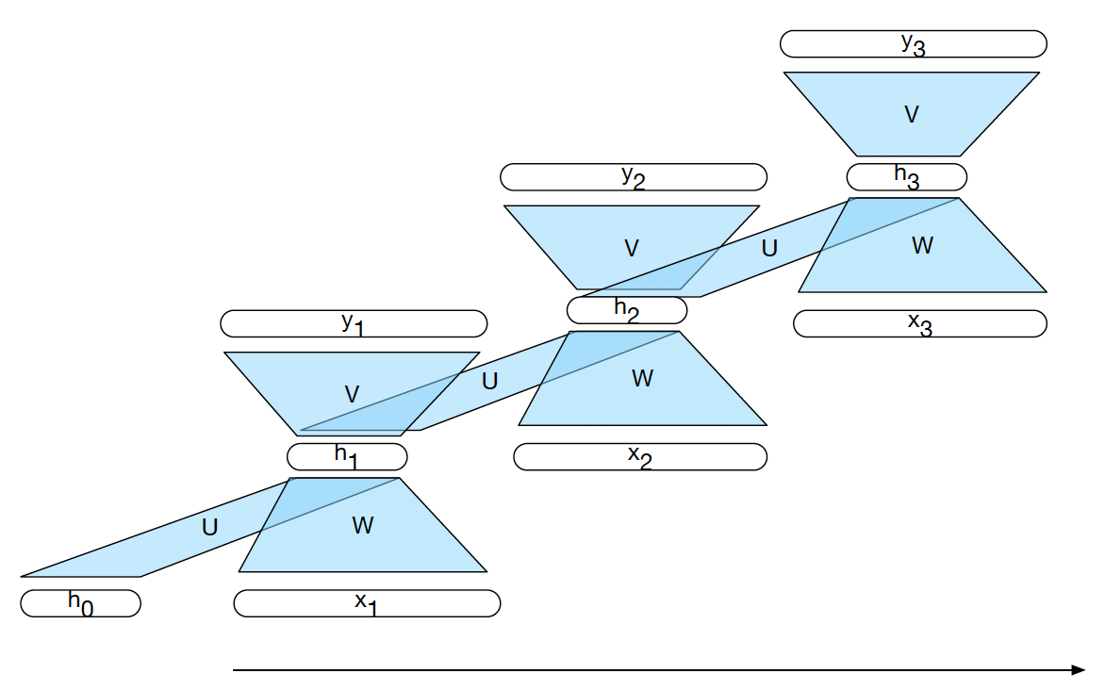
A basic RNN unrolled in time

Slide 34

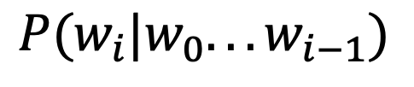
RNNs for generation
To generate a string w0w1…wn wn+1, give w0 as first input, and then pick the next word according to the computed probability
Feed this word in as input into the next layer.
$$P(w_{i}|w_{0}...w_{i−1})$$
output
hidden
input

Slide 35
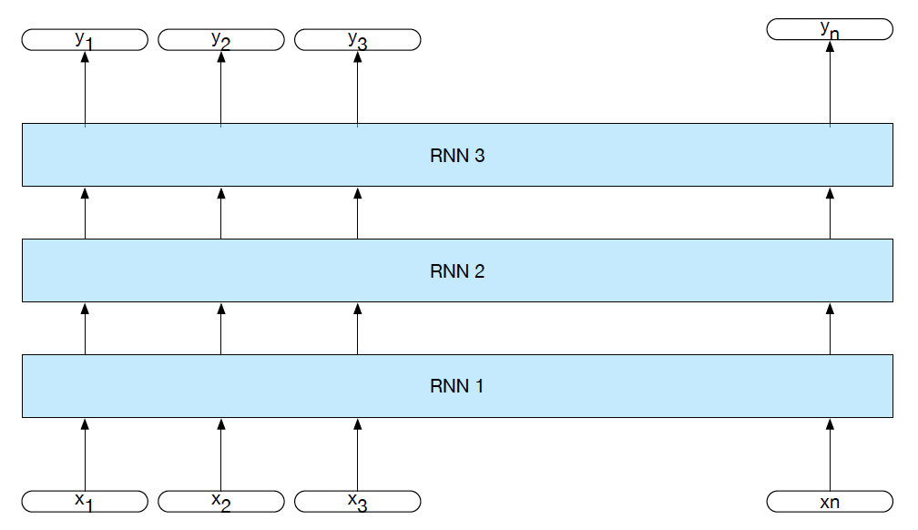
Stacked RNNs
We can create an RNN that has “vertical” depth
(at each time step) by stacking multiple RNNs

Slide 36
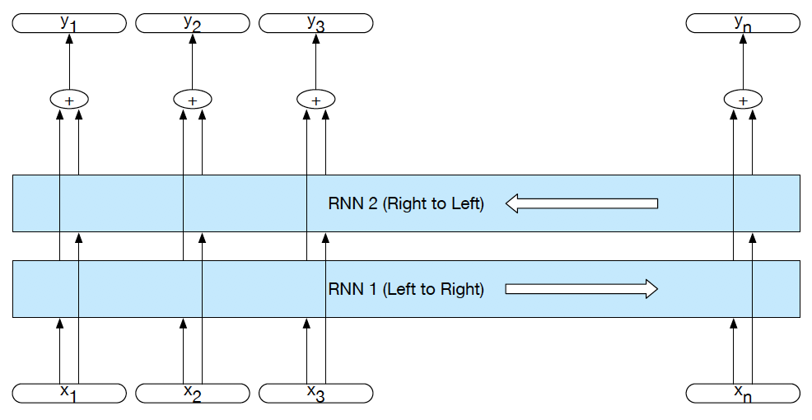
Bidirectional RNNs
Unless we need to generate a sequence,
we can run two RNNs over the input sequence
— one going forward, and one going backward.
Their hidden states will capture different context information.

Slide 37
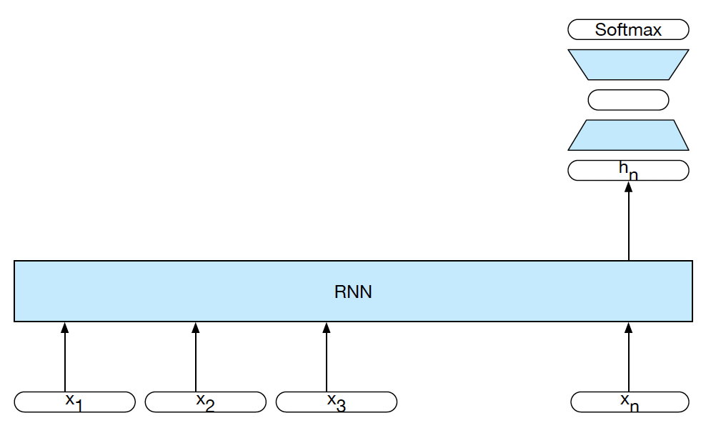
RNNs for sequence classification
If we just want to assign one label to the sequence,
we don’t need to produce output at each time step,
so we can use a simpler architecture.
We can use the hidden state of the last word
in the sequence as input to a feedforward net:

Slide 38

Encoder-Decoder (seq2seq) model
Task: Read an input sequence and return an output sequence
    Machine translation: translate source into target language
    Dialog system/chatbot: generate a response
Reading the input sequence: RNN Encoder
Generating the output sequence: RNN Decoder
Encoder
Decoder
output
hidden
input

Slide 39
Neural Word Embeddings

Slide 40
Word Embeddings (e.g. word2vec)
Main idea:
If you use a feedforward network to predict the probability of words that appear near an input word, the hidden layer of that network provides a dense vector representation of the input word.
Words that appear in similar contexts (that have high distributional similarity) will have very similar vector representations.
These models can be trained on large amounts of raw text (and pretrained embeddings can be downloaded)

Slide 41
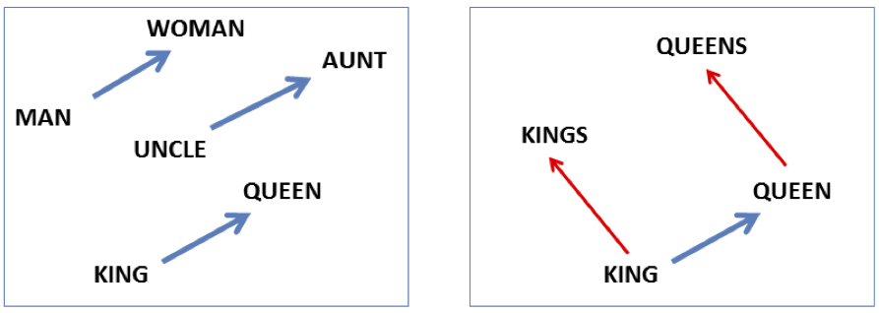
Analogy: Embeddings capture relational meaning!
vector(‘king’) - vector(‘man’) + vector(‘woman’) = vector(‘queen’)
vector(‘Paris’) - vector(‘France’) + vector(‘Italy’) = vector(‘Rome’)

Slide 42
Embeddings you can use
Static embeddings:
Word2vec (Mikolov et al.) https://code.google.com/archive/p/word2vec/
Fasttext http://www.fasttext.cc/
Glove (Pennington et al.) http://nlp.stanford.edu/projects/glove/
More recent developments:
RNN-based embeddings that depend on current word context
BERT (Devlin et al.)
https://github.com/google-research/bert
ELMO https://allennlp.org/elmo (Peters et al.)

Slide 43
Summary

Slide 44
Today’s lecture (I)
NLP is difficult because…
  … natural languages have very large (infinite) vocabularies
  … natural language sentences/documents have variable length
  … natural language is highly ambiguous
The traditional NLP (NLU) pipeline consists of a sequence of models that predict symbolic features for the next model
  … but that is quite brittle: mistakes get propagated through the pipeline
Traditional statistical NLG relies on fixed order n-gram models
  … but these are very large, and don’t capture long-range dependencies

Slide 45
Today’s lecture (II)
To use neural nets for NLP requires…
  … the use of word embeddings that map words to dense vectors
  … more complex architectures (e.g. RNNs, but also CNNs)
Word embeddings help us handle the long tail of rare and unknown words in the input
  Other people have trained them for us on massive amounts of text
RNNs help us capture long-range dependencies between
words that are far apart in the sentence.
  No need to make fixed-order Markov assumptions

Slide 46
Word Embeddings (e.g. word2vec)
Main idea:
If you use a feedforward network to predict the probability of words that appear in the context of (near) an input word, the hidden layer of that network provides a dense vector representation of the input word.
Words that appear in similar contexts (that have high distributional similarity) wils have very similar vector representations.
These models can be trained on large amounts of raw text (and pretrained embeddings can be downloaded)

Slide 47
Sequence-to-sequence (seq2seq) models
Task (e.g. machine translation):
  Given one variable length sequence as input,
  return another variable length sequence as output
Main idea:
  Use one RNN to encode the input sequence (“encoder”)
  Feed the last hidden state as input to a second RNN (“decoder”) that then generates the output sequence.

Slide 48
Neural n-gram models
Architecture:
  Input Layer: x = [v(w1)….v(wk)]
  v(w) = E[w]
  Hidden Layer: h = g(xW¹ + b¹)
  Output Layer: P(w | w1…wk) = softmax(hW² + b²)
Parameters:
  Embedding matrix: E ∈ R^{|V|×dim(emb)}
  Weight matrices and biases:
  first layer: W¹ ∈ R^{k∙dim(emb)×dim(h)} b¹ ∈ R^{dim(h)}
  second layer: W² ∈ R^{k∙dim(h)×|V|} b² ∈ R^{|V|}

Slide 49
Neural n-gram models
Advantages over traditional n-gram models:
    Increasing the order requires only a small linear increase in the number of parameters.
      W¹ goes from R^{k∙dim(emb)×dim(h)} to R^{(k+1)∙dim(emb)×dim(h)}
    Increasing the number of words in the vocabulary also leads only to a linear increase in the vocabulary
    Easy to incorporate more context: just add more input units
    Easy to generalize across contexts (embeddings!)
Computing softmax over large V is expensive:
  requires matrix-vector multiplication with W²,
  followed by |V| exponentiations
  Solution (during training): only sample a subset of the vocabulary (or use hierarchical softmax)

Slide 50
Word representations as by-product of neural LMs
Output embeddings: Each column in W² is a dim(h)-dimensional vector that is associated with a vocabulary item w ∈ V
h is a dense (non-linear) representation of the context Words that are similar appear in similar contexts.
Hence their columns in W² should be similar.
Input embeddings: each row in the embedding matrix is a representation of a word.
output layer
hidden layer h

Slide 51
Modifications to neural LM
If we want good word representations (rather than good language models), we can modify this model:
  1) We can also take the words that follow into account: compute P(w3 | w1w2_w4w5) instead of P(w5 | w1w2w3w4)
  Now, the input context c = w1w2_w4w5, not w1w2w3w4
  2) We don’t need a distribution over the output word.
  We just want the correct output word to have a higher score s(w,c) than other words w’. We remove the softmax, define s(w,c) as the activation of the output unit for w with input context c and use a (margin-based) ranking loss:
      Loss for predicting a random word w’ instead of w:
      L(w, c, w’) = max(0, 1 − (s(w, c) − s(w’, c))

Slide 52
Obtaining Word Embeddings

Slide 53
Word2Vec (Mikolov et al. 2013)
Modification of neural LM:
    Two different context representations:
  CBOW or Skip-Gram
    Two different optimization objectives:
    Negative sampling (NS) or hierarchical softmax
Task: train a classifier to predict a word from its context (or the context from a word)
Idea: Use the dense vector representation that this classifier uses as the embedding of the word.

Slide 54
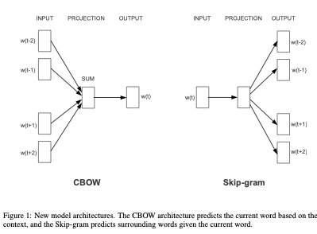
CBOW vs Skip-Gram

Slide 55
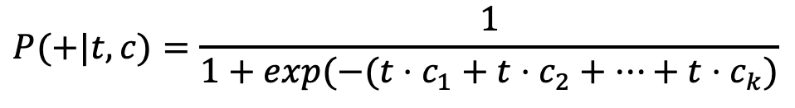
Word2Vec: CBOW
CBOW = Continuous Bag of Words
Remove the hidden layer, and the order information of the context.
Define context vector c as a sum of the embedding vectors of each context word ci, and score s(t,c) as tc
c = ∑i=1…k ci
s(t, c) = tc
$$P(+|t,c)=\frac{1}{1+exp(−(t⋅c_{1}+t⋅c_{2}+…+t⋅c_{k})}$$

Slide 56
Word2Vec: SkipGram
Don’t predict the current word based on its context,
but predict the context based on the current word.
Predict surrounding C words (here, typically C = 10).
Each context word is one training example

Slide 57
Skip-gram algorithm
Treat the target word and a neighboring context word as positive examples.
Randomly sample other words in the lexicon to get negative samples
Use logistic regression to train a classifier to distinguish those two cases
Use the weights as the embeddings
11/27/18

Slide 58
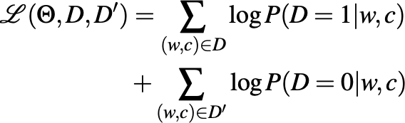
Word2Vec: Negative Sampling
Training objective:
Maximize log-likelihood of training data D+ ∪ D-:

Slide 59
Skip-Gram Training Data
Training sentence:
... lemon, a tablespoon of apricot jam a pinch ...
c1 c2 target c3 c4
Asssume context words are those in +/- 2 word window
11/27/18

Slide 60
Skip-Gram Goal
Given a tuple (t,c) = target, context
  (apricot, jam)
  (apricot, aardvark)
Return the probability that c is a real context word:
P(D = + | t, c)
P( D= − | t, c) = 1 − P(D = + | t, c)
11/27/18

Slide 61
How to compute p(+ | t, c)?
Intuition:
  Words are likely to appear near similar words
  Model similarity with dot-product!
    Similarity(t,c) ∝ t ∙ c
Problem:
  Dot product is not a probability!
  (Neither is cosine)

Slide 62
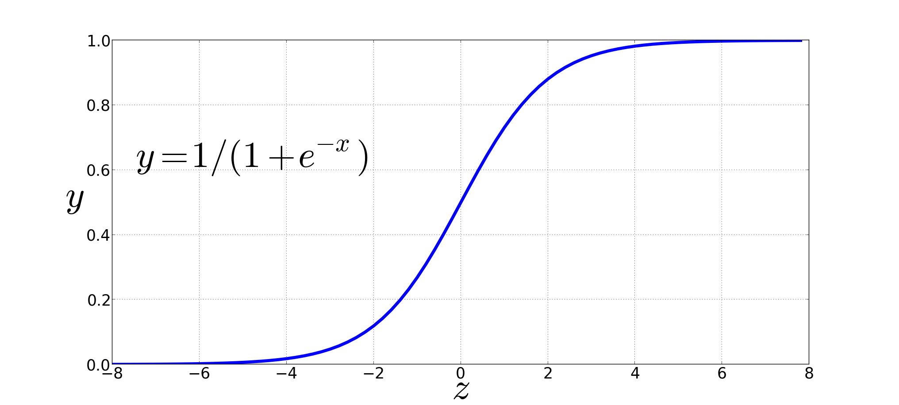
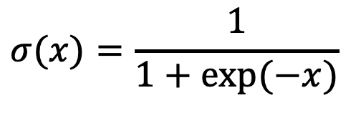
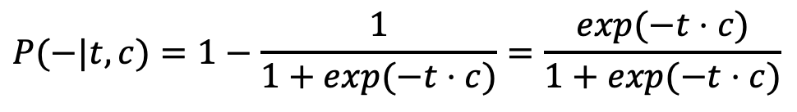
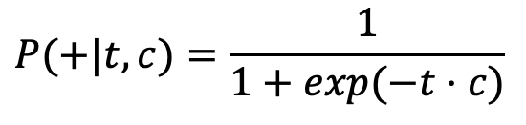
Turning the dot product into a probability
The sigmoid lies between 0 and 1:
$$σ(x)=\frac{1}{1+exp(−x)}$$
$$P(+|t,c)=\frac{1}{1+exp(−t⋅c)}$$
$$P(−|t,c)=1−\frac{1}{1+exp(−t⋅c)}=\frac{exp(−t⋅c)}{1+exp(−t⋅c)}$$

Slide 63

Word2Vec: Negative Sampling
Distinguish “good” (correct) word-context pairs (D=1),
from “bad” ones (D=0)
Probabilistic objective:
  P( D = 1 | t, c ) defined by sigmoid:
  P( D = 0 | t, c ) = 1 — P( D = 0 | t, c )
  P( D = 1 | t, c ) should be high when (t, c) ∈ D+, and low when (t,c) ∈ D-

Slide 64
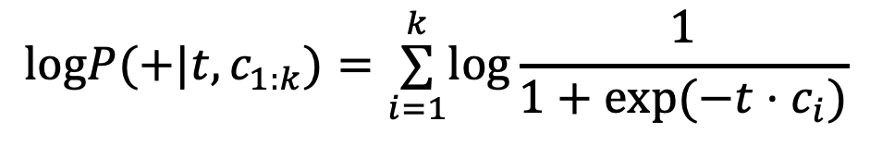
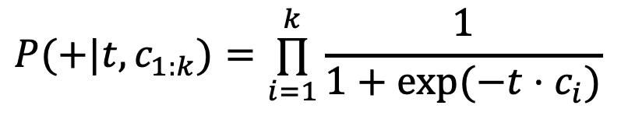
For all the context words
Assume all context words c1:k are independent:
$$P(+|t,c_{1:k})=\overset{k}{\underset{i=1}{∏}}\frac{1}{1+exp(−t⋅c_{i})}$$
$$logP(+|t,c_{1:k})=\overset{k}{\underset{i=1}{∑}}log\frac{1}{1+exp(−t⋅c_{i})}$$

Slide 65
Word2Vec: Negative Sampling
Training data: D+ ∪ D-
D+ = actual examples from training data
Where do we get D- from?
  Lots of options.
  Word2Vec: for each good pair (w,c), sample k words and add each wi as a negative example (wi,c) to D’
      (D’ is k times as large as D)
  Words can be sampled according to corpus frequency
  or according to smoothed variant where freq’(w) = freq(w)^{0.75}
      (This gives more weight to rare words)

Slide 66
Skip-Gram Training data
Training sentence:
... lemon, a tablespoon of apricot jam a pinch ...
c1 c2 t c3 c4
Training data: input/output pairs centering on apricot
Assume a +/- 2 word window

Slide 67
Skip-Gram Training data
Training sentence:
... lemon, a tablespoon of apricot jam a pinch ...
c1 c2 t c3 c4
Training data: input/output pairs centering on apricot
  Assume a +/- 2 word window
  Positive examples:
  (apricot, tablespoon), (apricot, of), (apricot, jam), (apricot, a)
  For each positive example, create k negative examples,
  using noise words:
  (apricot, aardvark), (apricot, puddle)…

Slide 68
Summary: How to learn word2vec (skip-gram) embeddings
For a vocabulary of size V: Start with V random 300-dimensional vectors as initial embeddings
Train a logistic regression classifier to distinguish words that co-occur in corpus from those that don’t
  Pairs of words that co-occur are positive examples
  Pairs of words that don't co-occur are negative examples
  Train the classifier to distinguish these by slowly adjusting all the embeddings to improve the classifier performance
Throw away the classifier code and keep the embeddings.

Slide 69
Evaluating embeddings
Compare to human scores on word similarity-type tasks:
WordSim-353 (Finkelstein et al., 2002)
SimLex-999 (Hill et al., 2015)
Stanford Contextual Word Similarity (SCWS) dataset (Huang et al., 2012)
TOEFL dataset: Levied is closest in meaning to: imposed, believed, requested, correlated

Slide 70
Properties of embeddings
Similarity depends on window size C
C = ±2 The nearest words to Hogwarts:
  Sunnydale
  Evernight
C = ±5 The nearest words to Hogwarts:
  Dumbledore
  Malfoy
  halfblood

Slide 71
Analogy: Embeddings capture relational meaning!
vector(‘king’) - vector(‘man’) + vector(‘woman’) = vector(‘queen’)
vector(‘Paris’) - vector(‘France’) + vector(‘Italy’) = vector(‘Rome’)

Slide 72
Using Word Embeddings

Slide 73
Using pre-trained embeddings
Assume you have pre-trained embeddings E.
How do you use them in your model?
    Option 1: Adapt E during training
  Disadvantage: only words in training data will be affected.
    Option 2: Keep E fixed, but add another hidden layer that is learned for your task
    Option 3: Learn matrix T ∈ dim(emb)×dim(emb) and use rows of E’ = ET (adapts all embeddings, not specific words)
    Option 4: Keep E fixed, but learn matrix Δ ∈ R^{|V|×dim(emb)} and use E’ = E + Δ or E’ = ET + Δ (this learns to adapt specific words)

Slide 74
More on embeddings
Embeddings aren’t just for words!
  You can take any discrete input feature (with a fixed number of K outcomes, e.g. POS tags, etc.) and learn an embedding matrix for that feature.
Where do we get the input embeddings from?
  We can learn the embedding matrix during training.
  Initialization matters: use random weights, but in special range (e.g. [-1/(2d), +(1/2d)] for d-dimensional embeddings), or use Xavier initialization
  We can also use pre-trained embeddings
  LM-based embeddings are useful for many NLP task

Slide 75
Dense embeddings you can download!
Word2vec (Mikolov et al.)
https://code.google.com/archive/p/word2vec/
Fasttext http://www.fasttext.cc/
Glove (Pennington, Socher, Manning)
http://nlp.stanford.edu/projects/glove/

Slide 76
Neural N-Gram Models

Slide 77
Word representations as by-product of neural LMs
Output embeddings: the weights that connect the last hidden layer h to the i-th ouput is a dim(h)-dimensional vector that is associated with the i-th vocabulary item w ∈ V
h is a dense (non-linear) representation of the context Words that are similar appear in similar contexts.
Hence their columns in W² should be similar.
Input embeddings: each row in the embedding matrix is a representation of a word.
output layer
hidden layer h

Slide 78
Further extensions
Character and substring embeddings
  We can also learn embeddings for individual letters.
  This helps generalize better to rare words, typos, etc.
  These embeddings can be combined with word embeddings (or used instead of an UNK embedding)
Context-dependent embeddings (ELMO, BERT, ….)
  Word2Vec etc. are static embeddings: they induce a type-based lexicon that doesn’t handle polysemy etc.
  Context-dependent embeddings produce token-specific embeddings that depend on the particular context in which a word appears.

Slide 79
CNNs for NLP

Slide 80
Neural Sequence Models

Slide 81
Seq2Seq Models

Slide 82
Further extensions
Character and substring embeddings
  We can also learn embeddings for individual letters.
  This helps generalize better to rare words, typos, etc.
  These embeddings can be combined with word embeddings (or used instead of an UNK embedding)
Context-dependent embeddings (ELMO, BERT, ….)
  Word2Vec etc. are static embeddings: they induce a type-based lexicon that doesn’t handle polysemy etc.
  Context-dependent embeddings produce token-specific embeddings that depend on the particular context in which a word appears.

