Slide 1
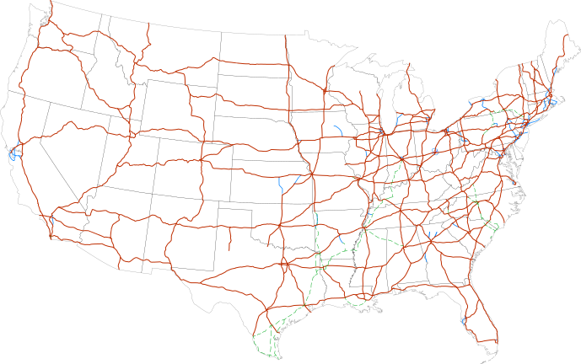
CS440/ECE 448 Lecture 4:
Search Intro
Slides by Svetlana Lazebnik, 9/2016
Modified by Mark Hasegawa-Johnson, 1/2019

Slide 2
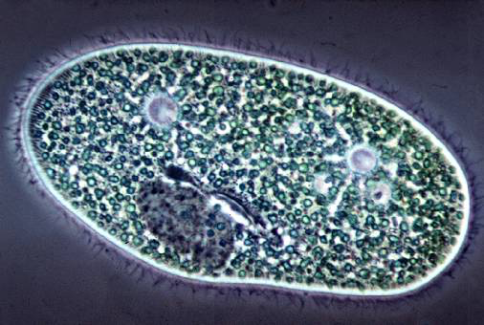
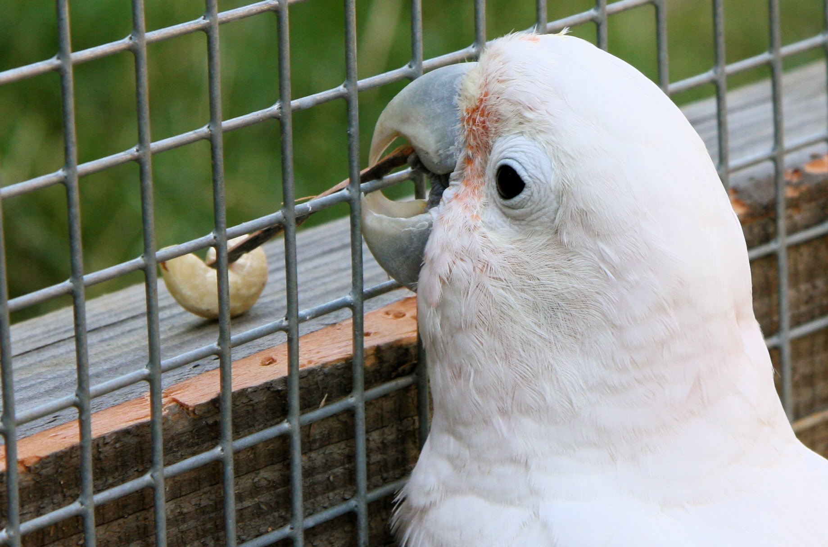
Types of agents
Reflex agent
Goal-directed agent
Consider how the world IS
Choose action based on current percept
Do not consider the future consequences of actions
Consider how the world WOULD BE
Decisions based on (hypothesized) consequences of actions
Must have a model of how the world evolves in response to actions
Must formulate a goal
Source: D. Klein, P. Abbeel
Notes:
Can a reflex agent be rational?

Slide 3
Outline of today’s lecture
How to turn ANY problem into a SEARCH problem:
  Initial state, goal state, transition model
  Actions, path cost
General algorithm for solving search problems
  First data structure: a frontier list
  Second data structure: a search tree
  Third data structure: a “visited states” list
Depth-first search: very fast, but not guaranteed
Breadth-first search: guaranteed optimal
Uniform cost search = Dijkstra’s algorithm = BFS with variable costs

Slide 4

Search
We will consider the problem of designing goal-based agents in fully observable, deterministic, discrete, static, known environments
Start state
Goal state

Slide 5
Search
We will consider the problem of designing goal-based agents in fully observable, deterministic, discrete, known environments
  The agent must find a sequence of actions that reaches the goal
  The performance measure is defined by (a) reaching the goal and (b) how “expensive” the path to the goal is
    The agent doesn’t know the performance measure. This is a goal-directed agent, not a utility-directed agent
    The programmer (you) DOES know the performance measure. So you design a goal-seeking strategy that minimizes cost.
  We are focused on the process of finding the solution; while executing the solution, we assume that the agent can safely ignore its percepts (static environment, open-loop system)

Slide 6
Search problem components
Initial state
Actions
Transition model
  What state results from
  performing a given action
  in a given state?
Goal state
Path cost
  Assume that it is a sum of
  nonnegative step costs
The optimal solution is the sequence of actions that gives the lowest path cost for reaching the goal
Initial
state
Goal
state

Slide 7
Knowledge Representation: State
State = description of the world
  Must have enough detail to decide whether or not you’re currently in the initial state
  Must have enough detail to decide whether or not you’ve reached the goal state
  Often but not always: “defining the state” and “defining the transition model” are the same thing

Slide 8
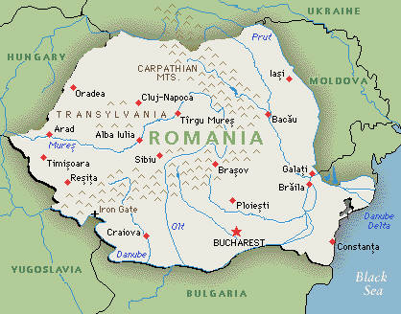
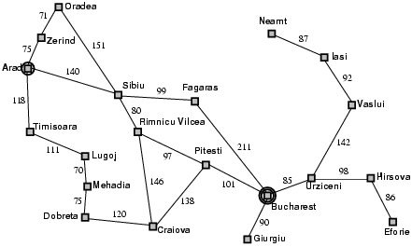
Example: Romania
On vacation in Romania; currently in Arad
Flight leaves tomorrow from Bucharest
Initial state
  Arad
Actions
  Go from one city to another
Transition model
  If you go from city A to
  city B, you end up in city B
Goal state
  Bucharest
Path cost
  Sum of edge costs (total distance traveled)

Slide 9
State space
The initial state, actions, and transition model define the state space of the problem
  The set of all states reachable from initial state by any sequence of actions
  Can be represented as a directed graph where the nodes are states and links between nodes are actions
What is the state space for the Romania problem?
  State Space = O{# cities}

Slide 10
Traveling Salesman Problem
Goal: visit every city in the United States
Path cost: total miles traveled
Initial state: Champaign, IL
Action: travel from one city to another
Transition model: when you visit a city, mark it as “visited.”
  State Space = O{2^#cities}

Slide 11
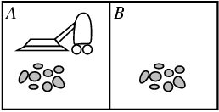
Example: Vacuum world
States
  Agent location and dirt location
  How many possible states?
  What if there are n possible locations?
    The size of the state space grows exponentially with the “size” of the world!
Actions
  Left, right, suck
Transition model

Slide 12
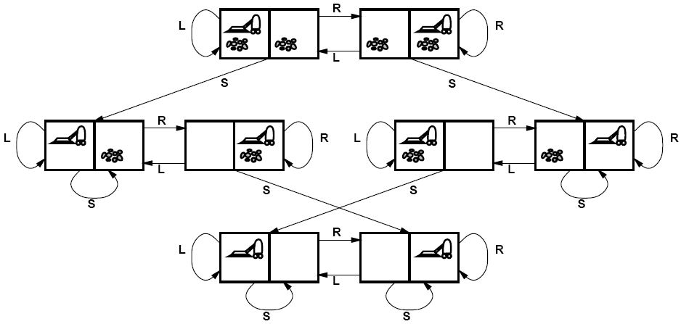
Vacuum world state space graph

Slide 13
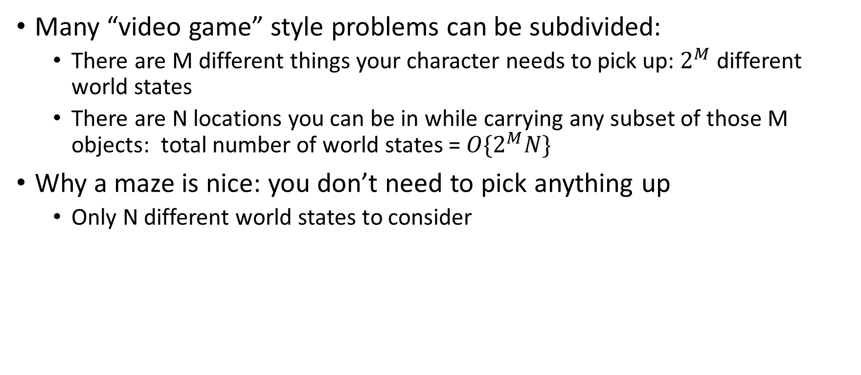
Complexity of the State Space
Many “video game” style problems can be subdivided:
  There are M different things your character needs to pick up: $2^{M}$ different world states
  There are N locations you can be in while carrying any subset of those M objects: total number of world states = ${O\{2}^{M}N\}$
Why a maze is nice: you don’t need to pick anything up
  Only N different world states to consider

Slide 14
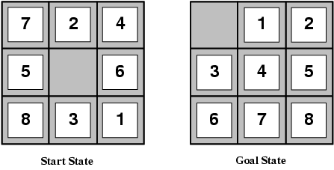
Example: The 8-puzzle
States
  Locations of tiles
    8-puzzle: 181,440 states (9!/2)
    15-puzzle: ~10 trillion states
    24-puzzle: ~10²⁵ states
Actions
  Move blank left, right, up, down
Path cost
  1 per move
Finding the optimal solution of n-Puzzle is NP-hard

Slide 15
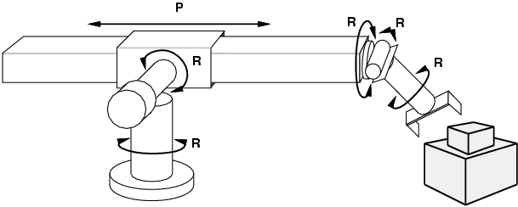
Example: Robot motion planning
States
  Real-valued joint parameters (angles, displacements)
Actions
  Continuous motions of robot joints
Goal state
  Configuration in which object is grasped
Path cost
  Time to execute, smoothness of path, etc.

Slide 16
Outline of today’s lecture
How to turn ANY problem into a SEARCH problem:
  Initial state, goal state, transition model
  Actions, path cost
General algorithm for solving search problems
  First data structure: a frontier list
  Second data structure: a search tree
  Third data structure: a “visited states” list
Depth-first search: very fast, but not guaranteed
Breadth-first search: guaranteed optimal
Uniform cost search = Dijkstra’s algorithm = BFS with variable costs

Slide 17
  First data structure: a frontier list
Let’s begin at the start state and expand it by making a list of all possible successor states
Maintain a frontier or a list of unexpanded states
At each step, pick a state from the frontier to expand:
  Check to see if it’s a goal state
  If not, find the other states that can be reached from this state, and add them to the frontier, if they’re not already there
Keep going until you reach a goal state

Slide 18
  Second data structure: a search tree
“What if” tree of sequences of actions and outcomes
The root node corresponds to the starting state
The children of a node correspond to the successor states of that node’s state
A path through the tree corresponds to a sequence of actions
  A solution is a path ending in the goal state
Starting state
Action
Successor state
…
…
…
…
Goal state

Slide 19
Knowledge Representation: States and Nodes
State = description of the world
  Must have enough detail to decide whether or not you’re currently in the initial state
  Must have enough detail to decide whether or not you’ve reached the goal state
  Often but not always: “defining the state” and “defining the transition model” are the same thing
Node = a point in the search tree
  Private data: ID of the state reached by this node
  Private data: the ID of the parent node

Slide 20
Tree Search Algorithm Outline
Initialize the frontier using the starting state
While the frontier is not empty
  Choose a frontier node according to search strategy and take it off the frontier
  If the node contains the goal state, return solution
  Else expand the node and add its children to the frontier
Search strategy determines
  Is this process guaranteed to return an optimal solution?
  Is this process guaranteed to return ANY solution?
  Time complexity: how much time does it take?
  Space complexity: how much RAM is consumed by the frontier?
For now: assume that search strategy = random

Slide 21

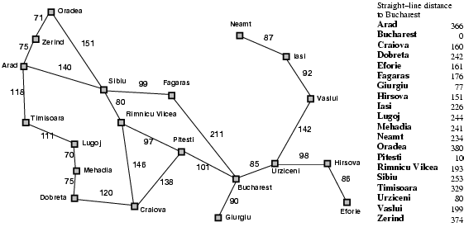
Tree search example
Start: Arad
Goal: Bucharest

Slide 22
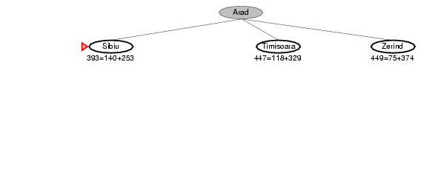
Tree search example
Start: Arad
Goal: Bucharest

Slide 23
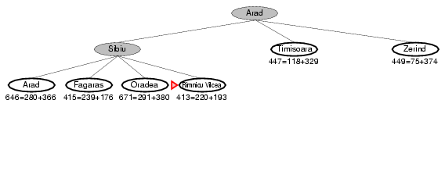
Tree search example
Start: Arad
Goal: Bucharest

Slide 24
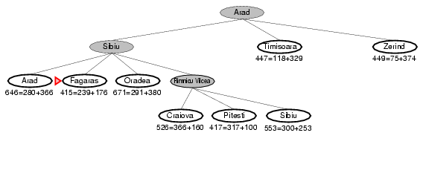
Tree search example
Start: Arad
Goal: Bucharest

Slide 25
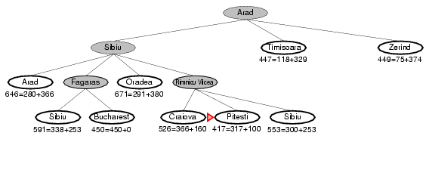
Tree search example
Start: Arad
Goal: Bucharest
e

Slide 26
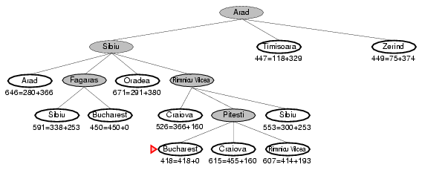
Tree search example
e
Start: Arad
Goal: Bucharest
e
e
e

Slide 27
Handling repeated states
Initialize the frontier using the starting state
While the frontier is not empty
  Choose a frontier node according to search strategy and take it off the frontier
  If the node contains the goal state, return solution
  Else expand the node and add its children to the frontier
To handle repeated states:
  Every time you expand a node, add that state to the
  explored set
  When adding nodes to the frontier, CHECK FIRST to see if they’ve already been explored

Slide 28
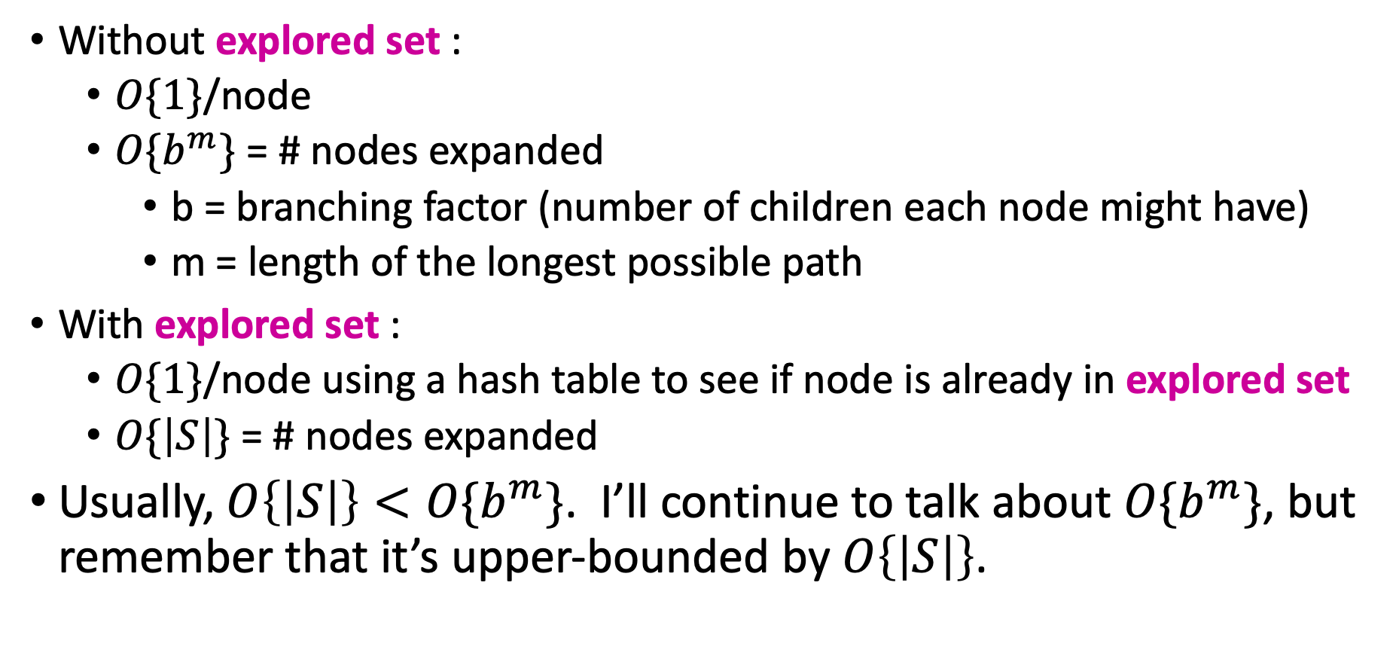
Time Complexity
Without explored set :
  $O\{1\}$/node
  $O\{b^{m}\}$ = # nodes expanded
    b = branching factor (number of children each node might have)
    m = length of the longest possible path
With explored set :
  $O\{1\}$/node using a hash table to see if node is already in explored set
  $O\{\left|S\right|\}$ = # nodes expanded
Usually, $O\left\{\left|S\right|\right\}<O\{b^{m}\}$. I’ll continue to talk about $O\{b^{m}\}$, but remember that it’s upper-bounded by $O\left\{\left|S\right|\right\}$.

Slide 29
Tree search w/o repeats
Start: Arad
Goal: Bucharest

Slide 30
Tree search w/o repeats
Explored:
Arad
Start: Arad
Goal: Bucharest

Slide 31
Tree search example
Explored:
Arad
Sibiu
Start: Arad
Goal: Bucharest

Slide 32
Tree search example
Explored:
Arad
Sibiu
Rimnicu Vilcea
Start: Arad
Goal: Bucharest

Slide 33
Tree search example
Explored:
Arad
Sibiu
Rimnicu Vilces
Fagaras
Start: Arad
Goal: Bucharest
e

Slide 34
Tree search example
Explored:
Arad
Sibiu
Rinnicu Vilces
Fagaras
Pitesti
Start: Arad
Goal: Bucharest
e
e
e

Slide 35
Outline of today’s lecture
How to turn ANY problem into a SEARCH problem:
  Initial state, goal state, transition model
  Actions, path cost
General algorithm for solving search problems
  First data structure: a frontier list
  Second data structure: a search tree
  Third data structure: a “visited states” list
Depth-first search: very fast, but not guaranteed
Breadth-first search: guaranteed optimal
Uniform cost search = Dijkstra’s algorithm = BFS with variable costs

Slide 36
Depth-First Search
Basic idea
try to find a solution as fast as possible
How:
From the frontier, always choose a node which is
AS FAR FROM THE STARTING POINT AS POSSIBLE
How:
Frontier is a LIFO queue.
The node you expand = whichever node has been most recently placed on the queue.

Slide 37
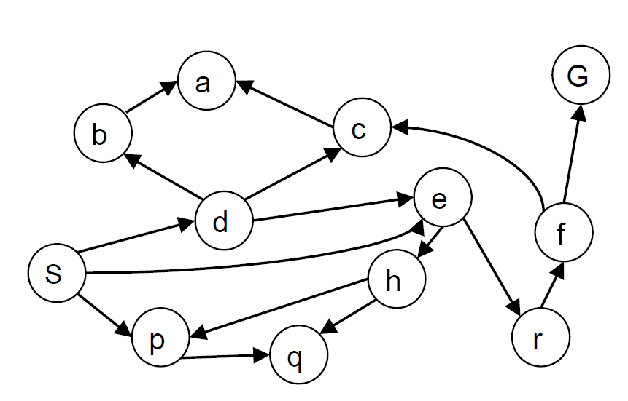
Depth-first search
Expand deepest unexpanded node
Implementation: frontier is LIFO (a stack)
Example state space graph for a tiny search problem

Slide 38
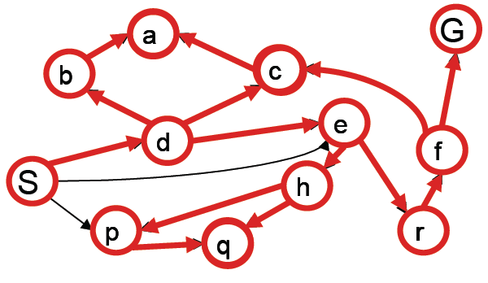
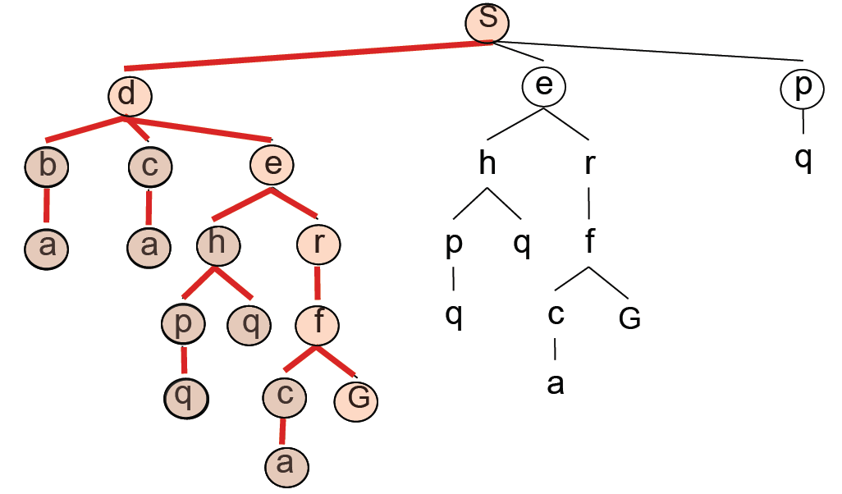
Depth-first search
Expansion order:
(s,d,b,a,
c,a,
e,h,p,q,
q,
r,f,c,a,
G)

Slide 39
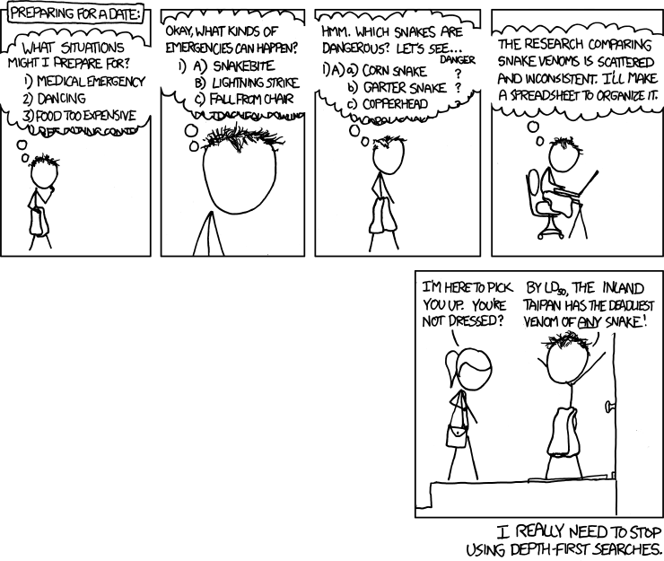
http://xkcd.com/761/

Slide 40
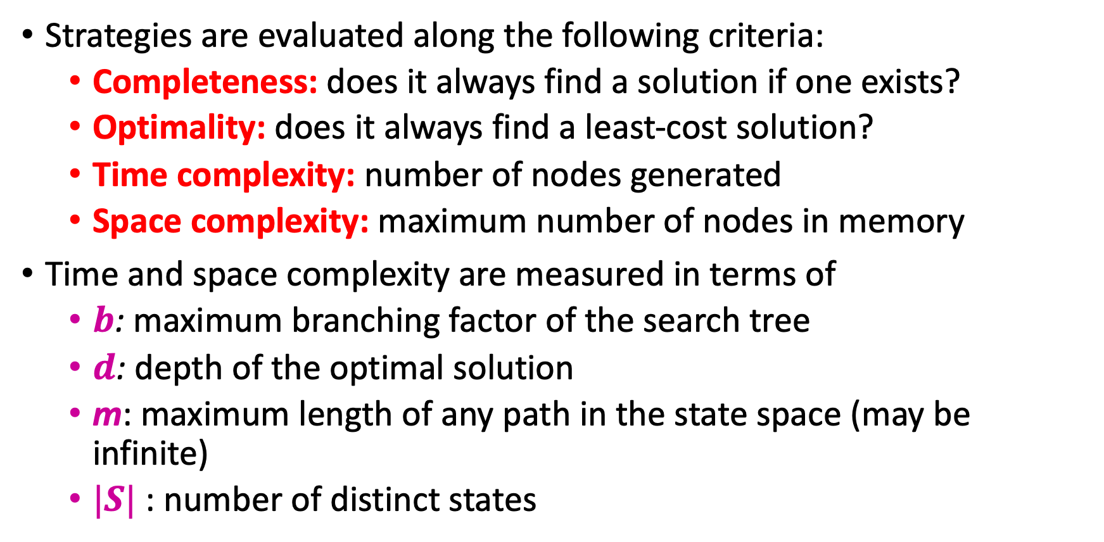
Analysis of search strategies
Strategies are evaluated along the following criteria:
  Completeness: does it always find a solution if one exists?
  Optimality: does it always find a least-cost solution?
  Time complexity: number of nodes generated
  Space complexity: maximum number of nodes in memory
Time and space complexity are measured in terms of
  $b$: maximum branching factor of the search tree
  $d$: depth of the optimal solution
  m: maximum length of any path in the state space (may be infinite)
  $|S|$ : number of distinct states

Slide 41
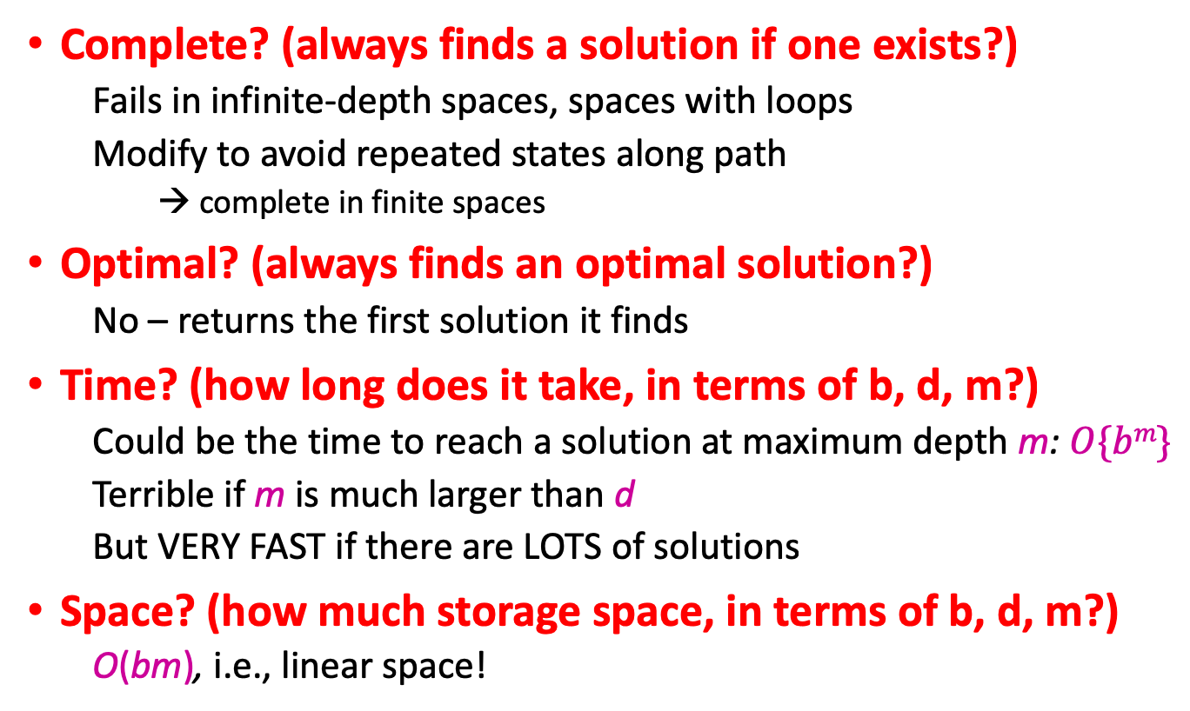
Properties of depth-first search
Complete? (always finds a solution if one exists?)
  Fails in infinite-depth spaces, spaces with loops
  Modify to avoid repeated states along path
    → complete in finite spaces
Optimal? (always finds an optimal solution?)
  No – returns the first solution it finds
Time? (how long does it take, in terms of b, d, m?)
  Could be the time to reach a solution at maximum depth m: $O\{bm\}$
  Terrible if m is much larger than d
  But VERY FAST if there are LOTS of solutions
Space? (how much storage space, in terms of b, d, m?)
  O(bm), i.e., linear space!

Slide 42
Outline of today’s lecture
How to turn ANY problem into a SEARCH problem:
  Initial state, goal state, transition model
  Actions, path cost
General algorithm for solving search problems
  First data structure: a frontier list
  Second data structure: a search tree
  Third data structure: a “visited states” list
Depth-first search: very fast, but not guaranteed
Breadth-first search: guaranteed optimal
Uniform cost search = Dijkstra’s algorithm = BFS with variable costs

Slide 43
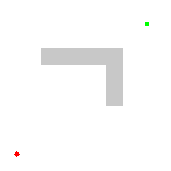
Breadth-first search
Initialize the frontier using the starting state
While the frontier is not empty
  Search strategy: choose one of the hodes which is CLOSEST to the starting state
  If the node contains the goal state, return solution
  Else expand the node and add its children to the frontier

Slide 44
Breadth-first search
Expand shallowest unexpanded node
Implementation: frontier is FIFO (a queue)
Example from P. Abbeel and D. Klein

Slide 45
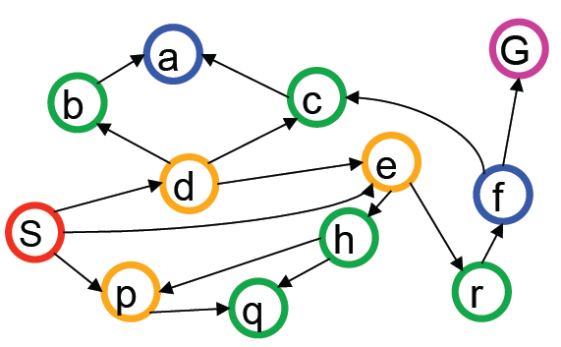
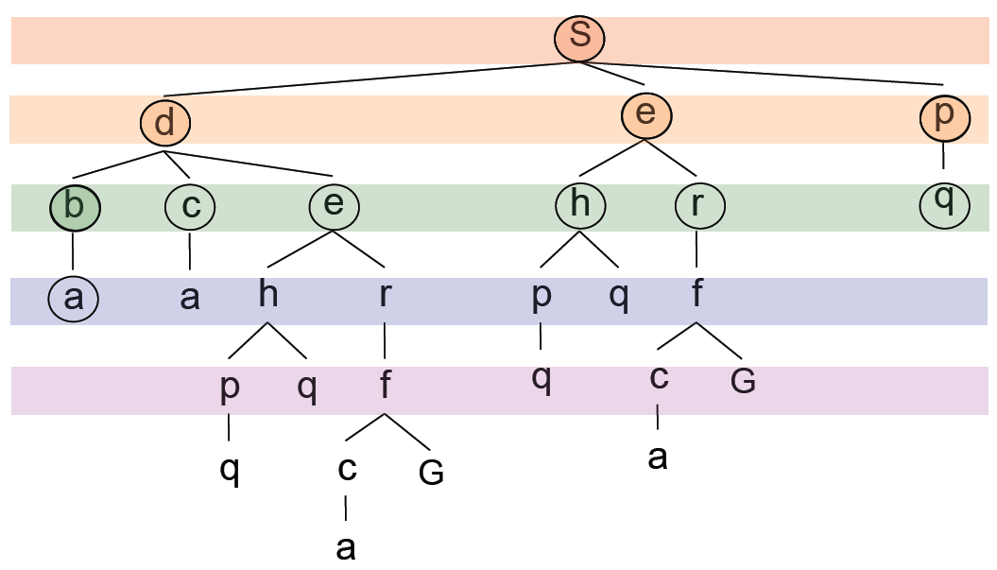
Breadth-first search
Expansion order:
(s,
d,e,p,
b,c,e,h,r,q,
a,a,h,r,p,q,f,
p,q,f,q,c,G)

Slide 46
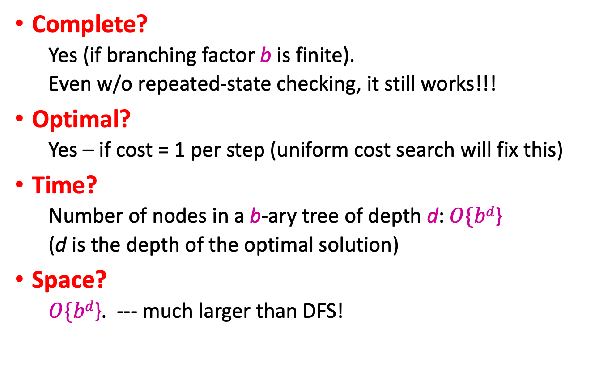
Properties of breadth-first search
Complete?
  Yes (if branching factor b is finite).
  Even w/o repeated-state checking, it still works!!!
Optimal?
  Yes – if cost = 1 per step (uniform cost search will fix this)
Time?
  Number of nodes in a b-ary tree of depth d: $O\{bd$}
  (d is the depth of the optimal solution)
Space?
  $O\{bd$}. --- much larger than DFS!

Slide 47
Outline of today’s lecture
How to turn ANY problem into a SEARCH problem:
  Initial state, goal state, transition model
  Actions, path cost
General algorithm for solving search problems
  First data structure: a frontier list
  Second data structure: a search tree
  Third data structure: a “visited states” list
Depth-first search: very fast, but not guaranteed
Breadth-first search: guaranteed optimal
Uniform cost search = Dijkstra’s algorithm = BFS with variable costs

Slide 48
Uniform-cost search = Dijkstra’s algorithm
For each frontier node, save the total cost of the path from the initial state to that node
Expand the frontier node with the lowest path cost
Implementation: frontier is a priority queue ordered by path cost
Equivalent to breadth-first if step costs all equal
Equivalent to Dijkstra’s algorithm, if Dijkstra’s algorithm is modified so that a node’s value is computed only when it becomes nonzero

Slide 49
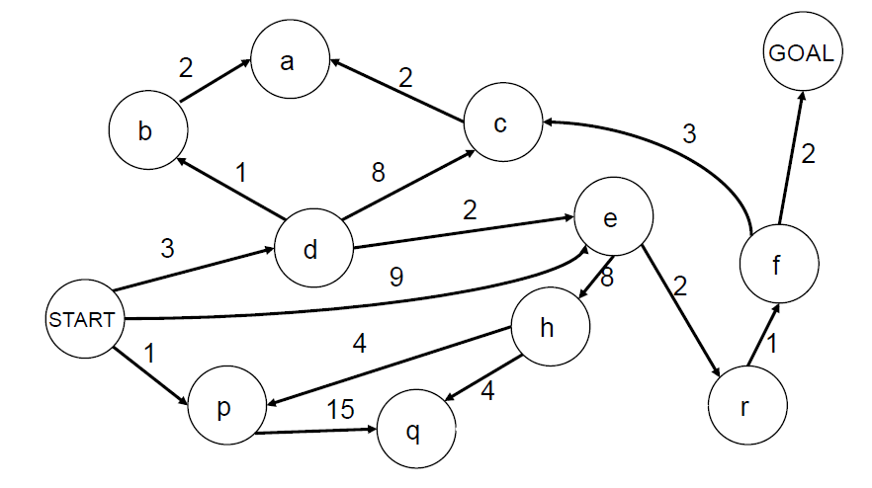
Uniform-cost search example

Slide 50
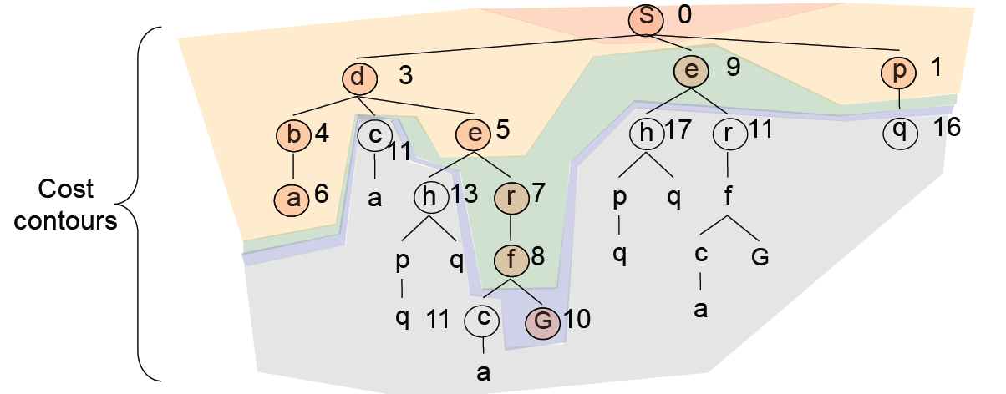
Uniform-cost search example
Expansion order:
(s,
p(1),d(3),b(4),e(5),a(6),
r(7),f(8),e(9),
G(10))

Slide 51
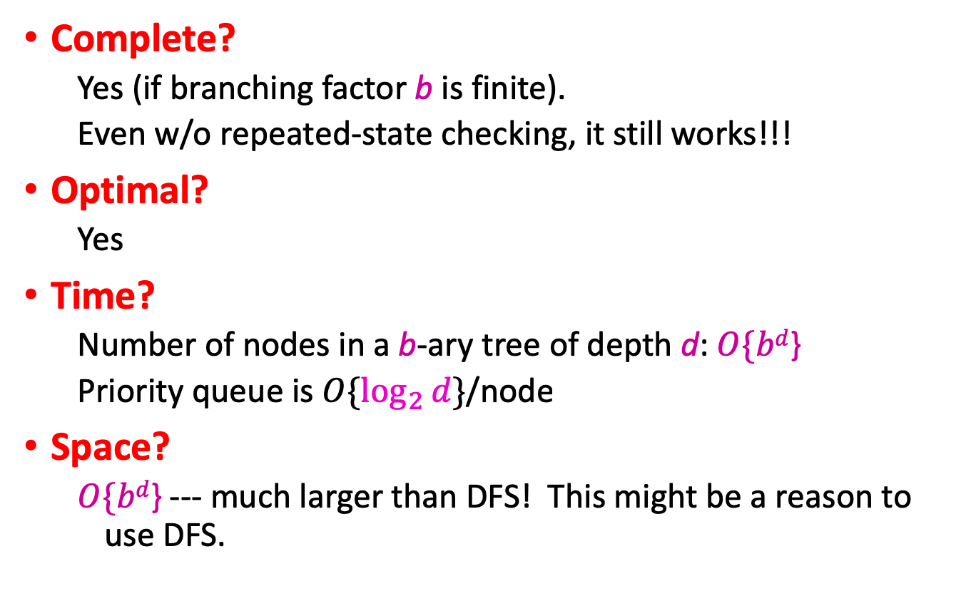
Properties of uniform-cost search
Complete?
  Yes (if branching factor b is finite).
  Even w/o repeated-state checking, it still works!!!
Optimal?
  Yes
Time?
  Number of nodes in a b-ary tree of depth d: $O\{bd$}
  Priority queue is $O\{\log_{2}{d}\}$/node
Space?
  $O\{bd$} --- much larger than DFS! This might be a reason to use DFS.

Slide 52
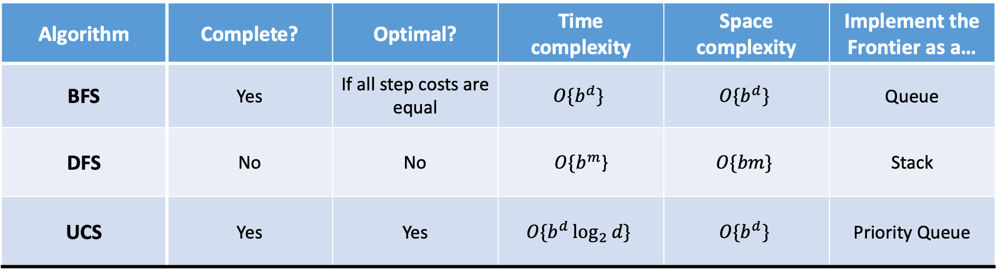
Search strategies so far
Algorithm | Complete? | Optimal? | Time complexity | Space complexity | Implement the Frontier as a…
BFS | Yes | If all step costs are equal | $$O\{b^{d}\}$$ | $$O\{b^{d}\}$$ | Queue
DFS | No | No | $O\{b^{m}$} | $$O\{bm\}$$ | Stack
UCS | Yes | Yes | $$O\{b^{d}\log_{2}{d}\}$$ | $$O\{b^{d}\}$$ | Priority Queue
Next time
Already we know how far it is, from the start point, to each node on the frontier.
What if we also have an ESTIMATE of the distance from each node to the GOAL?

