Slide 1
Introduction to Virtual Reality
CS 498VR
UNIVERSITY OF ILLINOIS AT URBANA-CHAMPAIGN

Slide 2
Welcome to CS 498 - Virtual Reality
Prof
Lead Instructor: Eric Shaffer
Office: 2209 Siebel Center
Office Hours: Tues 10AM-11AM

Slide 3
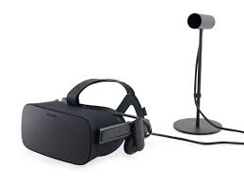
VR Lab - SC4107
20 workstations with Oculus Rift CV1s
6GB RAM
NVidia GeForce Titan Blacks
Dual 27 inch monitors
Windows. Unity3d.
Work in pairs on 4 assignments + final project

Slide 4
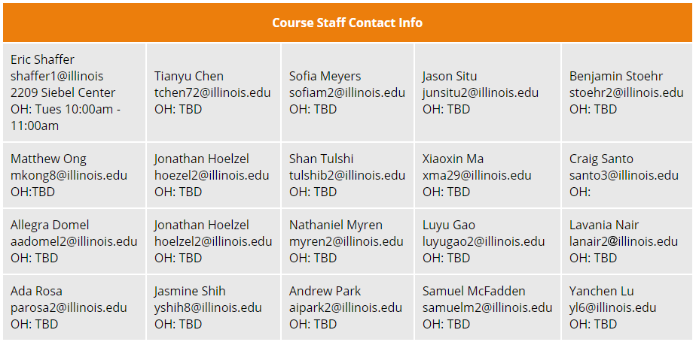
Tremendous Course Staff

Slide 5
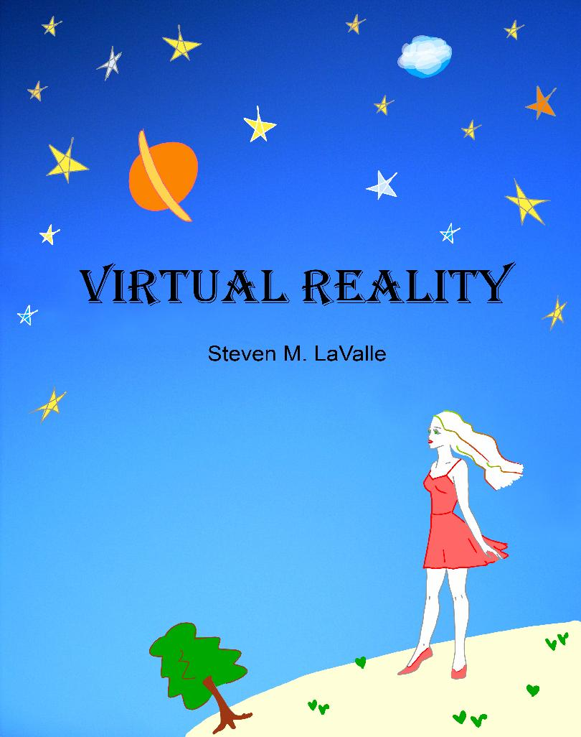
Course Materials
Webpage: https://courses.engr.illinois.edu/cs498vr3/
Piazza: https://piazza.com/illinois/fall2018/cs498vr
Textbook: Virtual Reality, S.M. Lavalle, 2016 (free online)
VR Lab: Siebel Center 4107

Slide 6
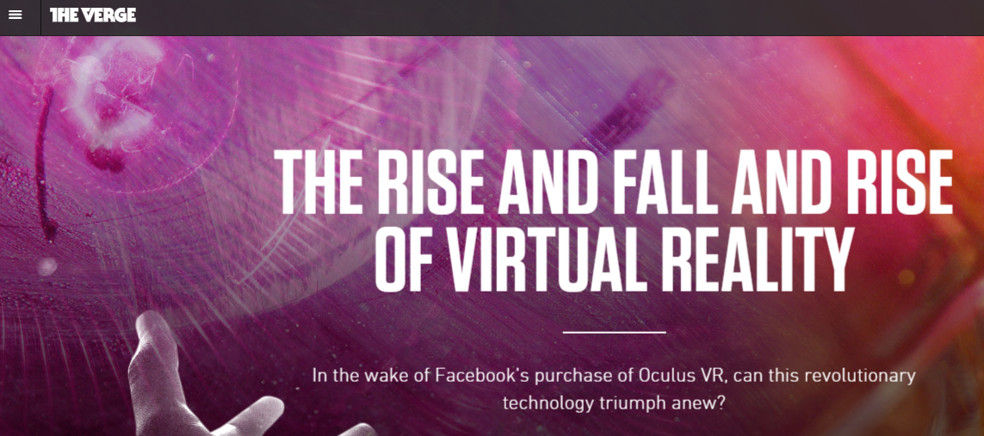
History Lessons: This is the Second Wave of VR

Slide 7
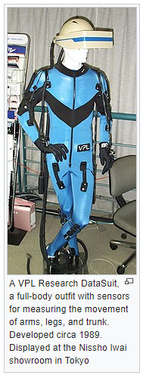
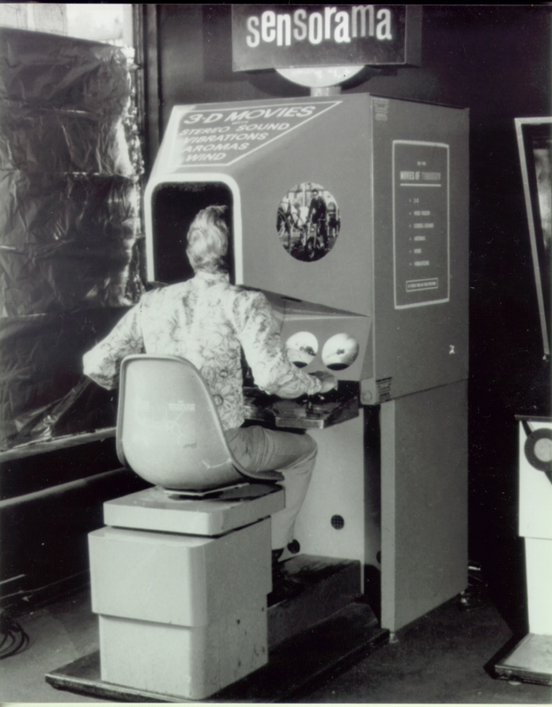
History Lessons: The First Wave
The Sensorama was released in the 1950s…it was a totally mechanical device.

Slide 8
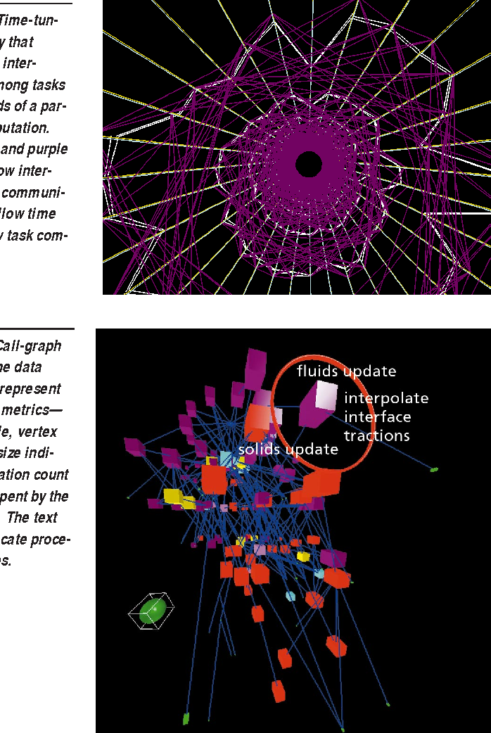
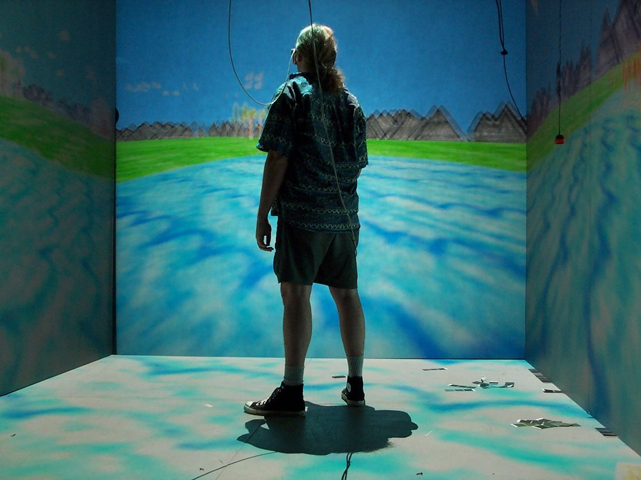
A Little More About Me….
It turns out I actually wrote (part of) of VR-based info vis system in 1999

Slide 9
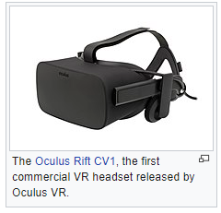
A Bit About Oculus
Early 2012, Palmer Luckey made a prototype headset (duct taped!!)
Aug 2012, John Carmack improved it and showed at E3
Aug 2012, Oculus was founded (Brendan Iribe, Michael Antonov, Nate Mitchell, and Jack McCauley)
Sept 2012, Kickstarter very successful
2012 - 2014, over 60,000 headsets sold
Mar 2014, Facebook acquires Oculus for $2 billion
Notes:
Steve and Anna were 6th and 7th employees.

Slide 10
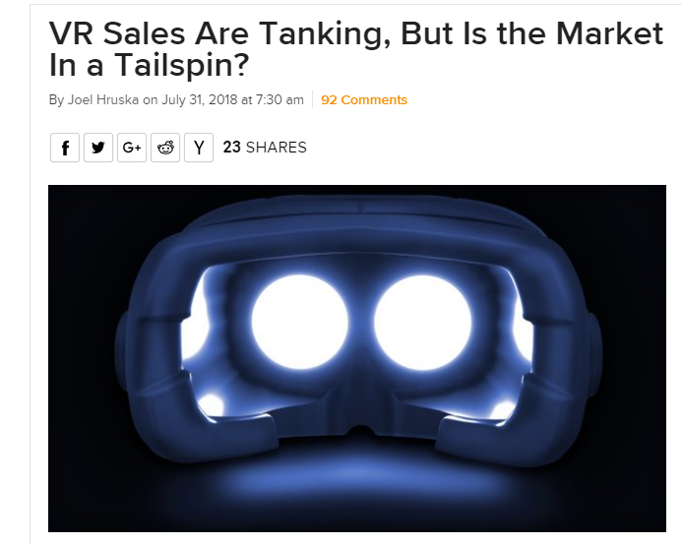
“Prediction is Hard, Especially About the Future” - Niels Bohr
Can anyone suggest some reasons why this might be happening?

Slide 11
A BIT ABOUT YOU
Have you tried VR before?
Do you own a VR headset?
Do you like rollercoasters?
Do you get motion sickness?
Notes:
Animated to fade in each question individually

Slide 12
What is this course about?
Learn how to build a*good* VR experience
Comfortable
Adequate for the task
Learn how VR works (engineering + psychology)
Learn how to criticize VR
Learn fundamentals to shape future of VR
Lecture, 4/5 MP’s, 2 exams, project
What are some examples of VR/AR tasks?

Slide 13
Definition of VR
Inducing targeted behavior in an organism by using artificial sensory stimulation, while the organism has little or no awareness of the interference

Slide 14
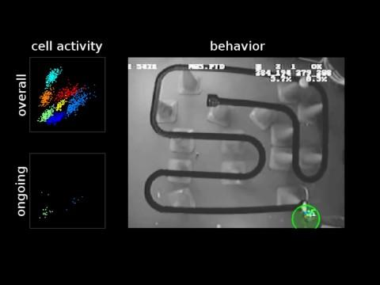
Awareness…Place Cells?
https://www.youtube.com/watch?v=lfNVv0A8QvI

Slide 15
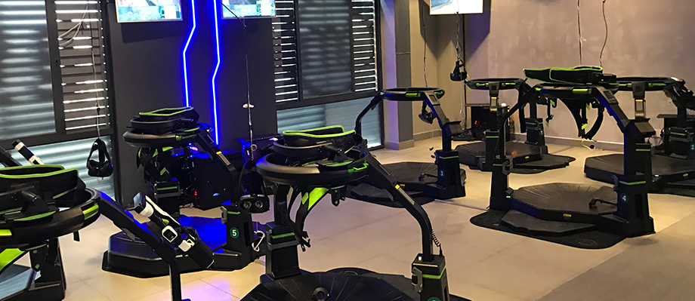
Examples of VR: Omni
https://www.youtube.com/watch?v=j1O8fZap3jM

Slide 16
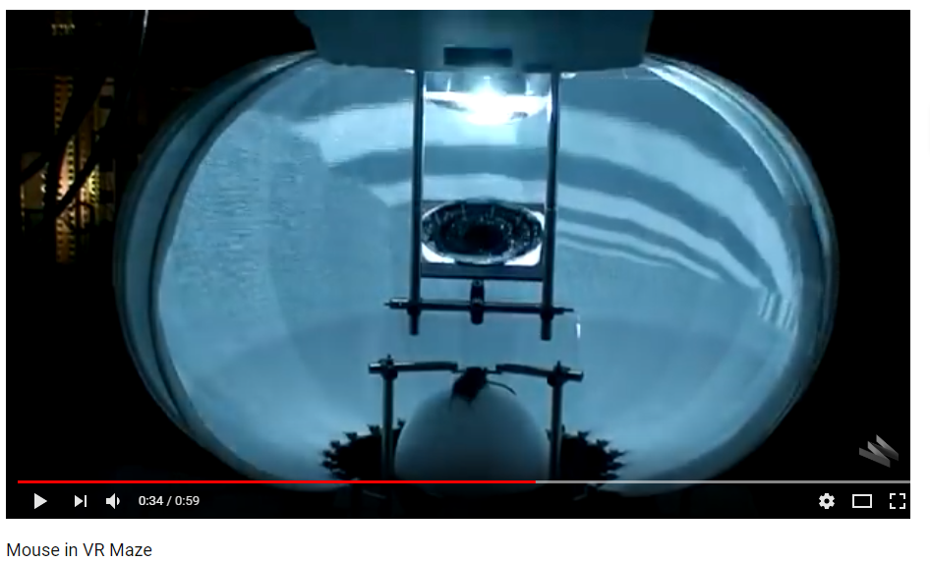
Examples of VR
https://www.youtube.com/watch?v=1DJOTEDBA2c
Notes:
Mouse in VR Maze. From "Intracellular dynamics of hippocampal place cells during virtual navigation." By Christopher D. Harvey, Forrest Collman, Daniel A. Dombeck & David W. Tank. Nature, Vol. 461 No. 7266, October 14, 2009

Slide 17
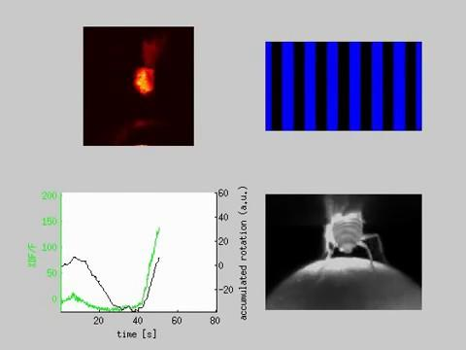
Examples of VR
https://www.youtube.com/watch?v=1ezL8nGo--I
Notes:
Fruit fly tethered in a virtual reality system. The fly is tethered by its head with the brain exposed to a microscope. The upper left image shows a single fluorescing cell in the brain. This cell responds to motion in a single lateral direction in the visual field. The blue bars are a simulation of the virtual world that the animal sees. Work was published in 2010 in Nature Methods: http://dx.doi.org/10.1038/nmeth.1468 It was also highlighted in June 2011 WIRED magazine article "Micro Machinist" Video uploaded by Gus Lott, designer of the high speed motion tracking system in this project.

Slide 18
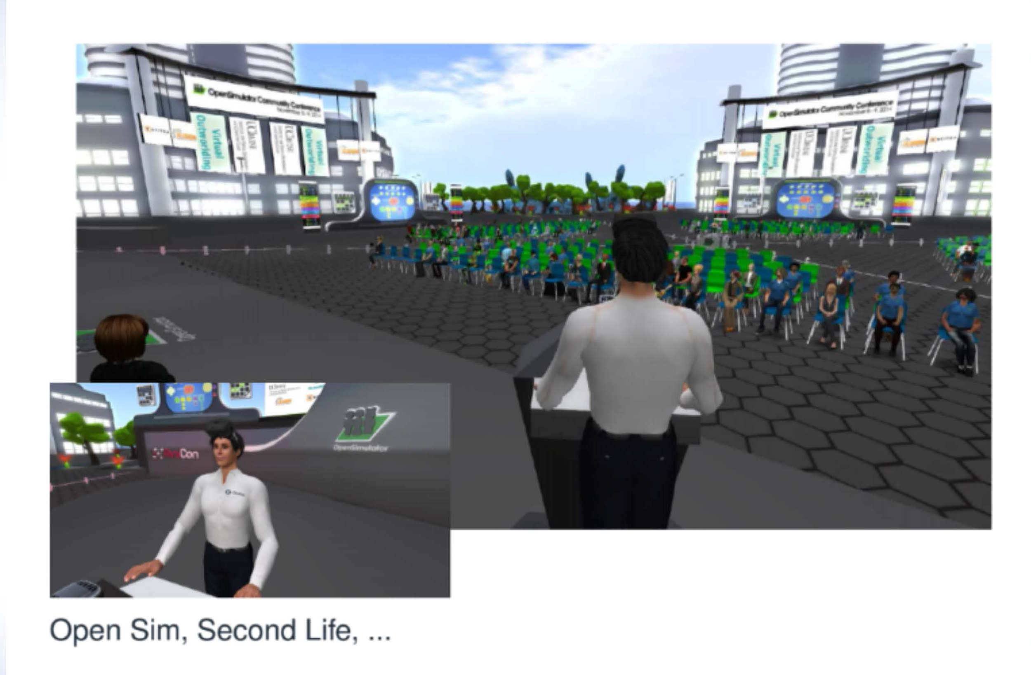
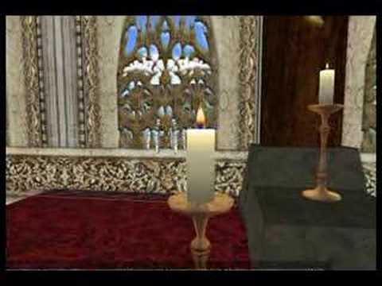
Definitely VR… Socializing in Virtual Spaces
Notes:
2nd life wedding of Nickel Berrelly and Bara Jonson (2008)
Funeral of Stanley W (2008)

Slide 19
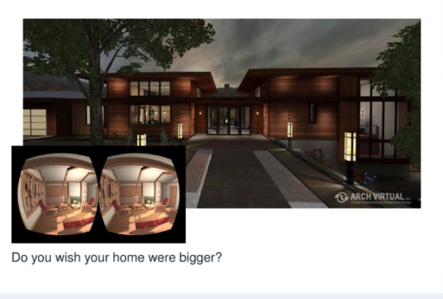
Definitely VR… Architecture and Real Estate

Slide 20
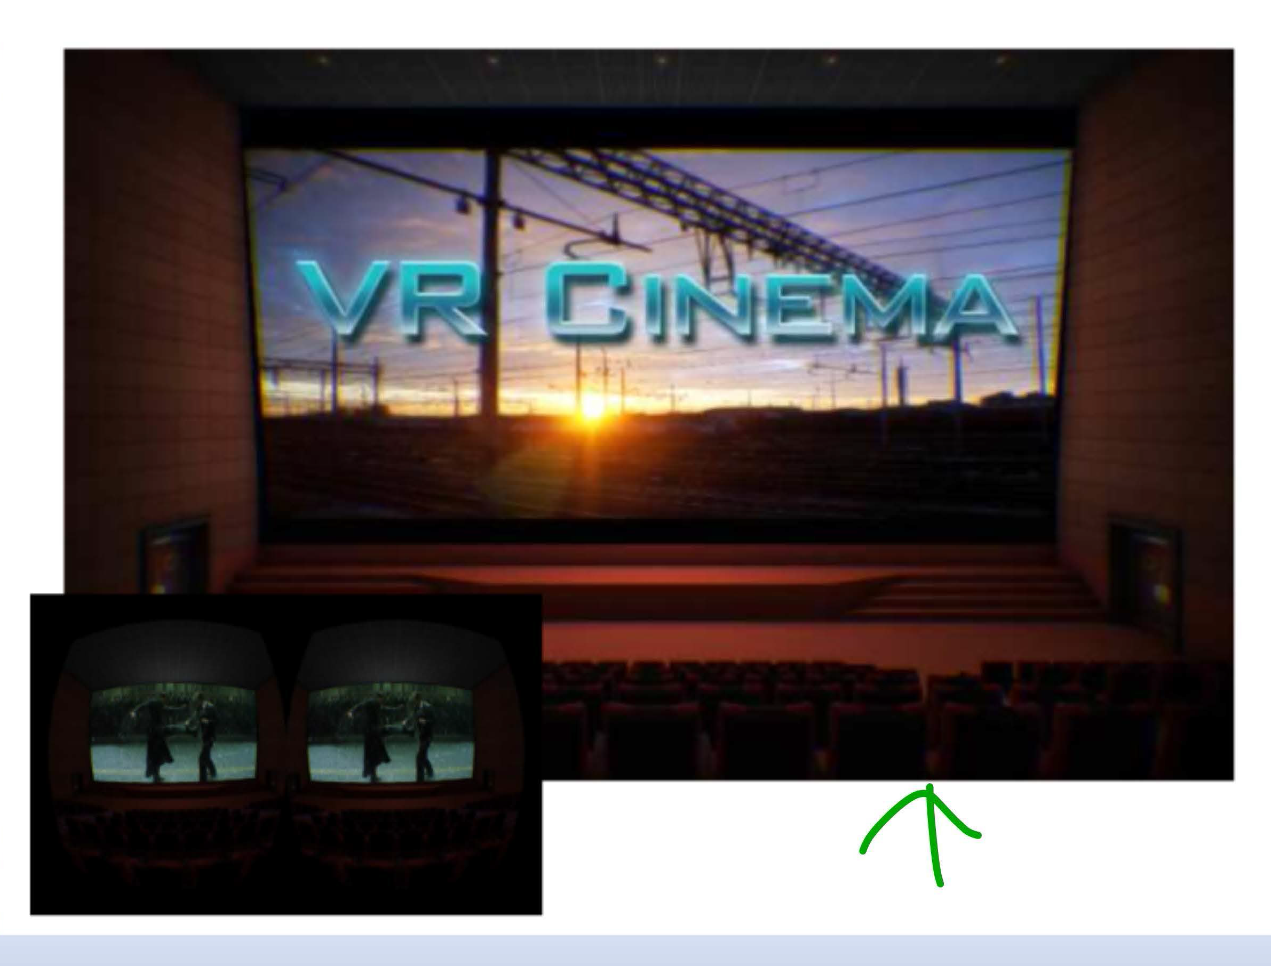
Definitely VR… Movies

Slide 21
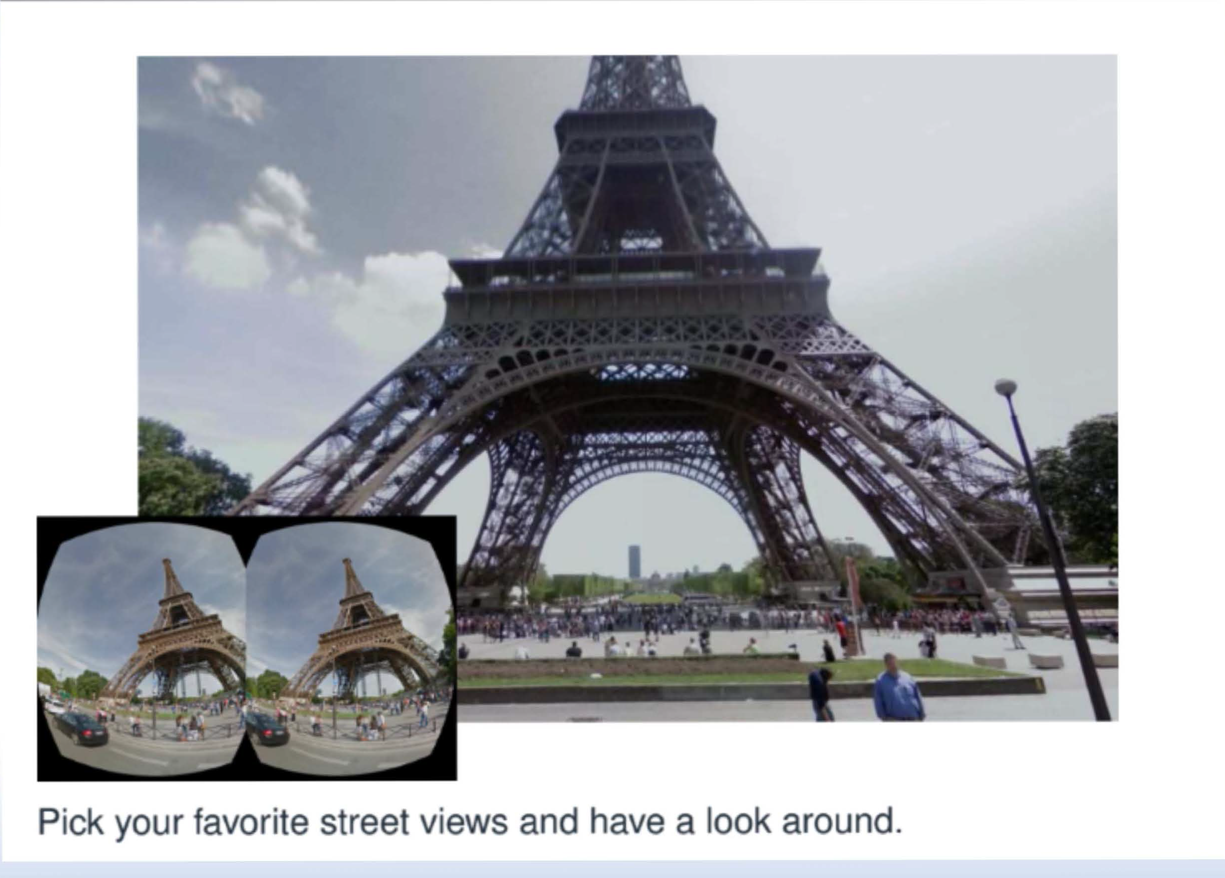
Definitely VR… Panoramas

Slide 22
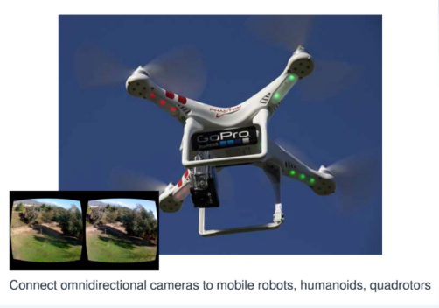
Definitely VR… VR + Robots

Slide 23
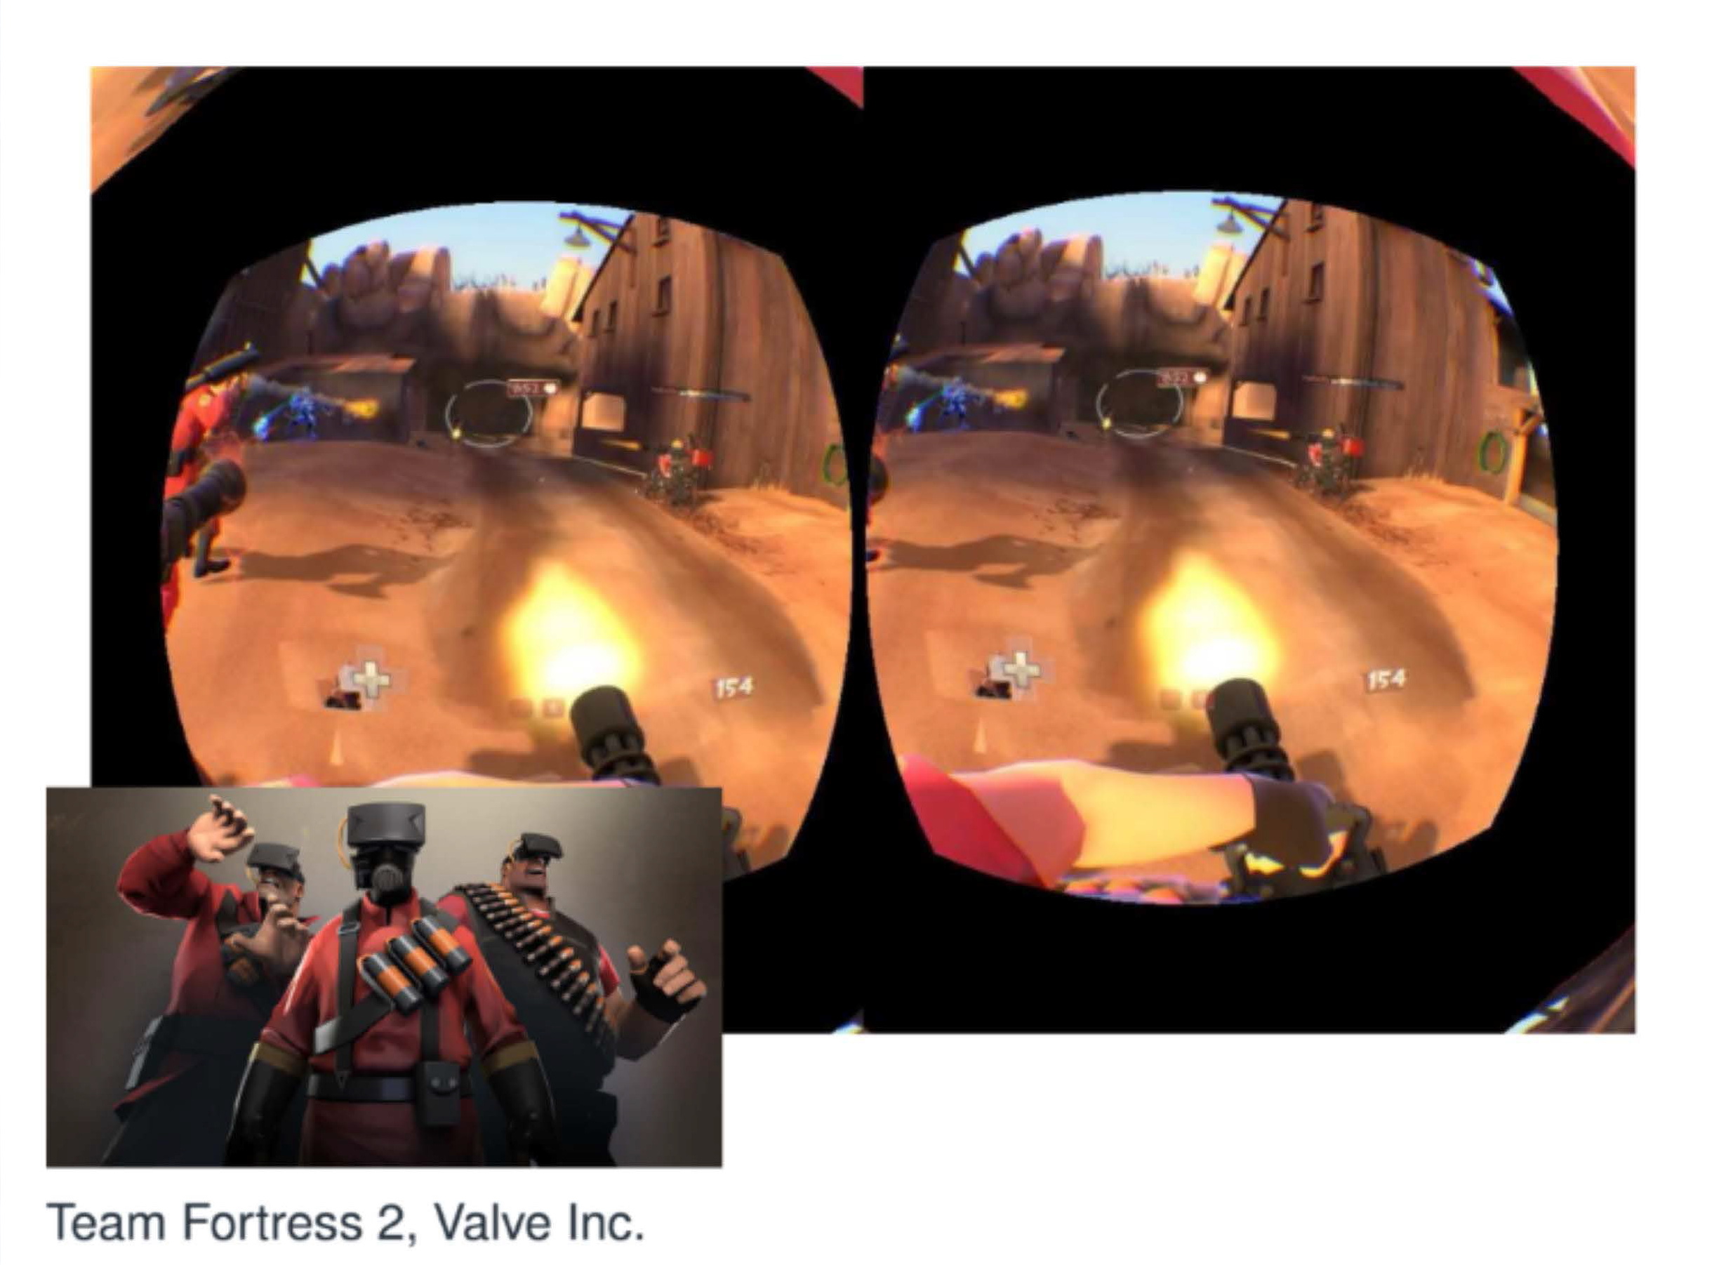
Definitely VR… First-Person Shooter Games

Slide 24
Definitely VR… Thrill Seekers

Slide 25
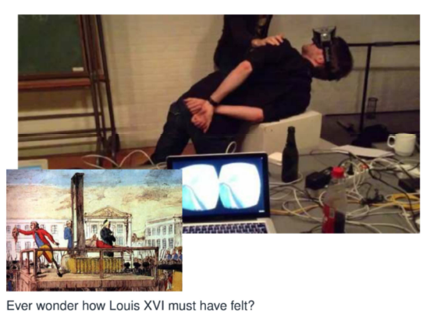
Definitely VR… Experiences

Slide 26
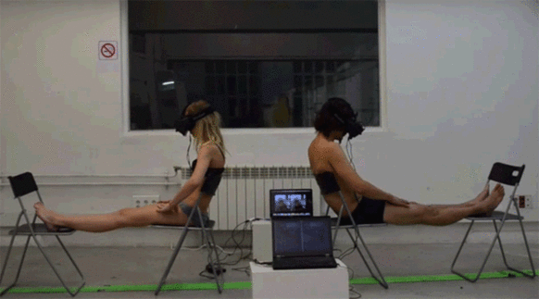
Definitely VR… Body Swapping

Slide 27
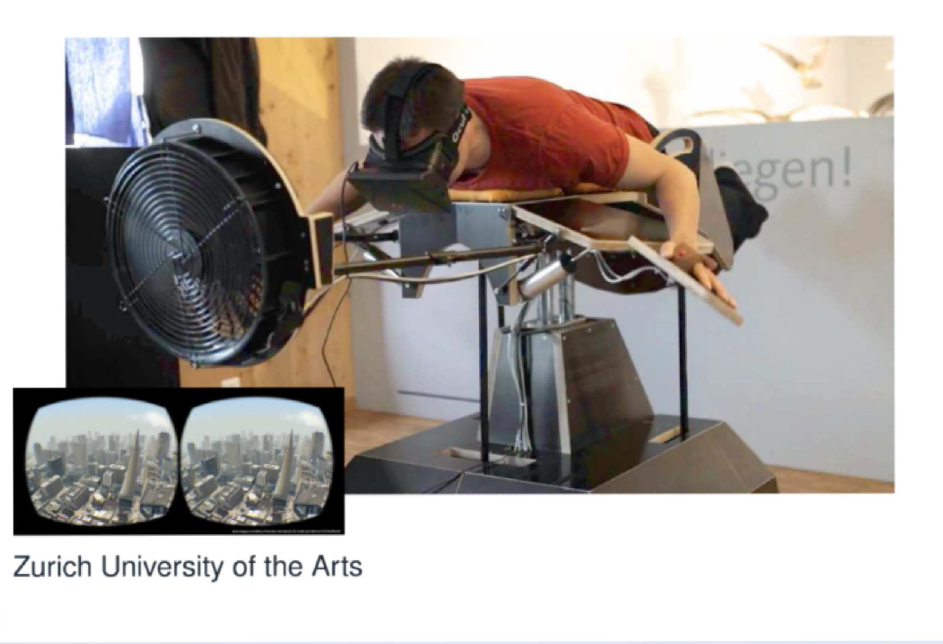
Definitely VR… Flying Like in Your Dreams

Slide 28
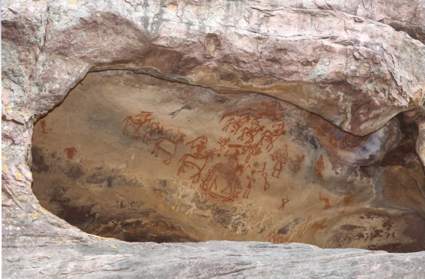
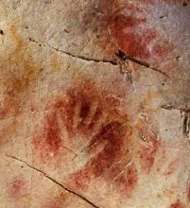
When did VR start? Paintings?
Notes:
Cueva de El Castillo, or the Cave of the Castle,Oldest known cave painting is in Spain 40.8K; possibly created by Neanderthals! Paint was blown onto the walls.

Slide 29
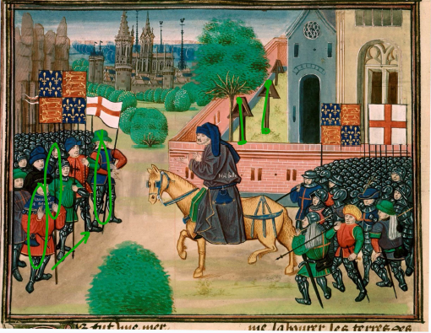
When did VR start?

Slide 30
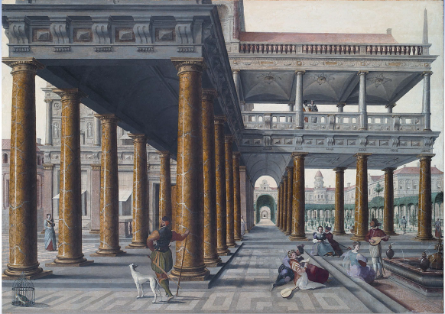
When did VR start?

Slide 31
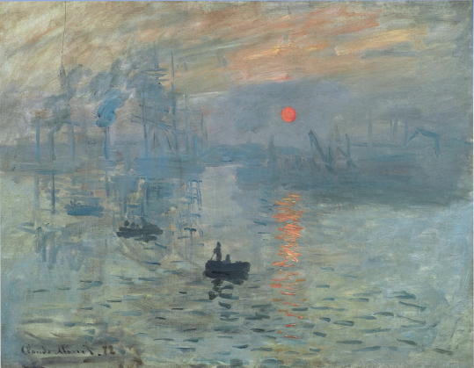
When did VR start?
Notes:
Impressionism not realism; invoke an experience of movement and colors.

Slide 32
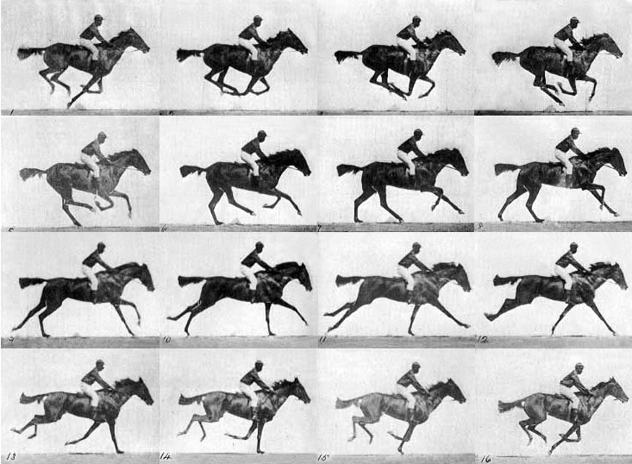
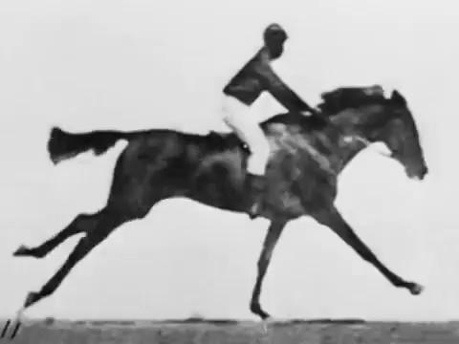
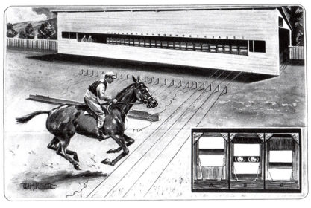
When did VR start? Motion pictures?
https://www.youtube.com/watch?v=IEqccPhsqgA
1878 Muybridge
Notes:
his Race Horse was the first Film ever, filmed in 1878 by Edward Muybridge.

Slide 33
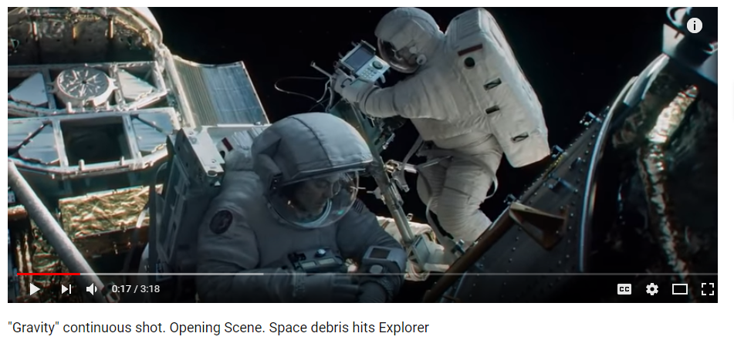
Compare to Modern Cinema…
https://youtube.com/watch?v=vKW-Gd_S_xc
Notes:
Gravity

Slide 34
Realism vs Simplicity in Cartoons

Slide 35
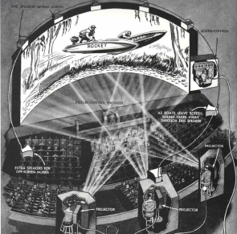
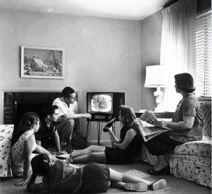
Realism vs Lower Cost and Portability

Slide 36
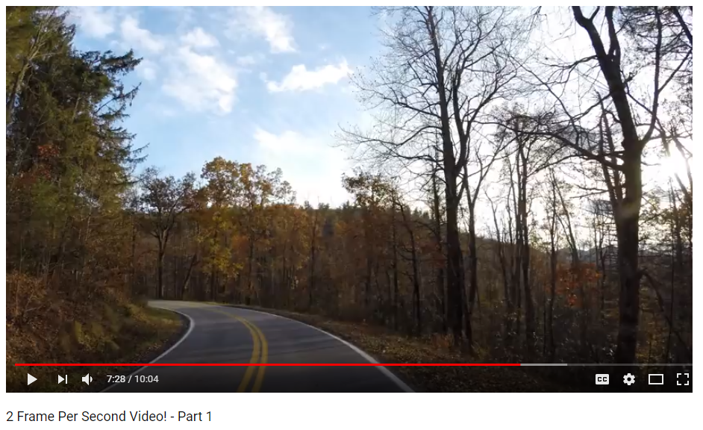
How many FPS are enough?
https://www.youtube.com/watch?v=-Qk7ZSXujRo

Slide 37
How many FPS are enough?

Slide 38
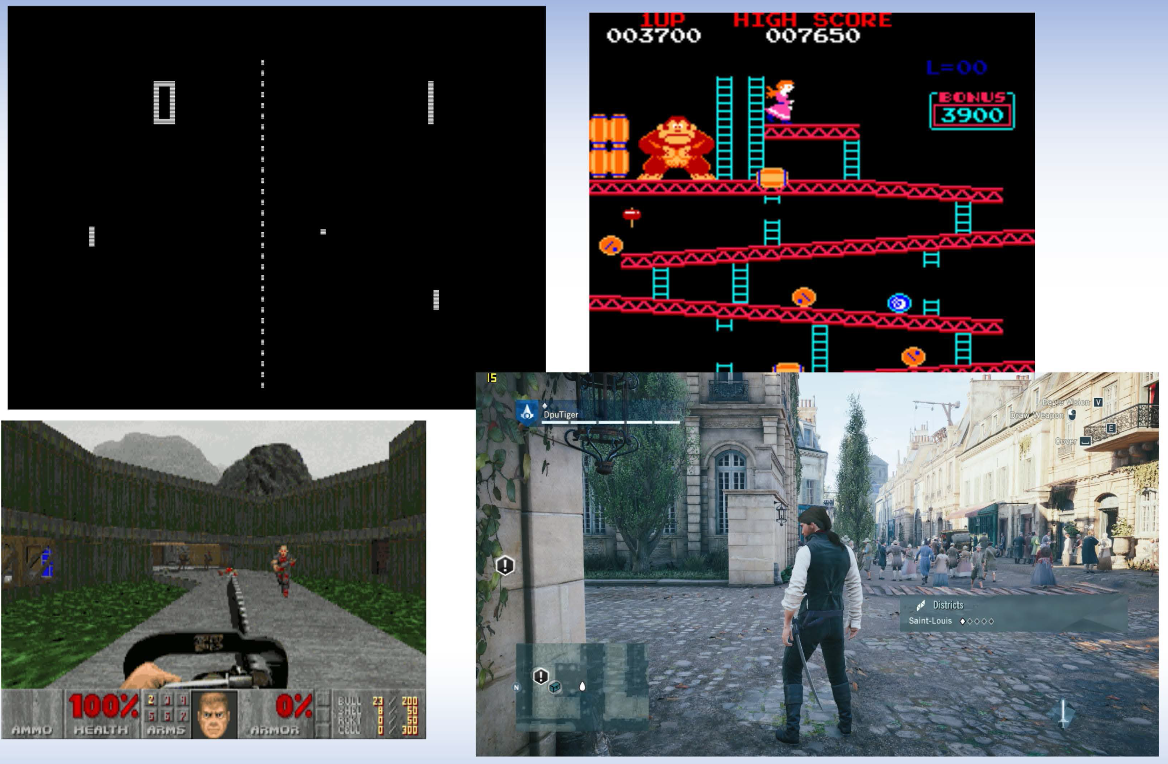
Evolution of Computer Games

Slide 39
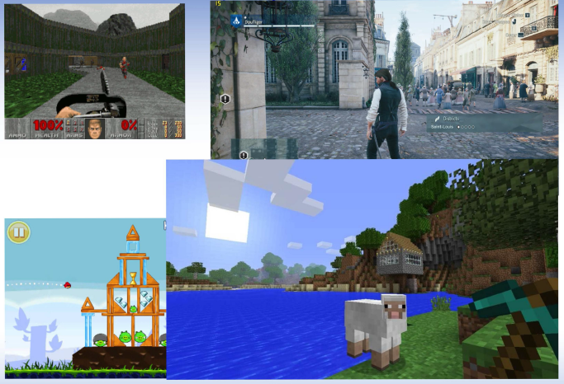
Realism vs Simplicity in Computer Games

Slide 40
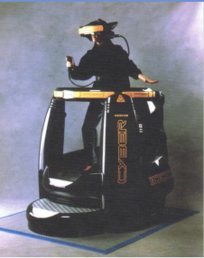
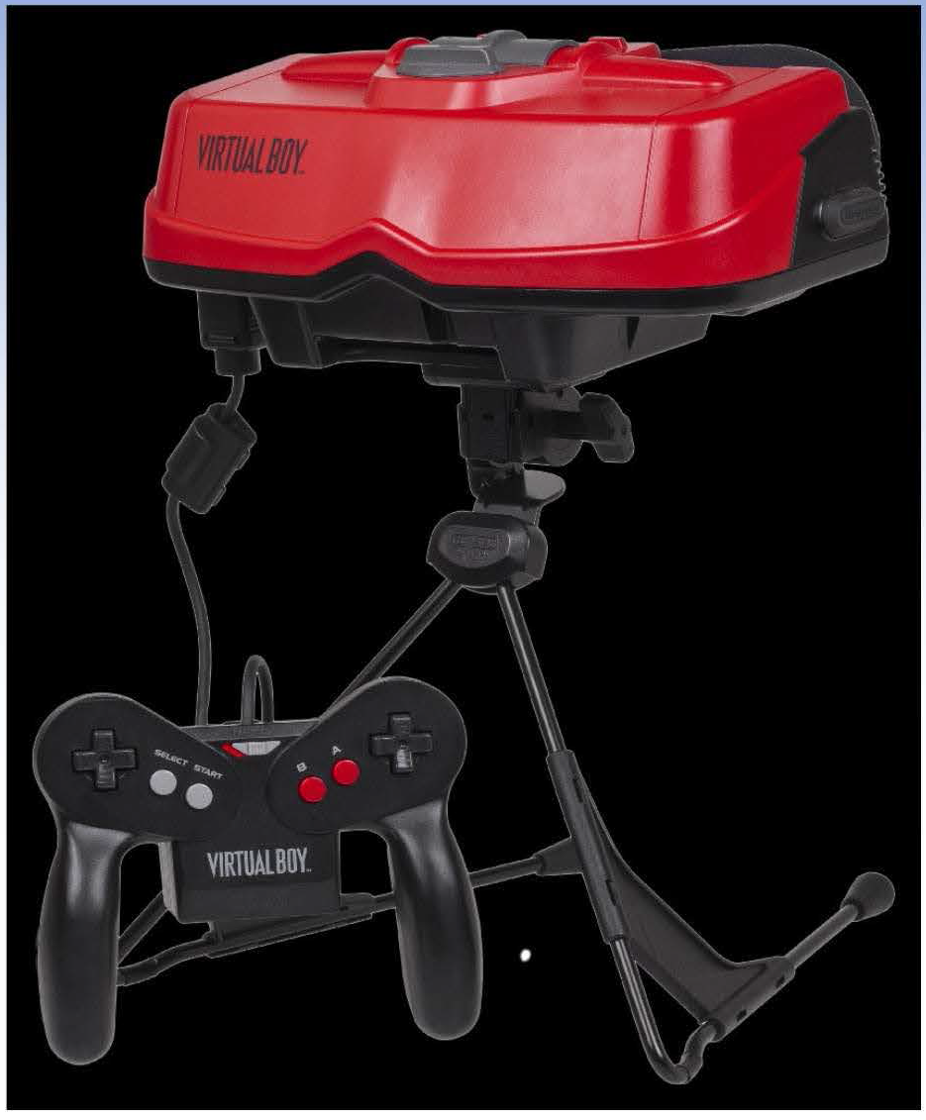
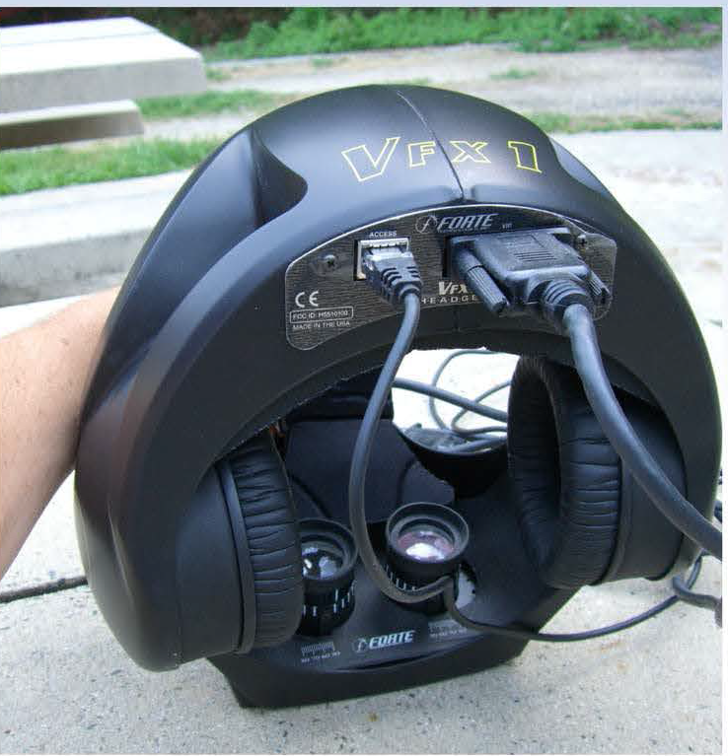
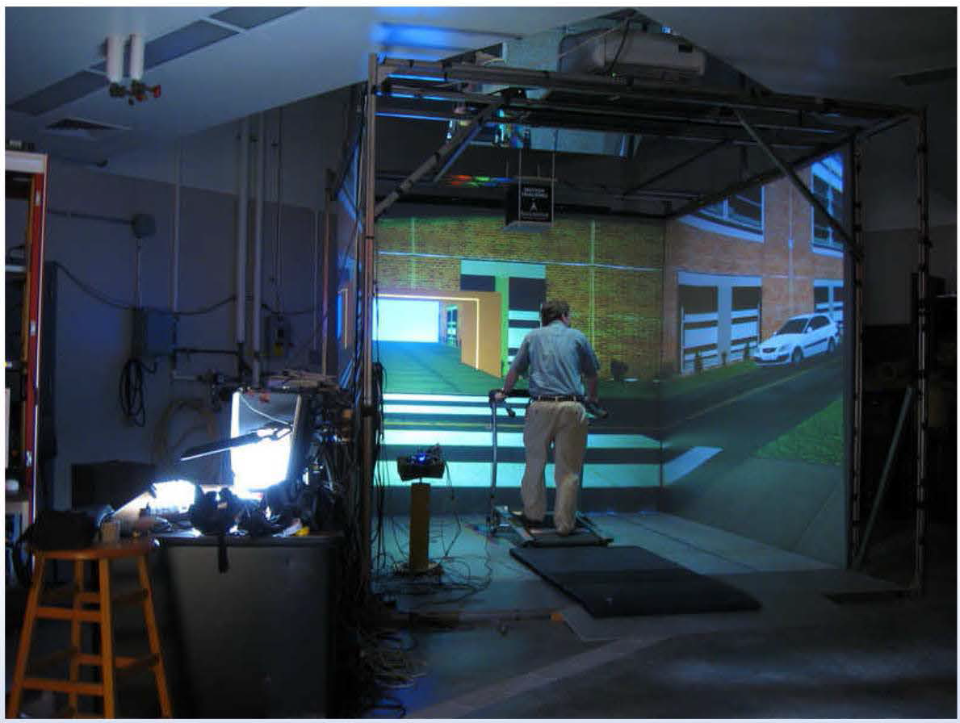
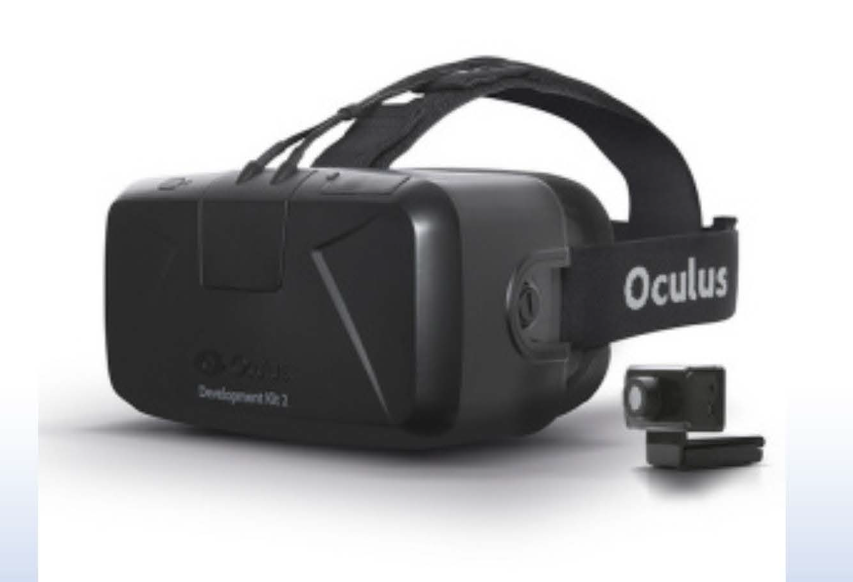
Headsets vs Cave

Slide 41
Birds-Eye View: Hardware
Displays (Rendering):
Visual:
Audio:
Touch:
Smell? Taste? Vestibular?
Tracking Hardware Components:
IMU’s:
Magnetometers:
Cameras
Controllers:
Lens:
Computer:
CPU:
GPU:

Slide 42
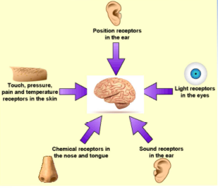
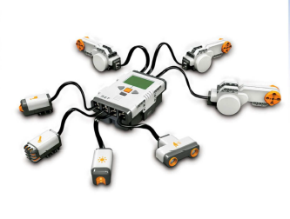
Hardware: Senses vs Sensors
A sensor is a transducer that transforms the physical world energy into a signal

Slide 43
Homework
Chapter 1 of Steve Lavalle’s VR online book Definition of VR, modern experiences, historical perspective.
Experiment on another student (not in this course): The Rubber Hand Illusion

