Slide 1
Human Vision: Perception
CS 498: Virtual Reality
UNIVERSITY OF ILLINOIS AT URBANA-CHAMPAIGN
Eric Shaffer

Slide 2
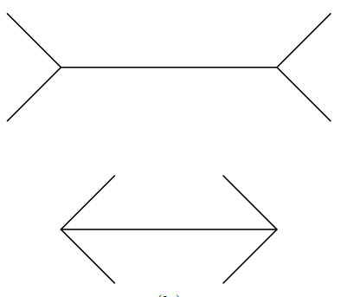
Visual Perception
Transition from discussing physiology of vision to perception.
How do our brains interpret the world around us so effectively?
…in spite of our limited biological hardware
Not always clear what we will perceive…e.g. optical illusions.
“ VR itself can be considered as a grand optical illusion. Under what conditions will it succeed or fail?” – Virtual Reality by LaValle

Slide 3
This painting uses a monocular depth cue called texture gradient
The bricks become smaller and thinner as the depth increases
“Paris Street, Rainy Day,” Gustave Caillebotte, 1877. Art Institute of Chicago …if you haven’t been, you should skip class and go sometime

Slide 4
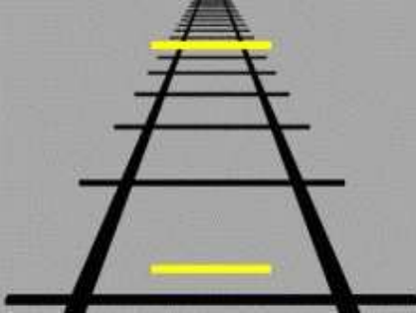
Perception of Depth
Depth perception relies on detecting cues in the image
Monocular depth cues
Require only one eye
Lots of them
Stereo depth cues
Fewer of them

Slide 5
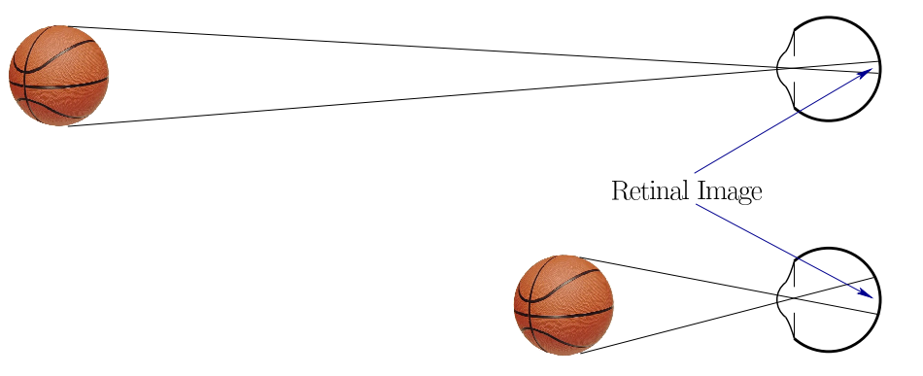
Retinal Image Size
Monocular cue
Requires knowing the size of an object in the scene
Size on the retina diminishes linearly with depth…we can infer depth from a known size

Slide 6
Ebbinghaus Illusion
Without a familiar object we perceive strange things

Slide 7
Cue: Height in Visual Field
Closeness to horizon implies further away
Monocular cue

Slide 8
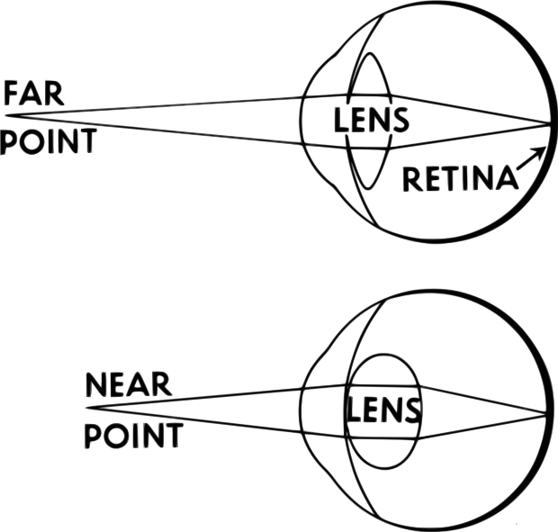
Accommodation
We can sense how much the ciliary muscles are contracting
Greater contraction yields an sense object is closer…
Does not rely on photoreceptors…at least not directly

Slide 9
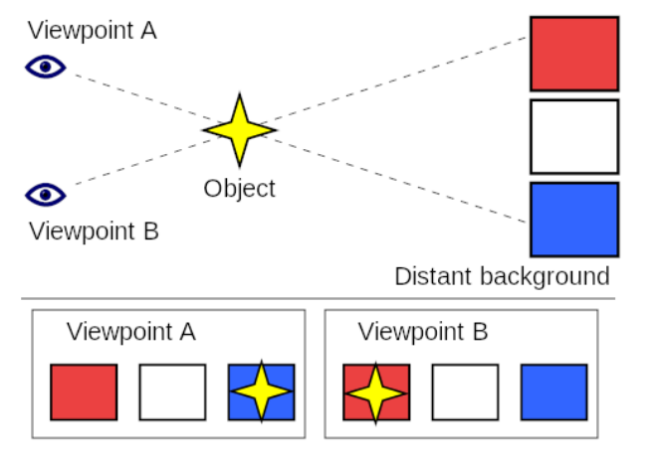
Motion Parallax
More distant objects shift visual position less as we move

Slide 10
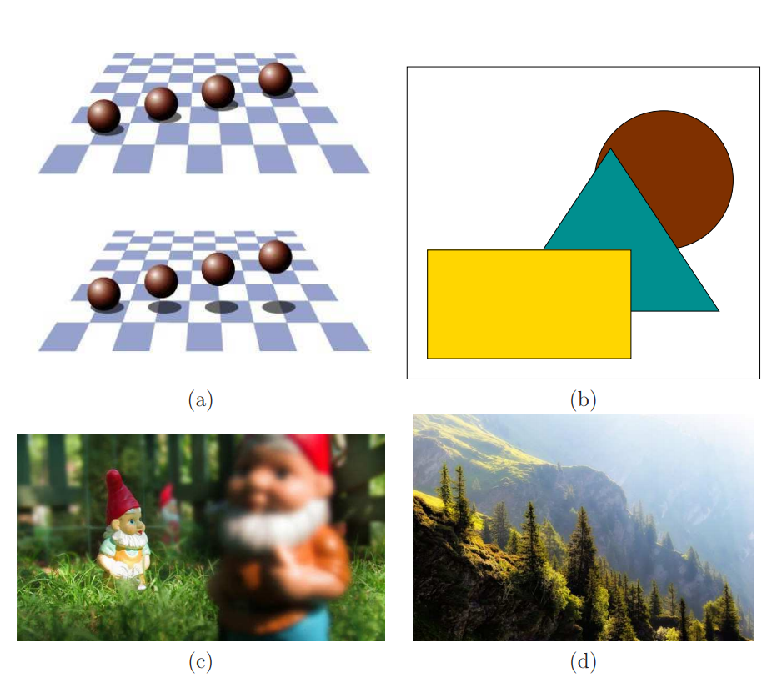
Other Monocular Cues
Shadows
Interposition
Image blur
Atmospheric cues

Slide 11
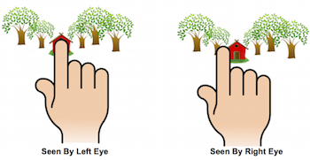
Stereo Depth Cue: Binocular Disparity
The shift in image position from left to right eye image
Greater the closer an object is

Slide 12
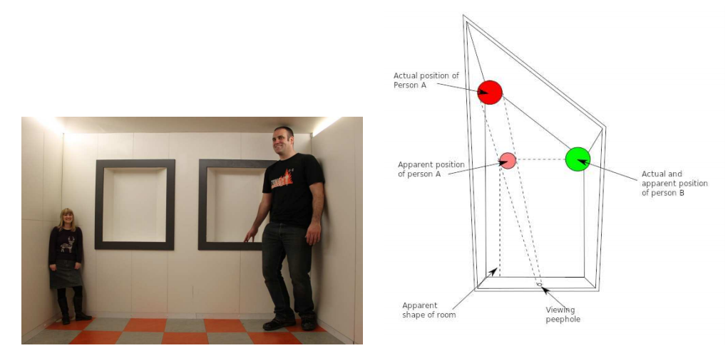
Misleading Depth Cues
No depth talk is complete with the Ames room

Slide 13
Implications for VR
Easy to mess up viewers depth perception
if the user’s pupils are 64mm apart in the real world but only 50mm apart in the virtual world, then the virtual world will seem much larger…
Some tracking systems track the head orientation only. This makes it impossible to use motion parallax as a depth cue if the user moves from side to side without any rotation. To preserve most depth cues based on motion, it is important to track head position….

Slide 14
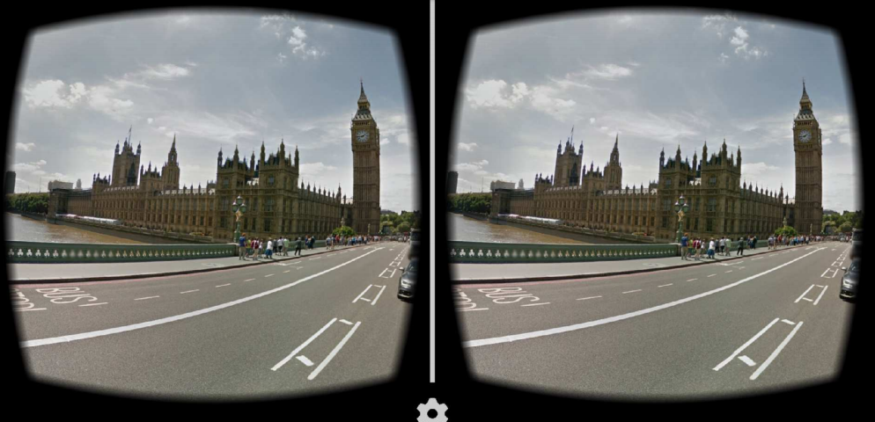
Monocular Cues are Powerful
Depth perceived even when same image is presented to both eyes
For VR, may not need stereo if it is too costly…

Slide 15
VR Developer Advice
Design your world in meters
Do not place objects closer than 1 meter away from viewer
Match virtual inter-pupillary distance (IPD) to actual IPD

Slide 16
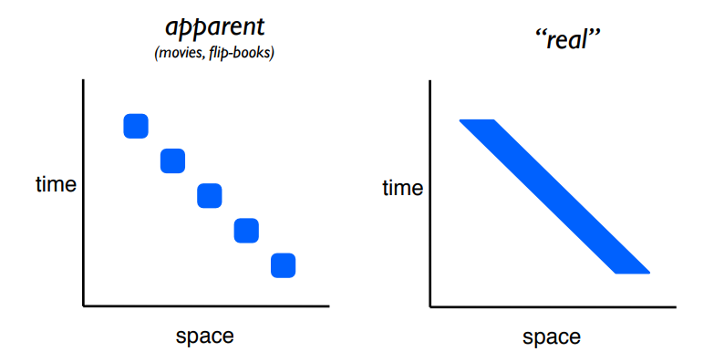
Motion Perception
Apparent Motion motion percept resulting from rapid display of stationary images in different locations
Why don’t we notice the difference?

Slide 17
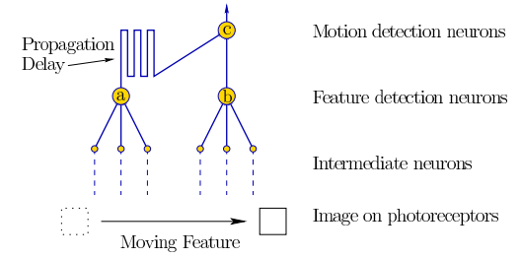
Reichardt Detector
A Reichardt Detector models the neural constructs that perceive motion
Not confirmed physiologically/anatomically
This structure would detect either apparent motion (i.e. like a series of discrete images) or continuous motion
Neuron C fires when B fires followed A firing…time differential is critical...

Slide 18
Fooling a Reichardt Detector
Based on speed and spacing of features detected, may fire inadvertently
wagon-wheel effect

Slide 19
Adaptation: Waterfall Illusion

Slide 20
Adaptation Spiral Aftereffect

Slide 21
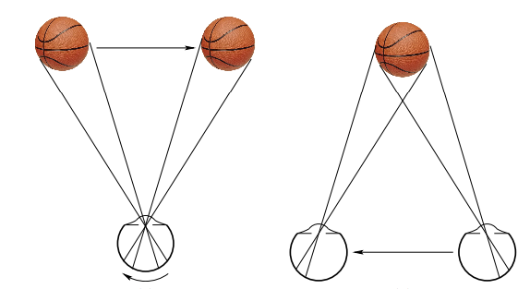
Distinguishing Observer and Object Motion
Observer and object motion can cause same movement of image on retina
What are two cues that help distinguish the situations?

Slide 22
Distinguishing Observer and Object Motion
Observer and object motion can cause same movement of image on retina
Two important cues to distinguish this
Proprioception (sense of body moving)
Global movement of scene

Slide 23
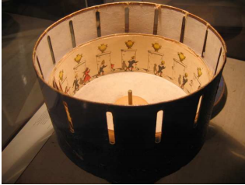
Stroboscopic Apparent Motion
The zoetrope was developed in the 1830s and provided stroboscopic
apparent motion as images became visible through slits in a rotating disc.
Generally accepted that the phenomenon of apparent motion is a result of Reichardt Detector activation

Slide 24
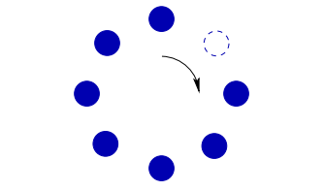
The Phi Phenomenon and Beta Movement
Phi phenomenon and beta movement are physiologically distinct effects in which motion is perceived
In a sequence of dots, one is turned off at any give time. A different dot is turned off in each frame.
At (2 FPS), beta movement triggers a motion perception of each on dot directly behind the off dot
At a higher rate, 15 FPS, there appears to be a moving hole; this corresponds to the phi phenomenon.

Slide 25
Phi Penomenon

Slide 26
Beta Movement

Slide 27
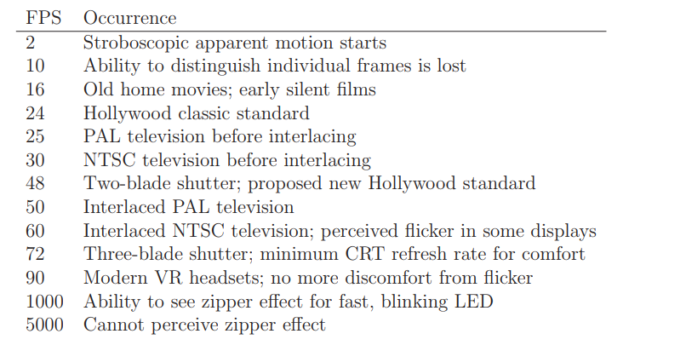
Frame Rate Thresholds

Slide 28
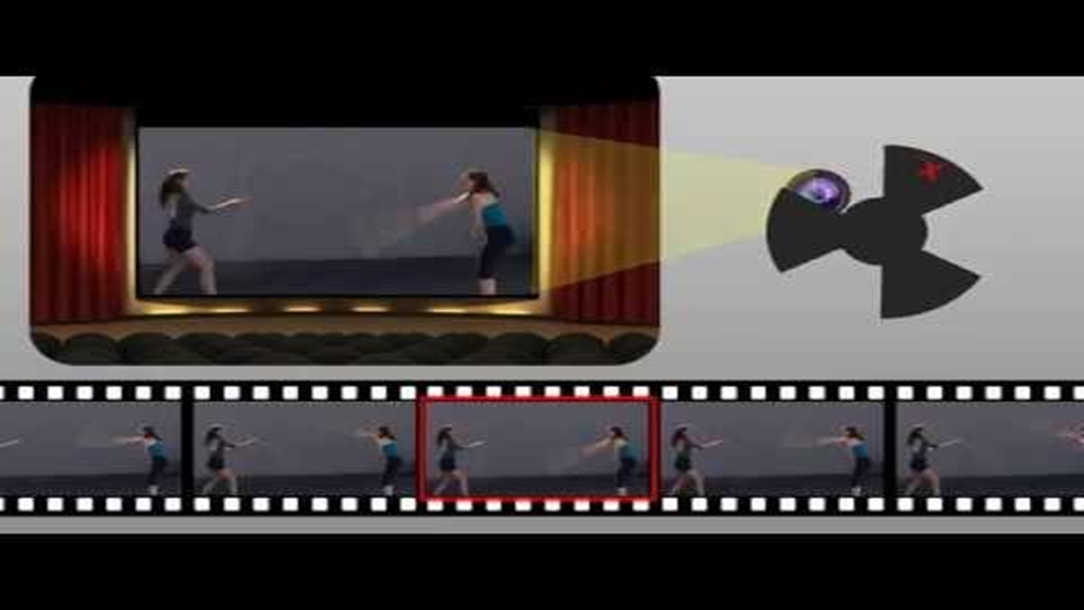
Flicker
With a low enough framerate, jumps between frames are visible
This is flicker
In ancient times, 3-Blade Shutters on projectors showed each frame 3 times
Reduced perceived flicker

Slide 29
Flicker
NTSC and PAL were encodings for 20th century analog television
Broadcast at 25 or 30 FPS
Displayed using x2 that rate by interlacing frames
Used interlacing to double perceived framerate and reduce flicker
Update half the lines on the display per refresh

Slide 30
Frames and Fields
Progressive frames are whole frames (images)
Film is shot (usually) at 24 progressive frames per second
Called 24p
A field is an interlaced frame
60i means the framerate is 30 FPS at 60 fields per second
Meaning that the video plays using 60 fields per second
…but there are only 30 whole images used during that time

Slide 31
Interlaced and Progressive Framerates

Slide 32
Digital Television in the United States
The five main ATSC formats of DTV currently broadcast in the U.S. are:
Standard definition—480i to maintain compatibility with existing NTSC sets when a digital television broadcast is converted back to an analog one
Enhanced definition—480p, about the same quality as current DVDs
High definition—720p
High definition—1080i
High definition—1080p
Most digital television sets sold in the U.S. use a display with a 16:9 aspect ratio to optimally display HDTV-formatted content

Slide 33
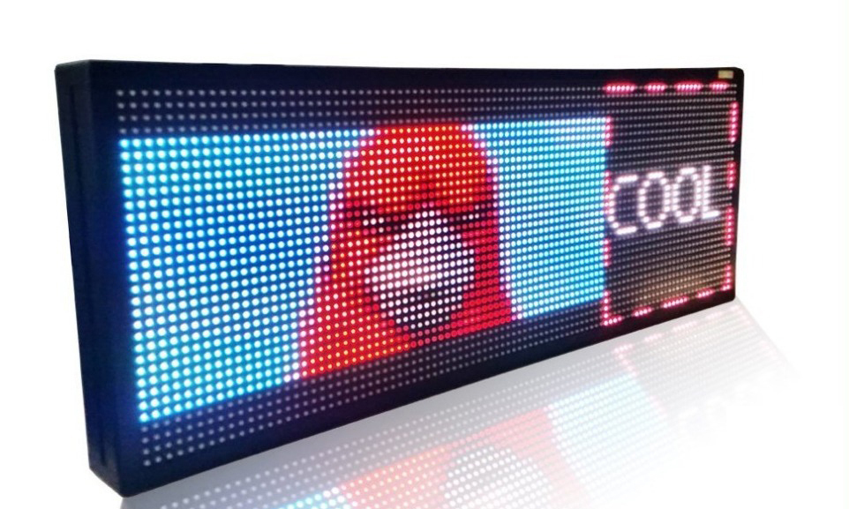
Flicker and Distance to Display
Sensitivity to flicker increases the closer a display is to eyes
Even if flicker is not directly perceived, it can cause headaches
To solve this problem in the 1990s, CRTs had 72,85, or 90 FPS
Modern LCD and LED displays typically 120 FPS

Slide 34
Zipper Effect
For moving displays and artifact called zippering can occur
Consider a moving LED at a 200 Hz pulse rate
If it is moving fast enough in a dark room, it appears as an array of lights
Result of imaging at different places on the retina due to motion

Slide 35
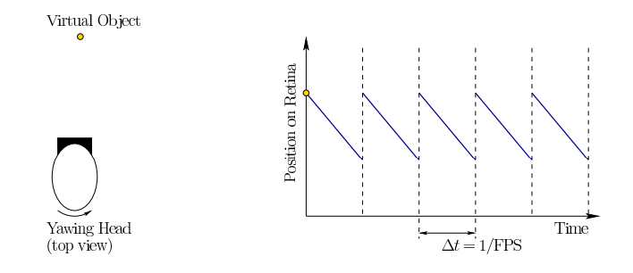
Implications for VR
VR displays need higher frame rates than stationary displays
Consider perception of stationarity:
Look at object while yawing head
In VR, object needs to shift across screen to appear motionless

Slide 36
Judder
The slip of the object across the retina between frames appears as judder
Looks like a high frequency low-amplitude wobble
Similar effects like smearing and strobing also called judder

Slide 37
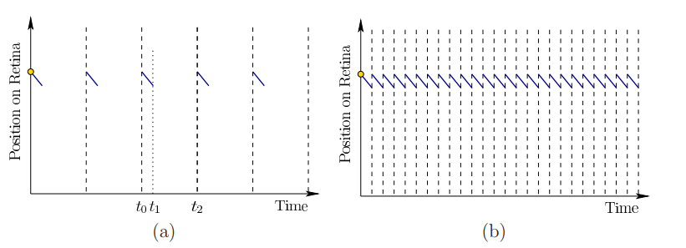
Judder
Low persistence display mode can alleviate judder (see (a) )
Screen is on for 1 or 2 milliseconds each frame
Black otherwise before next frame
Problem is that at 60 FPS you get flicker
Need +90 FPS
Or…at 500 FPS there is no judder (see (b) )

Slide 38
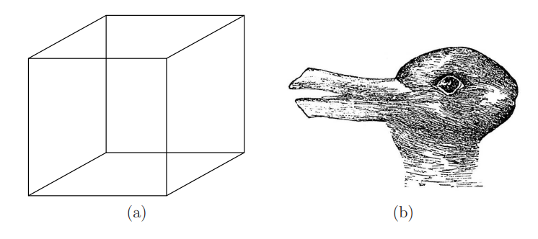
Combining Sources of Information
Perception is very complicated
Often relies on combining multiple sensory cues
Plus long-term memory
Plus short-term memory
The ambiguity in perception is illustrated by multi-stable perception
Is the front face of the cube higher or lower than the back?
Duck or Rabbit?

Slide 39
McGurk Effect

Slide 40
Implications for VR
Many unintended perceptions may arise in a VR system Requires extensive testing to avoid
Example:
“One example, which actually occurred in the VR industry, involved designing a popup
menu. Suppose that users are placed into a dark environment and a large menu
comes rushing up to them. A user may perceive one of two cases: 1) the menu
approaches the user, or 2) the user is rushing up to the menu. The vestibular sense
should be enough to resolve whether the user is moving, but the visual sense is
overpowering. Prior knowledge about which is happening helps yield the correct
perception. Unfortunately, if the wrong interpretation is made, then VR sickness
in increased due to the sensory conflict.” -- Virtual Reality by LaValle

