Slide 1
Visual Rendering for VR
CS 498VR: Virtual Reality
UNIVERSITY OF ILLINOIS AT URBANA-CHAMPAIGN
Eric Shaffer

Slide 2
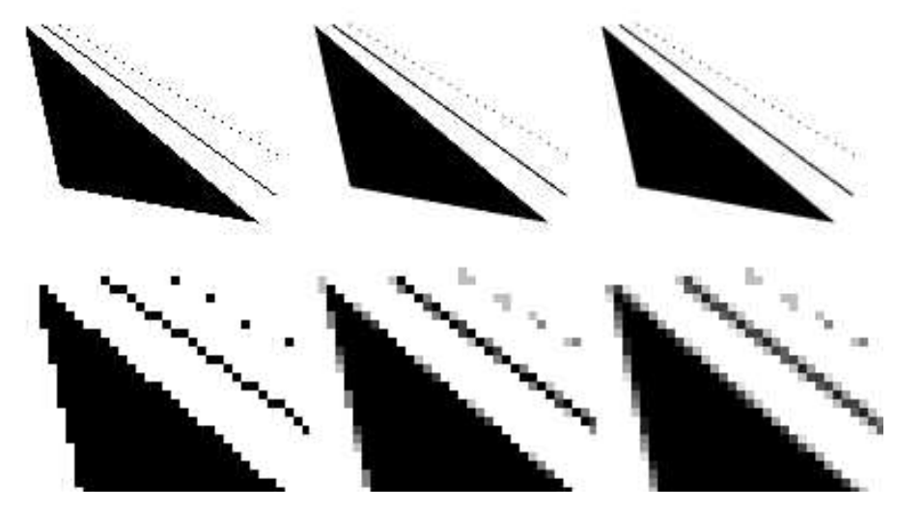
Aliasing and Anti-aliasing
Rasterization can result in “jaggies”
Each pixel is either on or off
When animated, jaggies become “crawlies”
More noticeable
More significant issue for VR than generic 3D graphics
Solve/reduce aliasing by multi-sampling.
E.g. mix the pixels at the border of edge/non-edge region
1 sample per pixel 4spp 8spp
Notes:
Problem with VR: Each aliasing rendering is independent of each eye. Small motion in head mounted display; causes random aliasing changes from one frame to the next
Subdivide each pixel into multiple sub pixels and sample e.g. 4x4 grid and interpolate results. Soften called super-sampling.

Slide 3
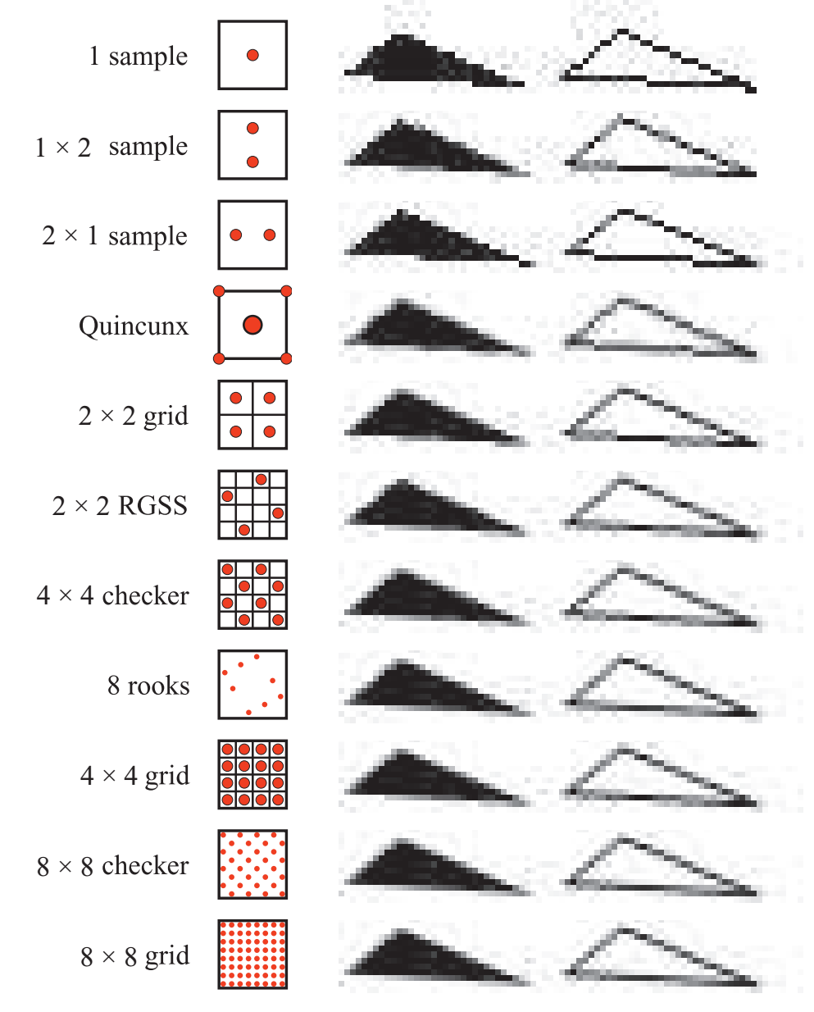
Multi-sampling
Construct pixel: average of multiple samples
C is a sampled color
w_{i} is a weight
….a lot of different schemes that can be used

Slide 4
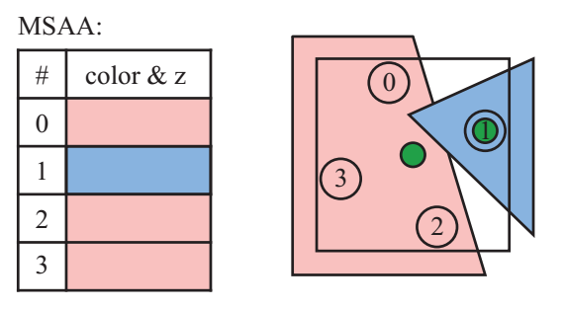
Multi-sampling
Screen-based anti-aliasing
Operate only using output samples from rendering pipeline
Full-scene anti-aliasing (FSAA) is simplest, just render at higher resolution
Multi-sampling anti-aliasing (MSAA)
Faster than (FSAA)
Computes shade of a surface only one per-fragment
Shade is used for each sample position covered by the fragment

Slide 5
Morphological Anti-aliasing
Morphological antialiasing determines the likely orientation of the edge that formed a discontinuity in the image. In the middle, the algorithm notes the likelihood of an edge by examining neighbors.
On the right, a best-guess edge is used to blend neighboring colors into the center pixel in proportion to the estimated coverage.
From Real-Time Rendering, Fourth Edition
Morphological methods use computer-vision techniques to generate anti-aliased images

Slide 6
Temporal Anti-aliasing
Temporal anti-aliasing uses multiple frames to compute averages
NVIDIA Multi-frame Anti-aliasing (MFAA) is an example
Reprojection techniques keep a velocity buffer that tracks pixel-flow
Fast-approximate Anti-aliasing (FXAA) is popular
Take ~1ms per frame
FXAA is screen-based and temporal
NVIDIA Control Panel…Windows XP style interface but more powerful than GeForce Experience for tuning GPU parameters

Slide 7
Optical Distortion
Recall optical distortion by our lens
VR HMDs use lenses to increase the field of view of the user
Notes:
(a) Original images. (b) Barrel distortion. (c) Pincushion distortion.

Slide 8
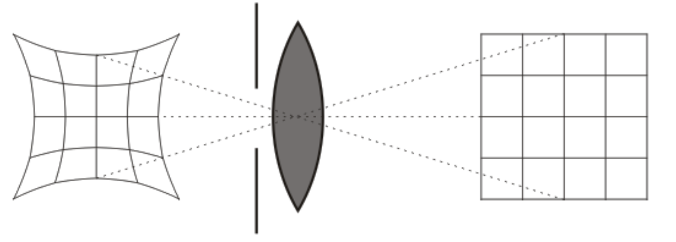
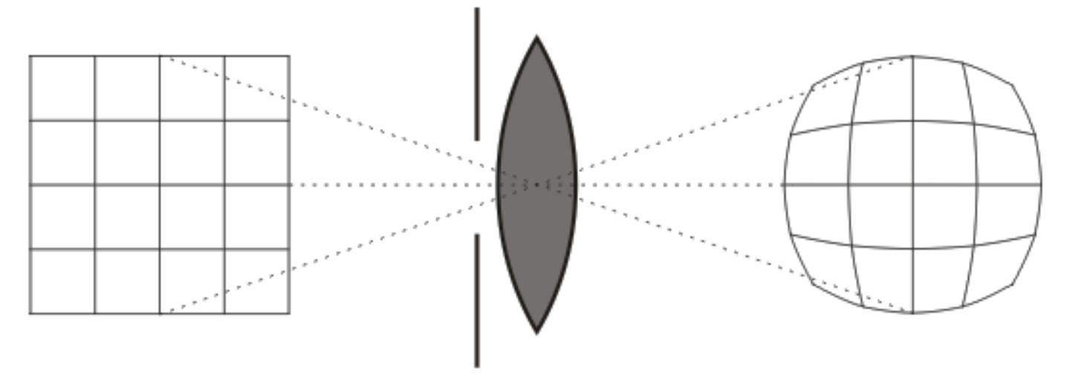
Optical Distortion
Typical HMD lens will generate pincushion distortion of image
Can be corrected by applying a barrel distortion

Slide 9
Barrel Distortion

Slide 10
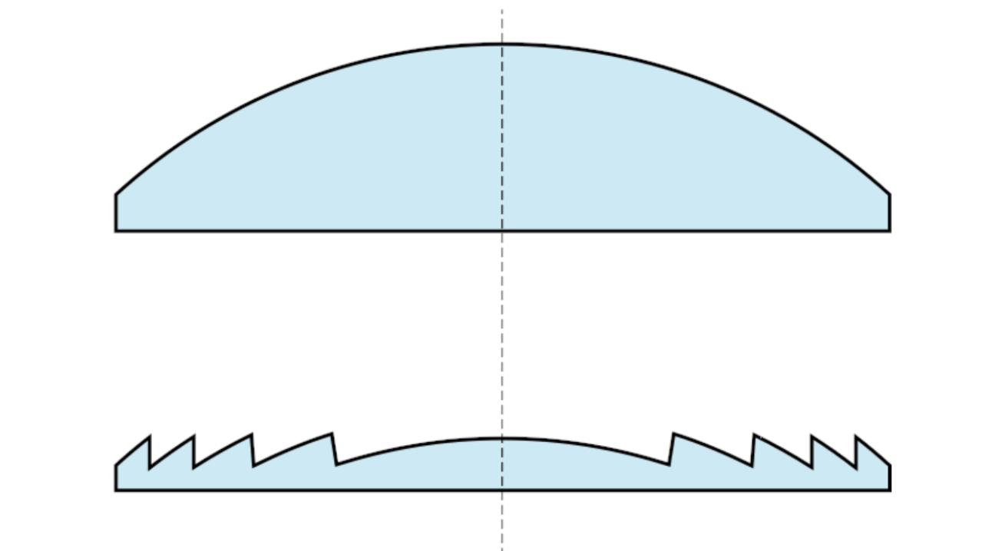
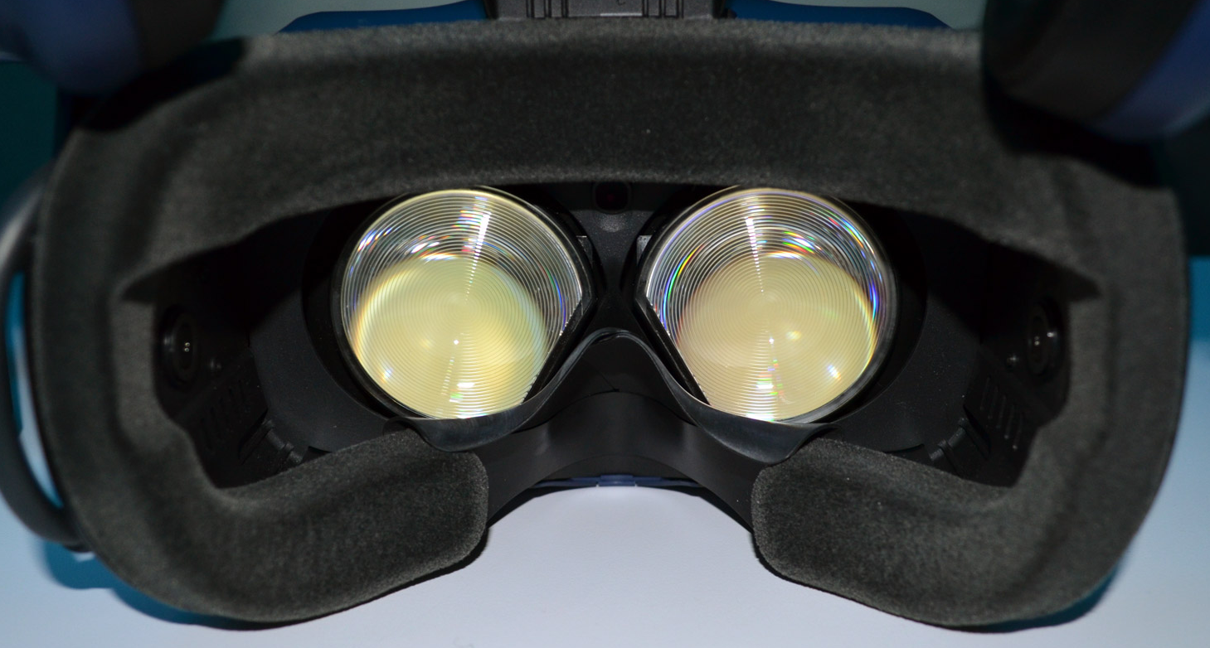
Hardware Solution to Optical Distortion
HTC Vive and Pro and Oculus Rift uses Fresnel Lenses
Also lighter than regular lens
But can exhibit glare from ridges
Can ameliorate spherical distortion
Pincushion still a problem

Slide 11
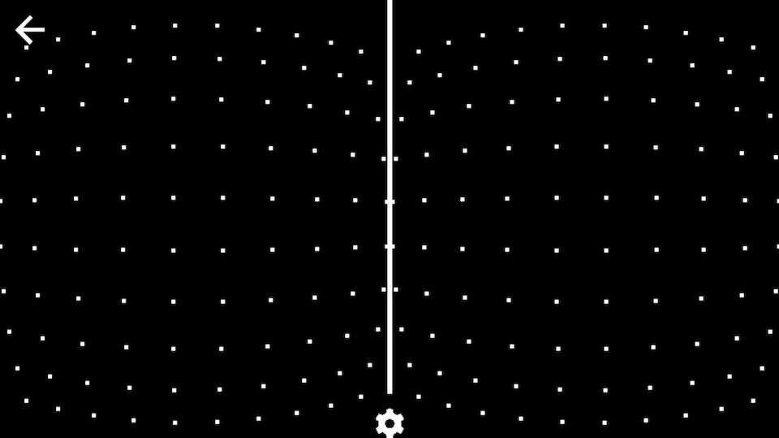
Correcting Optical Distortion
One image warping approach renders images into textures that would be applied to warped meshes
Consider referring to fragments in the canonical view volume [-1,1] x [-1,1] by polar coordinates
then a distortion is given by
c₁ and c₂ are constants you pick….c₁<0 generates a barrel distortion and c₁>0 generates pincushion
You need to find the inverse of the f giving a pincushion distortion…the is the corrective barrel distortion
It can be approximated as
…or more exact numerical methods can be used to find a better approximation.
Finding the correction function is done prior to runtime for a given lens setup.
Notes:
P(r) is trying to do polynomial (e.g. Taylor) approximations for the radial transform.

Slide 12
Challenge in VR: Latency
Latency: time it takes to update display in response to head orientation and position.
GPU pipeline has been optimized for triangle throughput, not latency
Some current methods for latency reduction:
Lower the complexity of the virtual world
Improve rendering pipeline performance
Remove delays along the path from the rendered images to switching pixels
Use prediction to estimate future viewpoints and world states
Distort the rendered image to compensate for last-moment viewpoint error
Notes:
More Practical suggestions on next lecture.

Slide 13
Latency by Example
Let d = 40 be the pixels per degree (pixel density) in the HMD Let ω = 50^{०}/s be the angular velocity of the head,
Let the latency l = 0.02 s be the time to update the display
How wrong is the image before the update can occur?
d ω l = 4 tells us the image is off by 4 pixels
Does a perfect system exist?
Historical problems: The perfect system is impossible
Variable latency are even worse due to the inability to adapt. People are used to 60 FPS.

Slide 14
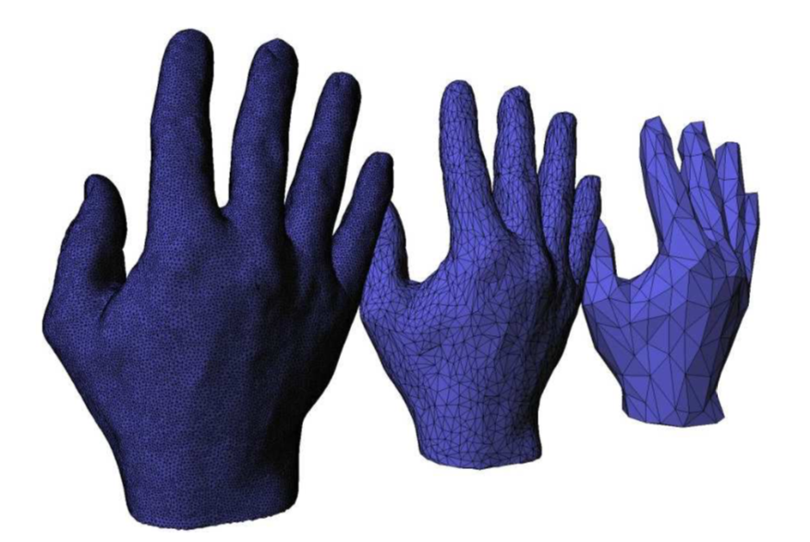
Simplify the Virtual World
Generate Levels-of-Detail using mesh simplification algorithms
Render far-away objects using coarser mesh
Lower the computational demands on the VWG (Virtual World Generator)
Notes:
Video1: 01-Vizup 3D mesh simplification and polygon reduction demo

Slide 15
LODS in Unity
Unity has tools to setup and use LODs

Slide 16
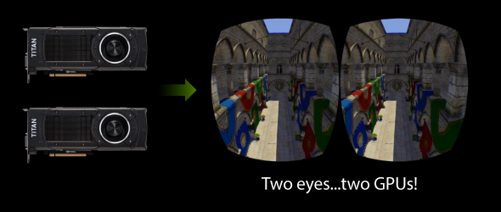
Parallel Rendering of Stereo Images

Slide 17
NVIDIA SLI for VR

Slide 18
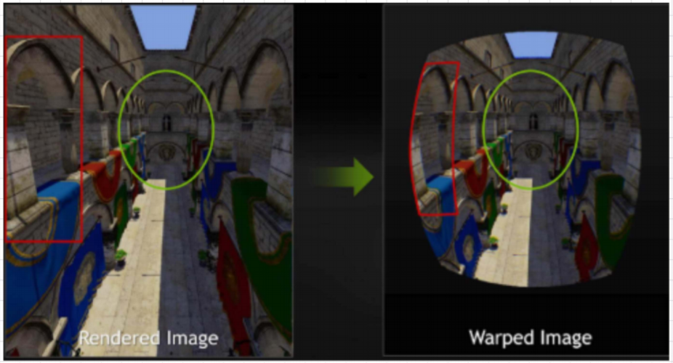
Optimizing Rendering for Image Warping
Current Approach. Optimization: Multi-resolution shading
Can you think of any rendering optimization we could do given that we know images will be warped?
What parts of the image could be rendered at a lower resolution?
Notes:
Classic rendering pipeline does not account for distortion.
Future: Aliasing concerns for both eye rendering.

Slide 19
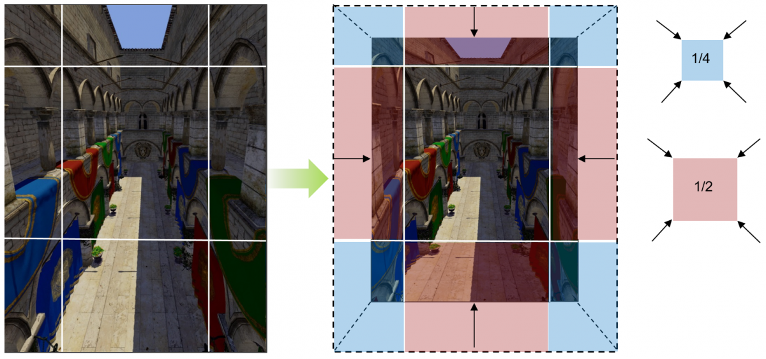
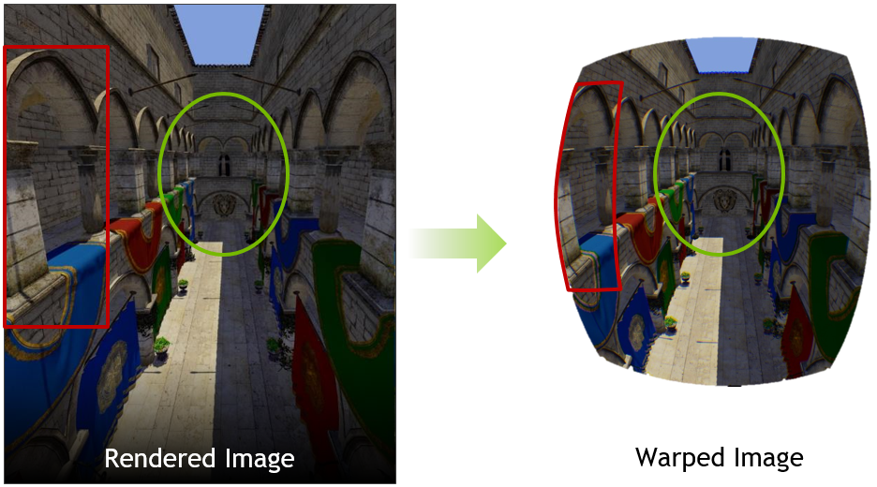
Optimizing Rendering for Image Warping
Current Approach. Optimization: Multi-resolution shading
NVIDIA Multi-resolution Shading breaks up view volume into pieces.
Renders the warped areas at lower resolution.
Notes:
Classic rendering pipeline does not account for distortion.
Future: Aliasing concerns for both eye rendering.

Slide 20
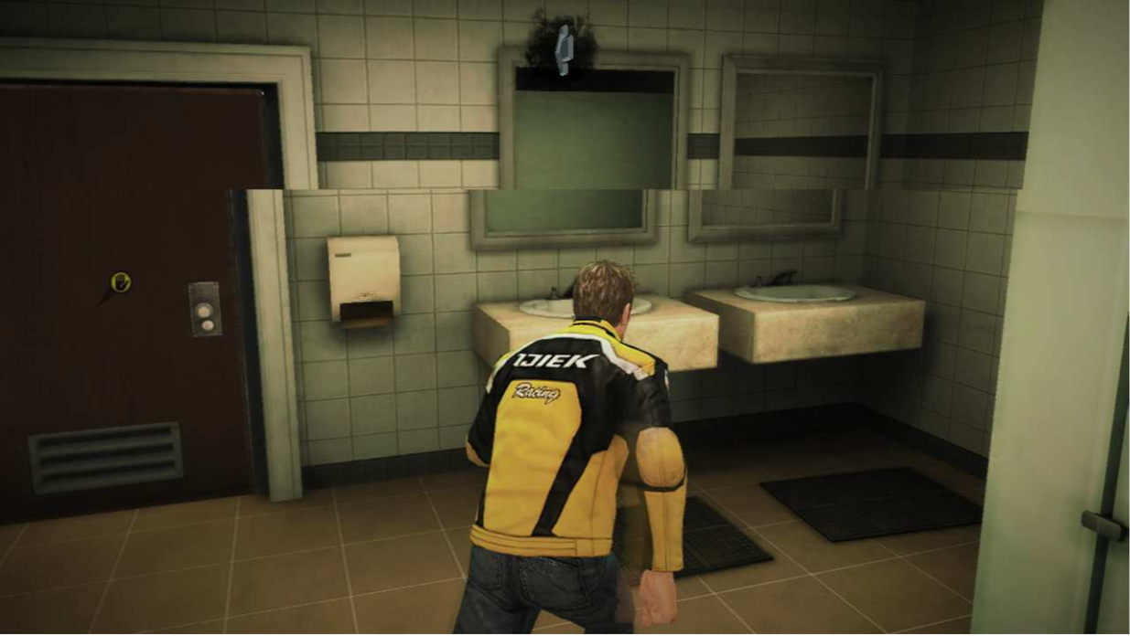
Images Tearing
Historically, CRTs required a Vertical Blanking Interval
Electron beam turned off as the gun was repositioned from bottom-right to top-left
In a single frame buffer systems it’s the time during which you can write to the buffer
If the buffer contents change during scan-out, you get tearing
Problem: Tearing
Notes:
What is “tearing”? And what is “blanking”?

Slide 21
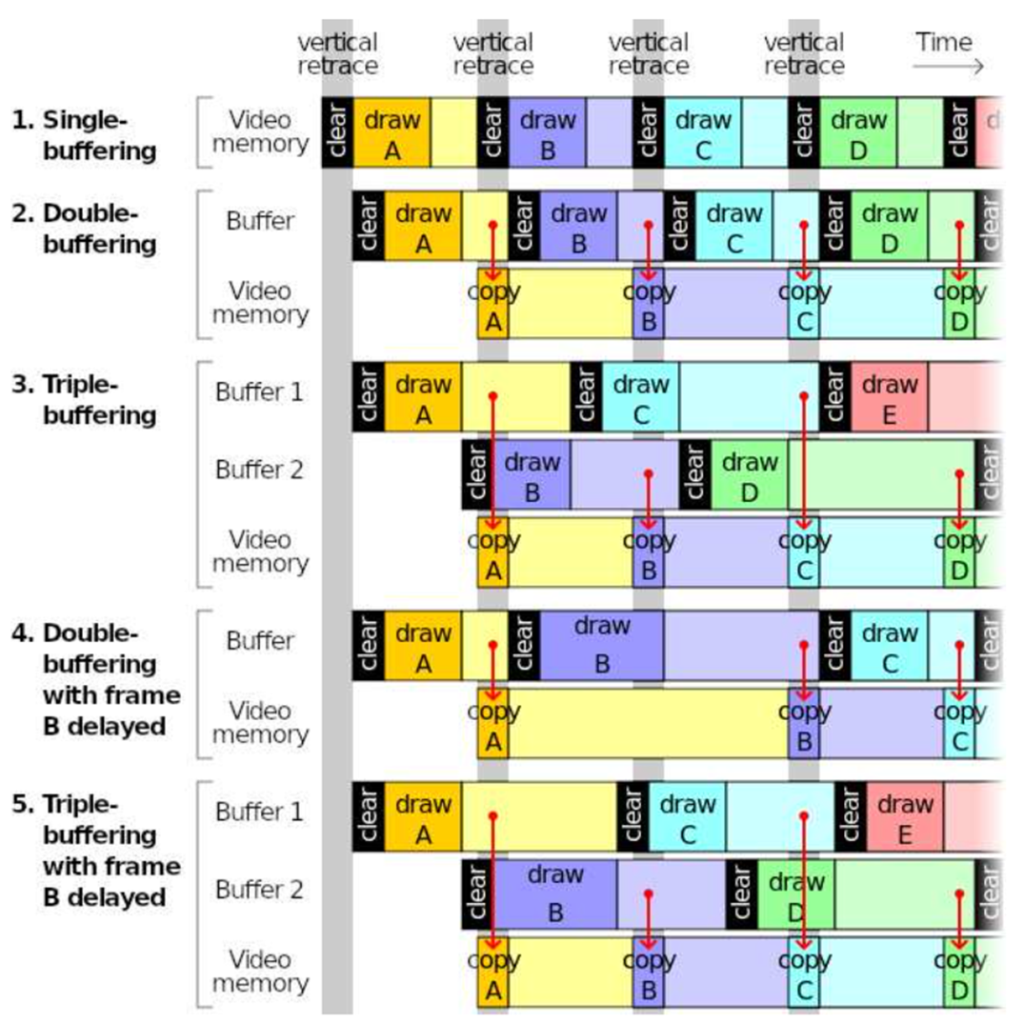
Solutions to Tearing
Buffering: Load frames into buffer not being scanned What implication does this have for VR?
Better solution would be
Simultaneous pixel update
Fast pixel switching (e.g. OLED display)

Slide 22
Accomodating Latency: Prediction
Three questions:
1. At what future time will the pixels be switched to the next image?
2. Where are the objects (position & orientation) at that time?
3. Where will the user be looking at that time?

Slide 23
Render the Future
Suppose we already know state of the viewer and world and time when pixels will be switched t_{s}
Ask the VWG to produce a frame for time t_{s} and then perform visual rendering for the viewport at time t_{s}.
Zero effective latency
Unrealistic…but maybe more doable than you think

Slide 24
Predicting Movement
Object’s movement in dynamic world is easy to predict. User motion and object movement caused by user is hard to predict
Use Momentum and Inertia: Head has more inertia, finger has less inertia and harder to predict
Head movement is predictable on the scale of 20ms.

Slide 25
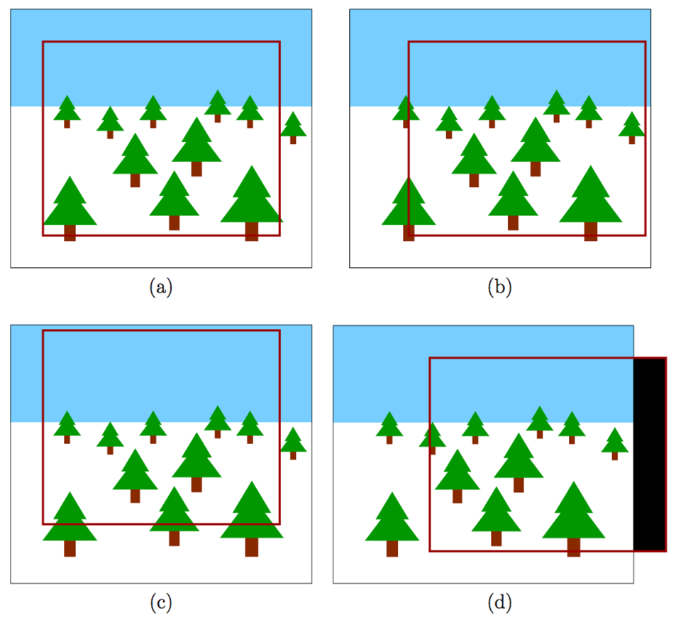
Post-rendering Image Warp
Rendered image is slightly larger than the display
Can then use shifts or distortion to compensate for bad prediction

Slide 26
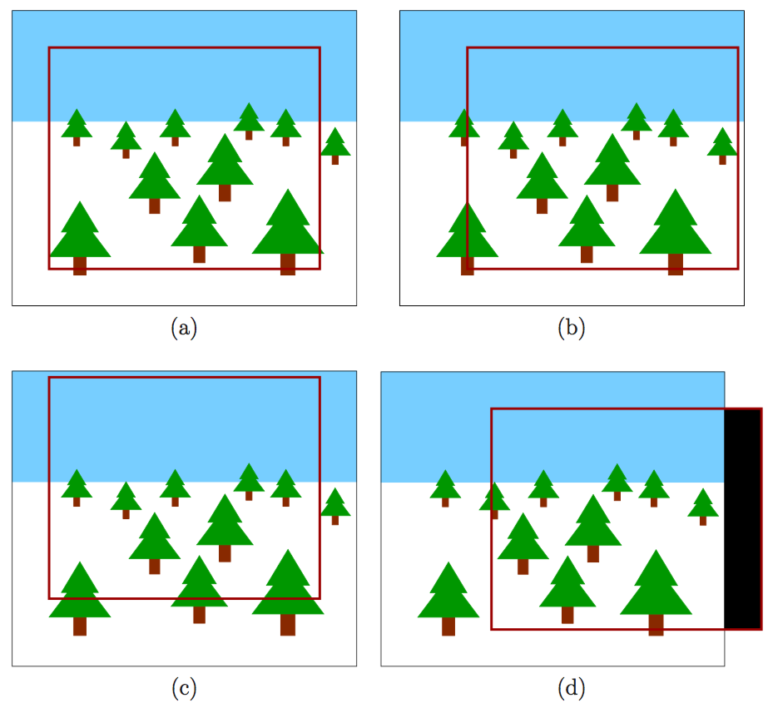
Post-rendering image warp
This is orientation change

Slide 27
Flaws in the Warped Image
Orientation changes (rotate head) are OK
But positional changes (translate head) are incorrect!
Visibility event: Part of a object may become visible only in the new viewpoint

Slide 28
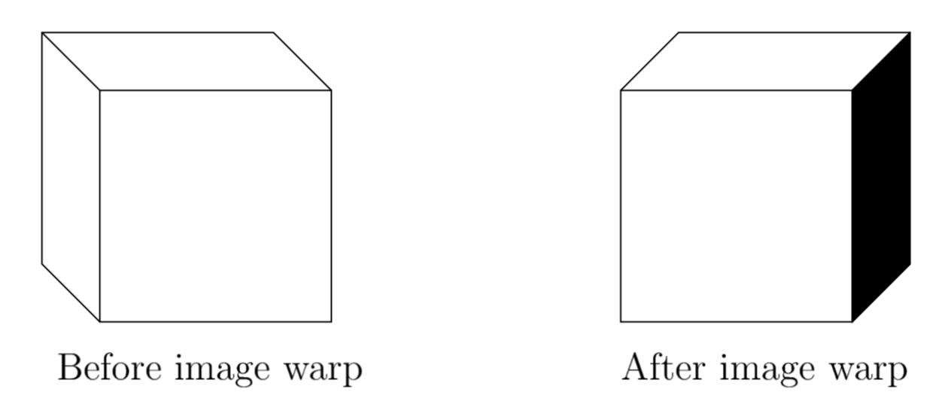
Visibility Event
Solutions:
Data structures: aspect graph & visibility complex
Parallel processing to sample several future viewpoints and render image for all of them

Slide 29
Increasing the Frame Rate
Inbetweening and tweening: insert warped frames for every rasterized image that is properly rendered
Example:
1 rasterized image per 100ms -> 10 FPS
(1 rasterized image + 9 warped frames) per 100 ms -> 100 FPS

