Slide 1
Motion in Real and Virtual Worlds
CS 498VR: Virtual Reality
UNIVERSITY OF ILLINOIS AT URBANA-CHAMPAIGN
Eric Shaffer

Slide 2
Mathematical Modeling of Motion
The physics of both real and virtual worlds impact VR experiences.
We will look at
How phsyics engines model motion in VR
How motion tracking methods rely on accelerations and velocities
How human vestibular organs rely on accelerations and velocities

Slide 3
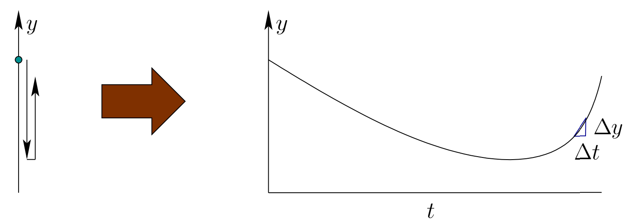
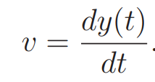
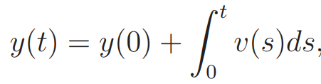
1D Motion
Suppose y(t) gives a position at a given time
How do you compute y(t) if you can measure velocity
Numerically we have since
Notes:
Sensor for v(t) is odometer
For constant v(t), y(t) = ? y(t) = y0 + vt For unconstant v(t), y(t) = ? numerical solution only

Slide 4
Acceleration
Acceleration is the rate of change of the velocity
We can approximate this numerically as before

Slide 5
Error
Numerically we have
We are approximating an integral by stepping in the direction of the velocity
This is called Euler Integration
Error is proportional to the size of the timestep O(Δt)…which is not good
Using a higher order method like 4th order Runge-Kutta (RK4) would be better
Notes:
Sensor for v(t) is odometer
For constant v(t), y(t) = ? y(t) = y0 + vt For unconstant v(t), y(t) = ? numerical solution only

Slide 6
A Simple Newtonian Physics Engine
We will animate particles (aka point masses)
Position is changed by velocity
Velocity is changed by acceleration
Forces alter acceleration
Our physics engine will integrate to compute
Position
Velocity
We set the acceleration by applying forces

Slide 7
Mass and Acceleration
To find the acceleration due to a force we have
So we need to know the inverse mass of the particle
You can model infinite mass objects by setting this value to 0
$\ddot{p}$ is the second derivative of some function $p$

Slide 8
Force: Gravity
Law of Universal Gravitation
G is a universal constant
m_{i} is the mass of object I
r is the distance between object centers
we care only about gravity of the Earth
m1 and r are constants
r is about 6400 km on Earth
We simplify to f = mg
g is about 10ms⁻²
For gaming, 10ms⁻² tends to look boring
Shooters often use 15ms⁻²
Driving games often use 20ms⁻²
Some tune g object-by-object

Slide 9
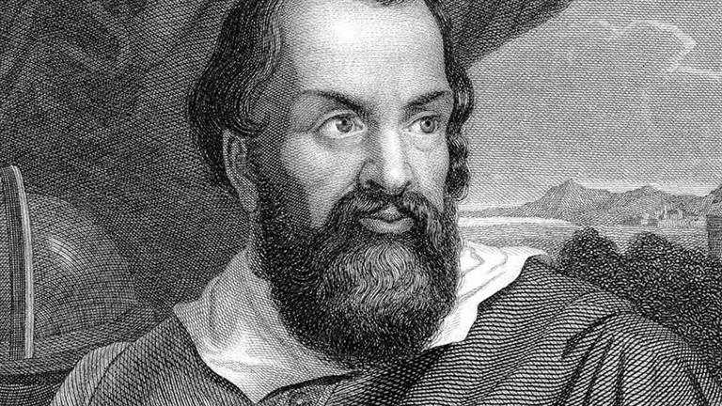
Force: Gravity
If we consider acceleration due to gravity we have
So acceleration due to gravity is independent of mass

Slide 10
Force: Drag
Drag dampens velocity
Caused by friction with the medium the object moves through
Even neglecting, you need to dampen velocity
Otherwise numerical errors likely drive it higher than it should be
A velocity update with drag can be implemented as
important to incorporate time so drag changes if the frame rate varies

Slide 11
The Integrator
The position update can found using Euler’s Method:
$$P_{new}=P_{old}+\dot{P}t$$
Note that is inaccurate, though good enough for simple things
Euler’s error is O(t)
Why is the error worse when acceleration is large?
The velocity update is

Slide 12
Collision Detection
Often requires use of bounding volumes or spatial data structures
Broad Phase: Uses bounding volumes to quickly determine which objects need to be checked closely for collision
Narrow Phase: Perform careful, expensive collision checks, such as triangle-triangle intersection for meshes

Slide 13
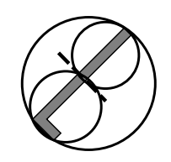
Bounding Volumes
Sphere AABB OOBB Convex Hull Hierarchical (BVH)
AABB=Axis Aligned Bounding Box
OOBB = Object-Oriented Bounding Box
BVH = Bounding Volume Hierarchy

Slide 14
Collision Detection
Surprisingly complex topic
Even a high-quality engine like Unity has issues
We will discuss how to simulate only two types of collision
Sphere-Wall
Sphere-Sphere
We check for a collision when updating position
If a collision occurs the velocity vector is altered
Position is determined by the contact
Position and velocity update are completed with new values
over the remaining time

Slide 15
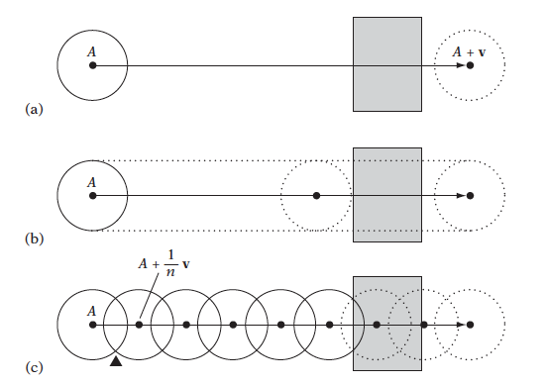
Dynamic Collision Detection
Dynamic collision tests an exhibit tunneling
if only the final positions of the objects are tested (a)
Or even if the paths of the objects are sampled (c)
A sweep test assures detection but may not be computationally feasible.

Slide 16
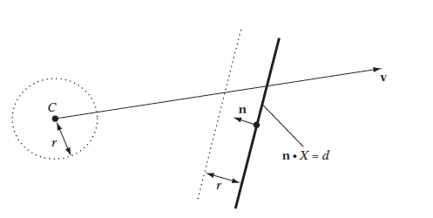
Sphere-Plane Collision
Can make it even simpler for the box walls in MP. How?

Slide 17
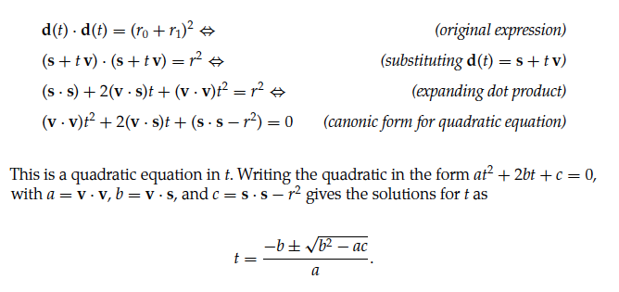
Sphere-Sphere Collision

Slide 18
Collision Resolution
First, find closing (aka separating) velocity
Component of velocity of two objects in direction from one to another
Collisions that preserve momentum are perfectly elastic
We will use v_{s_after} = -cv_{s}
c is the coefficient of restitution…a material property that you choose

