Slide 1
VR Hardware Overview
CS 498 VR
UNIVERSITY OF ILLINOIS AT URBANA-CHAMPAIGN

Slide 2
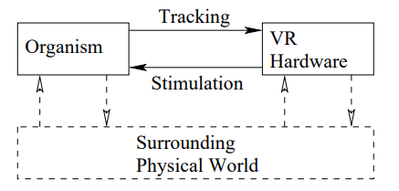
Birds-Eye View: Hardware
Can anyone list what components are part of a modern VR system?

Slide 3
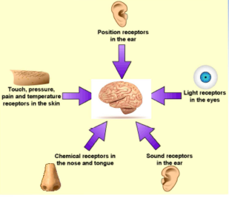
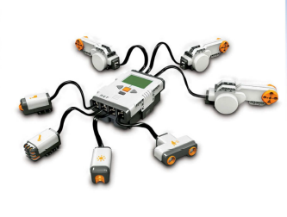
Sensors and Sense Organs
A sensor is a transducer that transforms the physical world energy into a signal
Sense organs are like biological sensors that convert stimuli into neural impulses
Engineered Components
Transducer: Converts energy from one form to another
Sensor: Transducer converting energy into an electrical signal
Receptor: Part of sensor that collects energy

Slide 4
Quick Aside: Why two ears in the diagram?

Slide 5
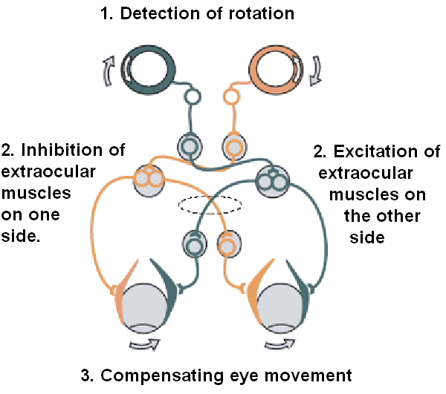
Quick Aside: Why two ears in the diagram?
The vestibular system, in most mammals, is the sensory system that provides the leading contribution to the sense of balance and spatial orientation for the purpose of coordinating movement with balance. Together with the cochlea, a part of the auditory system, it constitutes the labyrinth of the inner ear in most mammals. As movements consist of rotations and translations, the vestibular system comprises two components: the semicircular canals which indicate rotational movements; and the otoliths which indicate linear accelerations. -- Wikipedia

Slide 6
Configuration Space of Sense Organs
A configuration space is like a state space.
For a sensor or sense organ, it is all possible ways the sensor can be transformed.
For example, an ear moves through 3D space with the body and head. So…we say it has 6 degrees of freedom (DOF) Translation accounts for 3 of the DOF →It can move forward and backward (translation along z axis?) →It can move up or down (translation along y axis?) →It can move side to side (translation along x axis?) Any other ways to configure it?

Slide 7
Hijacking the Senses
Why do we care about understanding senses?

Slide 8
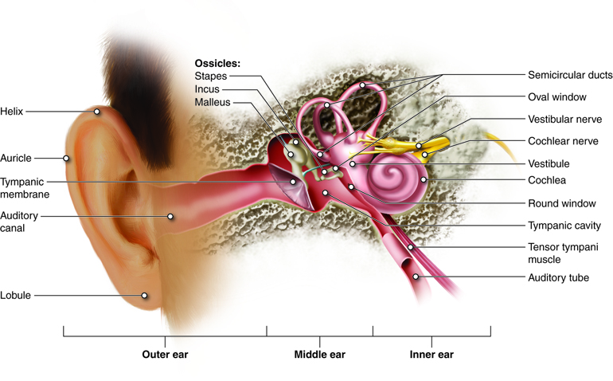
Ears and DOFs
Any other DOFs?
Why do we care about the position and orientation of the ear in space when implementing a VR system?
Notes:
3 linear DoF
3 rotation Yaw Pitch Roll
(Also Timpanic muscle)

Slide 9
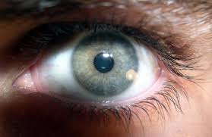
Eyes and DOFs
How many?
Notes:
3 linear. 3 rotation + 2 rotation
Pupil dilation + lens focusing (could also include open/closed eyelid)

Slide 10
Eyes and DOFs
How many?
3 for location in space
3 for orientation of head
2 for rotation of the eye (why not maybe?)
1 for dilation → dilation of pupil that determines amount of light received
1 for accommodation → focus determined by lens shape and vergence
Notes:
3 linear. 3 rotation + 2 rotation
Pupil dilation + lens focusing (could also include open/closed eyelid)

Slide 11
Displays
A display is output device designed to stimulate a sense
We will go into greater detail in later lectures about display technology
Right now, we want to establish vocabulary and an high-level understanding

Slide 12
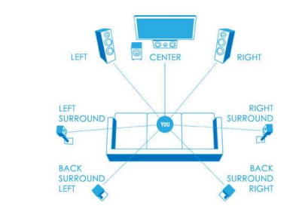
Aural Displays (Audio)
World-fixed User-fixed

Slide 13
Aural Displays (Audio)
World-fixed User-fixed
Some considerations when designing an aural VR system:
Surround-sound is distant from ears, headphones produce sound close to ears
One implication is that headphones require less power to produce a sound of equal perceived loudness
Headphones are private…large speakers systems less so
Wearing headphones for long periods of time becomes uncomfortable
Headphones are far cheaper
These are all important considerations when designing a VR system…but how about a software-related one?
Are there situations in which headphones would require extra processing of audio to create a true VR experience?

Slide 14
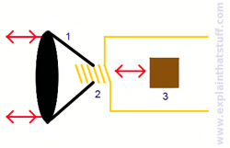
Audio Displays: How Does a Speaker Work?
Cone
Electromagnet
Permanent Magnet The electromagnet moves due to pulses of electricity and it’s attraction/repulsion to the permanent magnet.
https://youtu.be/_otCquvos8o

Slide 15
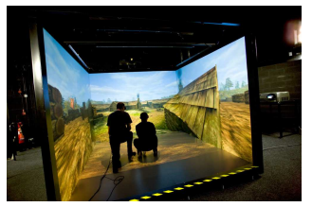
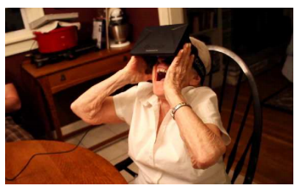
Visual Displays
Two Settings:
World-fixed
User-fixed
For a user-fixed visual display we need to process the displayed scene in response to user movement.
How do we need to transform the geometry when someone rotates their head to their right?
The inability measure head movement accurately – and the VR sickness that failure produced – is one of the main failings of 1990s era VR technology.

Slide 16
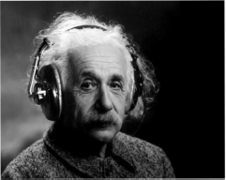
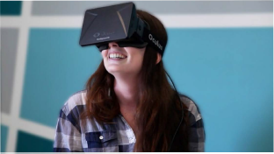
Why is Video ahead of Audio? Is Video ahead of Audio?

Slide 17
Why is Video ahead of Audio?
People are really sensitive to visual stimuli….less so to audio
…but true immersion does require 3D audio as and it is a current area of research and development.

Slide 18
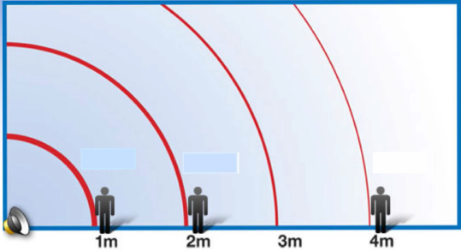
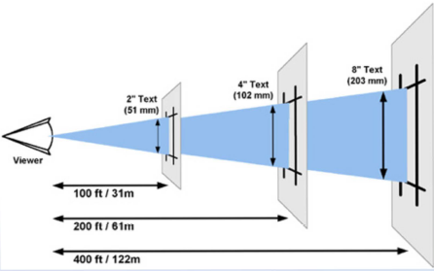
Distance to Displays
Video displays have similar energy considerations to audio in terms of behavior with respect distances.

Slide 19
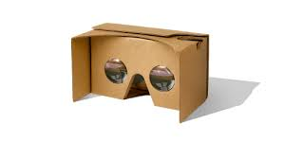
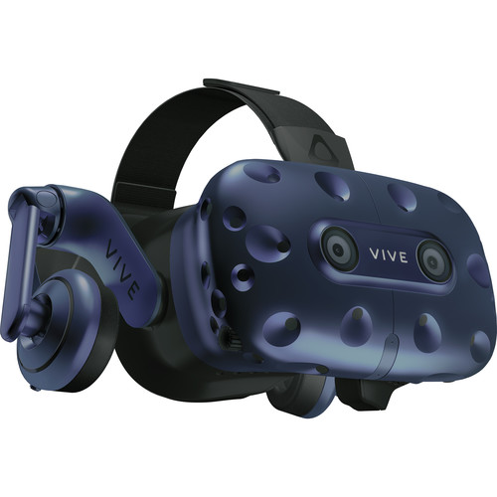
Current User-Fixed Display Hardware
A cellphone with one additional lens per eye
HMD with individual LED displays for each
Targeting 90 Hz and +2 megapixels per eye
Direct retinal display…e.g. hololens

Slide 20
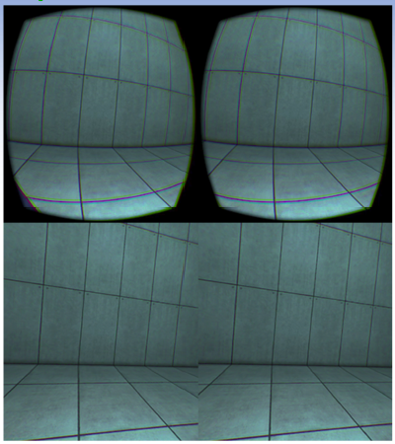
Hardware: Lens
Why do HMDs use lenses?
What issue arises that must be dealt with?
FOV: __________________________________________________________
Distortion: ______________________________________________________

Slide 21
Hardware: Lens
https://www.youtube.com/watch?v=NCBEYaC876A

Slide 22
Hardware: Lens
Why do HMDs use lenses?
To enable the human eye to focus on the display
What issue arises that must be dealt with? Distortion …for example, straight lines not appearing straight
FOV: __________________________________________________________
Distortion: ______________________________________________________

Slide 23
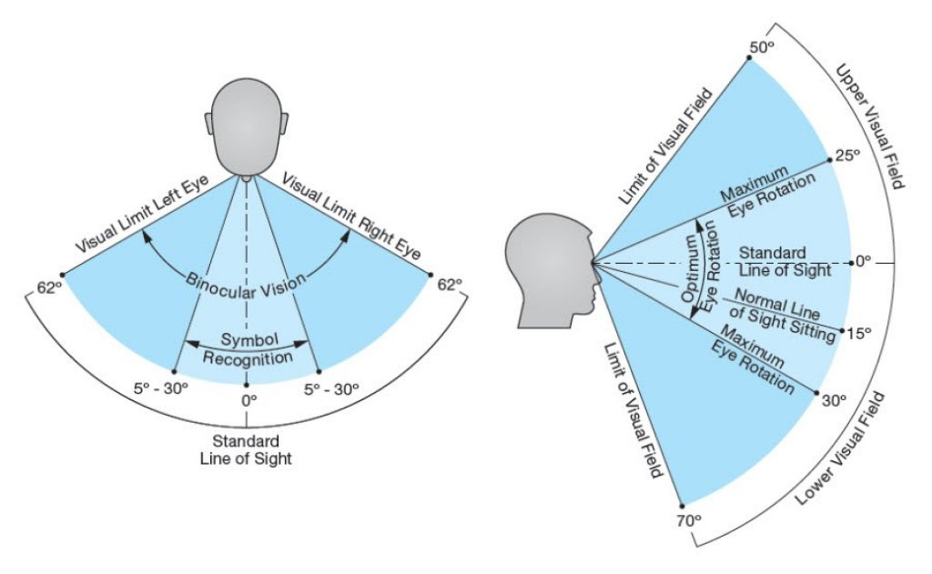
Hardware: Display and Lens Considerations
Field of View: The solid angle (a set of directions) in which the eye receives light
Do we want a large FoV? What are the pros and cons?
FOV: __________________________________________________________
Distortion: ______________________________________________________

Slide 24
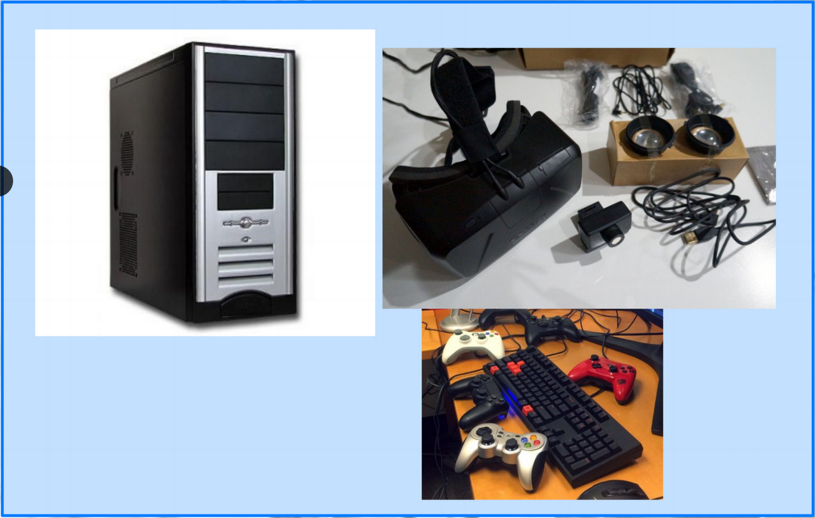
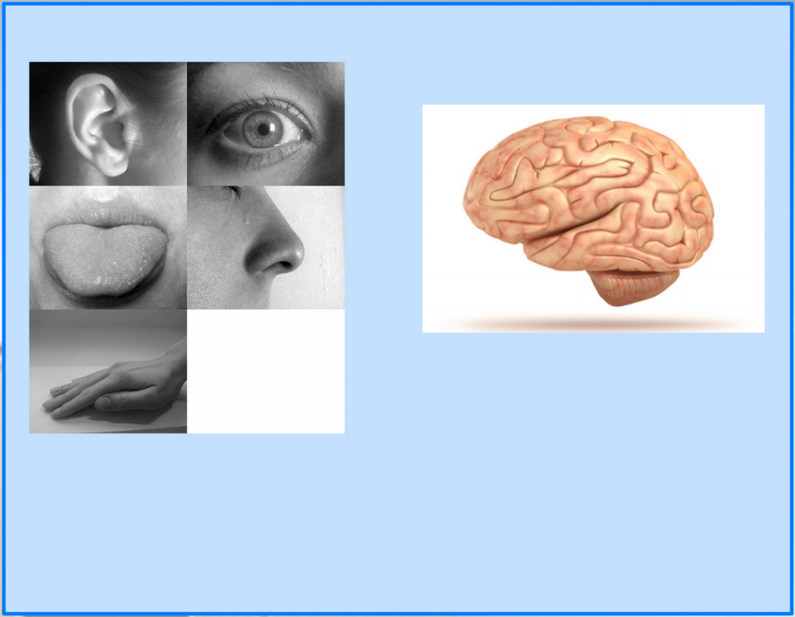
VR System: Hardware and Perceptual Psychology
Again, to design an adequate system we need to understand perception… We will talk about human perceptual systems and engineering considerations in greater detail later in the semester…
But…what’s one engineering issue that based on the fact the humans have multiple senses?

Slide 25
Oculus DK2 Teardown
https://www.youtube.com/watch?v=Lfytw8VQGJc

Slide 26
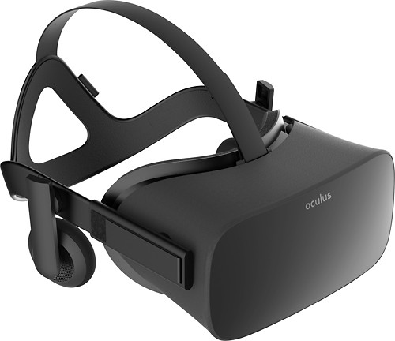
Tracking Hardware
The VR system needs to track the position and orientation of the head in the HMD
This is typically done using both Inertial Measurement Unit (IMUs) and IR cameras
Tracking is: _____________________________________________________
HMD vs Cave
HMD vs Headphones
Notes:
Tracking is: Updating the virtual world according to configuration changes of the sense

Slide 27
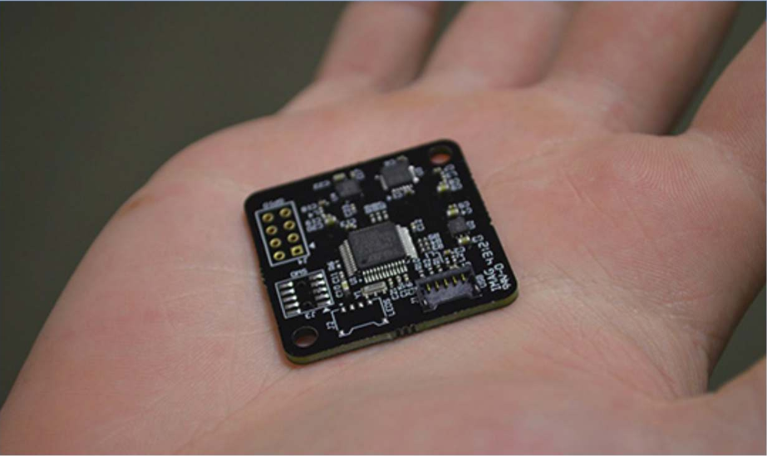
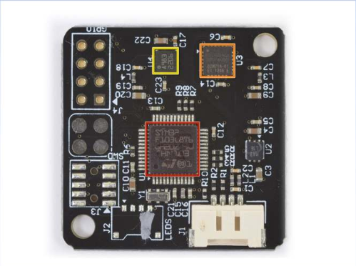
Tracking Hardware: IMUs
Used for:
Consists of:
Common in:
Cost:
Include a gyroscope for measuring
An accelerometer
A magnetometer
Notes:
IMU’s: Inertial measurement units
Consists of:
Gyroscope
Accelerometer
Magnetometer
Common in: airplanes
Cost: $ - $$$

Slide 28
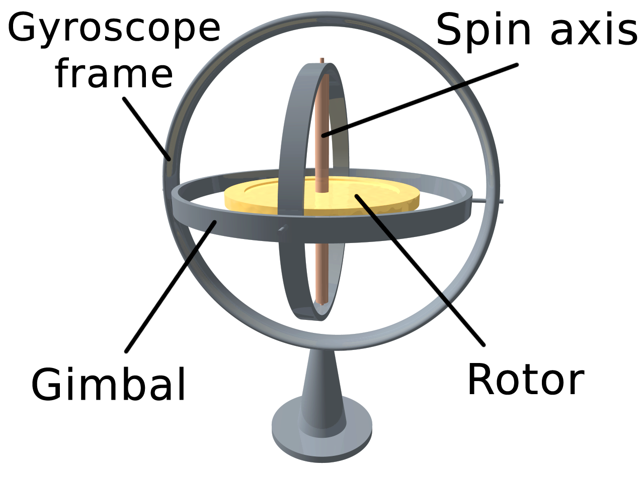
Gyroscope
Gyroscope measures angular velocity
Modern hardware uses MEMS-based gyroscopes that measure the effect of rotation on a vibrating object

Slide 29
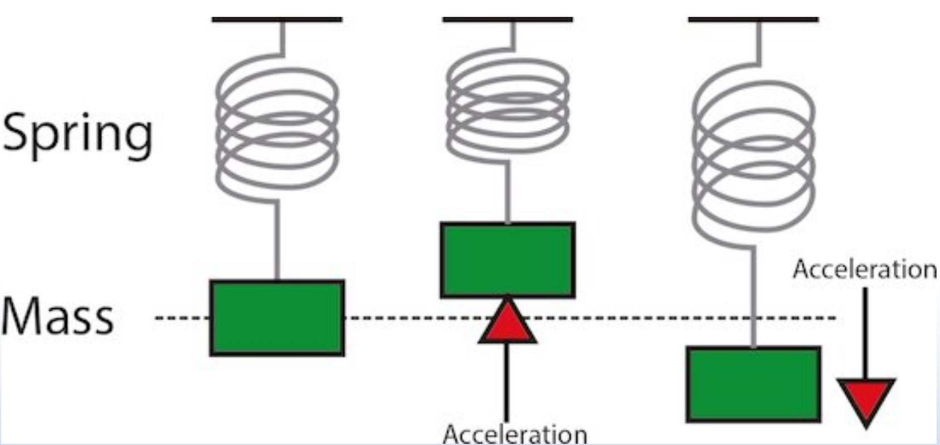
Tracking Hardware: Accelerometers
How can we compute position from acceleration…what mathematical process can we use?
Conceptually, an accelerometer behaves as a damped mass on a spring. When the accelerometer experiences an acceleration, the mass is displaced to the point that the spring is able to accelerate the mass at the same rate as the casing. The displacement is then measured to give the acceleration. Modern accelerometers are often small micro electro-mechanical systems (MEMS), and are indeed the simplest MEMS devices possible --Wikipedia
Notes:
IMU’s contain gyroscope + accelerometer

Slide 30
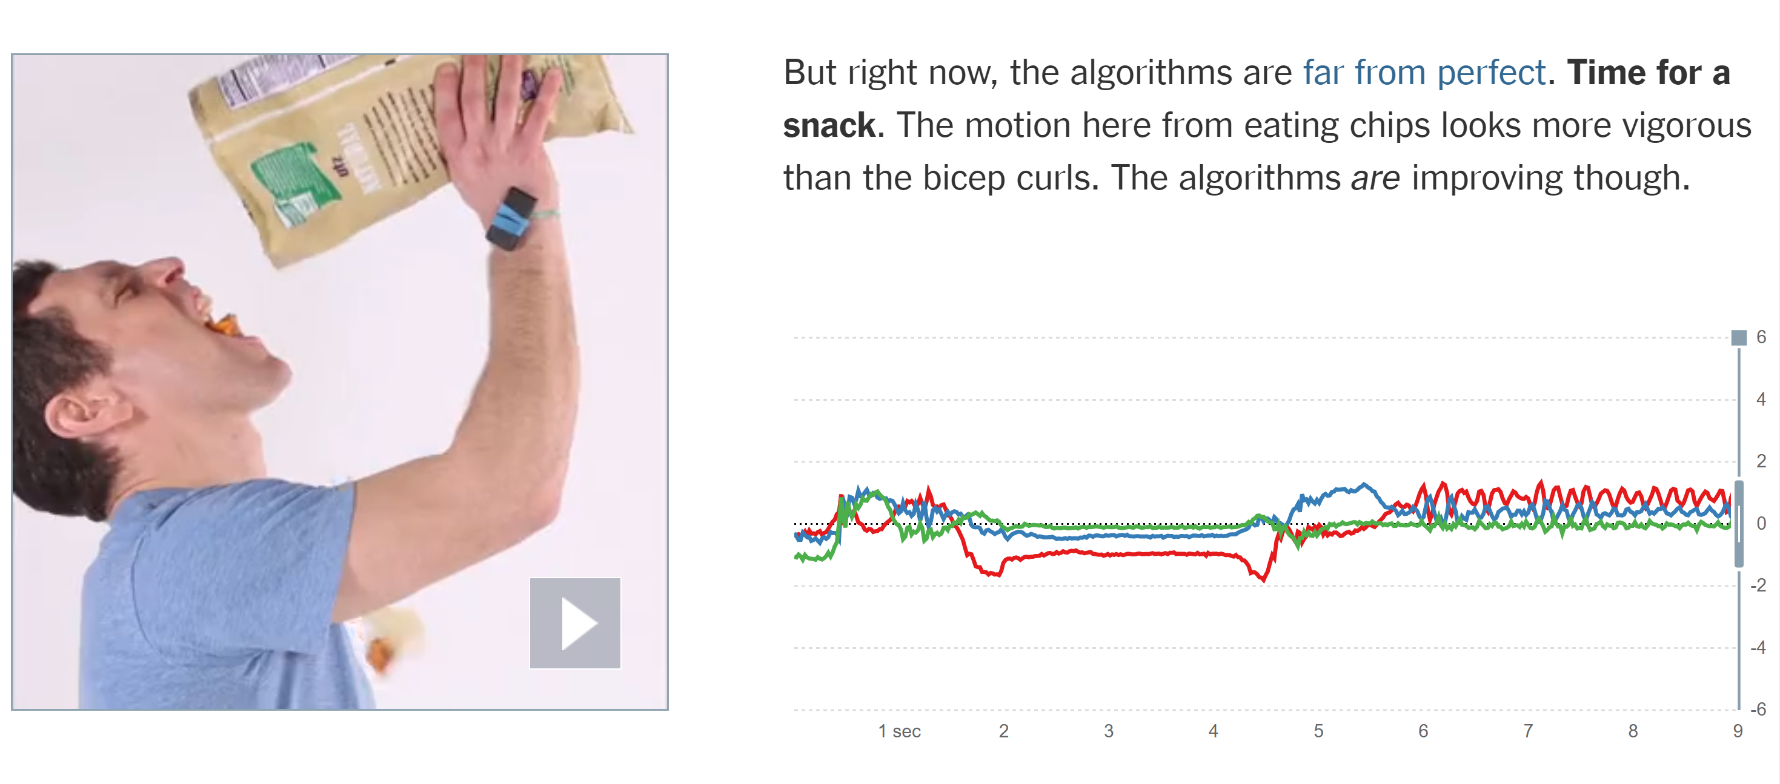
Fun Facts about Accelerometers
https://www.nytimes.com/interactive/projects/well/2014/03/accelerometers.html

Slide 31
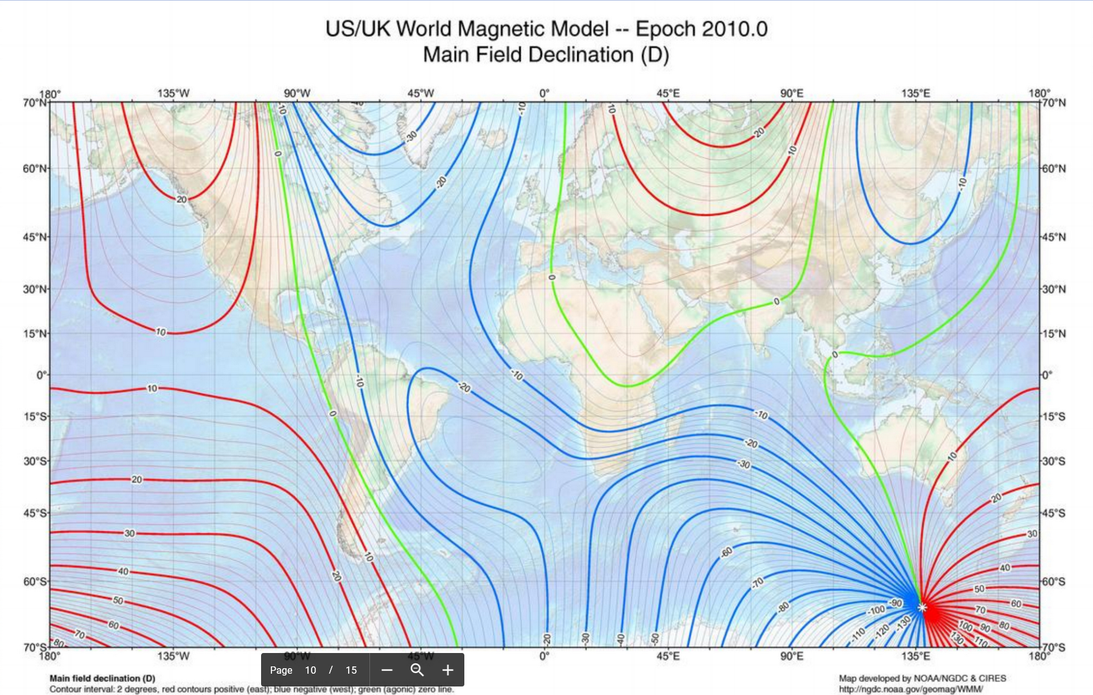
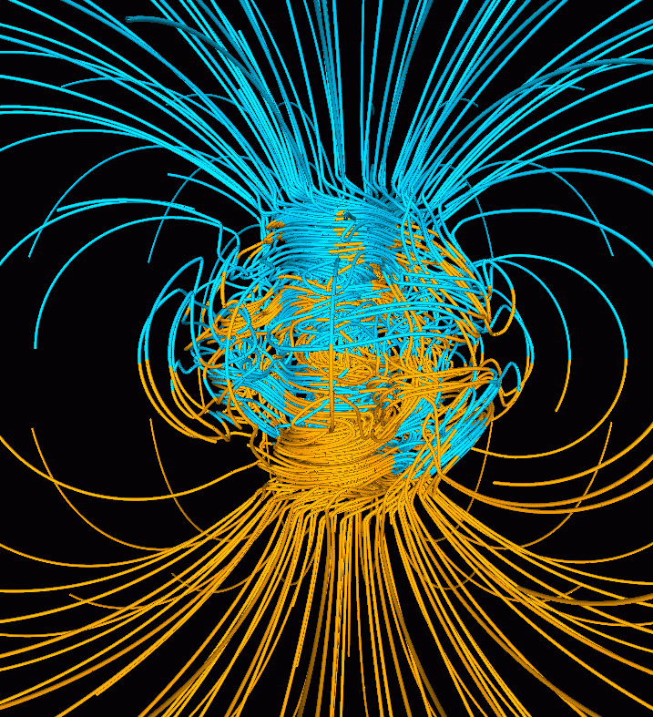
Tracking Hardware: IMUs
Vector magnetometers measure the vector components of a magnetic field….such as the Earth’s magnetic field.
We can use it in tracking to estimate changes in position by using it like a compass…
Notes:
On the left - Inclination angles: Computer simulation of the Earth's field in a period of normal polarity between reversals.^{[1]} The lines represent magnetic field lines, blue when the field points towards the center and yellow when away. The rotation axis of the Earth is centered and vertical. The dense clusters of lines are within the Earth's core.^{[2]}
On the right - Declination angles: magnetic declination is the angle on the horizontal plane between magnetic north and true north

Slide 32
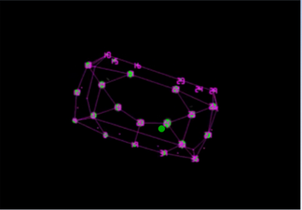
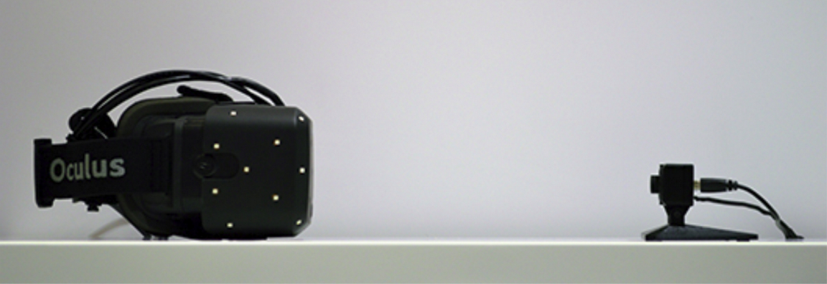
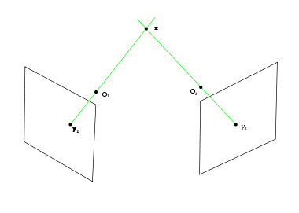
Tracking Hardware: Cameras
An infrared camera can be used to detect the position of IR on the headset.
Depth can be estimated in multiple ways…two cameras can find depth through triangulation
What’s another potential way to find depth using IR light?
Why use IR?
Notes:
This is an example of outside-in tracking.
Inside out tracking has the camera on the HMD and scans the world for cues

Slide 33
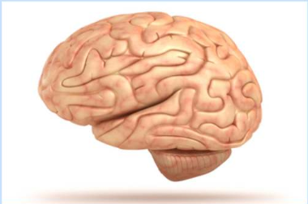
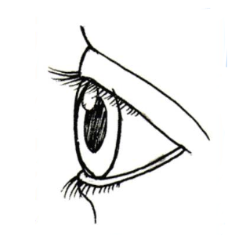
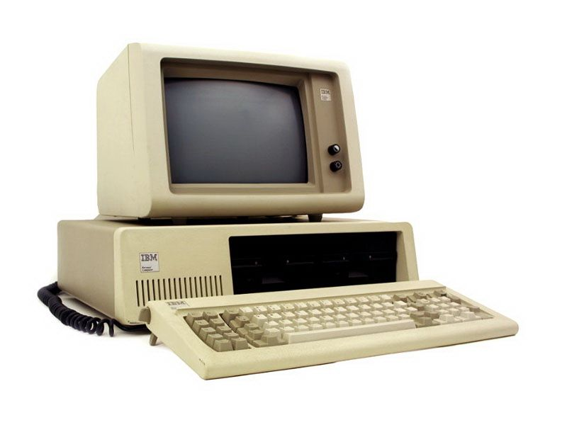
VR System: Component we haven’t talked about…. Software

Slide 34
Birds-Eye View: Hardware
We can now fill the list that we saw in the first lecture….an overview of the hardware components
Displays:
Visual…e.g. HMDs with lenses
Audio….e.g. earphones
Touch…haptic devices (e.g. steam controllers have some vibrational feedback) Smell? Taste? Vestibular?
Tracking Hardware Components:
IMU’s
Cameras
Controllers: e.g. steam controllers or more advanced tracked Vive controller
Computer:
CPU:…sure…need one.
GPU:…at least an NVIDIA 2080 TI right?

Slide 35
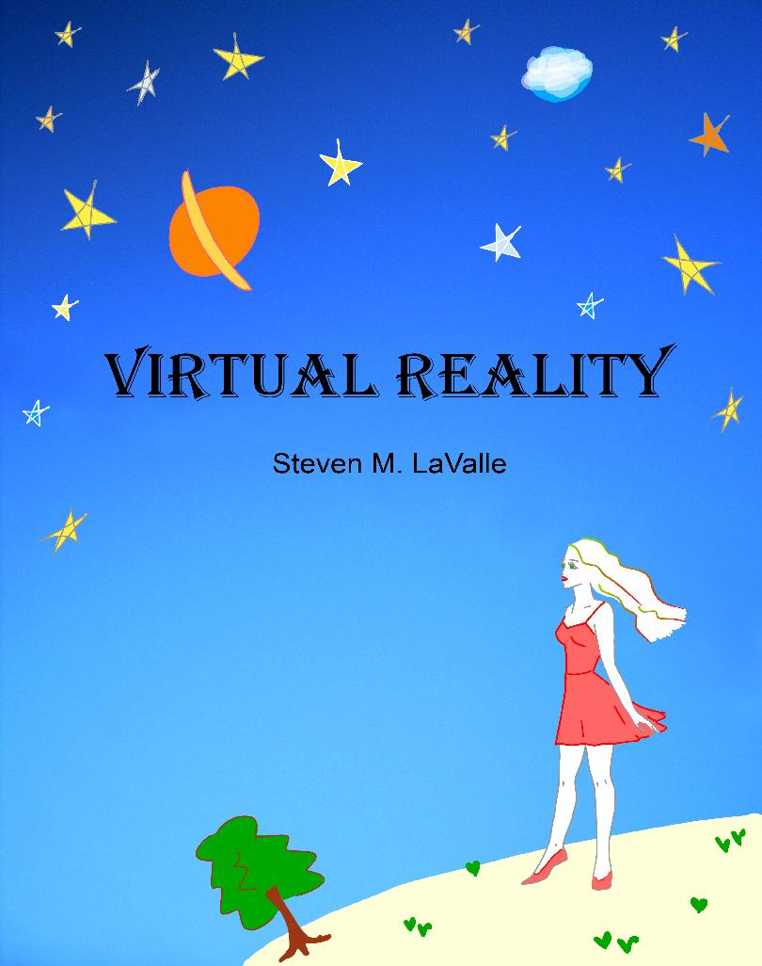
Homework
Chapter 2.1 of Steve Lavalle’s VR online book VR Hardware
Machine Problem 1 - Not yet (Waiting for the lab)

Slide 36
Reminder about homework & expectations
Lectures will be recorded, but why not come to class?
Read the book! It’s free and explains things well
Check Piazza often - updates about class, deadlines, etc
MP’s are to be done in pairs, class projects are in groups of 3 to 5
There are only 20 computers and 200 students, so start on your MP’s early or you might have trouble getting on a computer!
Notes:
Bullet points will appear one at a time

