Slide 1
Current Research in VR Display Technology
CS 498VR: Virtual Reality
UNIVERSITY OF ILLINOIS AT URBANA-CHAMPAIGN
Eric Shaffer

Slide 2
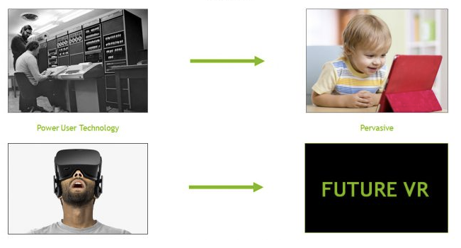
Current(ish) Research in VR Display Pipeline
Based on article: How NVIDIA Research is Reinventing the Display Pipeline for the Future of VR by Dr. Morgan McGuire
From 2017…you can find it with the Google

Slide 3
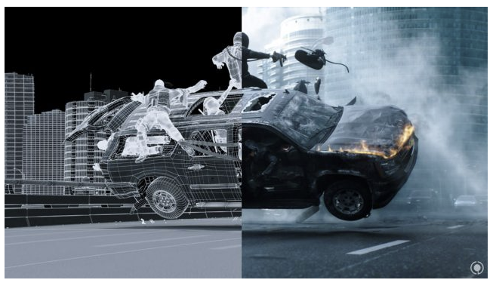
Background: Cinematic CGI Pipeline

Slide 4
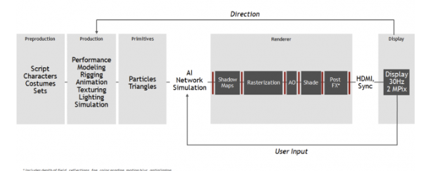
3D Game Pipeline

Slide 5
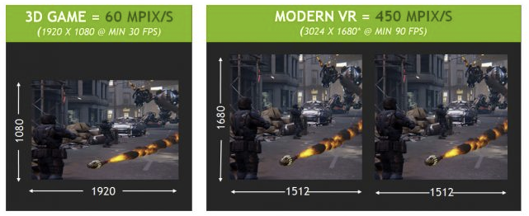
Modern VR Systems
Increased Throughput
450 Mpix/s on Rift or Vive is 7x of standard 1080p at 30fps
Must Reduce Latency
100-150ms between player input and pixel change in traditional game
Need to reduce this by a factor of at least 7 for VR

Slide 6
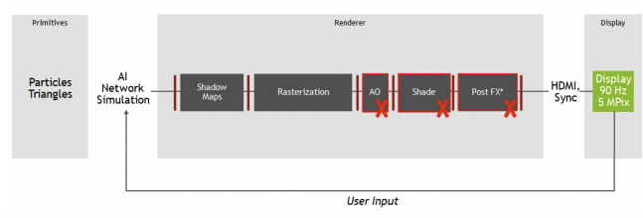
Reducing Latency
Reducing the number of pipeline stages reduces latency
No deferred shading?
No post fx passes
Reduced throughput and image quality

Slide 7
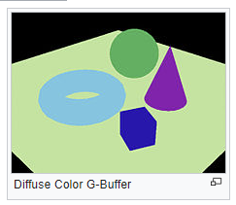
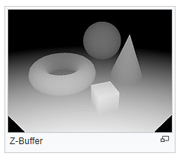
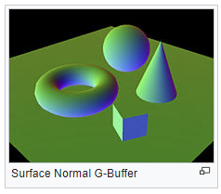
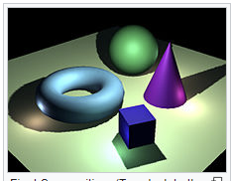
What is Deferred Shading?
No shading done in first pass of vertex and fragment shaders
Instead positions, normal, material info is gathered
Stored in the G-Buffer (geometry buffer) using render to texture
Final pass performs shading
Advantage: shading is only performed pixels that will be seen

Slide 8
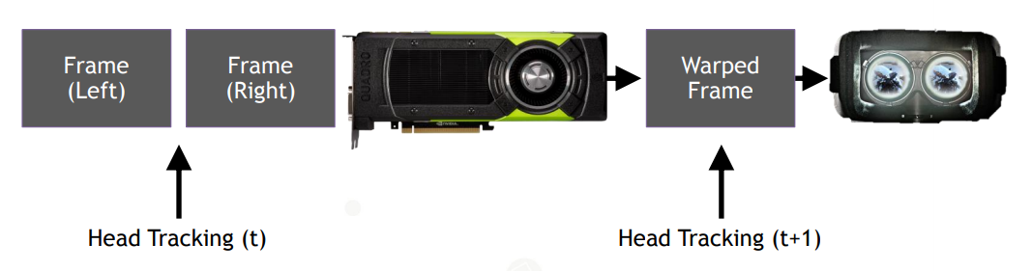
Time Warp
Images shown updated without full trip through the graphics pipeline Tracking data are routed to a GPU stage that appears after rendering is complete Warps the already-rendered image to match the latest head-tracked data This brings the perceived latency down from about 50ms to zero in the best case.

Slide 9
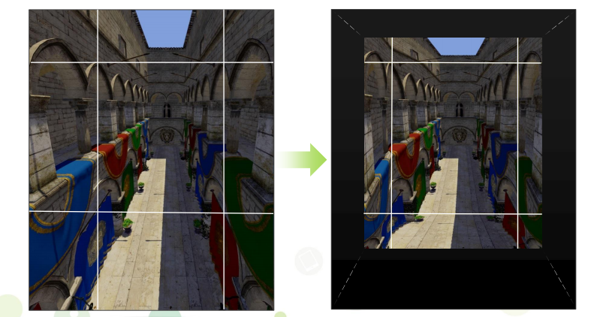
Lens Distortion: Multi-Resolution Shading
Image must be distorted to correct for lens
Can use that knowledge to optimize rendering
Multi-resolution shading
Subdivide image
Shrink the outskirts

Slide 10
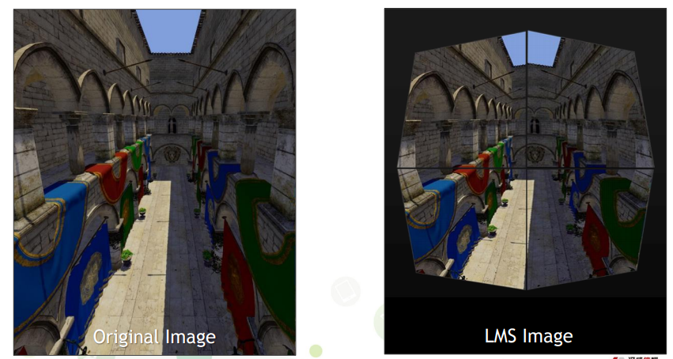
Lens Distortion: Lens-Matched Shading
Slightly newer technique
Uses 4 sub-images and distorts geometry in clip-space

Slide 11
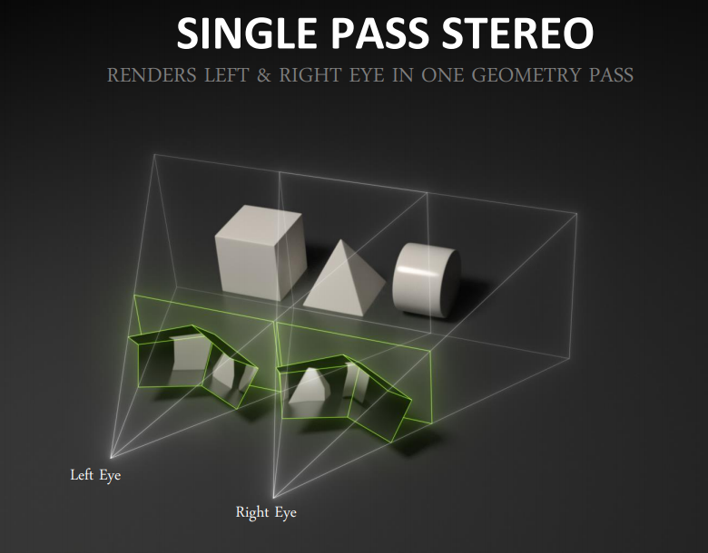
Simultaneous Multiprojection

Slide 12
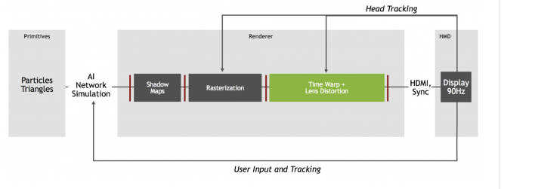
Modern VR Pipeline

Slide 13
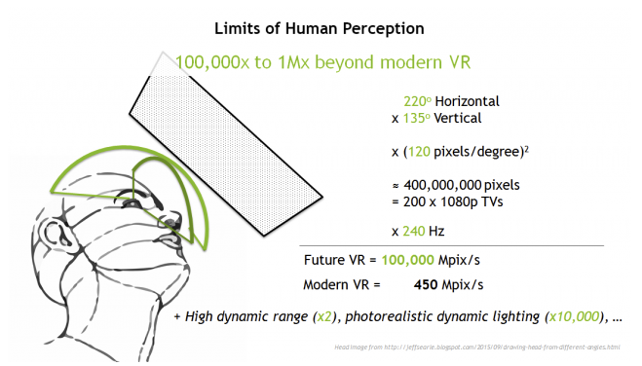
What Would be the Perfect VR Display?
Equivalent to 200 HDTVs updating at 240 Hz 100,000 megapixels per second
Need 200x performance increase

Slide 14
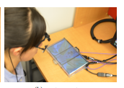
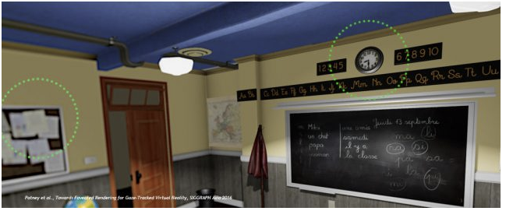
Future: Foveated Rendering
Track eye…render at lower res on periphery

Slide 15
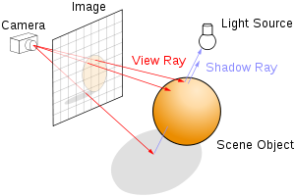
Real-Time Ray Tracing
Volta architecture: ~1 billion rays/per second (almost good enough)
Ray-tracing
removes the need for shadow map generation
can render lens distortion directly
can update each pixel on the fly…no frames?

Slide 16
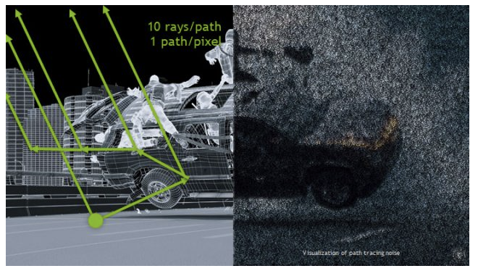
Real-Time Path Tracing
Path-tracing is ray-tracing…with more recursion
Generates indirect lighting effects (global illumination)
A single path per-pixel will be noisy…need thousands
So…maybe 1000x more expensive than simple ray-tracing

Slide 17
Image Denoising
New image denoising functions generated through machine learning
…faster than shooting more rays

Slide 18
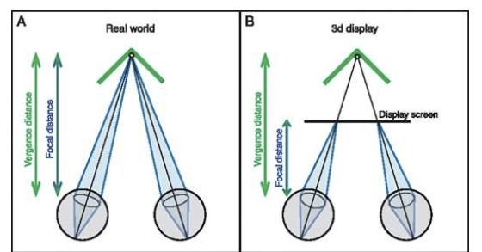
Solving Vergence-Accommodation

Slide 19
Solving Vergence-Accommodation

Slide 20
Solving Vergence-Accommodation
SIGGRAPH Asia 2017

Slide 21
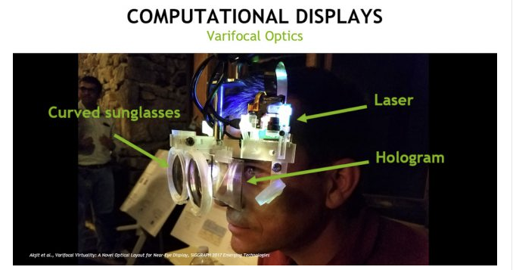
Solving Vergence-Accommodation
Track the eye and distort image depth of field to match

Slide 22
Computing on the HMD
Local GPU(s) in HMD plus Cloud-based GPU

Slide 23
Computing on the HMD

Slide 24
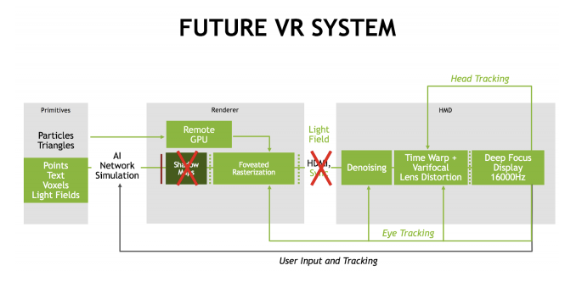
What do you think?

