Slide 1
The SNOW Theorem and Latency-Optimal Read-Only Transactions
Presenter: Tianyi Shan

Slide 2
Organization
Motivation and background
The “SNOW” theorem
COPS-SNOW design and Rococo-SNOW design
Evaluation of the results
Takeaway and Discussion

Slide 3
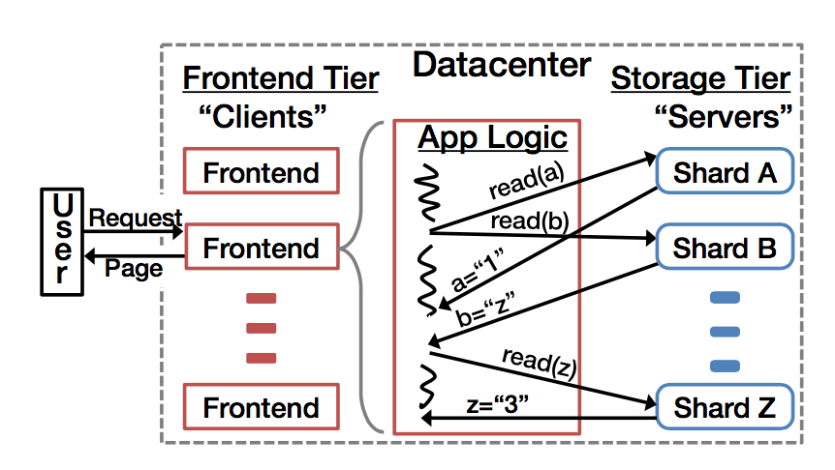
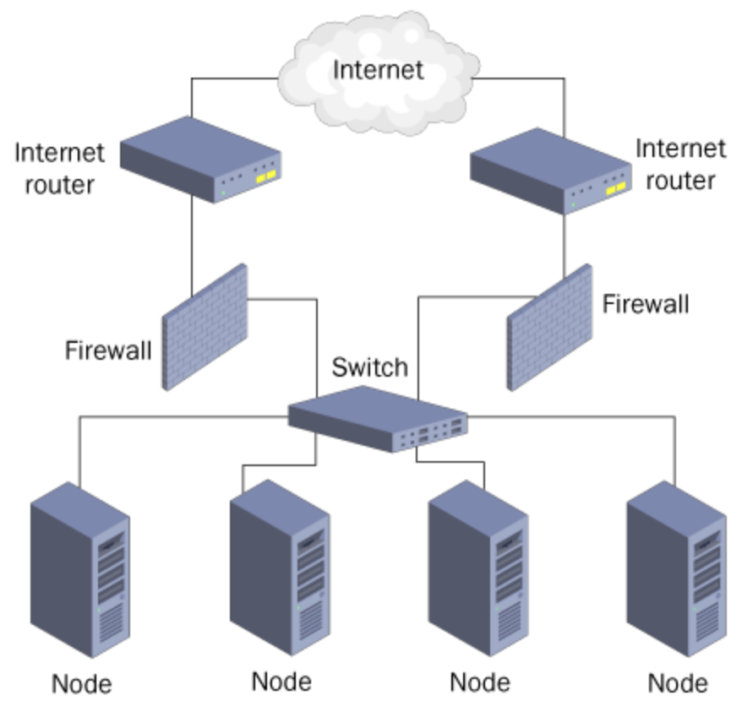
Motivation and background
Web service may read from its data store thousands of times for a single page.
many real-world workloads of web service are dominated by reads.(99.8% of the operations for Facebook’s distributed data are reads store TAO are reads).
Reduce Latency
Reference: https://www.globaldots.com/knowledge-base/network-load-balancing/

Slide 4
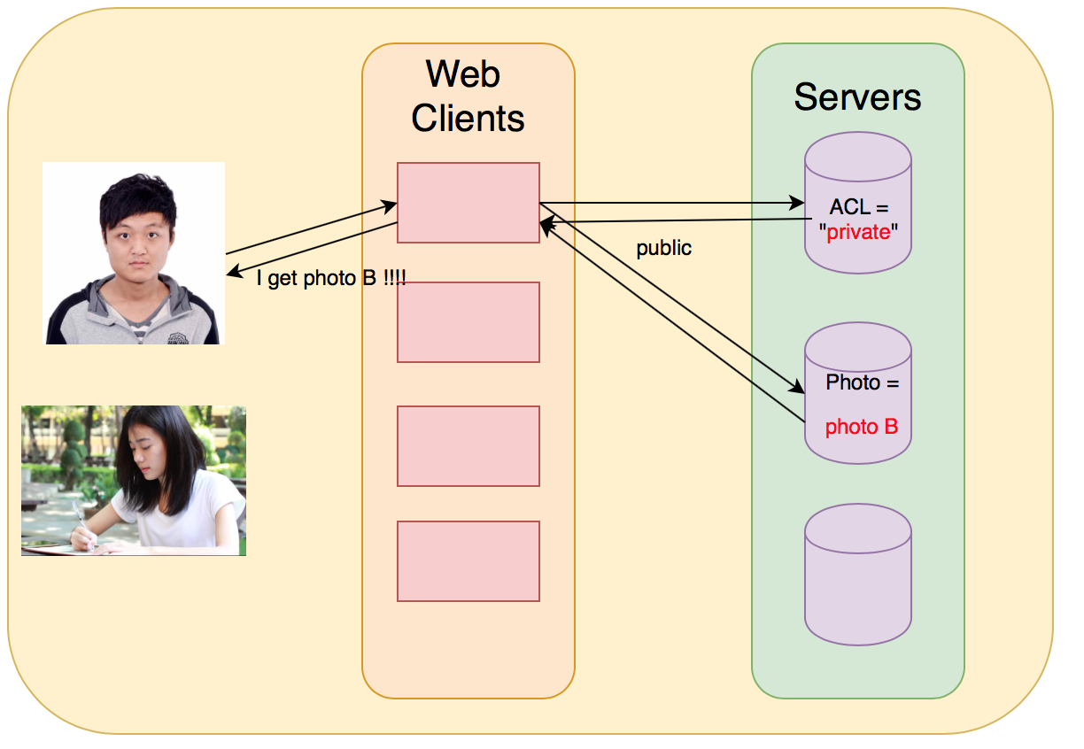
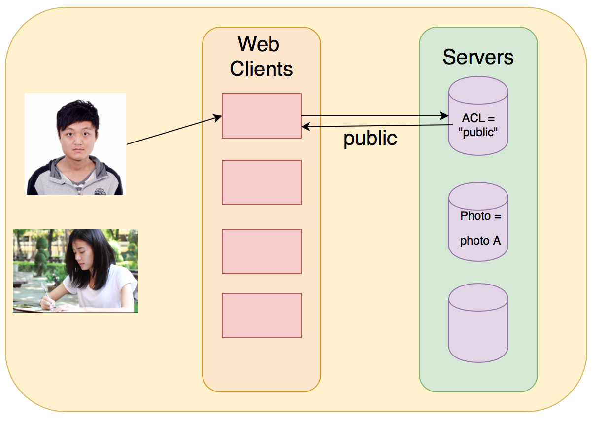
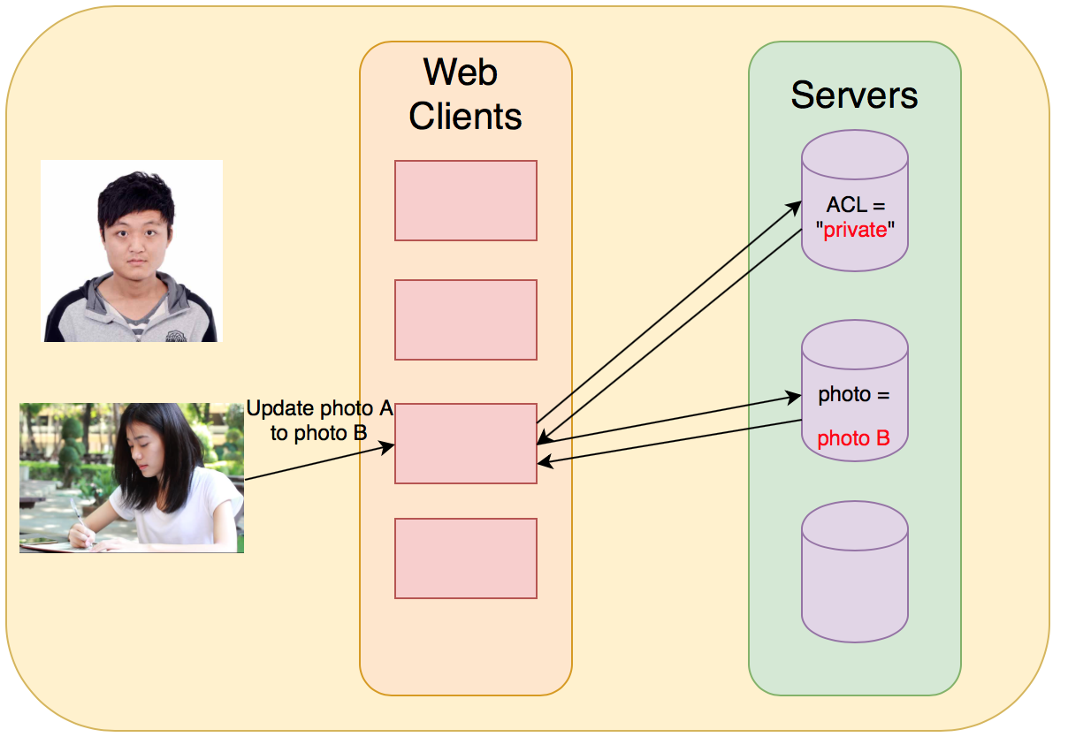
Motivation and background
When data is spread across machines, reading to different shards will arrive at different times and see different views of the data store.
When two transactions are concurrent there , the transactions may not ensure isolation.
Guarantee “Power”
Result:
I load Photo B (public)

Slide 5
The “SNOW” theorem
Non-blocking operations
Reduce Latency
One-response from each shard
VS
Strict serializability
Guarantee “Power”
Write transactions

Slide 6
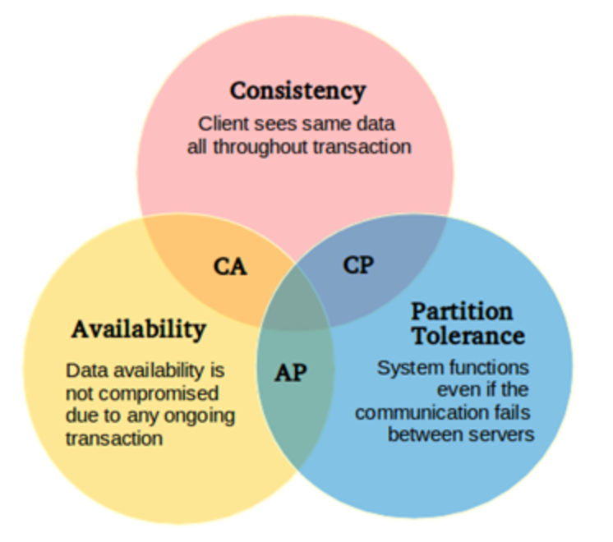
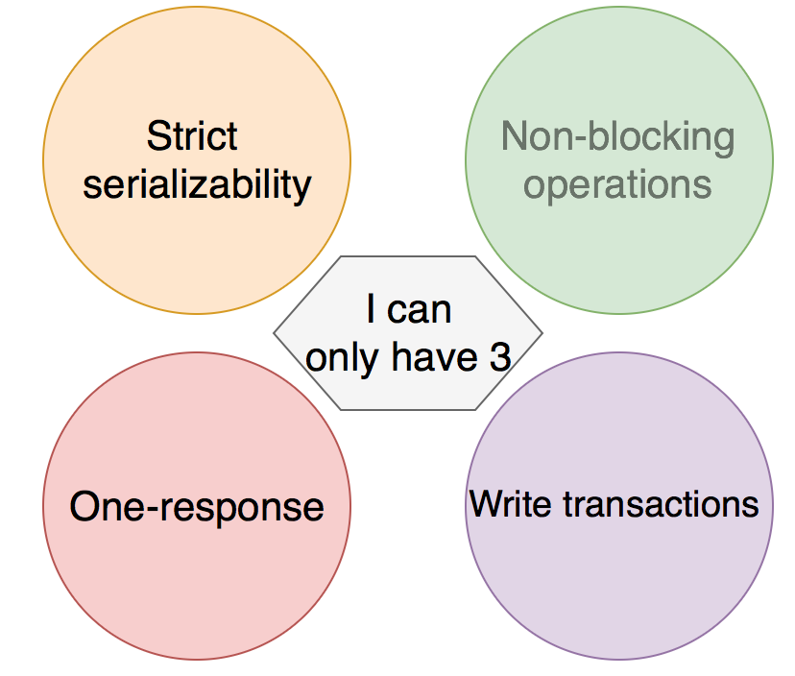
The “SNOW” theorem
“CAP” theorem(CAP is impossible)
“SNOW” theorem(SNOW is impossible)
Reference: https://www.developer.com/java/data/getting-started-with-mongodb-as-a-java-nosql-solution.html

Slide 7
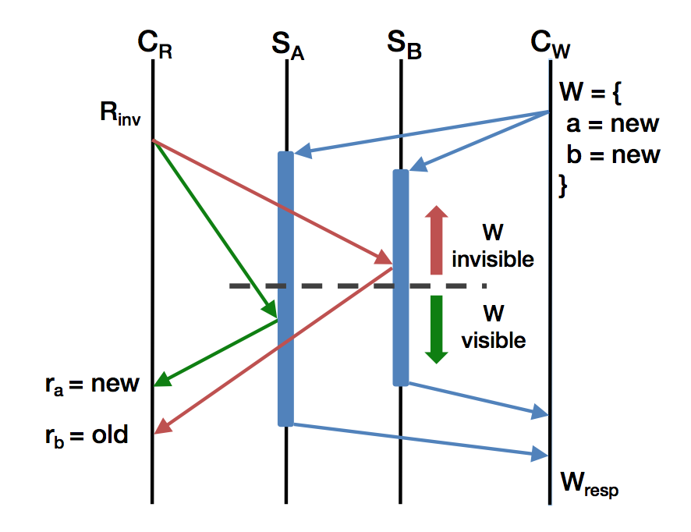
The “SNOW” theorem
Lemma 1. The default behavior at servers returns values that are used by clients.
Lemma 2 Servers initially return old by default.
Lemma 3. Servers eventually return new by default.
Corollary 4. There exists a transition at each server be- tween defaulting to old and defaulting to new.
R_{a =} new R_{b} = old
“SNOW” is impossible!
Reference: The SNOW theorem and latency-optimal read-only transactions, Lu, et.al. Proceeding OSDI'16 Proceedings of the 12th USENIX conference on Operating
Systems Design and Implementation Pages 135-150

Slide 8
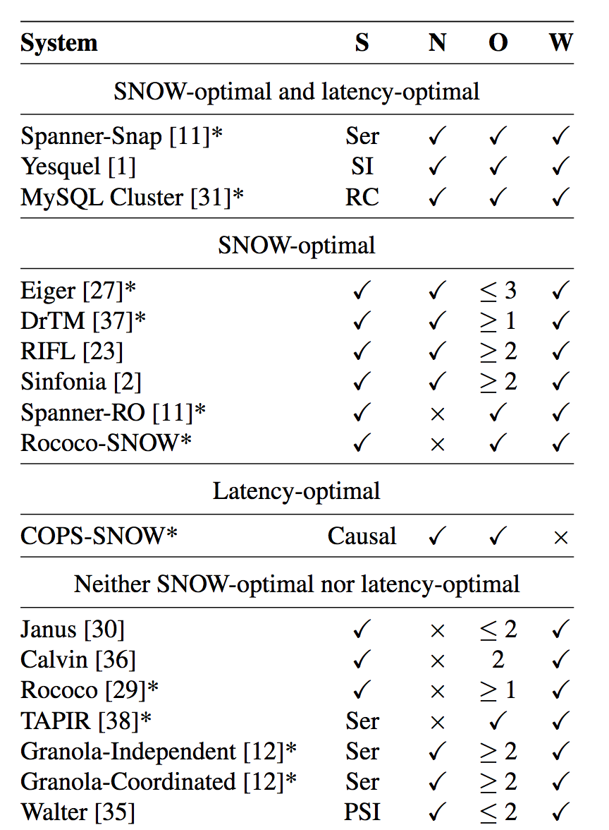
The “SNOW” theorem
SNOW-Optimal: 3 of S,N,O,W
LATENCY-Optimal: N + O.
Read >> Write
Sacrifice
Write!
Reference: The SNOW theorem and latency-optimal read-only transactions, Lu, et.al. Proceeding OSDI'16 Proceedings of the 12th USENIX conference on Operating
Systems Design and Implementation Pages 135-150

Slide 9
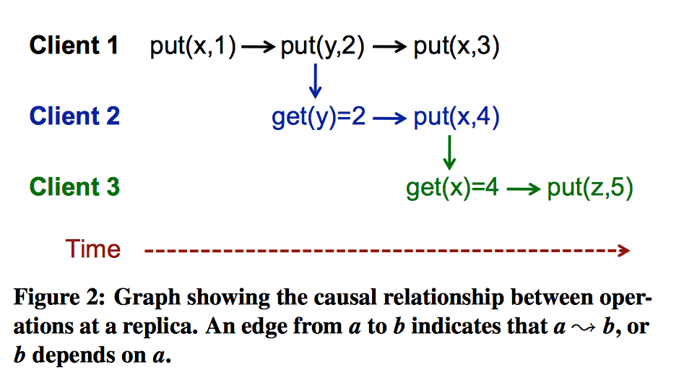
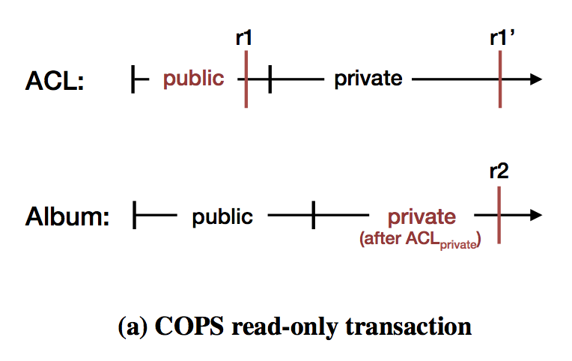
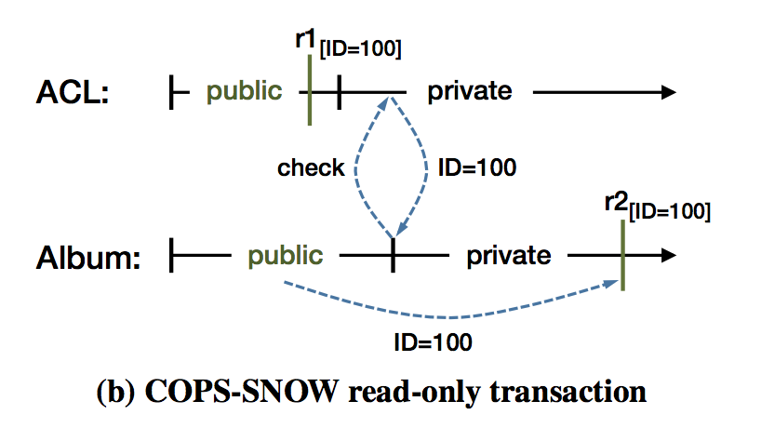
COPS-SNOW design and Rococo-SNOW design
causally consistency
ACL:a Album:b a₁->b₁
r1(public):a₀ r1(private):a₁ r2(public):b₀ r2(private):b₁
Strict serializability :
Real-time ordering => returns the most recent values.
Causally consistency :
Process ordering => may not return the most recent values
Both Casual and Strict guarantee Isolation.
Reference: Don’t Settle for Eventual:Scalable Causal Consistency for Wide-Area Storage with COPS, Wyatt Lloyd

Slide 10
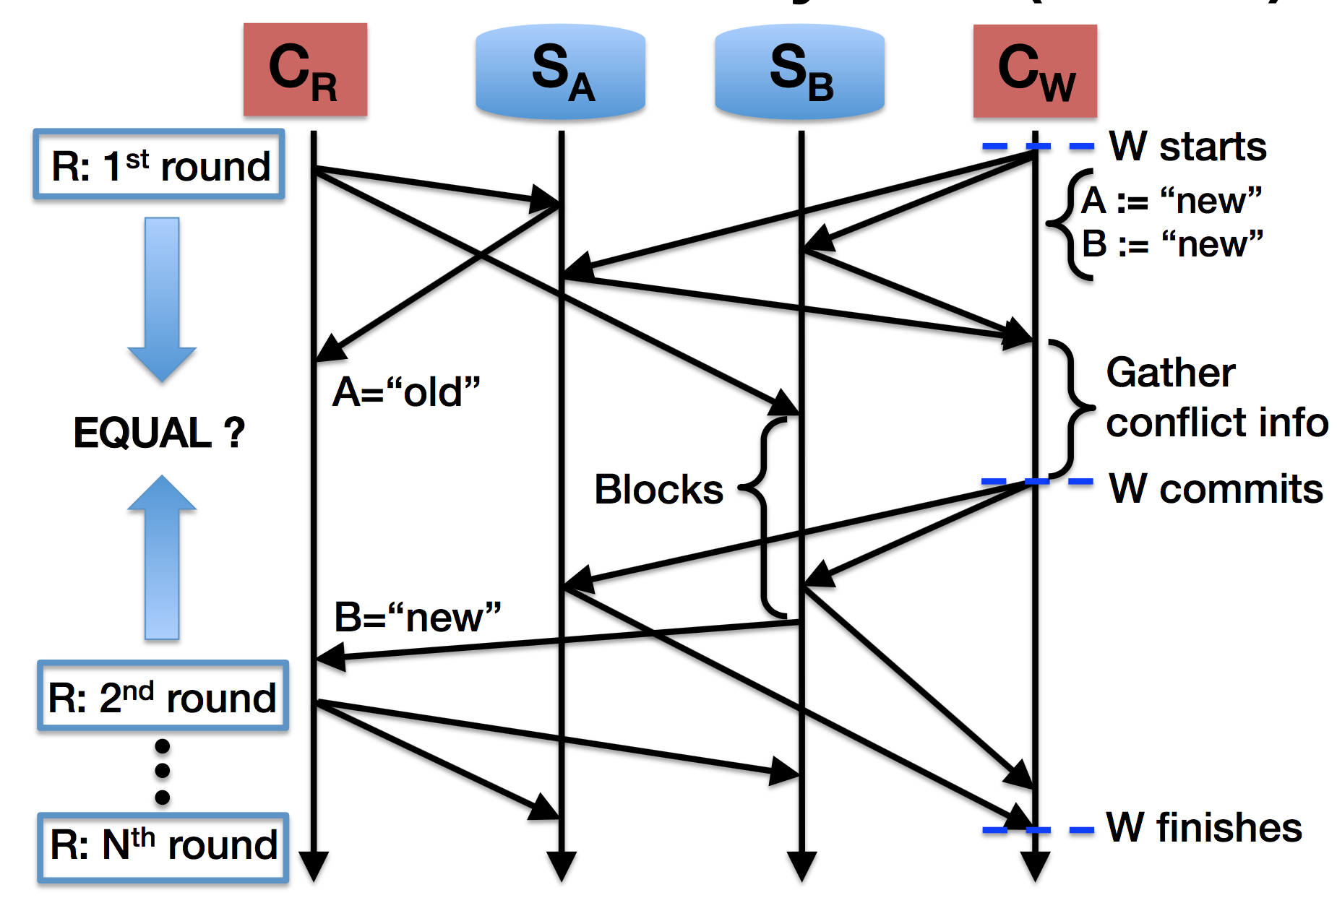
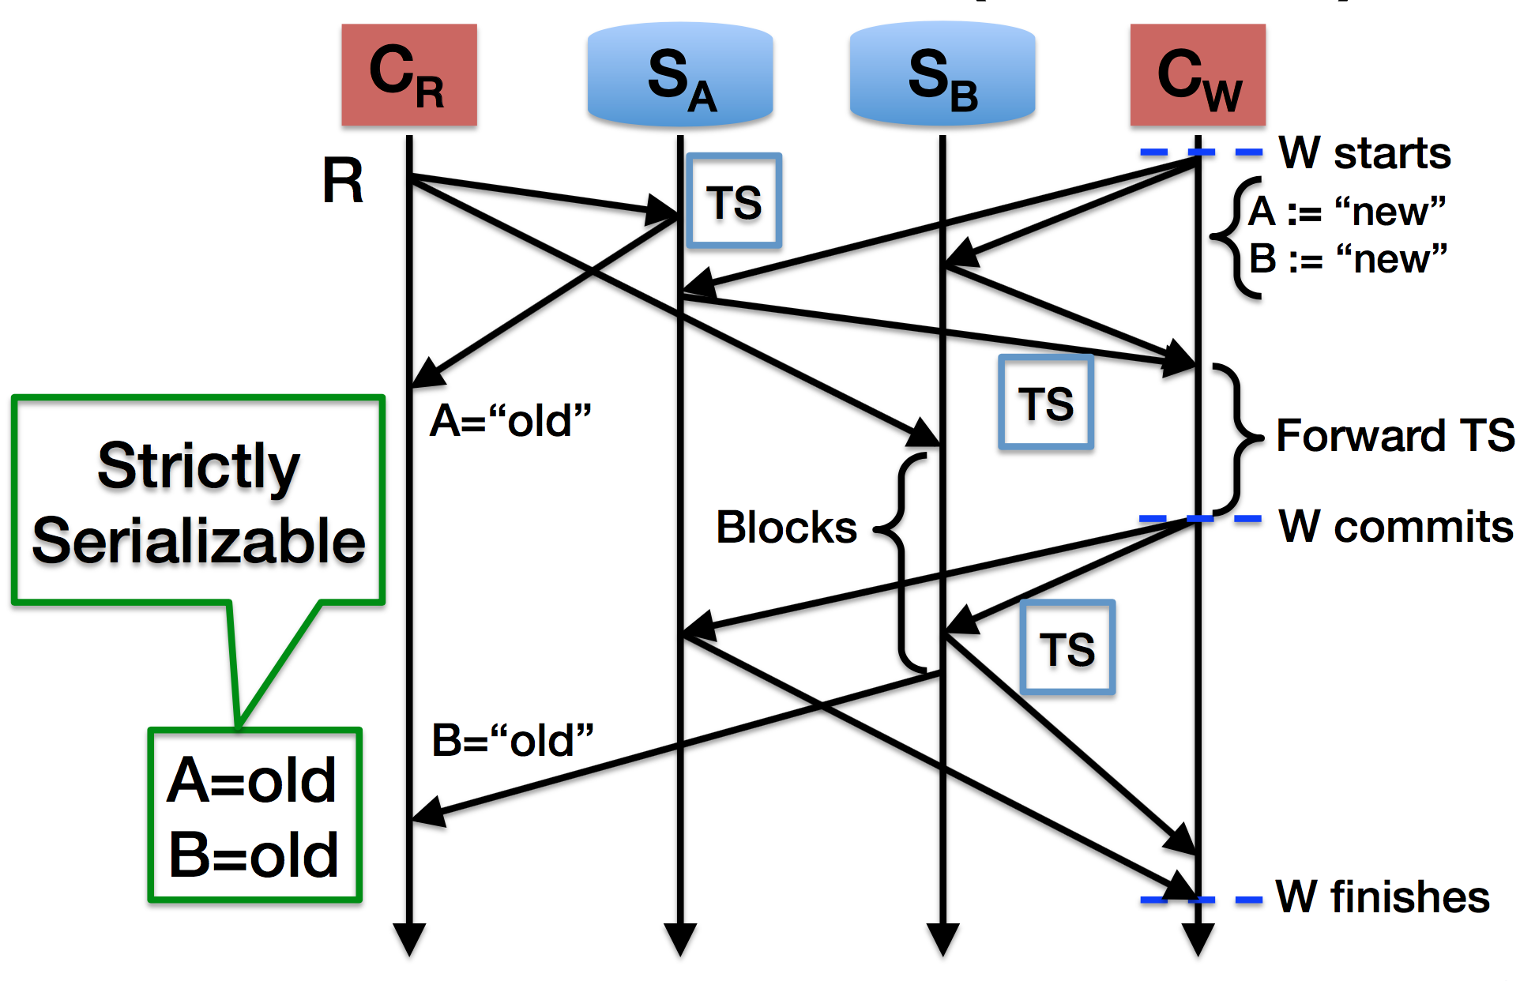
COPS-SNOW design and Rococo-SNOW design
The second round is identical, and Rococo considers the read-only transaction successful only if both rounds read the same values.
Reference: https://www.usenix.org/sites/default/files/conference/protected-files/osdi16_slides_lu_haonan.pdf

Slide 11
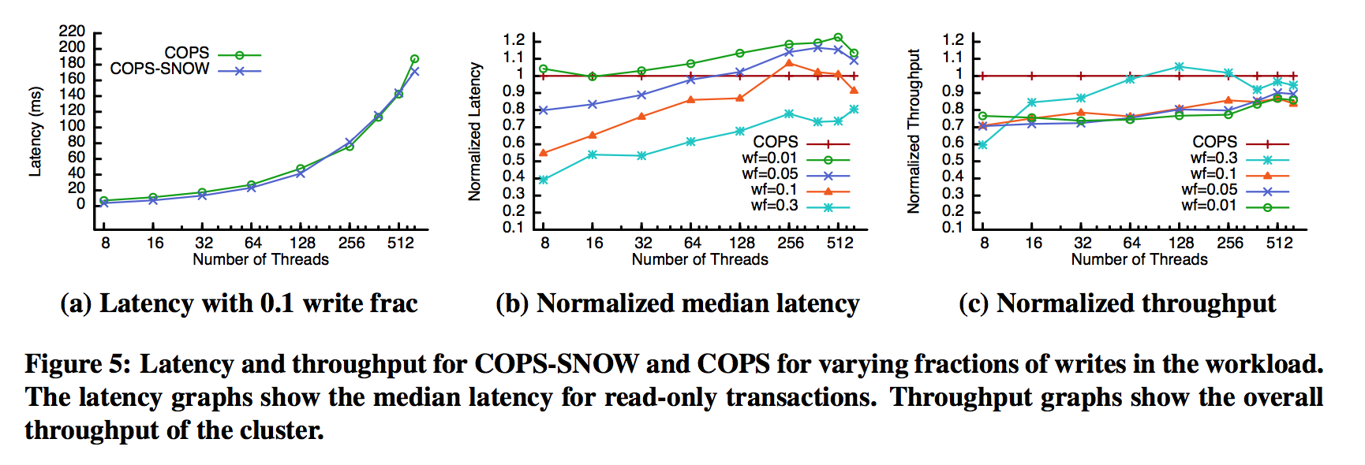
Evaluation of the results(COPS-SNOW)
COPS-SNOW achieves low latency at the cost of lower system throughput.
COPS-SNOW has a latency advantage that increases as read-only transactions increase
Reference: The SNOW theorem and latency-optimal read-only transactions, Lu, et.al. Proceeding OSDI'16 Proceedings of the 12th USENIX conference on Operating
Systems Design and Implementation Pages 135-150

Slide 12
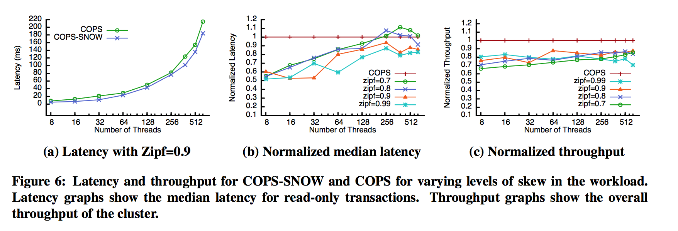
Evaluation of the results(COPS-SNOW)
SIPF: Describe the data gets distributed more or less evenly
COPS-SNOW has an increasing latency advantage as the workload becomes more skewed.
throughput disadvantage of COPS-SNOW decreases slightly as the workload becomes more skewed.
Reference: The SNOW theorem and latency-optimal read-only transactions, Lu, et.al. Proceeding OSDI'16 Proceedings of the 12th USENIX conference on Operating
Systems Design and Implementation Pages 135-150

Slide 13
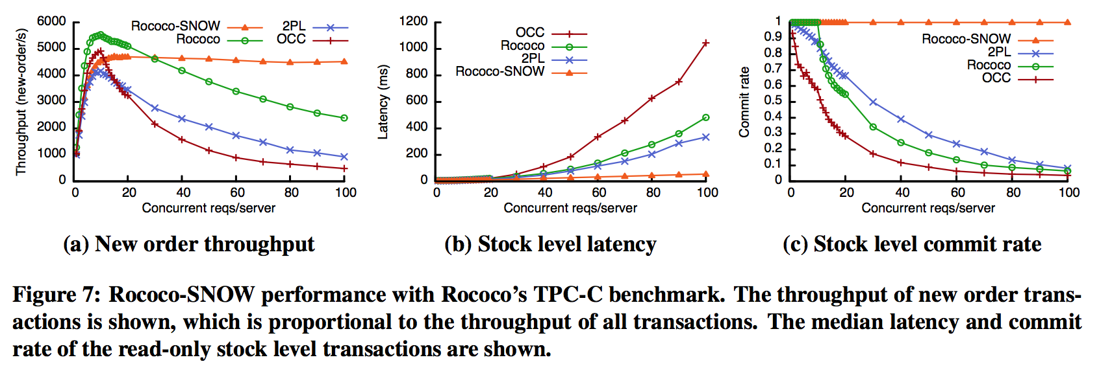
Evaluation of the results(ROCOCO-SNOW)
Rococo-SNOW provides lower peak throughput than Rococo. because with so few requests Rococo-SNOW makes the write algorithm more complex.
Rococo-SNOW provides lower latency and higher throughput as the reqs/servers increases.
Reference: The SNOW theorem and latency-optimal read-only transactions, Lu, et.al. Proceeding OSDI'16 Proceedings of the 12th USENIX conference on Operating
Systems Design and Implementation Pages 135-150

Slide 14
Take Away
The “SNOW” is impossible
There is a fundamental trade-off between the power and latency of read-only transactions
Help understand existing read-only systems.
Help avoid trying to improve systems that we cannot(beyond SNOW).
Two new systems COPS-SNOW (Latency-optimal) and Rococo-SNOW(SNOW-optimal).
Both reduce the read latency at the cost of makes the write algorithm more complex.

Slide 15
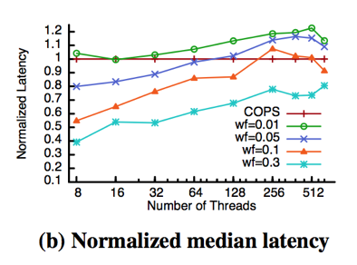
Discussion
Why COPS-SNOW reduce so much latency (less than half of COPS)?
Why the latency increase above the COPS as the number of threads increase? What is the overload?
Do you think the prove of ”NO SNOW” is perfect? Why?

Slide 16
An Evaluation of Distributed Concurrency Control
Presenter: Xinzhou Zhao

Slide 17
Background & Main purpose
Data generation and query volumes are outpacing the capacity of single-server DBMS
Organizations are increasingly partitioning data across several servers
Quantify the effects of distribution on concurrency control protocols in a distributed environment
Evaluated 6 classic and modern protocols
In-memory distributed database evaluation framework-- Devena

Slide 18
Deneva

Slide 19
Transaction Protocols
Two-phase Locking (2PL) [NO_WAIT, WAIT_DIE]
Timestamp Ordering [TIMESTAMP, MVCC]
Optimistic [OCC]
Deterministic [CALVIN]
Two-Phase Commit (2PC)

Slide 20
CALVIN

Slide 21
EVALUATION
Table partitions are loaded on each server
A load of 10,000 open client connections per server
Measure throughput as the number of transactions successfully completed after the warm-up period

Slide 22
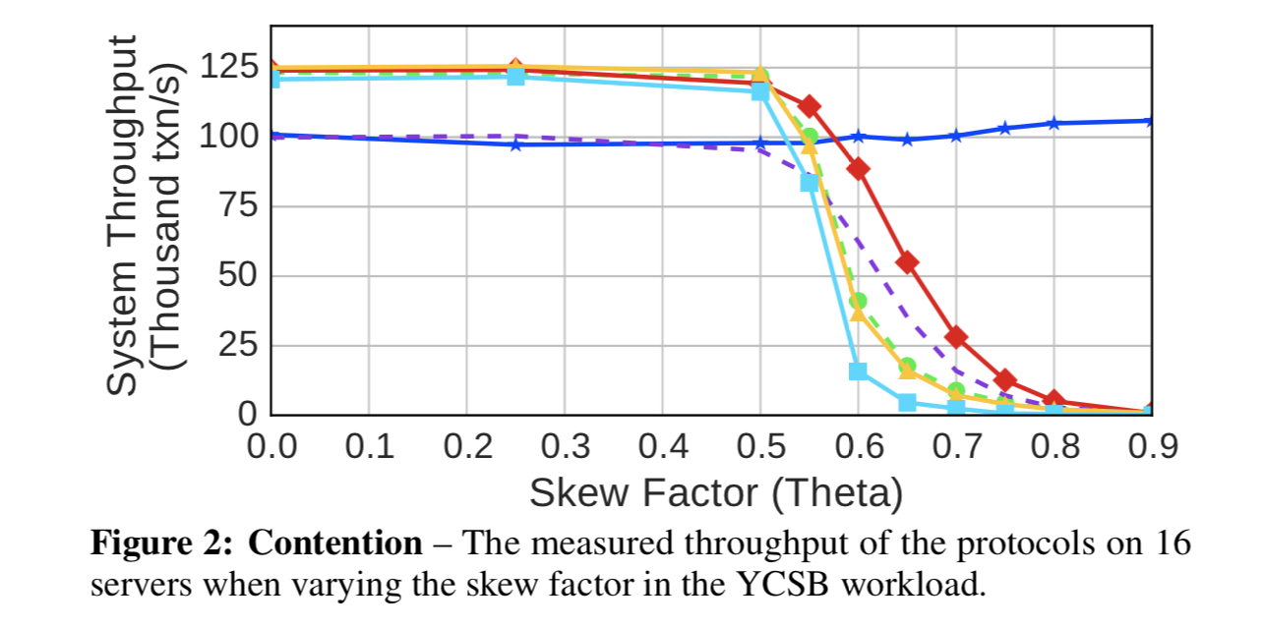
Contention

Slide 23
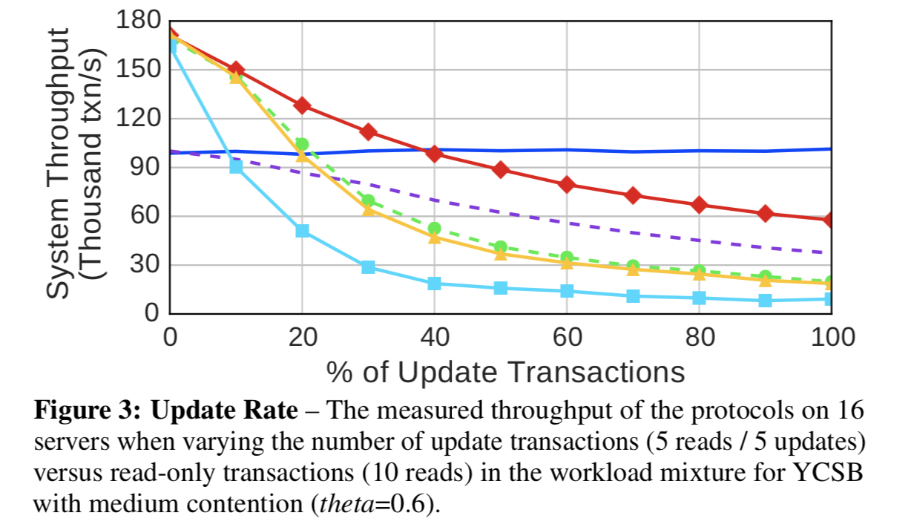
Update Rate

Slide 24
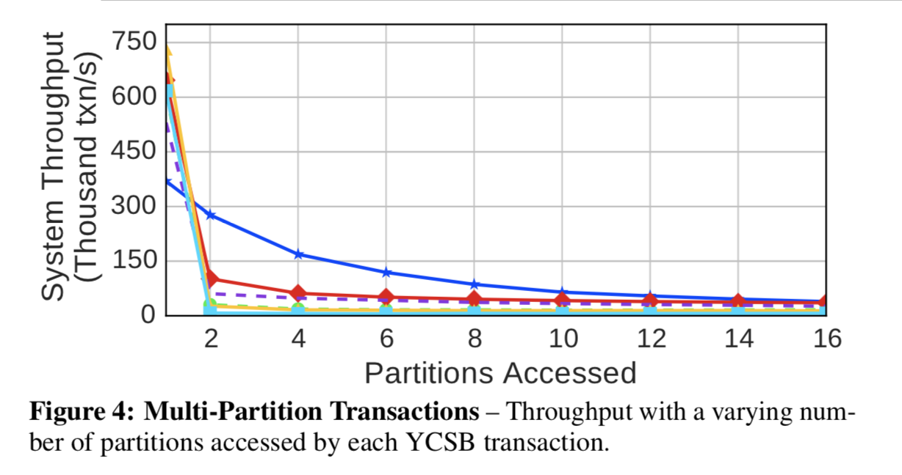
Multi-Partition Transactions

Slide 25
Scalability

Slide 26
Scalability

Slide 27
Scalability

Slide 28
Distributed DBMS Bottlenecks

Slide 29
Potential Solutions
Improve the Network
Adapt the Data Model
Seek Alternative Programming Models

Slide 30
Thoughts & Discussion Points
More bottlenecks of distributed DBMS
More solutions to the bottlenecks
As soon as a transaction acquires all of its locks, a worker thread executes it right away and then releases the locks immediately afterward. This means that locks are not held long enough for the scheduler to process conflicting transactions.

Slide 31
Discussion
Haoyu Wang
CS525
Advanced Distributed System
University of Illinois

Slide 32
Deneva
Do you think the experiment is well-designed
Matrices chosen
Fairness
Other

Slide 33
Deneva
Fault-tolerance
Is this assumption good enough
Any influence on concurrency control protocol evaluation

Slide 34
Deneva
Problem:
How to improve the testing system itself (Deneva)
Possible Approaches:
Execution Engine
Storage Engine
Modularity
Timestamp

Slide 35
Snow
Can you be persuaded if the tightness of the theorem only by few examples?
If not, how could we use the simple example to illustrate any combinations of three properties can be possible

Slide 36
Snow
Write transaction
Read-only transaction?
Write-heavy transaction?
Mixture?

Slide 37
Snow
Open Question:
The spectrum of SNOW theory
i.e. What is the minimum round of read to guarantee SNW
What is the strongest consistent model can be reached to guarantee NOW

Slide 38
Thank you！！

