Slide 1
Spanner: Becoming a SQL System
David F. Bacon et al.
Google, Inc.
Presenter: Che-Lin Huang

Slide 2
Overview
Motivation
Introduction to Spanner
Distributed Query
Query Range Extraction
Query Restart
Common SQL Dialect
Thoughts
Takeaway

Slide 3
Motivation
Bigtable (2006)
Key-value storage system
Difficult to build online transaction processing application without strong schema, cross-row transaction, consistent replication and a powerful query language
Megastore (2011)
Transaction processing system build on top of Bigtable
Lack many relational database features such as a robust query language
Spanner (2012)
Distributed data storage not yet support SQL query interface until 2017

Slide 4
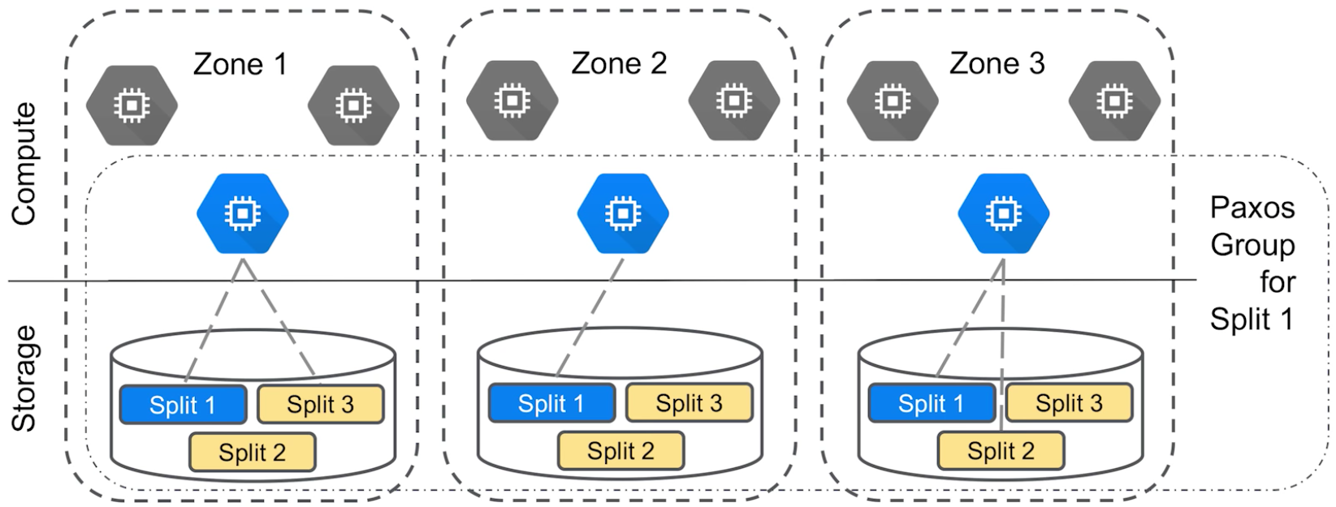
Introduction to Spanner
Use Paxos consensus algorithm to agree on transaction
Consists of Paxos groups, each shard assign to one Paxos group
Writes must initiate the Paxos protocol at the leader
Reads can be done at any replica that is sufficiently up-to-date, otherwise need to check with leader
Source: Presentation slides of Google Cloud Next '17- "Cloud Spanner 101"

Slide 5
Introduction to Spanner
Coprocessor framework, a special RPC framework:
determine which Paxos group own the data
find nearest replica of that group that is sufficiently up-to-date
Use a combination of pessimistic locking and timestamping for concurrency control
Source: Presentation slides of Google Cloud Next '17- "Cloud Spanner 101"

Slide 6
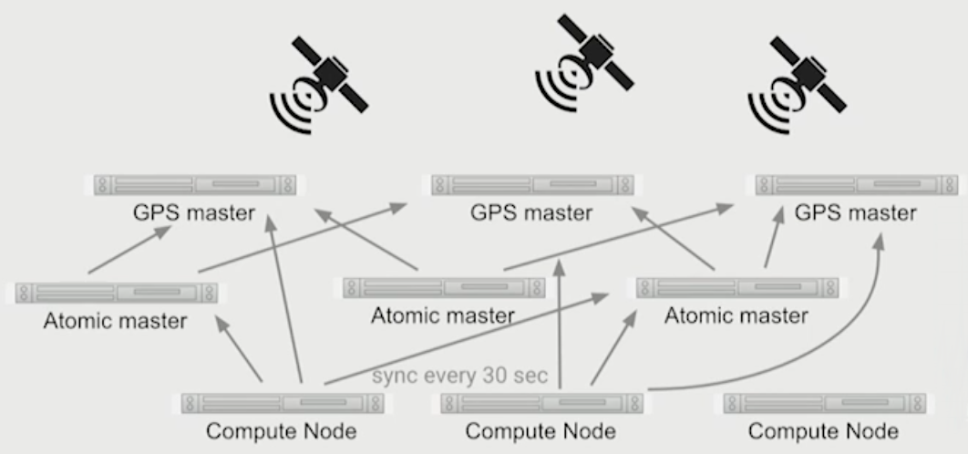
Introduction to Spanner
TrueTime represents time as an interval $\left[t−ε,t+ε\right]$ with $\overline{ε}=4ms$
Error bound $ε$ depends on worst-case local clock drift, time-master uncertainty and communication delay to the time masters
Implemented by set of time master, majority time masters have GPS clock, others have atomic clock
Read time from a quorum of time master
Source: Presentation slides of DEVOXX '17- "Spanner - a fully managed horizontally scalable relational database"

Slide 7
Introduction to Spanner
Spanner enforce external consistency invariant:
If the start of a transaction T₂ occurs after the commit of a transaction T₁, then the commit timestamp of T₂ must be greater than the commit timestamp of T₁
Acquired locks
Release locks
T
Pick s = TT.now().latest
s
Wait until TT.now().earliest > s
Commit wait
average ε
average ε
Source: Presentation slides of OSDI '12 - "Spanner: Google’s Globally-Distributed Database"

Slide 8
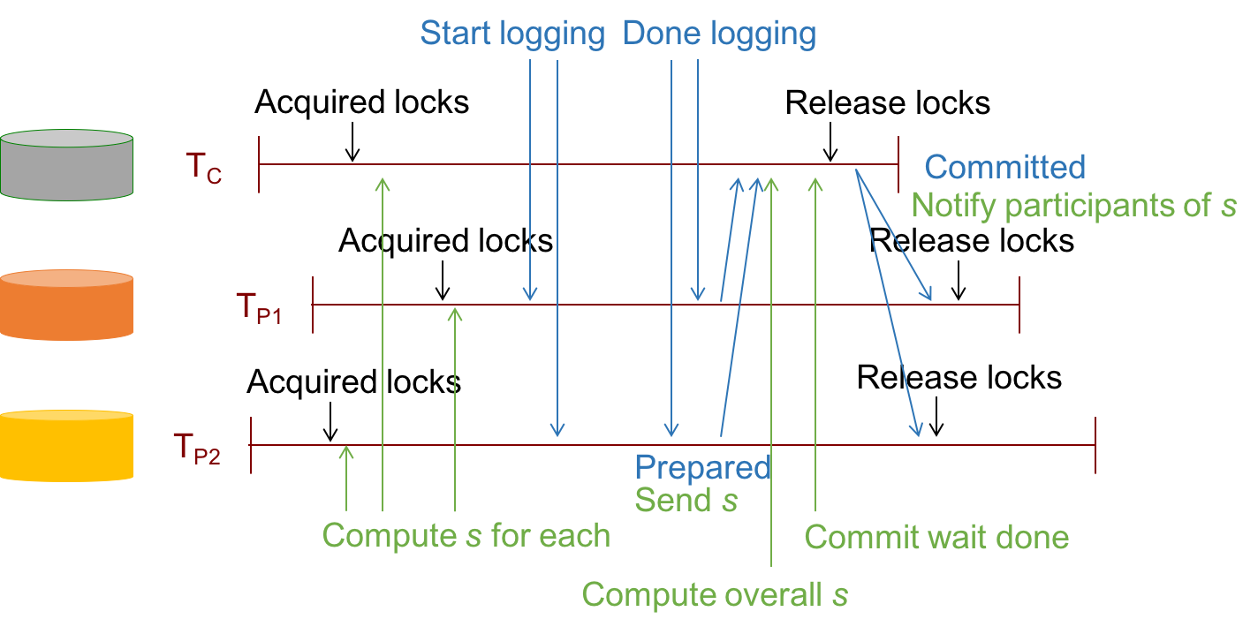
Introduction to Spanner
For write transaction, use two-phase locking ensures serializability within Paxos group, while two-phase commits ensure serializability across the database
Source: Presentation slides of OSDI '12 - "Spanner: Google’s Globally-Distributed Database"

Slide 9
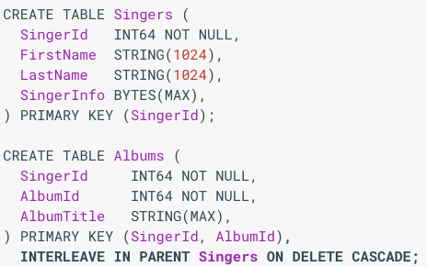
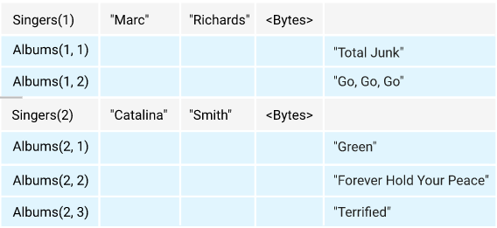
Introduction to Spanner
Parent-child relationship between tables:
Child table can be co-located and interleave with parent table
Schema example defines Albums as a child of Singers Physical layout of rows of Singers and its child table Albums
Source: https://cloud.google.com/spanner/docs/schema-and-data-model

Slide 10
Distributed Query - Compilation
Query compiler uses traditional approach of building relational algebra operator tree and optimizing it using equivalent rewrite
Distributed union: ship subquery to shards and concatenate results
$$Scan\left(T\right)⟹DistributedUnion[shard⊆T](Scan(shard))$$
Partitionability for a relational operation $F$requires:
$$F\left(Scan\left(T\right)\right)=OrderedUnionAll\left[shard⊆T\right]\left(F\left(Scan\left(shard\right)\right)\right)$$
For the aggregate expression $Op=OpFinal∘OpLocal$
$$Op\left(DistributedUnion[shard⊆T]\left(F\left(Scan\left(shard\right)\right)\right)\right)=OpFinal\left(DistributedUnion[shard⊆T]\left(OpLocal\left(F\left(Scan\left(shard\right)\right)\right)\right)\right)$$
Join between same prefix of primary key are pushed below Distributed Union

Slide 11
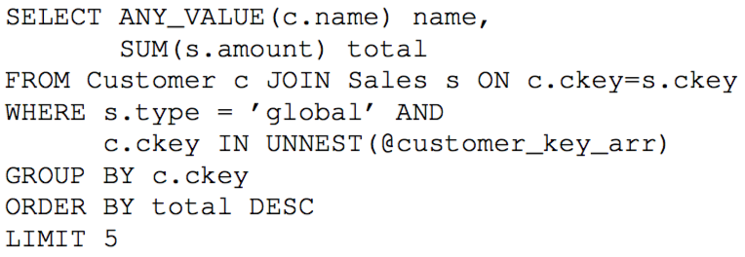
Distributed Query - Query Plan
Distributed query plan for the following SQL query
Source: Spanner: Becoming a SQL System, David F. Bacon et al, SIGMOD 2017

Slide 12
Distributed Query - Execution
Runtime analysis to extract a set of shard key range
Send subquery to minimal relevant shards
If key range cover whole table, send subquery to servers that hosting multiple shards of target table
Dispatch subqueries in parallel to reduce latency
Parallelized between subshard for large shards
Detect if target shards are host locally to avoid making remote call

Slide 13
Distributed Query - Join
Naïve implementation of apply-style joins is expensive:
Cross-machine call per row
Use batched apply join to minimize cross-machine call
Distributed Apply performs shard pruning using following steps:
Extract sharding key range using column values from each row
Merge sharding key range for all rows
Compute minimal set of shards to send the batch
Construct minimal batch for each shard
Enroll table
NetID | Course
clhuang1 | CS 525
clhuang2 | CS 425
Student table
Name | NetID
John | clhuang1
Jerry | clhuang2
Jack | clhuang3
Joey | clhuang4
NetID | Course
clhuang3 | CS 325
clhuang4 | CS 225
Example SQL join query involves student and enroll table:
SELECT *
FROM Student s JOIN Enroll e on s.NetID = e.NetID
NetID | Course
clhuang5 | CS 125

Slide 14
Query Range Extraction
Distributed range extraction
What table shards are referenced by query
Seek range extraction
What fragments of relevant shard to read
Lock range extraction
What fragment of table to be locked
Checked for potential pending modification
Ranges given param1 = P001 param2= 2017-01-01:
(P001)
(P001, /proposals/doc1, 2017-01-01), (P001, /proposals/doc2, 2017-01-01)
(P001, /proposals)
Source: Spanner: Becoming a SQL System, David F. Bacon et al, SIGMOD 2017

Slide 15
Query Restart
Transient failures: network disconnects, machine reboots, process crashes, distributed wait and data movement
Spanner transparently resumes execution of query if transient failures
Redo minimum work after restarting from transient failure
Benefit:
Improved tail latency for online request
Zero downtime for schema change and Spanner upgrade

Slide 16
Common SQL Dialect
A common data model, type system, syntax, semantics, and function library shared within systems in Google
Google SQL library:
Shared compiler front-end
Shared library of scalar functions
Shared testing framework: compliance tests and coverage tests
Compliance tests: developer written tests
Coverage tests: random query generation tool and a reference engine

Slide 17
Thoughts
Although Spanner is relational database system, some design consideration is different from traditional relational database system
Choice of primary key and it’s value
Interleave a table or not
No experimental data? Here are some:
A year after Spanner switch to a common Google-wide SQL dialect, the SQL query volume increased by a factor of five
Over 5,000 databases run in production instances
Tens of millions of query per second across all Spanner databases
Managing hundreds of petabytes of data
Any possible drawback of Spanner?

Slide 18
Takeaway
Spanner combine OLTP, OLAP, and full-text search capabilities in a single system
Shard boundaries change dynamically for load balancing and reconfiguration, thus require a communication layer to route queries
Trade offs for seek and lock range extraction, need judicious algorithm
Query restart upon transient failures, which simply the client’s work on dealing with failures

Slide 19
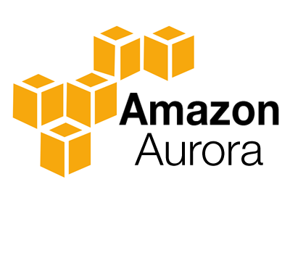
Amazon Aurora:
Design Considerations for High Throughput Cloud-Native Relational Databases
Alexandre Verbitski et al.
Amazon Web Services
Presenter: Wen-Chen Lo

Slide 20
What is Aurora and Why Amazon built Aurora?
Aurora is a relational database as part of Amazon Web Services especially designed for high throughput workloads
It is built based upon InnoDB (database engine for MySQL) with new design consideration
Easy for migration: marketing policy

Slide 21
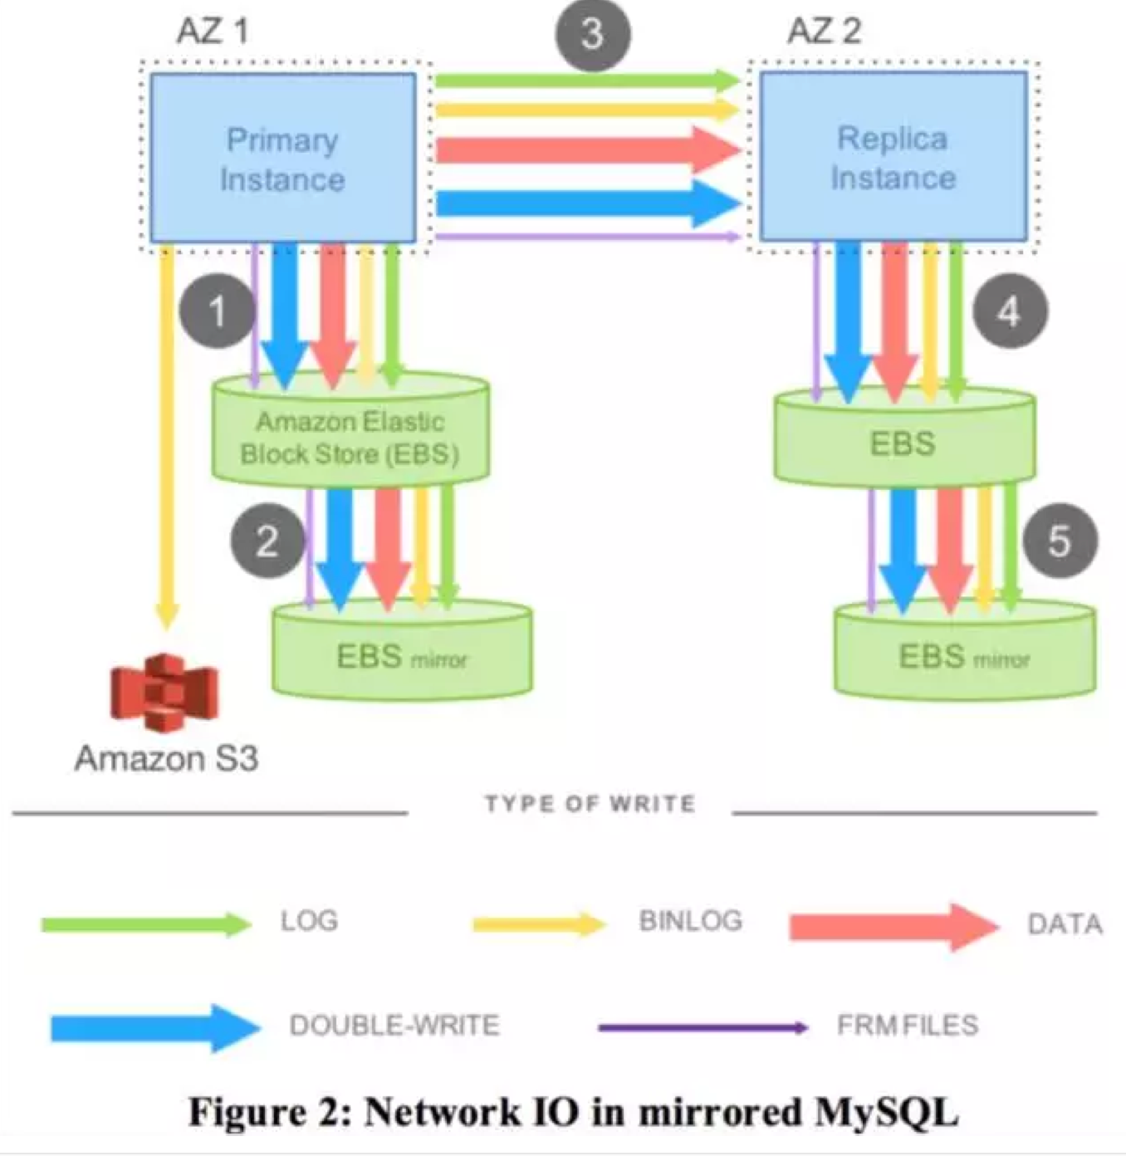
Motivation
Game changes in the Cloud
Resource is on demand in the cloud
Throughput is highly important
Resilient to failure
Traditional design of database is not desirable
Too many synchronous points
Chain replication
Replicated Block Device
High overhead in network I/O
Trouble with commits on synchronization protocols
Two-phase commit protocol is challenging
Source: A Verbitski et al.(2017). Amazon Aurora. SIGMOD '17

Slide 22
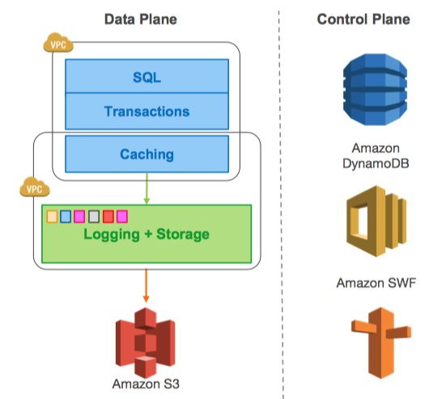
Design Consideration of Aurora
Decoupling storage from compute
Main constrain of throughput moves from compute and
storage to network
How to do decoupling?
Replace lower quarter of MySQL (file system) by a proprietary distributed storage system
Computing Tier:
Database logic
Maintain most traditional kernel: query processor, transactions, buffer cache, etc
Storage Tier:
Redo logging, durable storage, recovery, backup
Multi-tenant storage service
Three main design considerations
Using Quorum to ensure durability and availability when
correlated failures occur
Offloading redo processing to storage tier
highly asynchronous storage service
Source: A Verbitski et al.(2017). Amazon Aurora. SIGMOD '17

Slide 23
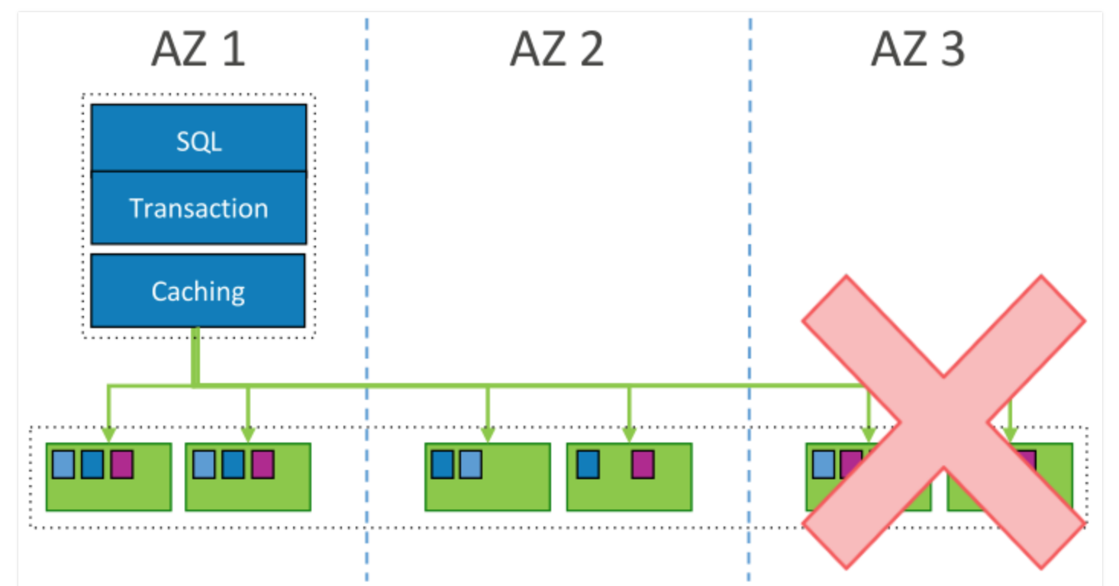
Quorum Model in Aurora
Read and write availability
V copies of replicated data
V r : # of read quorum; V w : # of write quorum
V r + V w > V
V w > V/2: avoids conflicting write
Aurora’s deployment
Storage deployed on three Availability Zone (AZ)
Two replica nodes on each AZ: 6 total replicas
How is the read/write availability?
The capability of fault tolerance
correlated failures up to AZ+1
High probability: Mean Time to Repair < Mean Time to Failure
10 GB segment can be repaired in 10 sec (10Gbps network)
Read availability

Slide 24
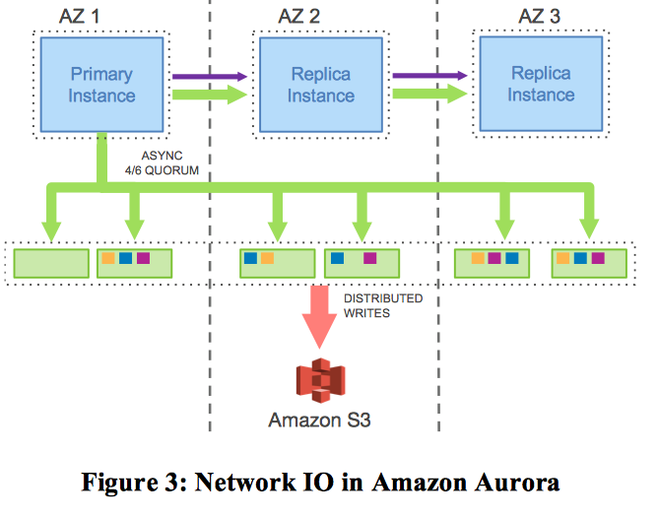
The Log is the Database
Redo log of traditional database
The log to transform in-memory before-image of page to after-image
Log applicator applies redo log when write operation is performed
Redo log is the only data type to write
From chain replication to star: reduce latency
Only propagate redo log: lower network I/O
Log applicator is pushed to storage tier
Write only workloads with 100GB data on r3.8xlarge EC2 instance
35x more
7.7x fewer
Source: A Verbitski et al.(2017). Amazon Aurora. SIGMOD '17

Slide 25
The Log is the Database (cont.)
Lazy page materialization
Materialization when
Read for current pages
Frequent page change
The advantage of offloading redo logs
Keep processing redo log in the background.
Utilize CPU resource wisely when foreground is busy.
Fast recovery
Source: A Verbitski et al.(2017). Amazon Aurora. SIGMOD '17

Slide 26
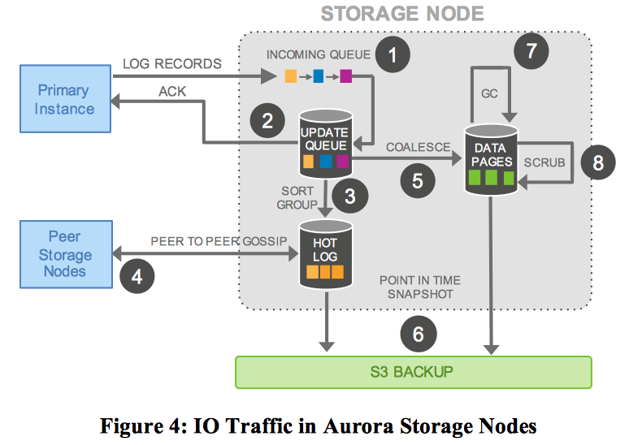
Design Points of Storage Service
Functionality
(1) Receive log record & add to an in-memory queue
(2) Persist record on disk and acknowledgement
(3) Organize records
(4) Gossip with peers to fill gaps
(5) Apply logs into new data pages
(6) Periodically backup log and pages
(7)(8) Examine and garbage collect old pages
Highly asynchronous
Only (1)(2) are synchronous
Other jobs are continuously running in the background
Minimize latency of write request
Source: A Verbitski et al.(2017). Amazon Aurora. SIGMOD '17

Slide 27
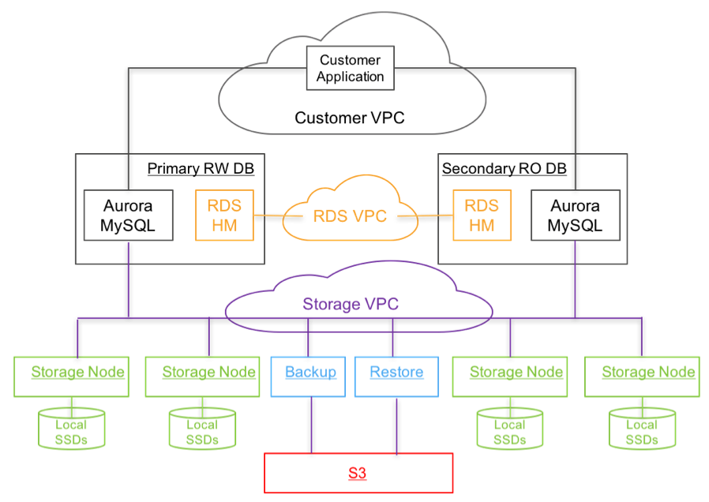
Putting it all together
Database engine is a fork from “community” MySQL
Unified view of storage is logically identical to local storage
Relational Database Service (RDS)
Control plane: Manage metadata
Host manager embedded in for monitoring
A single writer and multiple read replicas
One region, cross AZ
Three layers of Virtual Private Cloud (VPC)
Storage service deployed on EC2 clusters
S3 and DynamoDB for backup
Source: A Verbitski et al.(2017). Amazon Aurora. SIGMOD '17

Slide 28
Evaluation (Standard Benchmarks)
MySQL 5.6 & MySQL 5.7
r3.8xlarge EC2 instances with 32 vCPUs and 244GB of memory if not specify
Attached EBS volume with 30K provisioned IOPS
Buffer cache set to 170GB
Benchmarks: SysBench & TPC-C
Setups

Slide 29
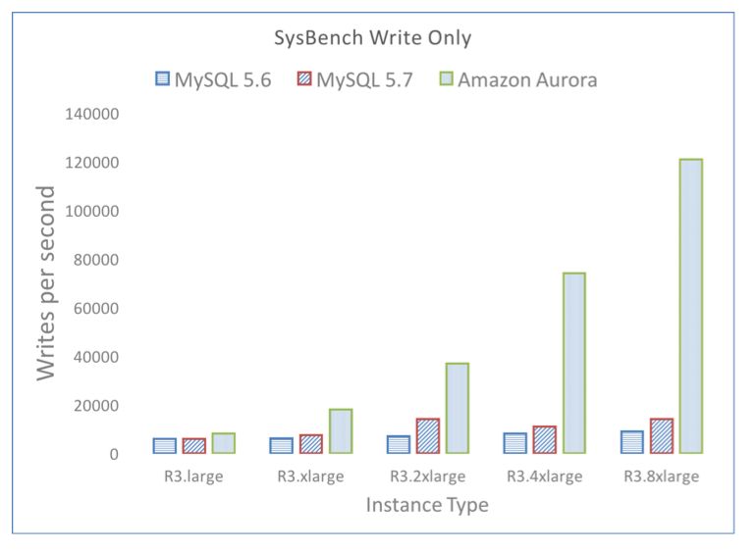
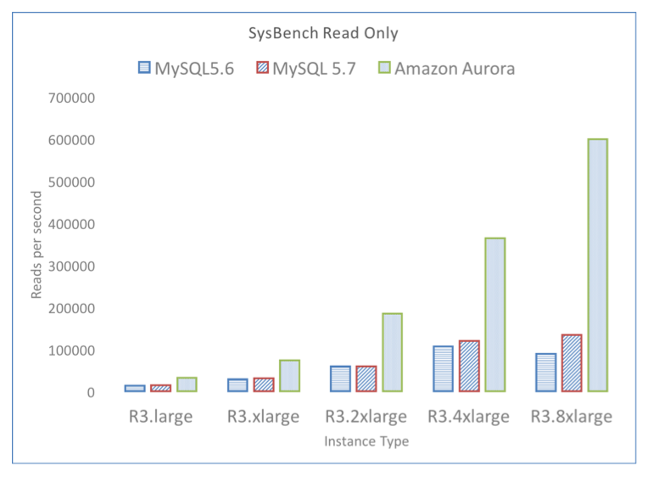
Write-only & Read-only workload (Aurora vs MySQL)
> 5x of MySQL
Aurora can scale linearly while MySQL cannot

Slide 30
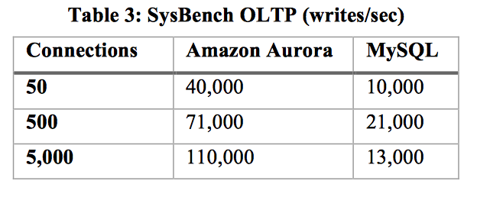
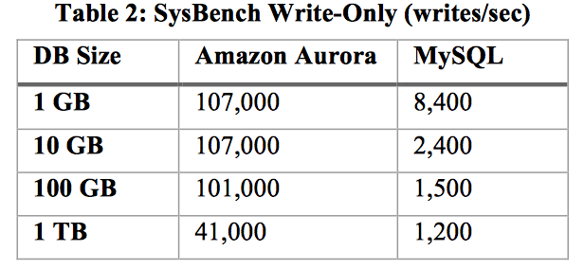
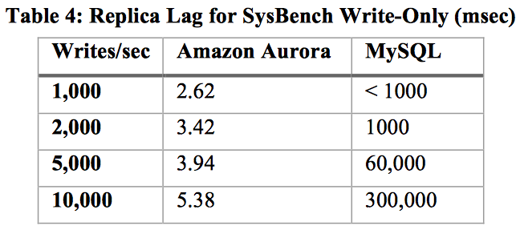
Scaling (Aurora vs MySQL)
Peak
Write-only and out-of-cache workload
growing
Up to 67x faster
Replica lag: time for committed transaction to be visible in the replica
34x faster
several orders of magnitude!

Slide 31
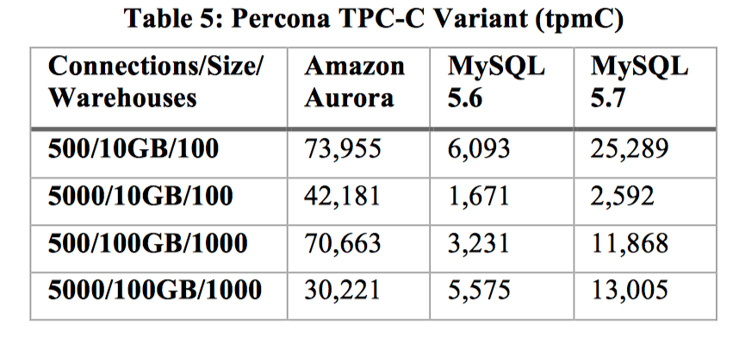
Throughput with hot row contention
Throughput 2.3x to 16.3x compare to MySQL

Slide 32
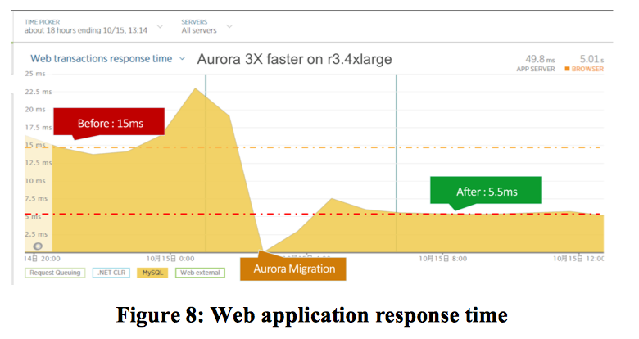
Evaluation (Real Customer Workloads)
An internet gaming company
Average response time for web transaction: 15 ms -> 5.5 ms after migration to Aurora

Slide 33
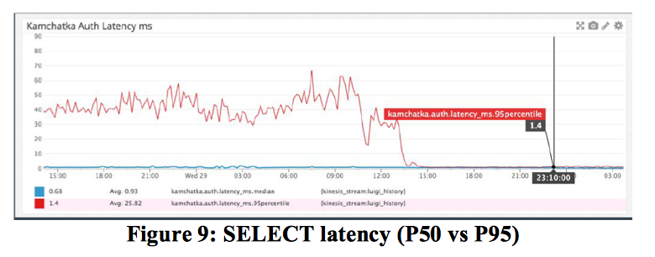
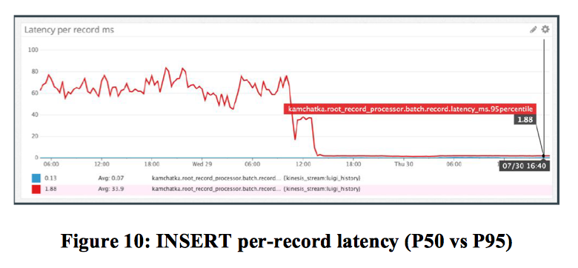
Evaluation (Real Customer Workloads)
An education technology company
P95 latency
P50 latency
After migration to Aurora, The P95 latency is almost equal to P50 latency
Prevent from poor outlier performance

Slide 34
Thoughts
Pros:
Decoupling of computing and storage makes the system flexible
Offloading redo log to storage significantly reduces latency
Multi-tenancy of storage service, reducing cost when scaling
Fast recovery and high availability (correlated failure is considered)
Fully compatible with MySQL. Migration cost is low
Support multiple secondary read-only instances, scalable for read
Cons:
The ability for complex query processing is week (community edition MySQL)
Only a single read-write primary instances, more suitable for read heavy workloads

Slide 35
Key Takeaways
Aurora is designed based on MySQL, easy for migration
Decouple storage from compute
Network I/O becomes bottleneck
Multi-tenant
Quorum model
Ensure durability and availability when correlated failure occurs
Minimize Mean Time to Repair
Offloading redo log processing to an independent storage service
Asynchronous: processing in the background
Aware of resource
Fast recovery

Slide 36
Discussion
Yifei Li
Notes:
Today we introduced two industry solutions in distributed database system. I checked the reviews piazza, and find that students are more interested in Google’s Spanner. Indeed, Spanner, as a one-fits-all database system, is a more mature system that involves years of development cycle. And there are some interesting aspect of this system that worth discussion. So we will start our first discussion now.

Slide 37
Spanner as a relational database
What gives Spanner the most performance boost as a relational database?
Query Compilation
Distributed Execution
Query Range Execution
Notes:
Spanner was originally designed to be a distributed data storage system, and it gradually develops into a fully-functional relational database. What gives spanner the most performance boost as a relational database?
Query Compilation: Partitionable. pushing operations down to each shard, then Union results at query executor.
Distributed execution: Add Locality. DistributedUnion function routes subquery to nearest replicas in nearest data centers.
Query Range Execution: Only extract entries that is relevant to query contents.

Slide 38
Spanner as a data storage
The original paper claims that Spanner provides externally consistent reads and writes, and globally-consistent reads across the database. This property ensures the correctness of distributed query executions. However, Spanner is highly specialized for Google’s read-heavy workload. If we want to adapt Spanner to other types of workload (i.e, write-heavy or read-write-balanced workload), what could be potential issues?
Notes:
Externally consistent means all transactions respect global real time ordering.
Spanner uses Paxos consensus protocol at top. It won’t incur much overheads in a read-heavy system but will potentially affect throughput on multiple writes.
And spanner relies on two-phase commit and two-phase locking for read/write transactions. The system will also experience a little performance degradation if the workload is more write-oriented.

Slide 39
Spanner’s synchronization
Spanner is the first distributed data storage system to use Global Synchronized Clock instead of a logical clock in other distributed data storages. Why would they make such design choice in the first place?
Notes:
One of the most innovative part of Spanner is using synchronized clocks to ensure external consistency.
In general, synchronized clocks can be used to avoid communication in a distributed system. For such a large system that has tons of data partitions across the world, logical clock would require more synchronization than real-time clock. Spanner’s External consistency requires monotonically increasing timestamps, synchronized clocks can satisfy this need. The data partition only need to “waiting out the uncertainty in time” to perform operations.

Slide 40
Aurora
Amazon develops the Aurora based on MySQL / InnoDB and evaluate their system against traditional relational database. However, as many people discussed in the piazza post, in terms of performance, Aurora’s potential competitor should to be Hadoop-based OLTP engine HBase and OLAP engine Impala. What do you think?

Slide 41
Lessons Learned
In industry, system developments are driven entirely by customers‘ need.
Building a great system requires efforts of multi-development cycles.

Slide 42
Thank you!

