Slide 1
PotPourri
Presented by: Ash Krishnan & Manasa Sanka
Scribed by: Aishwarya Nadella
University of Illinois at Urbana-Champaign

Slide 2
HotSpot: Automated Server Hopping in Cloud Spot Markets
Supreeth Shastri
David Irwin
Presented by: Ash Krishnan

Slide 3
Motivation
Problem: Spot VMs are cheaper than on-demand VMs but risk revocation
Many try minimize the risk of revocation spot VMs through:
Fault-tolerance mechanisms
Bidding strategies
Neither strategy takes price risk into account
Notes:
Due the current and predicted increase of spending in public clouds, platforms such as Amazon’s Elastic Compute Cloud (EC2) are encouraged to provision many different types of VMs with different levels of cost and performance.
On-demand instances can be purchased for a fixed rate per hour and provide uninterrupted service to the user. Spot instances are significantly cheaper alternatives to on-demand instances with the catch that they risk revocation by the provider. Users bid on spot instances and if their bid amount exceeds that of the spot price, they pay the spot price and receive the allocated VM. The price of the VM will occasionally fluctuate, according to the supply and demand of the spot market, and if the spot price rises above the bid price, the VM is revoked by EC2.
Because spot instances are so cheap, many try to minimize the risk and impact of revocation by utilizing bidding strategies or fault-tolerance mechanisms. These strategies treat revocations as failures and uses methods like checkpointing to limit the amount of work lost during a revocation.
Since prior work runs on a spot VM until a revocation occurs, the bidding strategy is also important in balancing high costs due to an increase in the spot price (when bidding too high) and the performance penalty from increased revocations (when bidding too low).
Neither of these strategies think to consider price risk, the risk that a VM’s price will rise relative to others.

Slide 4
Basic Definitions
Virtual Machine: Provides hardware virtualization_{[2]}
Container: Provides operating-system-level virtualization_{[2]}
Memory Footprint: Amount of main memory that a program uses or references while running_{[3]}
EC2 Compute Unit: Amazon’s measure of a VM’s integer processing power_{[1]}
Availability Zone: Separate, isolated datacenter in an AWS region_{[1]}
Notes:
· Container: Containers share the host system’s kernel with other containers, unlike VMs. For some particular reasons, we will be using containers in the implementation of HotSpot
· The memory footprint of a VM affects application performance. As the footprint size decreases, performance degrades.
· ECU: More ECUs indicate a larger, higher capacity instance type
· AZ: EC2’s spot market is complex: it sets a different dynamic spot price for each type of VM in each Availability Zone (AZ)

Slide 5
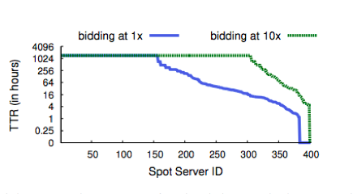
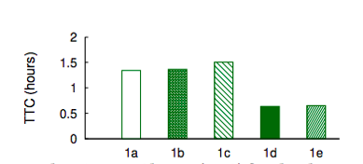
Importance of Price Risk
Average Time-to-Revocation for Linux spot VMs in EC2’s us-east-1 region when bidding at and 10x the on-demand price over a two month period [1].
Time-to-Change for the cheapest VM in each of AZs of the us-east-1 region over a two month period [1].
Applications more likely to experience price changes than revocations
Notes:
There is also no penalty for bidding, you pay the spot price and once the spot price exceeds your bid price, the VM is revoked. A simple strategy to evoke here would be to bid well-above the spot price (HotSpot bids 10x more than the on-demand price) to reduce the rate of revocation.
Here is a graph demonstrating the average Time-to-Revocation over a two-month period when bidding the on-demand price vs bidding 10x the on-demand price. We can see the vast majority of VMs have high TTRs. And that bidding 10x the amount is an optimal strategy. The average TTR for the 10x bid is 47 days.
This graph shows the average time until the price of the cheapest VM in the market changes, Time-to-Change (TTC). The cheapest VM changes every 1.1 hours. Since the average TTC is much less than the average TTR, applications are much more likely to experience a price change during their execution than a revocation.

Slide 6
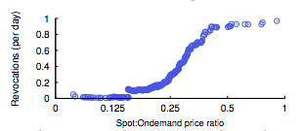
Revocation Risk
The x-axis is the spot-to-on-demand ratio, while the y-axis is the average revocation rate across spot VMs when the spot price is less than or equal to the x-axis value [1].
A side effect of minimizing price, is low revocation risk
Notes:
There is a relationship between a VM’s instantaneous revocation risk and the ratio of current spot price to its on-demand price. The lower the ratio of spot to on-demand price, the lower the rate of revocation. This is because the lower the ratio, the greater the change needed to balance supply and demand such that spot price rises above the on-demand price and a revocation is triggered. This relationship is demonstrated by the graph. We can clearly see that a side effect of minimizing cost, is a low revocation rate.

Slide 7
Summary
Market-level analysis
Price risk is more dynamic than revocation risk.
The lowest-cost VM tends to have a low revocation risk
A VM’s cost per unit of resource is independent of its capacity
Solution
VM hopping can lower cost without increasingly revocation risk or degrading performance
Notes:
· Price risk is more dynamic than revocation risk
· The lowest-cost VM tends to have the lowest revocation risk, as a high discount means low demand relative to supply
· A VM’s cost per unit of resource is independent of its capacity. So, HotSpot can manipulate its migration policy to favor higher-capacity containers as we’ll see later
This market analysis reinforces the solution that VM hopping, or dynamically selecting the lowest cost VM and self-migrating to it as prices change, reduces revocation risk and does not degrade performance. (THIS IS WHAT HOTSPOT DOES). The differences in price of an instance from time t0 to t1 reflect the cost savings possible from hopping VMs.

Slide 8
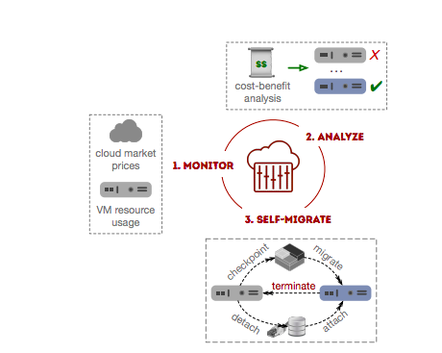
Design
Basic Control Loop
Monitors spot prices and application resource usage
Finds when and where to migrate to based on migration policy
Performs migration
[1]
Notes:
HotSpot is self-contained. It requires no external infrastructure or application modification because HotSpot’s functions are entirely embedded into its host VM, hidden from the user. By default, HotSpot runs only a single container per host VM, which has access to all of the VM’s resources. Applications execute inside this container.
A controller daemon runs on each host VM, which executes HotSpot’s monitoring, analysis, and migration functions. The source controller requests and spawns a new VM, based on the cost-benefit analysis, then migrates the container to it using stop-and-copy migration. Stop-and-copy means that it copies the source container’s memory state from the source VM to the destination VM without saving it to stable storage.
Control of the destination container is then given to the controller daemon running on the new host VM. The new controller then terminates the source VM.
While HotSpot is compatible with many systems-level virtualization technology, we use Linux Containers (LXC) for multiple reasons:
· Containers permit VM to VM migration without requiring explicit support from the cloud or VM hardware with less performance overhead than nested VMs
· Containers allow migrations to and from any VM
· Container migration is more efficient than VM migration

Slide 9
Migration Policy
Goal: Optimizes cost-efficiency, which is the cost per unit of resource an application utilizes per unit time
Determinants of Migration: Spot prices and resource usage determine when and where to migrate
Resource usage metric: Quantified by processor utilization
Performance Optimization: VMs with less memory than the current VM’s memory footprint are not considered
Notes:
Cost-efficiency is in units of dollars/ECU-utilized/hour. So, if a VM has a low average CPU utilization, then that increases the relative cost of the CPU capacity it utilizes.

Slide 10
Migration Policy: Expected Utilization
Determine which to seek
Seek higher CPU usage
Seek higher capacity
[1]
For every VM i, HotSpot finds the expected utilization based on the current VM’s utilization by considering low and high utilization
Notes:
The first step to calculating cost-efficiency if computing expected utilization, we can do this based on low and high utilization.
Low utilization:
If uc(t) is below the threshold (usually near 100%), we are wasting computing resources and thus increasing relative spot price according to our normalization of spot price over CPU utilization. If VM i has less ECU’s, more of VM i’s CPU will be utilized. For example, if VM c has 4 ECUs while VM i has 2, that means ECU utilization will double in the new VM I, bounded by 100% utilization. If VM i has more ECUs, less of VM i’s CPU will be utilized.
High utilization:
If uc(t) is above the threshold, we are not wasting computing resources! If VM i’s ECUs are less than that of VM c, we will have near 100% utilization. But if VM i has more ECUs, we make the extreme assumption that our application will utilize any number of ECUs. So we will always return 100% utilization in this case. From my understanding, it seems like if VM c’s CPU utilization is high enough, we can relax the condition of not wasting resources in order to obtain ECUs and more capacity to improve application performance.
If e is set high, we will always enter the second condition and we will be aggressively searching for higher capacity VMs. If e is set low, we are looking for improved CPU utilization.

Slide 11
Migration Policy: Cost-Efficiency
Goal to minimize
Encourage migration to higher capacity
[1]
We perform cost-analysis for each VM i which has better cost-efficiency than our current one
Notes:
We will perform cost-analysis for each VM i which is more cost-efficient than our current one.
In the denominator, we take into account, the number of ECU’s in VM i to encourage migration to higher-capacity VMs. If ui(t) is very low, relative spot price will increase, meaning the relative cost of the CPU capacity it utilizes increased. Thus, we are looking to minimize ei(t).

Slide 12
Cost Analysis: Transaction Cost
Time for migration
Time remaining in billing interval
[1]
The cost to migrate to a new VM at time t is a function of the cost of the new and current VM over the time to migrate
Notes:
This equation is the transaction cost to migrate to a new VM i at time t: the cost of the source and destination VMs over the migration period.
Two things HotSpot requires to estimate the transaction cost are:
· the time remaining Tr in the current billing interval (known)
· the time required Tm to migrate the container
The migration time Tm is a function of the container’s memory footprint and network bandwidth. Migration time related to downtime.
We take the maximum of Tr and Tm because we will be charged a fee if we try to vacate the VM before the billing interval ends.
A simplifying assumption is made that the new VM’s price stay fixed during the migration period (which is fine because migrations last average 100-150 seconds while TTC is 1.1 hours).

Slide 13
Cost Analysis: Expected Savings
Time to be spent in new VM
Encourages migration to higher capacity
[1]
The savings of migrating to VM i from VM c at time t is a function of expected utilization, cost-efficiency, and time spent in the new VM
Notes:
HotSpot estimates its expected cost savings Si(t) from migrating to a new host VM i at time t as the difference between the cost-efficiency on the current VM ec(t) and the new VM ei(t) (we want ei(t) to be smaller than ec(t) for positive savings).
We then multiply this value against the number of ECUs in the new VM i, which encourages hopping to higher capacity VMs, and against Ti, the time spent in the new VM.
The major unknown variable is Ti. This may be a downfall. Ti is extremely hard to estimate: to have an accurate estimate of Ti, HotSpot must be able to determine things like the spot prices of other VMs, future resource usage, and remaining lifetime of the container. This paper makes many simplifying assumptions regarding Ti such as that the containers are long-lived, when they could terminate before paying off their transaction costs. Ti is estimated as the maximum of the billing interval and average TTC. We used average TTC, because as soon as the cheapest VM changes again, we need to do this analysis all over again.
Finally, HotSpot may migrate to a more cost-efficient VM, incurring transaction costs during the migration, only to find an even more cost-efficient VM becomes available before it has recouped the previous transaction costs. So, we reduce the expected savings by taking into account our current VM utilization to account for this. So, in theory, HotSpot will only migrate to a new VM, if the benefit of moving to that new VM is greater than the cost of accumulated, unpaid transaction costs.

Slide 14
Experimental Evaluation
Implemented on EC2 and evaluated using:
A small-scale prototype
A simulation over a long period using a production Google workload trace and publicly-available EC2 spot price traces
Cost, risk, and performance are compared against:
On-demand VMs
Spot VMs without fault-tolerance (SpotFleet)
Spot VMs with fault tolerance (SpotOn)
Notes:
There are many possible time-varying variables, but this paper focuses on how price characteristics and application resource usage affects cost, performance, and revocation risk.
For application resource, use a job emulator that generates a fixed, predictable CPU load and memory footprint for our baseline job
For price control, generate synthetic spot price traces that reflect the real market
We compare HotSpot with three other approaches:
· on-demand VM (Current practice)
· spot VM (SpotFleet)
· spot VM plus fault-tolerance (SpotOn)
Job is run in Linux container and acquiring, migration, checkpoints HotSpot functions are performed. Graphs bar values reflect the percentage of the on-demand value. The error bars are maximum and minimum values for each metric and demonstrate how high or low the cost can be.

Slide 15
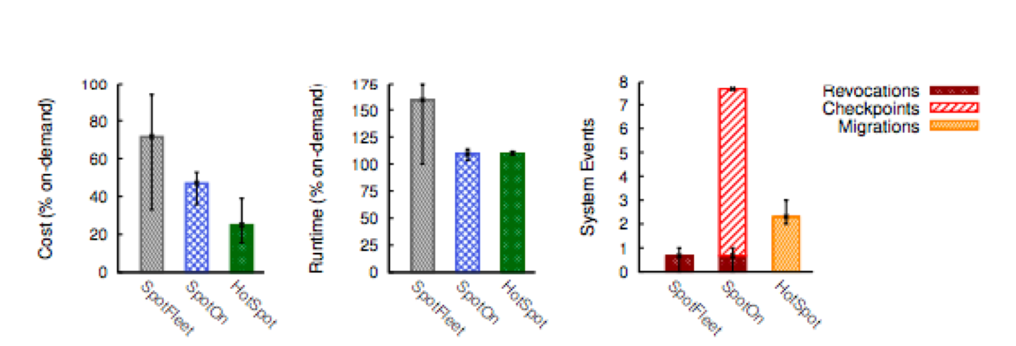
Prototype: Baseline
[1]
A comparison for the cost, runtime, and performance of using on-demand, SpotFleet, SpotOn, and HotSpot VMs
Notes:
· In the left graph, SpotFleet can be as inexpensive as SpotOn, which uses checkpointing to mitigate the effects of a revocation, in the case of no revocations. In the case of a revocation, however, SpotOn can be very expensive because it will have to start the entire job from scratch. HotSpot’s cost is the lowest because it never experiences revocations and always migrates to the lowest cost VM.
· In the middle graph, SpotFleet has a high runtime due to the overhead of having to restart jobs after revocations. SpotOn and HotSpot incur a small overhead from checkpointing and migrations, respectively.
· In the right graph, because SpotFleet does not perform any checkpointing or migrations, it does not incur any performance degradation from these events. Although HotSpot migrates, it migrates much less often than SpotOn checkpoints, giving it a better performance overhead

Slide 16
Prototype: Changing Memory Footprint
[1]
The same analysis is performed by varying the application’s memory footprint size, which affects the transaction cost of migration
Notes:
This graph evaluates how the metrics are affected by changing an application’s memory footprint, which dictates the transaction cost of migration and checkpointing
· In the left graph, SpotFleet maintains the same cost across all memory footprints because it does not perform checkpointing or migrations. SpotOn’s cost decreases as the size of the memory footprint decreases, because the larger the footprint, there more overhead from checkpointing, which is way SpotOn’s cost is so high for 64GB memory.
· In the middle graph, the similar results are evident. SpotFleet does not depend on the memory footprint. Although, the runtime for SpotOn still increases faster than that of HotSpot, they are more equal here because the overhead from checkpointing and migrating is somewhat equivalent here.
· In the right graph, something interesting to note is that for low memory footprints, SpotOn checkpoints frequently, since the overhead of checkpointing is low. However, for large memory footprints, the checkpointing overhead is high so SpotOn only checkpoints once. Thus, the revocations for SpotOn at large memory footprints incur a large recomputation overhead that increases its running time like in the middle graph. SpotFleet is again not affected by the memory footprint and HotSpot never experiences revocations.

Slide 17
Prototype: Changing Spot Price Variability
[1]
The same analysis is performed by varying price variability, which affects the number of revocations, emulating a volatile market
Notes:
Revocation rate is varied by changing the periodicity of the price function.
· In the left graph, HotSpot always has a lower cost because it migrates to the lowest cost VM when prices change.
· In the middle graph, the revocation rate increases to a point where SpotFleet cannot even finish the job, because it must keep starting from scratch, marked by the infinity sign. SpotOn mitigates running time with its periodic checking to relieve the impact of revocations. HotSpot incurs overhead of migration.
· In the right graph, because the baseline memory footprint is small here, 8GB, SpotOn checkpoints much more frequently to mitigate the impact of revocation. The lowest-cost VM changes more frequently as price volatility increases, which requires HotSpot to migrate more frequently. But it still incurs no recomputation overhead.

Slide 18
Simulation
[1]
HotSpot maintains the lowest cost, runtime, and revocation rate in the simulation
Notes:
· In the left graph, as expected, all the spot-based approaches have lower cost than on-demand VMs, and HotSpot is able to maintain the lowest cost.
· In the middle graph, all the approaches’ runtimes are slightly higher than that of the on-demand VM. This is because jobs in the original trace run on over-provisioned servers, such that the average CPU utilization is low which degrades performance as there is no higher-capacity container to migrate to. In order to demonstrate that HotSpot can improve runtime when given a larger-capacity VM, we have HotSpot (m4) which runs on a high-capacity on-demand VM which reduces runtime. Of course, because it is on-demand, however, costs will be higher for HotSpot (m4).
· In the right graph, shows the revocation, checkpointing, and migration rate per day of each approach. It’s hard to see, but all approaches experience revocation, with HotSpot being the lowest.

Slide 19
Thoughts/Concerns
Application Agnostic: Application are able to utilize any number of cores (or hardware threads) on a new VM
VMs Are Self-Contained: Do not coordinate their migration decisions with other HotSpot VMs
High Downtime: Stop-and-copy migrations and container migration functions increase application downtime
Simplification of Ti Calculation: Assumes containers are long-lived
Notes:
· Application Agnostic: Application are able to utilize any number of cores (or hardware threads) on a new VM
o HotSpot claims to be application-agnostic, which means that its migration policy is not defined for any kind of specific application with any kind of specific needs. Consequently, very simplifying assumptions must be made about these applications because they must be flexible enough to perform well in any kind of new VM, which is not always feasible. When we examined the high utilization component of the expected utilization equation model, the paper assumed that applications were able to saturate any number of ECUs. What if the new VM has so many more ECUs than the source VM that the CPU utilization drops significantly and thus relative spot price increases and a great deal of CPU resources are wasted? The paper claims that once again, if their assumptions are wrong, the algorithm will self-correct, as cost-efficiency will not be optimal and a migration will be triggered. But suppose HotSpot makes incorrect assumptions and the system must keep self-correcting. That would be a great deal of overhead incurred. The migration policy must cater to more specific needs of applications.
· Not Global: HotSpot VMs are self-contained and do not coordinate their migration decisions with other HotSpot VMs
o As a result, HotSpot’s local migration decisions may not be globally optimal for distributed applications with complex dependencies. The paper states that because migrations across AZs and regions require significant additional overhead to migrate disk state, we limit HotSpot to migrating within an AZ. In a related work, “Towards Index-based Global Trading in Cloud Spot Markets,” by the same authors, it describes how prior spot predictions focus on individual server markets such as this paper. EC2’s spot market is complex: it sets a different dynamic spot price for each type of VM in each Availability Zone (AZ) of each region and there are around 5,000 individual server markets across EC2’s global platform. Modeling and predicting the behavior of each of these individual markets is very hard, which is why HotSpot is limited to within an AZ. This other paper suggests “index-based” modeling and prediction that aggregates prices from many markets in each region and availability zone instead of individual server spot prices. This method is more feasible for global migration. HotSpot would need to significantly change its cost-analysis predictor model in order to function more globally.
· High Downtime: Stop-and-copy migrations and container migration functions increase downtime
o Application downtime occurs during a migration, when no work is being done, in the source or destination VM and applications are idle.
o Containers have unsophisticated migration functions when compared with VMs relatively so it does not have optimizations that minimize downtime and network traffic. In addition, HotSpot’s stop-and-copy migrations increases downtime. HotSpot uses direct memory-to-memory transfers, which increase downtime when compared to live migration, which decreases downtime. Live migrations are not incorporated into the prototype because containers do not support live migrations. This paper just expects that containers will eventually adopt these optimizations.
· Simplification of Ti Calculation: Assumes containers are long-lived
o Ti is challenging to calculate, since it depends on the future value of numerous other variables. A significant change in any of these variables can affect the time Ti that HotSpot spends on a new VM, changing the expected savings and altering the cost-benefit analysis.
o In order to calculate Ti, we also assume containers are long-lived and do not terminate before paying off their transaction costs. And that an application’s utilization is constant in the near term, which may not always be the case.

Slide 20
Related Works
Probabilistic Predictions: Select optimal spot VM based on an application’s expected resource usage and future spot prices
Reduce Revocation Risk: Using fault-tolerance mechanisms
Bidding strategies: Balance high costs and performance penalties
Artificiality of the EC2 market: Spot prices are not driven by supply and demand
Notes:
The is not much work prior that is as similar to HotSpot, where migration is dynamically triggered by changes in the spot price market. Prior work has focused on:
· Selecting the “optimal” spot VM based on an application’s expected resource usage and future spot prices (after a revocation)
o [20] Proteus has a resource allocation component called BidBrain. It makes an allocation decision, or request, to AWS in the form of an instance type, count, and bid price tuple. It makes this decision by keeping track of current and historical market prices for different types of instance types and calculating the total expected cost and work of each instance type and their current spot market price.
o [22] Cumulon, a system aimed at helping users develop and deploy matrix-based data analysis programs in a public cloud. Uses non-parametric density estimation to approximate the conditional distribution of the future prices given the current and historical prices
o Probabilistic is not good:
§ HotSpot is much more deterministic: because migration decisions are largely based on current cost, risk, and performance information
§ If fault-tolerance is based on something probabilistic:
· If applications experience a change in the prices (volatility), they may incorrectly configure their fault-tolerance mechanism, by checkpointing too much or too little which will affect overhead
· Migrating acts as a checkpointing scheme for HotSpot and it is not based on probabilistic information
· Reducing revocation risk through fault-tolerance mechanisms, such as checkpointing and replication
o [31] Flint: Batch-Interactive Data-Intensive Processing on Transient Servers
§ Checkpointing enables restarting an application on a new server, and requires only partial recomputation from the last checkpoint. Of course, each checkpoint introduces an overhead. Prior work has only applied such fault-tolerance mechanisms at the systems level:
§ But an application-aware approach is used here:
· i) improve efficiency by adapting the fault-tolerance policy to each application’s characteristics
· ii) avoid implementing complex distributed snapshotting schemes
o [22] Cumulon uses a combination of (implicit) caching and (explicit) sync operations to copy selected states from the transient store to the primary one.
· Bidding strategies:
o Bidding strategies are not important to HotSpot as it migrates based on price changes
o [26] In order to predict what future spot prices will be, we have to gain some understanding of how they change over the time. So, we use the autocorrelation function (ACF), which measures the correlation of a random variable with itself at different points in time, as a function of the two times or of the time difference, lag (l)
§ Depending on a particular threshold x, if the correlation returned by ACF is above the threshold, we can just use linear regression to predict prices, otherwise, correlation is small and we need a more complicated function. This paper proposes something called a quantile function. Our bid amount becomes the highest price returned by either function.
· Artificiality of the EC2 market as Amazon is the primary provider and operator
o [15] HotSpot does not reply on the supply and demand of the market just on the price difference between two VMs, but many existing solutions that exploit spot instances do rely on the supply and demand of the market
o Amazon publicizes the spot price but does not tell us how it is determined. By analyzing the spot price histories of Amazon's EC2 cloud, this paper reverse engineers how prices are set and constructs a model that generates prices consistent with existing price traces. We find that prices are usually not market-driven as sometimes previously assumed
· Smart Spot
o Utilizes live migration to take advantage of the spot market
o Proposes a centralized scheduler that optimizes the placement of groups of VMs on spot VMs so as to reduce costs
o But relies on fault-tolerance for revocation risk

Slide 21
Thank You!
Questions?

Slide 22
Workload Compactor: Reducing datacenter cost while providing tail latency SLO guarantees
Timothy Zhu (Pennsylvania State University)
Michael A. Korzuch (Intel Labs)
Mor Harchol-Balter (Carnegie Mellon University)
Presented by: Manasa Sanka

Slide 23
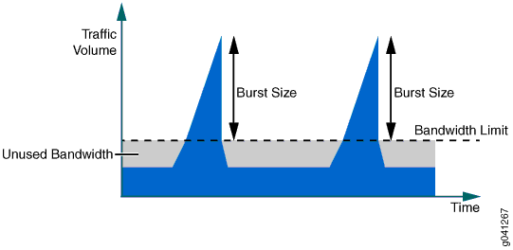
Basic Need-to-Know
Tail latency Service Level Objectives (SLO) - metric for performance that clients often provide to data center service providers (i.e. % of requests to complete within # ms.)
Especially important for user-facing applications
Bursty Workloads - internet traffic is often sporadically heavy.
For a user, very busy to load a resource, then regular network bandwidth for the remainder
Storage Workload - r/w and other requests to access data on storage servers
Image Credit: [4]
Manasa Sanka

Slide 24
Motivation
Tail latency SLO is still met while using fewer resources
Datacenter resources cost $$ to service provider
Rate limit is chosen to limit congestion and consolidate work
Manasa Sanka
Notes:
Hard to meet tail SLO using bursty network loads, so instead service providers guarantee throughput - which is unnecessary b/c reserving throughput leads to higher reservations than ncessarary in order to meet hte bump

Slide 25
Motivation
Goal: consolidate workloads onto fewer servers (reduce $ for service provider)
Current Solution: rate limits set by customer for # workloads that can be co-located while meeting tail latency SLO
Problem: No one knows how to choose rate limit
Solution: WorkloadCompactor automatically chooses rate limits and appropriate server based on workload trace
Notes:
Mail server is a workload connected to/run on a VM, connected to few EBS volumes hosted on storage server
VM connects to storage server over network
WC helps Amazon → which server to host volume on, rate limits for workloads (mail server) accessing the storage (queue there if too many workload requests)
EBS, databases, memcached servers, NFS servers are all systems that can be used w WC

Slide 26
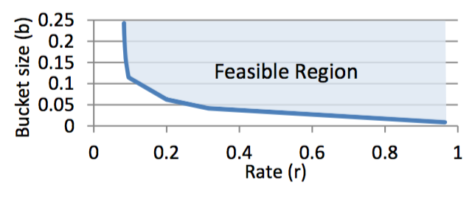
Token Bucket Rate Limiters
Add token when request arrives
<= b
Tokens
Remove tokens at rate r
Requests
R-b tradeoff curve: Consists of <r,b> tuples that entail feasibility for the workload.
Feasible: doesn’t delay workload requests
r * t + b = requests accomplished in “t” time
Proceed if space in bucket to add token
Queue
Bursty load
Fixed load
Graph reproduced from original paper
Notes:
B = burstiness
R = rate (bandwidth used)
High r allows for small burstiness, but may use high bandwidth also
TRADEOFF between bucket size and rate
All points on curve are feasible tuples, choose one of the many based on the needs of the remaining workloads on the server

Slide 27
Architecture
Different curves for 1) network traffic into 2) out of server 3) storage traffic at server
Workload trace: list of requests
<arrival time, request type, request size>
rbGen: Given trace,
1. iterate through r values
2. configure feasible b using maximum
tokens in bucket at any time in trace
3. Normalize <r,b> tuples with network
link bandwidth (r=1)
Image reproduced from original paper
Notes:
rbGen: Want to compute minimum b so requests NOT queued
Different workload trace for different parts of network - different amounts of data
tokensFunc () converts request size to tokens → for ex. # bytes for read, constant ack for write
Storage model for amount of “work” for a request.
***end to end latency ACROSS STAGES

Slide 28
Architecture
3
wcLatencyChecker: ensure SLO.
Get latency of queuing at each server for selected <r,b>
New workload added
<r,b> values assigned to existing workloads on chosen server.
Request rate changed. Request either queues or proceeds at storage device and network
1
wcPlacer: Uses fast-first-fit to choose potential server, accounting for how full server is before reconfiguration
2
wcOptimizer: determine new optimal <r,b> tuple from respective curves of existing workloads on selected server so that new workload can be co-located
R-b Curves, specified SLO
Image reproduced from original paper
Notes:
wcPlacer: presents order of which servers to check
Full server, then no placement
→ Full when all rate configs (r_j sum >= 1) - bandwidth used up!
3-4% more servers than naive first fit, but much better computation time tradeoff
NOW:
New worklaod has rate set by r,b selected, other workloads on same server are reconfigured w values chosen
Requests now queue/pass thru based on current settings

Slide 29
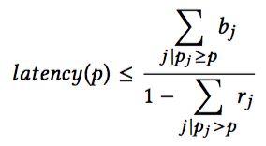
Latency Checker
On a single server:
Upper bound of tail latency for all workloads with priority p.
latency(p) correlates to SLOp
Sum of b of all workloads with priority >= p
Sum of r of all workloads with priority > p
Need to do this for all stages of network
p - higher priority when lower SLO
<r_j, b_j> - selected param for workload j
Notes:
Numerator
Denominator
Turn into inequality (do algebra)
If constraint fits

Slide 30
Latency Checker (cont.)
Create optimization problem for <r,b> values of all workloads on server given constraints
1
2
NOT AN INEQUALITY!
Notes:
Network calculus
Uses off the shelf to actually solve the optimization problem (r,b) value set that workS??

Slide 31
Relaxation
Add relaxation variable for each priority level for each of 3 stages: Rp
stage
Substitute in denominator
Do some simple algebra.

Slide 32
Constraints
1
Resembles
r * t + b from r-b curve
2
<rj, bj> ≥ piecewise components of
r-b curve of workload j
3
Do offline calculation to find set of <r,b> values for all workloads that satisfies these constraints. If constraint is satisfied, place on this server. Otherwise, wcPlacer finds new potential server.
Notes:
Resembles b+rt
Total bandwidth must be <=1 (otherwise server is FULL)
rj and bj must be on r-b curve of workload j, whihc can be represented as piece wise function
glmk
If constraint fits for all workloads on server, use current settings. Else, reconfigure.

Slide 33
Prototype Used in Experiments
Solid State Drives (SSD) as storage device.
Performance profile of SSD
Priority is enforced by limiting number and size of outstanding requests at SSD
Allows SSD to parallelize requests
Bound wait time of high priority request
Also, limit number and size of low p requests while high p in progress
Prevents starvation of high p req
“Work” . 1 .
of request: IOPS(size)
Small request sizes are limited by device’s Input/output operations/sec
Some r/w requests exhibit tail latency due to SSD’s behavior. Use this to simulate “bursty” workload effect.
Large requests are limited by device’s bandwidth capability
Graph reproduced from original paper
Notes:
SSDs have various quirks that need to be accounted for, so create a performance profile.
r/w separate b/c difference performance: w may erase blocks so very different throughputs
Request size is important for ssd, dtermines its “work”
Work = 1/ iops(size)
Assume: storage performance is fairly constant, AND variation in performance can be fixed w/ lower throughput #s
REPLACE tail latency of burstiness w/ ssd’s in-built behavior of batching writes or garbage collections etc. which adds latency to some requests.
PRIORITY: ssd parallelizes requests for high throughput, which interferes w WC
High p req wait for outstanding low p reqs
Unintional delay of high p request to make low p more efficinet = starvation
SO priority enforced by limiting # of requests at SSD (low p while high p, and requests overall)

Slide 34
Experiment
Rate limit chosen by 3 different methods using first-fit and abiding tail latency SLO constraints
Compared in terms of number of servers used relative to WC (12)
Use half of existing production storage traces from Microsoft services as workloads and half to generate r-b curve
Use only workloads that can reach SLO when isolated
Testbed: 12 clients, 12 servers; 64 GB DRAM, 300 GB SSD
Replay trace on VM w/ 64-bit Ubuntu, NFSv3 server/client
Notes:
f real production storage traces of Microsoft services (e.g., LiveMaps, Exchange)

Slide 35
Rate Limit Selection Methods
R-B Tradeoff Curve
r = k * average
work rate
b = corresponding spot on curve OR trial/error
r = necessary bandwidth to meet SLO
b = 0
Avg Rate
1.5x and 2.0x
Effective Bandwidth
Knee of R-B Curve
Notes:
Avg rate→ high r means small bursts allowed (higher rate @ a time) BUT also means bandwidth used up
K = 1.5,2 bc tested 1->20, performs worse than e.b.
SILO
E.b. isolate workload burstiness
→ doenst allow prioritization
Knee: min of r+b

Slide 36
Compare Rate Limit Selectors
Normalized to 12 servers
Effective Bandwidth performs second best when SLO is uniform, but Knee of r-b is second when SLOs differ
Graph reproduced from original paper
Notes:
12 servers
→ because can do prioritization
→ effectie bandwidth aslo bad w multiple stages (network AND storage)

Slide 37
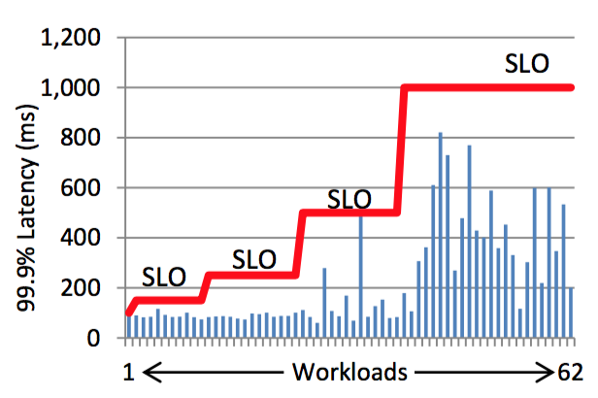
Safety Margin Added
Specified SLO accounts for the safety margin. Latency results remain within the necessary limit, increasingly for 100, 250, and 1000ms SLOs. When workloads assigned random SLO, WC still manages to place them on servers such that tail latency SLOs are met.
Experiment when safety margin is added in case workloads deviate from expected behavior, burstiness
chosen by customer based on needs of workload
Latency of Workloads compared to Specified SLO on WC
10% safety margin added
Graphs reproduced from original paper
Notes:
10% margin added

Slide 38
Scaling Number of Workloads
WorkloadCompactor’s ability to pack workloads densely is impervious to cluster size
Number of Servers Used vs. Number of Workloads
Random SLOs Assigned for 1000 Workloads, repeat 10x
Graphs reproduced from original paper
Notes:
Uses 40% fewer servers than best approach rn

Slide 39
Departing Workloads
Work even better with randomly arriving and departing workloads because WC dynamically reconfigures r, b values of ALL workloads with current state of the server.
Random SLOs for 1000 Arriving, Departing Workloads
*Maximum number of servers used at any point is represented
Graphs reproduced from original paper

Slide 40
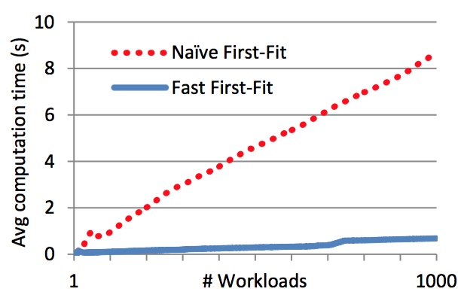
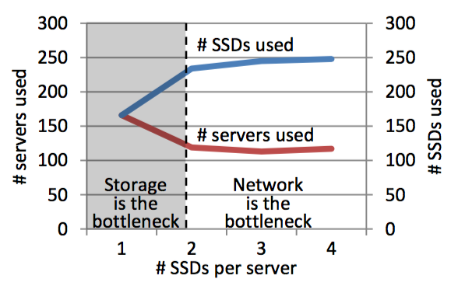
Other Experimental Results
Increasing number of SSDs per server helps with storage bottlenecks, but plateaus when network bandwidth is full.
WC latency checker accounts for both stages, so balances load, doesn’t use excess SSDs per server.
wcPlacer’s fast first-fit accounts for full servers when proposing potential servers for the new workload
Scalable
Lower computation time (fewer servers to consider)
Graphs reproduced from original paper

Slide 41
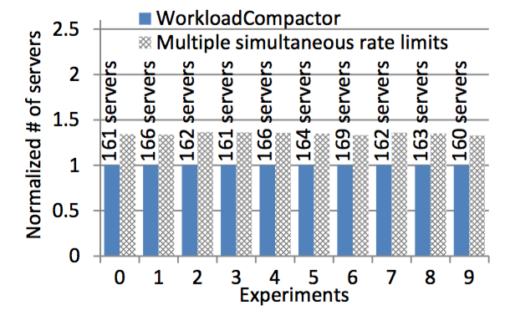
Proposed Alternative Strategy
WC outperforms PriorityMeister, which uses multiple rate limits, because
High computation
Added complexity causes conservative choices with equal priority workloads
Graph reproduced from original paper

Slide 42
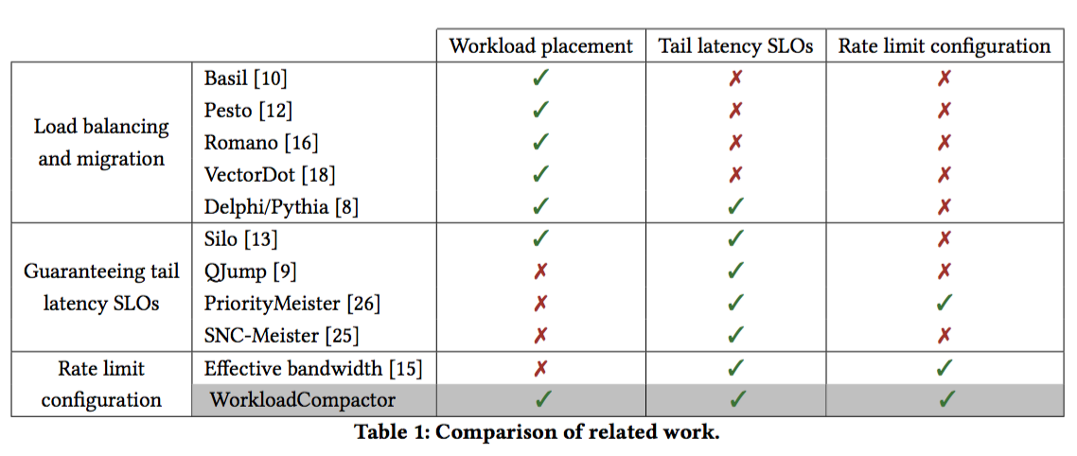
Compare Related Work
Table reproduced from original paper
Notes:
Delphi/Pythia → WC meets tail slos AFTER mistake is violated, LEARNS to fix it
Migrate worklaods to meet slos
Silo, qjump, snc only deal w netwroks, not storage
Silo doens’t eal w set rate limits
Priority meister multpkle simultatneous limiters, works worse, NO w placement
Select rate lmiti: effective bandwidth if 1 stage, same SLO for all worklaods

Slide 43
Analysis
Problems may arise with:
customer choosing the safety margin → don’t know workload’s long-term expected behavior
Computation time may be high if r-b curves are generated constantly if workloads phase in/out very fast.
When workload deviates from usual, how long before noticed and assigned a new r-b curve? Long-term burstiness, which is unpredictable, is not accounted
LatencyChecker : if system changes while workload is being assigned, or bottleneck at latency check if many workloads added at once
Experiment substitutes SSD-induced tail latency effects of requests as a “burstiness” simulator → are these equal?
There is no load balancing mechanism or analysis
Fault tolerance if WC components crash or server fails
Notes:
migh t not notice one server acting strangely when a worklaod departs : will it adjust in time
What if one server with a workload that is not meeting expected behavior, but old r-b curve is still used - how long before this is noticedl
How often are workloads in/out? If its often, comptuation time is high. Also, high overhead of even adding a workload
If fails → recompute all worklaods that crashed? Doesn rlly discuss it
**EASIY PORT! Add-on to network/storage devices. Open source.
LONG TERM BURSTINESS not acocunted for, or bustiness not noted in the “training data” or trace. Bustiness IS unpredictable, so may require regenerating r-b many times

Slide 44
Takeaways
WorkloadCompactor consolidates workloads onto fewer servers compared to other state-of-the-art mechanisms while meeting tail latency SLOs.
Selection of workload rate limits (rate and burst) is crucial to compacting process
Network calculus used to determine if colocated
Enforce rate and priority in network AND storage

Slide 45
Discussion
Scriber: Aishwarya Nadella

Slide 46
HotSpot
The paper describes the lack of coordination between HotSpot VMs as a limitation. What are some ways HotSpot VMs could coordinate? Do you think these are beneficial enough to be included in the implementation?
Notes:
In a distributed application with dependencies. If a HotSpot VM is about to hop in a certain period of time (in migration). The VM could be included as a possible VM to hop to. The time it would take for the destination VM to vacate would be included into the cost-analysis. Could globally find an optimal solution.

Slide 47
HotSpot
With the HotSpot design, users are not left with much say in the configurations. Do you think it would be beneficial for users to be able to configure certain features?
For example, HotSpot chooses the bidding policy that works for its migration policy (bidding 10x the on-demand price).
Notes:
I think it could be beneficial for the users to have more freedom, they may have their own strategies they would like to use. For example, bidding price. However, the evaluation done shows that 10x bidding price provides low revocation and price risk without degrading performance so allowing users to configure may interfere with this. This bidding schema seems to work on EC2 only. (Piazza)
Users cannot customize the migration policy - Piazza
Assumptions: Life time of container
App’s future usage
Assume containers are long lived

Slide 48
HotSpot
Hotspot makes the assumption that an application’s utilization is constant in the future in its migration policy. Do you think there is a better heuristic?
Notes:
Could observe trend in the application utilization up to the point. Lots of assumptions are made for the migration policy - piazza

Slide 49
HotSpot
HotSpot does not mention the use of any fault-tolerance techniques because it claims revocation is minimized with its migration policy’s aim to minimize price risk. What if the migration fails? Do you think HotSpot should include a backup plan for failures?
Notes:
Revocation risk is not considered just based on data analysis that it is not necessary. No stable storage during stop and copy.

Slide 50
HotSpot
The migration overhead from the experiments in the paper show that it ranges from 25-56s, which is 0.7-1.6% of the runtime of half-hour jobs. Do you think it is worth looking into live migration?
Notes:
This is for half-hour jobs. Overhead could be way larger for larger jobs. I think it is worth experimenting with longer jobs to see if it is necessary once technology permits live migration.

Slide 51
WorkloadCompactor
“In addition to the work generated by a request, there is also a tail latency effect due to the SSD and storage stack.”
Would the WorkloadCompactor give better results on if used on other storage devices?
Notes:
Does cloud storage also cause added tail latency effect?
SSD requires garbage collection that affects tail latency
Why did they choose SSD instead of other storage

Slide 52
WorkloadCompactor
Is the WorkloadCompactor portable to other technologies?
“Though our techniques can be extended to various storage devices, our WorkloadCompactor prototype focuses on Solid-State Drives (SSDs).”
“In addition to the work generated by a request, there is also a tail latency effect due to the SSD and storage stack.”
Notes:
The paper mentions that the tail latencies caused by SSDs must be incorporated into calculations. Other storage devices will have other tail latencies that need to be incorporated. The way priority is handled is very specific to SSD’s. What if cloud storage was used? Different tail latencies.

Slide 53
WorkloadCompactor
WorkloadCompactor does not focus on migrating workloads between servers in order to optimize the number of servers used. Would including migrations benefit the system?
Notes:
If there are several small workloads requiring less resources on a single server that can be distributed to other servers in order to make room for a bigger workload. Migration could help. Load balancing.

Slide 54
WorkloadCompactor
The paper lacks information on failure cases. What are some issues that may occur?
Notes:
Server failures - how to rebalance
What happens if any component goes down - single point of failure issues.. (WcPlacer, WcOptimizer, LatencyChecker)

Slide 55
Thank You!
Questions?

Slide 56
References and Image Credits
[1] Supreeth Shastri and David Irwin. 2017. HotSpot: automated server hopping in cloud spot markets. In Proceedings of the 2017 Symposium on Cloud Computing (SoCC '17). ACM, New York, NY, USA, 493-505. DOI: https://doi.org/10.1145/3127479.3132017
[2] Kasireddy, Preethi. “A Beginner-Friendly Introduction to Containers, VMs and Docker.”FreeCodeCamp, FreeCodeCamp, 4 Mar. 2016, medium.freecodecamp.org/a-beginner-friendly-introduction-to-containers-vms-and-docker-79a9e3e119b.
[3] “Memory Footprint.” Wikipedia, Wikimedia Foundation, 10 Apr. 2018, en.wikipedia.org/wiki/Memory_footprint.
[4] https://www.juniper.net/documentation/en_US /junos/topics/concept/policer-mx-m120-m320-burstsize-determining.html

