Slide 1
Stream Processing:
Drizzle & AF-Stream
Arnav Agarwal
Srujun Thanmay Gupta
Shivam Bharuka

Slide 2
What is Stream Processing?
Infrastructure for continuous processing of data
Various applications for analysis of live data streams
Two types of operations:
Stateless: filter, map, merge
Stateful: aggregate, time window, join
Notes:
Infrastructure for processing continuous data, as opposed to Hadoop which is running batch-oriented analysis on static data
Example application: two streams “page views” and “ad clicks”, can join these two streams to understand which pages get the most ad clicks
Can be thought of as a directed graph with each node applying some transformation to the data.
Transformations can be
stateless: simple operations where output message depends only on input messages
stateful: output message depends on input message and the messages seen before it

Slide 3
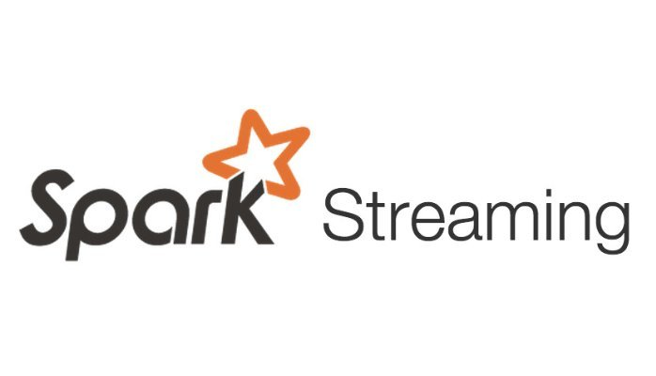
Existing Stream Processing Solutions
Notes:
This seems to be a problem

Slide 4
Drizzle
Fast and Adaptable Stream Processing at Scale
Venkataraman et al.

Slide 5
Background – Spark and Spark Streaming
Streaming using extension of the core Spark API
Divides the data into micro-batches, which are then processed by the Spark engine to generate the final stream of results (also in batches)
Basic abstraction: DStream (discretized stream)
input data stream or processed data stream
represented by a continuous series of RDDs
using batches of RDDs (resilient distributed dataset)

Slide 6
Issue
Current stream processing systems choose between low latency during execution or incurring minimal impact during recovery
Micro-batch systems adapt rapidly, but have high latency during normal operations (Eg - Spark Streaming, FlumeJava)
Continuous operator streaming systems have low latency but high overloads during recovery (Eg - Naiad, Flink)

Slide 7
Current Implementations:
Continuous Operator Streaming | Micro-Batch

Slide 8
Continuous Operator Streaming systems
Specialized for low latency during normal operation periods.
No barriers and data is transferred between the operators directly. Therefore no scheduling overhead or communication delays.
Utilize checkpointing algorithms to create snapshots periodically(synchronously or asynchronously).
Pros:
Due to absence of barriers, lower latency due to lesser overhead.
Cons:
Lack of a centralized driver, all nodes are reverted to the last checkpoint and replayed, thereby increasing latency in case of failures.

Slide 9
Micro-batch systems
These systems use the bulk-synchronous parallel model. Occurs in stages of computations followed by barriers where the nodes can communicate to begin the next stage (Eg - MapReduce).
These computations can be seen as a directed-acyclic graph (DAG) of the operators.
A micro-batch is created for T seconds, in which data from the streaming source is collected and then processed through the DAG and finally outputted to the streaming sink.
Uses a centralized driver to schedule tasks.

Slide 10
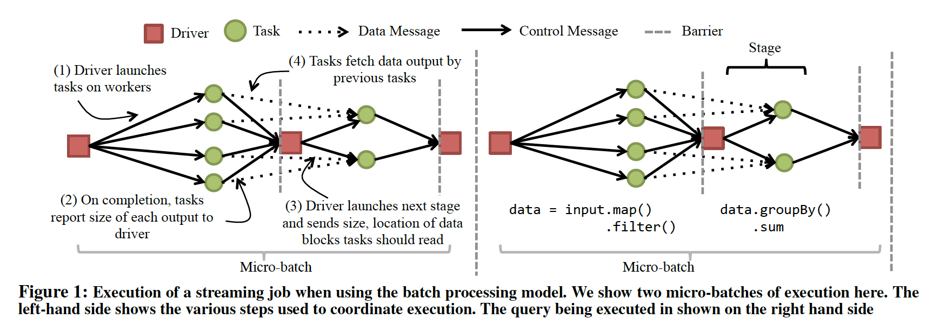

Slide 11
Micro-batch systems
Pros:
Due to presence of barriers, fault tolerance and scalability is simplified.
Snapshots can be taken at each barrier and therefore failures can be recovered using these snapshots as the reference points.
Progress and failures can be checked at the end of each stage. The centralized scheduler can reschedule tasks accordingly.
Cons:
If T is too low, there is a significant overhead due to more communication required (as there will be more micro-batches)
Due to this overhead during communications at each barrier stage, the latency becomes quite high.

Slide 12
Drizzle
Based on the observation that streaming workloads require millisecond-level processing latency, workload while cluster properties change at a much slower rate.
Drizzle extends the BSP model, though it believes one can use the Continuous Operator model also and add a centralized coordination mechanism to get the benefits of the BSP model.
The paper presents the following high level approach: decouple the micro-batch size being processed from the coordination interval. This reduces the micro-batch size and helps achieve sub-second latencies while ensuring coordination due to the centralized driver of the BSP.

Slide 13
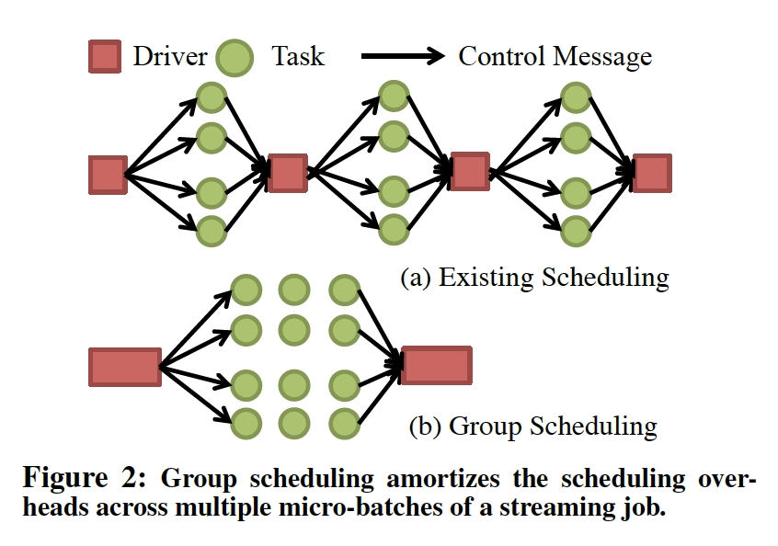
Drizzle: Modifications to BSP
Group Scheduling:
Done to reduce the overhead due to coordination between the micro-batches.
Based on the observation that the DAG of the operators is largely static and therefore scheduling decisions can be reused for several micro-batches.
This group scheduling amortises the overhead due to the centralized scheduling.

Slide 14
Drizzle: Modifications to BSP
Pre-Scheduling:
Aims to reduce overhead due to barriers before shuffles.
Downstream tasks are scheduled before upstream tasks.
Therefore, no coordination required after completion of the downstream task.
Push-metadata and pull-data approach.
Notes:
Aims to reduce overhead due to barriers present in micro-batches to coordinate the data transfer for the shuffle operations.
Downstream tasks are scheduled before upstream tasks, and then the metadata to the downstream tasks also contain information about which upstream task to notify after completion.
Therefore, there is no coordination required after completion of the downstream task.
Push-metadata and pull-data approach. Implemented using a local scheduler on each worker machine that keeps track of the dependencies for the task. Once the dependencies are met, it starts the task execution by taking the data from the upstream tasks.

Slide 15
Drizzle: Modifications to BSP
Adaptability:
Fault Tolerance:
Synchronous checkpoints that can be taken at the end of a group.
Heartbeats sent from workers to the centralized scheduler.
Elasticity is handled by integrating cluster managers like YARN or Mesos.
Group Size selection:
Adaptive group size tuning algorithm inspired by the TCP congestion control.
Use counters to see time spent at the various parts of the system, and accordingly find the scheduling overhead which needs to be kept within user specified bounds

Slide 16
Drizzle: Modifications to BSP
Data-plane Optimizations:
Workload analysis shows that about 25% queries used some aggregation function. Therefore, supporting partial aggregates gives a better performance.
Intra-batch Optimizations: Batching the computation of aggregates provides significant performance benefits due to vectorized operations on CPUs and minimizing network traffic from partial merges.
Inter-batch Optimizations: Collection of metrics after execution are sent to a query optimizer to check the best query plan.

Slide 17
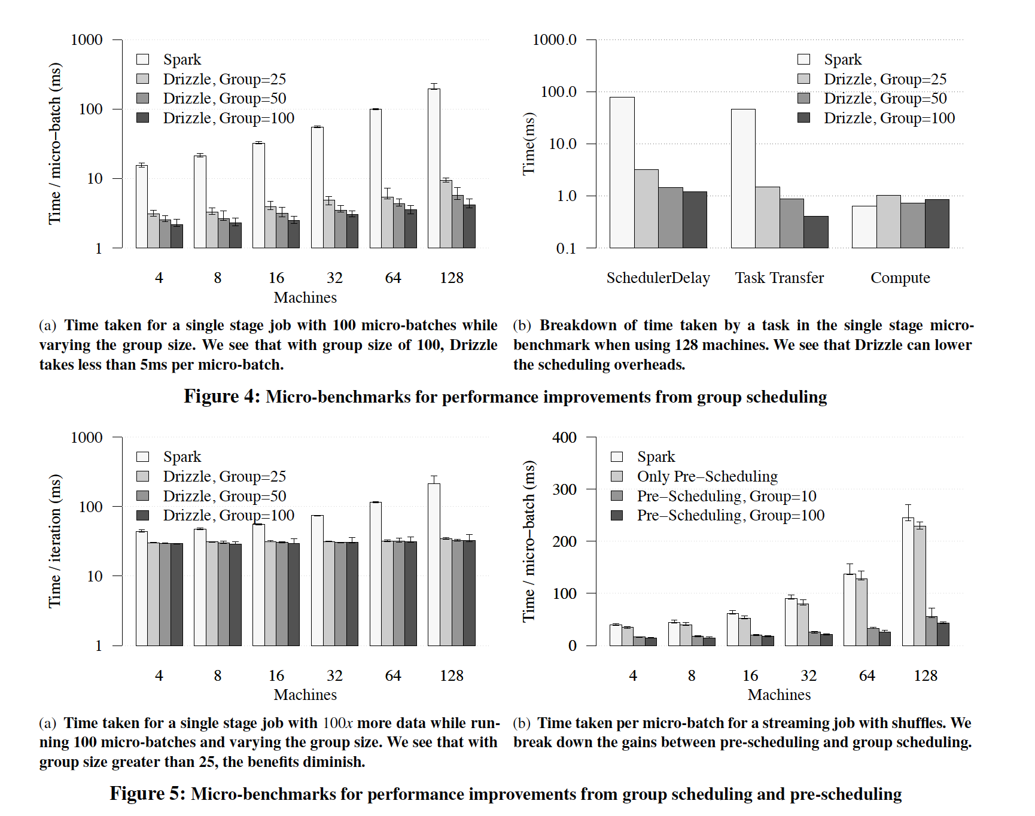

Slide 18
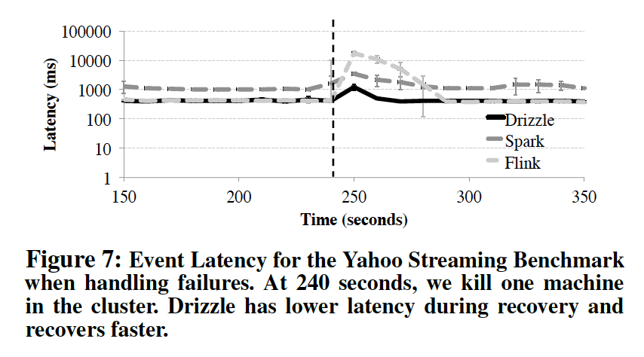

Slide 20
Drizzle – Future Work
Additional techniques to improve the data-plane.
Integration with other engines for general purpose low-latency scheduling.
Smarter algorithm for bound selection rather than being user defined
… your ideas?

Slide 21
AF-Stream
Approximate Fault Tolerance
Qun Huang & Patrick P. C. Lee

Slide 22
Fault Tolerance in Stream Processing
Errors can result from missing in-memory state and missing unprocessed items
Achieving error-free fault tolerance requires substantial performance sacrifices
Best-effort fault tolerance implementations (S4, Storm) can incur unbounded errors
Justification for approximate fault tolerance:
Streaming algorithms tend to produce approximate results, hence can tolerate a few bounded errors
Failures occur relatively infrequently over the lifetime of streaming applications
Notes:
Two main types of errors can occur upon failures:
missing state
missing unprocessed items
With the velocity of live streaming data, it is extremely challenging to ensure no errors in stream processing without sacrificing performance
Since performance is so important in live streaming scenarios, some implementations offer best-effort fault tolerance as performant options but errors in this scenario can be unbounded, rendering the results useless
Some justifications that the authors offer to support their work:
most streaming algorithms produce approximate results anyways, so as long as we can ensure bounds on the number of errors, the results are still reliable
in most systems, failures occur infrequently throughout these streaming applications (the systems tend to be running much longer than static data processing)

Slide 23
Solution: AF-Stream
Adaptively issue backups of state and items: only when actual and ideal deviate beyond a threshold
Estimate errors upon failures based on user-defined parameters, thus incurring only bounded errors
Errors are bounded independent of:
number of failures
number of workers in a distributed environment
Design choices for streaming features:
primitive operators: AF-Stream maintains fault tolerance for each operator
state updates: AF-Stream supports partial state backup
windowing operators: AF-Stream resets thresholds based on windows
Notes:
Bounds errors upon failures in two aspects: state divergence and number of lost items
estimate errors using parameters defined by the user, thus only errors are bounded
and are independent of the number of failures and the number of workers in a distributed environment

Slide 24
AF-Stream Architecture
To scale and parallelize streaming algorithms in a distributed implementation
Two common approaches:
Pipelining:
Divides an operator into multiple stages
Each division corresponds to another operator or a primitive
Operator duplication:
Parallelization by multiple copies of same operator
AF-Stream uses both approaches simultaneously

Slide 25
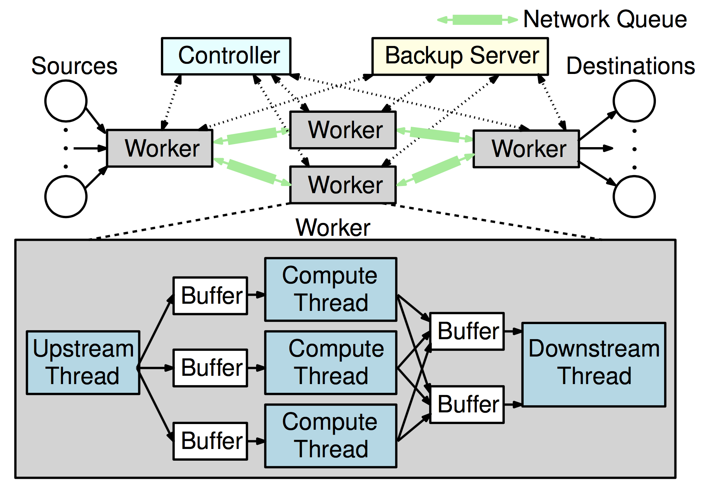
AF-Stream Architecture
Controller: coordinates the executions of all workers
Workers: manage single operators
upstream and downstream workers: location in stream graph
upstream thread: forwards input items to compute thread
downstream thread: forwards to downstream worker
compute threads: collaboratively process items

Slide 26
AF-Stream Architecture
Feedback mechanism:
downstream thread can forward feedback messages to upstream workers
Communication model:
inter-worker communication: bi-directional network queue
inter-thread communication: in-memory circular ring buffers

Slide 27
Programming Model
Item types:
data: flow from upstream to downstream
feedback: from from downstream to upstream (ack info, sequence numbers)
punctuation: specify end of stream or windowed sub-stream
User-defined interfaces for fault tolerance:
StateDivergence: quantify divergence between current state and backup state
BackupState: operators use this to save state when needed
RestoreState: how operators should obtain and recover the last backup state

Slide 28
Approximate Fault Tolerance
AF-Stream defines 3 runtime thresholds, the user-configurable parameters, and actions to take when the threshold exceeds them:
Runtime Thresholds | Parameters | Actions
θ – deviation of most recent backup state against current state | Θ | issue backup of current state
ℓ – maximum number of unprocessed data items | L | issue backup of pending items
ɣ – maximum number of unacknowledged items at sender | Γ | block worker from sending new items
θ, ℓ, and ɣ are adapted at runtime to with respect to Θ, L, and Γ

Slide 29
Error Analysis and Boundedness
Two aspects:
let divergence between the actual and ideal states be at most α
let number of output items be at most β
Single failure of a worker
total state divergence: θ + ℓα
maximum lost items: γ + ℓβ
all are bounded!
Θ - state deviance
L - pending items
Γ - unacked items
Notes:
single failure:
upon restore: restored state diverges from the actual state before the failure by at most θ
at most ℓ items lost before failure - changes divergence by at most α
total is θ + ℓα
lost at most γ unacked output items
at most ℓ items lost before failure - so at most β lost output items
total is γ + ℓβ

Slide 30
Error Analysis and Boundedness
Multiple failures of a single worker
initial threshold at each worker:
after k failures:
summing over k failures we get:
maximum divergence: Θ + Lα
maximum lost items: Γ + Lβ
Failures in multiple workers
single worker case extends to n operators
Θ - state deviance
L - pending items
Γ - unacked items
all are bounded!
Notes:
AF-Stream bounds the accumulated errors by adapting the three thresholds θ, l, and γ with respect to the three user-specified parameters Θ, L and Γ,
and the number of failures denoted by k

Slide 31
Types of Streaming Algorithms
3 main classes of streaming algorithms studied in the paper:
Data Synopsis:
summarize large-volume data streams into compact in-memory data structures
examples: sampling, histograms
Stream database queries:
manage data streams with SQL-like operators
Online machine learning:
useful when training on data of which all is not available in advance
defined with a local objective function tuned with locally optimal parameters
local output eventually converges to global optimal point after many data items are processed

Slide 32
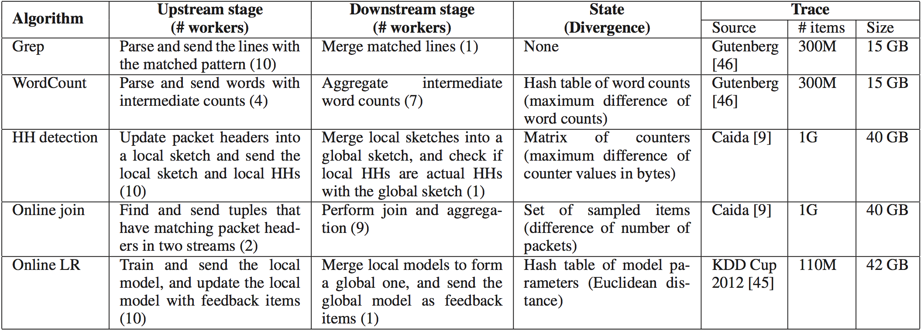
Experiments

Slide 33
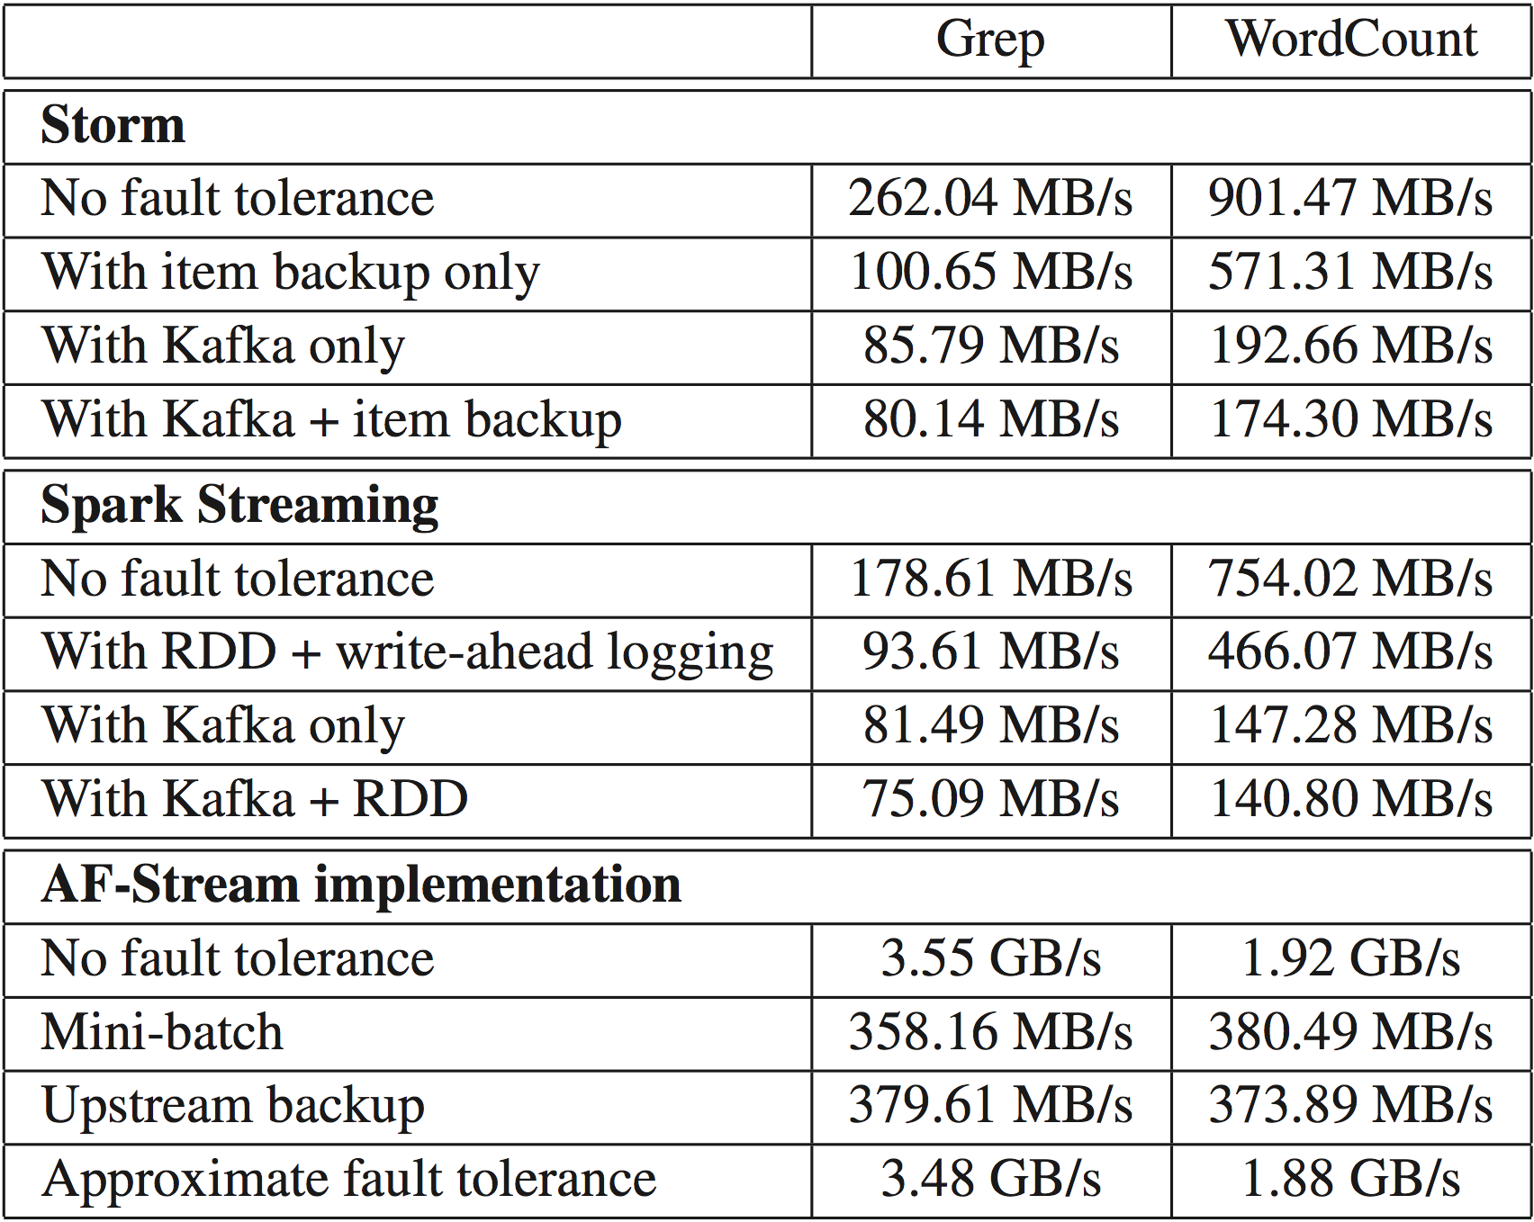
AF-Stream has fewer overheads than Storm and Spark because of its barebones implementation
* Θ=10⁴ L=10³ Γ=10³
Grep vs. WordCount
Comparisons with Existing Fault Tolerance Approaches
Notes:
Bottlenecks of Storm and Spark Streaming are mainly due to frequent item backups
Even then, the no-fault tolerance difference in AF-Stream is staggering and the only explanation is the barebones implementation. It somewhat invalidates the other numbers since a better explanation of the disparity is not given.

Slide 34
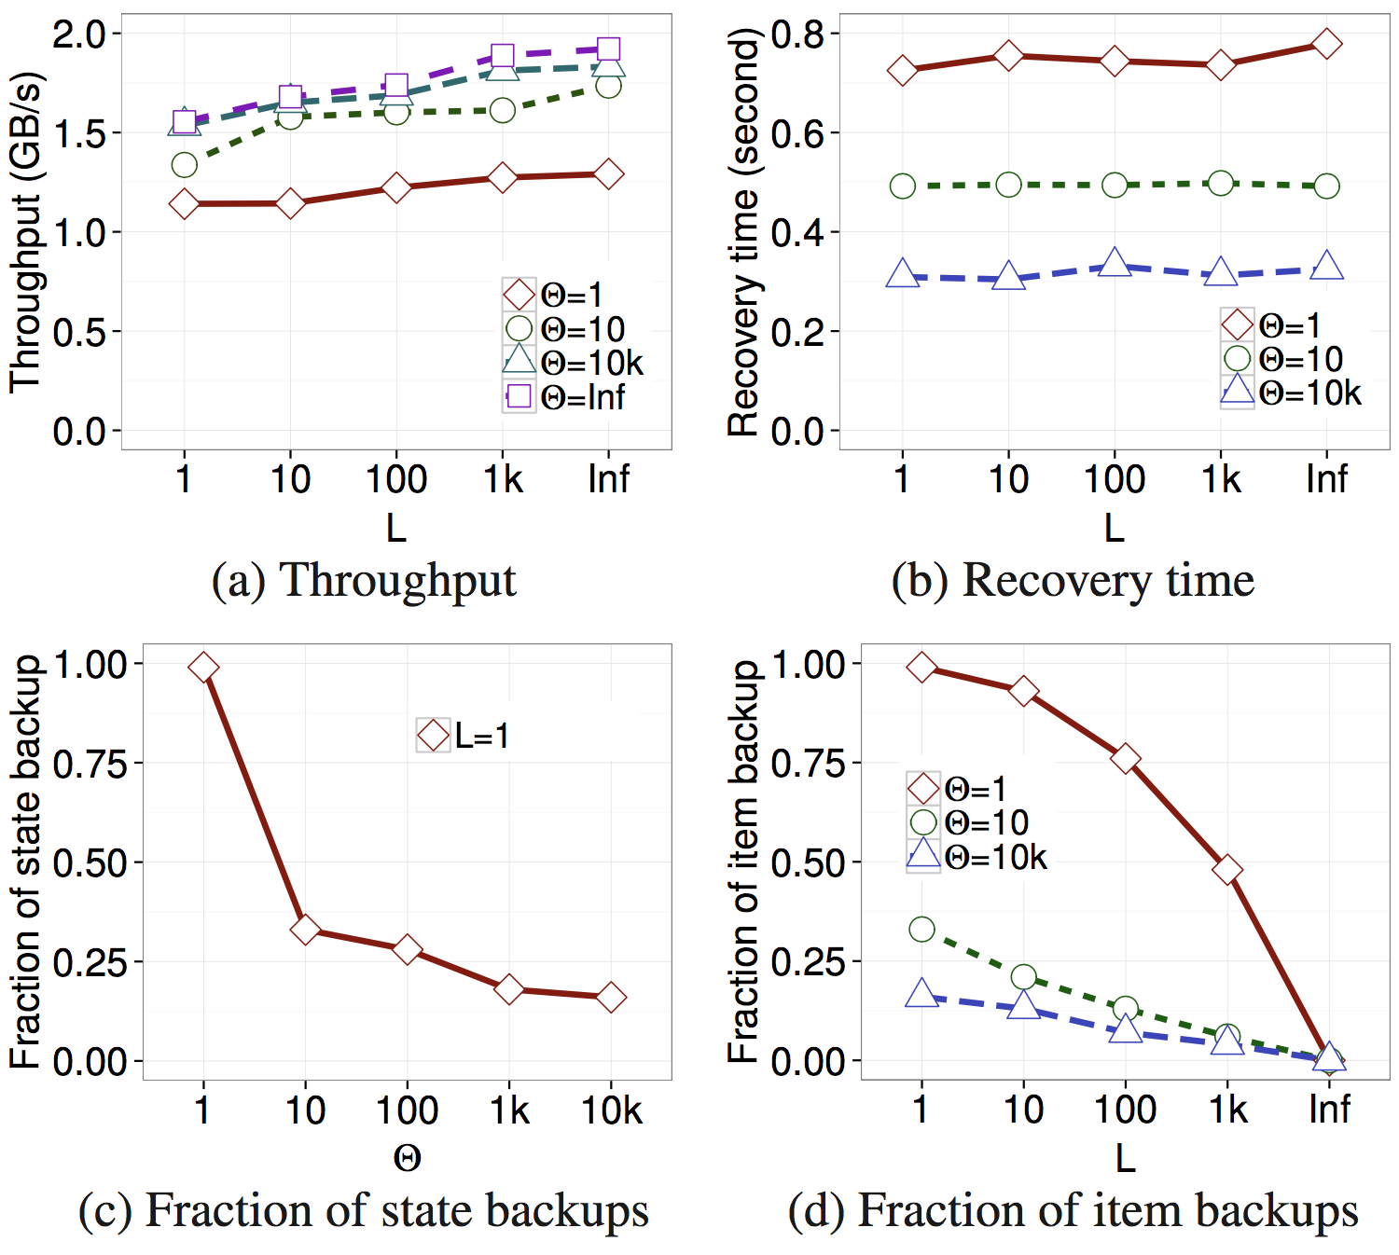
Θ - state deviance
L - pending items
Γ - unacked items
unlimited pending items allowed (essentially no fault tolerance)
WordCount (Γ=10³)
Impact of Thresholds on Performance

Slide 35
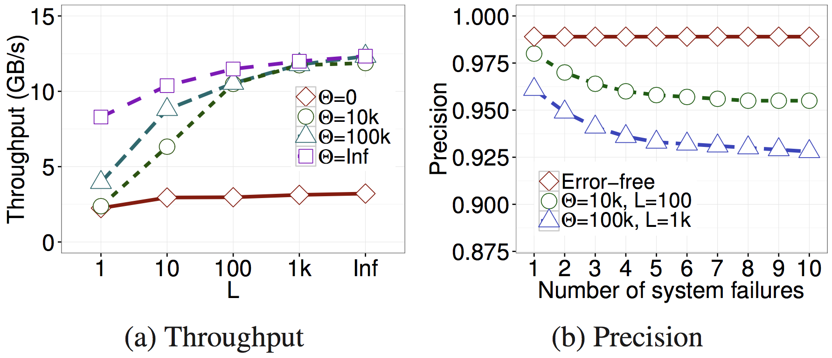
Θ - state deviance
L - pending items
Γ - unacked items
increase in allowed state deviance increases throughput drastically
failures marginally affect the precision
Heavy Hitter Detection (Γ=10³)
Experiments for Performance-accuracy Trade-offs
Notes:
Heavy Hitter detection is understanding which IP sources are creating the most traffic to a given website

Slide 36
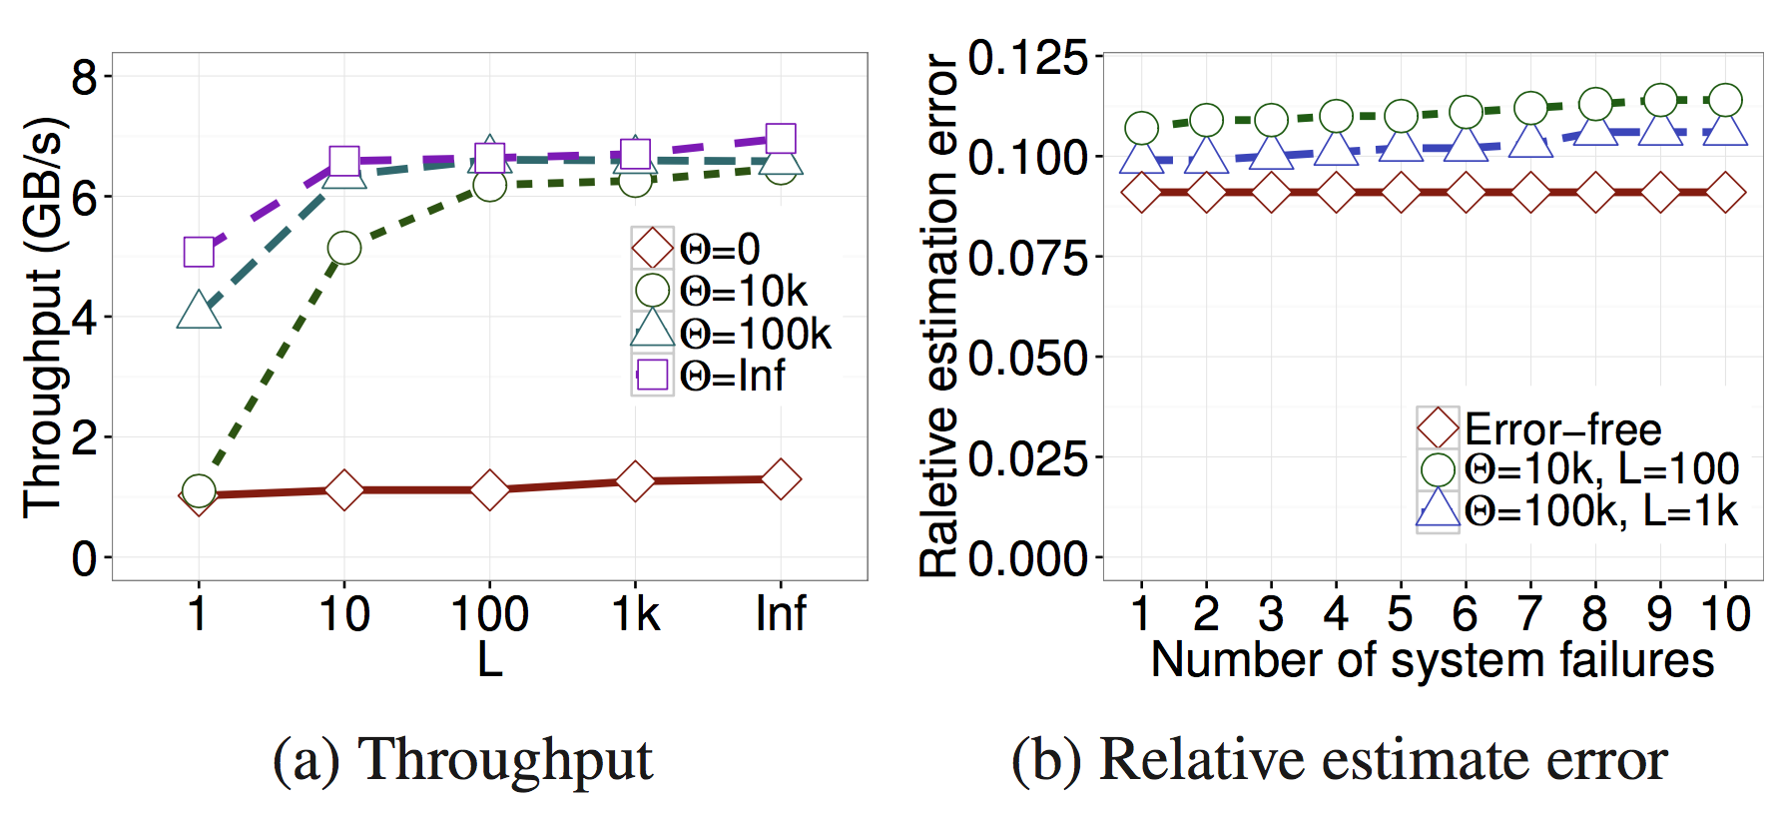
Θ - state deviance
L - pending items
Γ - unacked items
very good performance on estimation error (regardless of failures or allowed error)
Online Join (Γ=10³)
Experiments for Performance-accuracy Trade-offs
Notes:
Similar throughput graph to Heavy Hitter

Slide 37
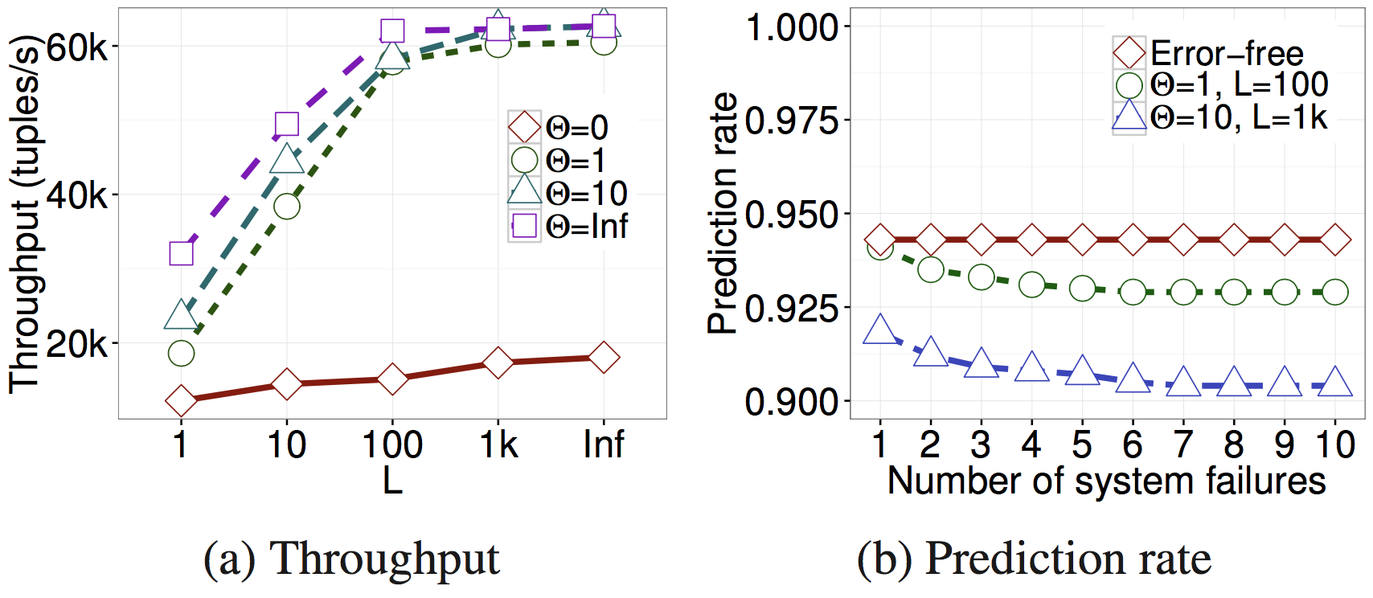
Θ - state deviance
L - pending items
Γ - unacked items
Online Logistic Regression (Γ=10³)
Experiments for Performance-accuracy Trade-offs
Notes:
Online machine learning performance
Performance drop is marginal when using adjusted parameters

Slide 38
Piazza Discussion: Drizzle
How does pre-scheduling reduce the scheduling time taken by the barrier?
How can we decouple adaptivity from group scheduling?
Notes:
Bhopesh Bassi and Arvind Kouta- p1

Slide 39
Discussion: Drizzle
The paper doesn’t do any analysis for group size based on the amount of resources available. What is the tradeoff between using a smaller group size for higher operator duplication versus using a larger group size for more pipelining?
Can we increase the group size without compromising the fault tolerance if we checkpoint at the end of an epoch?
Notes:
Continuous operator streaming takes checkpoint at the end of a processing epoch.

Slide 40
Drizzle: Drawbacks
Bounds for group selection depending on the user input might not be ideal
Single point of failure due to centralized coordinator
Other drawbacks?

Slide 41
Piazza Discussion: AF-Stream
Worker thread failure?
Adaptive parameters instead of user-defined parameters for thresholds.
Notes:
Tianyi - p1
Tarique - p2

Slide 42
Discussion: AF-Stream
How did they achieve high performance compared to Spark Streaming and Storm with no fault tolerance?
The paper doesn’t talk about false positives in failure detection. The protocol can be optimized by taking this into consideration.

Slide 43
AF-Stream: Drawbacks
Requires users to have domain knowledge on configuring the parameters with respect to the desired level of accuracy
State Divergence has to be computed each time an item updates the current state (or a certain percentage of updated) – can be expensive depending on how divergence is computed.
Other drawbacks?

