Slide 1




Systems for ML
Training (TensorFlow)
On a single CPU/GPU, within a data center or across data centers
Techniques used
  Data Parallelism
  Model Parallelism
  Parameter Server
Goals: Fast training, accuracy
Gaia
Inference (TensorFlow Serving)
On a single CPU/GPU or within data center
Techniques used: batching, caching
Goal: Inference query latency, throughput, accuracy
Clipper

Slide 2
Clipper, NSDI 2017
D. Crankshaw, X. Wang, G. Zhou, M. Franklin, J. Gonzalez, Ion Stoica
Presented by Vipul Harsh (vharsh2@illinois.edu)
CS 525, UIUC

Slide 3
The need for fast inference
Modern Large scale Machine learning systems
  Real time (Latency)
  Heavy query load (Throughput)
  Accuracy

Slide 4
The need for accuracy
Immediate feedback about prediction quality
Incorporate into model
Not possible with a single model
Recommender systems
Vision applications
Speech Recognition

Slide 5
Problem Statement
  System for real time ML inference
    Latency SLO
    Within Datacenter
    Immediate Feedback about prediction
  Goals: Latency, Throughput, Accuracy
    Incorporate user feedback
    Make system general enough for all frameworks

Slide 6
Models Galore
Many models to choose from (SVM, Neural net, Regression)
… from different frameworks (Tensorflow, Mllib, Caffe etc.)
Static Model not enough for diverse set of clients
  Room for improving accuracy using multiple models

Slide 7
Clipper
  Unified prediction interface across models & frameworks
  Online model selection for accuracy
  Adaptive batching to meet latency & throughput
  Caching predictions

Slide 8
Clipper Architecture
User Request
Reply
Feedback, true label
Clipper
Model Selection Layer
Model 1
Model 2
Model n

Slide 9
Adaptive Model selection: 2 approaches
  Single Model Selection
    Have weights for each model
    Pick model with highest weight
    Update weight based on feedback
  Multiple Model Selection
    Inference on all models
    Ensemble all predictions
    Update weight based on feedback
Notes:
Think about the tradeoffs.

Slide 10
Adaptive Model selection: Tradeoffs
  Single Model vs Multiple model selection
    Performance
      Latency
      Throughput
      Stragglers
    Accuracy
Notes:
Think about the tradeoffs.

Slide 11
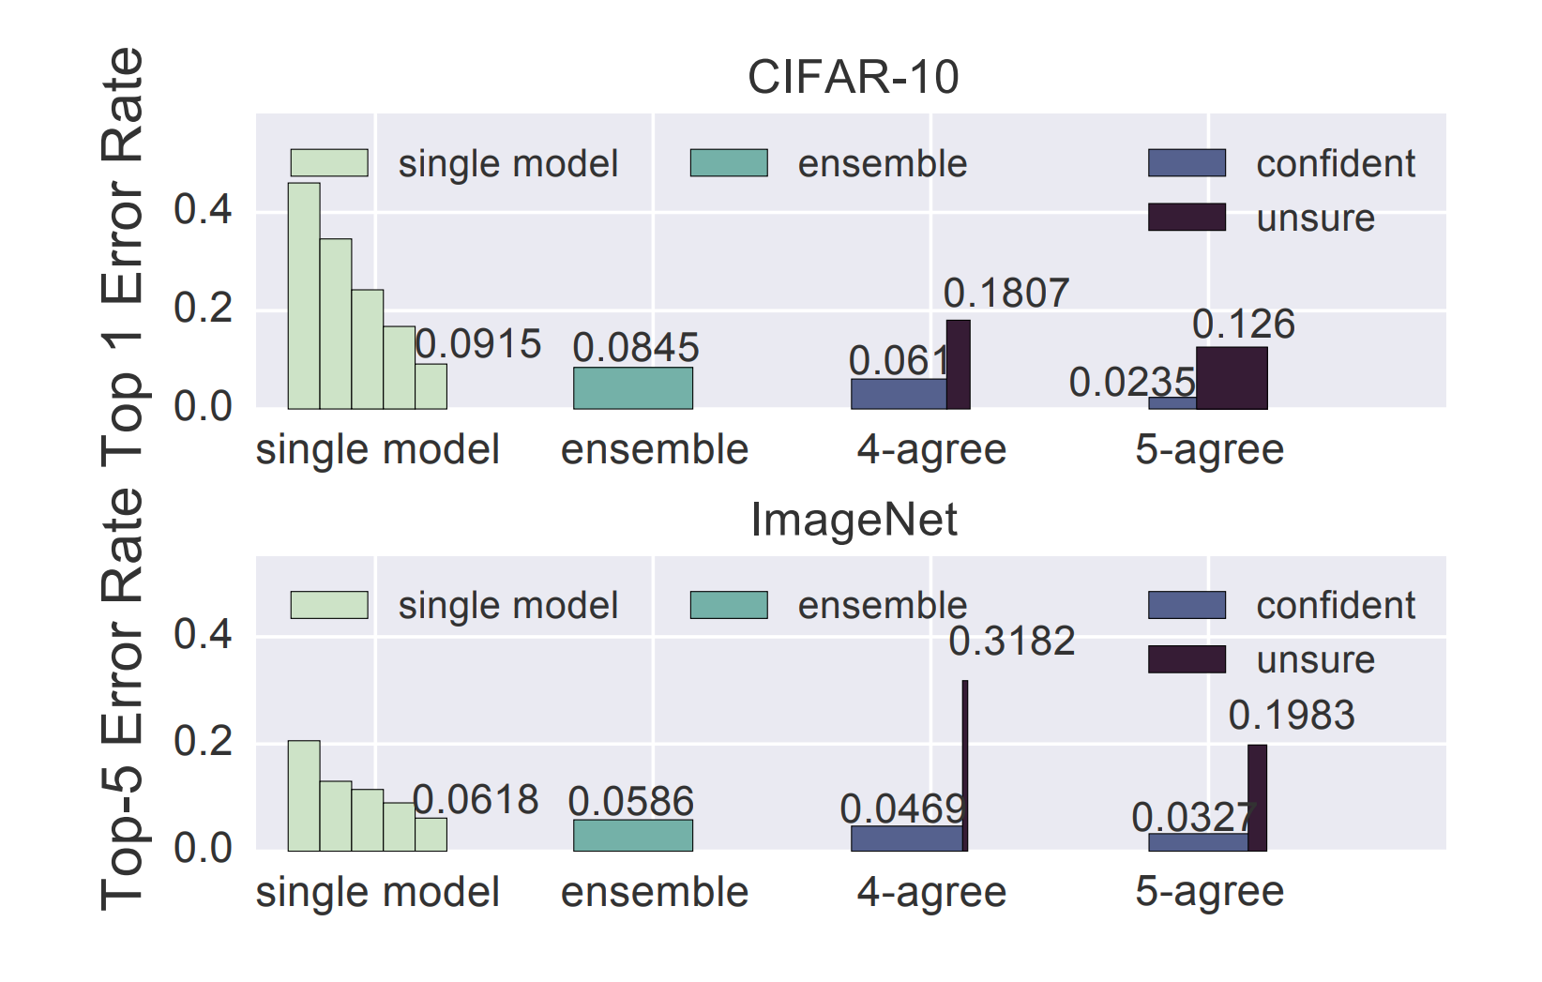
Adaptive Model selection:
Notes:
Think about the tradeoffs.

Slide 12
Model Abstraction Layer
  3 components
    Caching Prediction
    Adaptive batching
    Model containers

Slide 13

Prediction Caching
    Given a model and example, cache predicted label
    LRU eviction policy

Slide 14
Adaptive Batching per Model
Different batch sizes for models, to meet SLO
How to determine correct batch size?
  AIMD
    Additively increase batch size, till latency is met,
    Then backoff by a small factor (10%)
  Quantile Regression
    Model latency as a function of batch-size
    Batch size based on 99%ile latency

Slide 15
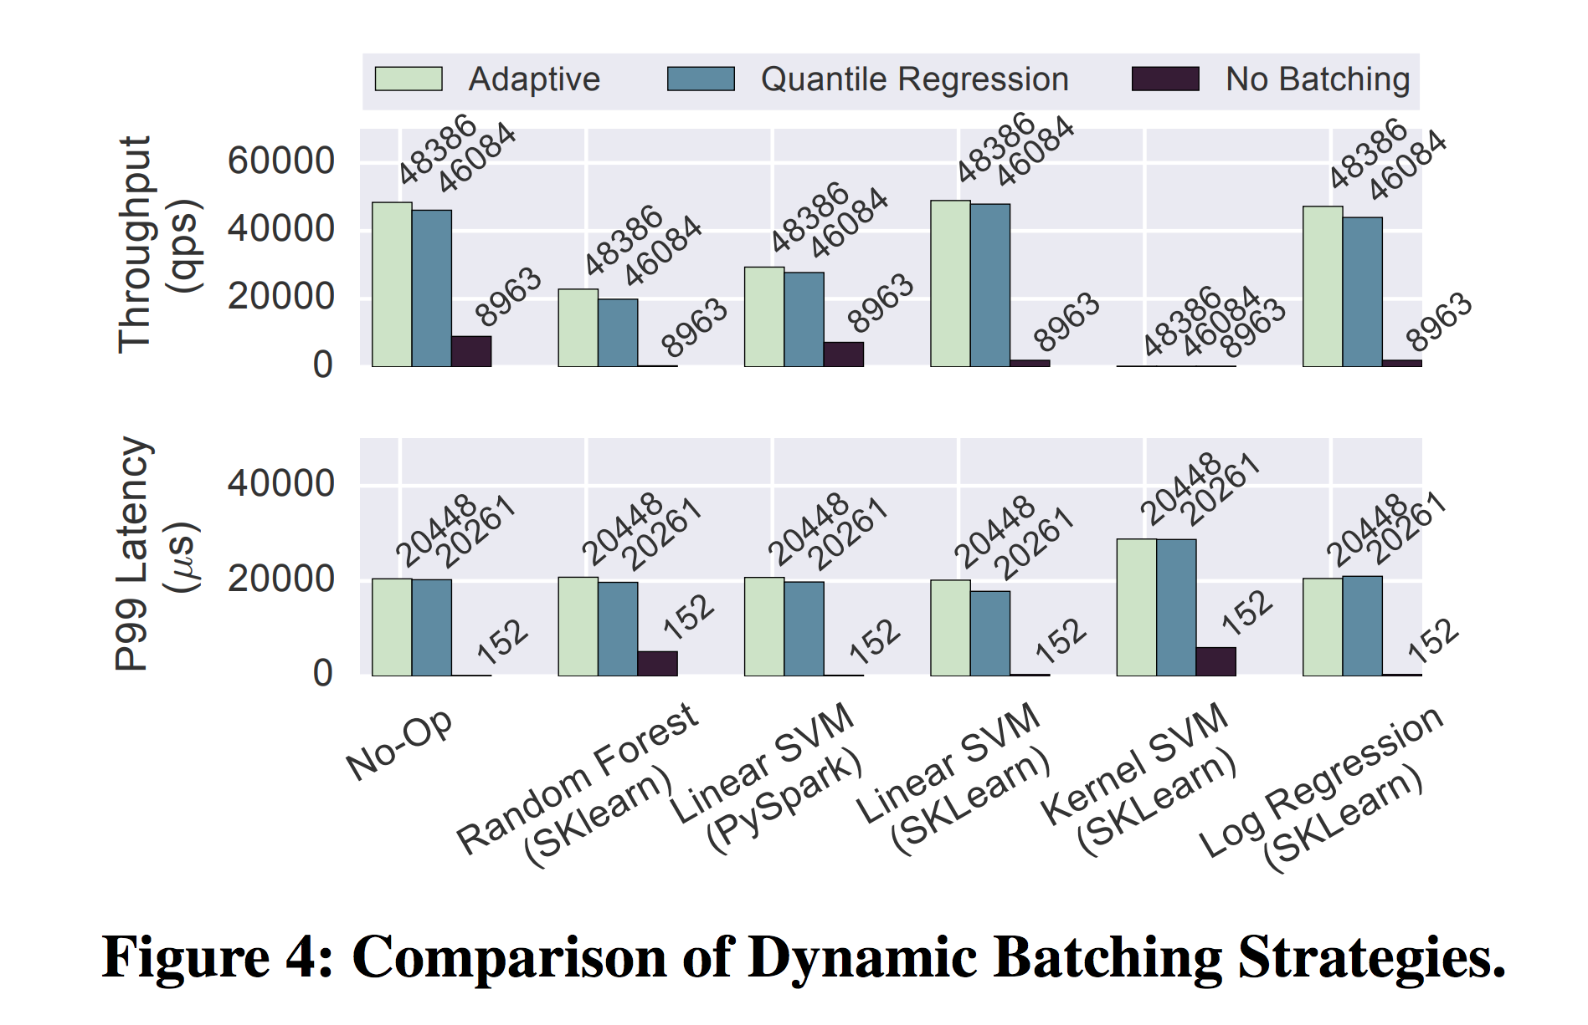
Adaptive Batching per Model

Slide 16
Model containers
Each model sits in a model container
Connection with clipper via RPCs
Can dynamically scale up/down replicas

Slide 17
Clipper Architecture
User Request
Reply
Feedback, true label
Clipper
Model Selection Layer
Model Abstraction Layer
Prediction Cache
Batch Queue
Model 1
Model 2
Model n

Slide 18
Takeaways:
Multiple model better than single model
  Incorporate user feedback
  Better accuracy
  Online model selection
Real-time queries require high Latency & Throughput
  Dynamic batching
  Caching

Slide 19
Discussion:
Room for improvments?
  Model selection
  Incorporating feedback

Slide 20
Gaia: Geo-Distributed Machine Learning Approaching LAN Speeds
Kevin Hsieh, Aaron Harlap, Nandita Vijaykumar, Dimitris Konomis, Gregory R. Ganger, and Phillip B. Gibbons, CMU; Onur Mutlu, ETH Zurich and CMU
Symposium of Networked Systems Design and Implementation (NSDI ‘17)
Presenter : Ashwini Raina

Slide 21
Large Scale ML Training
Training within data center
  Data is centrally located
  Training happens over LAN (fast)
Training Across data centers
  Data is geo-distributed
  Copying data to a central location is difficult
    WAN bandwidth is scarce
    Privacy and data sovereignty laws of countries
  Training over WAN is slow (1.8-53.8X slower)
  Image Reference: https://www.usenix.org/sites/default/files/conference/protected-files/nsdi17_slides_hsieh.pdf

Slide 22
Training with Parameter Servers

Slide 23
Key Questions Asked
How slow is ML training in geo-distributed data centers?
  Training over WAN compared to LAN
Are all parameter updates in ML training “significant”?
How to quantify ”significant” updates?
Are BSP and SSP the best ML synchronization models?
How to design a new synchronization model that only shares significant updates?
  Will the ML algorithm converge?
  What training time speed ups can we expect?

Slide 24
Parameter Synchronization Models
Bulk Synchronous Parallel (BSP)
  All workers are synchronized after each iteration
Stale Synchronous Parallel (SSP)
  Fastest worker is ahead of the slowest worker by a bounded number of iterations
Total Asynchronous Parallel (TAP)
  No synchronization between workers
BSP and SSP guarantee convergence. TAP does not.

Slide 25
Design Goal
Develop a geo-distributed ML system that
  minimizes communication over WANs; and
  is applicable to a wide variety of ML algorithms
Key Intuition
  Stale Synchronous Parallel (SSP) bounds how stale a parameter can be.
  ASP bounds how inaccurate a parameter can be.
Vast majority of parameter updates are insignificant.
  95% of the updates produce less than a 1% change to the parameter value.

Slide 26
WAN Bandwidth Measurements
WAN BW is 15X slower than LAN on average and 60X slower in the worst case (Singapore <-> Sao Paulo)
WAN BW of close regions is 12X that of distant regions (Oregon <-> California vs Singapore <-> Sao Paulo)

Slide 27
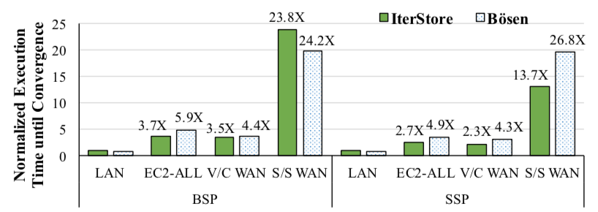
Training time over LAN vs WAN
IterStore and Bosen are Parameter Server based ML frameworks
ML application is Matrix Factorization
V/C WAN (Virginia <-> California WAN) is closer than S/S WAN (Singapore<->Sao Paulo WAN)

Slide 28
Gaia
Challenge 1 - How to effectively communicate over WANs while retaining algorithm convergence and accuracy?
Challenge 2 - How to make the system generic and work for ML algorithms without requiring modification?

Slide 29
Gaia System Overview

Slide 30
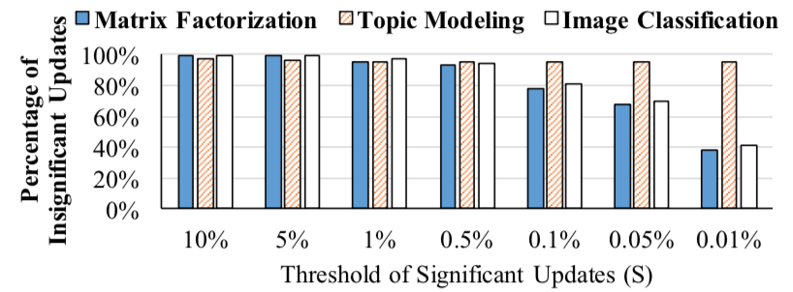
Update Significance

Slide 31
Approximate Synchronous Parallel
Significance Filter
  Significance function (|Update/Value|)
  Initial significance threshold (1%)
    To guarantee convergence, threshold is reduced by square root of the number of iterations
ASP Selective Barrier
Mirror Clock

Slide 32
Experimental Setup
Amazon EC2 – 22 machines spread across 11 regions
Emulation EC2 – 22 machines on local cluster emulating WAN
Emulation Full Speed – 22 machines on local cluster (no slow downs)
ML Applications
  Matrix Factorization (Netflix dataset)
  Topic Modeling (Nytimes dataset)
  Image Classification (ImageNet 2012 dataset)

Slide 33
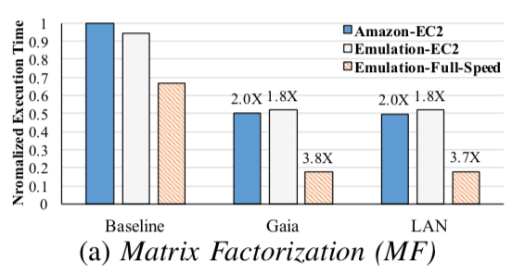
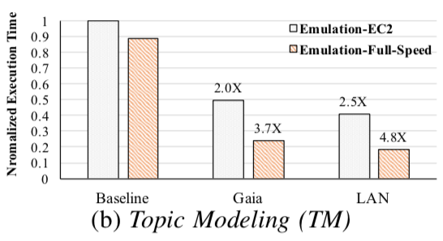
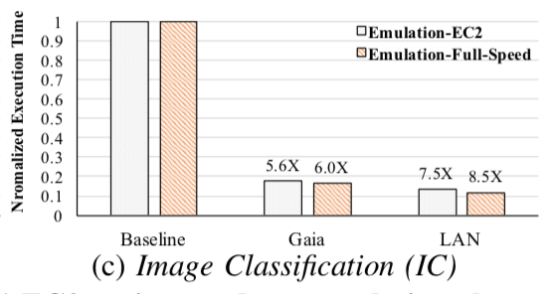
Convergence Time Improvement

Slide 34
Convergence Time and WAN Bandwidth
Virginia<->California WAN (close by)
Singapore<->Sao Paulo WAN (far apart)

Slide 35
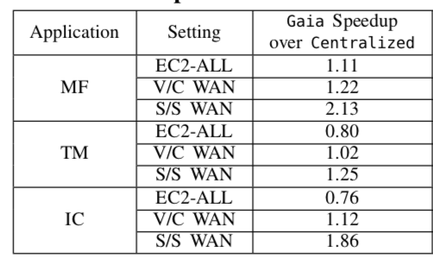
Gaia vs Centralized

Slide 36
Gaia vs Gaia_Async

Slide 37
Key Take-aways
ML training is 1.8-53.7X slower on geo-distributed data centers
Vast majority of parameter updates are insignificant
BSP and SSP synchronization models are WAN bandwidth-heavy
ASP model shares “significant” updates only and has proven convergence properties

Slide 38
Thoughts
Gaia expects the ML programmer to provide a significance function which may not be straightforward for non-linear functions.
Paper mentions 1-2% of threshold should work in most cases. ML application training is a vast space. It is not very intuitive to me why this claim might hold for most applications.
Google introduced Federated Learning for training ML models on mobile devices without copying the data to the server. Motivations for doing so were similar (privacy, bandwidth, power etc.). It will be good to understand the similarities/differences in design.

Slide 39
Clipper and Gaia Discussion
Zack Kimberg

Slide 40
Clipper Questions
In Machine Learning models, training is usually performed offline and then the final model is used for production inference. Clipper is designed solely to improve production inference performance, but how could it be modified to also allow online training while in production?

Slide 41
Clipper Questions
What are the pros and cons of implementing the production system with black box models like clipper vs. integrated models like Tensorflow Serving?

Slide 42
Clipper Questions
Clipper contains several pieces of functionality necessary for a production system such as batching, caching, and model selection. What additional pieces of functionality could be added for faster or more robust inference?

Slide 43
Gaia Questions
When would you use Gaia vs. a one-time centralization by shipping all the data to one data center?

Slide 44
Gaia Questions
What potential issues could arise with the Gaia system?

Slide 45
Gaia Questions
How could Gaia be improved?

Slide 46
Thank You !

