Slide 1
Graph Processing
Presenter: Yue Leng, Yizhi Zhu
Scriber: Jialin Liu

Slide 2
QFrag: Distributed Graph Search via Subgraph Isomorphism
Marco Serafini, Gianmarco De Francisci Morales, and Georgos Siganos
Qatar Computing Research Institute - HBKU
Presenter: Yue Leng

Slide 3
Subgraph isomorphism problem
Used most in data analysis and pipelines like dependency-driven analysis
Computational expensive even for small graph fits in memory
Find groups of three friends
Find groups of three friends that one studies at U of I and the other two studies at the same university other than U of I
NP-complete
Data graph G_{D}
Query graph G_{Q}

Slide 4
Existing framework and problems
Single machine search engine
Neo4j and RDF-3X
Cannot scale out and utilize parallel search
Graph partition framework
Dream
Extra cost in synchronization and coordination
Unbalanced work load in partitions, cannot handle vertex degree’s data skew
Bulk synchronous processing system like Spark
GraphFrames
Existing work only focus on optimized query pattern like defining specific vertex

Slide 5
QFrag’s proposal
Utilize state-of-art graph isomorphism algorithm
Use tree-based subgraph isomorphism algorithms —— TurboISO
In memory search
Target at computational complex query problems rather than graph partitioning
Replicate graph for every worker
Divide graph search
Parallel graph search starting from different vertex
Fragment task to subtask and processing in bulks to address skew

Slide 6
Algorithm - TurboISO
Problem definition:
Let $G=(V_{G}, E_{G}, L_{G})$ , Q$=(V_{Q}, E_{Q}, L_{Q})$ , find subgraph in $G$ that matches Q.
$V_{G}$ - Set of vertices in $G$
$E_{G}$ - Set of undirected edges in $G$, $E_{G}∈V_{G}× V_{G}$
$L_{G}$ - Labelling function maps a vertex or an edge to a set of labels
$$v_{7}$$
$$q_{1}$$
Query graph $G_{Q}$
$$v_{2}$$
Data graph $G_{D}$
$$v_{1005}$$
$$q_{2}$$
$$q_{5}$$
$$v_{5}$$
$$…$$
$$v_{1}$$
$$q_{3}$$
$$q_{4}$$
$$q_{6}$$
$$v_{6}$$
$$v_{1004}$$
$$v_{4}$$
$$v_{3}$$

Slide 7
TurboISO - cont.
CS$(q_{6},v_{3})$
2. Construct candidate tree
CS$(q_{3},v_{1})$
CS$(q_{4},v_{1})$
CS$(q_{5}, r)$
$$…$$
CS$(q_{2}, r)$
$$…$$
$$…$$
$$v_{3}$$
$$v_{4}$$
$$v_{5}$$
CS$(q_{6},v_{4})$
1. Construct query spanning tree
$$v_{1}$$
$$v_{2}$$
$$…$$
$$q_{1}$$
$$r$$
CS$(q_{3},v_{2})$
CS$(q_{4},v_{2})$
$$D(q_{1})$$
$$…$$
$$…$$
CS$(q_{6},v_{5})$
$$q_{2}$$
$$q_{5}$$
$$…$$
$$D(q_{2})$$
$$D(q_{5})$$
$$q_{3}$$
$$q_{4}$$
$$D(q_{3})$$
$$D(q_{4})$$
$$q_{6}$$
$$D(q_{6})$$
Candidate tree ${CT}_{r}$
Query spanning tree $T_{Q}$
CS$\left(q_{i},v_{j}\right)$ is the candidate set of vertices partially matching the relationship of $q_{i},v_{j}$
$D(q_{i})$ is the domain set of vertices satisfying properties of $q_{i}$
3. Embedding enumeration
For vertices in ${CT}_{r}$, compare the omitted relationship in $T_{Q}$
Most time-consuming work, usually use backtracking to complete
Traverse the Cartesian Product of Candidate Tree.

Slide 8
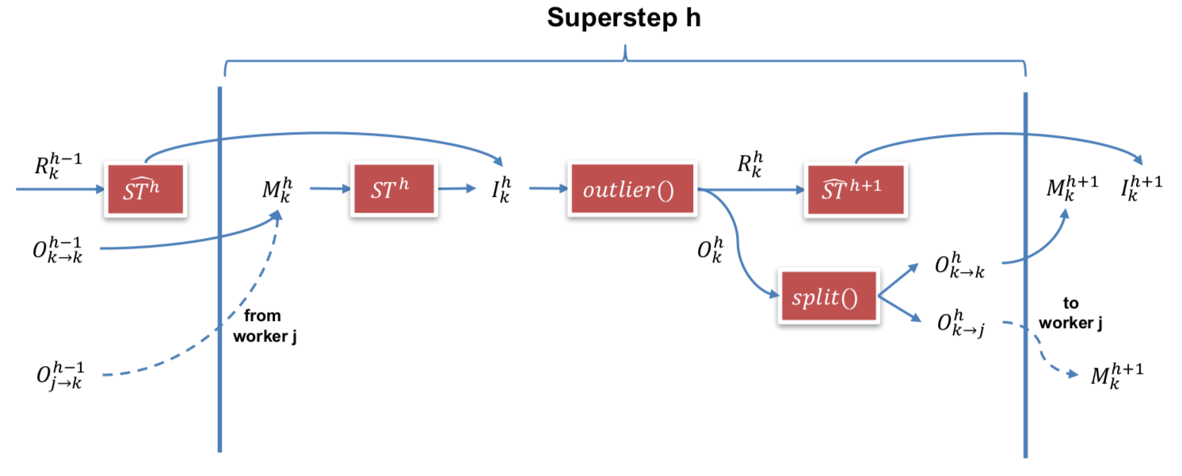
Task Fragmentation
Break the task $T$into subtasks ${ST}^{1}, …$, ${ST}^{H},$in every superstep h, get input $I_{k}^{h}$, compute outlier and split $O_{k}^{h}$ to send out for the next subtask to compute.
$$M_{k}^{h}=\left\{\begin{aligned}I_{k}^{0}, h=1 \\ &∪_{j∈\left[K\right]}O_{j→k}^{h−1}, h>1\end{aligned}\right.$$
$I_{k}^{h}= {ST}^{h}(M_{k}^{h})$ $∪{\hat{ST}}^{h}$($R_{k}^{h−1}$)
Overview of a single step (subtask) when applying task fragmentation

Slide 9
Task Fragmentation – cont.
Worker:
Superstep 1:
For every vertex received, build candidate tree. Estimate embedding enumeration cost for candidate tree, split top k% cost trees, send as the input of next superstep for different workers.
Do embedding enumeration for the rest (100-k)% trees, generate part of results.
Superstep 2:
Get the splited tree from other workers and do embedding enumeratio on trees.

Slide 10
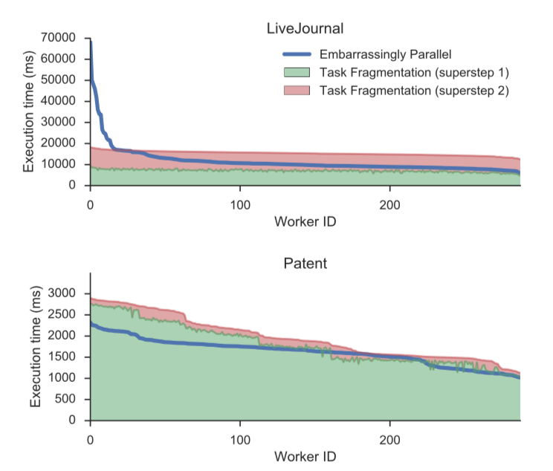
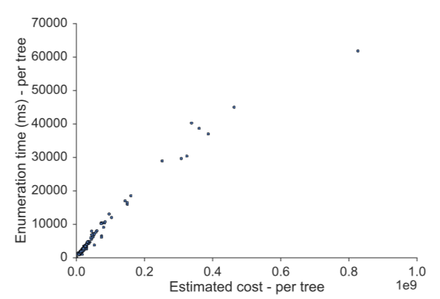
Task Fragmentation vs Embarrassing Parallel
Why not just distribute vertex in embedding enumeration?
Vertex degree skew, causing some workers do more complex computation
Estimate embedding enumeration work
Cost function definition
$cost\left(CT\left(r\right)\right)=c\left(D_{r}\right)$
$c\left(D\right)=\left|D\right|×\prod_{D^{′}∈Children(D)}{c(D^{′})}$
$c\left(D_{l}\right)=|D_{l}|$
Split Candidate Tree in domain $D\left(u_{q}\right)$
For every vertex in $D\left(u_{q}\right)$, drop related candidate sub region $CS\left(u_{q},v_{i}\right)$ to split accordingly
Drop the rest sub region to all split

Slide 11
Experiments and Evaluation Results
Experiment setting
Dataset:
1. Labeled: Citation edges between US patents & YouTube videos and related
2. Unlabeled: Orkut & LiveJournal dataset, social network graph from KONECT
Query pattern:
a
a
a
a
a
a
a
a
b
b
b
c
d
b
c
b
c
b
c
b
b
c
c
c
Q3
d
e
Q5
c
d
d
e
f
d
Q1
d
Q4
Q6
Q7
Q8
Q2

Slide 12
Experiments and Evaluation Results
Baseline:
Neo4j: production-level graph database
VF2: well-known algorithm for sub-graph isomorphism
TriAD: state-of-art asynchronous distributed join algorithm with partition based index, implemented in C++ on MPI platform
GraphFrame: Spark package to handle graph datasets
Research Questions
Performance in sequential execution
Performance in distributed execution
Task fragmentation vs embarrassingly parallel implementation

Slide 13
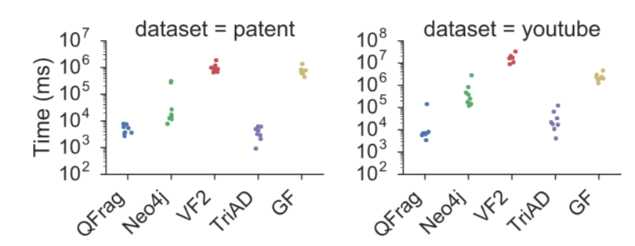
Sequential Efficiency
Use labelled query for 4 baselines
Response time with labeled queries and sequential execution in log scale
QFrag outperform TriAD for more complex queries.

Slide 14
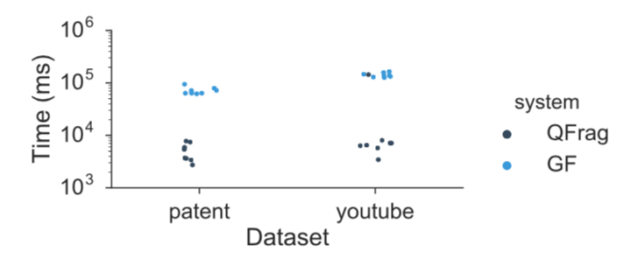
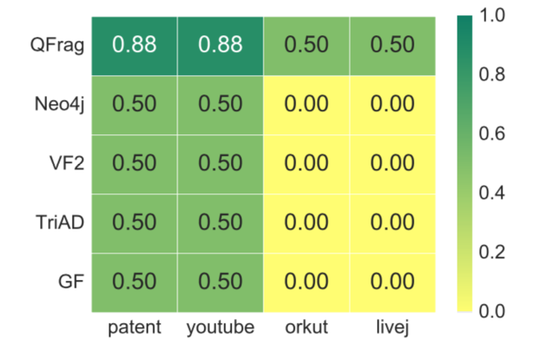
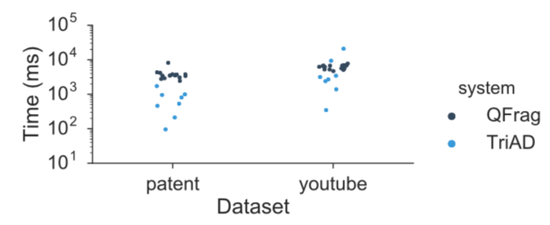
Distributed Efficiency
Response time of GraphFrames (320 processes) vs QFrag (1 process)
Labelled queries
Fraction of queries that each system is able to successfully run for each dataset
Response time of TriAD (32 processes) vs QFrag (32 workers)
Labelled queries

Slide 15
Parallelization Policies
Comparison between embarrassingly parallel and task fragmentation
Benefits of task fragmentation compared to embarrassingly parallel
when increasing the number of workers

Slide 16
Parallelization Policies
Comparison between embarrassingly parallel and task fragmentation
Speedup of task fragmentation over embarrassingly parallel for the same configuration of dataset, query, and processes

Slide 17
Key insights
State-of-art algorithm to solve problems
Leveraging subgraph isomorphism rather than join
Distributing computation rather than data
Well designed structure to handle parallel bottlenecks
Focus on split evenly workload for each worker
Leave room for improvement
Implement on Spark to serve as a library
Modular design for each part of algorithm and open for modification

Slide 18
TUX2: Distributed Graph Computation for Machine Learning
Presented by: Yeech Zhu (yzhu44)

Slide 19
Motivation
Many machine learning problems can be modeled with graphs and solved by iterative convergence algorithms
Graph engines release developers from worrying about managing data layout and partitioning, or about scheduling parallel executions
Existing graph engines lack flexibility and other key capabilities for efficiency

Slide 20
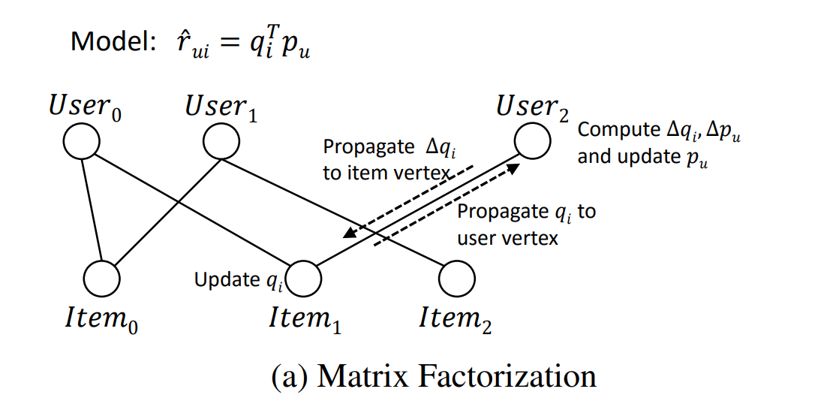
Examples of Graph Abstraction on ML
Matrix Factorization (GraphLab, TUX2)
Graph abstraction for Matrix Factorization (Netflix Recommendation)

Slide 21
Examples of Graph Abstraction on ML
Latent Dirichlet Allocation (TUX2)
Document-Word graph
Block Proximal Gradient (TUX2)
Sample-Feature(weight) graph
Video Co-segmentation (Distributed GraphLab)
Super Pixel connected to adjacent pixels in time and space
Named Entity Recognition (Distributed GraphLab)
Noun-phrase – Context graph

Slide 22
Previous Work -- GraphLab Abstraction
Common ML patterns have sparse data dependency
GraphLab is a sequential shared memory abstraction where each vertex can read and write to data on adjacent vertices and edges
GraphLab provides a globally shared data table to support arbitrary access
Scope of access for vertex V

Slide 23
Previous Work -- Distributed GraphLab
Extend the multi-core GraphLab abstraction to the distributed setting
Provide a formal description of the distributed execution model
Three Major Parts:
Data Graph: data broadly to refer to model parameters, algorithm state, and even statistical data
Update function: a stateless procedure that modifies the data within the scope of a vertex, and schedule future execution of other vertices’ update
Sync operation: runs continuously in the background to maintain updated estimates of the global value.

Slide 24
Previous Work -- PowerGraph
Graph abstractions rely on each vertex having a small neighborhood to maximize parallelism
Graphs derived from real-world phenomena, like social networks and the web, typically have power-law degree distributions
This skewness introduces difficulties on work balance, partitioning,

Slide 25
Previous Work -- PowerGraph
Single vertex program is allowed to span multiple machines
Instead of edge cut, it uses P-Way Vertex Cut
Randomly nominate master which maintains the master version of the vertex data
All remaining replicas of v are then mirrors and maintain a local cached read only copy of the vertex data
Vertex Cut and Master Mirror illustration

Slide 26
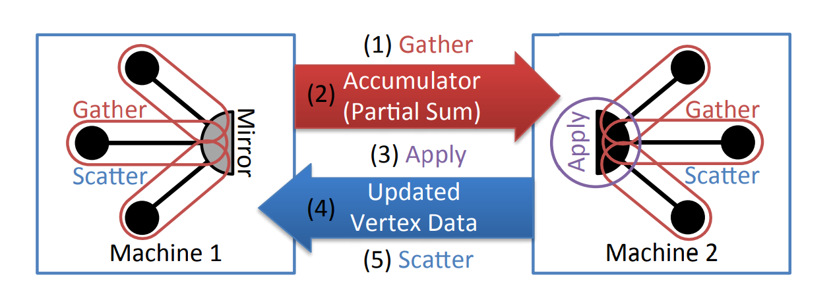
Previous Work -- PowerGraph
a state-less vertex-program Interface (GAS)
Gather: accumulates data in adjacent vertices and edges (map).
Sum: commutative and associative operation (reduce)
Apply: takes the summed value and computes a new vertex value, write back to the data graph.
Scatter: invoked in parallel on adjacent edges, to compute new edges and write back.
Illustration of GAS stages on the vertex spanning multiple machines

Slide 27
TUX2 -- Claimed Gaps
Data models often have different types of vertices playing distinct roles, thus not homogeneous
An iteration of graph computation may involve multiple rounds of propagations, which requires several GAS phases.
Machine learning frameworks have been shown to be robust to variations and slack, which can be leveraged to improve efficiency and parallelism.

Slide 28
TUX2 -- Design
Vetex-Cut based partition, master and mirrors (like PowerGraph).
Allows to specify type of vertices to support heterogeneity
maintains vertices and edges in separate arrays
Edges in the edge array are grouped by source vertex
Each vertex has an index giving the offset of its edge-set in the edge array
This design is optimized for traversal and claimed to outperform lookup table used in GraphLab.

Slide 29
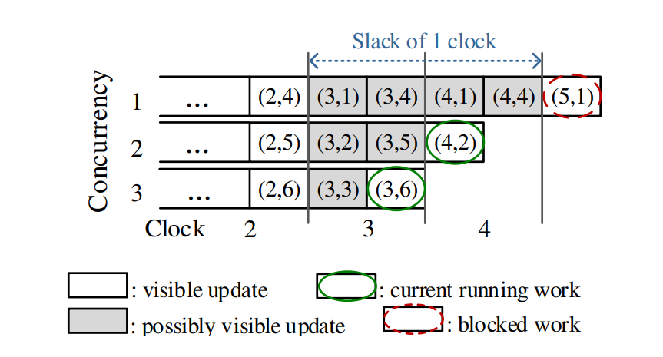
TUX2 -- SSP Scheduling
Stale Synchronous Parallel (SSP) model with bounded staleness and mini-batches.
Clock: an iteration over a mini-batch executed by a set of tasks
Define slack s, a task at clock t, can see all updates from clocks 1 to t −s−1, and may see the updates from clocks t −s to t −1
Illustration of bounded staleness. (i,j) indicates a task with id j in clock i

Slide 30
TUX2 -- MEGA Model
Each stage has user-defined functions (UDF) to be applied
MiniBatch: composite stage
Exchange: enumerates edges on set of vertices
Global Sync: synchronizing the contexts across worker and vertices
Apply: accumulates deltas from mirrors, and synchronizes
D are data associated with vertices and edges, a are the accumulated delta, s is the context data

Slide 31
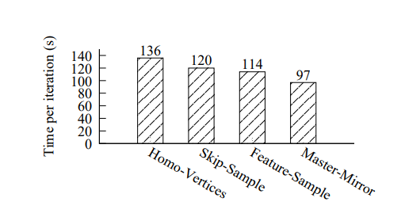
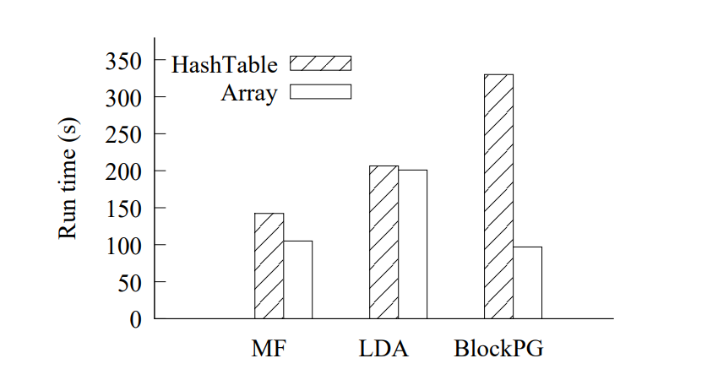
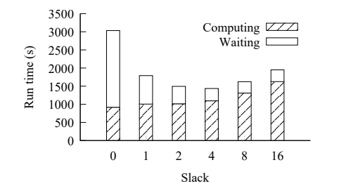
TUX2 -- Parameter Tuning
Running time comparison for different heterogeneity on BlockPG
Running time comparison on different data layout
Accuracy?
Running time analysis of different slack size on BlockPG

Slide 32
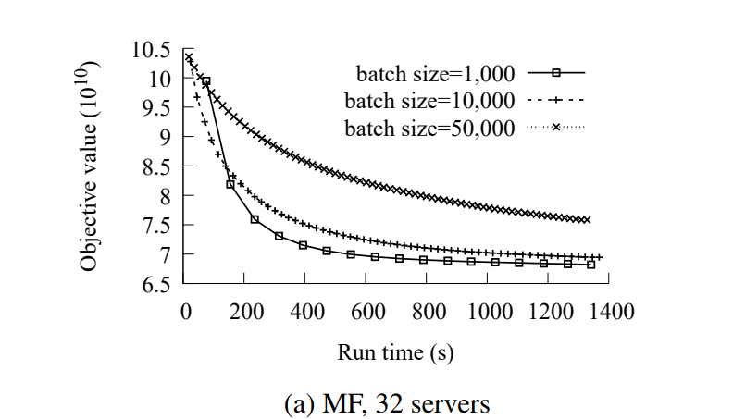
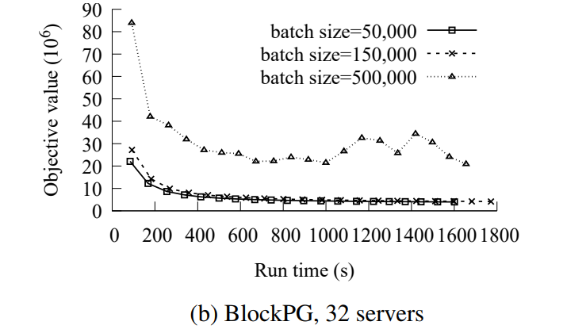
TUX2 -- Evaluation on Mini-Batch size
Tuning different Mini-Batch size on MF and BlockPG to show that the size of mini-batch effects the communication overhead (smaller mini-batch, faster convergence, more overhead).

Slide 33
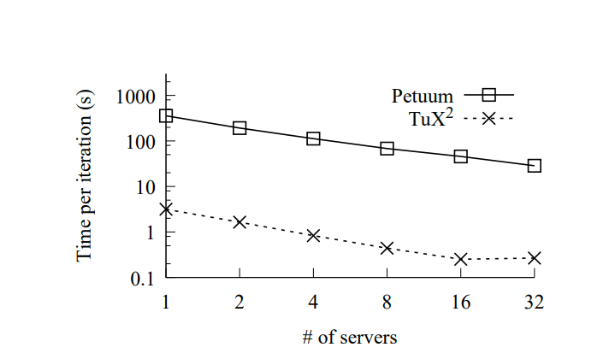
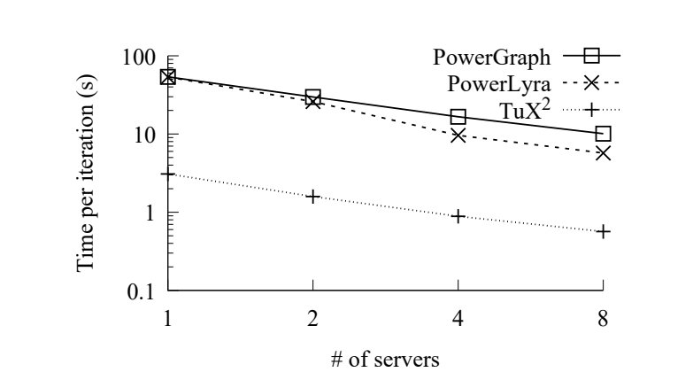
TUX2 -- Performance Comparison
The improved performance over PowerGraph/PowerLyra comes from the flexibility of MEGA model
The performance difference from Petuum because the distributed shared memory table has a multi-layer hash structure, and data are stored in parameter server

Slide 34
TUX2 -- Take Away
TUX2 introduces MEGA model to provide more flexibility to fit different ML tasks
TUX2 supports Stale Synchronous Parallel to improve parallelism
Thoughts:
A good implementation or a good research project?
Lack comparison with major baseline PowerGraph/PowerLyra?
Programmability vs PowerGraph/GraphLab?
Fault Tolerance?

Slide 35
Reference
Y. Low, J. Gonzalez, A. Kyrola, D. Bickson, C. Guestrin, and J. M. Hellerstein. Graphlab: A new parallel framework for machine learning. In UAI, pages 340–349, 2010.
LOW, Y., BICKSON, D., GONZALEZ, J., GUESTRIN, C., KYROLA, A., AND HELLERSTEIN, J. M. Distributed GraphLab: A framework for machine learning and data mining in the cloud. Proc. VLDB Endow. 5, 8 (Apr. 2012).
GONZALEZ, J. E., LOW, Y., GU, H., BICKSON, D., AND GUESTRIN, C. PowerGraph: Distributed graph-parallel computation on natural graphs. In Presented as part of the 10th USENIX Symposium on Operating Systems Design and Implementation (2012), OSDI’12, USENIX
W. Xiao, J. Xue, Y. Miao, Z. Li, C. Chen, M. Wu, W. Li, and L. Zhou. Tux²: Distributed Graph Computation for Machine Learning. In USENIX NSDI, 2017

Slide 36
Graph Processing Discussion
Scriber: Jialin Liu
Date: Apr 25th

Slide 37
TuX²

Slide 38
TuX²
Performance
Usability
Robustness

Slide 39
Performance
How will its performance be affected?

Slide 40
Performance
How will its performance be affected?
By dataset
By physical machine
By its own abstraction

Slide 41
Robustness
Is TuX² able to handle machine failure?
Possible but hard...

Slide 42
Usability
Is the system easy to use in reality?
Is graph abstraction able to represent all ML algorithms?

Slide 43
QFrag

Slide 44
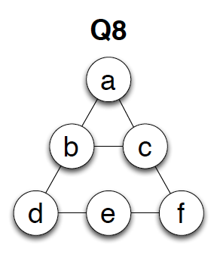
QFrag
Limitations:
Piazza Reviews:
In-memory graph processing.
High Latency? Not an issue actually...
Still very long running time on large unlabeled graph.

Slide 45
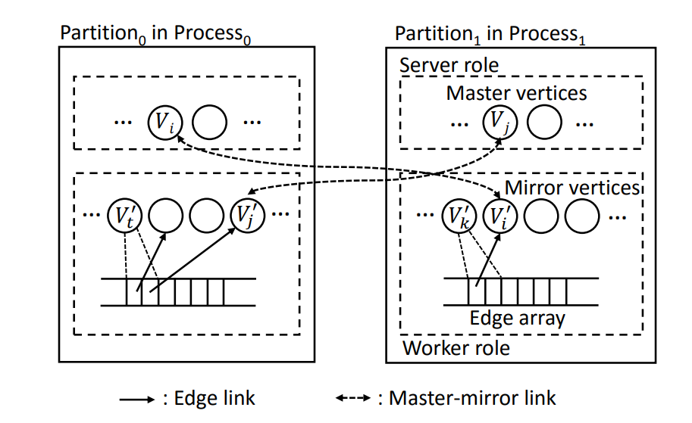
TUX2 -- Design
Each partition(thread) plays both a worker role and a server role.
Worker: enumerates vertices in the partition and propagate vertex data along edges
Server: synchronizes states between mirror vertices and their corresponding masters.

Slide 46
TUX2 Heterogeneity
Scanning item vertices in a mini-batch leads to mirror vertices being located contiguously in an item vertex array.
TUX 2 can therefore easily identify them for master-mirror synchronization by simply rescanning the corresponding range of that array (a).
In contrast, scanning user vertices in a mini-batch would require an extra index structure to identify the mirror updates. This is because they are scattered in an item vertex array (b)

Slide 47
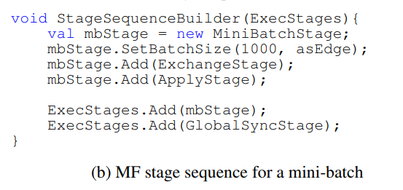
TUX2 -- MF Example

