Slide 1
SLAQ: Quality-Driven Scheduling for Distributed Machine Learning
Haoyu Zhang, Logan Stafman, Andrew Or, Michael J. Freedman
Princeton University
Presenter: Tianshi Wang
Notes:
Distributed machine learning, which is a very popular topic today. Frameworks like Tensorflow, PyTorch, MXNet and Caffee 2 all support distributed machine learning function. Using distributed distributed machine learning becomes critical to speedup the training process when we trying to do complex machine learning jobs like training a deep neural network. In this paper, the authors present a new job-level scheduler for distributed machine learning which is called SLAQ. And let’s check out why they design such a scheduler and understand its algorithm.

Slide 2
Background and Motivation
What is distributed machine learning?
Job 0
Job 1
Job 2
Model parameters
Model parameters
Model parameters
Task1
Task2
Task3
Task1
Task2
Task3
Task1
Task2
Task3
send task
send task
update parameters
update parameters
Scheduler
update parameters
send task
send task
update parameters
Worker 0
Worker 1
Worker 2
Notes:
I’ll start with the background and motivation of SLAQ. Most of us might be familiar with training machine learning model with frameoworks like Tensorflow on a single machine. What is it like if we do distributed machine learning? This is based on Spark MLLib architecture. Because SLAQ is implemented based on Spark, so this figure is about the architecture of Spark.
Driver programs. Each of the job has one driver.
Back and forth, ideally the parameters will converge and then we can get the final model.

Slide 3
Background and Motivation
2 steps for a scheduler:
Job level scheduling: allocating resources (CPUs) to each of the active jobs
Task level scheduling: for each job, assigning tasks to the available workers
Current job-level schedulers focus on resource fairness (each job gets the same resources)
Notes:
In this distributed training architecture, the scheduler has 2 steps to do:
1. Because we are talking about running multiple machine learning jobs on one cluster. So there exists contention on the resources among those active jobs. Good scheduling strategy is critical for the overall performance of the cluster
2. locality or some other factors to assign tasks to the available workers

Slide 4
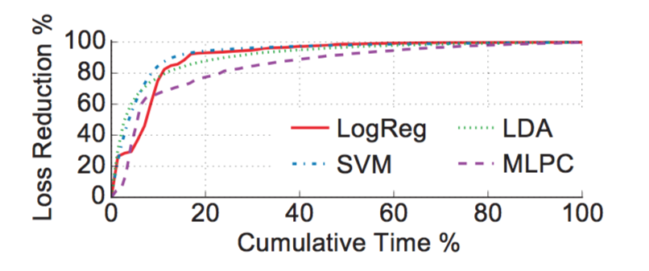
Background and Motivation
Problems for current job-level scheduler
Loss reduction rate gradually
drops
Allocate less resources
Loss reduces rapidly
at the early stage
Allocate more resources
Key Observation: Give more resources in the early stage of an job, its loss could decrease much faster
Zhang, Haoyu, et al. "SLAQ: quality-driven scheduling for distributed machine learning." Proceedings of the 2017 Symposium on Cloud Computing. ACM, 2017.
Notes:
What is the problem of using fair scheduler in distributed machine learning?
Different machine learning jobs.
At each iteration of training, we’ll get a loss. Based on the loss, we can update our parameter.
Y-axis: loss reduction. Loss reduction grows to 100% -> converge.
If we can spend our resources in the early stage of an job, we can get more improvement on the quality of the model.

Slide 5
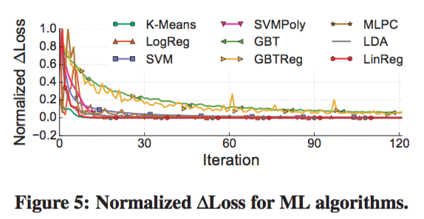
SLAQ --- Challenges
1. Difficult to compare the training progress of different jobs
ML algorithms use various different measurement metrics to indicate the quality of model training
Use Normalized Loss Reduction
normalize the change in loss values between iterations
generally follow similar convergence properties
$∆L$ always converges to 0
Normalized $∆L$ = loss reduction of current iteration / the largest loss reduction we have ever seen so far
Notes:
Loss normalization: “we normalize the change of loss values in the current iteration with respect to the largest change we have seen so far.“

Slide 6
SLAQ --- Challenges
2. How to predict the impact that an extra unit of resources would have on the quality and runtime of ML training jobs
(i) how many iterations the job will have completed by the next scheduling epoch
c$∙$S/N
constant determined by the algorithm complexity
number of CPUs
size of data
(ii) how much progress (loss reduction) the job could make within these iterations
Distributed optimization algorithms:
sublinear algorithms: $f\left(k\right)=\frac{1}{ak^{2}+bk+c}+d$
linear and superlinear algorithms: $f\left(k\right)= μ^{k−b}+c$
+
weights assigned to loss values decay exponentially when new iterations finish
Notes:
Here we want to predict the impact of allocating more resources to a job and so that we can decide whether we should give this job more resources. This is another challenge.
The iterations number: linear relation between the number of cpus and the number of iterations
Step 1, we know how many iterations this job could complete in the given scheduling epoch. To understand how much quality improvement the job could get, we also need to predict the loss reduction in the following several iterations. We can broadly categorize the algorithms by their convergence rate
With the assumptions of loss convergence rate, we use curve fitting to predict future loss reduction based on the history of loss values

Slide 7
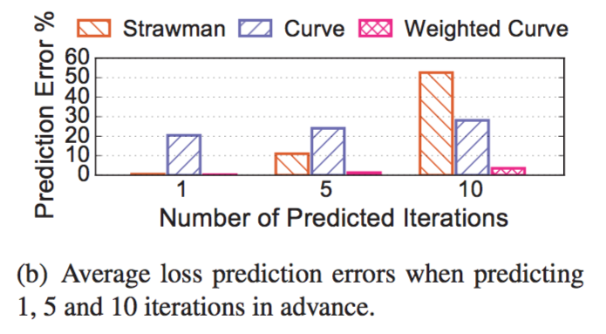
SLAQ --- Challenges
2. How to predict the impact that an extra unit of resources would have on the quality and runtime of ML training jobs
Notes:
A strawman solution is to directly use the loss reduction obtained from the last iteration as the predicted loss reduction value for the following several iterations

Slide 8
SLAQ --- Main Ideas
Normalized loss -> universal unit for evaluating progress
Runtime prediction + loss prediction -> functions for optimization
Notes:
Now we have the

Slide 9
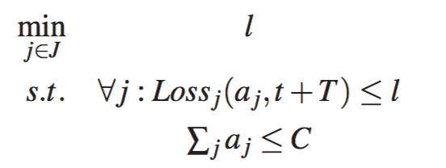
SLAQ --- Main Ideas
Scheduling Based on Quality Improvements
1. Maximizing the total quality
2. Maximizing the minimum quality
3. Prioritize jobs on shared clusters
4. Mixing ML with other types of jobs
Notes:
1. maximizing the total normalized loss reduction
3. This can be easily adjusted to account for jobs with different importance by adding a weight multi- plier to the jobs, identically to how max-min fairness can be easily changed to weighted max-min fairness.
4. For non-ML jobs, the scheduler falls back to fairness or reservation based resource allocation.
Sum of allocated resources a j cannot exceed the cluster resource capacity C.

Slide 10
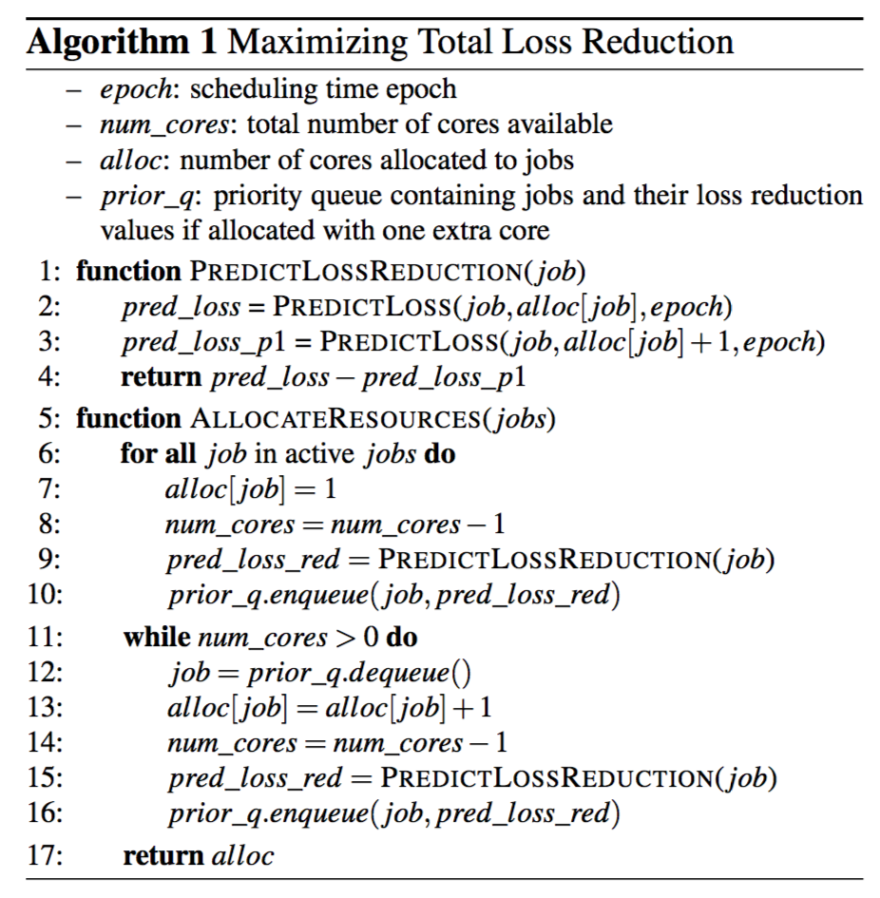
SLAQ --- Main Ideas
Scheduling Based on Quality Improvements
1. Allocate 1 CPU to each job
find the job with highest loss reduction
2. Allocate rest of CPUs based
on loss reduction order
Recompute loss reduction
Reorder the priority queue

Slide 11
SLAQ --- Experiments
Implementation: Apache Spark + MLlib
Testbed: 20 cloud VMs (each has 32 vCPUs, 60GB RAM and 10Gb Ethernet links)
Workload:
Datasets: 200GB distinct datasets, data processed at each iteration to be 100%
Baseline: fair scheduler

Slide 12
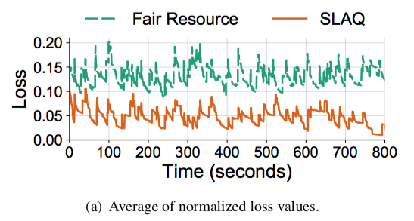
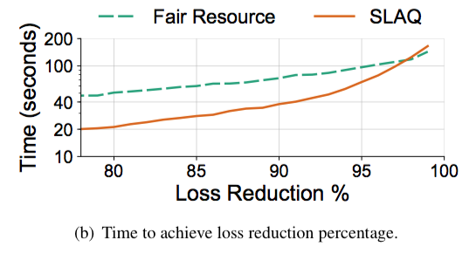
SLAQ --- Experiments
Scheduler Quality and Runtime Improvement
Spikes refer to new job arrival
Job quality is less likely to improve
Scheduling overhead
Jobs are submitted to the cluster with their arrival time following a Poisson distribution (mean arrival time 15s)

Slide 13
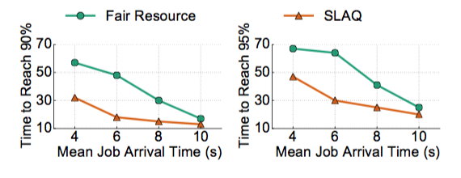
SLAQ --- Experiments
Handling Different Workloads
More contentious
SLAQ achieves a greater relative benefit over a fair schedule under more contentious or aggressive workloads

Slide 14
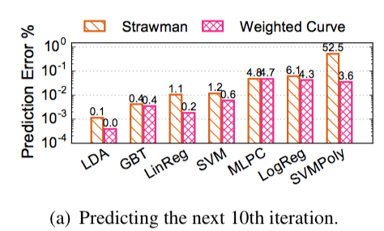
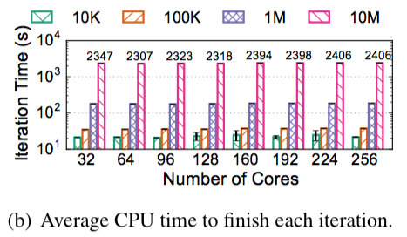
SLAQ --- Experiments
Robustness of Prediction
Number of CPUs doesn’t influence the average iteration’s CPU time
Not linearly increase
Our prediction achieves less than 5% prediction errors for all the algorithms
Each iteration’s CPU time is c · S (c as a constant), regardless of how many workers are allocated

Slide 15
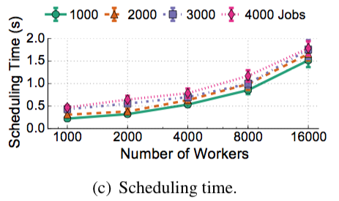
SLAQ --- Experiments
Scalability and Efficiency
SLAQ is sufficiently fast and scalable for (rather aggressive) real-world needs
Notes:
These decisions are made each scheduling epoch, a timeframe of a few seconds

Slide 16
Takeaways
SLAQ is a job-level scheduler for distributed machine learning
Allocate CPUs to jobs to maximize the total quality of all jobs
Largely reduce the training time for getting a good model
In many cases we don’t need to maximize the accuracy of a model
When tuning training parameters, we can stop training before it converges (to save time)
SLAQ can save a lot of time for training in a multi-tenant cluster

Slide 17
Device Placement Optimization with Reinforcement Learning
Azalia Mirhoseini, Hieu Pham, Quoc V. Le, Benoit Steiner, Rasmus Larsen, Yuefeng Zhou, Naveen Kumar, Mohammad Norouzi, Samy Bengio, Jeff Dean
Google Brain
UIUC, CS 525, Spring 2018
Presenter: Shiqi Sun
Notes:
What is one of the most trendy topics in computer science (even in the society)

Slide 18
Neural Network!
What can it do?
Image classification, speech recognition, machine translation, speech synthesis, etc.
Growth in size and computational requirements
Cannot train on only one machine, too slow
ImageNet-1k with ResNet-50 on a NVIDIA M40 GPU takes 14 days...
How to speed up?
Distributed training!
Heterogeneous environment: CPUs + GPUs
Placement issue: Which operations on which devices?
Notes:
Computational requirements growth for both training and inference. Clearly, one machine cannot handle large jobs with multiple operations
Computations in neural nets consist of a bunch of operations.
As today’s topic may suggest..... ML for system for ML!

Slide 19
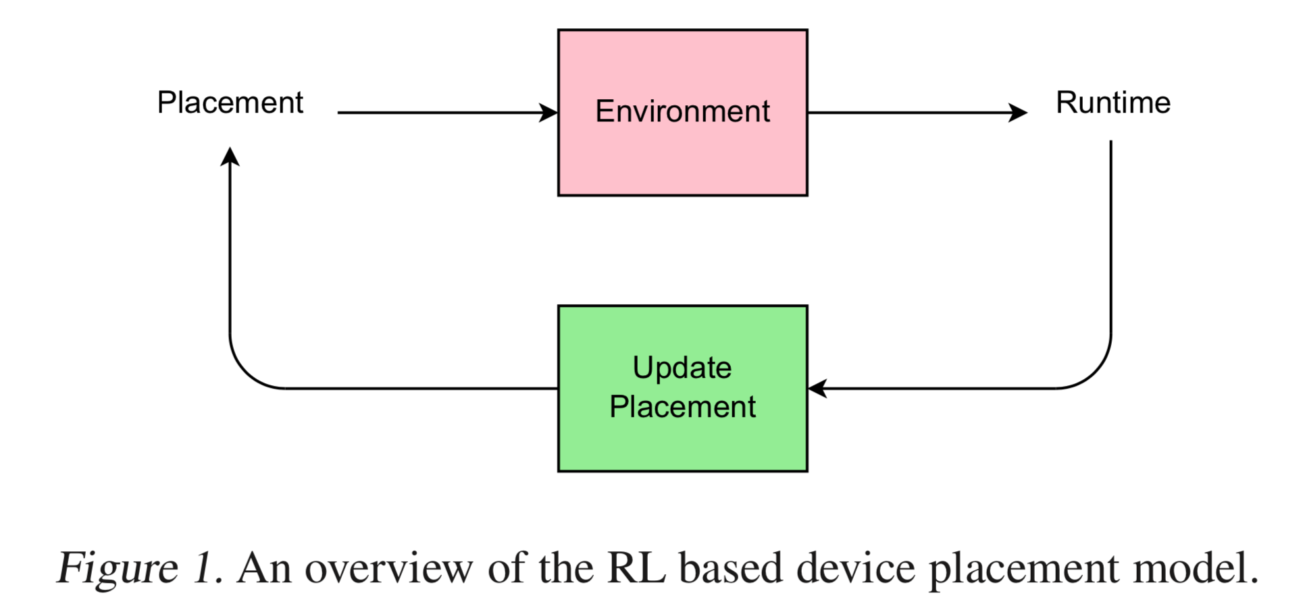
ML for System for ML
Use reinforcement learning (RL) to make device placement decision in NN
Neural Network Platform: TensorFlow
Reward: Execution time
Experiments
Notes:
The method takes into account information of the environment by performing series of experiments to understand which parts of the model should be placed on which device, and how to arrange the computations so that the communication is optimized.
Each proposal is executed in the hardware environment to measure the execution time. The execution time is then used as a reward signal to train the recurrent model so that it gives better proposals over time.
In the case of TensorFlow, the computations of programs are modeled as a graph whose vertices represent operations, while the graph edges represent the multidimensional data arrays (tensors) communicated between them.

Slide 20
Problem Definition
Computational graph 𝒢 with $M$ operations $\left\{o_{1}, o_{2},…,o_{M}\right\}$ and $D$ devices
Placement $𝒫=\{p_{1}, p_{2}, …, p_{M}\}$, an assignment of an operation $o_{i}∈𝒢$ to device $p_{i}$, where $p_{i}∈\{1,2,…,D\}$
E.g., $M=5$and $P=3$, $𝒫=\{3,1,2,2,1\}$ means operation $o_{1}$ is placed to device 3, operation $o_{2}$ to device 1, $o_{3}$ to 2, etc.
$r\left(𝒫\right) :=$ execution time of computation 𝒢 under placement $𝒫$
Objective: find $𝒫$ such that $r\left(𝒫\right)$ is minimized

Slide 21
Problem Definition (cont.)
More definitions!
$π\left(𝒫 | 𝒢;θ\right) :=$ (stochastic) policy
Deterministic policy: a decision of an exact action (i.e. $𝒫$) at given state (i.e. $𝒢$)
Stochastic policy: gives action at a state according to a probabilistic distribution
$θ :=$ the parameter(s) that decides the placement
$J\left(θ\right) :=$ objective function
Notes:
Deterministic policy in our case: each operation is assigned to one and only one device
Stochastic policy is better because 1) the environment can be stochastic, and 2) partially observable state
https://www.quora.com/How-do-we-benefit-from-stochastic-policies-in-reinforcement-learning

Slide 22
Now the problem becomes...
Train $π\left(𝒫 | 𝒢;θ\right)$ to minimize the objective
$$J\left(θ\right)=E_{𝒫\sim π(𝒫|𝒢;θ)}[R(𝒫)|𝒢]$$
$R(𝒫)$ not $r(𝒫)$?
$R\left(𝒫\right)=\sqrt{r(𝒫)}$
Issues for $r(𝒫)$:
At beginning, $r(𝒫)$is noisy due to bad placement sampling
Near converge, less distinguishable training signals due to small difference in $r(𝒫)$
$R\left(𝒫\right)$ defined empirically
Keep in mind that $π(𝒫|𝒢;θ)$ is a probabilistic model
Notes:
Then how is $π(𝒫|𝒢;θ)$ implemented?

Slide 23
Detailed architecture of $π\left(𝒫 | 𝒢;θ\right)$
A sequence-to-sequence model with long short-term memory (LSTM) and a content-based attention mechanism.
Used to sample placement.
Encoder RNN
Decoder RNN
Notes:
Model has two main part: encoder RNN and decoder RNN
Parameter $θ$ resides in this model!
Attention: global attention (one large vector)

Slide 24
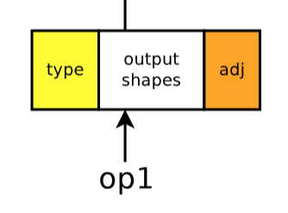
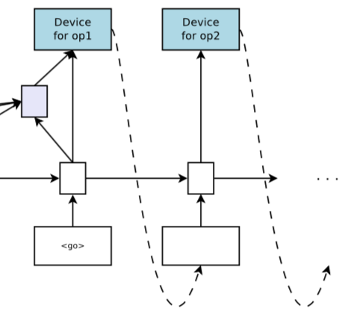
Architecture (cont.)
Encoder RNN
Input: sequence of operations of the input graph
Embed the operations by concatenating:
Type of operation (e.g. MatMul, conv2d)
Output shape list: size of each operation’s list of output tensors
One-hot encoding vector that represents the operations that are direct input and output of each operation (adjacency information)
Decoder RNN
An attentional LSTM with same time step as encoder
(which is the number of operations in 𝒢)
Each device also has its own embedding, fed as input
to the next decoder time step
Notes:
Tensor:
Attention mechanism:

Slide 25
Back to equations!
Recall the objective function: $J\left(θ\right)=E_{𝒫\sim π(𝒫|𝒢;θ)}[R(𝒫)|𝒢]$
Policy gradient (REINFORCE equation):
$$∇_{θ}J\left(θ\right)=E_{𝒫\sim π(𝒫|𝒢;θ)}[R\left(𝒫\right)⋅∇_{θ}log p\left(𝒫 | 𝒢;θ\right)]$$
Then we can update parameter $θ$:
$$θ=θ−α∇_{θ}J(θ)$$
Estimate $∇_{θ}J\left(θ\right)$ by drawing $K$ placement samples using $𝒫_{i}\sim π(⋅|𝒢;θ)$, and reduce the variance of policy gradient by a baseline term $B$:
$$∇_{θ}J\left(θ\right)≈\frac{1}{K}\sum_{i=1}^{K}{\left(R\left(𝒫_{i}\right)−B\right)⋅∇_{θ}log p(𝒫_{i}|𝒢;θ)}$$
This is partial derivative over $θ$
Notes:
Cannot compute the expected value directly, so sample the distribution $π$ and compute the average gradient
If there are lots of questions about $B$, explain it when talking about distributed machine learning:
Each worker machine is different, so if only measure execution time, the result varies.

Slide 26
Some details in practice
Some placements can fail to execute
E.g. put all operations of a huge LSTM on a single GPU will exceed the memory
Manually set $R(𝒫)$ to large constant (failing signal) for input graph $𝒢$
Through training, some placements fail (perhaps) due to state of machine
Undesirable towards the end, since this results in large difference between $R(𝒫_{i})$ and $B$, thus can perturbs the trained $θ$ from (near) optimum
Hard-code that after 5,000 steps, only update $θ$ when the sampled $𝒫$ executes
Notes:
Assumes after 5000 steps it is close to optimum

Slide 27
Co-locating Operations
Computational graphs are huge (thousands of operation types)
Causes vanishing and exploding gradient issues, and large memory footprint
Co-location groups:
Use TensorFlow’s default colocate_with feature
Heuristics: if the output of an operation $X$ is only consumed by another operation $Y$, then $X$ and $Y$ are co-located.
Notes:
Force operations on same device

Slide 28
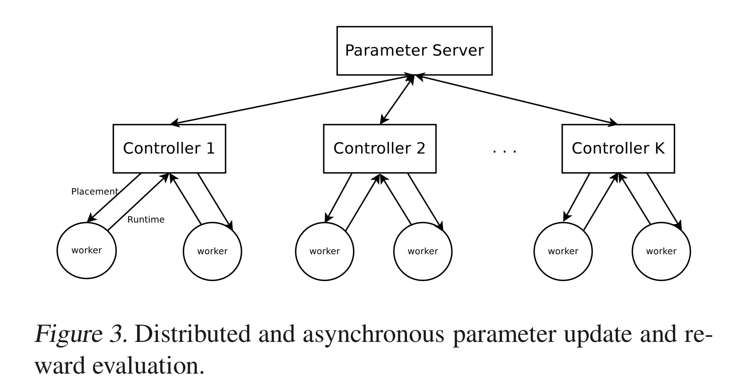
Distributed Training Process
Speed up training process using asynchronous distributed training
Parameter server: interact with controllers; hold controllers’ parameters
Controller: execute the current policy defined by the attentional sequence-to-sequence model; interact with $K$ workers
Worker: compute execution time
Recall:
$∇_{θ}J\left(θ\right)≈\frac{1}{K}\sum_{i=1}^{K}{\left(R\left(𝒫_{i}\right)−B\right)⋅∇_{θ}log p(𝒫_{i}|𝒢;θ)}$
Notes:
We note that the parameter server holds only the controllers’ parameters, and not the input graph’s param- eters, because keeping the input graph’s parameters on the parameter server can potentially create a latency bottleneck to transfer these parameters

Slide 29
Distributed Training Process (cont.)
Two alternating phases:
Workers wait for placement
Controllers sample $K$ placements and send to workers; phase changes
Workers execute placement 10 steps and measure average running time using all steps except for the first
Controllers wait for running times from workers and compute gradients to asynchronously update controller parameters in the parameter server
Notes:
We observe that in TensorFlow, the first step can take longer to execute compared to the follow- ing steps, and hence we treat itss runing time as an outlier

Slide 30
Training Process in Experiments
20 controllers, each with 4 or 8 workers, normally takes 12 to 27 hours to find the best placement
Each controller has its own baseline $B$
Notes:
More worker more accurate, but have to put more workers in idle states, which is a waste
Different baseline due to discrepancies between machines

Slide 31
Experiments Setups
Benchmarks
Recurrent Neural Language Model (RNNLM)
Attentional Neural Machine Translation (NMT)
Inception-V3 (image classification)
Baselines for comparison
Single-CPU/GPU
Scotch: attempt to balance computational load and reduce communication cost
MinCut: Scotch without CPU
Expert-designed (human)
Devices
CPU: Intel Haswell 2300 CPU, 18 cores
GPU: Nvidia Tesla K80 GPUs
Memory: 50 GB of RAM for all models
Notes:
These are three important neural networks in the deep learning literature
RNNLM: multiple LSTM layers, The grid structure of this model introduces tremendous potential for parallel executions because each LSTM cell can start as soon as its input and previous states are available
NMT: similar to RNNLM, but its large number of hidden states due to the source and target sentences makes model parallelism a necessity. Experts propose to place each LSTM layer, the attention layer, and the softmax layer, each on a separate device; it’s good, but not optimal.
Inception-V3 is Google’s latest model available to public so far, released in 2015, with 3.46% top-5 error on ImageNet.
Co-location: preprocess the TensorFlow computational graph and create co-location groups.
Scotch: graph partitioning algorithm with heuristic

Slide 32
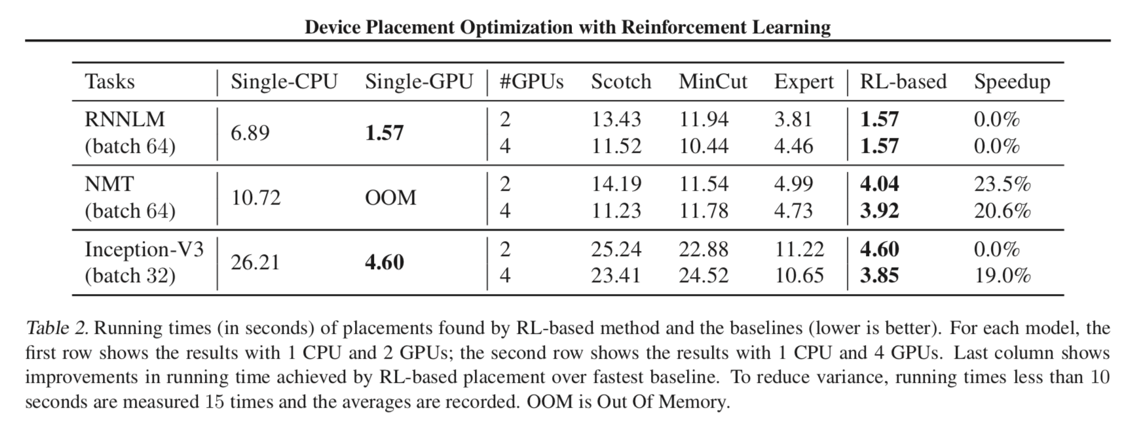
Single-Step
Evaluate time for one forward pass, one backward pass and one parameter update
Notes:
Either tied or better than other methods.
Result shows that despite being given no information other than the running times of the placements and the number of available devices, our model learns subtle tradeoffs between performance gain by parallelism and the costs induced by inter-device communications
Inception-V3:
When 2 GPUs, the degree of freedom for model parallelism is limited. RL-based placer learns to put all computation in only one GPU. However, if 4 GPUs available, it learns an efficient way to use all of the GPUs, thus the per-step execution time is reduced from 4.60s to 3.85s.

Slide 33
Result Placement for NMT
Placement searching space: 5^280
Notes:
Specify the placement space: 5^280
This is a non-trivial placement.

Slide 34
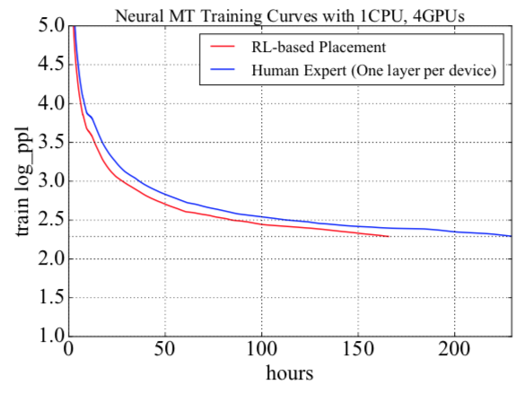
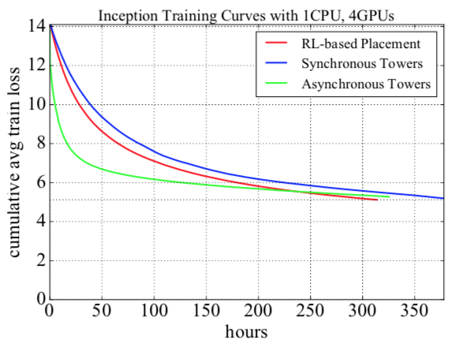
End-to-End: run through entire training process
NMT: 200,000 steps, trained each model 4 times and took average
Inception-V3: average of 4 runs, baselines are Synchronous Towers and Asynchronous Towers (expert-designed placements)
RL finishes early
Faster than Sync Towers
Async Towers converge slow
RL-based crossed Async eventually
Notes:
(WMT14 English-German dataset, vocabularies of both languages consist of 32, 000 word pieces
only the translation pairs where no sentence has more than 40 word pieces)
Right-hand figure: Keep training until the model reaches the accuracy of 72% on the validation set. Training curves of Inception-V3 model using RL-based placement and two expert-designed placements: Synchronous towers and Asynchronous towers. The per-step running time as well as the perplexities are averaged over 4 runs.
Asynchronous towers, puts one replica of the Inception-V3 network on each GPU
Synchronous Tower, is the same as Asynchronous towers, except that it waits for the gradients of all copies before making an update
In machine learning, the term perplexity has three closely related meanings. Perplexity is a measure of how easy a probability distribution is to predict. Perplexity is a measure of how variable a prediction model is. And perplexity is a measure of prediction error. The third meaning of perplexity is calculated slightly differently but all three have the same fundamental idea. “Easiness of prediction”, 2^H(p), entropy
Train loss: It is a summation of the errors made for each example in training sets. The lower the loss, the better a model.
RL-based placement of Inception-V3. Devices are denoted by colors, where the transparent color represents an operation on a CPU and each other unique color represents a different GPU. RL-based placement achieves the improvement of 19.7% in running time compared to expert-designed placement

Slide 35
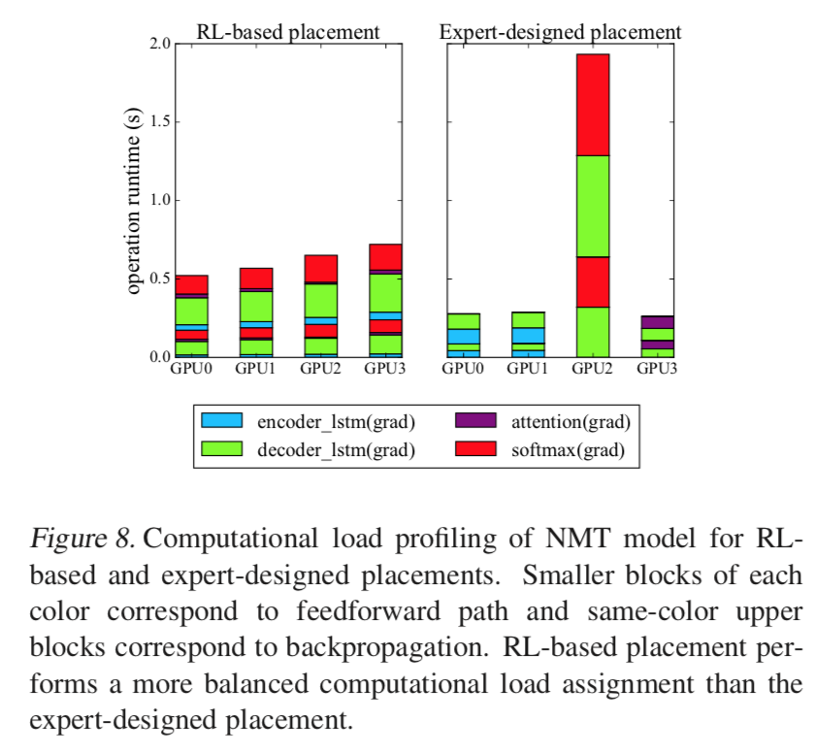
Analysis of Placement
NMT
per-device computational loads (measured in operation runtime)
Balanced!
Notes:
Expert-designed: imbalance

Slide 36
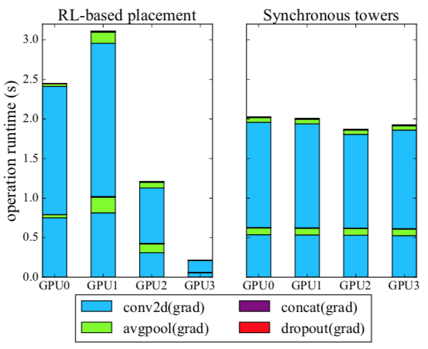
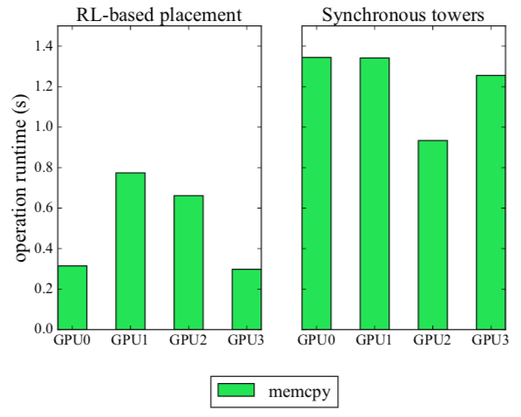
Analysis of Placement (cont.)
Time reduction comes from less time copying data between devices
Inception-V3
Imbalance in RL-based!
Notes:
Imbalanced operation runtime in RL-based!
The paper suspect this is because Inception-V3 has more dependencies, allowing less room for model parallelism across GPUs.
Discussion: good result is app-dependent?
The reduction in running time of the RL-based placement comes from the less time it spends copying data between devices.

Slide 37
Takeaway
Adaptive reinforcement learning method to optimize device placement in neural networks.
Sequence-to-sequence model to propose device placement.
RL-based placer learns the trade-off between performance enhanced by parallelism and communication cost.
For image classification, language modeling, and machine translation RL-based placement either ties or beats other methods, including human expert.
Notes:
Discussion:
Still has manual tuning: e.g. 5000 steps
Never mention about accuracy, but probably not a problem since placing difference should not influence accuracy

Slide 38
Thank you!

Slide 39
Discussion ML for (SYSTEMs FOR ML)
Scriber:Qishan Zhu
04/11/2018

Slide 40
System for ML What’s the difference?
SLAQ:
Resource allocation across multiple jobs
Device Placement Optimization with Reinforcement Learning:
Device allocation for TensorFlow computational graph
(a single job)

Slide 41
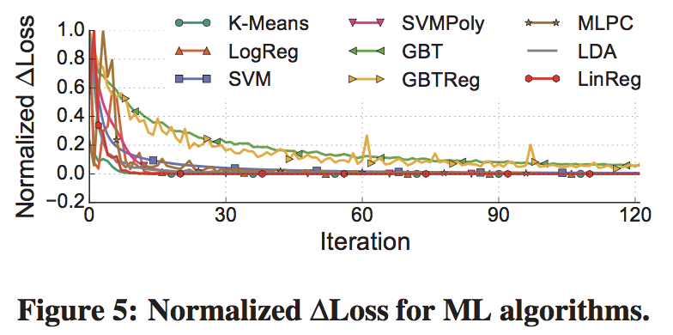
SLAQ Problem: Is the normalization robust?
Normalize the change in loss values between iterations
Hard to make good adjustment on scheduling at the beginning. However, this paper claims that the beginning steps are most important to have improvements.
Notes:
I think it is robust to some extend. Because the loss prediction actually works well as we can see, the experiment result is better than human heuristics and intuition. But as we can see in the figure, the normalized loss is not monotonously decrease in some algorithm especially in the curve of MLPC. So for some specific ML algorithm, the performance may reduced especially in the first several steps

Slide 42
SLAQ Problem: non-convex optimization
SLAQ’s loss prediction is based on the convergence property of the underlying optimizers and curve fitting with the loss history.
Proposed Solution: let users provide the scheduler with hint of their target loss or performance
How do you think about this solution?
Notes:
I dont think this solution can work. Although users provide their eager loss, it can be used as a prediction in each iteration. Although user can just how much the optimization has achieved by comparing the initial loss, the current loss and the target loss. It wont help with design how much computing resource should be allocated to the job. The most important reason here is that non-convex problem doesn’t guarantee a decreasing loss change. So we can not assume that the convergence rate decreases in the later iterations.

Slide 43
Reinforcement Learning Problem: Is the time cost worthwhile?
it takes between 12 to 27 hours to find the best placement for the models in our experiments.
Is the cost worthwhile?
Notes:
Actually spending tens of hours to find a device placement is indeed a long time. Especially in some computational graph, it would only takes several hours for training. So although the optimal device placement brings better training time, the overhead of finding the optimal placement should be taken into account. So I think it is hard to be to applied in industry since its large time cost.
But it can be used combined with other methods. We can firstly let job run under a non-optimal device placement

Slide 44
Reinforcement Learning Problem: Too much manual adjustment!
empirically find that the square root of running time makes the learning process more robust.
specify the failing signal manually
hard-code the training process so that after 5, 000 steps, one performs a parameter update with a sampled placement P only if the placement executes.
Too much manual adjustment and hardcode!
What do you think?
Notes:
I think thats actually contradictory to its initial purpose. It is initially designed to be free from expert heuristic and human intuition. But they do many manual adjustment and hardcode stuff during its training process. So that’s actually contradictory. But after all, it is still instructive for human.

Slide 45
Thanks!
Scriber:Qishan Zhu

