Slide 1
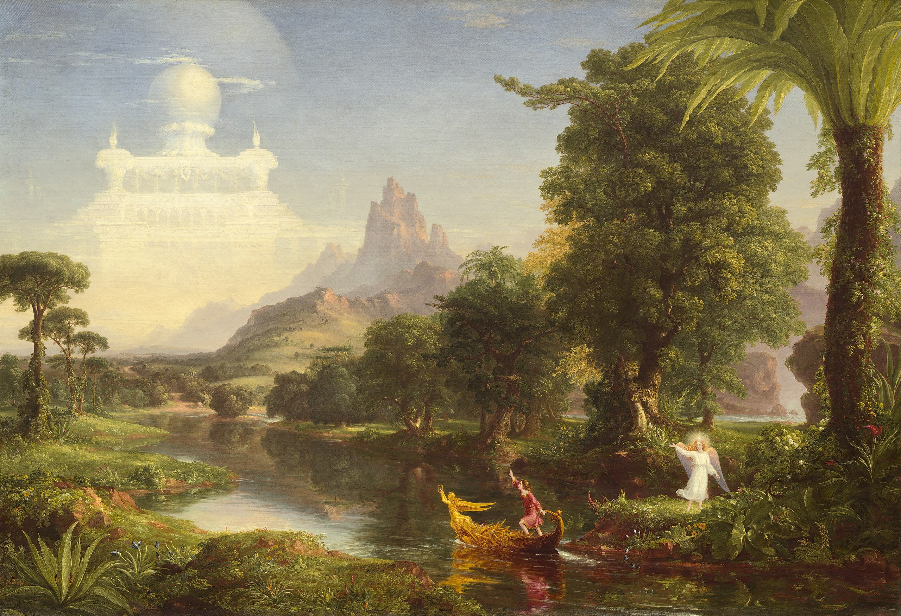
Fall 2025 CS 591 PHD Seminar
Beginning the Journey Towards Earning a Ph.D.

Slide 2
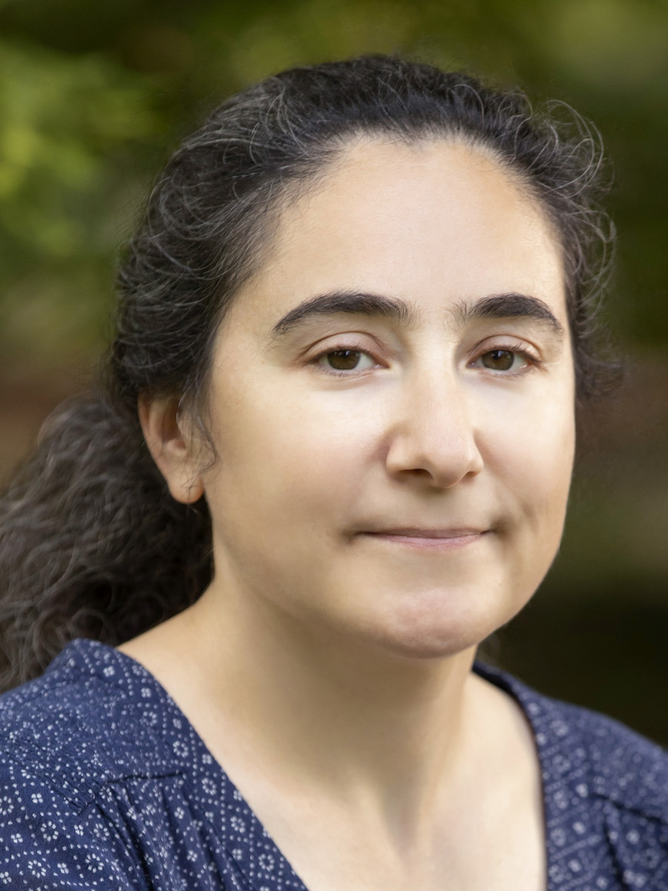
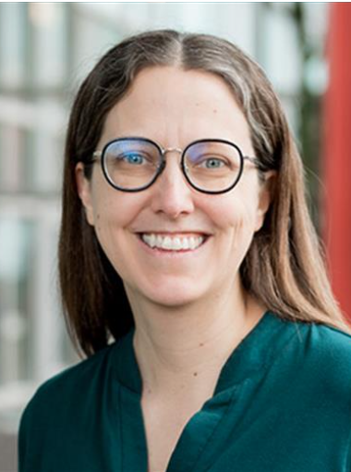
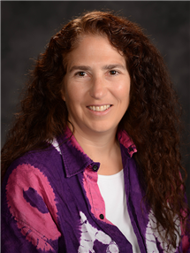
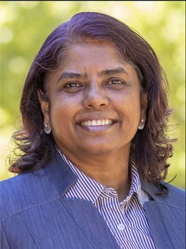
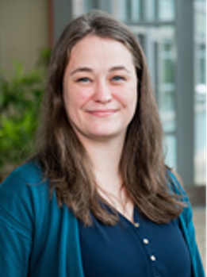
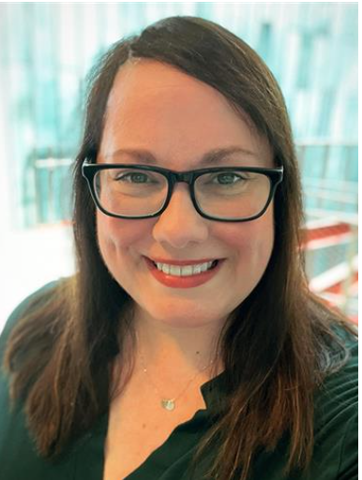
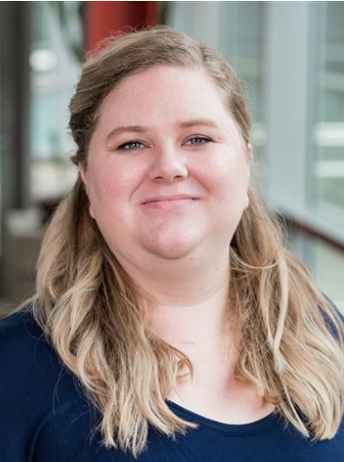
Introductions
Svetlana Lazebnik
DGS
Colleen Lewis
Associate DGS
Nancy Amato
Head of SSCDS
Viveka Kudaligama
Senior Assistant DGS
Jennifer Comstock
Senior Academic Advisor
Celia Johnston
Academic Advisor
Cassandra Phelps
Senior Academic Advisor

Slide 3

Meet the DGS
DGS office hours:
Wednesdays 4:30-6PM in 1218 Siebel (also on Zoom)

Slide 4
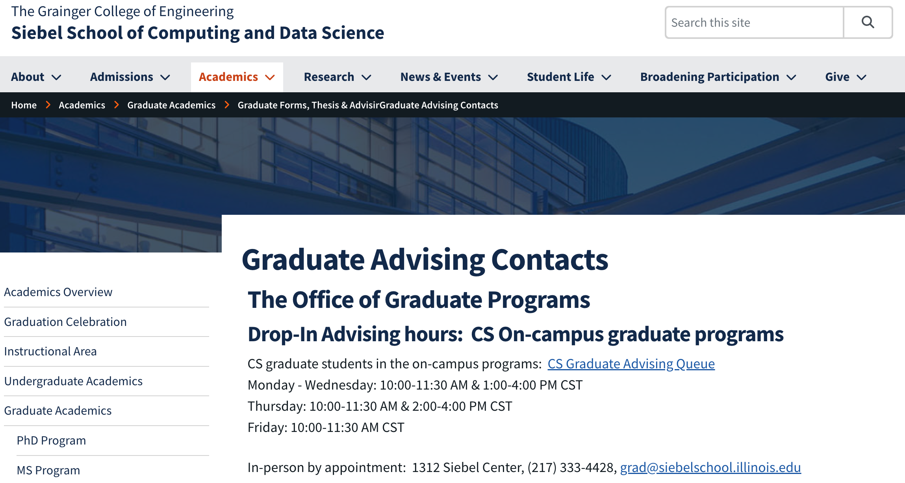
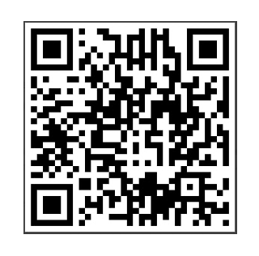
Meet the grad advisors
Grad office advising and contact info:
https://siebelschool.illinois.edu/academics/graduate/graduate-forms-advising-resources/graduate-advising-contacts

Slide 5
Logistics
We meet on Mondays, 11:00-11:50 AM
  Schedule and policies are posted on the website: https://courses.engr.illinois.edu/cs591phd/fa2025/
  Recordings will be posted to the class Mediaspace channel
  You should get an invite to the Slack channel – join and introduce yourself
To receive a Satisfactory (“S”) grade:
  Have no more than two absences
  Complete a few required tasks on time
Come to class prepared to engage in discussion and put away extraneous electronic devices!

Slide 6
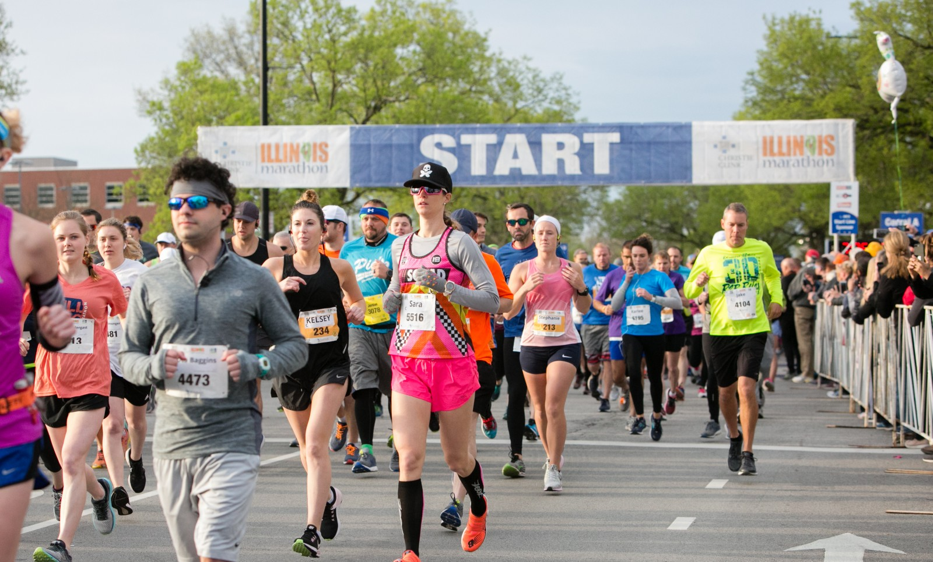
The path to a Ph.D. is like a marathon
Notes:
All of you start at the same time, but will proceed at a pace that works for you.
There will be periods when you are performing well, and periods when you struggle.
And what matters most is that you finish.
The purpose of the CS graduate office is to keep you on pace, and maybe to cheer you on when you need it

Slide 7
Challenges along the way
Transitioning from consuming to producing knowledge
Learning how to communicate your research findings
Building your professional profile and network
Managing time and stress
Dealing with setbacks, uncertainties, rejections
Notes:
That investment also comes with challenges. It requires more then putting in the work.

Slide 8
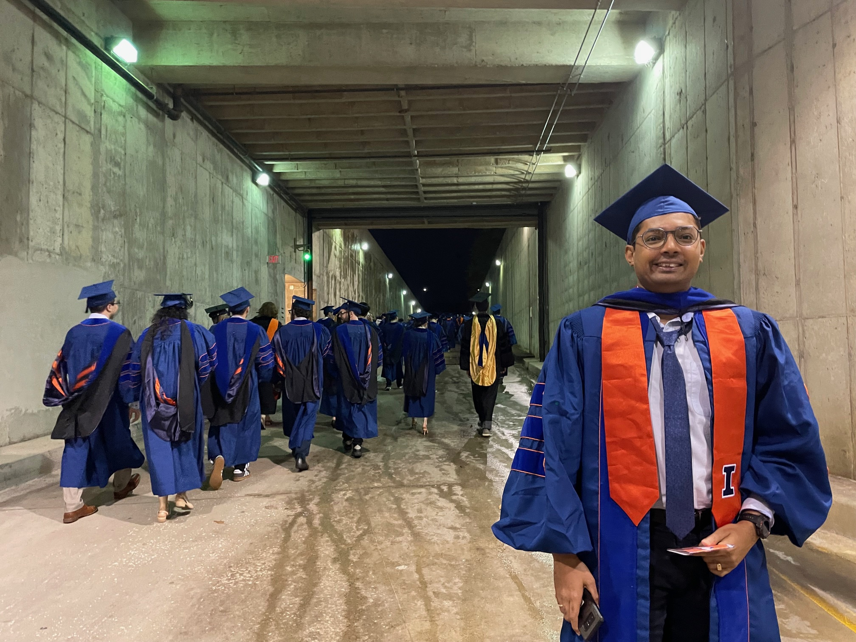
The light at the end of the tunnel
My former Ph.D. student Viraj Shah after the 2025 Hooding Ceremony
Notes:
After its all done, you will deserve a hug!

Slide 9

You are investing BIG in your career
Achievement (only about 2% of U.S. population has a Ph.D.)
Knowledge and discovery
New career pathways
Image source
Notes:
We are all here because each of you would like to earn a PhD. I admire you because this is a big investment in your career. Most of you will spend 5 to 7 years working toward your degree, and these years come during a precious time in your life. Many of your friends will get married, grow in their professional career; all while you are pursuing a doctoral degree.

Slide 10
Goals of this seminar
Understand Ph.D. program requirements
Get exposure to all the research areas in the school
Learn how to be a successful researcher
Develop professional skills
Learn about campus resources
Build community
Notes:
How to be a successful student (career paths and expectations, communication skills, ethics, etc.)
Skills (speaking, writing, people skills), need money (grant writing skills)

Slide 11
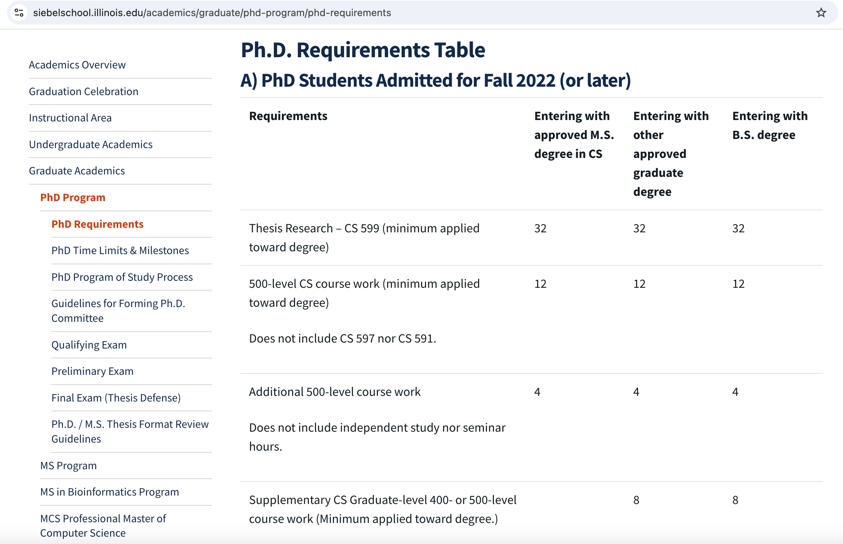
Next time: Ph.D. requirements

Slide 12
Sample Ph.D. timeline
(after a B.S. degree)
Year 1 |  |  | Year 2 |  |  | Year 3 |  |  | Year 4 |  |  | Year 5 |  |  | Year 6
Satisfy coursework requirements |  |  |  |  |  |  | TA
Find advisor + topic |  |  |  | Qual 1 |  | Qual 2 |  |  |  | Prelim |  |  |  |  |  | Defend and deposit dissertation
 |  |  |  | Submit paper |  |  | Submit paper |  | Submit paper |  |  |  | Submit paper
 |  |  |  |  | Intern ship |  |  | Intern ship |  |  | Intern ship |  |  |  | Seek jobs
Required
Desired
Desired

Slide 13
Goals for your first year
Complete two independent studies (CS 597) to find your advisor(s) and initial research topic
Take courses and plan your program of study
Start preparing for the qualifying exam

Slide 14
First year funding and independent studies
All first-year Ph.D. students are supported by the department
You must enroll for (a minimum of) 4 hours of CS 597 in the Fall and Spring semester
  The goal is to use these to secure your advisor(s)
  Can be with the same or different faculty
  Recommended: 1 or 2 “true” course plus 4 or 8 hours of CS 597
Departmental travel/equipment grant: $2500
    Subject to all university restrictions
    Any equipment purchased is the property of the department
    Not for use for personal property or travel
    Must be used in your first year

Slide 15
Finding an advisor and research topic
TAKE RELEVANT COURSES AND READ PAPERS
Attend seminars and research group meetings
Perform independent study
MEET with potential advisors AND COLLABORATORS

Slide 16
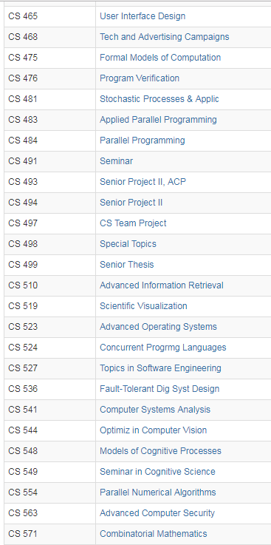
Mapping out your coursework
Use Program of Study process to help with planning
Notes:
About 70 courses each semester. There is something for everybody. You can choose the curriculum path you want and we will help you do that through the program of study process. We will have some sessions to talk about program requirements and get the program of study completed.

Slide 17
Student Employment (Non-Fellowship)
If you’re a new employee at the university, you need to complete work authorization paperwork
If you have paycheck, tuition waiver, or employment-related questions:
Please contact HR at cs-hr@cs.illinois.edu

Slide 18
By Next Time
1. Get on Slack and introduce yourself
2. Skim the Ph.D. requirements page (https://siebelschool.illinois.edu/academics/graduate/phd-program/phd-requirements) and the Graduate College Handbook (http://www.grad.illinois.edu/gradhandbook)
3. Come to class with questions

Slide 19
Online Resources
SSCDS Grad Program: http://siebelschool.illinois.edu/current-students/graduate-students
My.Siebelschool portal: http://my.siebelschool.illinois.edu
Grad College Website: http://www.grad.illinois.edu
Grad Handbook: http://www.grad.illinois.edu/gradhandbook

Slide 20
Expectations of Conduct
We are committed to the creation of an anti-racist, inclusive community that welcomes diversity along a number of dimensions, including, but not limited to, race, ethnicity and national origins, gender and gender identity, sexuality, disability status, class, and religion.
We support a safe and encouraging learning and work environment that
allows all students, staff and faculty equitable opportunities and respect.
We expect professional and respectful interaction and communication from all students, staff, and faculty.

