Slide 1

Fall 2025 CS 591 PHD Seminar How to get started in research
C. Vanloo, Architecture, 1752-53

Slide 2
Recall: Goals for your first year
Plan your coursework and start fulfilling coursework requirements – don’t forget to complete your Program of Study form!
Establish a relationship with an advisor and start making progress in research

Slide 3
Today
How to navigate the research process and the student-advisor relationship
How to meet with your advisors/mentors/collaborators
How to do experiments
How to generate research ideas

Slide 4


Navigating the student-advisor relationship
From semester to semester
Make sure you understand the advisor’s expectations for meeting major milestones
Ask for a “status” meeting – ideally every semester, but at least once a year
From week to week
You need to “manage” both yourself and your advisor to get useful guidance and make steady progress in research
Image source

Slide 5
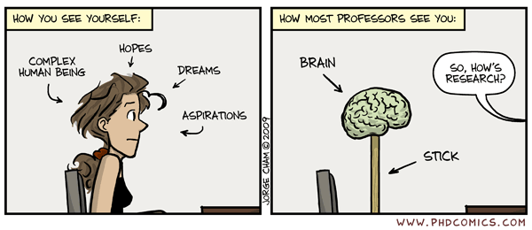
Navigating the student-advisor relationship
STUDENT’S POV
Ph.D. Comic #1126

Slide 6
Navigating the student-advisor relationship
STUDENT’S POV
Ph.D. Comic #1126

Slide 7
Navigating the student-advisor relationship
PROFESSOR’S POV
STUDENTS
SO, WHAT SHOULD I DO NEXT?
Ph.D. Comic #1126

Slide 8
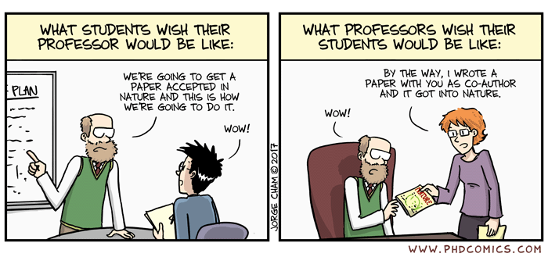
Navigating the student-advisor relationship
“Your advisor is an input-output machine: you throw them something, you get something out” – Jia-Bin Huang
❌ Input-only: You do everything and report final results
❌ Output-only: They tell you to do something and you do it
✅ Input and output: You get frequent and valuable guidance!
Ph.D. Comic #1936

Slide 9
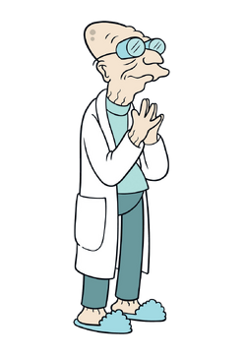
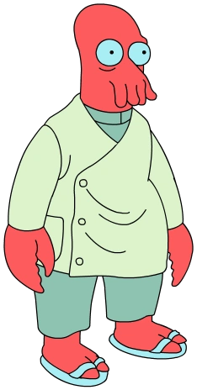
Some example interactions…
Try this approach on this problem, then come back and tell me how it worked.
Professor
Student 1
I’m not sure this is the best possible problem for me to work on. I need to go away and figure out what kind of problem could truly inspire me.
DON’T WAIT FOR THE PERFECT PROBLEM!
Image source

Slide 10
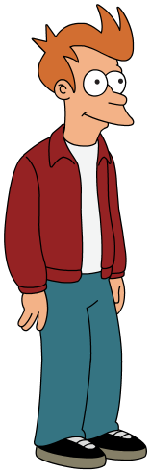
Some example interactions…
Try this approach on this problem, then come back and tell me how it worked.
Professor
Student 2
I don’t have experience doing this at all. Give me a year to take classes and do my homework. After that give me another year to TA and prepare for my qual. After that I will be too tired and will need to go on vacation.
DON’T WAIT TILL YOU’RE PERFECTLY READY!
Image source

Slide 11
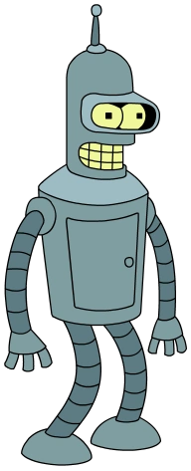
Some example interactions…
Try this approach on this problem, then come back and tell me how it worked.
Professor
Student 3
I tried it. It didn’t work.
CAN YOU DO BETTER?
Image source

Slide 12
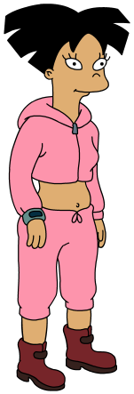
Some example interactions…
Try this approach on this problem, then come back and tell me how it worked.
Professor
Student 4
I tried your approach and it didn’t work. I’ve narrowed down the problem to step D. Until step D, you put in X and get out Y as we expect. But you can see how it fails here at D. I’ve ruled out possible failure causes U and V, and think that W is the most likely cause. Next I will investigate W.
CAN YOU DO EVEN BETTER?
Image source

Slide 13
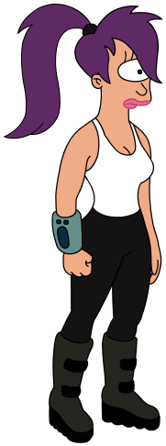
Some example interactions…
Try this approach on this problem, then come back and tell me how it worked.
Professor
Student 5
I tried your approach and it didn’t work. Then I looked at related papers, talked to other students, had a different idea, implemented it, and it worked!
THIS SHOULD BE ALL OF YOU IN FIVE YEARS!
Image source

Slide 14
The moral of the story so far
Don’t wait for the perfect problem and perfect knowledge – take the plunge and learn as you go!
Don’t just do what your advisor tells you to do – do more!
Don’t just say “it didn’t work” – think critically about your results and figure out why!
Don’t just stay stuck – learn how to pivot!

Slide 15
How to meet with your advisors/mentors
Start by establishing context and agenda.
Source: Jia-Bin Huang

Slide 16
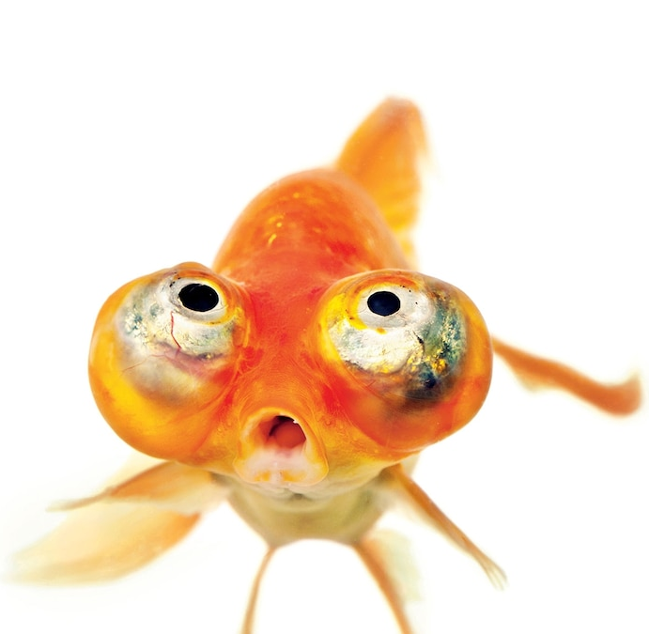
How to meet with your advisors/mentors
Start by establishing context and agenda.
❌ Dive into technical details too quickly. ✅ Remind your advisor where things stood at the end of the last meeting. Manage the meeting to ensure you cover all the topics you want to discuss.
“Your advisor will forget everything you discuss the moment you step out the door. Treat your advisor as goldfish. Always provide high-level contexts first.” – Jia-Bin Huang
Source: Jia-Bin Huang

Slide 17
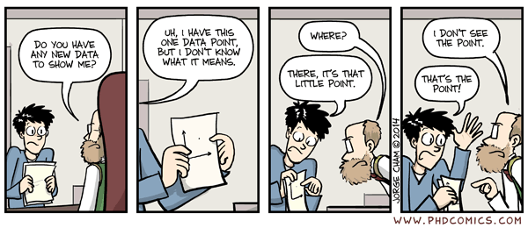
How to meet with your advisors/mentors
Start by establishing context and agenda.
Show results – and interpret them.
❌ "Here are the results. Look at this table full of numbers." ✅ Contextualize your results: What did you do? Why and how did you do it? What did you find? Does it make sense?
Ph.D. Comic #1762
Source: Jia-Bin Huang

Slide 18
How to meet with your advisors/mentors
Start by establishing context and agenda.
Show results – and interpret them.
Propose next steps and timeline.
❌ "That's all my progress. What do you suggest I do next?" ✅ "That's all my progress. Based on the results, I suggest follow-up tasks A, B, C (and why). It should take me about this long to do this."
Source: Jia-Bin Huang

Slide 19
How to meet with your advisors/mentors
Start by establishing context and agenda.
Show results – and interpret them.
Propose next steps and timeline.
Summarize your meeting.
❌ Memorize the discussions in the meeting without taking notes. ✅ Summarize the meeting and the next steps agreed on. Send an email/post on Slack right away. Don’t hesitate to ask for clarifications.
Source: Jia-Bin Huang

Slide 20
How to waste half your semester
Week 1: Meet with advisor, decide on initial research plan
Week 2: Realize you’re not sure about some parts of the plan, but don’t ask for clarification. Realize you’re not sure how to set up the experimental environment, but don’t ask anybody for help
Week 3: Get busy with homework, put off experiments
Week 4: Finally get set up and start experiments
Week 5: Still working on getting results
Week 6: Get some results, ask to meet with advisor
Week 7: Spend the first half of the meeting reminding the advisor what you were supposed to be working on, then present your results and realize they don’t make sense

Slide 21
How to do experiments
Don’t just try stuff – formulate hypotheses and test them!
Think critically about your results
Display your results in a way that is easy to understand – both for your own sake and for your advisors/collaborators!
If you don’t understand your results, make sure you sanity check them
Make sure you have strong debugging skills
Be systematic and organized
Use version control, document everything
Break methods down into components and validate them one at a time
Explore different choices systematically
Don’t be afraid to ask for help and feedback

Slide 22
How to generate research ideas
No foolproof recipe – if this were easy, we wouldn’t be here!
Read papers – and ask questions
Follow arXiv and social media – but don’t overdo it
Identify leading/inspirational researchers in your field and follow their work
Attend reading groups and talks
Talk to other Ph.D. students and join their projects – but don’t spread yourself too thin
Learn patterns of research ideas

Slide 23





A few patterns of research ideas
Build a hammer and find nails
Start small and then grow
Fill in the blank/check the checkboxes
 | Feature 1 | Feature 2 | Feature 3
Method 1 | ✔️
Method 2 |  | ✔️ | ✔️
My method | ✔️ | ✔️ | ✔️
Create datasets and benchmarks
Extend/expand on previous work
Reproduce previous work
Source

Slide 24
How do I know if my idea is good?
Ideas are cheap – it’s the execution that counts!
Try lots of ideas and validate (or reject) them fast
Always ask for feedback!
Know when to pivot – one of the hardest decisions!

Slide 25
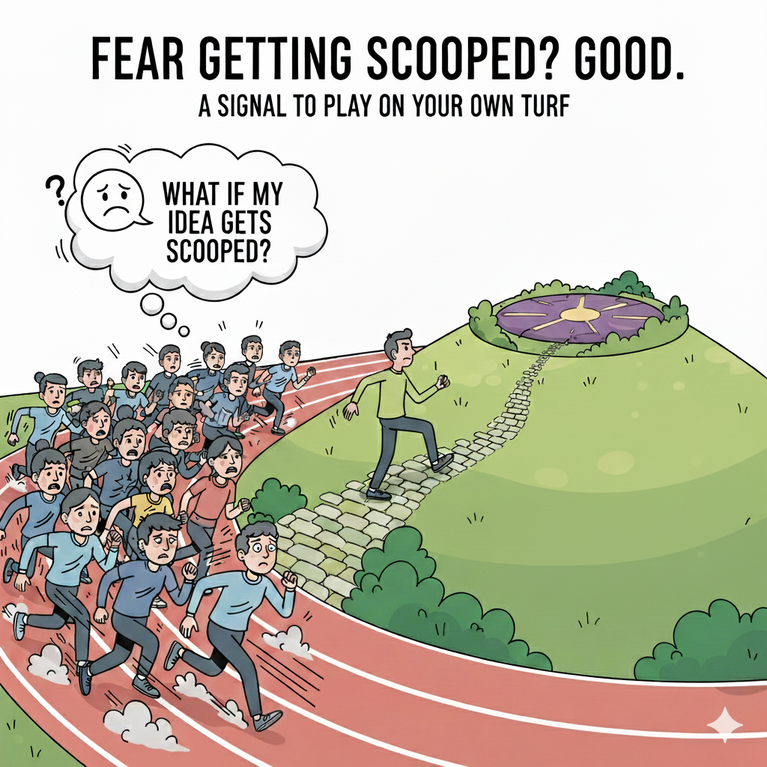
Idea positioning and tradeoffs
If you work on popular topics, you might maximize your impact and attention, but you risk getting lost in the crowd, being scooped, or making only incremental contributions
If you work on more niche topics, you develop a more distinctive profile and have less risk of being scooped, but you get fewer citations and less attention
Source: A. Bhattad (generated by Google Nano-Banana)

Slide 26
Some hard truths about research
There is no guaranteed recipe for success
There is not always a direct relationship between inputs (time, effort) and outputs (papers, citations, fame, fortune)
You will experience failure and frustration
You will keep seeing researchers who seem smarter and more successful
What to do about it?
Keep tending your own garden and do research for the right reasons!

