Slide 1
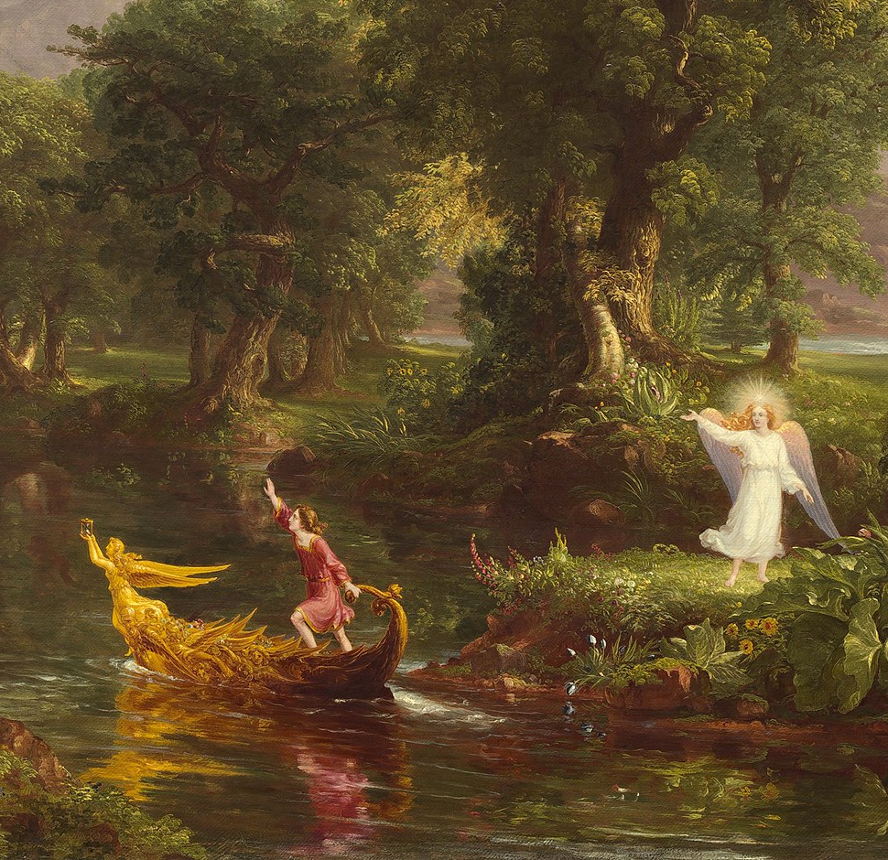
Fall 2025 CS 591 PHD Seminar Wrap-up

Slide 2
Reminders
Make-up quiz: Through this Wednesday
Program of study
CS 597 sign up for next semester

Slide 3
Recall: Goals of this seminar
Understand Ph.D. program requirements
Get exposure to all the research areas in the school
Learn how to be a successful researcher
Develop professional skills
Learn about campus resources
Build community
Notes:
How to be a successful student (career paths and expectations, communication skills, ethics, etc.)
Skills (speaking, writing, people skills), need money (grant writing skills)

Slide 4
Today: some last-minute advice (and free pizza!)

Slide 5
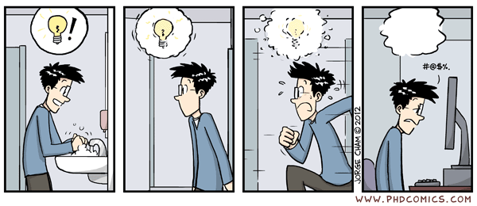
How to generate research ideas
https://phdcomics.com/comics.php?f=1481

Slide 6
How to generate research ideas
No foolproof recipe – if this were easy, we wouldn’t be here!
Read papers – and ask questions
Follow arXiv and social media – but don’t overdo it
Identify leading/inspirational researchers in your field and follow their work
Attend reading groups and talks
Talk to other Ph.D. students and join their projects – but don’t spread yourself too thin
Learn patterns of research ideas

Slide 7





A few patterns of research ideas
Build a hammer and find nails
Start small and then grow
Fill in the blank/check the checkboxes
 | Feature 1 | Feature 2 | Feature 3
Method 1 | ✔️
Method 2 |  | ✔️ | ✔️
My method | ✔️ | ✔️ | ✔️
Create datasets and benchmarks
Extend/expand on previous work
Reproduce previous work
Source

Slide 8
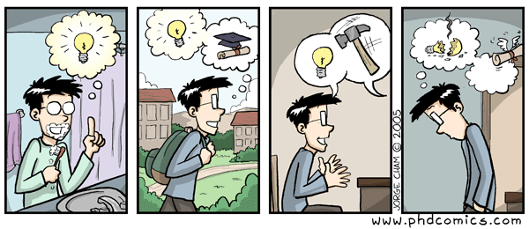
How do I know if my idea is good?
Always ask for feedback!
https://phdcomics.com/comics/archive.php?comicid=537

Slide 9
How do I know if my idea is good?
Always ask for feedback!
Ideas are cheap – it’s the execution that counts!
Try lots of ideas and validate (or reject) them fast
Know when to pivot (also a very hard skill to master)

Slide 10
Some hard truths about research
There is no guaranteed recipe for success
There is not always a direct relationship between inputs (time, effort) and outputs (papers, citations, fame, fortune)
You will experience failure and frustration
You will keep running into others who seem smarter and more successful
What to do about it?
Keep tending your own garden and do research for the right reasons!

Slide 11
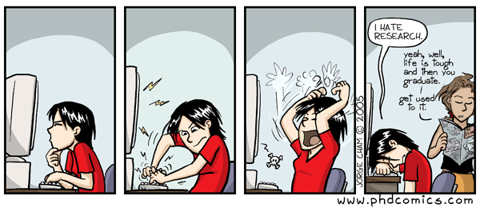
Looking forward
https://phdcomics.com/comics/archive.php?comicid=545

Slide 12
Looking forward
Don’t wait until your last year to build your professional profile and social network
Consider taking the Ph.D. Job Search seminar early

Slide 13
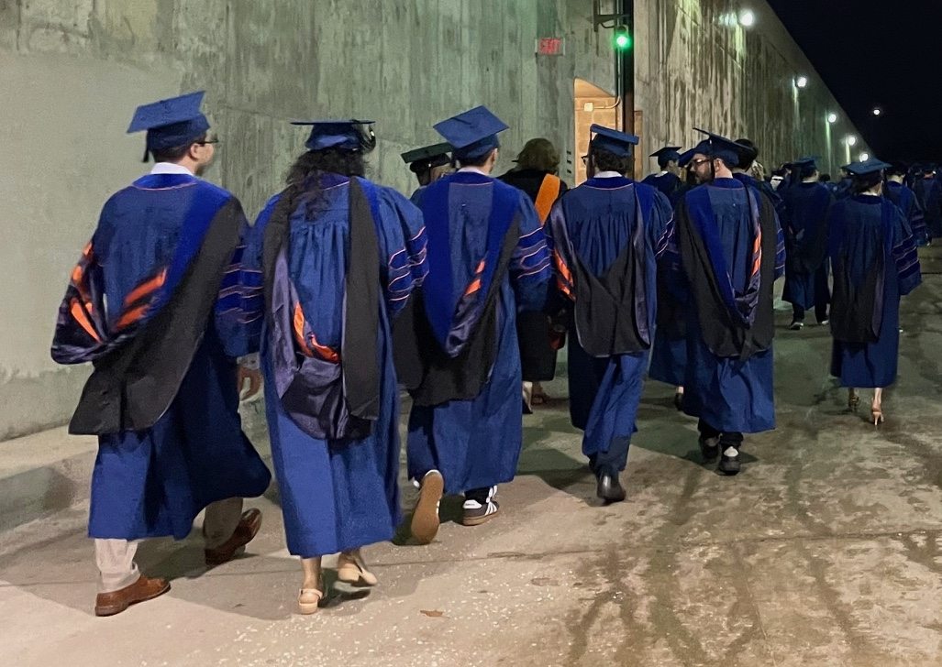
Good luck!

