Slide 1
PPAD-hardness for Two-Player Games
CS 598RM
Ruta Mehta

Slide 2
Previous Lecture
PPAD
Sperner
$ε$-Brouwer
$ε$-Nash

Slide 3
Today
PPAD
2D-Sperner
PL: Piecewise-Linear
PL-Brouwer
$2$-Nash
Rational solutions

Slide 4
Today
PPAD
2D-Sperner
PL: Piecewise-Linear
PL-Brouwer
$2$-Nash
Rational solutions

Slide 5
Recall: 2D-Sperner
[Sperner 1928]: Color the boundary using three colors in a legal way. No matter how the internal nodes are colored, there exists a tri-chromatic triangle. In fact an odd number of those.

Slide 6
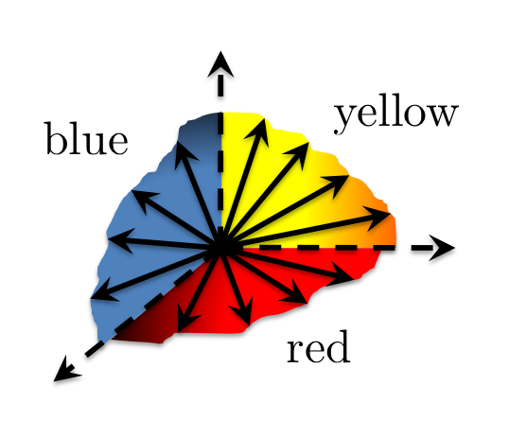
Recall: Proof of 2D-Sperner’s Lemma
For convenience we introduce an outer boundary, that does not create new tri-chromatic triangles.
[Sperner 1928]: Color the boundary using three colors in a legal way. No matter how the internal nodes are colored, there exists a tri-chromatic triangle. In fact an odd number of those.

Slide 7
2D-Sperner
blue
red
yellow
Lemma: Color the boundary in a legal way. No matter how the internal nodes are colored, there exists a tri-chromatic triangle.

Slide 8
2D-Sperner
bits($p_{1}$)
bits($p_{2}$)
$$……$$
$$……$$
$$⋀ ⋁⫎$$
$$B$$
p
y
r b
Only one is non-zero
Lemma: Color the boundary in a legal way. No matter how the internal nodes are colored, there exists a tri-chromatic triangle.

Slide 9
Today
PPAD
2D-Sperner
PL: Piecewise-Linear
PL-Brouwer
$2$-Nash
Rational solutions

Slide 10
PL-Brouwer (Linear-FIXP)
$$F:{\left[0, 1\right]}^{k}→{\left[0, 1\right]}^{k}$$
$$λ_{1} λ_{2} … λ_{k}$$
$$a∈ℚ$$
+
Find a fixed
Point of F:
$x∈{\left[0,1\right]}^{k}$ s.t.
$$F\left(x\right)=x$$
max
$$×$$
Arithmetic Circuit
$$…$$
Continuous piecewise-linear function

Slide 11
PL-Brouwer (Linear-FIXP)
(EY’07) $F:{\left[0, 1\right]}^{2}→{\left[0, 1\right]}^{2}$
We need only 2-D
$$λ_{1} λ_{2}$$
$$a∈ℚ$$
+
Find a fixed
Point of F:
$x∈{\left[0,1\right]}^{k}$ s.t.
$$F\left(x\right)=x$$
max
$$×$$
Can also simulate
min and $−$
Arithmetic Circuit
Continuous piecewise-linear function

Slide 12
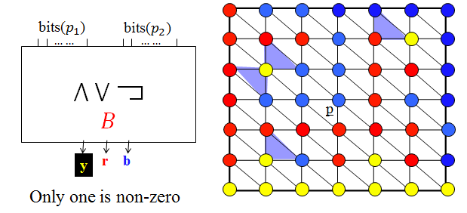
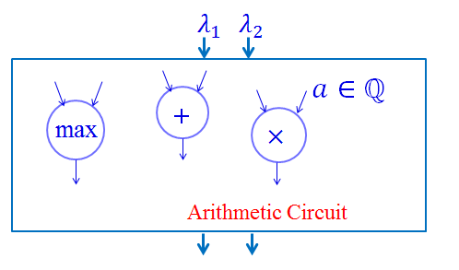
Today
PPAD
2D-Sperner
PL-Brouwer
$2$-Nash

Slide 13
2D-Sperner: As a Discrete Function
g(p) = p + D(p)
D( ) = (-1, -1)
D( ) = (1, 0)
D( ) = (0, 1)
Boolean
Circuit
p
bits($p_{1}$)
bits($p_{2}$)
$$……$$
$$……$$
$$⋀ ⋁⫎$$
$$B_{g}$$
Given $B_{g}$ find a tri-
chromatic square.
$$a_{1} { s}_{1}$$
$$a_{2} { s}_{2}$$
D(p) = ($a_{1}{−s}_{1}, a_{2}−s_{2})$

Slide 14
2D-Sperner: As a Discrete Function
g(p) = p + D(p)
D( ) = (-1, -1)
D( ) = (1, 0)
D( ) = (0, 1)
p
bits($p_{1}$)
bits($p_{2}$)
$$……$$
$$……$$
$\bigwedge{} \bigvee{}⫎x$
min
max
1-$x$
D(p) = ($a_{1}{−s}_{1}, a_{2}−s_{2})$
$$a_{1} { s}_{1}$$
$$a_{2} { s}_{2}$$
Arithmetic
Circuit for D
$$−$$
$$−$$
D

Slide 15
$g →$ Continuous Func. (A possibility)
g(p) = p + I(p)
D( ) = (-1, -1), D( ) = (1, 0), D( ) = (0, 1)
$$p^{2}$$
Interpolate:
$q=\sum_{i}{α_{i}p^{i}}⇒g\left(q\right)=\sum_{i}{α_{i}g\left(p^{i}\right)}$
$∴g\left(q\right)=q+\sum_{i}{α_{i}D\left(p^{i}\right)}$
q
$$p^{1}$$
$$p^{3}$$
$$D(q)$$
Claim: q is a fixed point of $g$
iff $D(q)=0$
iff q is center of a trichromatic
triangle
To evaluate $D(p^{1})$
need bits($⌊q⌋$)
Floor is a discontinuous function !

Slide 16
Computing $bits of ⌊\text{q}⌋$
L: large number
$$b_{1}^{q}$$
$$b_{2}^{q}$$
$$……$$
$$……$$
Arithmetic Circ:
min, max, (1-x)
.
Good
D
$$Z_{G}$$
q
$$D(\left\lfloor q\right\rfloor )$$
Bad
$$1/L^{2}$$
$$Z_{B}$$
$b^{q}=bits(\left\lfloor \text{q}\right\rfloor )$if in $Z_{G}$,
$$⇒correct D(\left\lfloor q\right\rfloor )$$
Else $0≤b_{1i}^{q}, b_{2i}^{q}≤1,$
$$i=1,..,n$$
Junk!
$D\left(\left\lfloor q\right\rfloor \right)∈{\left[−1, 1\right]}^{2}$
0
1
2
3

Slide 17
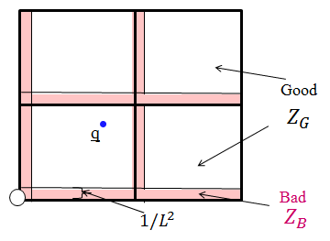
Computing bits(${⌊q}_{d}⌋), d=1,2$ when $q∈Z_{G}$
Set $a=q_{d}$
For $i=n−1, …, 0$
$b_{di}=\min{\{\max\left\{\left(a−2^{i}\right)∗L^{2}, 0\right\}, 1\}}$
$a=a−(b_{di}∗2^{i})$
$q=$ int + frac
frac $∈\left[\frac{1}{L^{2}}, 1\right]$
Claim: (i) At the start of any iteration if $a≤2^{i}⇒b_{di}=0$
if $a≥2^{i}+\frac{1}{L^{2}}⇒b_{di}=1.$
(ii) If $a∈Z_{G}$ at the start of an iteration, then at the end of it too$a∈Z_{G}$
Requires O(n) sized arithmetic circuit.

Slide 18
Sampling Lemma (CDT’06)
Given $q ∈{\left[0, 2^{n}−1\right]}^{2}$,
$${\text{q}}^{k}=\text{q}+\frac{k−1}{L}, 1≤k≤16$$
$$⋯⋯$$
$r^{k}$= $D\left(⌊{\text{q}}^{k}⌋\right)$if ${\text{q}}^{k}$ $in Z_{G}$,
.
Good
$$Z_{G}$$
else $r^{k}∈{\left[−1, 1\right]}^{2}$.
q
If $r=\sum_{k}{r^{k}}=0$then
q$∈$ trichromatic square.
Bad
$$1/L^{2}$$
$$Z_{B}$$
Proof: At most two $r^{k}s$ in $Z_{B}$, generating junk $∈{\left[−2, 2\right]}^{2}$.
In $\left\{r^{k}, k∈Z_{G}\right\}:$
If no yellow $⇒$ all are either (1, 0) or (-1, -1)
$⇒$ $r_{2}≤−1, or r_{1}≥1$
If no red $⇒$ only (0, 1) or (-1,-1) $⇒$ $r_{1}≤−1, or r_{2}≥1$
If no blue $⇒$ only (1, 0) or (0, 1) $⇒$ $\max\left\{r_{1}^{},r_{2}^{}\right\}≥1$

Slide 19
2D-Sperner $→$ PL-Brouwer
$$q_{1}$$
$$q_{2}$$
Arithmetic Circuit
$${\text{q}}^{k}=\text{q}+\frac{k−1}{L}, 1≤k≤16$$
$$q^{1}$$
$$q^{16}$$
… …
bits
bits
D
D
$$r^{1}$$
$$r^{16}$$
$(q_{1}+\sum_{k}{r_{1}^{k}}$)
$(q_{2}+\sum_{k}{r_{2}^{k}}$)
$$q_{1} q_{2}$$
only if q in trichromatic
triangle, due to CDT lemma.

Slide 20
2D-Sperner $→$ PL-Brouwer
Theorem 1: 2D-Sperner is polynomial-time reducible to (2D) PL-Brouwer.

Slide 21
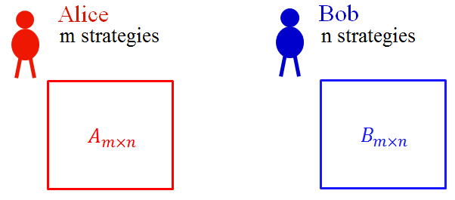
Today
PPAD
2D-Sperner
PL-Brouwer
$2$-Nash

Slide 22
2D-PL-Brouwer
$$F:{\left[0, 1\right]}^{2}→{\left[0, 1\right]}^{2}$$
$$λ_{1} λ_{2}$$
$$a∈ℚ$$
Find a fixed
Point of F:
$x∈{\left[0,1\right]}^{k}$ s.t.
$$F\left(x\right)=x$$
+
$$×$$
max
Arithmetic Circuit
Can also simulate
min and $−$

Slide 23
No Max Gate
$$λ_{1} λ_{2}$$
$$a∈ℚ$$
Example on board.
+
$$×$$
$$⋮$$
$$O_{1} O_{2}$$

Slide 24
No Max Gate
$$λ_{1} λ_{2}$$
$$O_{1}:=a_{1}λ_{1}+b_{1}λ_{2}+c_{1}$$
$$O_{2}:=a_{2}λ_{1}+b_{2}λ_{2}+c_{2}$$
$$a∈ℚ$$
+
$$×$$
$$⋮$$
$$O_{1}=λ_{1}$$
$$O_{2}=λ_{2}$$
Fixed-point:
$$O_{1} O_{2}$$

Slide 25
$$a∈ℚ$$
+
$$×$$
Linear
Expression
$$L$$
$$R$$
max
$$y≥L, y≥R$$
$$(y−L)\left(y−R\right)=0$$
$$y$$

Slide 26
$$a∈ℚ$$
+
$$×$$
Linear
Expression
$$L$$
$$R$$
$$−$$
$$−$$
$$L$$
$$R$$
$$L−R$$
$$R−R=0$$
max
max
$$y$$
$$y$$
+
$$x=y+R$$

Slide 27
$$a∈ℚ$$
+
$$×$$
Linear
Expression
$$L−R$$
$$R−R=0$$
max
$$y≥L, y≥R$$
$$(y−L)\left(y−R\right)=0$$
$$y+R$$

Slide 28
$$a∈ℚ$$
+
$$×$$
Linear
Expression
$$L$$
$$0$$
max
$$x≥L, x≥0$$
$$\left(x−L\right)x =0$$
$$x$$

Slide 29
$$a∈ℚ$$
+
$$×$$
Linear
Expression
$$L$$
$$0$$
max
$$x≥0 ⏊ x≥L$$
$$x$$

Slide 30
Modeling max Gates
Ordering among max gates: $g_{1}, …, g_{n}$
$L_{1}$- Linear in$λ_{1}\& λ_{2}$
$$x_{1}≥0 ⏊ x_{1}≥L_{1}$$
$$λ_{1} λ_{2}$$
+
$$×$$
$$⋮$$
$$L_{1}$$
$$0$$
max
$$g_{1}$$
$$x_{1}$$

Slide 31
Modeling max Gates
$L_{i}$- Linear in $x_{1},…, x_{i−1, }λ_{1}, λ_{2}$
$x_{i}≥0 ⏊ { x}_{i}≥L_{i}$
$$λ_{1} λ_{2}$$
+
$$×$$
$$g_{1}$$
$$g_{i−1}$$
$$x_{1}$$
$$x_{i−1}$$
$$⋮$$
$$L_{i}$$
$$0$$
max
$$g_{i}$$
$$x_{i}$$
n: #max gates
$$x_{n−1} x_{n}$$

Slide 32
Lemma 1: Given ($λ_{1},λ_{2}$), ($x_{1},…,x_{n})$ satisfy the following
$$S: x_{i}≥0 ⏊ x_{i}≥L_{i}\left(x_{1},…,x_{i−1},λ_{1},λ_{2}\right), ∀i≤n$$
$$F\left(λ_{1},λ_{2}\right)=(x_{n−1},x_{n})$$
Proof: ($⇒$) By construction, $x_{i}$ has to be the output of $i^{th}$ max gate
when input to the circuit is ($λ_{1},λ_{2}$).
$(⇐)$ Evaluate the circuit of F at given ($λ_{1},λ_{2}$).
Set $x_{i}$ to output of $i^{th}$ max gate, then $(x_{1},…,x_{n})$ has to
satisfy S, because two of the inputs of this max gate are ‘0’
and expression $L_{i}$.

Slide 33
$$S: x_{i}≥0 ⏊ x_{i}≥L_{i}\left(x_{1},…,x_{i−1},λ_{1},λ_{2}\right), ∀i≤n$$
$A∈R^{n×n}$ lower-
triangular with 1s
on diagonal
$$\underline{x}≥0 ⏊ A\underline{x}≥λ_{1}\underline{d}+λ_{2}\underline{e}+\underline{b}$$
Fixed Point $⇒$ $λ_{1}=x_{n−1}, λ_{2}=x_{n}$
$$≡$$
$$\underline{x}≥0 ⏊ A\underline{x}≥x_{n−1}\underline{d}+x_{n}\underline{e}+\underline{b}$$
$$A^{′}=A−[\underline{0}, …,\underline{0},\underline{d},\underline{e}]$$
$$≡$$
LCP:
$$\underline{x}≥0 ⏊ A′\underline{x}≥\underline{b}$$
LCP = Linear
Complemetarity Problem
Lemma 2: $\underline{x}$ is a solution of the LCP iff it is a solution of S ,
(then using Lemma 1) iff ($x_{n−1},x_{n})$ is a fixed point.

Slide 34
LCP $→$ Game
LCP: $\underline{x}≥0 ⏊ A′\underline{x}≥\underline{b}$
Z = $\left[\begin{matrix}−A′ & \underline{b}+\underline{1} \\ \underline{0} & 1\end{matrix}\right]$
Symmetric Game: ($Z, { Z}^{T})$

Slide 35
Recall: Nash Eq. of (A, B)
$$\underline{y}∈Δ_{n}$$
$$\underline{x}∈Δ_{m}$$
$$∀i, x_{i}≥0 ⏊ {\left(A\underline{y}\right)}_{i}≤α$$
$$∀j, y_{j}≥0 ⏊ {\left({\underline{x}}^{T}B\right)}_{j}≤β$$
Complementarity:
$$⇔$$
$(\underline{x},\underline{y})$ is a NE
$α and β$ are the payoffs

Slide 36
Symmetric Nash Eq. of ($Z, Z^{T}$)
$$m=n$$
$$\underline{x}=\underline{y}$$
$$\underline{x}∈Δ_{m}$$
$$∀i, x_{i}≥0 ⏊ {\left(Z\underline{x}\right)}_{i}≤α$$
$$∀i, x_{i}≥0 ⏊ {\left({\underline{x}}^{T}Z^{T}\right)}_{i}≤β$$
Complementarity:
$$⇔$$
$$≡$$
$(\underline{x},\underline{x})$ is a Symm. NE
$α and β$ are the payoffs

Slide 37
Symmetric Nash Eq. of ($Z, Z^{T}$)
$$\underline{x}∈Δ_{m}$$
Complementarity:
$$∀i, x_{i}≥0 ⏊ {\left(Z\underline{x}\right)}_{i}≤α$$
$$⇔$$
$(\underline{x},\underline{x})$ is a Symm. NE
$α$is the payoff to both

Slide 38
LCP $→$ Game
LCP: $\underline{x}≥0 ⏊ A′\underline{x}≥\underline{b}$
Claim: $A′$ is strictly semi-monotone.
Z = $\left[\begin{matrix}−A′ & \underline{b}+\underline{1} \\ \underline{0} & 1\end{matrix}\right]$
Symmetric Game: ($Z, { Z}^{T})$
Theorem 2: If $\left(\underline{x},t\right)$is a symmetric NE (both play the same),
then ${\underline{x}}/t$ is the LCP solution.

Slide 39
LCP $→$ Game (Proof)
LCP: $\underline{x}≥0 ⏊ A′\underline{x}≥\underline{b}$
Game: ($Z, { Z}^{T})$
$\left(\underline{x}, t\right)$ be a symmetric Nash
Z = $\left[\begin{matrix}−A′ & \underline{b}+\underline{1} \\ \underline{0} & 1\end{matrix}\right]$
$$\left[\begin{matrix}\underline{x} \\ t\end{matrix}\right]$$
$$∀i, x_{i}≥0 ⏊ {\left(−A^{′}\underline{x}\right)}_{i}+b_{i}t+t≤α$$
$$t≥0 ⏊ t≤α$$

Slide 40
LCP $→$ Game (Proof)
LCP: $\underline{x}≥0 ⏊ A′\underline{x}≥\underline{b}$
$∀i,$ $x_{i}≥0 ⏊ {\left(−A^{′}\underline{x}\right)}_{i}+b_{i}t+t≤α$
$$t≥0 ⏊ t≤α$$
Claim 1: If $t>0$ then $\frac{\underline{x}}{t}$ is a soln of the LCP.
Proof:
$$t>0 ⇒ t=α ⇒ {\left(A^{′}\left(\frac{x}{t}\right)\right)}_{i}≥b_{i}$$

Slide 41
LCP $→$ Game (Proof)
LCP: $\underline{x}≥0 ⏊ A′\underline{x}≥\underline{b}$
$∀i,$ $x_{i}≥0 ⏊ {\left(−A^{′}\underline{x}\right)}_{i}+b_{i}t+t≤α$
$$t≥0 ⏊ t≤α$$
Claim 2: $t>0,$ if $A^{′}$ is strictly semi-monotone.
$\underline{x}≥0,\underline{x}≠0$ then $∃i, x_{i}>0,{\left(A^{′}x\right)}_{i}>0$
Proof: $t=0⇒α≥0$
$x_{i}>0 and {\left(−A^{′}x\right)}_{i}<0≤α.$ Contradiction!

Slide 42
Main Result
Theorem 3: Given circuit of function F, construct game $\left(Z, Z^{T}\right).$ $\left(\underline{x},t\right)$ is a symmetric NE of this game iff $\left(\frac{x_{n−1}}{t},\frac{x_{n}}{t}\right)$ is a fixed-point of F.
(Recall) Theorem 1: $\left(\frac{x_{n−1}}{t},\frac{x_{n}}{t}\right)$ is a fixed-point of F iff it is in trichromatic triangle of the 2D-Sperner problem.
Main Theorem: 2D-Sperner is polynomial-time reducible to symmetric NE in symmetric 2-player game.

Slide 43
Symmetric 2-Nash 2-Nash
$\left(Z,Z^{T}\right)$ $(I,Z)$
$\left(\underline{x},\underline{x}\right)$ $(\underline{x}, \underline{y})$
“Imitation Games”
(McLennan and Tourky’10)
Q.E.D.!

Slide 44
PPAD
2D-Sperner
PL-Brouwer
$2$-Nash

Slide 45
Recall: The PPAD Class
Suppose that an exponentially large graph with vertex set {0,1}^{n} is defined by two circuits:
possible previous
node id
node id
$${P(v}_{2})=v_{1} \& N\left(v_{1}\right)=v_{2}$$
P
$$v_{2}$$
node id
N
node id
$$v_{1}$$
possible next
END OF A LINE:
Given P and N, and unbalanced node 0^{n}, find another unbalanced node.

Slide 46
Recall: END OF A LINE
{0,1}^{n}
0^{n}
...
= solution
$$v_{2}$$
$$⇔P\left(v_{2}\right)=v_{1} \& N\left(v_{1}\right)=v_{2}$$
$$v_{1}$$

Slide 47
Recall: 2D-Sperner
Can also be thought of
as poly-time procedure

Slide 48
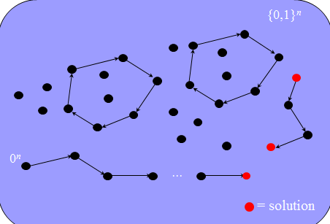
PPAD
2D-Sperner
PL-Brouwer
$2$-Nash

Slide 49
K=$2^{n}−1$
K.i
K.o
…
3.i
$$v_{0}→v_{2}$$
3.o
$$→v_{1}$$
2.i
$$→v_{3}$$
2.o
1.i
How to
Avoid
crossings?
1.o
0.i
0.o
0$→$1
0$→$2
0$→3$
…
1$→3$
…
2$→1$
…
K$→K−1$

Slide 50
K=$2^{n}−1$
K.i
K.o
…
3.i
$$v_{0}→v_{2}$$
3.o
$$→v_{1}$$
2.i
$$→v_{3}$$
2.o
1.i
How to
Avoid
crossings?
1.o
0.i
0.o
0$→$1
0$→$2
0$→3$
…
1$→3$
…
2$→1$
…
K$→K−1$

Slide 51
K=$2^{n}−1$
K.i
K.o
…
3.i
$$v_{0}→v_{2}$$
3.o
$$→v_{1}$$
2.i
$$→v_{3}$$
2.o
1.i
How to
Avoid
crossings?
1.o
0.i
0.o
0$→$1
0$→$2
0$→3$
…
1$→3$
…
2$→1$
…
K$→K−1$

Slide 52
K=$2^{n}−1$
K.i
K.o
$$v_{0}→v_{2}$$
…
$$→v_{1}$$
3.i
$$→v_{3}$$
3.o
2.i
Extra cycles
2.o
But no extra
End-points
1.i
1.o
0.i
0.o
0$→$1
0$→$2
0$→3$
…
1$→3$
…
2$→1$
…
K$→K−1$

Slide 53
K=$2^{n}−1$
K.i
K.o
$$v_{0}→v_{2}$$
…
$$→v_{1}$$
3.i
$$→v_{3}$$
3.o
Extra cycles
2.i
But no extra
End-points
2.o
1.i
Coloring?
1.o
0.i
0.o
0$→$1
0$→$2
0$→3$
…
1$→3$
…
2$→1$
…
K$→K−1$

Slide 54
Proof of Sperner’s Lemma
Rule:
Claim: The walk cannot exit the square, nor can it loop into itself.
Hence, it must stop at tri-chromatic triangle…
Cross R – Y
Keeping
R on left
!
[Sperner 1928]: Color the boundary using three colors in a legal way. No matter how the internal nodes are colored, there exists a tri-chromatic triangle. In fact an odd number of those.

Slide 55
K=$2^{n}−1$
K.i
K.o
$$v_{0}→v_{2}$$
…
$$→v_{1}$$
3.i
$$→v_{3}$$
3.o
Extra cycles
2.i
But no extra
End-points
2.o
1.i
Coloring?
1.o
Constant
Blow-up
0.i
0.o
0$→$1
0$→$2
0$→3$
…
1$→3$
…
2$→1$
…
K$→K−1$

Slide 56
K=$2^{n}−1$
$$v_{0}→v_{2}$$
…
$$→v_{1}$$
$$→v_{3}$$
3.1
Extra cycles
But no extra
End-points
Coloring?
Constant
Blow-up

Slide 57
Poly-time Procedure for Coloring?
Every row uniquely correspond to a vertex in/out
Every column uniquely correspond to $v_{i}→v_{j}$
For every grid point of the initial grid, can use circuit N and P of PPAD to check if a line is passing through it and in what direction.
Even further subdivision in constantly many cells is predetermined.
What about crossings?
Again checking and uncrossing are locally possible.

