Slide 1
ECE 333
Renewable Energy Systems
Lecture 9: Photovoltaic Materials and Electrical Characteristics
Dr. Karl Reinhard
Dept. of Electrical and Computer Engineering
University of Illinois at Urbana-Champaign
reinhrd2@illinois.edu

Slide 2
Announcements
HW 4 is due on Thursday, 15 Feb
Quiz 4 on Thursday 15 Feb.
Read Chapter 5 (Photovoltaic Materials and Electrical Characteristics)
Report 2 due Thursday 15 Feb.

Slide 3
Total Clear Sky Insolation
The total insolation is the sum of the direct beam, diffuse and reflected
  Most is direct beam; models for diffuse and reflected are more approximate (and certainly site dependent)
θ is angle between sun and
normal to collector
Superscript h indicates values on surface in front of collector; ρ is estimates reflectivity of surface, ranging from 0.8 for snow to 0.1 for dark shingles

Slide 4
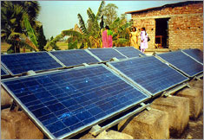
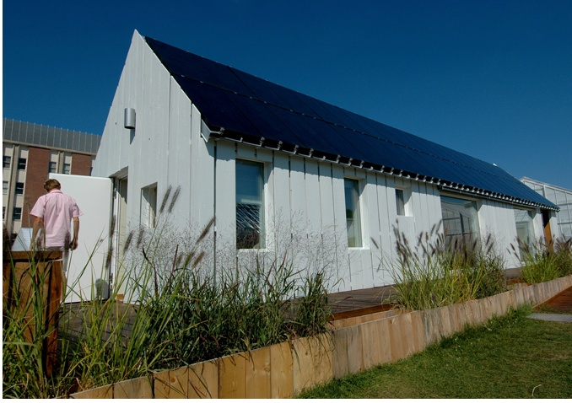
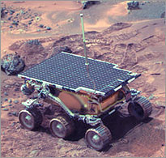
Photovoltaics (PV)
Photovoltaic definition- a material or device that is capable of converting the energy contained in photons of light into an electrical voltage and current
"Sojourner" exploring Mars, 1997
UIUC Solar Decathalon House – 2nd place overall in 2009
PV serving village health center, West Bengal, India
http://www.solardecathlon.uiuc.edu/gallery.html#
http://www1.eere.energy.gov/solar/pv_use.html

Slide 5
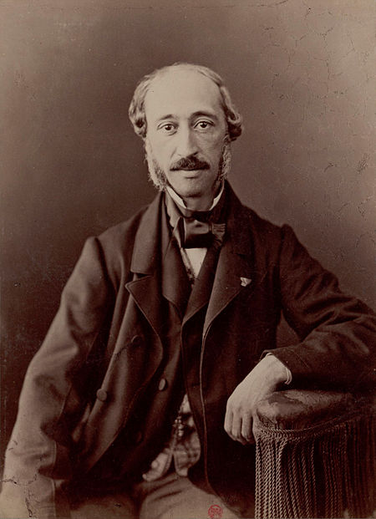
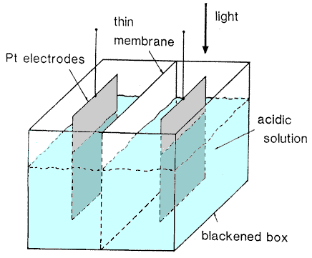
PV History – Edmond Becquerel
Edmond Becquerel (1820 – 1891), French physicist
Studied solar spectrum, magnetism, electricity, and optics.
Observed / documented the photovoltaic effect, in 1839 (age 19)
Generated electricity by illuminating an electrode with different types of light, including sunlight
  ( https://en.wikipedia.org/wiki/Edmond_Becquerel accessed 9 Feb 18 )
Diagram of Becquerel’s Apparatus
http://www.pveducation.org/pvcdrom/manufacturing/first-photovoltaic-devices accessed 9 Feb 18

Slide 6
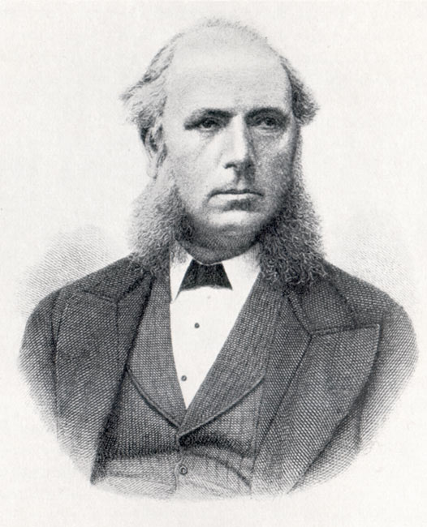
PV History – Willoughby Smith
Willoughby Smith (1828 – 1891), English Elect Engr
Discovered selenium’s (Se) photoconductive behavior
Worked for the Gutta Percha Company, which manufactured telegraph wires – including underwater cables
Gutta-percha tree (Malayan for “percha latex”) sap is a natural latex elastomer – a good insulator https://en.wikipedia.org/wiki/Gutta-percha
In 1873, Smith developed a method in the lab for continually testing an underwater cable as it was being laid using Se rods
However inconsistent results in practice; discovered that the Se rod σ increased significantly when exposed to strong light
Smith published "Effect of Light on Selenium during the passage of an Electric Current" in Nature Magazine, Feb 1873
(https://en.wikipedia.org/wiki/Willoughby_Smith accessed 9 Feb 18 )

Slide 7
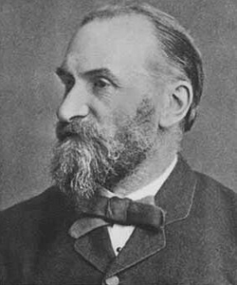
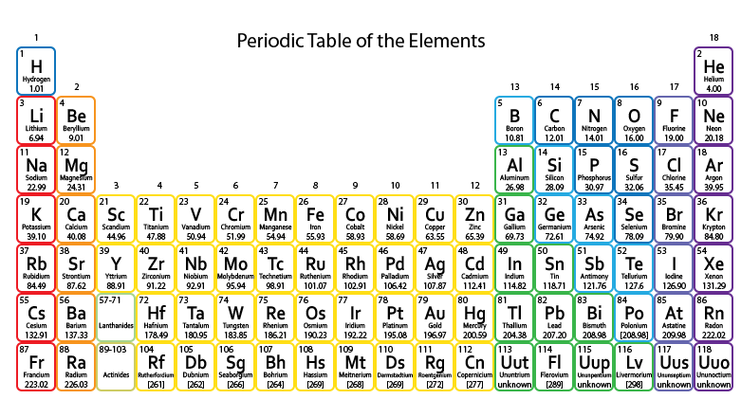
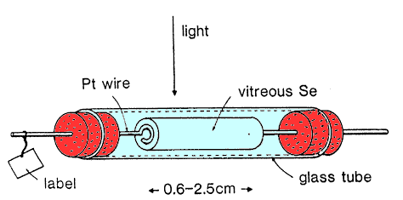
PV History – Adams and Day
William Grylls Adams, Professor, (1836-1915)
and student Richard Evans Day @ King’s College
Were experimenting with Se
Following Smith’s1873 report, they investigated photoelectric effects
In 1876, demonstrated Se’s photovoltaic behavior
https://www.popsci.com/article/science/invention-solar-cell#page-2 accessed 9 Feb 18
William Grylls Adams
http://www.pveducation.org/pvcdrom/manufacturing/first-photovoltaic-devices

Slide 8
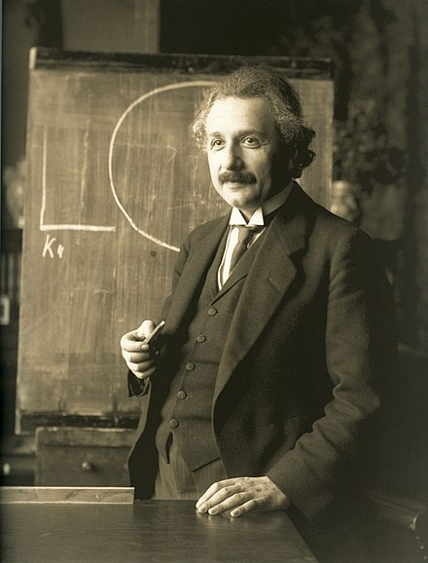
PV History – Albert Einstein
Albert Einstein, Theoretical Physicist, (1879 - 1955)
1905 published 4 Groundbreaking Papers
  Photoelectric Effect (Nobel Prize in Physics 1921)
  Brownian motion
  Special relativity
  Equivalence of mass and energy
Photoelectric Effect
  Light occurs packets of energy, quanta (i.e. photons)
  Light quanta power varies according to the light’s wavelength – shorter the wavelength, the more power
  Provided scientific framework to “photoelectricity”
  Explained the photoelectric phenomenon in scientific terms
https://www.popsci.com/article/science/invention-solar-cell#page-2
https://en.wikipedia.org/wiki/Albert_Einstein

Slide 9
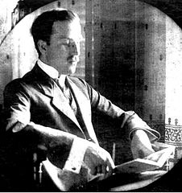
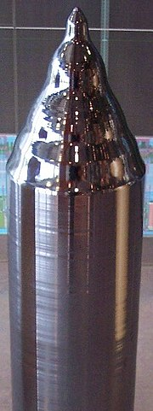
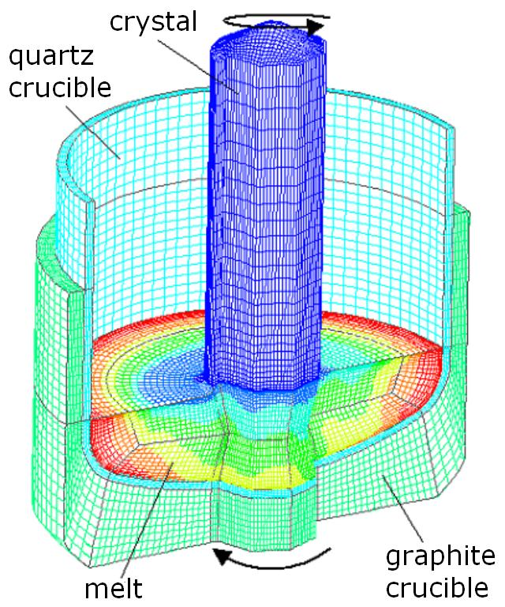
PV History – Jan Czochralski
Jan Czochralski, Polish Chemist, (1885 – 1953)
Developed the Czochralski Process for growing single crystals (1915) → semiconductor wafer production
Accidental discovery – instead of dipping his pen into the inkwell, he did so in molten tin and drew a tin filament, that later proved to be a single crystal.
(https://en.wikipedia.org/wiki/Jan_Czochralski)
https://strgmbh.de/melt/100-mm-cz-si/
https://en.wikipedia.org/wiki/Czochralski_process

Slide 10
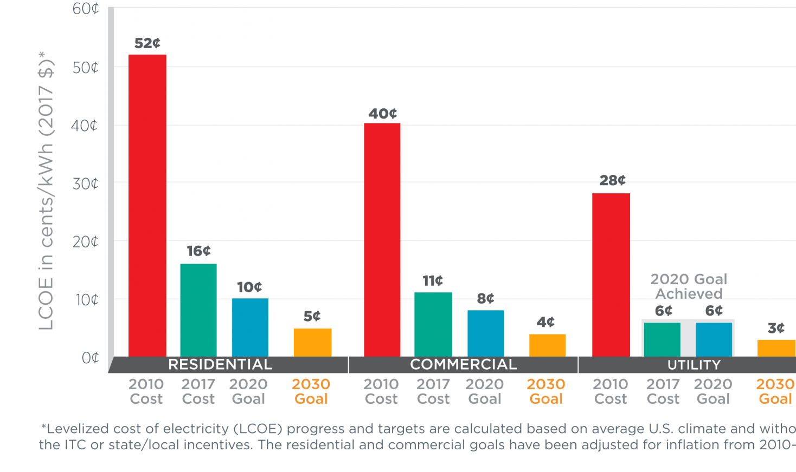
PV History in the Making – DOE SunShot Initiative
SunShot Initiative aims
  Reduce utility-scale solar electricity cost 50% between 2020 -- 2030 to $0.03 /kWh
  Address Grid integration challenges reduce market entry barriers
https://energy.gov/eere/solar/goals-solar-energy-technologies-office

Slide 11
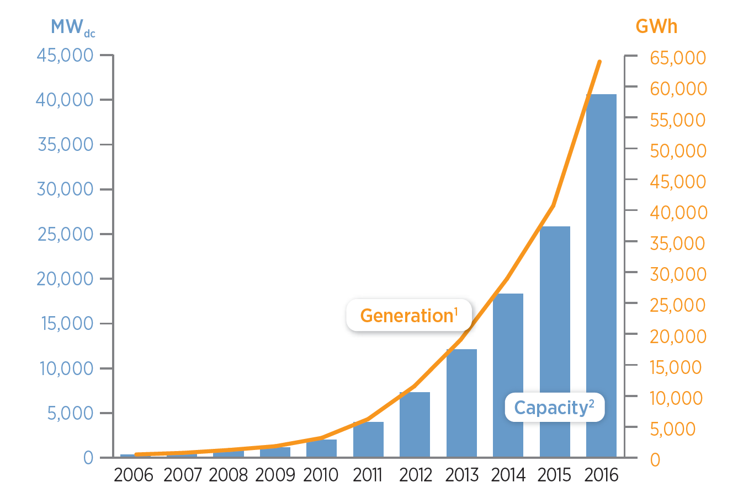
Recent Growth in Solar
U.S. PV Electricity Installed Capacity & Generation
Source: DoE 2016 Renewable Energy Book
https://www.nrel.gov/news/press/2018/data_book_shows_continued_growth_of_renewable_electricity.html accessed 31 Jan 18

Slide 12
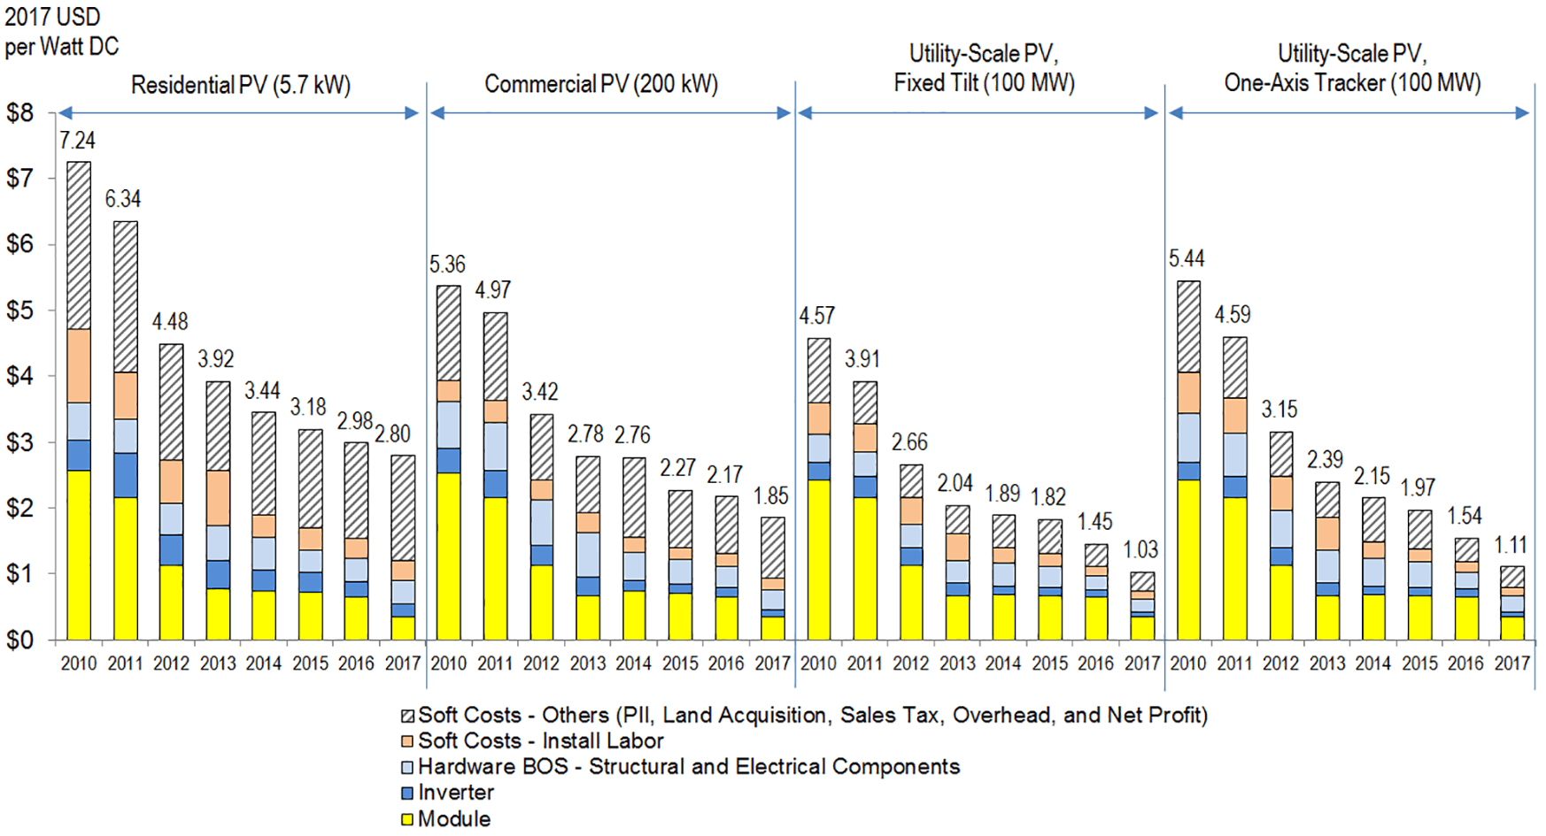
Recent Solar Installation Costs
NREL PV system cost 2010–2017 summary
(inflation adjusted)
https://www.nrel.gov/news/press/2017/nrel-report-utility-scale-solar-pv-system-cost-fell-last-year.html
accessed 1/31/18

Slide 13
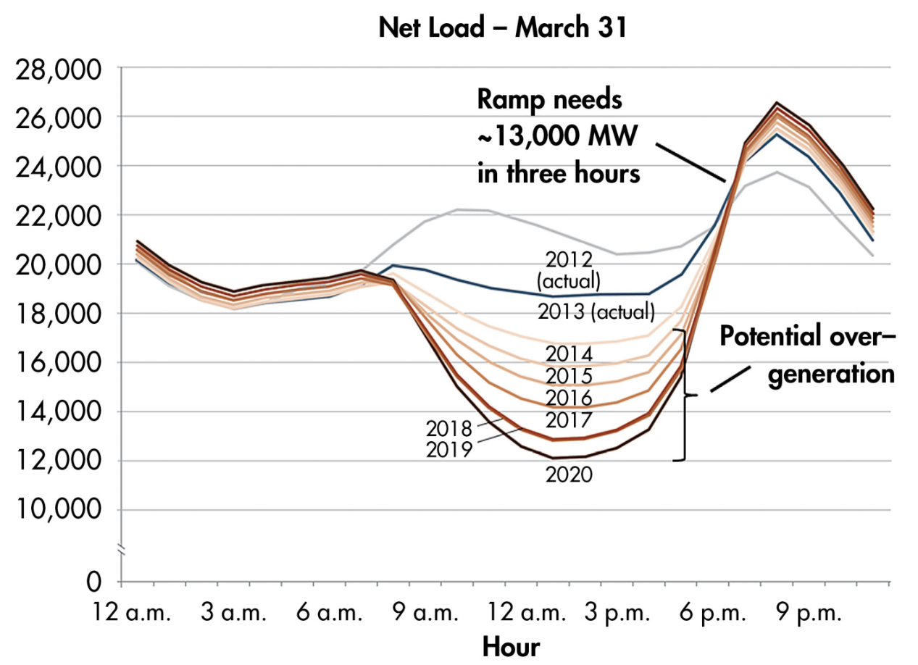
PV Integration Challenges
Duck Curve
High solar adoption challenges utilities to balance new grid supply and demand dynamics
Fast Gen Ramp at sunset
Overgeneration during day
PV Generators Paying for Grid Infrastructure costs
Image: http://www.caiso.com/documents/flexibleresourceshelprenewables_fastfacts.pdf
https://energy.gov/eere/articles/confronting-duck-curve-how-address-over-generation-solar-energy

Slide 14
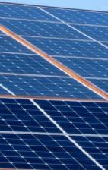
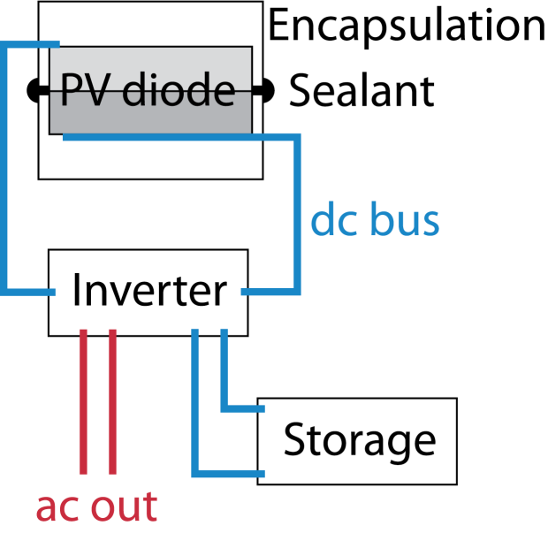
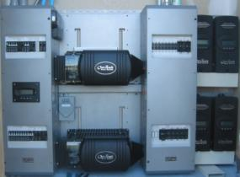
Nominal PV System Overview
Solar cell is a diode
Photon energy converted to DC
Shadows on panel & panel PV material defects non-linearly reduce energy conversion
Power Inverter converts DC to AC
Unpredictable / changing loads
Storage enables matching energy generated to energy consumed
Shadows

Slide 15

General PV Issues
PV diode
  Efficiency, cost, manufacturability, automation, testing
Packaging (encapsulation)
  Cost, weight, strength, yellowing, etc.
Accelerated life-cycle testing
  30 year outdoor test is not practical
  Damp, heat, light, immersion, etc.
Inverter & system design
  Micro-inverters, blocking diodes, reliability
  “Right sizing” components

Slide 16
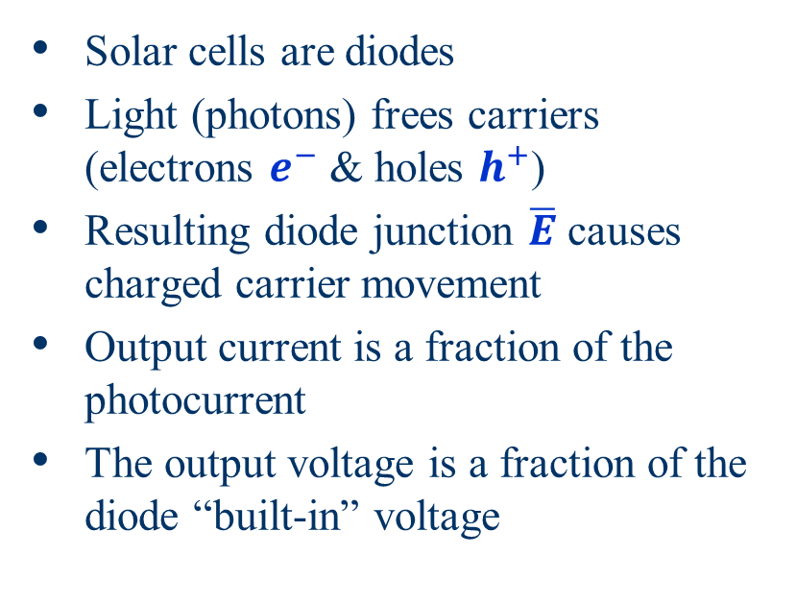
What are Solar Cells?
Load
-
+
Solar cells are diodes
Light (photons) frees carriers (electrons $e^{−}$ & holes $h^{+}$)
Resulting diode junction $\overline{E}$ causes charged carrier movement
Output current is a fraction of the photocurrent
The output voltage is a fraction of the diode “built-in” voltage
n-type
p-type
+
-
Open-circuit voltage
Voltage
Maximum Power Point
Current
Short-circuit current

Slide 17
Standard Equivalent Circuit Model
Where does the power go?
Series
R_{s}
(minimize)
Ideal Photocurrent source
Diode
Shunt
R_{p}
(maximize)
Load
Building to this model….
Notes:
16

Slide 18
Photon Energy
Photons characterized by λ (wavelength), υ (frequency), & E (energy)
In this context, energy is often expressed in electron-volts (eV), defined as 1.6 ×10⁻¹⁹ J….
Planck's constant (h): 6.626 ×10⁻³⁴ J-s
Light’s velocity (c): 3×10⁸ m/s
  … the energy gained by a single electron moving across a 1 volt potential difference
Typically E (eV) & λ (μm)

Slide 19
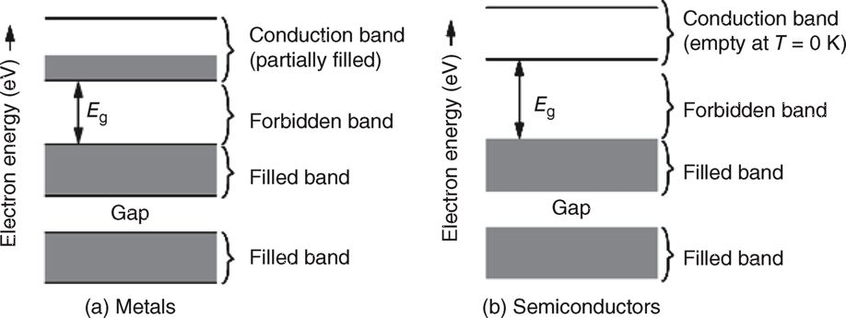

Band-Gap Energy
I is free $e^{−}$ flow in conduction band
At $0^{o}K$, Metals have free $e^{−}$s available → good conductors
  ( → Metal conductivity (σ) ↓ w/ ↑ T )
  Semi-conductors, e.g. Si, have NO free $e^{−}$ @ $0^{o}K$ → good insulators
FIGURE 5.4 Energy bands for (a) metals and (b) semiconductors.
Metals have partially filled conduction bands, which allow them to carry electric current easily. Semiconductors at absolute zero temperature have no electrons in the conduction band, which makes them insulators
Masters, Gilbert M. Renewable and Efficient Electric Power Systems, 2nd Edition. Wiley-Blackwell

Slide 20
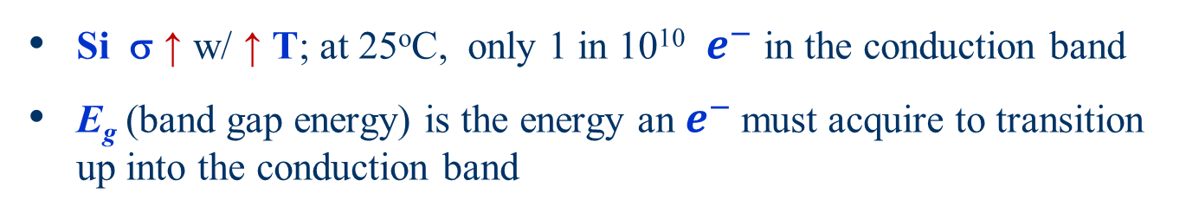
Band-Gap Energy (cont)
  Si σ ↑ w/ ↑ T; at 25ºC, only 1 in 10¹⁰ $e^{−}$ in the conduction band
  E_{g} (band gap energy) is the energy an $e^{−}$ must acquire to transition up into the conduction band
Band Gap (eV) & Wavelength (λ) Cut-offs…. Above which Electron Excitation Doesn’t Occur
Quantity | Si | GaAs | CdTe | InP
Band gap (eV) | 1.12 | 1.42 | 1.5 | 1.35
Cut-off wavelength (μm) | 1.11 | 0.87 | 0.83 | 0.92

Slide 21
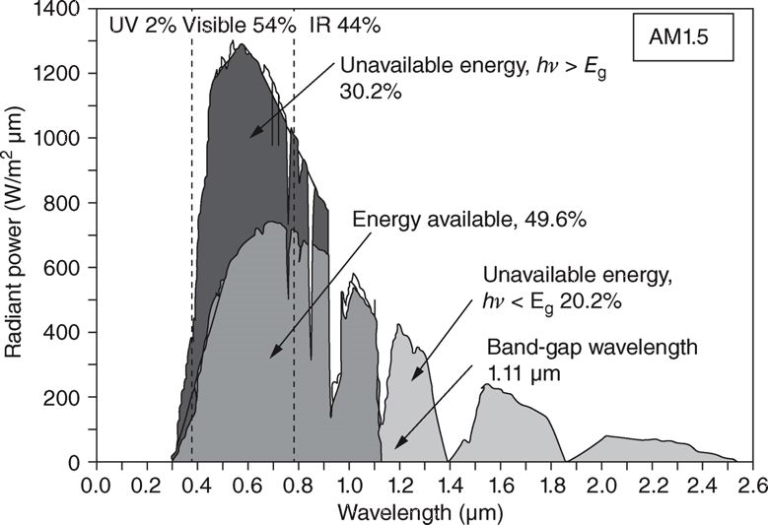
Silicon Solar Cell Energy Conversion Limits
FIGURE 5.7 Si PV Convertible Solar Energy at AM1.5
Masters, Gilbert M. Renewable and Efficient Electric Power Systems, 2nd Edition. Wiley-Blackwell
λ < 1.11
λ > 1.11
AMR 1.5, Max Si PV incident energy conversion to electrical energy is 49.6%
  Photons w/ λ > 1.11 μm Photon energy < E_{g} – unavailable
  Photons w/ λ < 1.11 μm Photon energy > E_{g} – unavailable

Slide 22
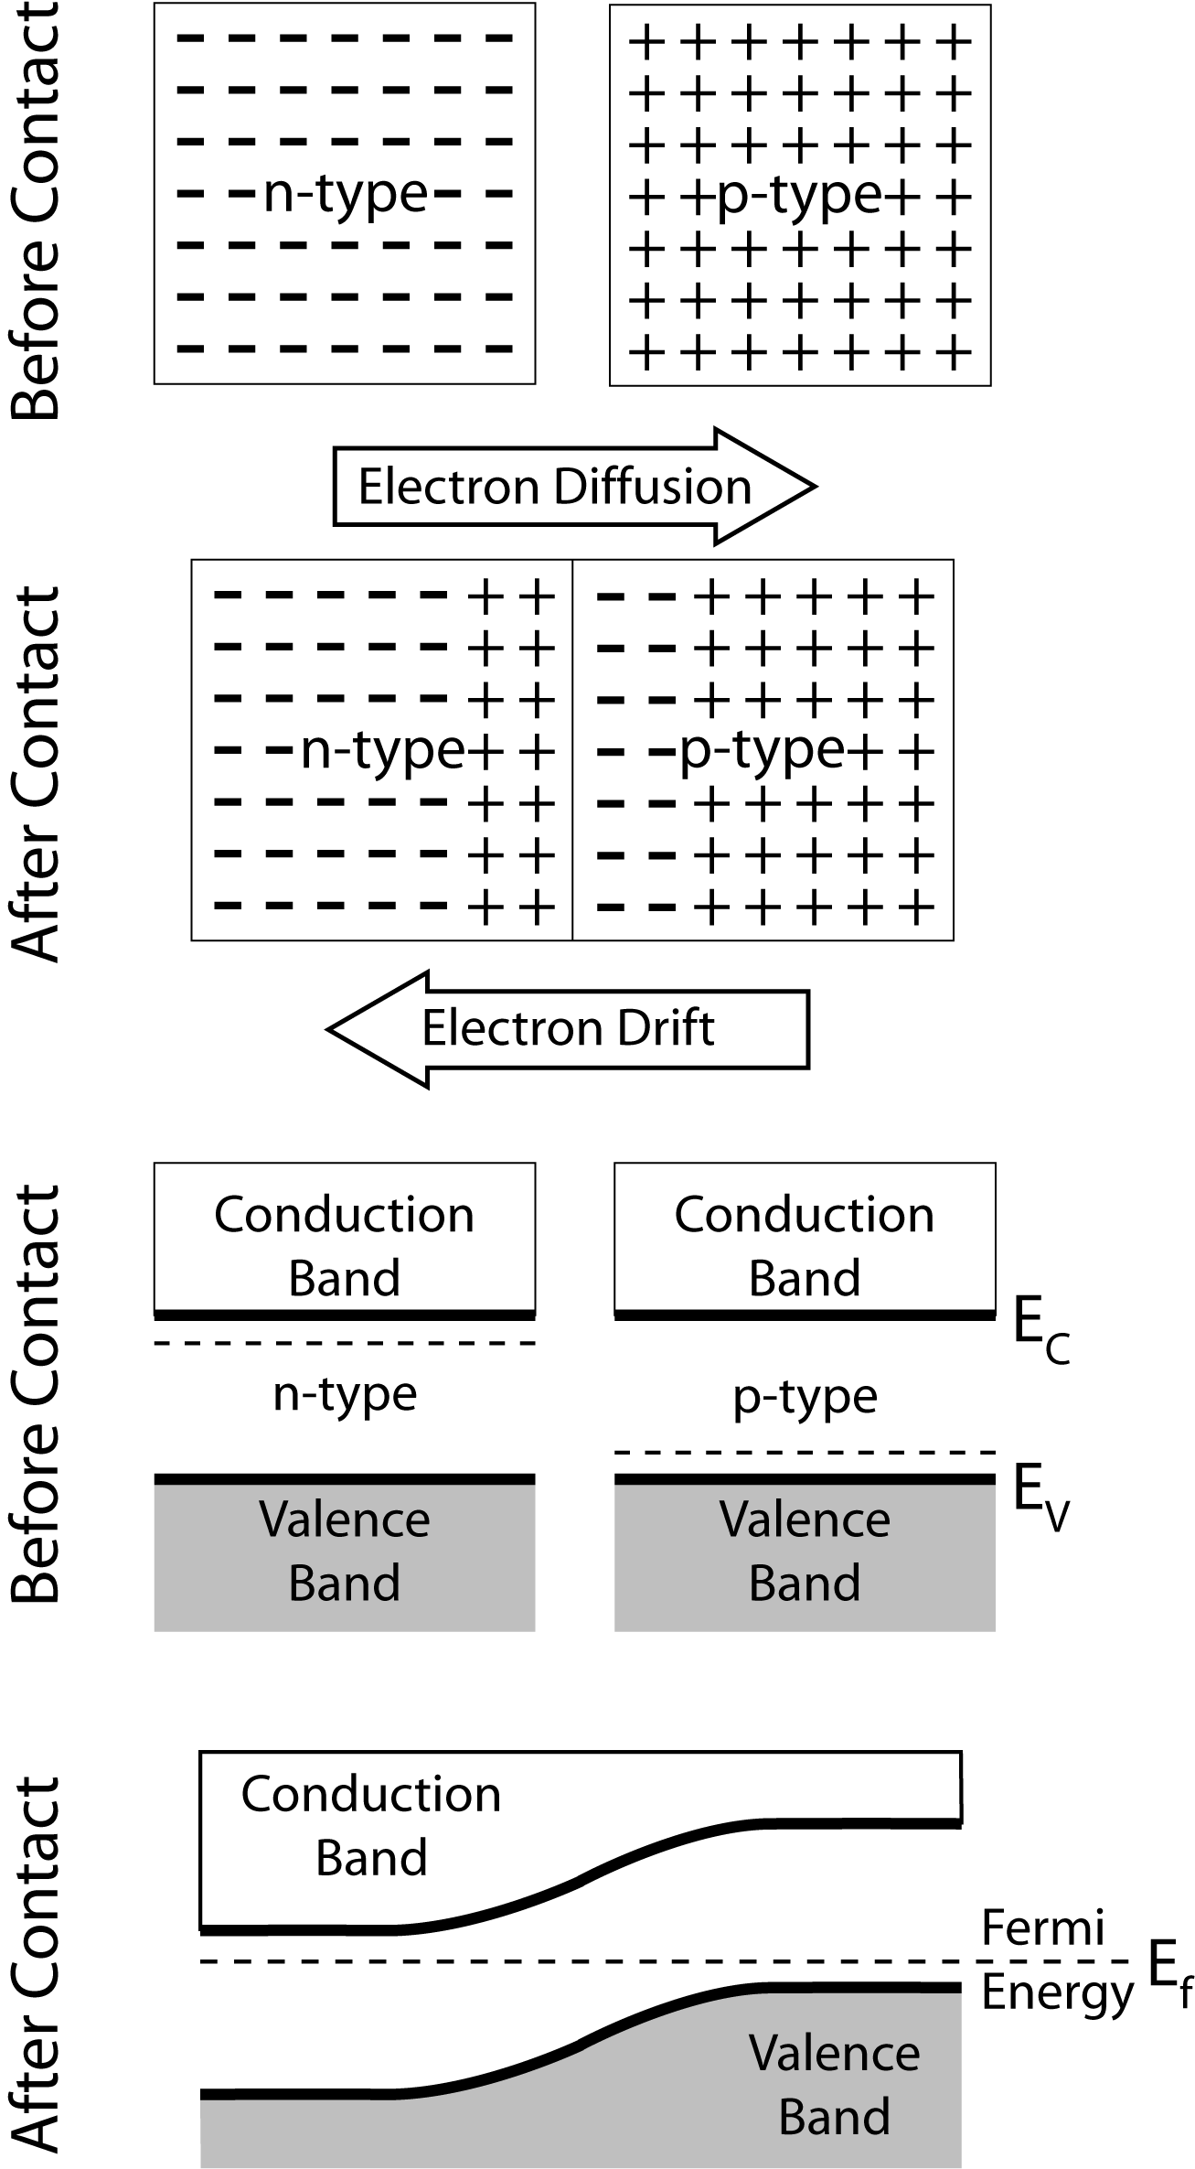
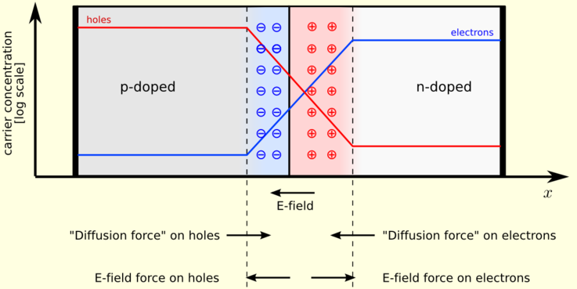
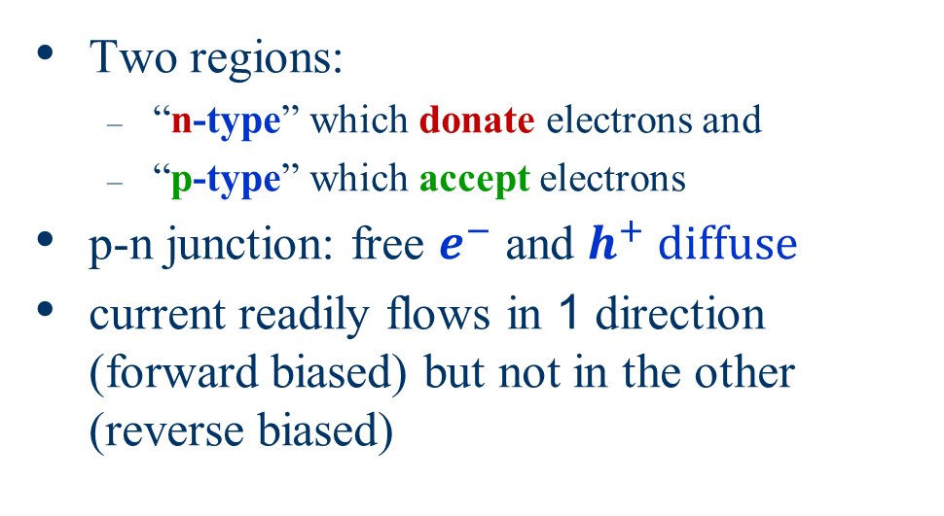
Diode – Key Concepts !!
Two regions:
  “n-type” which donate electrons and
  “p-type” which accept electrons
p-n junction: free $e^{−}$ and $h^{+} diffuse$
current readily flows in 1 direction (forward biased) but not in the other (reverse biased)
http://en.wikipedia.org/wiki/File:Pn-junction-equilibrium.png

Slide 23
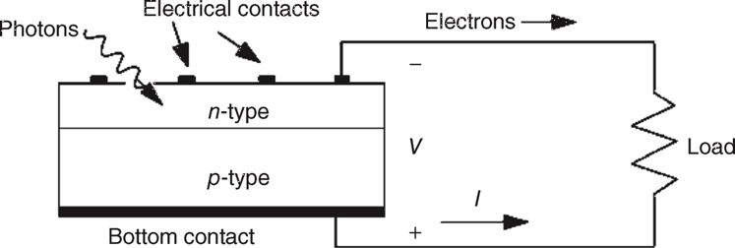
Diode – Biasing !!
  “n-type” which donate electrons
  “p-type” which accept electrons
Gotta Understand the sign polarity Logic!!
_
_
V_{d}
+
+
http://en.wikipedia.org/wiki/File:Pn-junction-equilibrium.png
FIGURE 5.15

Slide 24
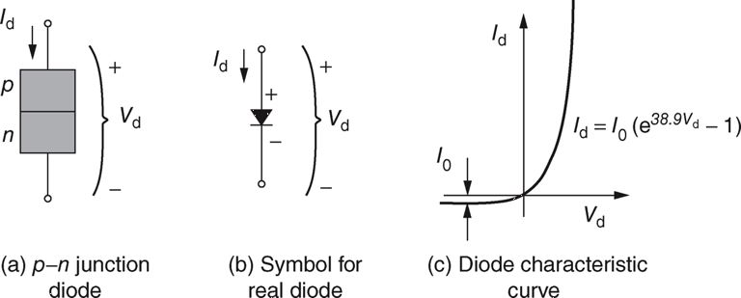
The p-n Junction Diode
Diode voltage-current (V-I) characteristics:
k = Boltzmann’s constant: 1.381x10⁻²³ [J/K]
T = junction temperature [K]
V_{d} = diode voltage
I_{d} = diode current
q = electron charge 1.602x10⁻¹⁹ C
I₀ = reverse saturation current

Slide 25
PV Cell Circuit Models
Simplest PV cell model is an ideal current source in parallel w/ a diode
Ideal source current, I_{SC} , proportional to insolation
If insolation drops by 50%, I_{SC} drops by 50%
PV cell
PV cell
I
I
+
I_{d}
+
+
I_{SC}
V_{Load}
V_{d}
V_{Load}
_
_
-

Slide 26
Circuit Models of PV Cells
I
+
I_{d}
+
I_{SC}
V_{d}
V_{Load}
-
The subscript SC
is for short circuit
-
Using KCL
The open circuit voltage, i.e. setting I = 0 (or V_{Load} = ∞)

Slide 27
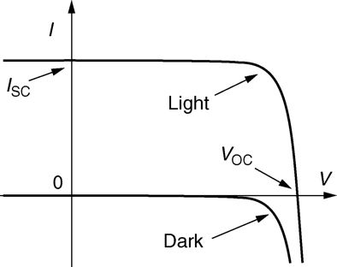
PV Cell I-V Characteristic
For any I_{SC} value, can calculate the relationship between cell terminal voltage and current (the I-V characteristics)
→ PV cell I-V characteristic is the upside-down diode I-V characteristic shifted down by I_{SC} (because I = I_{SC} – I_{d})
The curve intersects the x-axis at V_{OC} and the y-axis is I_{SC}
I_{sc}
-1

Slide 28
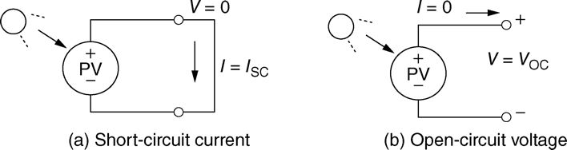
PV Cell I-V Curves
I-V curve for an illuminated cell = “dark” curve + illuminated I_{SC} curve
FIGURE 5.24 I_{SC} and V_{OC}
Masters, Gilbert M. Renewable and Efficient Electric Power Systems, 2nd Edition. Wiley-Blackwell
FIGURE 5.25 Photovoltaic current–voltage relationship for “dark” (no sunlight) and “light” (an illuminated cell).
Masters, Gilbert M. Renewable and Efficient Electric Power Systems, 2nd Edition. Wiley-Blackwell

Slide 29
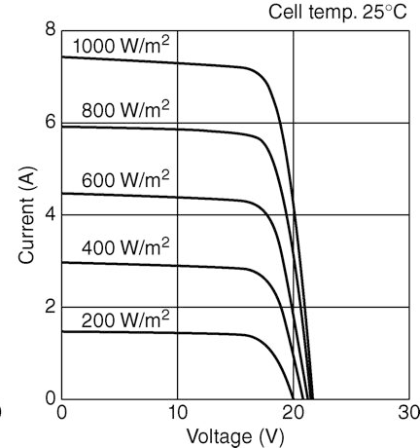
PV Cell I-V Curves
More light effectively shifts the curve up in I, but V_{OC} does not change much
By varying the insolation, we obtain not a single I-V curve, but an infinite set of I-V curves of varying with InSolation
Insolation

Slide 30
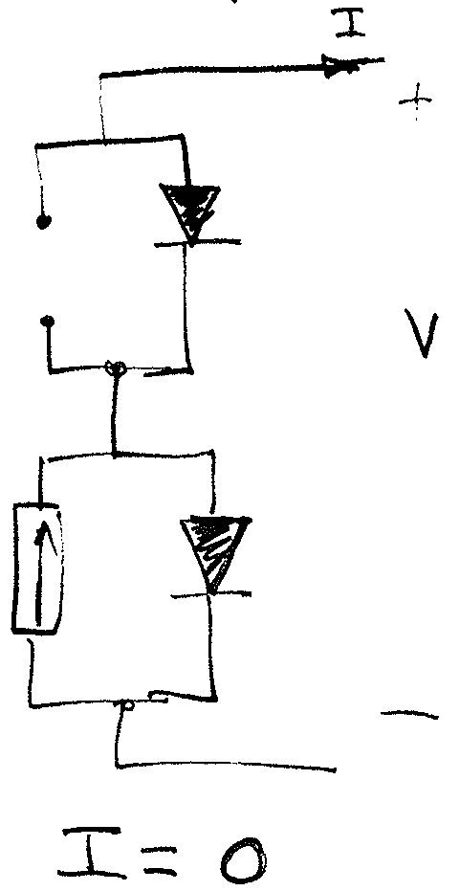
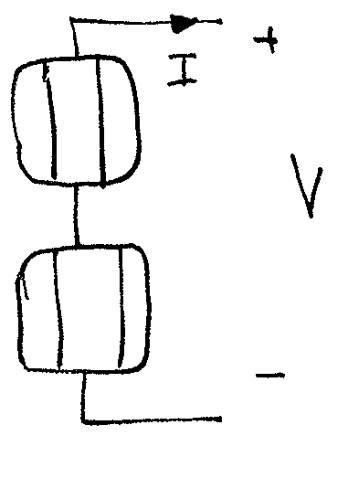
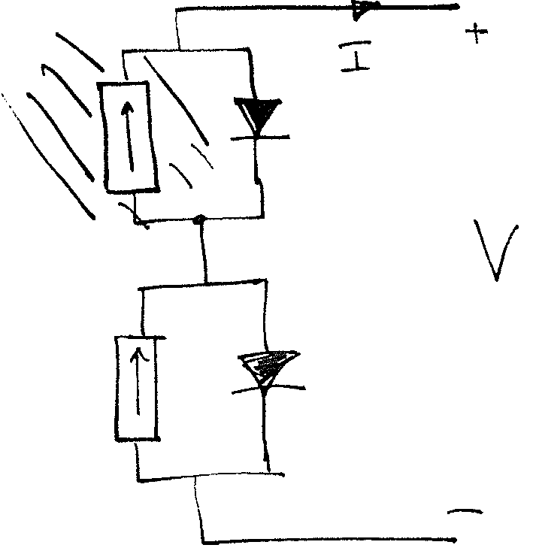
Need for a More Accurate Model
The previous circuit is not realistic for analyzing shading effects (we’ll talk more about shading later)
Using this model, absolutely NO current can pass when one cell is shaded (I = 0)

Slide 31

PV Equivalent Circuit
Shading has a big impact on solar cell power output… BUT it does not shutdown energy conversion!
Otherwise, a single shaded cell would force a multi-cell module’s entire output to zero.
A more accurate model includes a leakage resistance R_{P} in parallel w/ the current source and ideal diode
  R_{P} is large: ~ R_{P} > 100
Series resistance, R_{S} , accounts for V (terminal voltage) being slightly smaller than V_{d}
  R_{S} is small: ~ R_{S} < 0.01

Slide 32
PV Equivalent with Parallel Resistor
From KCL:
For any V, adding R_{p} (parallel leakage resistance) reduces I by
Parallel-Only
I
I_{d}
+
+
I_{SC}
Photocurrent source
V_{d}
(maximize)
V
R_{P}
Load
Shunt resistance drops some current (reduces output current)
-
-

Slide 33
PV Equivalent with Series Resistor
Add series resistance R_{s} due to
  contact resistance between cell and wires
  semiconductor resistance
The output voltage V drops by IR_{s}
Series R added to ideal
I
R_{s}
Series resistance reduces V_{d} to V at the cell terminals
Photocurrent source
I_{SC}
I_{d}
+
(minimize)
+
V_{d}
V
Load
-
-

Slide 34
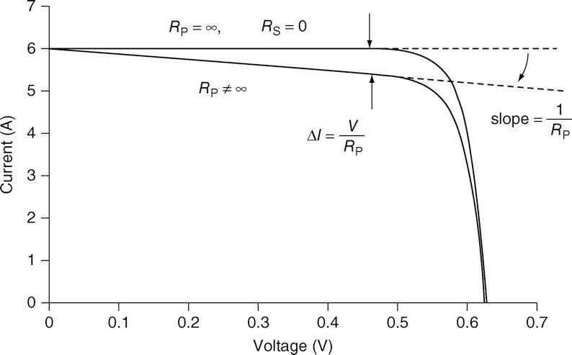
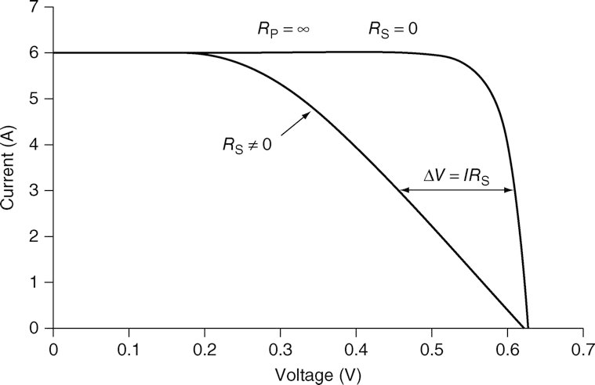
Series and Shunt Resistance Effects
R_{P} – I drops by ΔI = V/R_{P}
I
I_{d}
+
+
I_{SC}
V_{d}
R_{P}
V
Load
_
_
R_{S} – V drops by ΔV = I R_{S}
R_{s}
I
I_{d}
+
+
I_{SC}
V_{d}
V
Load
_
_

Slide 35
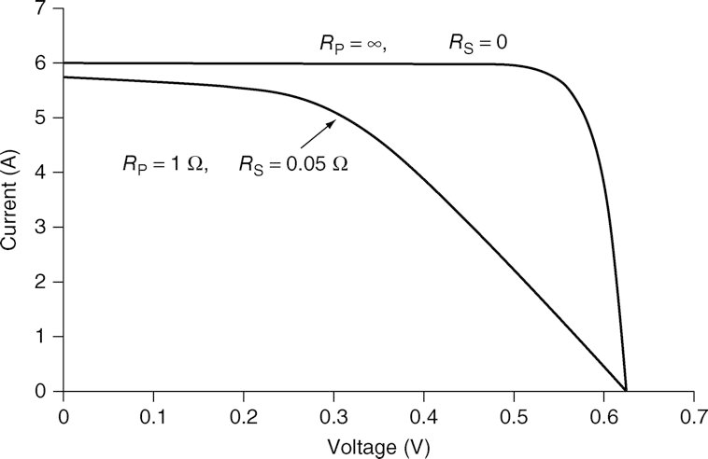
Series and Shunt Resistance Effects
R_{s}
I
I_{d}
+
(minimize)
+
I_{SC}
Photocurrent source
V_{d}
R_{P}
V
Load
_
(maximize)
_

Slide 36
General PV Cell Equivalent Circuit
The general equivalent circuit model considers both parallel and series resistance
Equivalent Circuit
R_{s}
I
I_{d}
+
(minimize)
+
I_{SC}
Photocurrent source
V_{d}
R_{P}
V
Load
_
(maximize)
_
Substituting for I_{d} and V_{d}
Diode equation

Slide 37
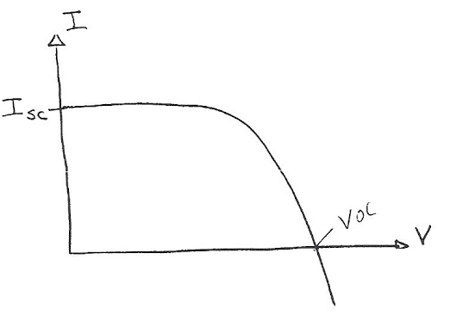
Fill Factor and Cell Efficiency
V_{R} • I_{R}
area = V_{oc} I_{sc}
Fill Factor (FF) =
V_{oc}• I_{sc}
Fill factor is ratio at the ratio at
the maximum power point
area = V_{R} I_{R}
V_{oc}• I_{sc}• FF
I_{max}• V_{max}
Cell Efficiency (η) =
=
Incident Pwr
Incident Pwr

Slide 38
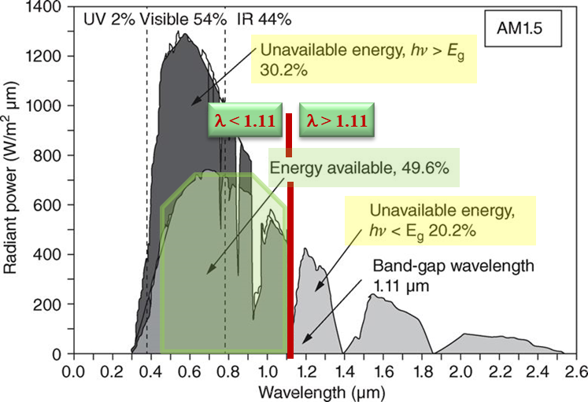
Multijunction Cells
Load
Problem: Single junction loses all of the photon energy above the gap energy.
-
-
+
-
-
+
+
+
p-type
p-type
n-type
p-type
n-type
n-type
p-type
n-type
Solution: Use a series of cells of different gaps….
… each cell captures the light transmitted from above.
Energy (eV)
180
4.0
3.0
2.5
2.0
1.7
1.5
1.3
1.1
1.0
0.9
160
140
120
100
Cell #4
(0.6 eV gap)
Intensity (mW/m²-μm)
80
Top Cell (1.9 eV gap)
60
Cell #2
(1.4 eV gap)
40
Cell #3
(1.0 eV gap)
20
0
300
500
700
900
1100
1300
1500
Wavelength (nm)

Slide 39
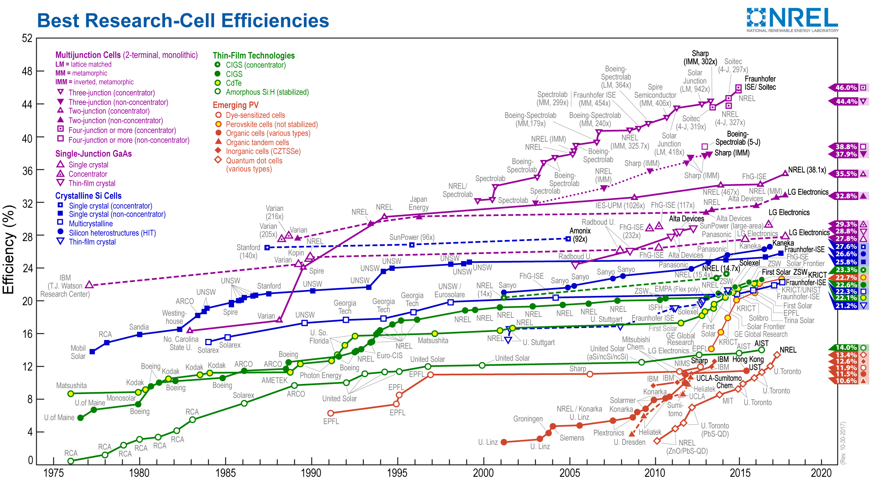
Record laboratory thin film PV cell efficiencies
Courtesy of the National Renewable Energy Laboratory, Golden, CO.
https://www.nrel.gov/pv/assets/images/efficiency-chart.png accessed 9 Feb 18
Notes:
Notes accompanying NREL PV efficiency-chart.png
https://www.nrel.gov/pv/assets/pdfs/cell_efficiency_explanatory_notes.pdf (accessed 9 Feb 2018)
The National Renewable Energy Laboratory (NREL) maintains a plot of compiled values of highest confirmed conversion efficiencies for research cells, from 1976 to the present, for a range of photovoltaic technologies.
Devices included in this plot of the current state of the art have efficiencies that are confirmed by independent, recognized test labs (e.g., NREL, AIST, Fraunhofer) and are reported on a standardized basis. The measurements for new entries must be with respect to Standard Test or Reporting Conditions (STC) as defined by the global reference spectrum for flat-plate devices and the direct reference spectrum for concentrator devices as listed in standards IEC 60904-3 edition 2 or ASTM G173. The reference temperature is 25°C and the area is the cell total area or the area defined by an aperture.
Cell efficiency results are provided within different families of semiconductors: (1) multijunction cells, (2) single-junction gallium arsenide cells, (3) crystalline silicon cells, (4) thin- film technologies, and (5) emerging photovoltaics. Some 26 different subcategories are indicated by distinctive colored symbols.
The most recent world record for each technology is highlighted along the right edge in a flag that contains the efficiency and the symbol of the technology. The company or group that fabricated the device for each most-recent record is bolded on the plot.
The information plotted by NREL is provided in good faith, but NREL cannot accept direct responsibility for any errors or omissions. The plot is not copyrighted and may be used in presentations and publications, with a notation included that states: “This plot is courtesy of the National Renewable Energy Laboratory, Golden, CO.”

Slide 40
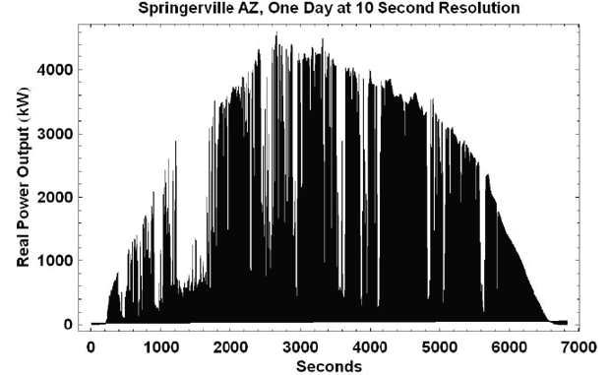
Solar PV can be Quite Intermittent
Because of Clouds
Intermittency
can be reduced
some when
PV is
distributed
over a larger
region; key
issue is
correlation
across an area
Image: http://www.megawattsf.com/gridstorage/gridstorage.htm

Slide 41
Silicon Solar Cell Energy Conversion Limits
FIGURE 5.7 Si PV Convertible Solar Energy at AM1.5
Masters, Gilbert M. Renewable and Efficient Electric Power Systems, 2nd Edition. Wiley-Blackwell
λ < 1.11
λ > 1.11
AMR 1.5, Max Si PV incident energy conversion to electrical energy is 49.6%
  Photons w/ λ > 1.11 μm Photon energy < E_{g} – unavailable
  Photons w/ λ < 1.11 μm Photon energy > E_{g} – unavailable

Slide 42
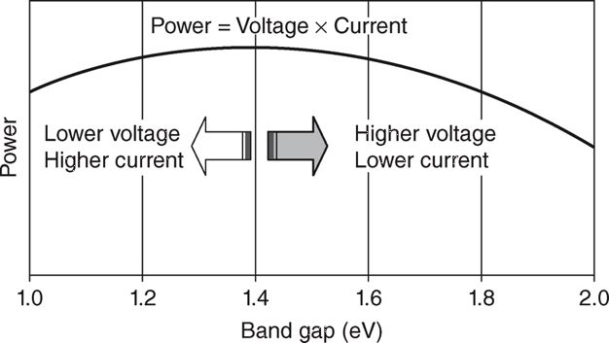
Solar Cell Efficiency
Factors that add to losses
  Electron/hole recombination
  Internal resistance
Smaller band gaps – easier e⁻ excitation, photons w/ extra energy
  → higher current, lower voltage
Higher band gaps –
  → higher voltage, lower current
Thus seek middle ground,
…. usually between 1.2 and 1.8 eV
  Photons not absorbed or reflected
  Heating
FIGURE 5.9 Maximum efficiency of photovoltaics as a function of their band-gap.
Masters, Gilbert M. Renewable and Efficient Electric Power Systems, 2nd Edition. Wiley-Blackwell

Slide 43
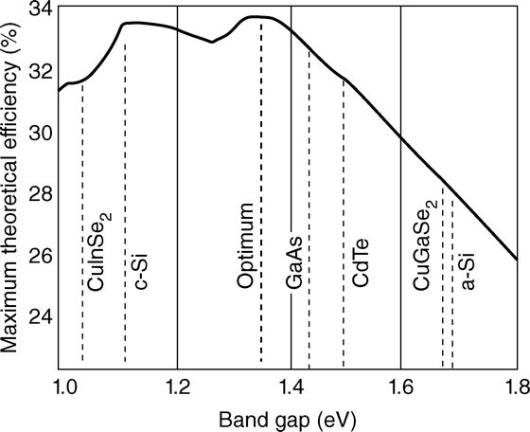
Maximum PV Cell Efficiency
Shockley and Queisser derived max single-junction PV cell in 1961
FIGURE 5.8 The Shockley–Queisser limit for the maximum possible solar cell efficiency (single-junction, unenhanced insolation) as a function of band-gap.
Masters, Gilbert M. Renewable and Efficient Electric Power Systems, 2nd Edition. Wiley-Blackwell

Slide 45
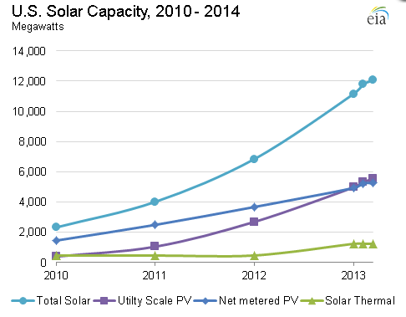
US Solar Capacity
US solar capacity is growing at close to 100% yearly, with most of the growth in solar PV (as opposed to solar thermal)
Solar PV
2004 6 GWh
2009 735 GWh
2013 8,121 GWh
2014 15,874 GWh
(about 0.4% of total)
Image: http://cleantechnica.com/2014/04/24/us-solar-energy-capacity-grew-an-astounding-418-from-2010-2014/

