Slide 1
Cache/VM interaction

Slide 2
Microarchitecture of Cache Memories
Address
Tag
Set
Offset
Tag Array
Data Array
Hit?
Hit?

Slide 3
Why This Organization?
Allows tag array to be faster than data array
Tag array is smaller
Don’t really need output of data array until hit/miss detection complete
Overlap some of data array access time with hit/miss detection
Also integrates well with virtual memory, as we’ll see

Slide 4
TLB – a Cache for Page Table Entries
Virtual Address
VPN
Offset
TLB
V
D
VPN
PPN
Hit?
Yes
PPN
Offset
No
Physical Address
Use Page Table

Slide 5
Typical values for a TLB
TLB size: 16-512 entries
Block size: 1-2 page table entries (4-8 bytes each)
Hit time: 0.5-1 clock cycle
Miss penalty: 10-100 clock cycles
Miss rate: 0.01-1%

Slide 6
Caches and Virtual Memory
Do we send virtual or physical addresses to the cache?
Virtual → faster, because don’t have to translate
Issue: Different programs can reference the same virtual address, either creates security/correctness hole or requires flushing the cache every time you context switch
Physical → slower, but no security issue
Actually, there are four possibilities
VIVT: Virtually-indexed Virtually-tagged Cache
PIPT: Physically-indexed Physically-tagged Cache
VIPT: Virtually-indexed Physically-tagged Cache
PIVT: Physically-indexed Virtually-tagged Cache

Slide 7
Virtually Indexed, Virtually Tagged
Fast cache access
Only require address translation upon miss
Issues
Homonym
Same VA maps to different PAs upon context switch
Synonym (also a problem in VIPT)
Different VAs map to the same PA when data is shared by multiple processes
cache line return
Main Memory
Processor
Core
VIVT
Cache
TLB
VA
miss
hit

Slide 8
Physically-Indexed Physically-Tagged
Slower, always translate address before accessing memory
Simpler for data coherence
cache line return
Main Memory
Processor
Core
TLB
PIPT
Cache
VA
PA
miss
hit

Slide 9
Virtually-Indexed Physically-Tagged
Gain benefit of a VIVT and PIPT
Very common in commercial processors
Parallel Access to TLB and VIPT cache
Issues
Synonym as VIVT; no homonym
TLB
Main Memory
PA
Processor
Core
miss
VA
VIPT
Cache
cache line return
hit

Slide 10
Deal w/ Synonym in VIPT Cache
index
VPN A
process a
point to the same
location within a page
process b
VPN B
VPN A != VPN B
how to eliminate duplication?
index
make cache index a == index b ?
tag array
data array

Slide 11
Synonym in VIPT Cache
if two VPNs do not differ in a then there is no synonym problem, since they will be indexed to the same set of a VIPT cache
imply # of sets cannot be too big
max number of sets = page size / cache line size
ex: 4KB page, 32B line, max set = 128
a complicated solution in MIPS R10000
VPN
page offset
cache tag
set index
line offset
a

Slide 12
R10000’s Solution to Synonym
32KB 2-Way virtually-indexed L1
direct-mapped physical L2
L2 is Inclusive of L1
VPN[1:0] is appended to the “tag” of L2
given two virtual addresses VA1 and VA2 that differs in VPN[1:0] and both map to the same physical address PA
suppose VA1 is accessed first so blocks are allocated in L1&L2
what happens when VA2 is referenced?
1 VA2 indexes to a different block in L1 and misses
2 VA2 translates to PA and goes to the same block as VA1 in L2
3. tag comparison fails (since VA1[1:0]≠VA2[1:0])
4. treated just like as a L2 conflict miss ⇒ VA1’s entry in L1 is ejected (or dirty-written back if needed) due to inclusion policy
VPN 12 bit
10 bit 4-bit
a= VPN[1:0] stored as part of L2 cache Tag

Slide 13
Deal w/ Synonym in MIPS R10000
VA1
VA2
page offset
page offset
index
index
a1
a2
1
TLB
miss
0
L1 VIPT cache
L2 PIPT
cache
physical index ||
a2
a2 !=a1
a1
phy. tag
data

Slide 14
Deal w/ Synonym in MIPS R10000
VA1
VA2
page offset
page offset
index
index
a1
a2
0
only one copy is
present in L1
TLB
1
L1 VIPT cache
L2 PIPT
cache
data return
a2
phy. tag
data

Slide 15
DECStation 3100/ MIPS R2000
3
1
3
0
2
9
1
5
1
4
1
3
1
2
1
1
1
0
9
8
3
2
1
0
Virtual Address
V
i
r
t
u
a
l
p
a
g
e
n
u
m
b
e
r
P
a
g
e
o
f
f
s
e
t
2
0
1
2
TLB
V
a
l
i
d
D
i
r
t
y
T
a
g
P
h
y
s
i
c
a
l
p
a
g
e
n
u
m
b
e
r
T
L
B
h
i
t
64 entries, fully associative
2
0
Physical Address
P
h
y
s
i
c
a
l
p
a
g
e
n
u
m
b
e
r
P
a
g
e
o
f
f
s
e
t
P
h
y
s
i
c
a
l
a
d
d
r
e
s
s
t
a
g
C
a
c
h
e
i
n
d
e
x
1
6
1
4
2
B
y
t
e
o
f
f
s
e
t
V
a
l
i
d
T
a
g
D
a
t
a
Cache
16K entries, direct mapped
3
2
C
a
c
h
e
h
i
t
D
a
t
a

Slide 16
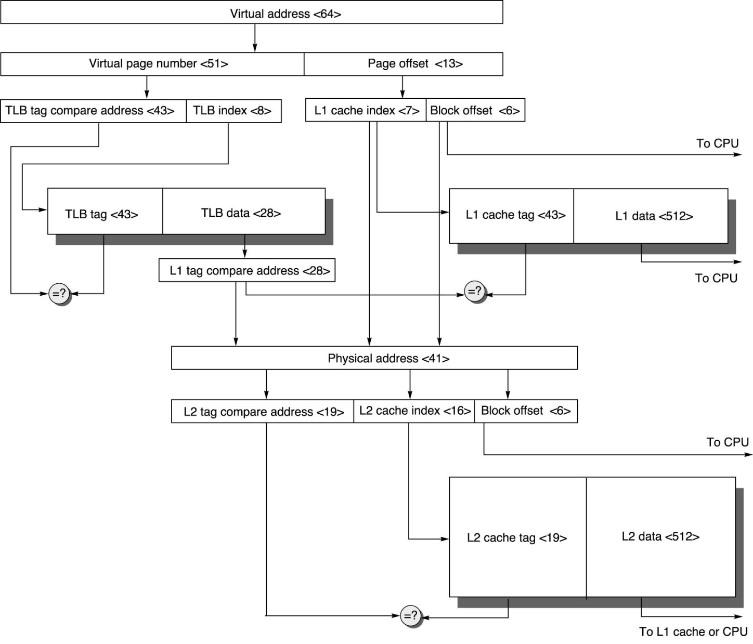
Putting it all together

Slide 17
Another example
Virtual Memory Address width:32 bits Page size:1 K bytes Single level page table Physical Memory 32 bit physical address space Cache Block size:16 bytes Cache size:1 K bytes Associativity:Direct mapped Translation Lookaside Buffer Number of translations:64 Associativity:Direct mapped

Slide 18
2-Level TLB Organization
 | Intel Nehalem | AMD Opteron X4
Virtual addr | 48 bits | 48 bits
Physical addr | 44 bits | 48 bits
Page size | 4KB, 2/4MB | 4KB, 2/4MB
L1 TLB (per core) | L1 I-TLB: 128 entries for small pages, 7 per thread (2×) for large pages L1 D-TLB: 64 entries for small pages, 32 for large pages Both 4-way, LRU replacement | L1 I-TLB: 48 entries L1 D-TLB: 48 entries Both fully associative, LRU replacement
L2 TLB (per core) | Single L2 TLB: 512 entries 4-way, LRU replacement | L2 I-TLB: 512 entries L2 D-TLB: 512 entries Both 4-way, round-robin LRU
TLB misses | Handled in hardware | Handled in hardware

Slide 19
3-Level Cache Organization
 | Intel Nehalem | AMD Opteron X4
L1 caches (per core) | L1 I-cache: 32KB, 64-byte blocks, 4-way, approx LRU replacement, hit time n/a L1 D-cache: 32KB, 64-byte blocks, 8-way, approx LRU replacement, write-back/allocate, hit time n/a | L1 I-cache: 32KB, 64-byte blocks, 2-way, LRU replacement, hit time 3 cycles L1 D-cache: 32KB, 64-byte blocks, 2-way, LRU replacement, write-back/allocate, hit time 9 cycles
L2 unified cache (per core) | 256KB, 64-byte blocks, 8-way, approx LRU replacement, write-back/allocate, hit time n/a | 512KB, 64-byte blocks, 16-way, approx LRU replacement, write-back/allocate, hit time n/a
L3 unified cache (shared) | 8MB, 64-byte blocks, 16-way, replacement n/a, write-back/allocate, hit time n/a | 2MB, 64-byte blocks, 32-way, replace block shared by fewest cores, write-back/allocate, hit time 32 cycles
n/a: data not available

