Slide 1
ECE418: Introduction

Slide 2
Remote Sensing: The Beginning
Aerial views of Frankfurt, Germany, 1909. Pictures taken by pigeon retrofitted with camera.
Frame rate: 1 picture every 5 minutes

Slide 3
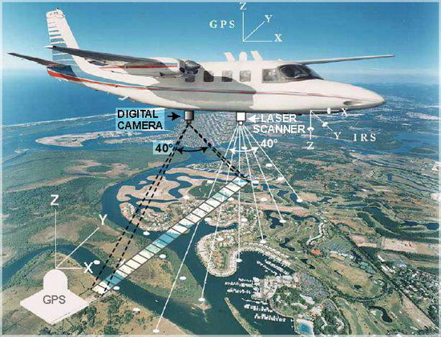
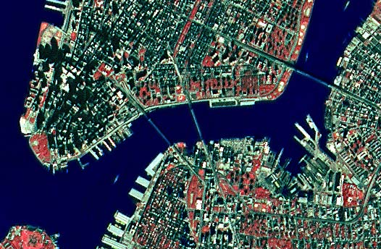
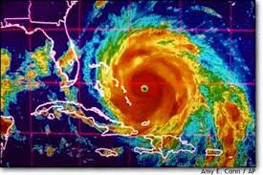
Remote Sensing

Slide 4
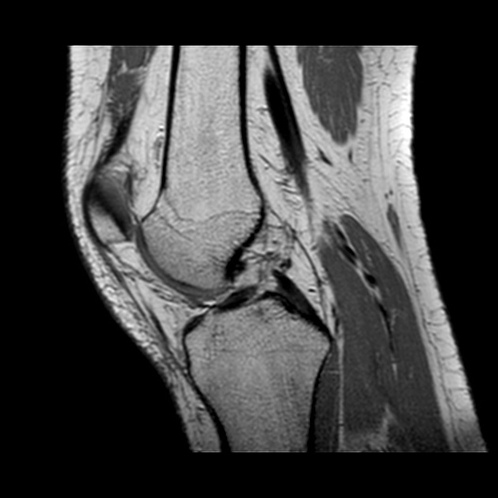
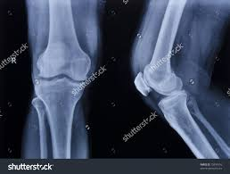
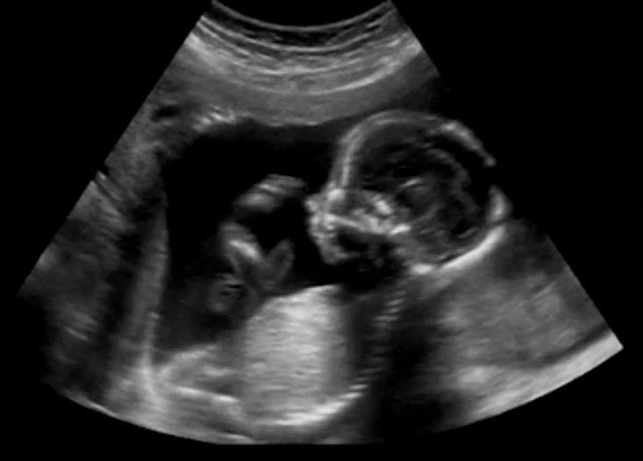
Medical images

Slide 5
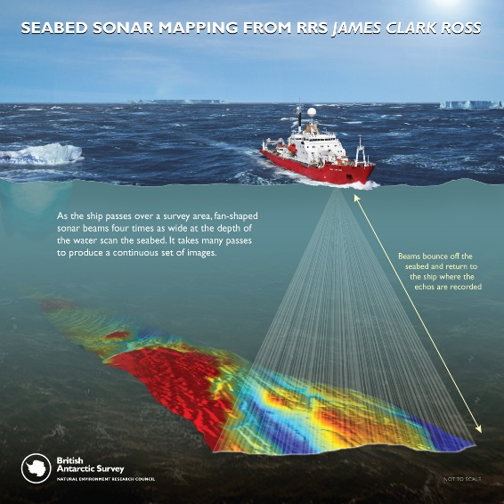
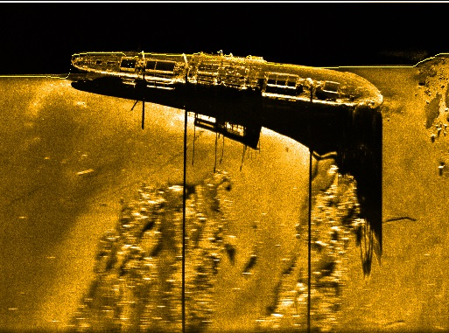
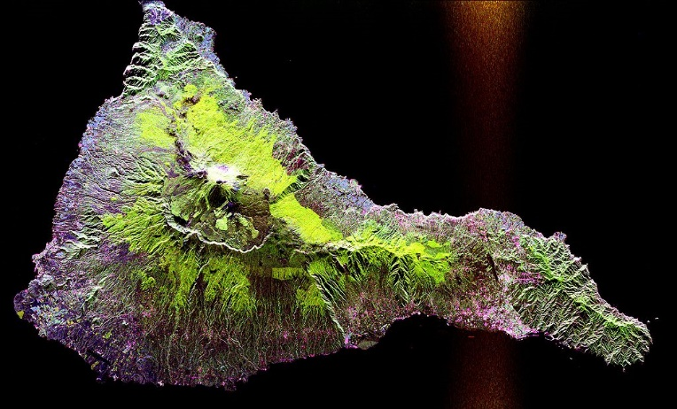
Radar and Sonar

Slide 6
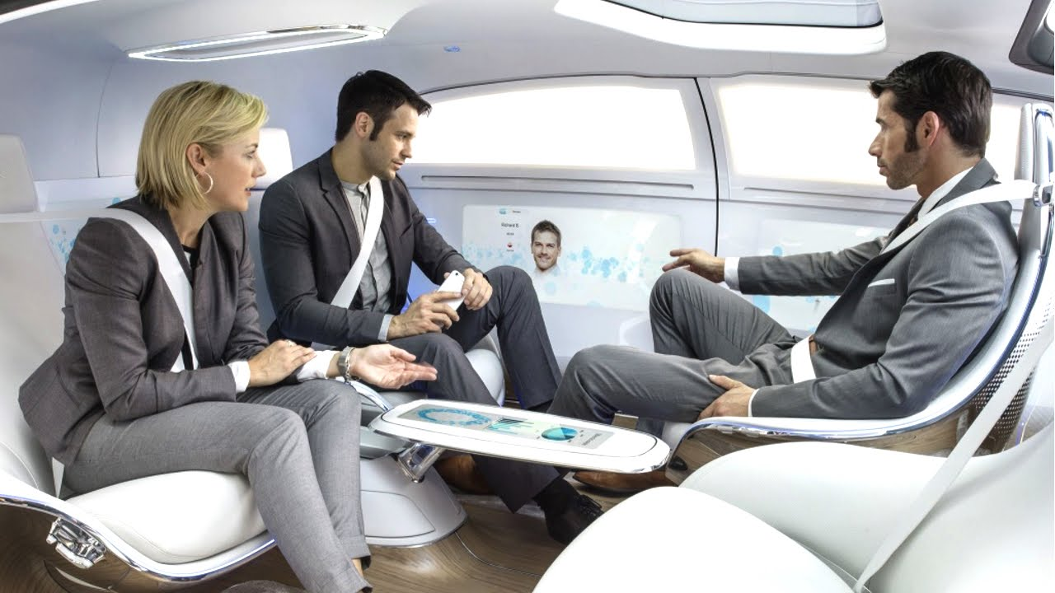
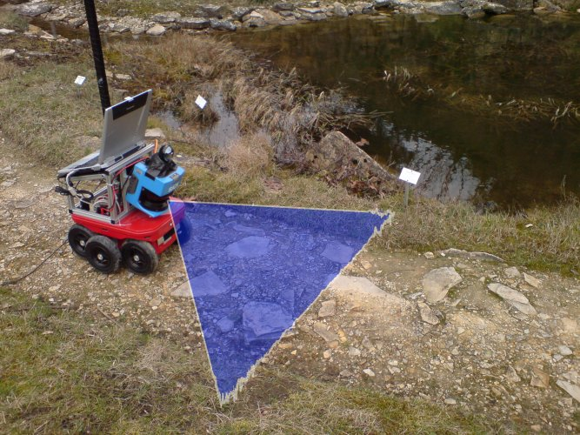
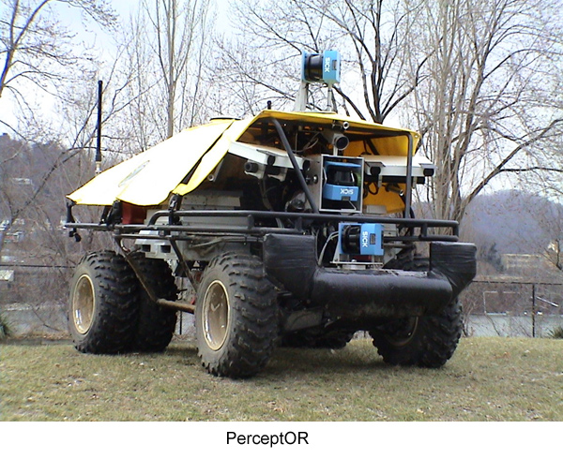
Robotics and navigation

Slide 7
Automatic character recognition

Slide 8
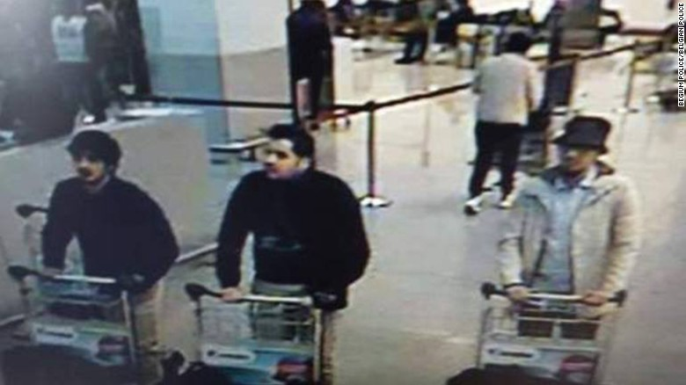
Law enforcement

Slide 9
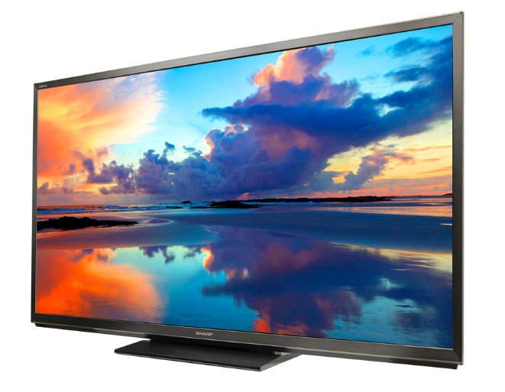
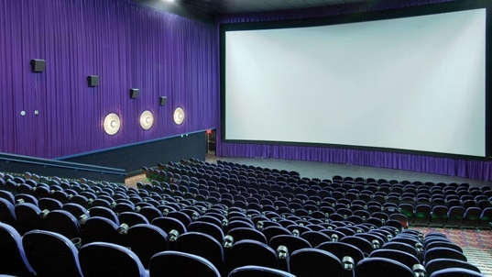
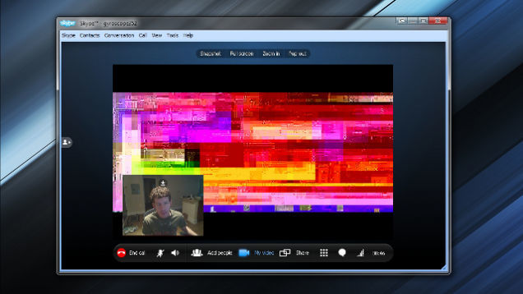
Business and entertainment

Slide 10
The Fourier Transform is very popular!

Slide 11
2D Fourier Transform

Slide 12
Aliasing artifacts

