Slide 1
Human Visual System

Slide 2
The Human Eye

Slide 3
Visual Cortex

Slide 4
Servo Diagram of Human Visual System

Slide 5
Visual Illusion: is this an old or young lady?

Slide 6
Is this a vase or two persons facing each other?

Slide 7
Do you see a Dalmatian dog?

Slide 8
Do you see black dots?

Slide 9
Which of the two center disks is larger?

Slide 10
Which of the three soldiers is bigger?

Slide 11
How different are these tabletops?

Slide 12
Schematic diagram of retina

Slide 13
Density of rods and cones in the retina

Slide 14
Brightness vs Luminance

Slide 15
Weber’s Law

Slide 16
Masking in presence of an edge

Slide 17
Masking

Slide 18
Luminous power
By Yonoodle,Kung-Shuo Heish - Own work, CC BY-SA 4.0, https://commons.wikimedia.org/w/index.php?curid=45321142

Slide 19
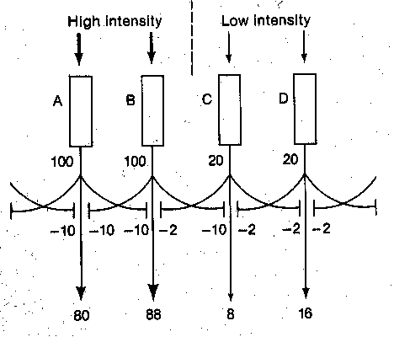
Lateral Inhibition
Light reduces response of neighboring receptors

Slide 20
Hermann Grid

Slide 21
Mach band effect

Slide 22
Modulation Transfer Function of HVS

Slide 23
Measurement of MTF

Slide 24
EM Spectrum

Slide 25
Light spectra

Slide 26
Spectral Sensitivity of HVS

Slide 27
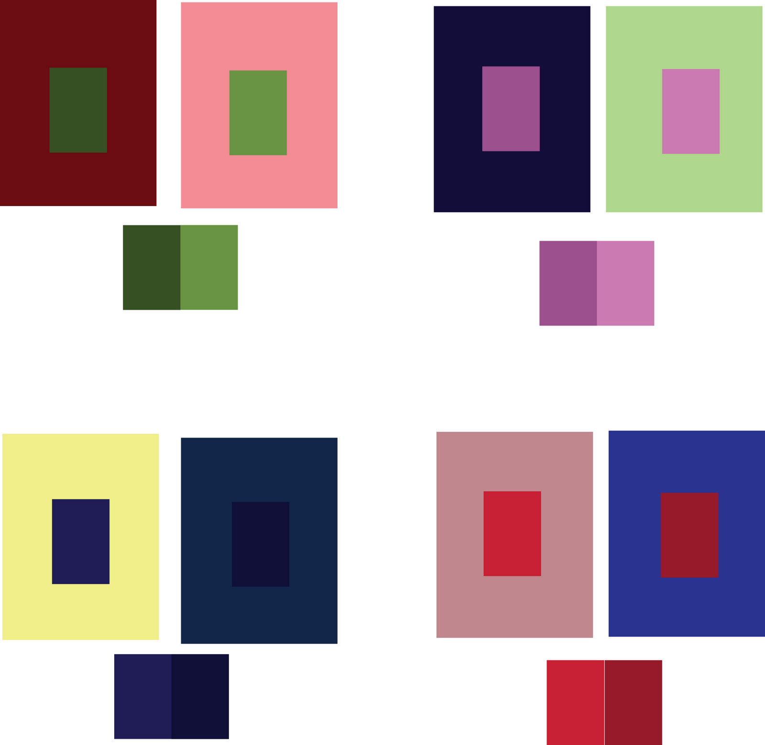
Simultaneous color contrast
For each pair of images, the center blocks appear to have the same color, but in reality they do not. The same blocks are repeated below each pair.

Slide 28
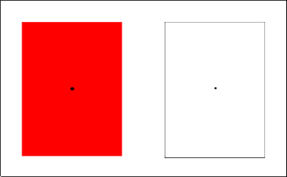
Desensitization of cones
Focus on the small black dot in the center of the red square for about 30 seconds. Then shift your focus to the small black dot in the center of the white square. What do you see?

Slide 29
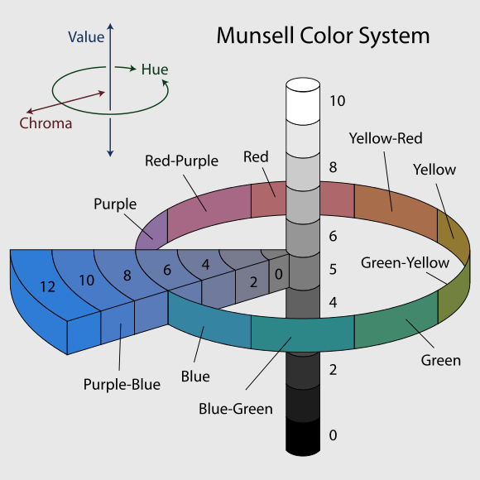
Munsell color system
The 3 attributes of color: Brightness, hue, and saturation

Slide 30
Typical Cone Absorption Spectra

Slide 31
Cone responses

Slide 32
Chromatic spatial frequency response of HVS

Slide 33
Primary Colors

Slide 34
Color gamut (RGB primaries)
CIE: R=700nm G=546.1nm B=435.8nm

Slide 35
Color gamut (XYZ color space)

Slide 36
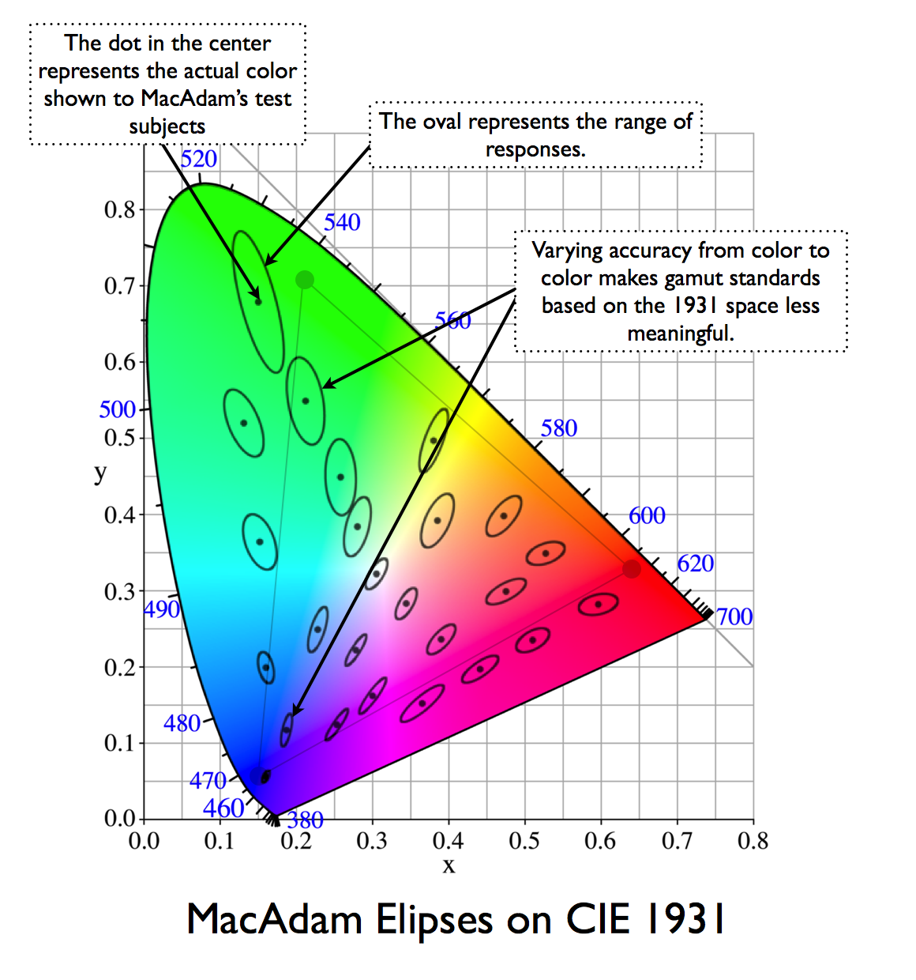
MacAdam Ellipses
Just noticeable differences

Slide 37
Flicker Visibility Curves

Slide 38
Spatio-Temporal MTF

Slide 39
Sections of spatio-temporal MTF

