Slide 1
Coil Gun Control System and UI
Group 52 - Adwaita Dani, Bryan Mbanefo, Felipe Fregoso

Slide 2
Introduction
Uses electromagnetic force to fire a projectile
Large amounts of current discharged in the windings to propel the projectile forward

Slide 3
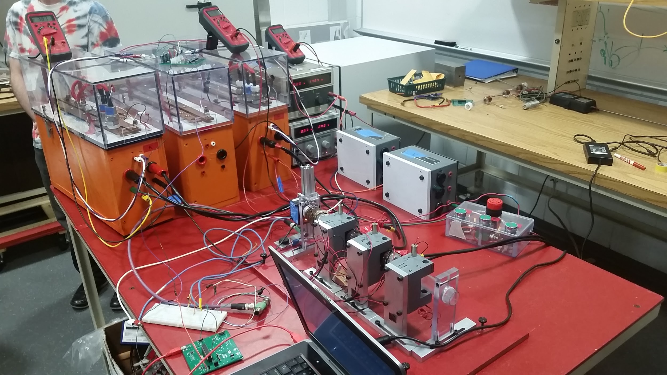
The Coil Gun

Slide 4
Objectives
Control circuit for trigger timing
User Interface

Slide 5
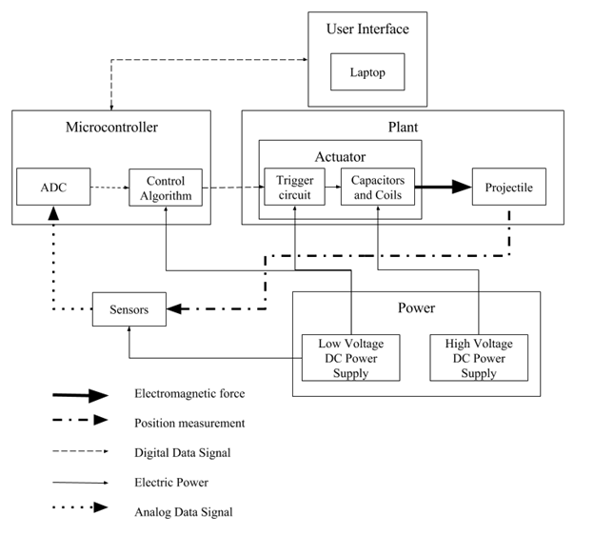

Slide 6
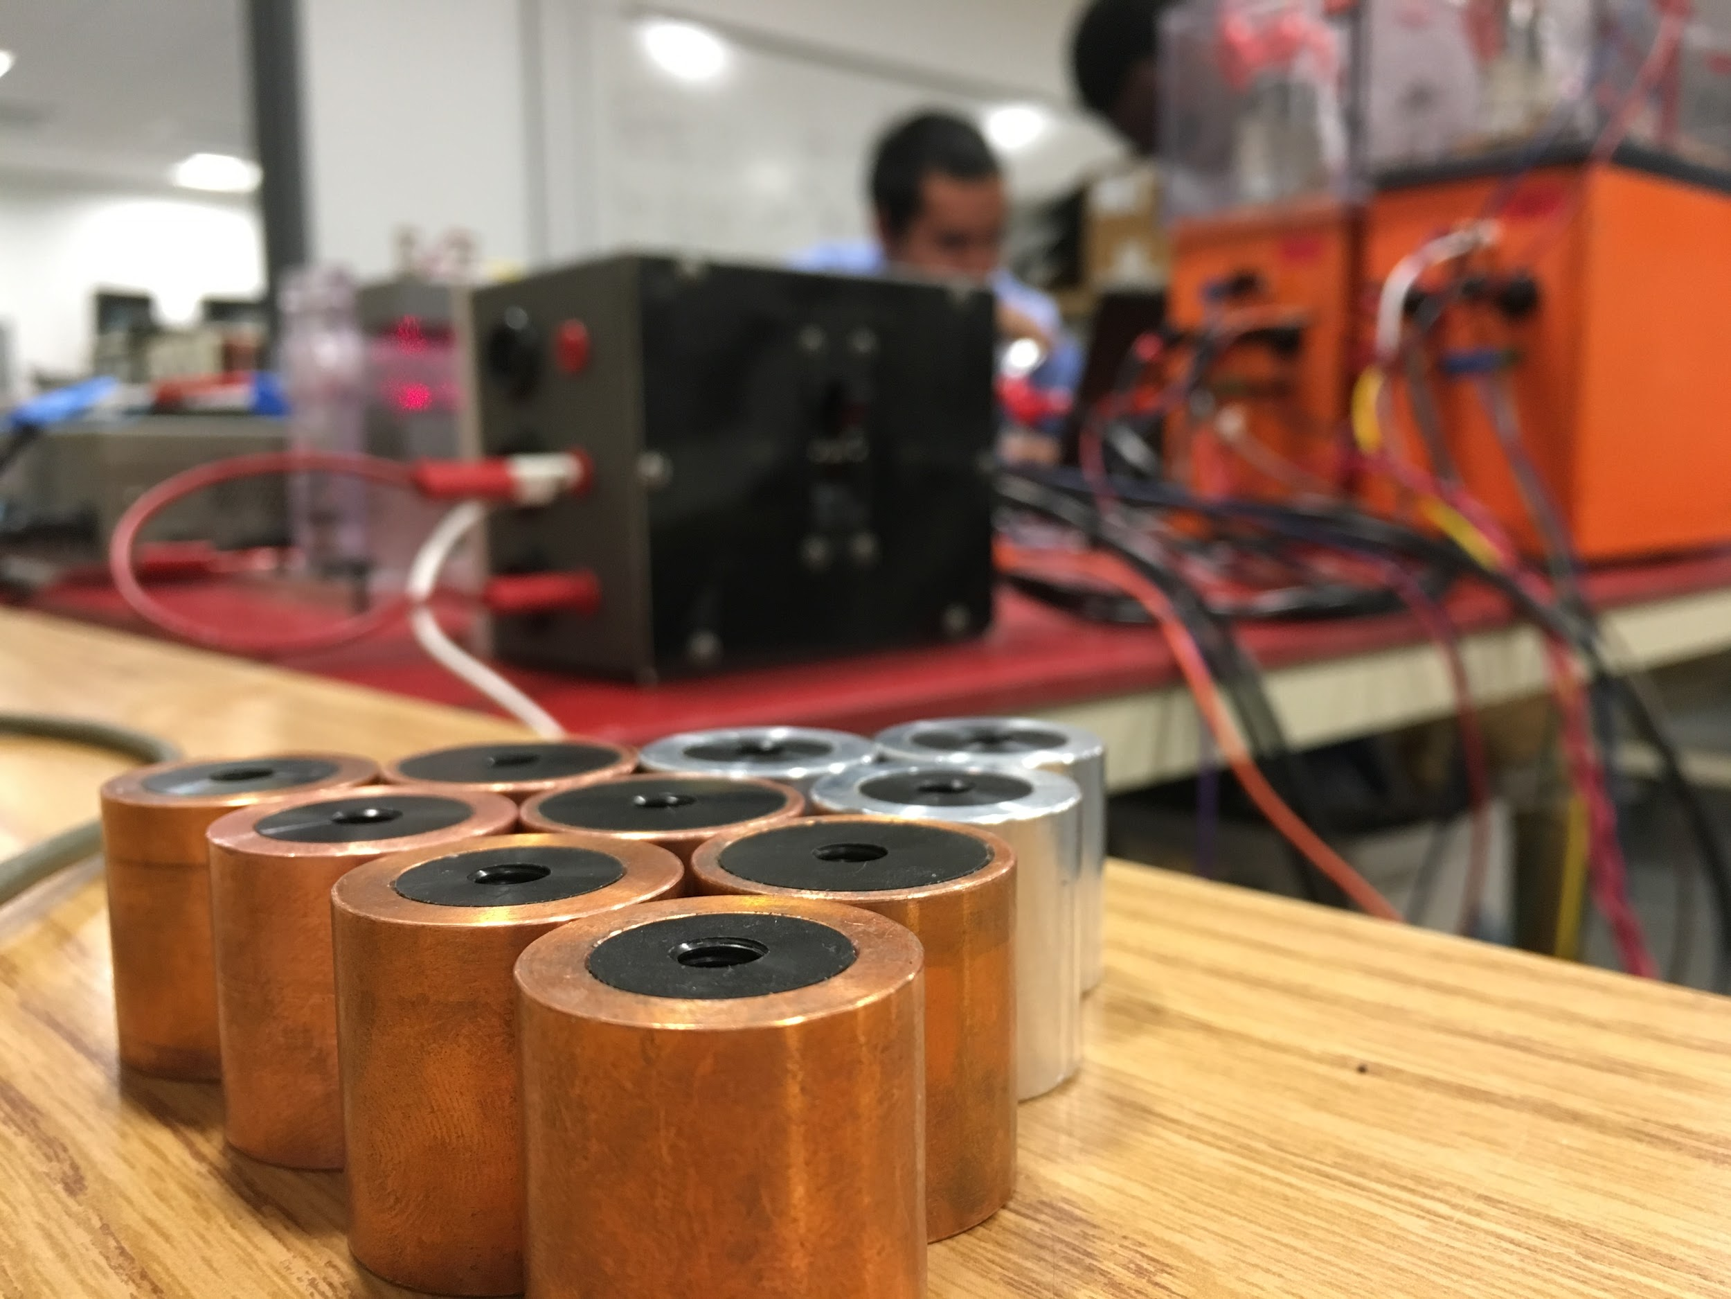
Projectile
Cylinder height: 2.5 cm
Outer diameter: 2.4 cm
Inner diameter: 1.6 cm
Materials: Aluminum and Copper

Slide 7
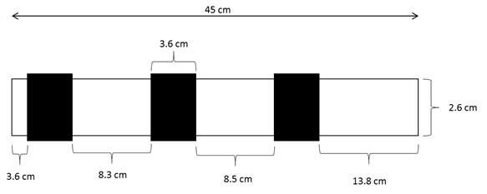
Barrel Dimensions
Coil

Slide 8
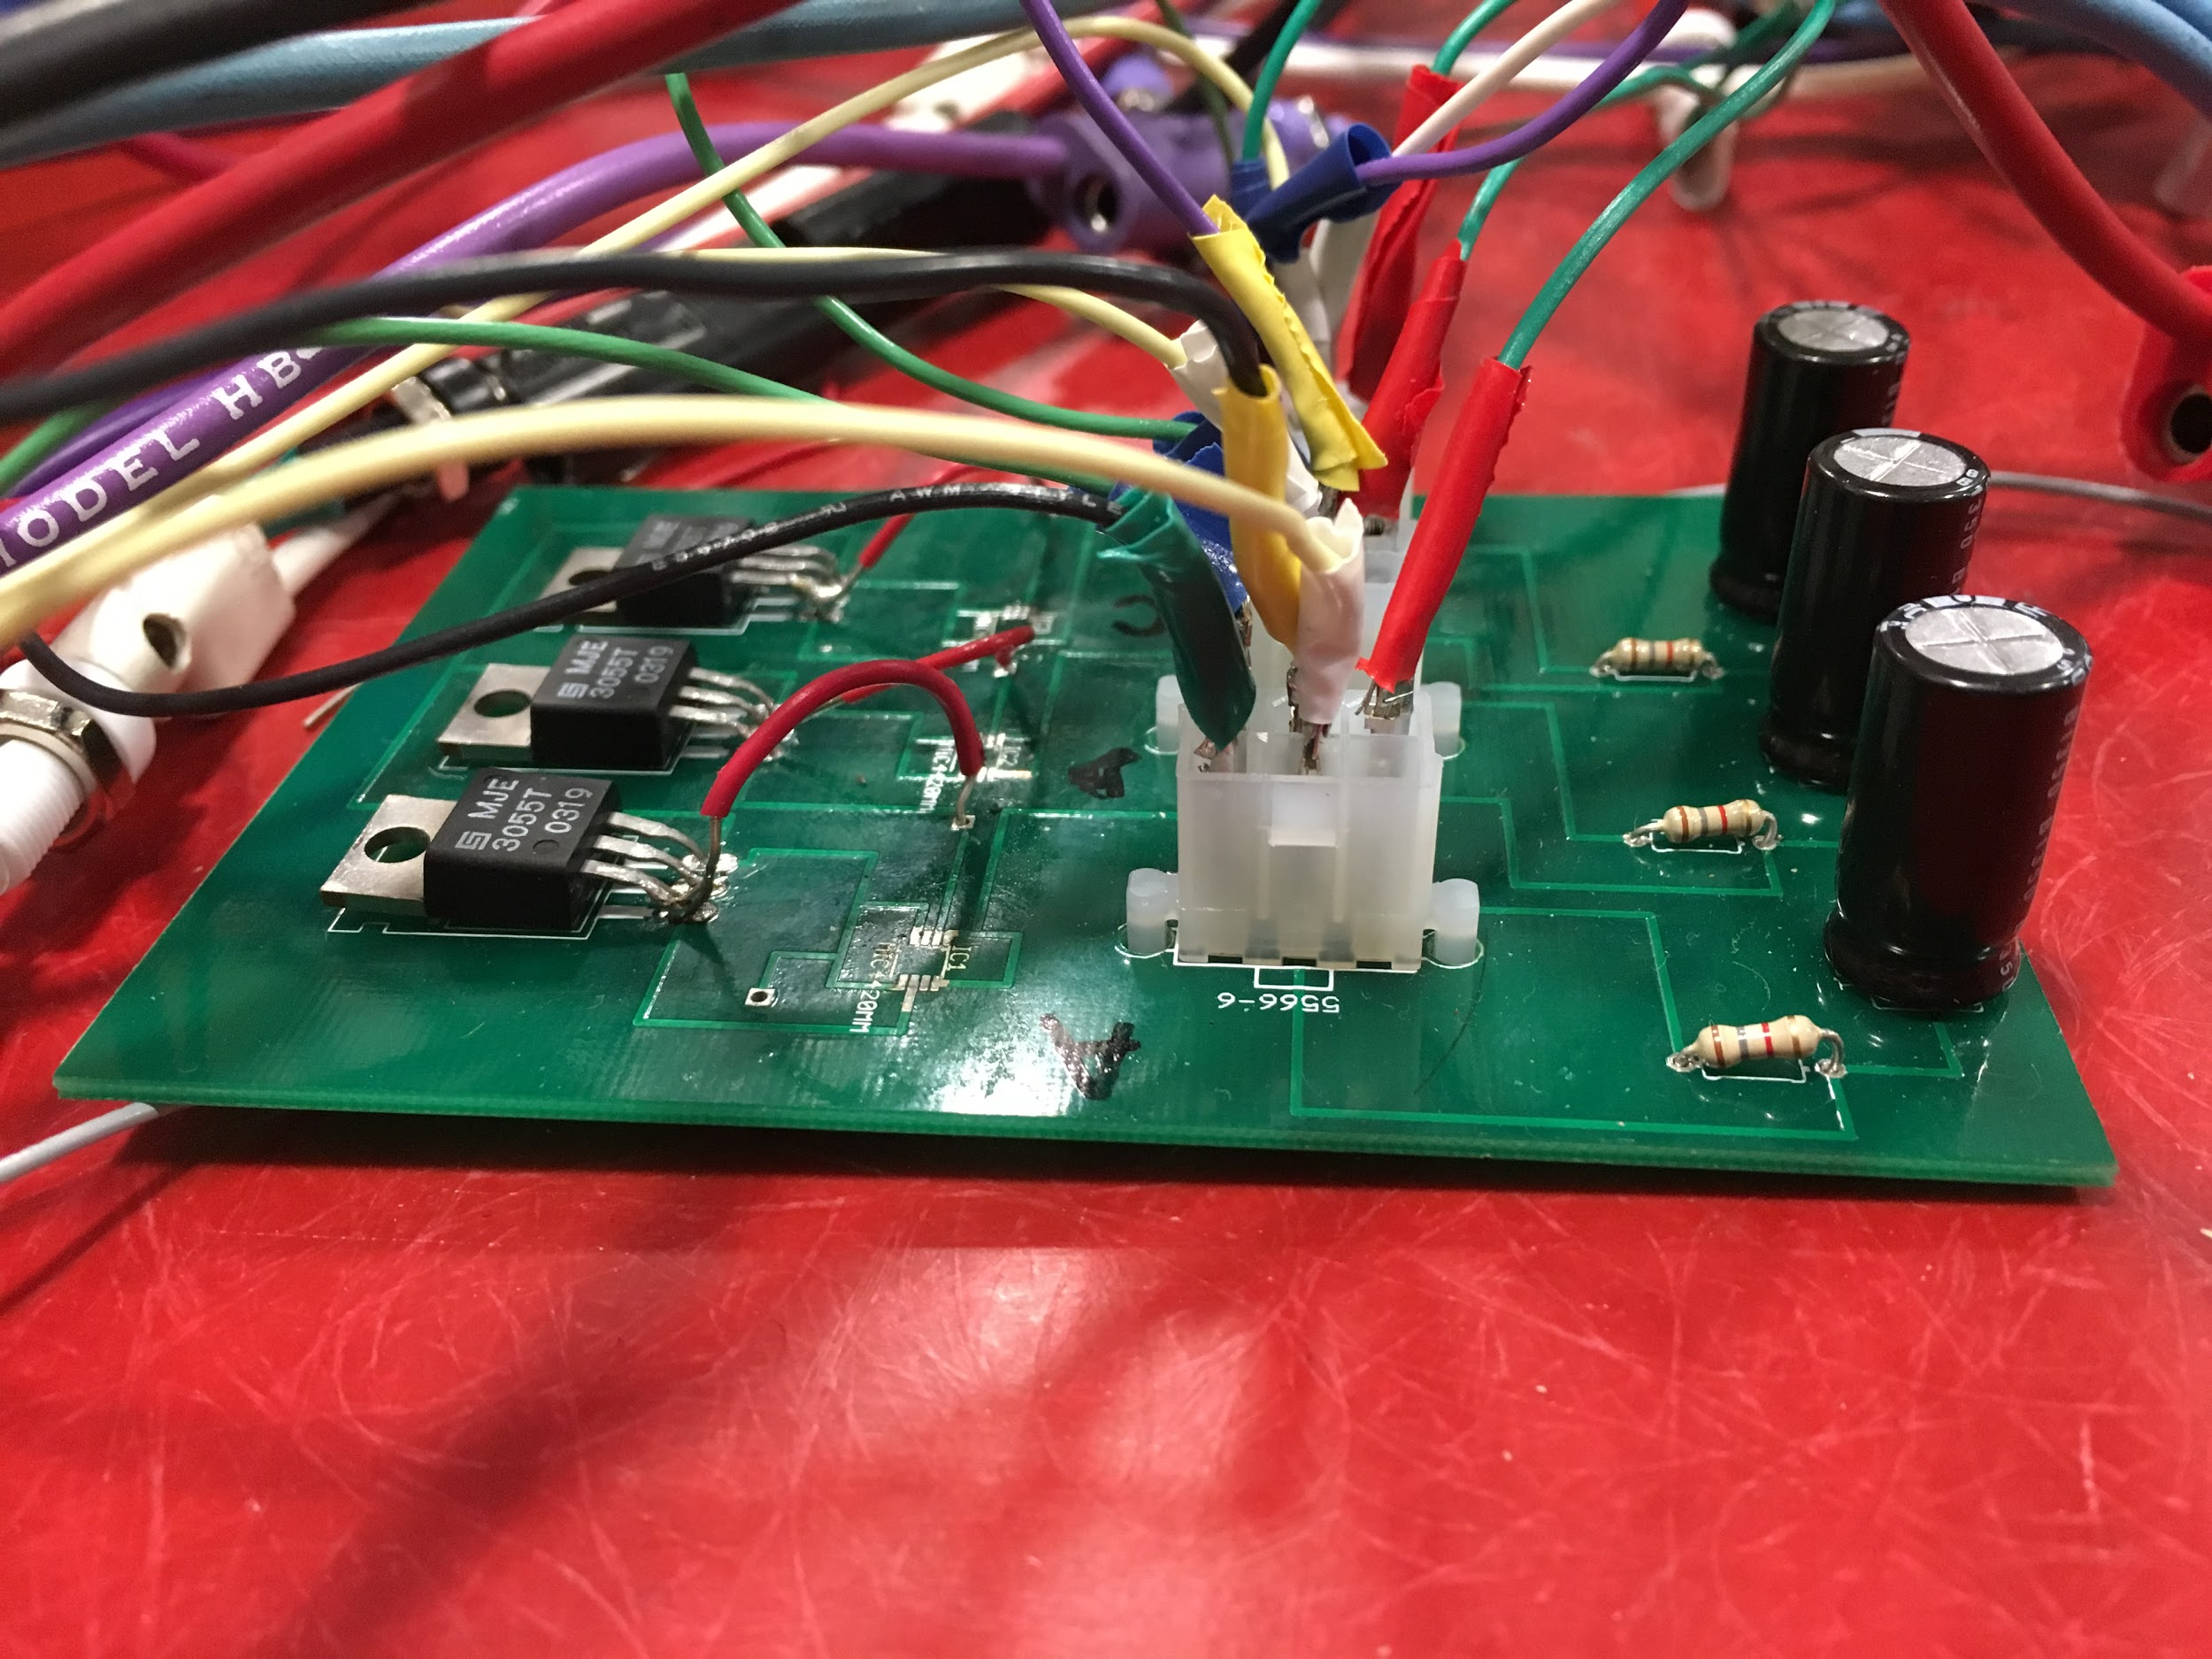
Trigger Circuit
Team 53’s work with the project
Need to supply them with 5V to trigger the SCRs

Slide 9
Microcontroller ATmega328
Receive analog data from position sensor
Send digital signal to trigger circuit to discharge the capacitor
Sample data at 8 kHz
Serial communication between microcontroller and user interface

Slide 10
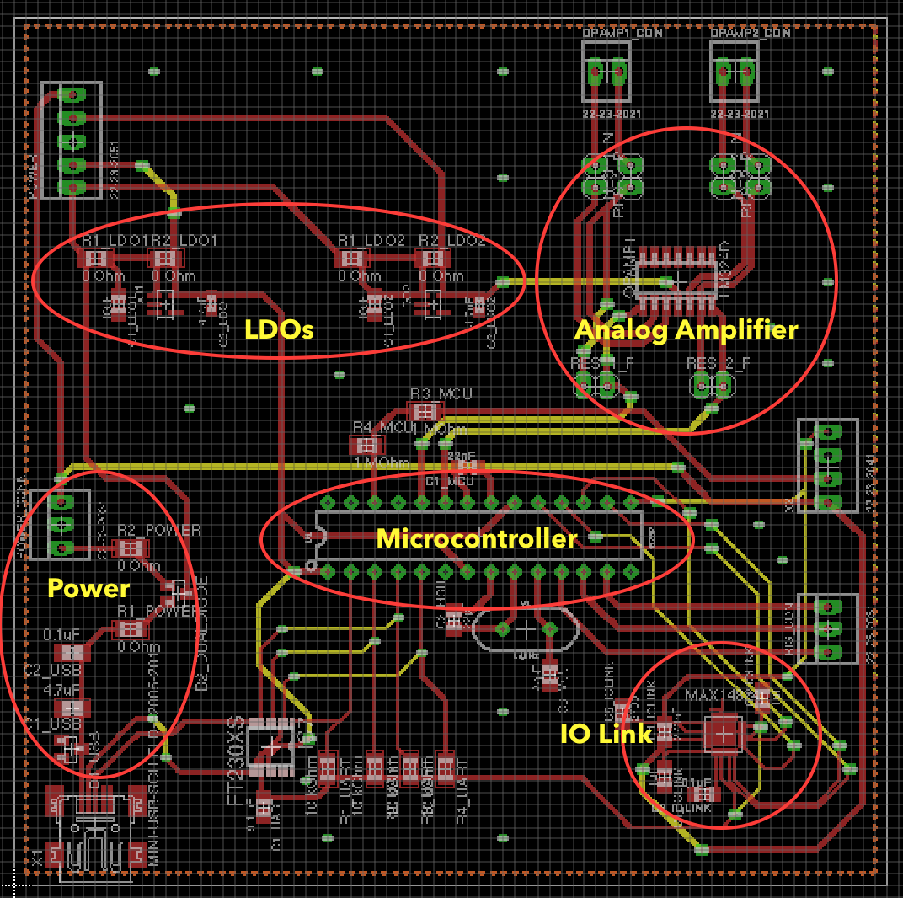
Microcontroller Circuit

Slide 11
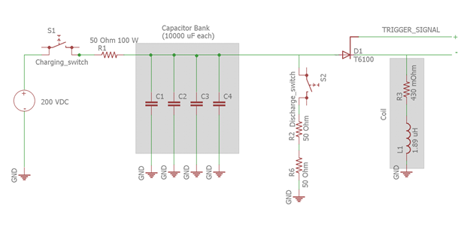
Power - Capacitor Bank
200 V power supply to provide voltage to the 10,000 uF capacitors

Slide 12
Power - Sensor and Microcontroller
24V power supply to LIDAR
24V to 5V buck converter for the microcontroller

Slide 13
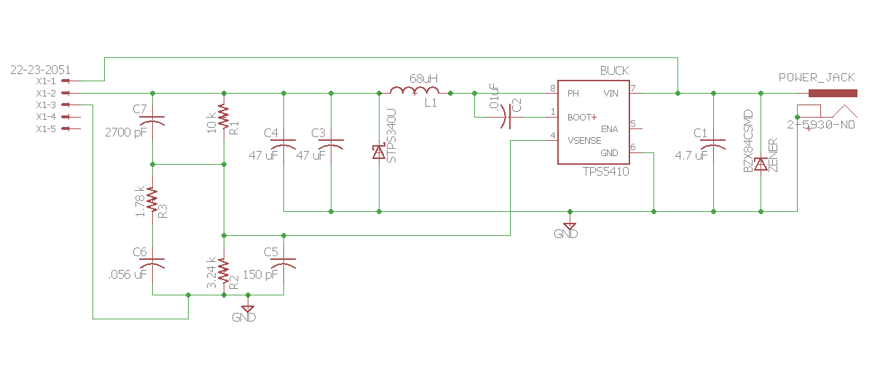
Power - Sensor and Microcontroller

Slide 14
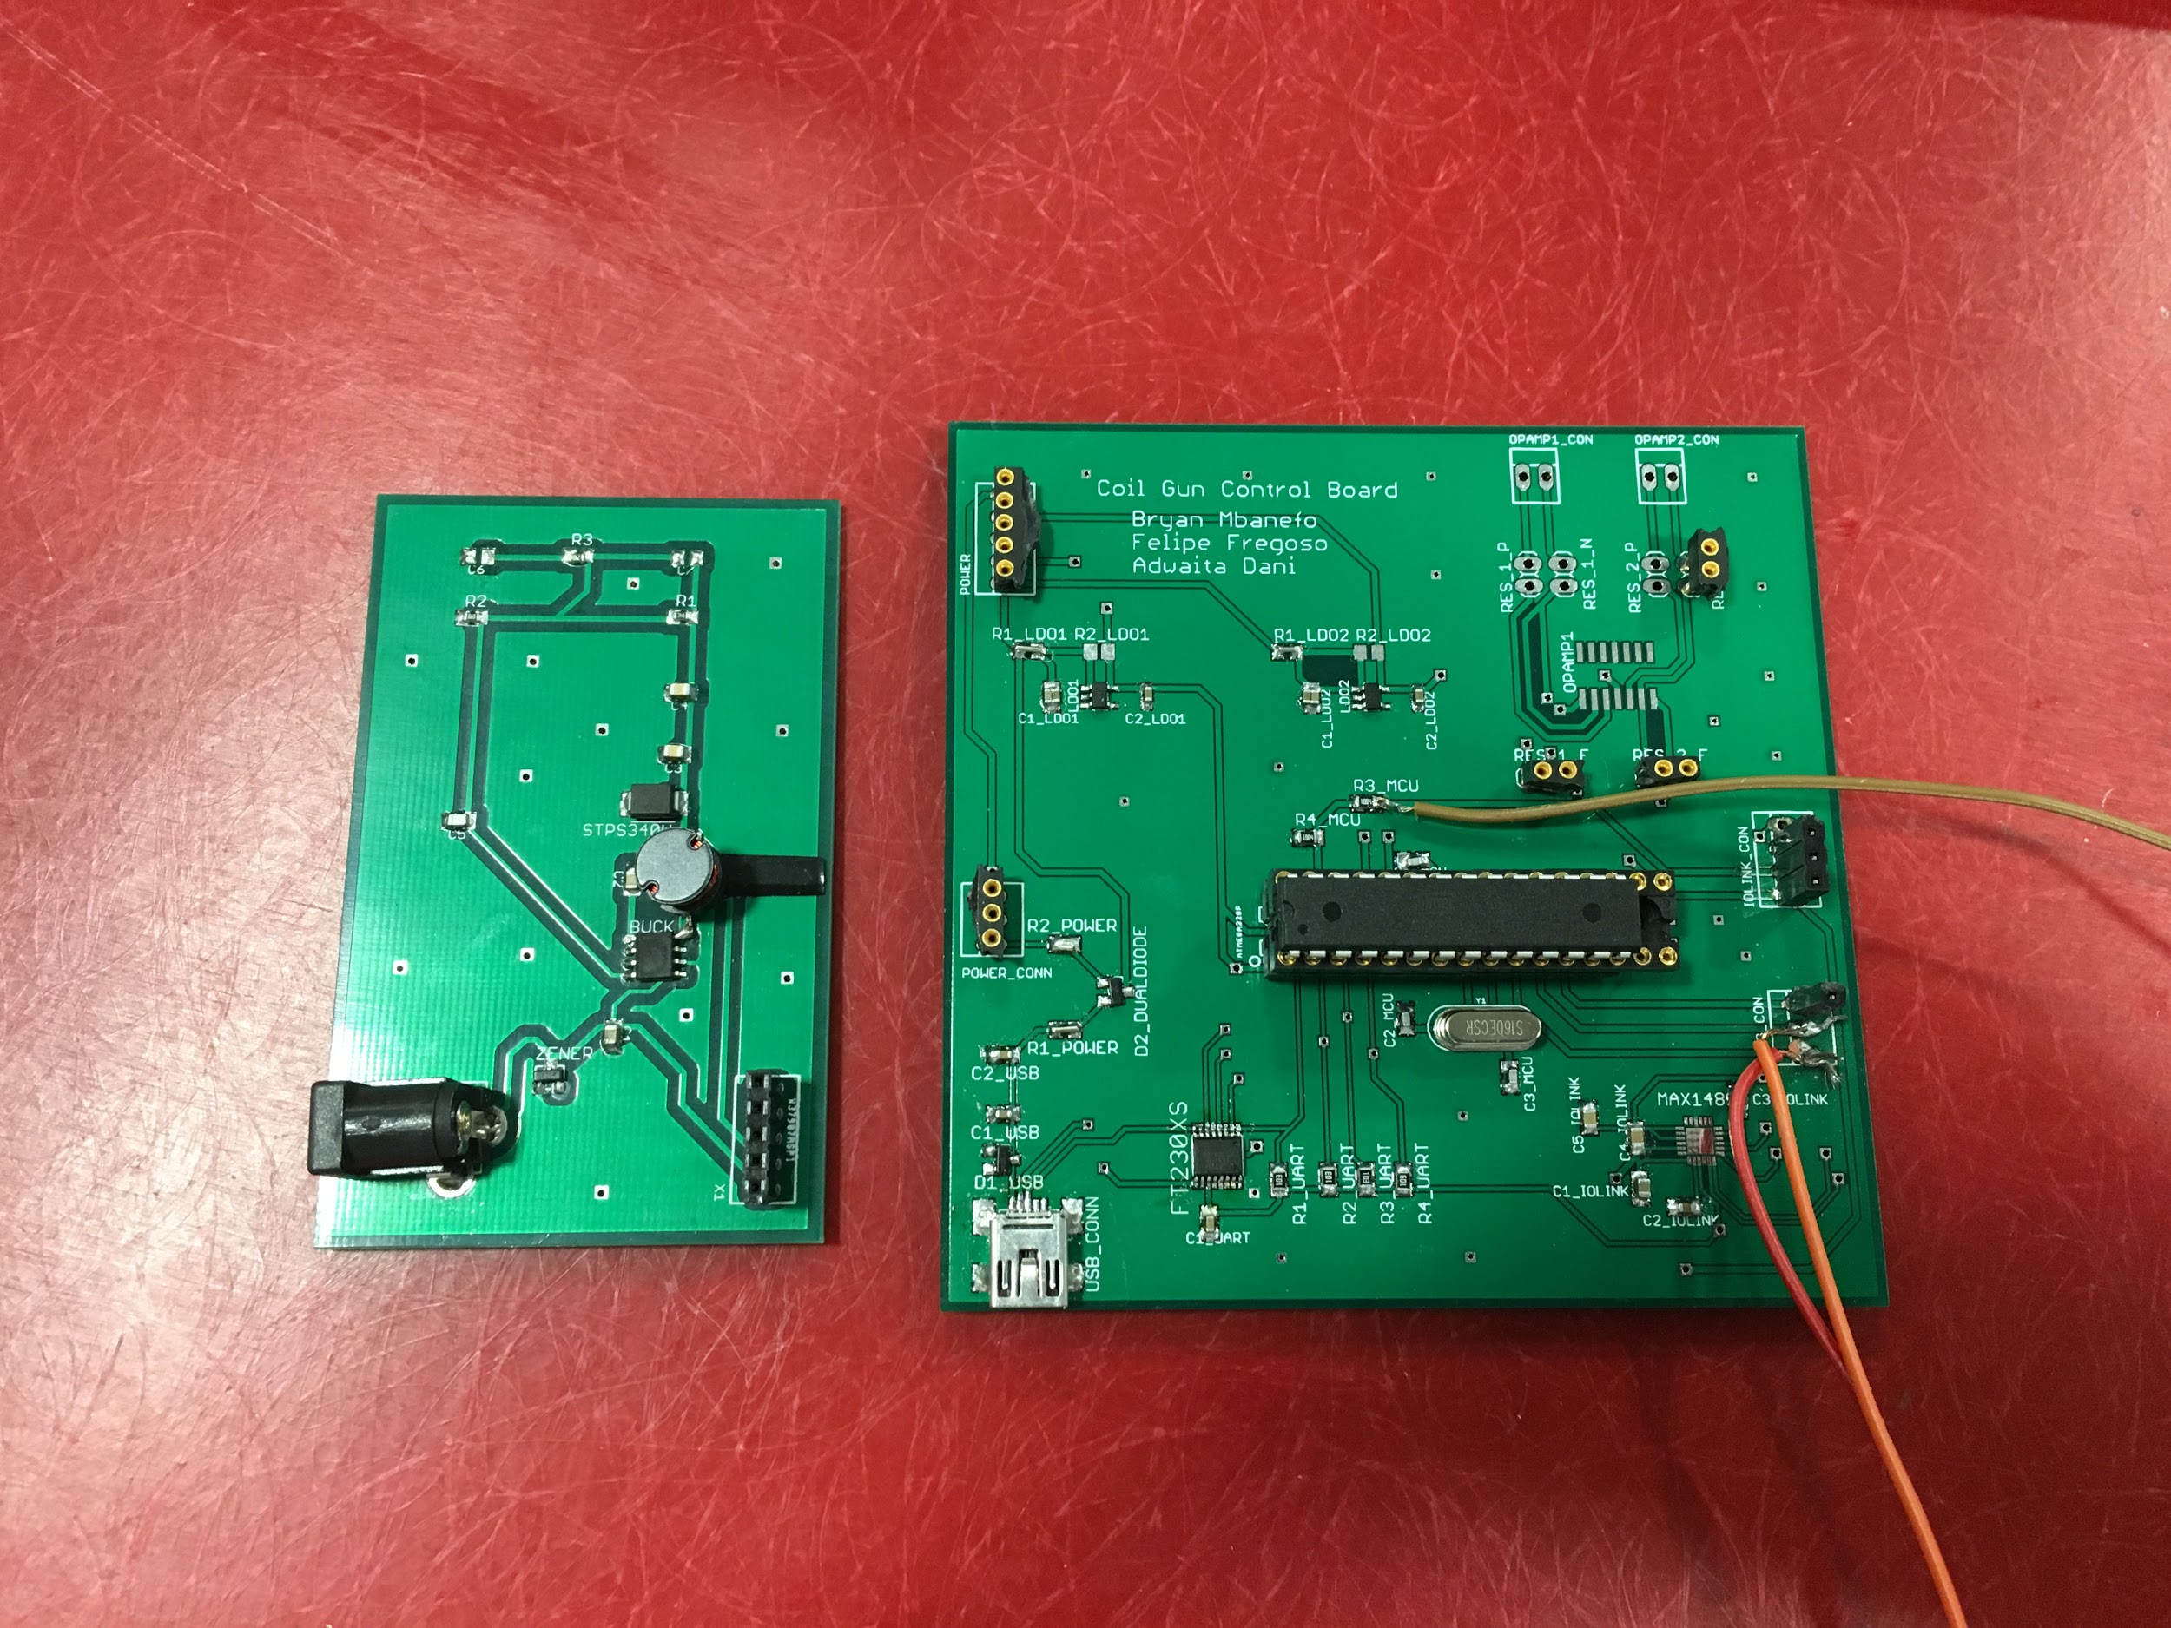
Printed Circuit Boards
Controller Board
Power Supply Board

Slide 15
Sensor
Original sensor used three photodiodes at different points on the tube
Use time projectile passes between two sensors to calculate the velocity
Highest velocity reached was ~10 m/s

Slide 16
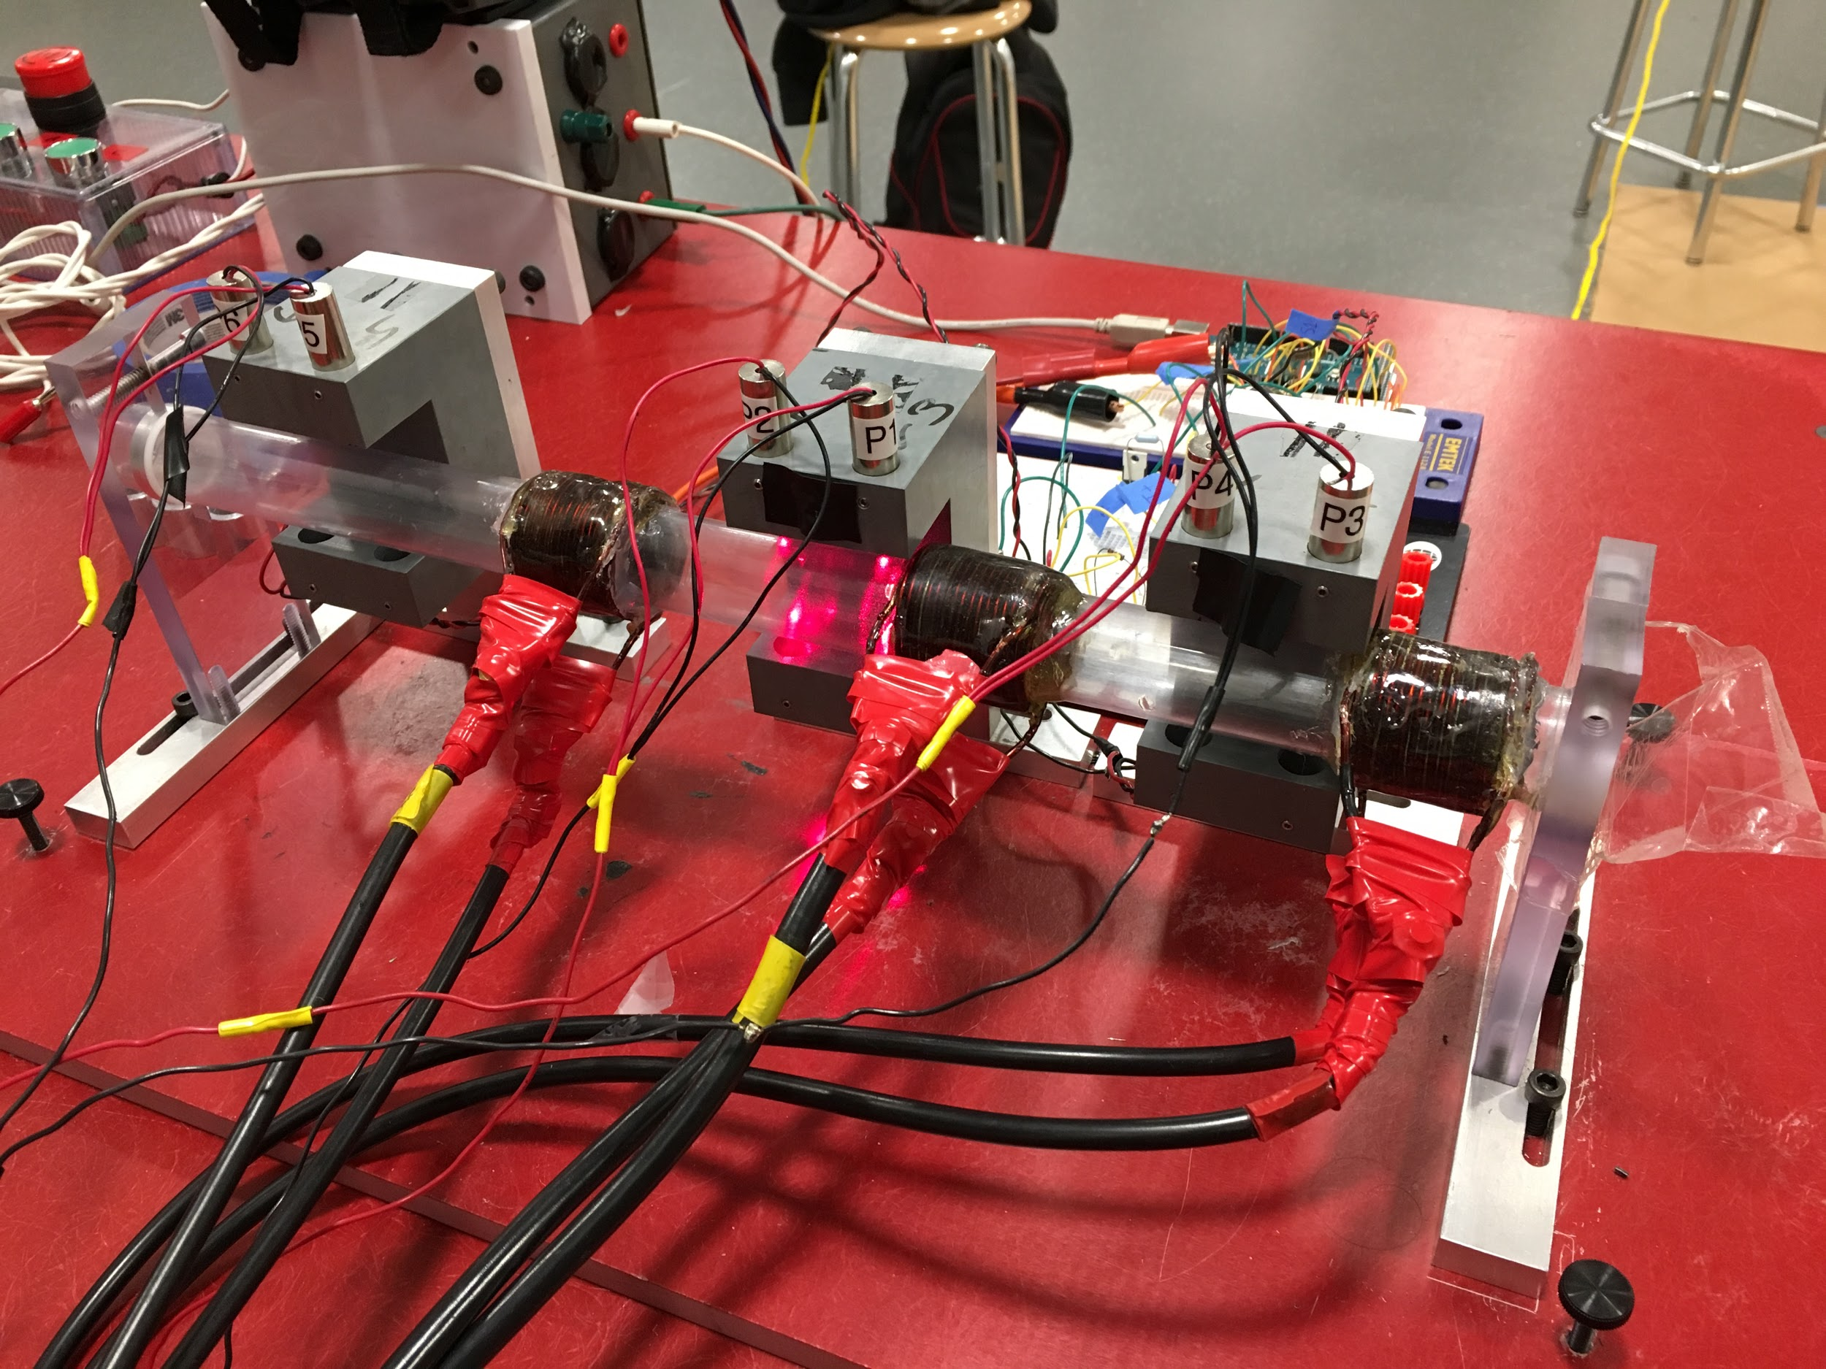
Old Sensor System
Laser
Photodiode

Slide 17
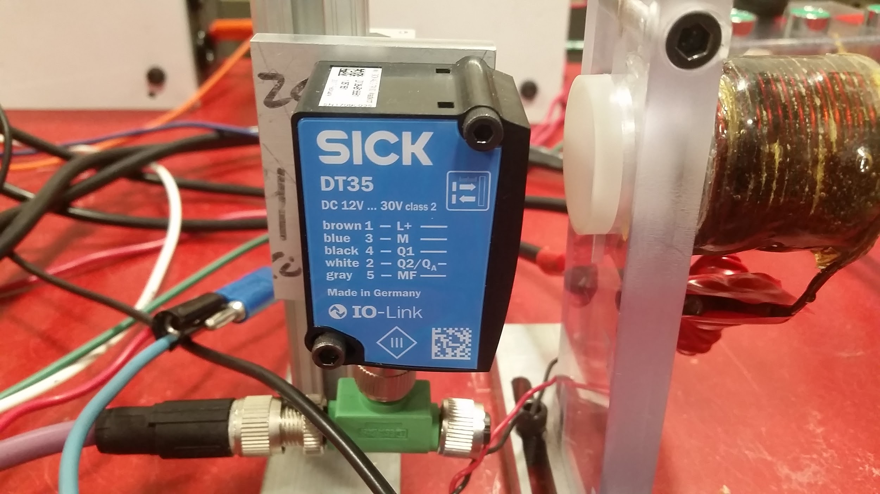
Sensor - Lidar
Pulsed laser to to that reflects of projectile to give the distance
Resolution within 0.1mm

Slide 18
Why did we choose this Lidar?
Resolution within 0.1mm.
Variable output response time.
Analog and Switching outputs
Size/Dimensions
Ease of programmability
Measuring range of 0.05m - 10m
Output rate 1ms

Slide 19
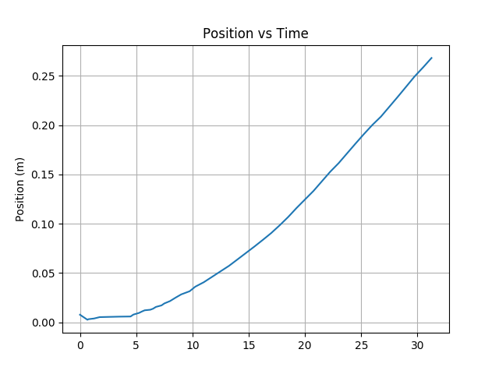
Sample Data from LIDAR

Slide 20
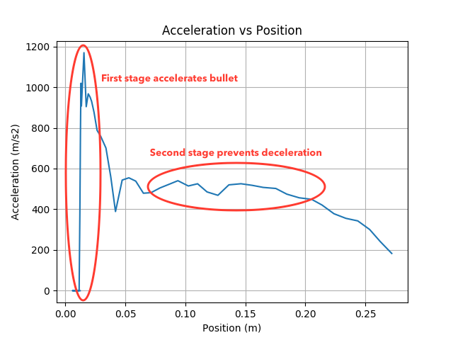
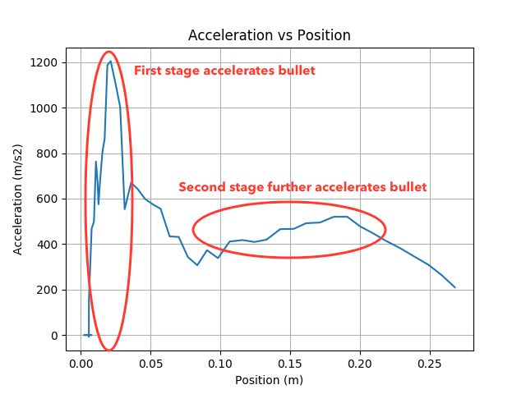
How do we find the optimal firing position?
Optimal Stage 1, Non-optimal Stage 2
Non-optimal Stage 1, Optimal Stage 2

Slide 21
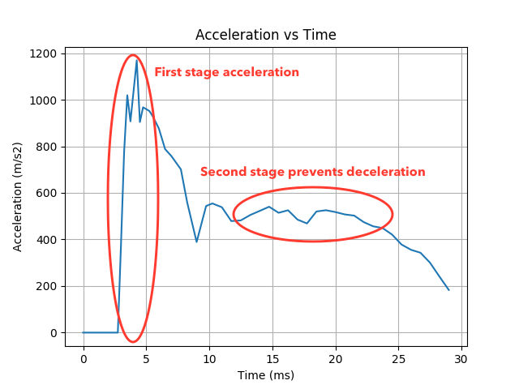
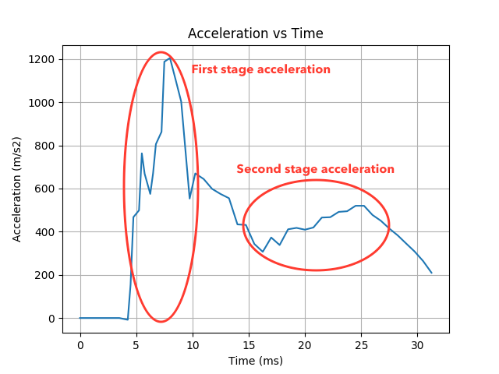
Acceleration versus time
Optimal Stage 1, Non-optimal Stage 2
Non-optimal Stage 1, Optimal Stage 2

Slide 22
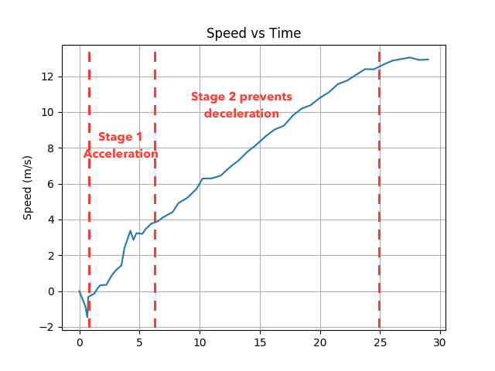
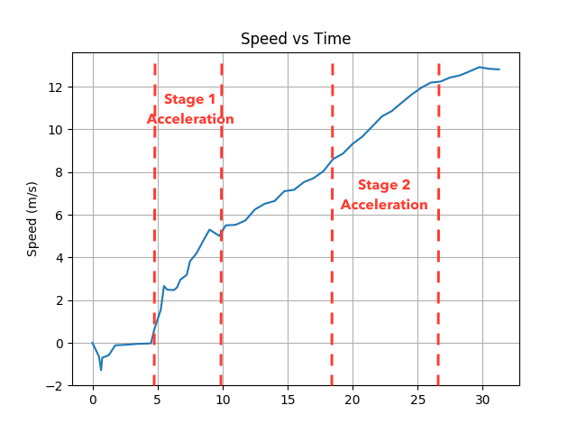
Bullet Speed with LIDAR-based Trigger
Optimal Stage 1, Non-optimal Stage 2
Non-optimal Stage 1, Optimal Stage 2

Slide 23
User Interface
Ease of use: Only press Fire button
Display required data as plots

Slide 24
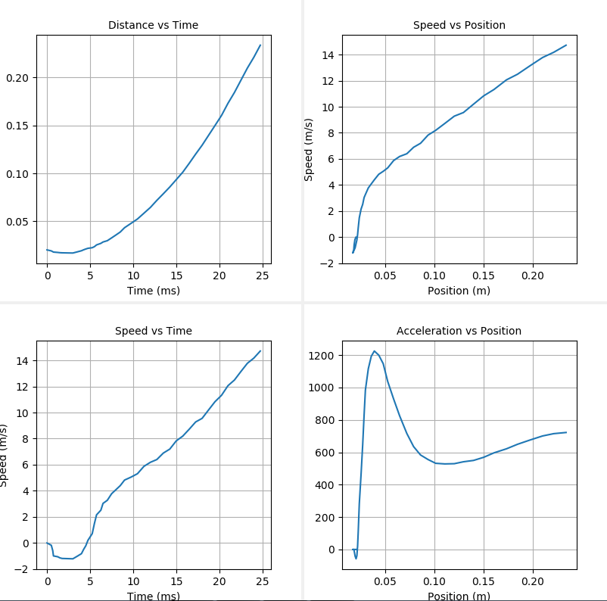
GUI Data Display

Slide 25
Accomplishments
More accurate technique of measurement
Attainment of higher top speed
Creation of a platform for ease of data viewing

Slide 26
Future Work
Documentation and instruction for firing
Create permanent product for future EOHs
Add striped bullet sensing to improve speed
Make trigger a function of both position and velocity

Slide 27
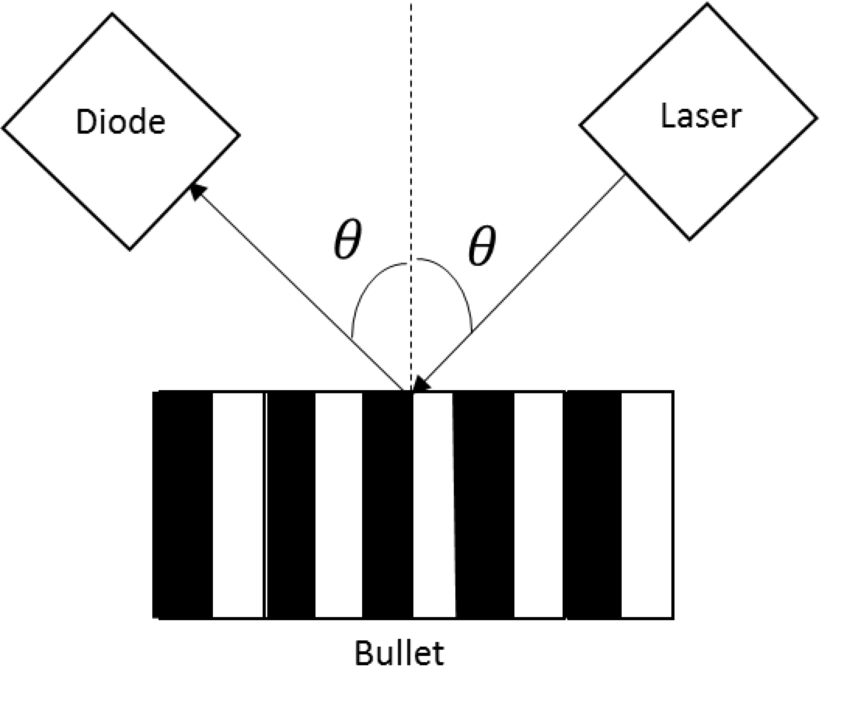
Striped bullet diagram

Slide 28
Special Thanks to:
Luke Wendt
Chris Barth
Scott A. McDonald
Kevin Colravy
Professor Reinhard

Slide 29
Thank you!
Questions?

