Slide 1
Electronic Betting System for Poker
ECE 445 – Senior Design
Spring 2019
Group 62

Slide 2
Team introduction
Umang Chavan
Computer Engineering
Anand Giridharan
Electrical Engineering
Varun Pitta
Computer Engineering

Slide 3
Agenda
Team Introductions | 2
Objective, Background, and Timeline | 4
Design Overview | 5
Requirements & Verifications | 9
Individual Modules | 13
Successes & Challenges | 16
Future Expansion | 17
Notes:
Amaan

Slide 4
Objective, Background, and Timeline
Objective
Background
The problem statement that we are addressing is to see if there is a more effective way of playing poker for cheap without worrying about chips
Our proposed solution is an electronic betting system that completely eradicates the need of physical poker chips
Monopoly Electronic Banking Edition by Hasbro eliminated the need for paper cash that is normally used by creating a debit card system
The purpose of this was to remove the hassle of having so much paper laying around
Phase 1
Developed circuit schematics and PCB designs
Phase 2
Tested individual modules of design (LCD, NRF24, etc.)
Phase 3
Completed and tested PCB and modules on PCB
Phase 4
Integrated player device and central hub and finished software game logic
Notes:
Amol

Slide 5
Design Overview
Notes:
Amaan

Slide 6
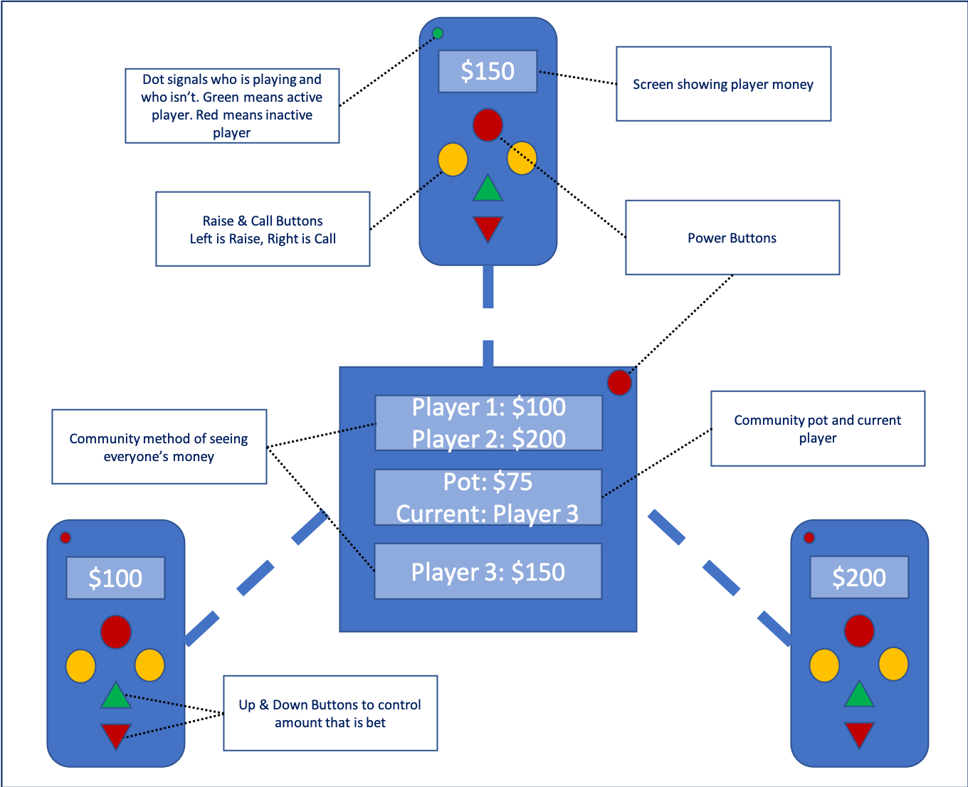
Physical Layout
Notes:
Amol

Slide 7
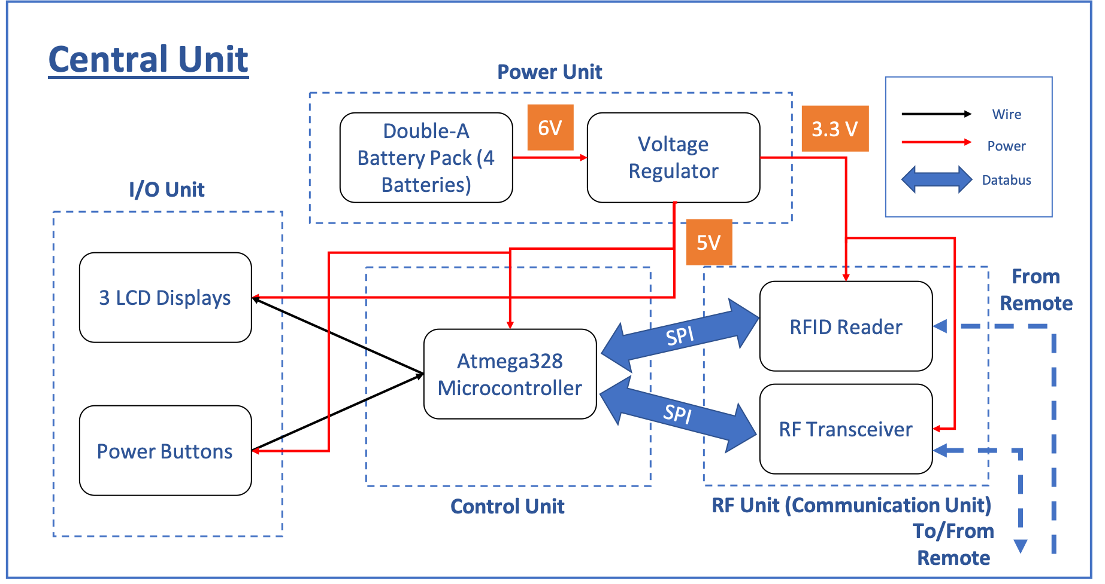
Central Unit Block Diagram
The central hub is responsible for keeping track of community game logic and also sends signals to player devices regarding the game state
Notes:
Amol

Slide 8
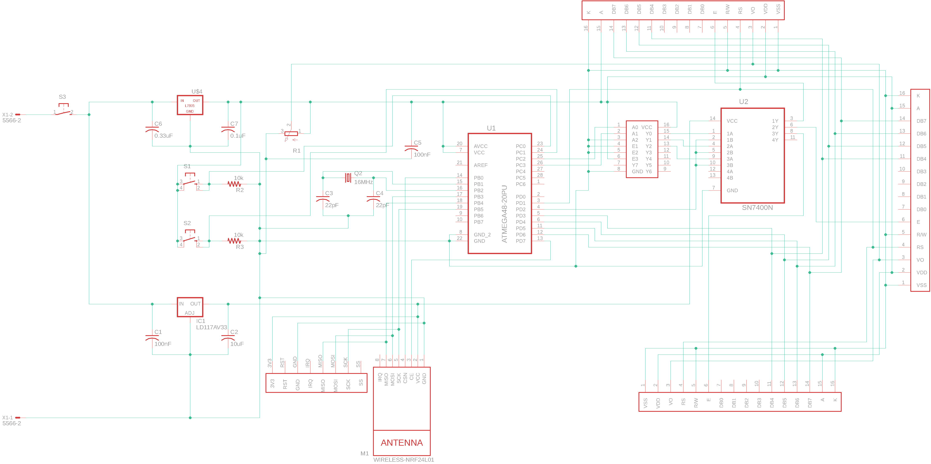
Central Hub Schematic

Slide 9
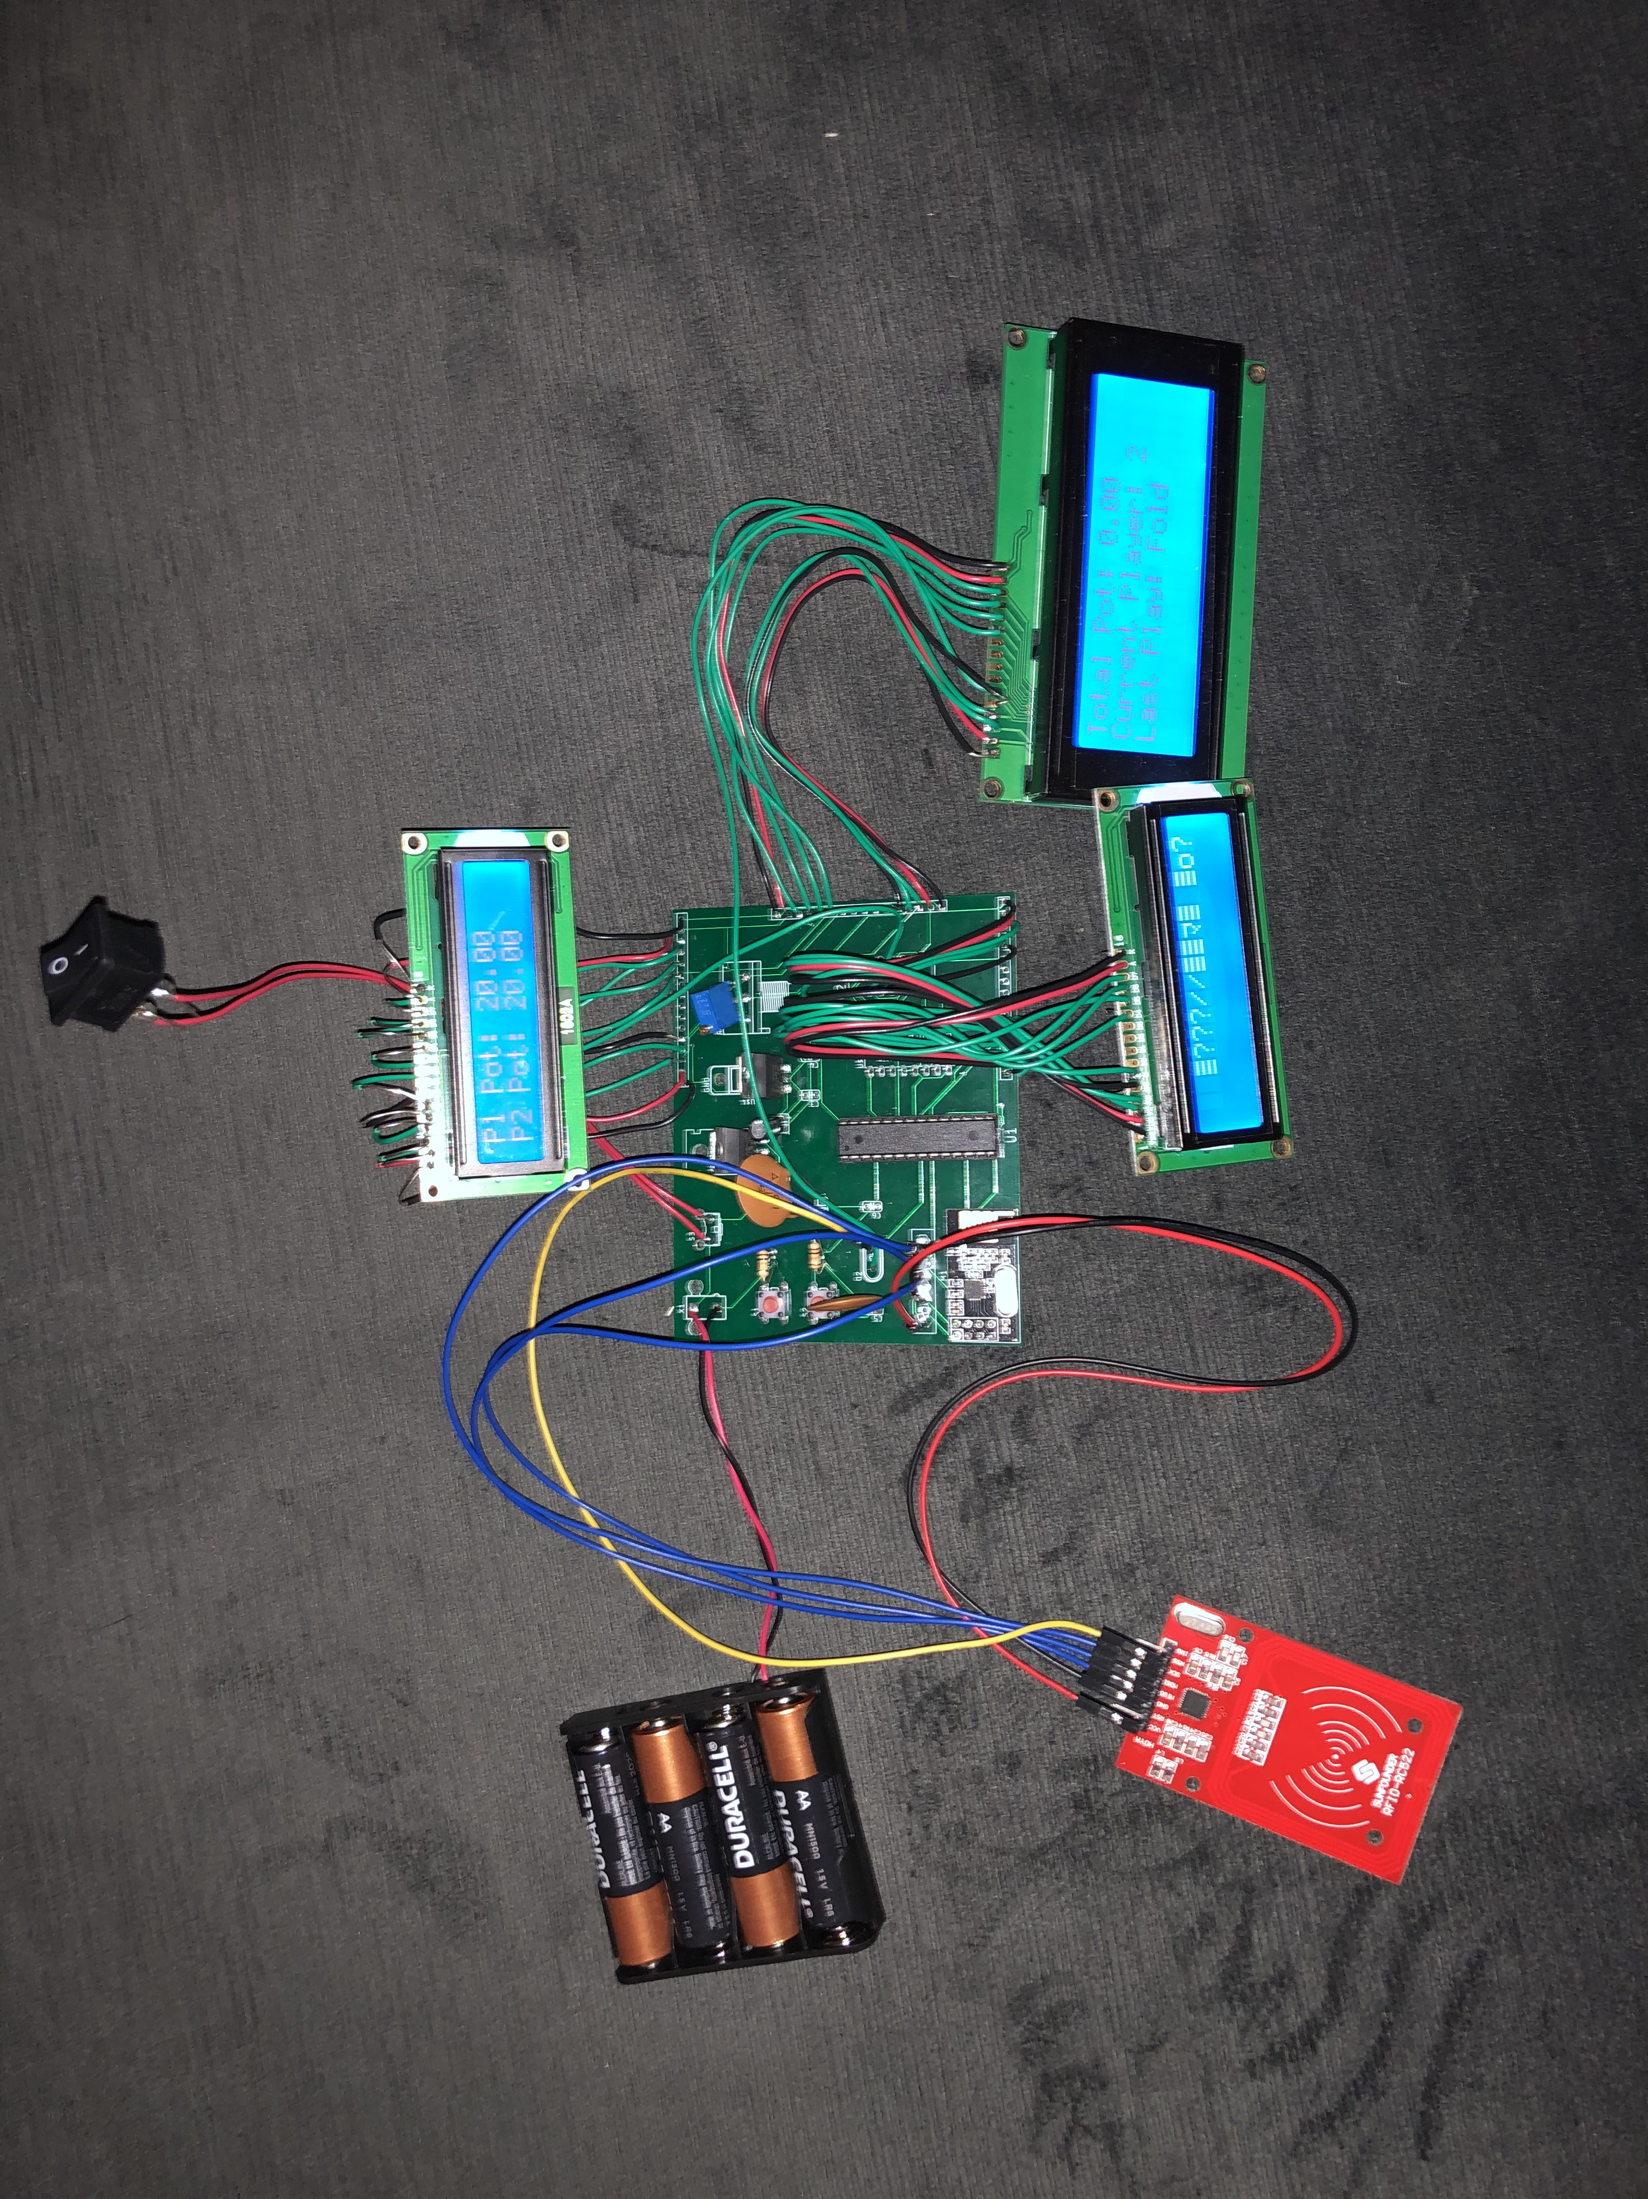
Central Hub

Slide 10
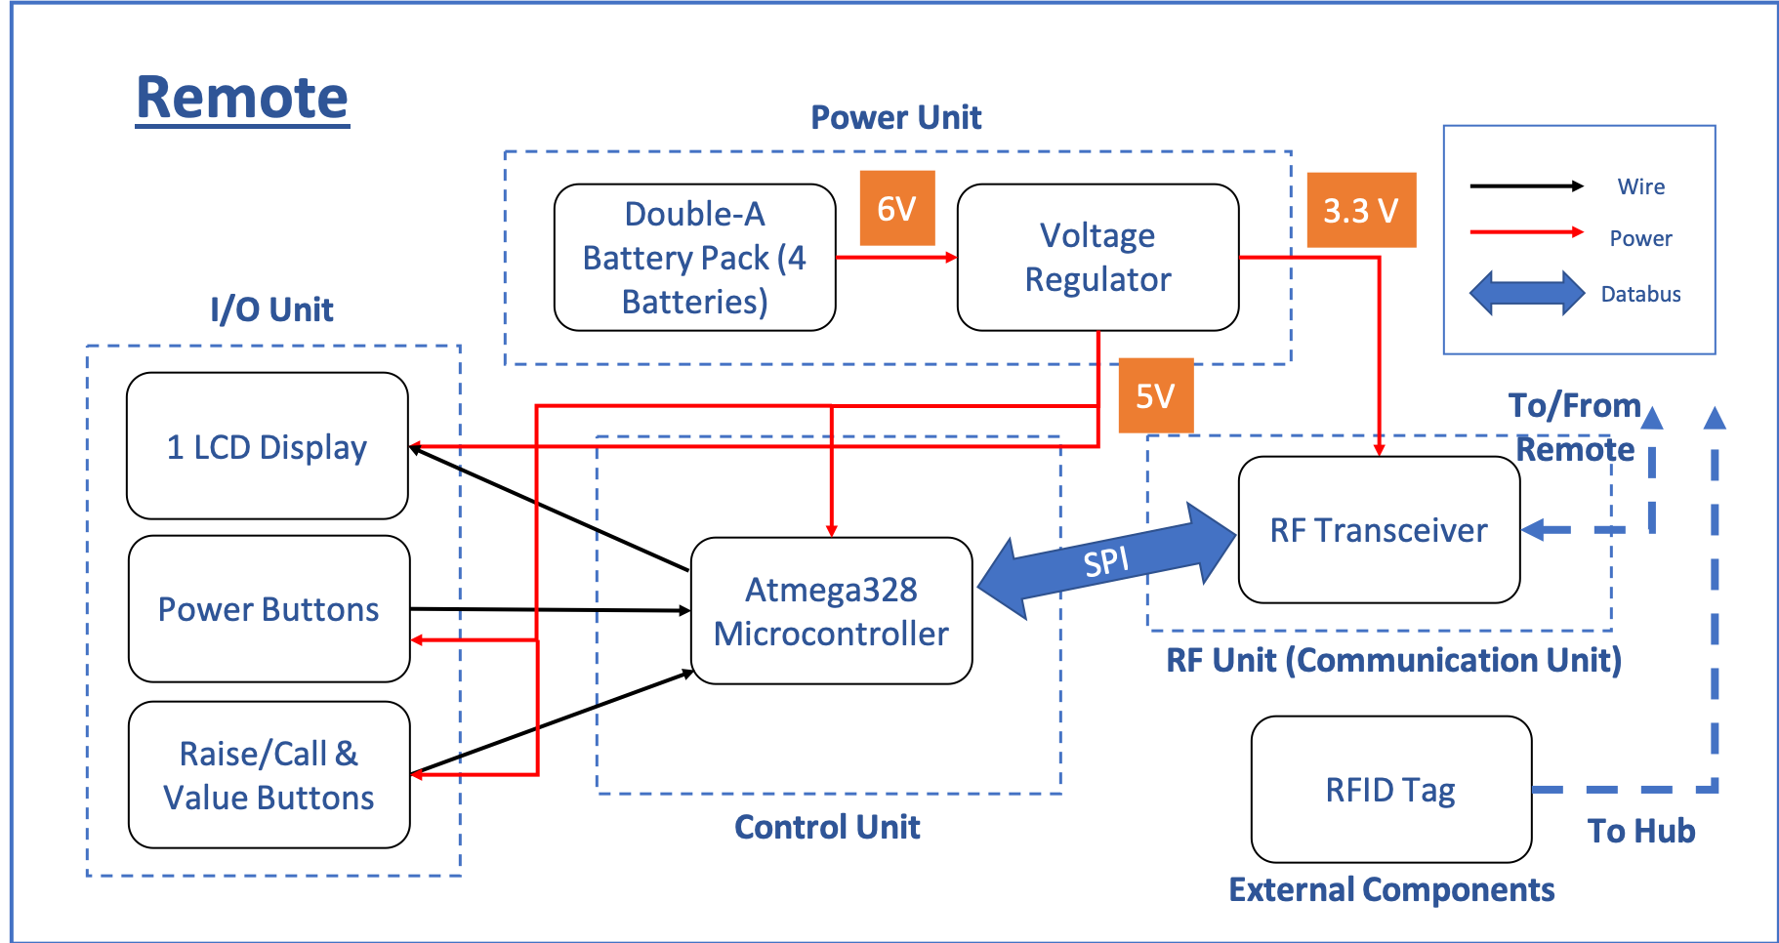
Remote Player Device Block Diagram
The player devices are controlled by the user and communicate bids and game decisions to the central hub for data management
Notes:
Amol

Slide 11
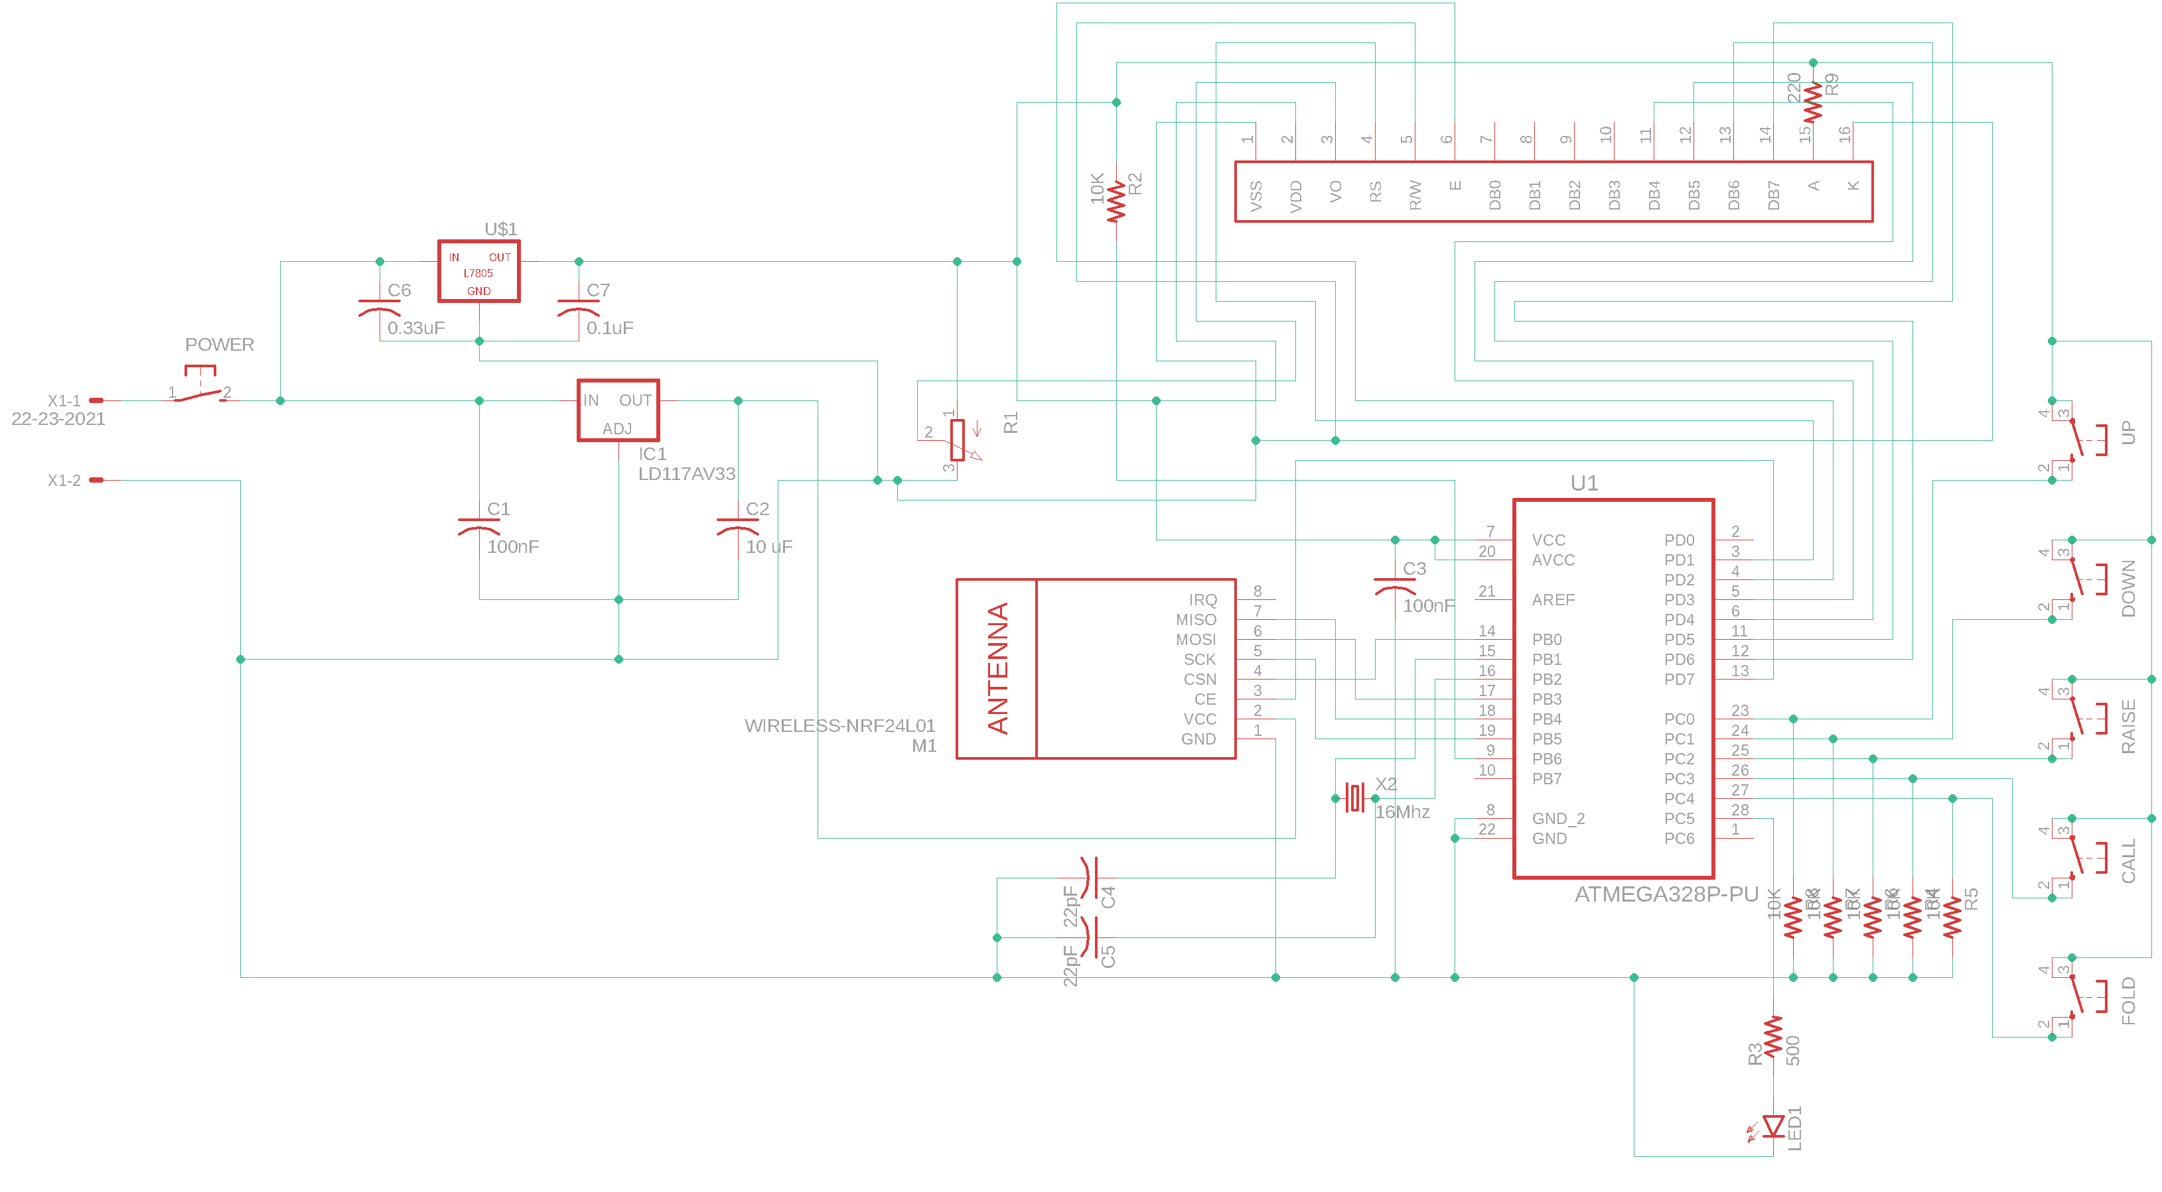
Player Device Schematic

Slide 12
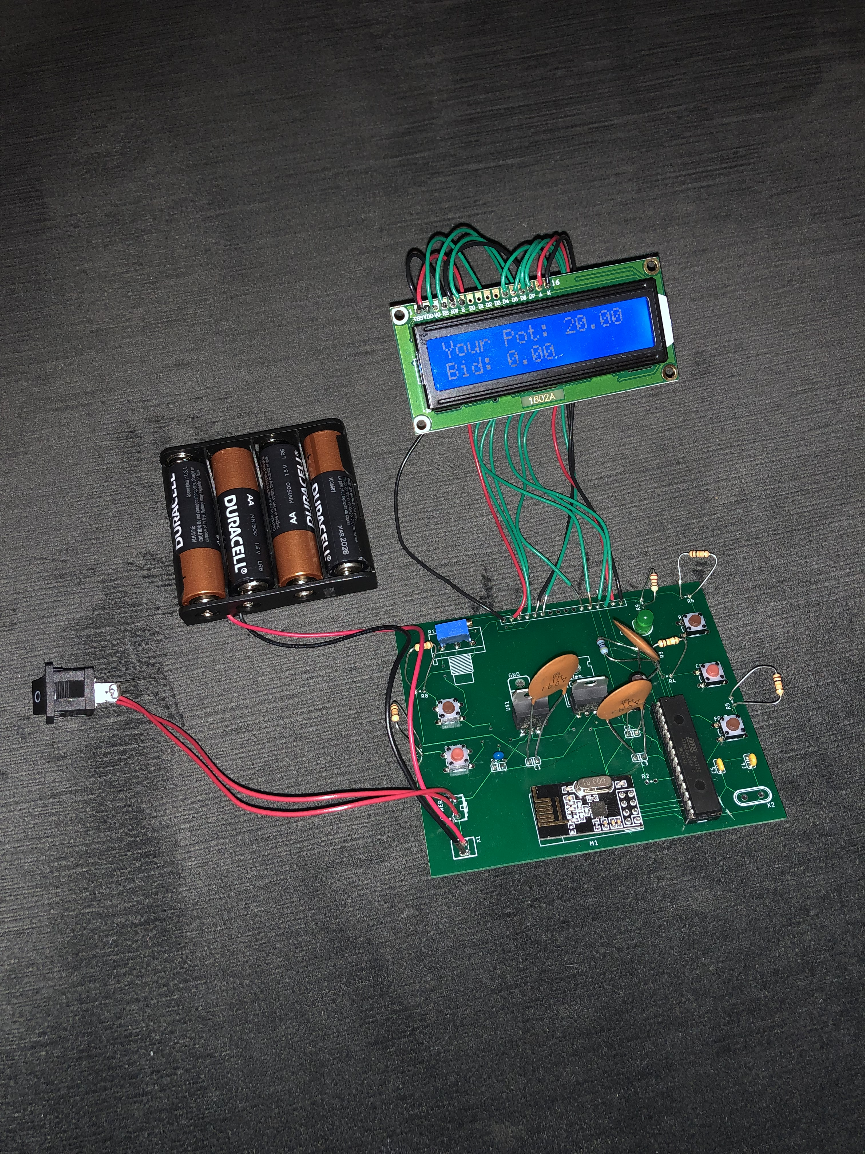
Player Device

Slide 13
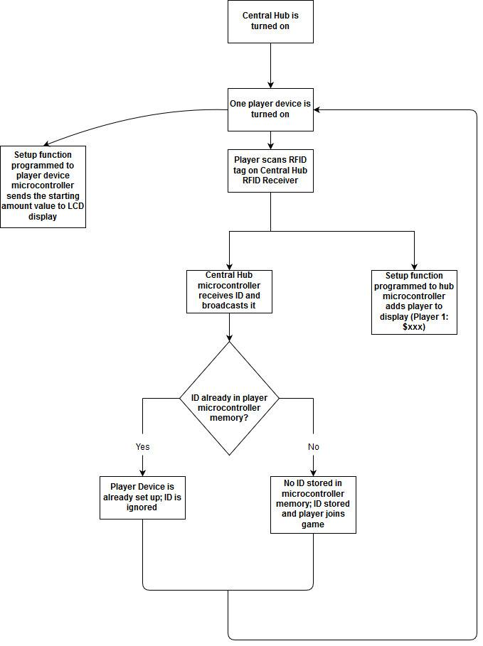
Software Flow Diagrams

Slide 14
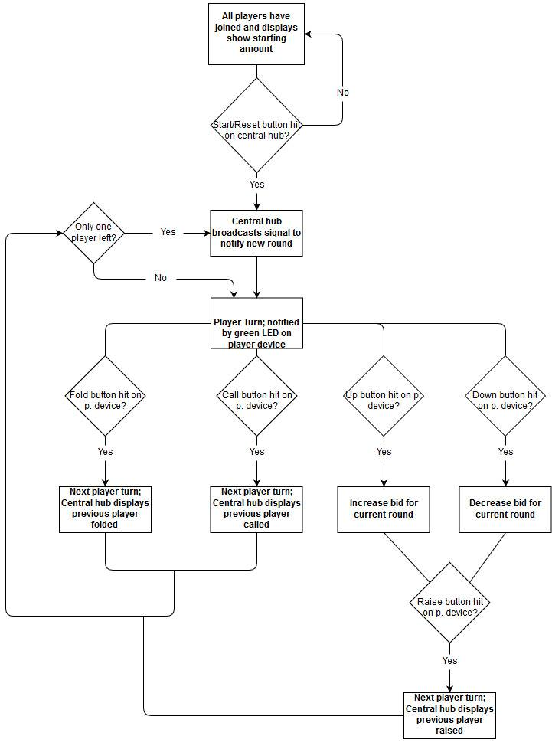
Software Flow Diagrams (cont.)

Slide 15
Requirements & Verifications
Notes:
Amaan

Slide 16
Voltage Regulator Tables
6 V Input from Battery Pack
5 V Regulator
3.3 V Regulator
Expected | Output | Error
5 | 5.054 | 1.06%
5 | 5.058 | 1.14%
5 | 5.051 | 1.01%
5 | 5.045 | 0.892%
5 | 5.058 | 1.14%
Expected | Output | Error
3.3 | 3.292 | 0.243%
3.3 | 3.281 | 0.579%
3.3 | 3.301 | 0.0303%
3.3 | 3.306 | 0.182%
3.3 | 3.298 | 0.0606%
Testing and validating that the voltage regulators are working properly is important for ensuring the safety of the rest of the circuit components

Slide 17
Functional and Integration Tests
Sent and received “Hello World” numerous time
Sent signals on different channels to different transceivers
1
Transceiver Communication
Display basic text for game state
Display different data on different screens (central hub)
2
LCD Displays
Test if button presses change state
Correct values of bids were being altered
3
Button Logic
Logical transitions between players accomplished
Memory saves game state on turn off/reset
4
Game State Progression
Apart from voltage regulator tests, there were several functional tests that had to be conducted to ensure efficient flow of the game and respective devices

Slide 18
Individual Modules
Notes:
Amaan

Slide 19
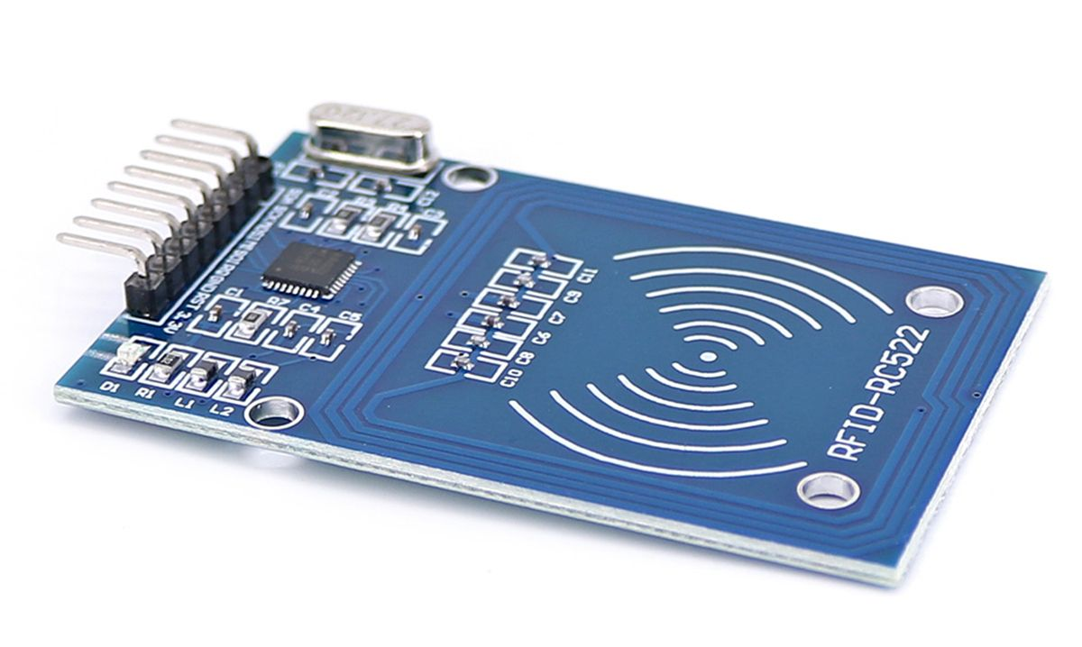
RF Unit & Communication
NRF24L01 Transceiver Module
RC522 RFID Reader
Share same SPI bus
(MISO, MOSI, SCK)
Utilizes 2.4 GHz band with baud rates upto 2 Mbps
Range of up to 100 meters, more than enough for the game of poker
Can communicate with 6 other modules at the same time
1.9-3.6 V operating voltage
Slave select pin allows for manual enabling/disabling
Operating frequency is approximately 13.56 Mhz
Read range for RFID tags is approximately 3cm
Data transfer rate is approximately 10 Mbps
The RF unit is critical for ensuring that the player device and central hub have consistent communication throughout the game

Slide 20
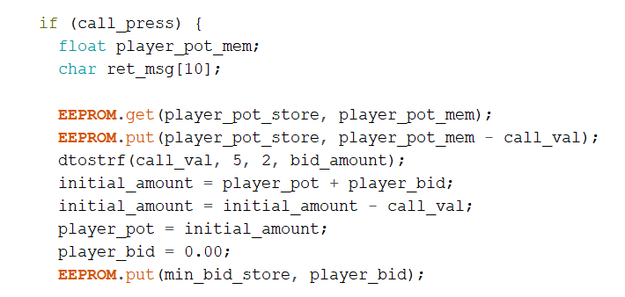
Memory Management and Atmega EEPROM
The ATmega328p comes with 32k bytes Flash memory (0.5k is used for the bootloader, 2k bytes of SRAM, and 1k byte of EEPROM
Flash and EEPROM are non-volatile, therefore they persist even if power is suddenly turned off
EEPROM is essential for our high-level requirement of storing data even if a device accidentally turns off or runs out of battery
Notes:
Amol

Slide 21
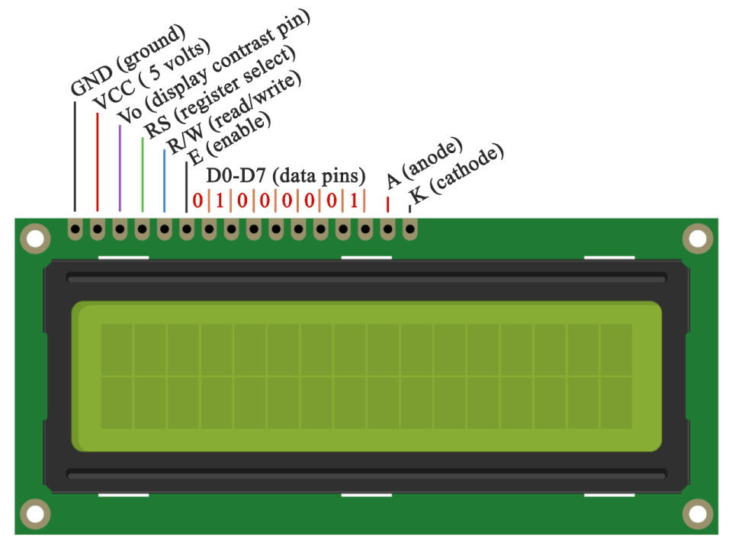
I/O Module – LCD Display
The V0 pin goes to the potentiometer which controls the contrast of the screen
There are 8 data pins, but only 4 are necessary for displaying information
These pins go to the ATmega328p and the signals control what is printed
The LCD display’s are critical to both the player device and central hub because it displays the game logic and the information necessary for players to see

Slide 22
Successes & Challenges
Notes:
Amaan

Slide 23
Successes and Challenges of the Project
Displaying various data to different LCD screens
Ensuring consistent comm. between transceivers
Saving game state to memory
Successes
Challenges
Handling concurrent usage of SPI bus between reader and transceiver
Progressing game state between players
Maintaining physical connections due to lack of casing

Slide 24
Future Expansion
Notes:
Amaan

Slide 25
Potential Future Expansion
Stronger Communication
Encasing
Purpose: Exploring different frequencies and/or different methods of communication
Purpose: Cleaner look and avoids human contact with electrical connections
Safety Measures
Error Handling
Purpose: Handling short circuits and avoiding moisture
Purpose: Ensures game state is consistent and smooth experience for user
After reflecting on semester’s work, these four categories are areas of improvement to consider to ensure an undisturbed game of poker
Notes:
Amaan

Slide 26
Questions?

